Slide 1
Network Security
Lecture 4
Presented by: Dr. Munam Ali Shah

Slide 2
Summary of the previous lecture
Prevention, Detection and Reaction
How much security
Security trade-offs (productivity, functionality)
Penetration testing tool
No free lunch

Slide 3
Outlines
Security through obscurity
Aspects of Security
OSI Security architecture
Active and Passive attacks
Protection and access rights

Slide 4
Objectives
To describe the difference between security and protection.
To understand access privileges and create access right metrix.
To understand how different security tools be used.

Slide 5
There is never a free lunch
Means don’t go for free software, free wallpapers etc.
No one is going to give you anything free

Slide 6
Security through obscurity … ?
Security through obscurity – hiding design
or implementation details to gain security:
  keeping secret not the key, but the encryption
  algorithm,
  hiding a DB server under a name different from “db”, etc.
The idea doesn’t work
  it’s difficult to keep secrets (e.g. source code gets stolen)
  if security of a system depends on one secret, then,
  once it’s no longer a secret, the whole system is compromised
  secret algorithms, protocols etc. will not get reviewed → flaws won’t be spotted and fixed → less security
Systems should be secure by design, not by obfuscation
Security AND obscurity

Slide 7
Aspects of Security
Security attack
  Any action that compromises the security of information owned by an organization.
Security mechanism
  A process that is designed to detect, prevent or recover from a security attack.
Security service
  Services that enhances the security of the data processing systems and the information transfers of an organization.
  These services are intended to counter security attacks, and they make use of one or more security mechanisms to provide the service.
Notes:
The OSI security architecture focuses on security attacks,mechanisms,and services.

Slide 8
OSI Security Architecture
International Telecommunication Union (ITU-T) recommends X.800, the security architecture for OSI
Defines a systematic way of defining and providing security requirements
Notes:
International telecommunication union (ITU) telecommunication standardization sector (ITU-T)

Slide 9
Security Attacks Classification
Any action that compromises the security of information owned by an organization
Information security is about how to prevent attacks, or failing that, to detect attacks
Classification according to X.800
  Passive attack
  Active attack
Notes:
A threat is a possible potential danger that might exploit a vulnerability.
Is a sequence of commands that take advantage of a vulnerability in order to cause
vulnerability is applied to a weakness in a system which allows an attacker to violate the integrity of that system.

Slide 10
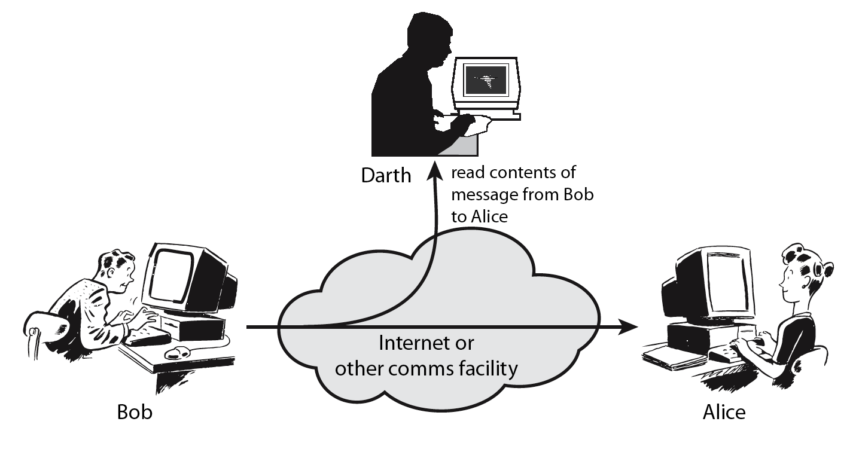
Passive attack
Obtaining message content
Traffic analysis
Notes:
Passive attacks attempt to learn or make use of information from the system but does not affect system resources.
By eavesdropping on, or monitoring of, transmissions to:
+ obtain message contents or
+ monitor traffic flows ( … opponent could determine the frequency and length of messages being exchange this kind of information maybe helpful in determining the nature of communication that was taking place)
Are difficult to detect because they do not involve any alteration of the data.

Slide 11
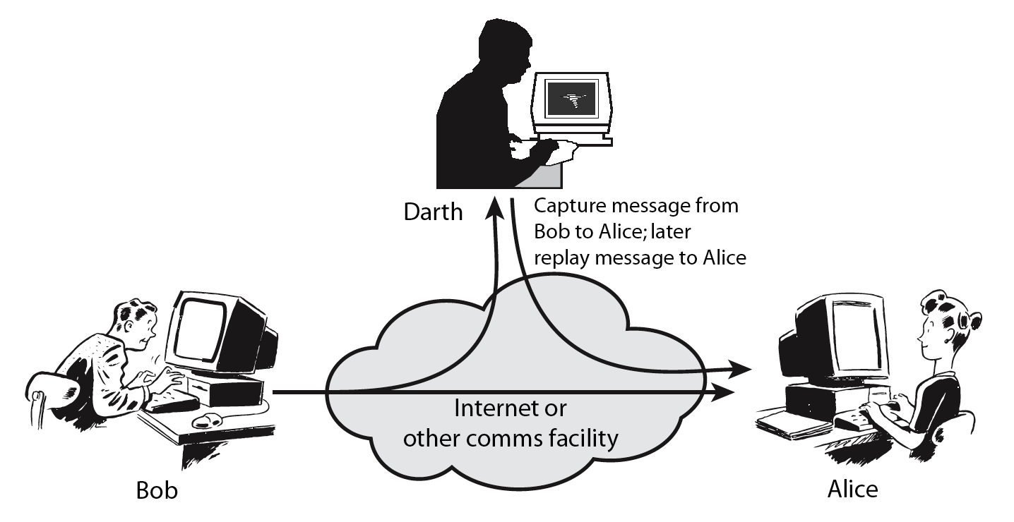
Active attack
Masquerade
Replay previous messages
Modify messages in transit
Denial of service
Notes:
Active attacks attempt to alter system resources or affect their operation.
By modification of data stream to:
+ masquerade of one entity as some other
+ replay previous messages (as shown above in Stallings Figure 1.4b)
+ modify messages in transit
+ denial of service
Active attacks present the opposite characteristics of passive attacks. Whereas passive attacks are difficult to detect, measures are available to prevent their success. On the other hand, it is quite difficult to prevent active attacks absolutely, because of the wide variety of potential physical,software,and network vulnerabilities. Instead, the goal is to detect active attacks and to recover from any disruption or delays caused by them.

Slide 12
Security Attacks
Security Attacks
Security Attacks
Security Attacks
Security Attacks
Security Attacks
Security Attacks
Security Attacks
Security Attacks
Snooping
Snooping
Snooping
Snooping
Modification
Modification
Modification
Modification
Denial of Service
Traffic Analysis
Traffic Analysis
Traffic Analysis
Traffic Analysis
Traffic Analysis
Traffic Analysis
Traffic Analysis
Traffic Analysis
Traffic Analysis
Traffic Analysis
Traffic Analysis
Traffic Analysis
Traffic Analysis
Traffic Analysis
Masquerading
Masquerading
Masquerading
Threat to Availability
Replaying
Replaying
Threat to Confidentiality
Repudiation
Threat to Integrity

Slide 13





Passive Versus Active Attacks
Bob
Alice
Alice and Bob want to communicate in presence of adversaries
  Adversaries:
    Passive – just looking
    Active – may change msgs

Slide 14
Categorization of passive and active attacks
Attacks | Passive/Active | Threatening
Snooping Traffic Analysis | Passive | Confidentiality
Modification Masquerading Replaying Repudiation | Active | Integrity
Denial of Service | Active | Availability

Slide 15
Security Service
Enhance security of data processing systems and information transfers of an organization
Intended to counter security attacks
Using one or more security mechanisms
X.800 defines a security service as
“a service provided by a protocol layer of communicating open systems, which ensures adequate security of the systems or of data transfers”

Slide 16
Protection
In one protection model, computer consists of a collection of objects, hardware or software
Each object has a unique name and can be accessed through a well-defined set of operations
Protection problem - ensure that each object is accessed correctly and only by those processes that are allowed to do so

Slide 17
Principles of Protection
Guiding principle – principle of least privilege
  Programs, users and systems should be given just enough privileges to perform their tasks
  Limits damage if entity has a bug, gets abused
  Can be static (during life of system, during life of process)
  Or dynamic (changed by process as needed) – domain switching, privilege escalation
  “Need to know” a similar concept regarding access to data
Must consider “grain” aspect
  Rough-grained privilege management easier, simpler, but least privilege now done in large chunks
  Fine-grained management more complex, more overhead, but more protective
    File ACL lists, RBAC
Domain can be user, process, procedure

Slide 18
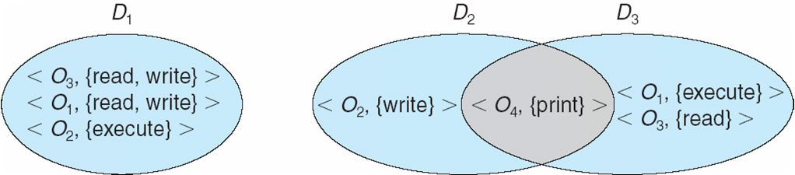
Domain Structure
Access-right = <object-name, rights-set>
where rights-set is a subset of all valid operations that can be performed on the object
Domain = set of access-rights

Slide 19
Access control
prevention of the unauthorized use of a resource, that is this service controls
- who can have access to a resource
- under what condition access can occur
- what those accessing are allowed to do

Slide 20
Access Matrix
View protection as a matrix (access matrix)
Rows represent domains
Columns represent objects
Access(i, j) is the set of operations that a process executing in Domain_{i} can invoke on Object_{j}

Slide 21
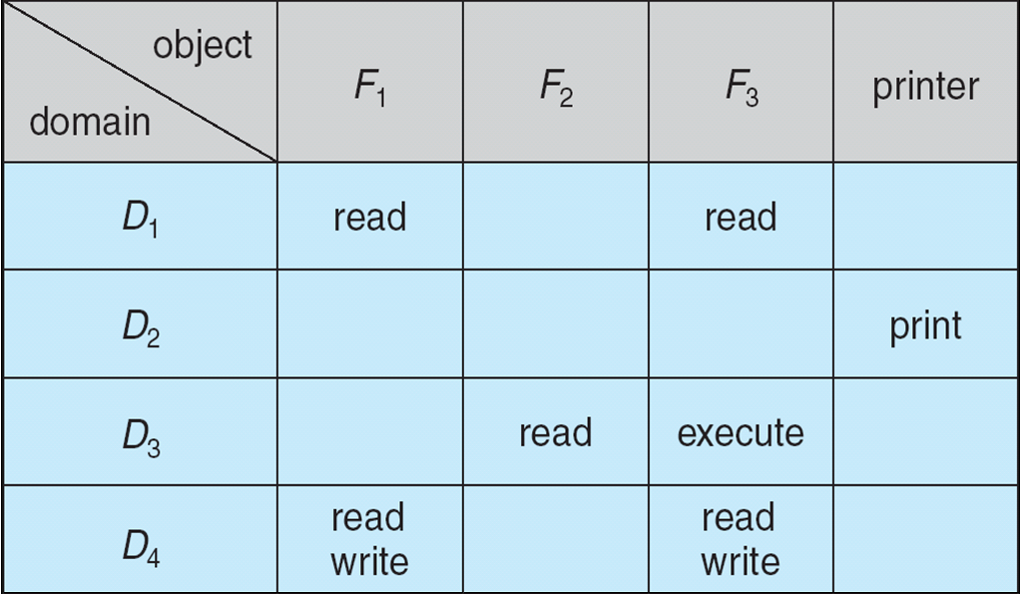
Access Matrix

Slide 22
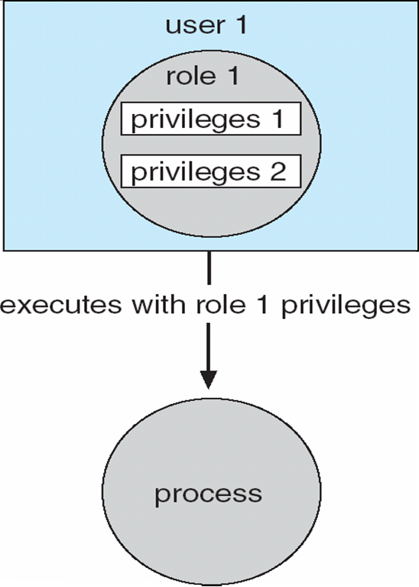
Role-based Access Control in Solaris 10

Slide 23
Summary of today’s lecture
In today’s lecture, we talked about security through obscurity
We also learnt about different types of attacks such as Active and Passive attacks.
We have developed an understanding about access rights and how to use access metrix

Slide 24
Next lecture topics
We will discuss different types of security attacks such as virus, worms, Trojan horse etc.
DoS attacks, DDoS attacks and its different types

Slide 25
The End

