Slide 1
Network Security
Lecture 32
Presented by: Dr. Munam Ali Shah

Slide 2
Course Revision

Slide 3
Security Threats in Mobile devices Environment
Lack of Physical security control
    User can use in different location other than organization premises
    Even if within organization, the user may move the device within secure and non-secured locations
    This can lead towards theft and tempering
    A malicious party attempt to recover sensitive data from the device itself
    May use the device to gain access to the organization’s resources

Slide 4
Security Threats in Mobile devices Environment
Use of untrusted mobile devices
Use of untrusted networks
Use of applications created by unknown parties
Interaction with other systems
    Automatically, synchronizing data with other computing or cloud storage devices
Use of untrusted content such as Quick Response Barcode
Use of location services
    GPS capability on mobile devices can be used to maintain a knowledge of the physical location of the device.

Slide 5
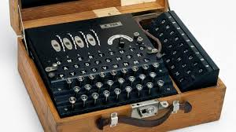
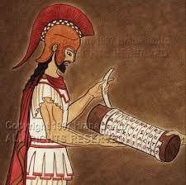
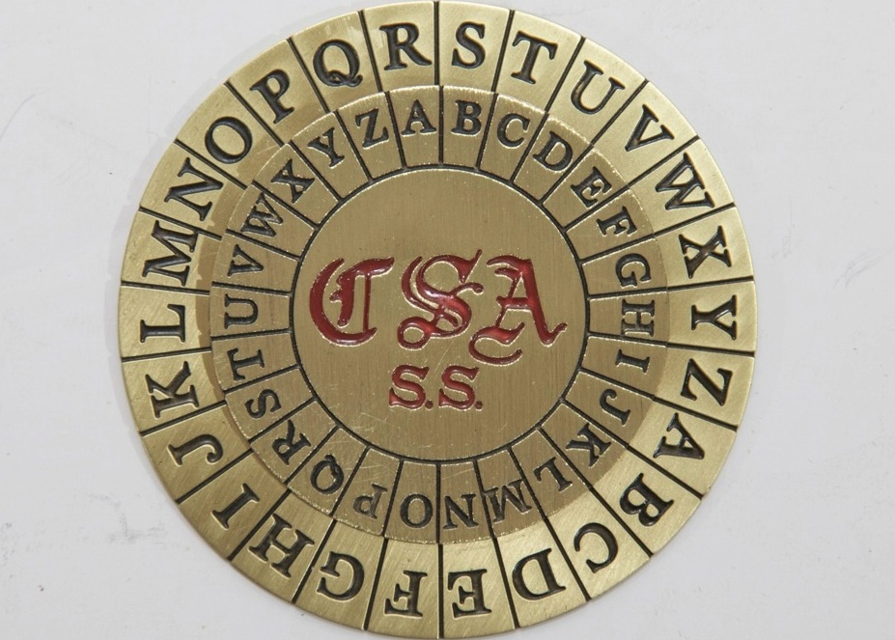
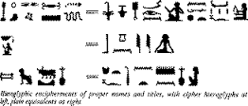
Cryptography
The art of secret writing

Slide 6
Cryptography
Cryptography is the art and science of secrecy
Hiding one’s secrets has always been human’s desire
Historically, cryptography has been associated with military
  But now its everywhere
Notes:
So! What is Cryptography? There can be many definitions. Actually I am not able to find a definition that portrays the whole picture covering all the goals and features of Cryptography. Most of the definitions talk only about data hiding which is just one aspect of Crypto but it has many more aspects such as data integrity, authentication and non-repudiation to name a few. Anyway this is one of the definitions of Crypto found in literature. It says “Cryptography is the art and science of secrecy”. Why an art? Because traditionally, crypto has been all about innovation and artistic thinking. Creating a new cipher or code is in a way similar to writing a new poem or to create a new musical composition. Starting from the Caesar’s cipher till the ciphers used in the last century, there was no scientific or mathematical proof of security. You find some innovative way to convert plaintext into ciphertext, you keep your key and you cipher/algorithm secret and you believe that it is extremely difficult for anyone having access to the ciphertext to find the corresponding plaintext without knowing your secret key; and that its. Obviously, without any mathematical proof, there are good chances that your belief about the security of your cipher is totally wrong. Actually we have a saying in Cryptography which is attributed to Bruce Schenier, who btw is an important guy in crypto being the author of books like “Applied Crypto” and coauthor (with Neil Ferguson) of “Practical Crypto” and an inventor of the block ciphers like BlowFish (one of the 5 finalists for AES). Anyway the saying is sometimes called Schenier’s Law and it states “Everyone can create a cipher that he thinks no one can break”. So you can see that this is the main problem with non-mathematical crypto that you may get a false sense of security which is obviously not desired.
In 1976, Whitfield Diffie and Martin Hellman presented their ground breaking work in IEEE Transactions on Information Theory namely “New Directions in Cryptography”. This paper is considered to be the most important paper in the area of cryptography. This gave the concept of “public key cryptography” which we will talk about in detail later today and it has made ground for making modern crypto stand on solid mathematical foundations. Modern crypto is a science with proofs of security based on known mathematical problems. We will also talk about these problems in the coming sessions.
And then historically crypto has been associated with military apps only. The earliest instance of cryto usage is known to be the one by julius ceasar to communicate with his troops then in the recent past, crypto was used extensively in WW1 and WW2. The most famous story being that how the codes of German Enigma machine were broken by the allies.
But today crypto is no more associated with military only. Its extensively used in ecommerce, credit card usage, internet banking, emails, social networking, mobile communication, audio and video communication, home and office security, you name it, its everywhere.

Slide 7
Cryptography
3 interrelated terms
  Cryptology
  Cryptography
  Cryptanalysis

Slide 8
What is cryptology?
Cryptology – science of hiding
  Cryptography, Cryptanalysis – hide meaning of a message
  Steganography, Steganalysis – hide existence of a message
Cryptography – secret writing
Cryptanalysis – analyzing (breaking) secrets
  Cryptanalysis is what attacker does
  Decipher or Decryption is what legitimate receiver does

Slide 9
Terminology
Characters
  Alice
  Bob
  Eve
  Trent
  ………
Plaintext/message
Ciphertext

Slide 10
Terminology
Key
  Single/secret/symmetric key
  Two/public/asymmetric key
Encryption/encipherment
    The conversion of data into ciphertext, that cannot be easily understood by unauthorized people.
Decryption/decipherment
    The process of converting encrypted data back into its original form so that it can be understood.

Slide 11
Cryptography
Encryption
plaintext
message
ciphertext
message
Decryption
Encrypted(Information) cannot be read
Decrypted(Encrypted(Information)) can be

Slide 12
Cryptography
Insecure Channel
Encrypt
Ciphertext
Decrypt
Plaintext
Plaintext
Alice
Eve
(active attacker)
Bob

Slide 13
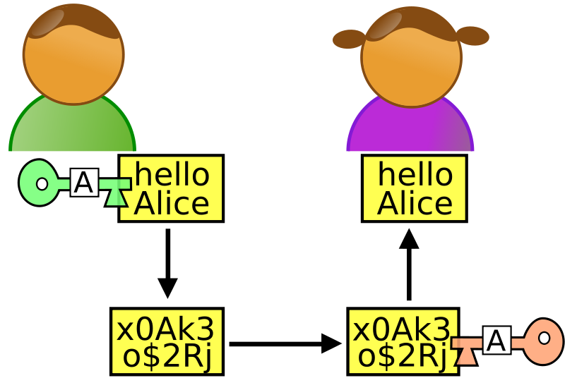
A simple example

Slide 14
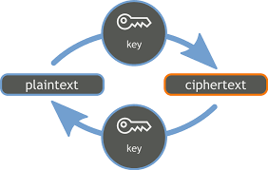
More simple example

Slide 15
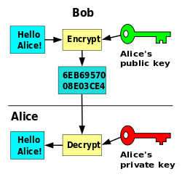
Another way to represent the concept of Cryptography

Slide 16
Goals of the Adversary
Get the key (ideally)
Get the message
Get part of the message/some information about the message

Slide 17
Cryptography
Cryptographic systems are characterized along three independent dimensions:
    The type of operations used for transforming plaintext to ciphertext.
    The number of keys used.
    The way in which the plaintext is processed.

Slide 18
Unconditional Security Vs Computational Security
Unconditional Security
  The cipher cannot be broken no matter how much computer power or time is available
  The only example is OTP (one time passwords)
Computational Security
  The cipher cannot be broken given limited computing resources
  The examples are DES, AES, RC4, etc.

Slide 19
Secret Vs Public Algorithm
Benefits of having algorithm secret
  Two levels of secrecy
Benefits of having algorithm public
  Peer review, evaluation and cryptanalysis

Slide 20
Cryptanalysis and Brute-Force Attack
Typically, the objective of attacking an encryption system is to recover the key in use rather than simply to recover the plaintext of a single ciphertext. There are two general approaches to attacking a conventional encryption scheme:

Slide 21
Cryptanalysis
Cryptanalytic attacks rely on the nature of the algorithm plusperhaps some knowledge of the general characteristics of the plaintext oreven some sample plaintext–ciphertext pairs.
This type of attack exploits the characteristics of the algorithm to attempt to deduce a specific plaintext or to deduce the key being used.

Slide 22
Brute-force attack
The attacker tries every possible key on a piece of ciphertext until an intelligible translation into plaintext is obtained. On average, half of all possible keys must be tried to achieve success.

Slide 24
Caesar Cipher
If each letter is assigned a number (a=0, z=25), Encryption/Decryption defined as:
  C = E(p) = (P + 3) mod (26)
  P = D(c) = (C – 3) mod (26)
Example:
  meet me after the toga party
  phhw ph diwhu wkh wrjd sduwb

Slide 25
Monoalphabetic Cipher
Instead of substituting each letter in a sequential order (shift), substitute the letters arbitrarily
Each plaintext letter maps to a unique ciphertext letter
Hence key is 26 letters long

Slide 26
Language Redundancy and Cryptanalysis
Have tables of single, double & triple letter frequencies for various languages
Which is the most common digram?
  TH
Which is the most common trigram?
  THE

Slide 27
Advanced Encryption Standard
A new standard was needed primarily because DES has a relatively small 56-bit key which was becoming vulnerable to brute force attacks.
In addition, the DES was designed primarily for hardware and is relatively slow when implemented in software.
While Triple-DES avoids the problem of a small key size, it is very slow even in hardware; it is unsuitable for limited-resource platforms; and it may be affected by potential security issues connected with the (today comparatively small) block size of 64 bits.

Slide 28
AES Stages
Four stages of AES: (Permutation, Substitution)
  Substitute Byte : Each byte of the block is replaced by its substitution
  Shift Rows : 1-byte circular shift is performed
  Mix columns : each byte of a column is mapped in to a new value.
  Add round key: The block is XOR with subkey

Slide 29
Stream Ciphers
process the message bit by bit (as a stream)
typically have a (pseudo) random stream key
combined (XOR) with plaintext bit by bit
randomness of stream key completely destroys any statistically properties in the message
  C_{i} = M_{i} XOR StreamKey_{i}
Keystream is XORed with plaintext bit by bit
but must never reuse stream key
  otherwise can remove effect and recover messages

Slide 30
Stream Cipher Properties
some design considerations are:
  long period with no repetitions
  statistically random
  depends on large enough key
  large linear complexity
  use of highly non-linear boolean functions
Notes:
Criteria from Rueppel

Slide 31
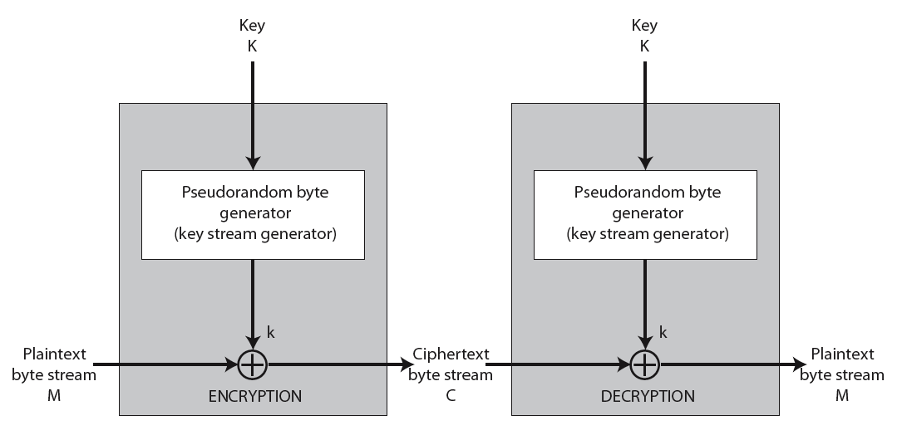
Stream Cipher Illustration

Slide 32
RC4
a proprietary cipher owned by RSA another Ron Rivest design, simple but effective
variable key size (1-256 bytes)
byte-oriented stream cipher
widely used (web SSL/TLS, wireless WEP)
key forms random permutation of all 8-bit values
uses that permutation to scramble input info processed a byte at a time
Remained trade secret till 1994

Slide 33
RC4 Working
Initialize state vector S
Permute S
Generate key stream
More details in Lecture 16 - 21 !!!

Slide 34
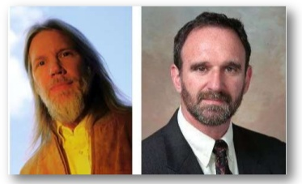
Public Key/Asymmetric Key Cryptography
Public key cryptography
Asymmetric key cryptography
2 key cryptography
  Presented by Diffie & Hallman (1976)
    New directions in cryptography

Slide 35
Why Public-Key Cryptography?
Key distribution under symmetric encryption requires
  Two communicants already share a key
  The use of Key Distribution Center (KDC)
Whitfield Diffie & Martin Hellman reasoned
  2nd requirement neglected the essence of cryptography, i.e. the ability to maintain total secrecy over your own communication
  how to verify a message comes intact from the claimed sender?

Slide 36
Private-Key Cryptography
traditional private/secret/single key cryptography uses one key
shared by both sender and receiver
if this key is disclosed communications are compromised
also is symmetric, parties are equal
hence does not protect sender from receiver forging a message & claiming is sent by sender

Slide 37
Public-Key Cryptography
involves the use of two keys:
  a public-key, which may be known by anybody, and can be used to encrypt messages, and verify signatures
  a private-key, known only to the recipient, used to decrypt messages, and sign (create) signatures
is asymmetric because
  those who encrypt messages or verify signatures cannot decrypt messages or create signatures

Slide 38
Public-Key Characteristics
Public-Key algorithms rely on two keys where:
  it is computationally infeasible to find decryption key knowing only algorithm & encryption key
  it is computationally easy to en/decrypt messages when the relevant (en/decrypt) key is known
  either of the two related keys can be used for encryption, with the other used for decryption

Slide 39
Essential steps
Each user
  generates its pair of keys
  Places public key in public folder
  Bob encrypt the message using Alice’s public key for secure communication
  Alice decrypts it using her private key

Slide 40
True Random number generator (TRNG)
A random number generator (RNG) is a computational or physical device designed to generate a sequence of numbers or symbols that lack any pattern, i.e. appear random. The many applications of randomness have led to the development of several different methods for generating random data

Slide 41
Pseudorandom number generator (PRNG)
A pseudorandom number generator (PRNG), also known as a deterministic random bit generator (DRBG), is an algorithm for generating a sequence of numbers whose properties approximate the properties of sequences of random numbers.
The PRNG-generated sequence is not truly random, because it is completely determined by a relatively small set of initial values, called the PRNG's seed (which may include truly random values).
Although sequences that are closer to truly random can be generated using hardware random number generators, pseudorandom number generators are important in practice for their speed in number generation and their reproducibility

Slide 42
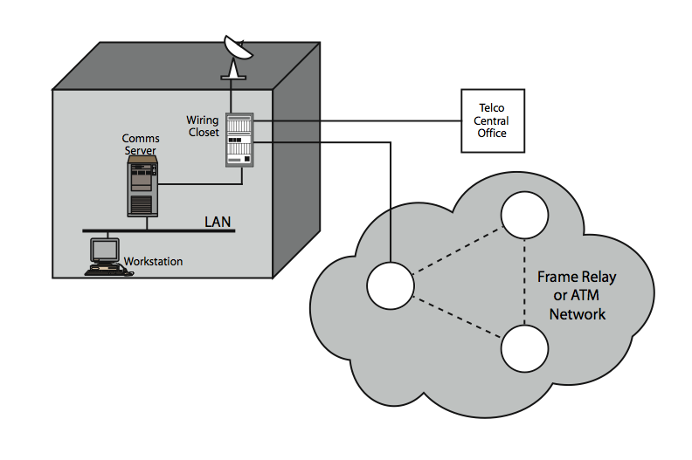
Potential locations for confidentiality attacks
Insider: eavesdropping the LAN
Outsider: from server or host with dial up facility
Patch panel is vulnerable if intruder access it physically: (can use low power radio transmitter)
Attack through transmission medium
  Wired (coaxial, twisted pair, fibre optic)
  Wireless(microwave, satellite)

Slide 43
Link vs. end to end encryption
have two major placement alternatives
link encryption
  vulnerable links are equipped with encryption device
  En/decryption occurs independently on every link
  requires many devices in a large network
  User has no control over security of these devices
  Many keys must be provided
end-to-end encryption
  encryption occurs between original source and final destination
  need devices at each end with shared keys
  Authentication

Slide 44
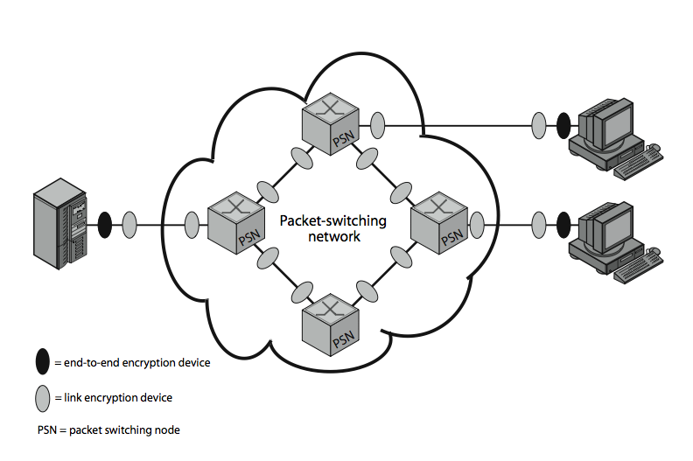

Slide 45
Message Authentication Code (MAC)
MAC = C(K,M)
  M: Input message
  C: MAC function
  K: Shared secret key
Message + MAC are sent to the intended recipient
Recipient calculates MAC’ = C(K,M’)
  If MAC = MAC’ then accept else reject

Slide 46
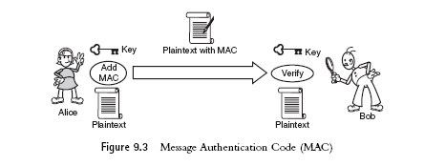
Properties of MAC
MAC function need not be reversible (in contrast to decryption function)
MAC input: arbitrary length
MAC output: fixed length (typically much smaller than message length)
MAC is many-to-one function

Slide 47
Hash Function
A variation of MAC
Does not need a key
h = H(M)
  h is called hash code/hash value/message digest

Slide 48
Requirements of Hash Function
Arbitrary length input
Fixed length output
H(x) is easy to compute
Given h, computationally hard to find x such that H(x) = h (called onewayness)
Given x, computationally hard to find y ≠ x such that H(x) = H(y) (called weak collision resistance)
Comp hard to find a pair x,y such that H(x) = H(y) (called strong collision resistance)

Slide 49
Problem in message authentication
Message authentication protect two parties from third party, will it protect two parties from each ??
John sends authenticated message to Marry (msg+MAC)
  Marry may forge a different message and claims that it comes from John
  John can deny sending the message to Marry later on
hence include authentication function with additional capabilities

Slide 50
Digital Signature Properties
must depend on the message being signed
must use information unique to sender
  to prevent both forgery and denial
must be relatively easy to produce
must be relatively easy to recognize & verify
be computationally infeasible to forge
  with new message for existing digital signature
  with fraudulent digital signature for given message
be practical save digital signature in storage

Slide 51
Authentication Applications
Kerberos
X.509

Slide 52
Kerberos
Authentication service developed at MIT
Uses trusted key server system
Provides centralised private-key third-party authentication in a distributed network
  allows users access to services distributed through network
  without needing to trust all workstations
  rather all trust a central authentication server
two versions in use: 4 & 5

Slide 53
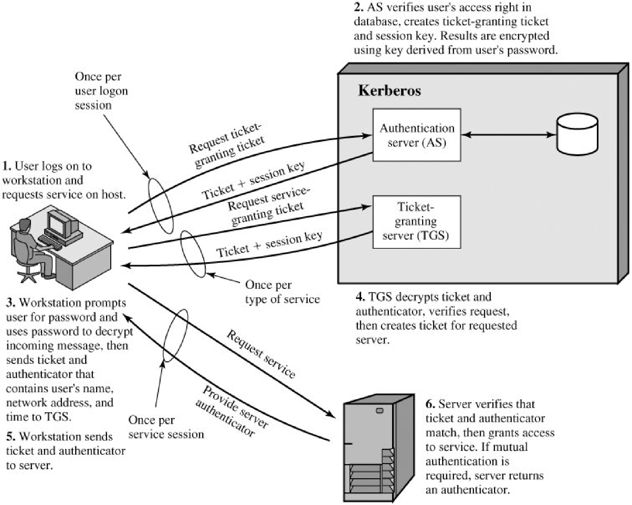

Slide 54
X.509 Authentication Service
defines framework for authentication services
  directory may store public-key certificates
  with public key of user signed by certification authority
uses public-key crypto & digital signatures
  algorithms not standardised, but RSA recommended
X.509 certificates are widely used
X.509 certificate associates public key with its user

Slide 55
Secure Electronic Transactions (SET)
Open encryption & security specification
To protect Internet credit card transactions
Developed in 1996 by Mastercard, Visa
Not a payment system
Rather a set of security protocols & formats
  secure communications amongst parties
  Provides trust by the use of X.509v3 certificates
  Privacy by restricted info to those who need it

Slide 56
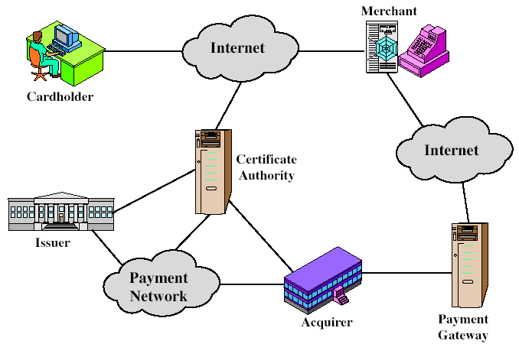
SET Participants
Must have relationship with acquirer
issue X.509v3 public-key certificates for cardholders, merchants, and payment gateways
e.g. a Bank
Provides authorization to merchant that given card account is active and purchase does not exceed card limit
Interface b/w SET and bankcard payment network

Slide 57
Secure Shell (SSH)
protocol for secure network communications
  designed to be simple & inexpensive
SSH1 provided secure remote logon facility
  replace TELNET & other insecure schemes
  also has more general client/server capability
SSH2 fixes a number of security flaws
documented in RFCs 4250 through 4254
SSH clients & servers are widely available
method of choice for remote login/ X tunnels
Notes:
Secure Shell (SSH) is a protocol for secure network communications designed to be relatively simple and inexpensive to implement. The initial version, SSH1 was focused on providing a secure remote logon facility to replace TELNET and other remote logon schemes that provided no security. SSH also provides a more general client/server capability and can be used for such network functions as file transfer and email. A new version, SSH2, fixes a number of security flaws in the original scheme. SSH2 is documented as a proposed standard in IETF RFCs 4250 through 4254. SSH client and server applications are widely available for most operating systems. It has become the method of choice for remote login and X tunneling and is a rapidly becoming one of the most pervasive applications for encryption technology outside of embedded systems.

Slide 58
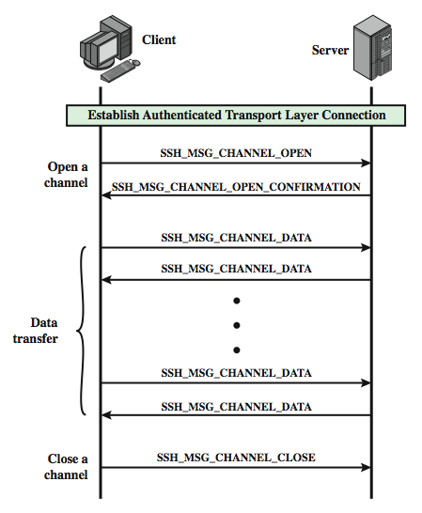
SSH Connection Protocol Exchange
Notes:
Stallings Figure 16.11 provides an example of Connection Protocol Exchange.

Slide 59
The course
Network Security concludes here
Notes:
Chapter 16 summary.

Slide 60
The End

