Slide 1
Network Security
Lecture 31
Presented by: Dr. Munam Ali Shah

Slide 2
Summary of the Previous Lecture
Secure Socket Layer (SSL)
    Architecture
    Connection
    Session
    Record Protocol Service
    Record Protocol operation
Three SSL-specific protocols that use the SSL Record Protocol
    SSL Change Cipher Spec Protocol
    Alert Protocol
    Handshake Protocol
Integrating SSL/TLS with HTTP ⇒ HTTPS
HTTPS and SSH

Slide 3
Course Revision

Slide 4
Outlines of revision lecture
Part -I System/Computer Security
The main concepts revised in this part are:
Security concepts, security violation categories, security measure levels, methods to violate security, types of attacks and firewalls.

Slide 5
Outlines of revision lecture
Part – II Network Security
This part is will cover most of the contents of the course. It has been further divided in following sub- parts:
  Analysis of network security
  Cryptography as a network security tool
  Symmetric key cryptography
  Asymmetric key cryptography
  Incorporating security in other parts of the network

Slide 6
Outlines of revision lecture
Part – III Internet/Web Security
This is the last part of the course. The main concepts that are discussed in this part are:
Tools and techniques to protect data during the transmission over the Internet, Sobig F. worm, grappling Hook attack, Morris Internet worm, Overview of the Internet security protocols such as https and ssh.

Slide 7
The Security Problem
“A System is secure if resources are used and accessed as intended under all circumstances”
(Silberschatz, Galvin and Gagne)
There are four things to notice here
    1- resources
    2- used and accessed
    3- as intended
    4- in all circumstances

Slide 8
Some examples
A transmit a file (containing sensitive information) to B. C, who is not authorized to read the file, is able monitor the transmission
Administrator D sends a message to computer E for updating an authorization file. F intercept the message, alters its content to add or delete entries, and then forwards the message to E. E accept the message and update the authorization file
Rather than intercept, F constructs its own message and send it to E

Slide 9
Security Violation Categories
Breach of confidentiality
  Unauthorized reading of data
Breach of integrity
  Unauthorized modification of data
Breach of availability
  Unauthorized destruction of data
Theft of service
  Unauthorized use of resources
Denial of service (DOS)
  Prevention of legitimate use

Slide 10
Security Measure Levels
Impossible to have absolute security, but make cost to perpetrator sufficiently high to deter most intruders
Security must occur at four levels to be effective:
  Physical
    Data centers, servers, connected terminals
  Human
    Avoid social engineering, phishing, dumpster diving
  Operating System
    Protection mechanisms, debugging
  Network
    Intercepted communications, interruption, DOS
Security is as weak as the weakest link in the chain
But can too much security be a problem?

Slide 11
Security needs and objectives
  Authentication (who is the person, server, software etc.)
  Authorization (what is that person allowed to do)
  Privacy (controlling one’s personal information)
  Anonymity (remaining unidentified to others)
  Non-repudiation (user can’t deny having taken an action)
  Audit (having traces of actions in separate systems/places)

Slide 12

The Hackers
Hacker
    A person who breaks in to the system and destruct data or steal sensitive information.
Cracker/Intruder/Attacker
    Intruders (crackers) attempt to breach security
    Intention is not destruction

Slide 13
Threat, Vulnerability and Attack
Threat / Vulnerability:
    What can go wrong
    A weakness in the system which allows an attacker to reduce it usage.
Attack
    When something really happen and the computer system has been compromised.

Slide 14
Threat Modeling and Risk Assessment
Threat modeling: what threats will the system face?
  what could go wrong?
  how could the system be attacked and by whom?
Risk assessment: how much to worry about them?
  calculate or estimate potential loss and its likelihood
  risk management – reduce both probability and consequences of a security breach

Slide 15
Threat Modeling and Risk Assessment
Secure against what and from whom?
  who will be using the application?
  what does the user (and the admin) care about?
  where will the application run?
  (on a local system as Administrator/root? An intranet application? As a web service available to the public? On a mobile phone?)
  what are you trying to protect and against whom?
Steps to take
  Evaluate threats, risks and consequences
  Address the threats and mitigate the risks

Slide 16
How much security?
Total security is unachievable
A trade-off: more security often means
  higher cost
  less convenience / productivity / functionality
Security measures should be as invisible as possible
  cannot irritate users or slow down the software (too much)
  example: forcing a password change everyday
  users will find a workaround, or just stop using it
Choose security level relevant to your needs

Slide 17
How to get secure?
Protection, detection, reaction
Know your enemy: types of attacks, typical tricks,
commonly exploited vulnerabilities
Attackers don’t create security holes and vulnerabilities
  they exploit existing ones
Software security:
  Two main sources of software security holes:
  architectural flaws and implementation bugs
  Think about security in all phases
  of software development
  Follow standard software development procedures

Slide 18
Security Attacks Classification
Any action that compromises the security of information owned by an organization
Information security is about how to prevent attacks, or failing that, to detect attacks
Classification according to X.800
  Passive attack
  Active attack
Notes:
A threat is a possible potential danger that might exploit a vulnerability.
Is a sequence of commands that take advantage of a vulnerability in order to cause
vulnerability is applied to a weakness in a system which allows an attacker to violate the integrity of that system.

Slide 19
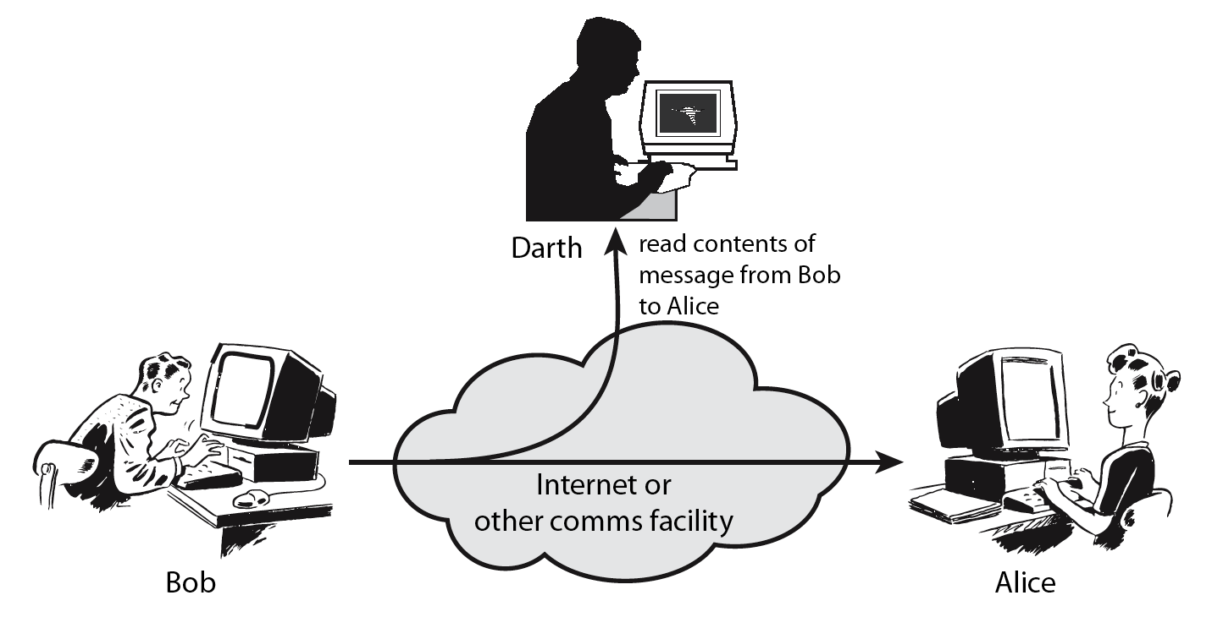
Passive attack
Obtaining message content
Traffic analysis
Notes:
Passive attacks attempt to learn or make use of information from the system but does not affect system resources.
By eavesdropping on, or monitoring of, transmissions to:
+ obtain message contents or
+ monitor traffic flows ( … opponent could determine the frequency and length of messages being exchange this kind of information maybe helpful in determining the nature of communication that was taking place)
Are difficult to detect because they do not involve any alteration of the data.

Slide 20
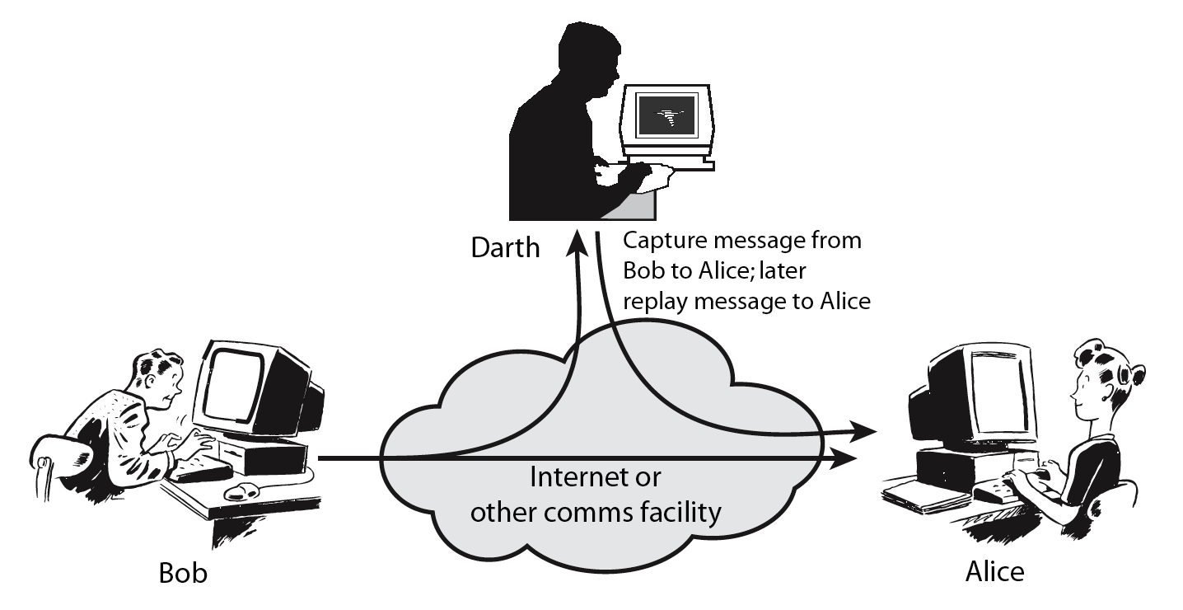
Active attack
Masquerade
Replay previous messages
Modify messages in transit
Denial of service
Notes:
Active attacks attempt to alter system resources or affect their operation.
By modification of data stream to:
+ masquerade of one entity as some other
+ replay previous messages (as shown above in Stallings Figure 1.4b)
+ modify messages in transit
+ denial of service
Active attacks present the opposite characteristics of passive attacks. Whereas passive attacks are difficult to detect, measures are available to prevent their success. On the other hand, it is quite difficult to prevent active attacks absolutely, because of the wide variety of potential physical,software,and network vulnerabilities. Instead, the goal is to detect active attacks and to recover from any disruption or delays caused by them.

Slide 21
Protection
In one protection model, computer consists of a collection of objects, hardware or software
Each object has a unique name and can be accessed through a well-defined set of operations
Protection problem - ensure that each object is accessed correctly and only by those processes that are allowed to do so

Slide 22
Principles of Protection
Guiding principle – principle of least privilege
  Programs, users and systems should be given just enough privileges to perform their tasks
  Limits damage if entity has a bug, gets abused
  Can be static (during life of system, during life of process)
  Or dynamic (changed by process as needed) – domain switching, privilege escalation
  “Need to know” a similar concept regarding access to data
Must consider “grain” aspect
  Rough-grained privilege management easier, simpler, but least privilege now done in large chunks
  Fine-grained management more complex, more overhead, but more protective
    File ACL lists, RBAC
Domain can be user, process, procedure

Slide 23
Different Types of Attacks and Threats
Virus
Worms
Trojan Horse
Botnet
Trap doors
Logic Bomb
Spyware

Slide 24
Viruses
A Virus infects executable programs by appending its own code so that it is run every time the program runs.
Viruses
  may be destructive (by destroying/altering data)
  may be designed to “spread” only
    Although they do not carry a dangerous “payload”, they consume resources and may cause malfunctions in programs if they are badly written and should therefore be considered dangerous!
Viruses have been a major threat in the past decades but have nowadays been replaced by self-replicating worms, spyware and adware as the no. 1 threat!

Slide 25
Trap Door
Trap Door
    Trap doors, also referred to as backdoors, are bits of code embedded in programs by the programmer(s) to quickly gain access at a later time.
    A programmer may purposely leaves this code in or simply forgets to remove it, a potential security hole is introduced. Hackers often plant a backdoor on previously compromised systems to gain later access

Slide 26
Worms
A Worm is a piece of software that uses computer networks (and security flaws) to create copies of itself
First Worm in 1988: “Internet Worm“
  propagated via exploitation of several BSD and sendmail-bugs
  infected large number of computers on the Internet
Some “successful“ Worms
  Code Red in 2001
    Infected hundreds of thousands of systems by exploiting a vulnerability in Microsoft‘s Internet Information Server
  Blaster in 2003
    Infected hundreds of thousands of systems by exploiting a vulnerability in Microsoft‘s RPC service

Slide 27

Trojan Horse

Slide 28
Trojan Horses
A Trojan is (non-self-replicating program) that appears to perform a desirable function for the user but instead facilitates unauthorized access to the user's computer system
It is embedded within or disguised as legitimate software
Trojans may look interesting to the unsuspecting user, but are harmful when actually executed
Two types of Trojan Horses
  Useful software that has been corrupted by an attacker to execute malicious code when the program is run
  Standalone program that masquerades as something else (like a game, or a neat little utility) to trick the user into running it
Trojan Horses do not operate autonomously

Slide 29
Definitions of DoS and DDoS attacks
A DoS (Denial of Service) attack aims at preventing, for legitimate users, authorised access to a system resource or the delaying of system operations and functions
DDoS are distributed Denial of Service attacks that achieve larger magnitude by launching coordinated attacks by using a framework of “handlers” and “agents”. A DDoS is innovative in the form of coordination of the attack.

Slide 30
Modes of attacks
1. Network connectivity attacks
  Flooding
  malformed traffic
2. Consumption of resources
  Filling-up of data structures
  storage (i.e. intentionally generating errors that must be logged)
  side effect of other forms of attack
  from a virus (i.e. SQL slammer virus)
  accounts locked-out during a password cracking
Notes:
SQL slammer exploited a buffer overflow bug in Microsoft's flagship SQL Serve

Slide 31
Ping of death
In the IP specification, the maximum datagram size is 64 KB.
Some systems react in an unpredictable fashion when receiving oversized (>64 KB) IP datagrams, causing systems crashing, freezing or rebooting, and resulting in a denial of service.
Example of a DoS that exploits a programming flaw: the IP implementation is unable to deal with the exceptional condition posed by the oversized datagram.

Slide 32
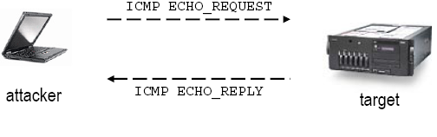
Another simple form of DoS: ICMP (ping) flood
Attackers flood a network link with ICMP ECHO_REQUEST messages using the “ping” command
Exploits a characteristic of the IP layer, that answers with ICMP ECHO_REPLY messages upon reception of ICMP ECHO_REQUEST messages
Notes:
The attack is successful only if the source host and the channel between source and target have enough network bandwidth to flood the target host

Slide 33
Directed broadcast addresses
The directed broadcast address is an IP address with all the host address set to 1. It is used to simultaneously address all hosts within the same network.
i.e. the directed broadcast address for the network class B 151.100.0.0 has IP address 151.100.255.255
For subnetted networks, the directed broadcast address is an IP address with all the host address set to 1 within the same subnet.

Slide 34
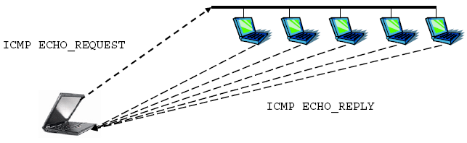
“ping” to a directed broadcast address
All hosts in the broadcast domain answer back
Network traffic “amplification”: 1 datagram generates n datagrams in response (where n is the number of systems replying to a broadcast ICMP ECHO_REQUEST)

Slide 35
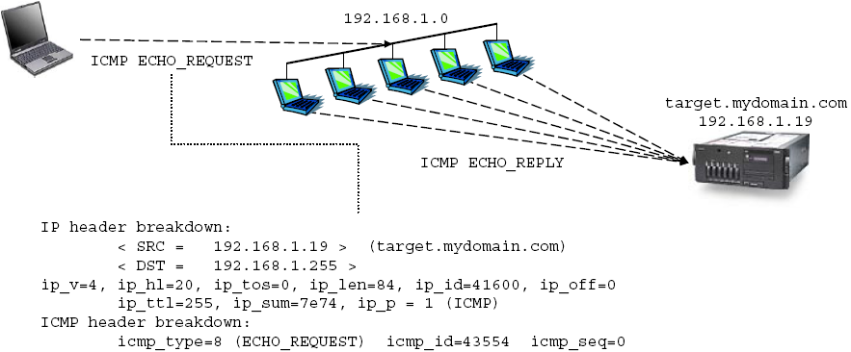
Smurf attack
In a Smurf attack, the attacker sends ping requests to a broadcast address, with the source address of the IP datagram set to the address of the target system under attack (spoofed source address)

Slide 36
Smurf attack protection
Hosts can be configured not to respond to ICMP datagrams directed to IP broadcast addresses. Most OS have specific network settings to enable/disable the response to a broadcast ICMP ping message.
Disable IP-directed broadcasts at your leaf routers: to deny IP broadcast traffic onto your network from other networks (in particular from the Internet)
A forged source is required for the attack to succeed. Routers must filter outgoing packets that contain source addresses not belonging to local subnetworks.

Slide 37
TCP SYN flood
A TCP SYN flood is an attack based on bogus TCP connection requests, created with a spoofed source IP address, sent to the attacked system. Connections are not completed, thus soon it will fill up the connection request table of the attacked system, preventing it from accepting any further valid connection request.
The source host for the attack sends a SYN packet to the target host. The target hosts replies with a SYN/ACK back to the legitimate user of the forged IP source address. Since the spoofed source IP address is unreachable, the attacked system will never receive the corresponding ACK packets in return, and the connection request table on the attacked system will soon be filled up.

Slide 38
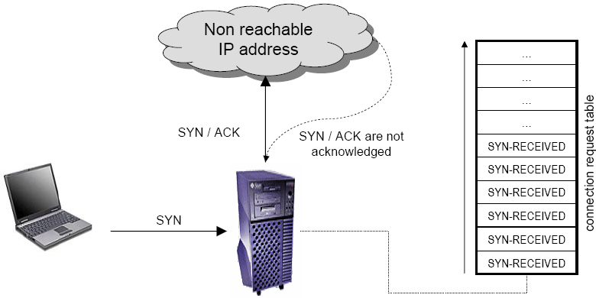
TCP SYN flood
Cont.

Slide 39
TCP SYN flood protection
Apply Operating System fixes:
  Systems periodically check incomplete connection requests,and randomly clear connections that have not completed a three-way handshake. This will reduce the likelihood of a complete block due to a successful SYN attack, and allow legitimate client connections to proceed.
Configure TCP SYN traffic rate limiting
Install IDS (Intrusion Detection Systems) capable of detecting TCP SYN flood attacks.

Slide 40
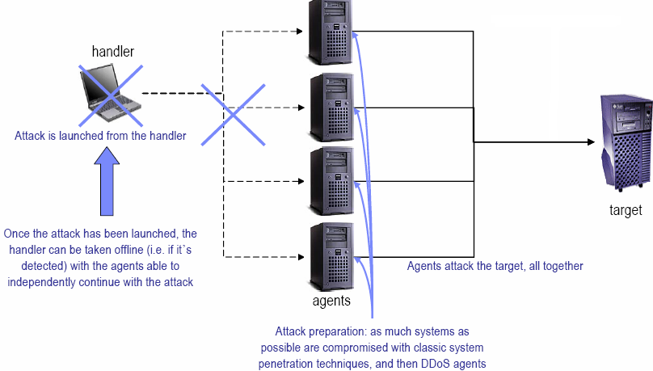
Distributed Denial of Service (DDoS)
The attacking host is replicated through an handler-agent distributed framework

Slide 41
DDoS protection
Configure routers to filter network traffic
  Perform ingress filtering
  Configure traffic rate limiting (ICMP, SYN, UDP, etc)
Deploy firewalls at the boundaries of your network
  The filtering system must be able to distinguish harmful uses of a network service from legitimate uses.
Perform regular network vulnerability scans
  common and known vulnerabilities could be exploited to install DDoS agents.
  Identify the agents that are listening to the handler’s commands
Notes:
Ingress: the right or permission to enter.

Slide 42
DDoS protection
Cont.
Install IDS (Intrusion Detection Systems) capable of detecting
  DDoS handler-to-agent communication
  DDoS agent-to-target attacks

Slide 43
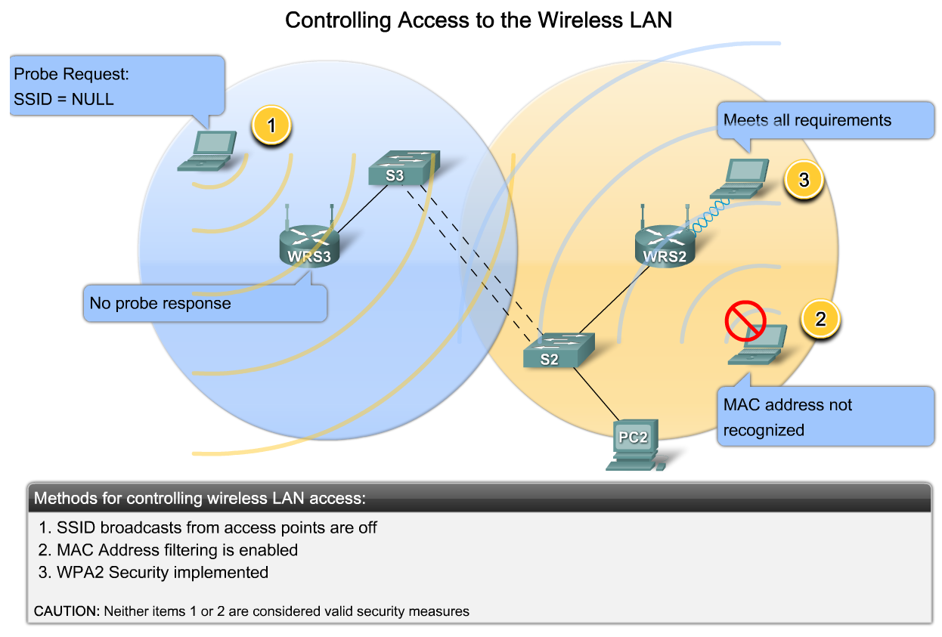
The Components and Operations of Basic Wireless LAN Security

Slide 44
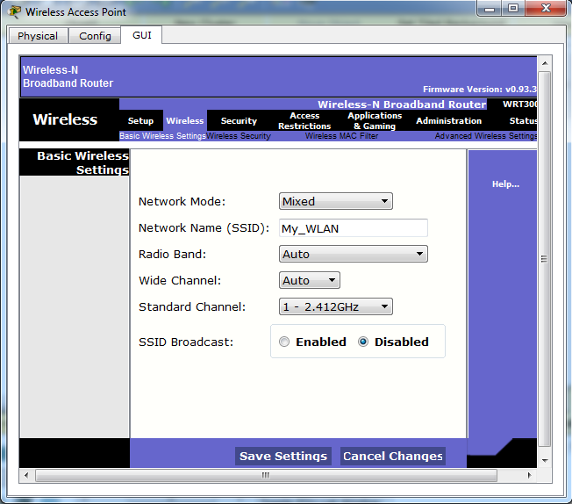
Security in a WLAN in 5 ways
Disabling the SSID

Slide 45
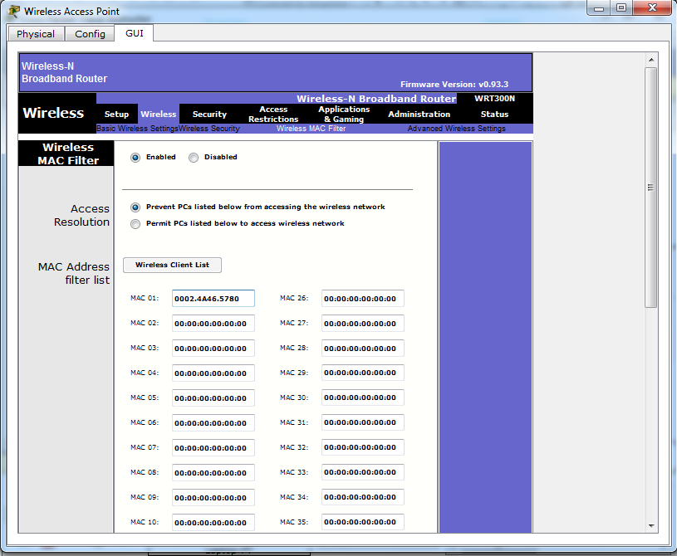
Security in WLAN
2. MAC address filtration

Slide 46
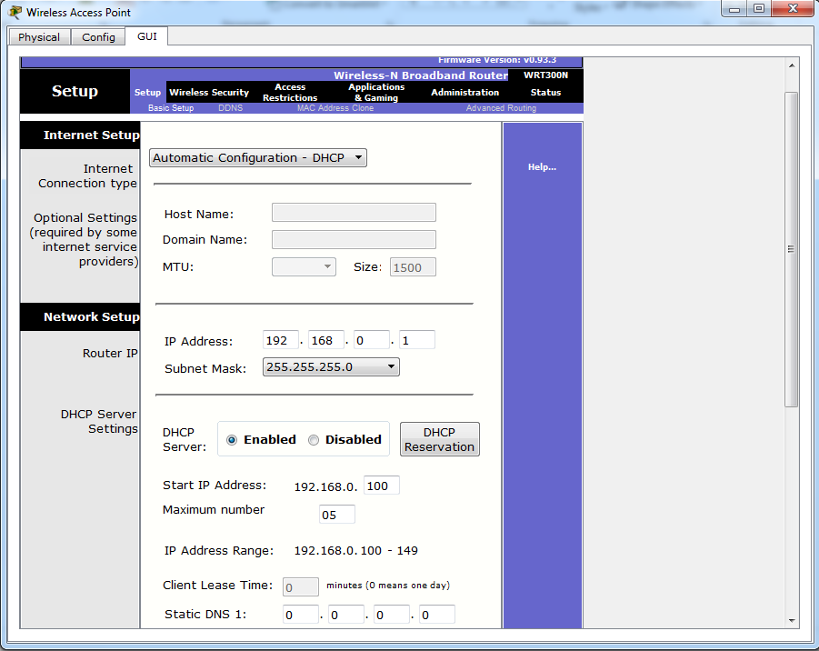
Security in WLAN
3. Limiting the number of IPs

Slide 47
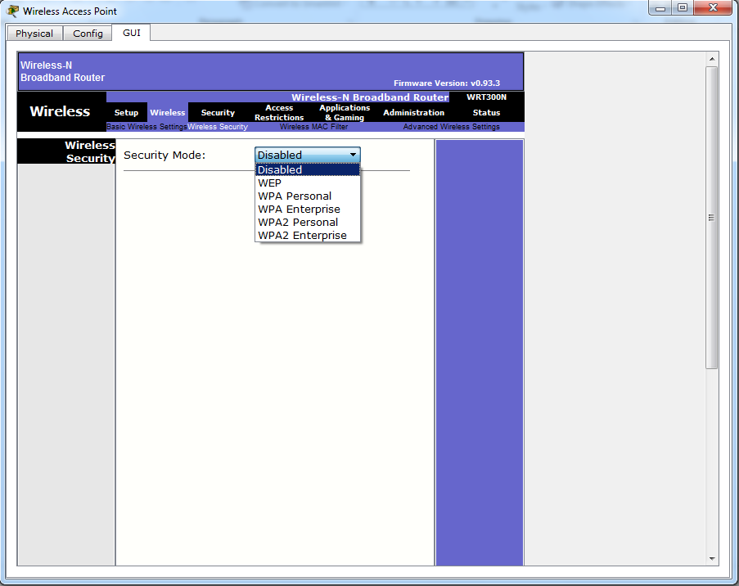
Security in WLAN
4. Enabling the Security mode

Slide 48
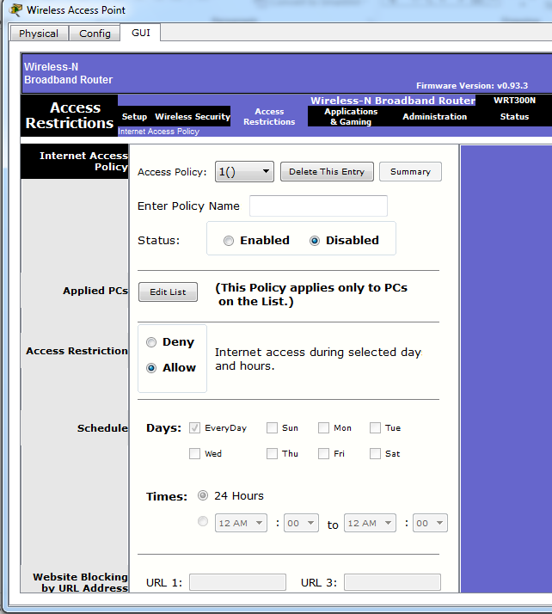
Security in WLAN
5. Internet Access
Policy

Slide 49
Summary
We have revised basics of system security.
Security violation categories were also revised
We also briefly reviewed different attacks
Notes:
Chapter 16 summary.

Slide 50
The End

