Slide 1
Network Security
Lecture 30
Presented by: Dr. Munam Ali Shah

Slide 2
Part 3
Internet Security
(Last lecture of last Part)

Slide 3
Summary of the Previous Lecture
  We had a discussion about following topics
  Email Security
  Pretty Good Privacy
    Why PGP is famous
    PGP Operating
    Message generation
    Message Reception
  Internet Mail Architecture
    Email Threats

Slide 4
Outlines of today’s lecture
Secure Socket Layer (SSL)
    Architecture
    Connection
    Session
    Record Protocol Service
    Record Protocol operation
Three SSL-specific protocols that use the SSL Record Protocol
    SSL Change Cipher Spec Protocol
    Alert Protocol
    Handshake Protocol
Integrating SSL/TLS with HTTP ⇒ HTTPS
HTTPS and SSH

Slide 5
Objectives
You would be able to present an understanding of how web security is achieved through different protocols.
You would be able demonstrate knowledge about SSH, HTTPS, TLS etc.

Slide 6
Web Security
Web now widely used by business, government, individuals
but Internet & Web are vulnerable
have a variety of threats
  integrity
  confidentiality
  denial of service
  authentication
need added security mechanisms
Notes:
The World Wide Web is widely used by businesses, government agencies, and many individuals. But the Internet and the Web are extremely vulnerable to compromises of various sorts, with a range of threats as shown briefly above, and in detail in Stallings Table 16.1. These can be described as passive attacks including eavesdropping on network traffic between browser and server and gaining access to information on a Web site that is supposed to be restricted; and active attacks including impersonating another user, altering messages in transit between client and server, and altering information on a Web site. The web needs added security mechanisms to address these threats.

Slide 7
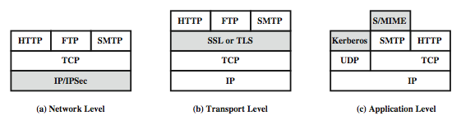
Web Traffic Security Approaches
A number of approaches to providing Web security are possible. The various approaches that have been considered are similar in the services they provide and, to some extent, in the mechanisms that they use, but they differ with respect to their scope of applicability and their relative location within the TCP/IP protocol stack.
Notes:
A number of approaches to providing Web security are possible. The various approaches that have been considered are similar in the services they provide and, to some extent, in the mechanisms that they use, but they differ with respect to their scope of applicability and their relative location within the TCP/IP protocol stack. Stallings Figure 16.1 illustrates this difference.
One way to provide Web security is to use IP Security (Figure 16.1a). The advantage of using IPSec is that it is transparent to end users and applications and provides a general-purpose solution. Further, IPSec includes a filtering capability so only selected traffic need incur the IPSec processing overhead.
Another relatively general-purpose solution is to implement security just above TCP (Figure 16.1b). The foremost example of this approach is the Secure Sockets Layer (SSL) and the follow-on Internet standard known as Transport Layer Security (TLS). At this level, there are two implementation choices. For full generality, SSL (or TLS) could be provided as part of the underlying protocol suite and therefore be transparent to applications. Alternatively, SSL can be embedded in specific packages, e.g. both the Netscape and Microsoft Explorer browsers come with SSL, & most Web servers have implemented it.
Application-specific security services are embedded within the particular application. Figure 16.1c shows examples of this architecture. The advantage of this approach is that the service can be tailored to the specific needs of a given application.

Slide 8
SSL (Secure Socket Layer)
Transport layer security service
originally developed by Netscape
version 3 designed with public input
subsequently became Internet standard known as TLS (Transport Layer Security)
uses TCP to provide a reliable end-to-end service
SSL has two layers of protocols
Notes:
SSL probably most widely used Web security mechanism, and it is implemented at the Transport layer (cf. figure 16.1b on previous slide).
SSL is designed to make use of TCP to provide a reliable end-to-end secure service. Netscape originated SSL. Version 3 of the protocol was designed with public review and input from industry and was published as an Internet draft document. Subsequently, when a consensus was reached to submit the protocol for Internet standardization, the TLS working group was formed within IETF to develop a common standard. This first published version of TLS can be viewed as essentially an SSLv3.1 and is very close to and backward compatible with SSLv3. SSL is not a single protocol but rather two layers of protocol, as shown next.

Slide 9
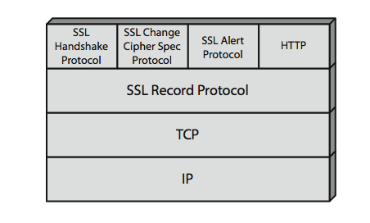
SSL Architecture
The SSL Record Protocol provides basic security services to various higher-layer protocols. In particular, the Hypertext Transfer Protocol (HTTP), which provides the transfer service for Web client/server interaction, can operate on top of SSL.
Three higher-layer protocols are also defined as part of SSL: the Handshake Protocol, Change Cipher Spec Protocol, and Alert Protocol. These SSL-specific protocols are used in the management of SSL exchanges.
Notes:
Stallings Figure 16.2 shows the SSL Protocol stack.
The SSL Record Protocol provides basic security services to various higher-layer protocols. In particular, the Hypertext Transfer Protocol (HTTP), which provides the transfer service for Web client/server interaction, can operate on top of SSL.
Three higher-layer protocols are also defined as part of SSL: the Handshake Protocol, Change Cipher Spec Protocol, and Alert Protocol. These SSL-specific protocols are used in the management of SSL exchanges.

Slide 10
SSL Architecture
SSL connection
  a transient, peer-to-peer, communications link
  associated with 1 SSL session
SSL session
  an association between client & server
  created by the Handshake Protocol
  define a set of cryptographic parameters
  may be shared by multiple SSL connections
Notes:
Two important SSL concepts are the SSL connection and the SSL session:
• Connection: A connection is a network transport that provides a suitable type of service, such connections are transient, peer-to-peer relationships, associated with one session
• Session: An SSL session is an association between a client and a server, created by the Handshake Protocol. Sessions define a set of cryptographic security parameters, which can be shared among multiple connections. Sessions are used to avoid the expensive negotiation of new security parameters for each connection.
Between any pair of parties (applications such as HTTP on client and server), there may be multiple secure connections. In theory, there may also be multiple simultaneous sessions between parties, but this feature is not used in practice.
There are a number of states associated with each session. Once a session is established, there is a current operating state for both read and write (i.e., receive and send). In addition, during the Handshake Protocol, pending read and write states are created. Upon successful conclusion of the Handshake Protocol, the pending states become the current states. A session state and a connection state are defined by sets of parameters, see text for details.

Slide 11
SSL Record Protocol Services
confidentiality
  using symmetric encryption with a shared secret key defined by Handshake Protocol
  AES, IDEA, RC2-40, DES-40, DES, 3DES, Fortezza, RC4-40, RC4-128
  message is compressed before encryption
message integrity
  using a MAC with shared secret key
  similar to HMAC but with different padding
Notes:
SSL Record Protocol defines two services for SSL connections:
• Confidentiality: The Handshake Protocol defines a shared secret key that is used for conventional encryption of SSL payloads. The message is compressed before being concatenated with the MAC and encrypted, with a range of ciphers being supported as shown.
• Message Integrity: The Handshake Protocol also defines a shared secret key that is used to form a message authentication code (MAC), which is similar to HMAC

Slide 12
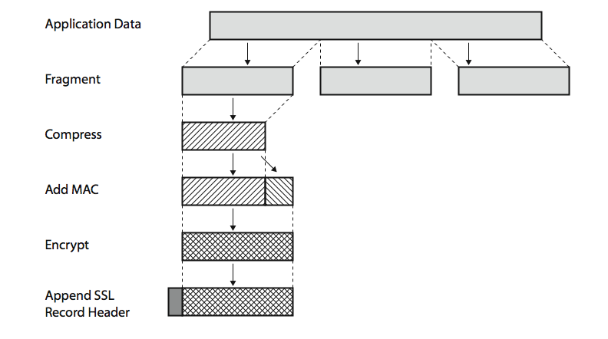
SSL Record Protocol Operation
The Record Protocol takes an application message to be transmitted, fragments the data into manageable blocks, optionally compresses the data, computes and appends a MAC (using a hash very similar to HMAC), encrypts (using one of the symmetric algorithms listed on the previous slide), adds a header (with details of the SSL content type, major/minor version, and compressed length), and transmits the resulting unit in a TCP segment. Received data are decrypted, verified, decompressed, and reassembled and then delivered to higher-layer applications
Notes:
Stallings Figure16.3 shows the overall operation of the SSL Record Protocol. The Record Protocol takes an application message to be transmitted, fragments the data into manageable blocks, optionally compresses the data, computes and appends a MAC (using a hash very similar to HMAC), encrypts (using one of the symmetric algorithms listed on the previous slide), adds a header (with details of the SSL content type, major/minor version, and compressed length), and transmits the resulting unit in a TCP segment. Received data are decrypted, verified, decompressed, and reassembled and then delivered to higher-layer applications. See text for additional details.

Slide 13
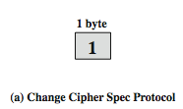
SSL Change Cipher Spec Protocol
One of 3 SSL specific protocols which use the SSL Record protocol
a single message
causes pending state to become current
hence updating the cipher suite in use
Notes:
The Change Cipher Spec Protocol is one of the three SSL-specific protocols that use the SSL Record Protocol, and it is the simplest, consisting of a single message (shown in Stallings Figure 16.5a), which consists of a single byte with the value 1. The sole purpose of this message is to cause the pending state to be copied into the current state, which updates the cipher suite to be used on this connection.

Slide 14

SSL Alert Protocol
conveys SSL-related alerts to peer entity
severity
    warning or fatal
specific alert
    fatal: unexpected message, bad record mac, decompression failure, handshake failure, illegal parameter
    warning: close notify, no certificate, bad certificate, unsupported certificate, certificate revoked, certificate expired, certificate unknown
compressed & encrypted like all SSL data
Notes:
The Alert Protocol is used to convey SSL-related alerts to the peer entity. As with other applications that use SSL, alert messages are compressed and encrypted, as specified by the current state.
Each message in this protocol consists of two bytes (as shown in Stallings Figure 16.5b), the first takes the value warning(1) or fatal(2) to convey the severity of the message. The second byte contains a code that indicates the specific alert. The first group shown are the fatal alerts, the others are warnings.

Slide 15

SSL Handshake Protocol
allows server & client to:
  authenticate each other
  to negotiate encryption & MAC algorithms
  to negotiate cryptographic keys to be used
comprises a series of messages in phases
  Establish Security Capabilities
  Server Authentication and Key Exchange
  Client Authentication and Key Exchange
  Finish
Notes:
The most complex part of SSL is the Handshake Protocol. This protocol allows the server and client to authenticate each other and to negotiate an encryption and MAC algorithm and cryptographic keys to be used to protect data sent in an SSL record. The Handshake Protocol is used before any application data is transmitted. The Handshake Protocol consists of a series of messages exchanged by client and server, which have the format shown in Stallings Figure 16.5c, and which can be viewed in 4 phases:
Phase 1. Establish Security Capabilities - this phase is used by the client to initiate a logical connection and to establish the security capabilities that will be associated with it
Phase 2. Server Authentication and Key Exchange - the server begins this phase by sending its certificate if it needs to be authenticated.
Phase 3. Client Authentication and Key Exchange - the client should verify that the server provided a valid certificate if required and check that the server_hello parameters are acceptable
Phase 4. Finish - this phase completes the setting up of a secure connection. The client sends a change_cipher_spec message and copies the pending CipherSpec into the current CipherSpec. At this point the handshake is complete and the client and server may begin to exchange application layer data.

Slide 16
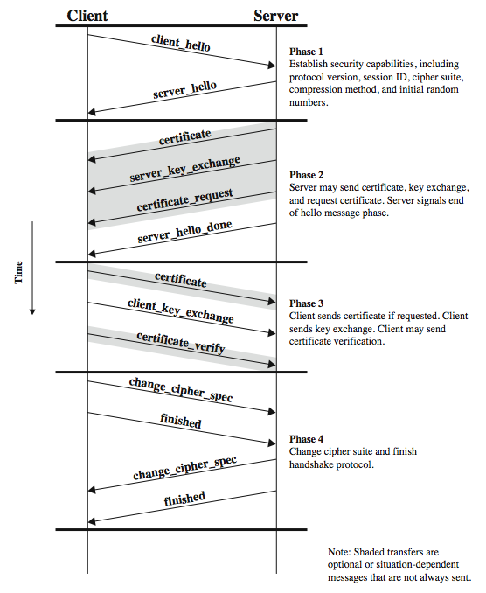
SSL Handshake Protocol
Notes:
Stallings Figure16.6 shows the initial exchange needed to establish a logical connection between client and server. The exchange can be viewed as having the four phases discussed previously. Additional details on the operation of these phases is given in the text.

Slide 17
TLS (Transport Layer Security)
IETF standard RFC 2246 similar to SSLv3
with minor differences
  in record format version number
  uses HMAC for MAC
  a pseudo-random function expands secrets
    based on HMAC using SHA-1 or MD5
  has additional alert codes
  some changes in supported ciphers
  changes in certificate types & negotiations
  changes in crypto computations & padding
Notes:
TLS is an IETF standardization initiative whose goal is to produce an Internet standard version of SSL. TLS is defined as a Proposed Internet Standard in RFC 2246. RFC 2246 is very similar to SSLv3, but with a number of minor differences in the areas shown, as discussed in the text.

Slide 18

Integrating SSL/TLS with HTTP ⇒ HTTPS
web
proxy
Two complications
Web proxies
solution: browser sends
CONNECT domain-name
before client-hello (dropped by proxy)
Virtual hosting:
two sites hosted at same IP address.
solution in TLS 1.1 (RFC 4366)
client_hello_extension: server_name=cnn.com
implemented in FF2 and IE7 (vista)
web
server
corporate network
web
server
client-hello
server-cert ???
cert_{CNN}
cert_{FOX}

Slide 19
Why is HTTPS not used for all web traffic?
Slows down web servers
Breaks Internet caching
    ISPs cannot cache HTTPS traffic
    Results in increased traffic at web site
Incompatible with virtual hosting (older browsers)
LETS SEE “HTTPS IN THE BROWSER”

Slide 20
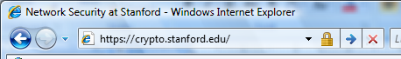
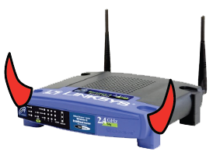
The lock icon: SSL indicator
Intended goal:
  Provide user with identity of page origin
  Indicate to user that page contents were not
  viewed or modified by a network attacker
In reality:
  Origin ID is not always helpful
    example: Stanford HR is hosted at BenefitsCenter.com
  Many other problems
Notes:
Network attacker: controls routers, DNS; can inject, delete, and modify packets

Slide 21
When is the (basic) lock icon displayed
All elements on the page fetched using HTTPS
(with some exceptions)
For all elements:
    HTTPS cert issued by a CA trusted by browser
    HTTPS cert is valid (e.g. not expired)
    CommonName in cert matches domain in URL

Slide 22
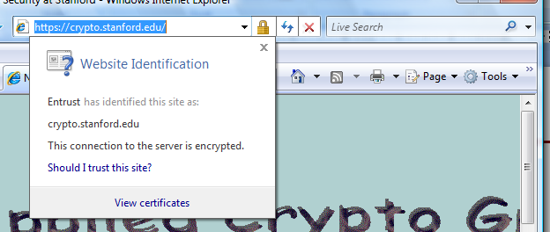
The lock UI: help users authenticate site
IE7:

Slide 23
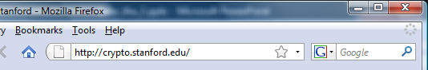
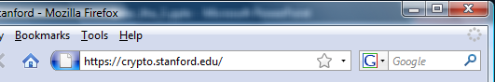
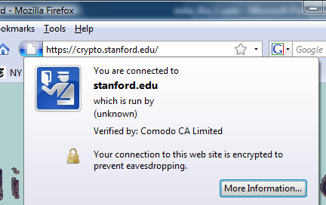
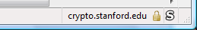
The lock UI: help users authenticate site
Firefox 3:
(no SSL)
(SSL)
Notes:
Click on fav icon gives pop-up on bottom.

Slide 24
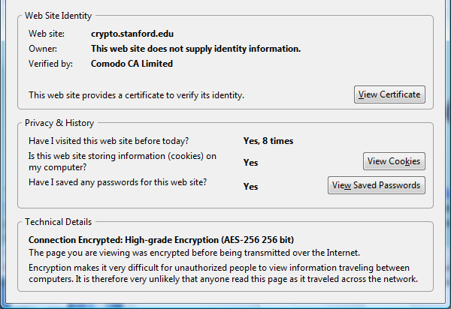
The lock UI: help users authenticate site
Firefox 3: clicking on bottom lock icon gives

Slide 25
The lock UI: Extended Validation (EV) Certs
Harder to obtain than regular certs
      requires human lawyer at CA to approve cert request
Designed for banks and large e-commerce sites
Helps block “semantic attacks”: www.bankofthevvest.com

Slide 26
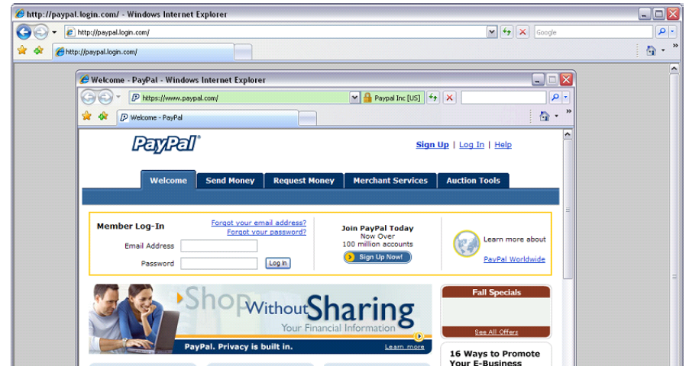
A general UI attack: picture-in-picture
Notes:
Both inner and outer windows are focused

Slide 27
HTTPS
HTTPS (HTTP over SSL)
  combination of HTTP & SSL/TLS to secure communications between browser & server
    documented in RFC2818
    no fundamental change using either SSL or TLS
use https:// URL rather than http://
  and port 443 rather than 80
encrypts
  URL, document contents, form data, cookies, HTTP headers
Notes:
HTTPS (HTTP over SSL) refers to the combination of HTTP and SSL to implement secure communication between a Web browser and a Web server. The HTTPS capability is built into all modern Web browsers. Its use depends on the Web server supporting HTTPS communication. The principal difference seen by a user of a web browser is that URL (uniform resource locator) addresses begin with https:// rather than http://. A normal HTTP connection uses port 80. If HTTPS is specified, port 443 is specified, which invokes SSL. When HTTPS is used, the following elements of the communication are encrypted: URL of the requested document, Contents of the document, Contents of browser forms (filled in by browser user), Cookies sent from browser to server and from server to browser, and Contents of HTTP header. HTTPS is documented in RFC 2818, HTTP Over TLS. There is no fundamental change in using HTTP over either SSL or TLS, and both implementations are referred to as HTTPS.

Slide 28
HTTPS Use
connection initiation
  TLS handshake then HTTP request(s)
connection closure
  have “Connection: close” in HTTP record
  TLS level exchange close_notify alerts
  can then close TCP connection
  must handle TCP close before alert exchange sent or completed
Notes:
For HTTPS, the agent acting as the HTTP client also acts as the TLS client. The client initiates a connection to the server on the appropriate port and then sends the TLS ClientHello to begin the TLS handshake. When the TLS handshake has finished. The client may then initiate the first HTTP request. All HTTP data is to be sent as TLS application data. Normal HTTP behavior, including retained connections is followed.
An HTTP client or server can indicate the closing of a connection by including in an HTTP record: “Connection: close”. This indicates that the connection will be closed after this record is delivered. The closure of an HTTPS connection requires that TLS close the connection with the peer TLS entity on the remote side, which will involve closing the underlying TCP connection. At the TLS level, the proper way to close a connection is for each side to use the TLS alert protocol to send a close_notify alert. TLS implementations must initiate an exchange of closure alerts before closing a connection. A TLS implementation may, after sending a closure alert, close the connection without waiting for the peer to send its closure alert, generating an "incomplete close". Note that an implementation that does this may choose to reuse the session. This should only be done when the application knows (typically through detecting HTTP message boundaries) that it has received all the message data that it cares about. HTTP clients must also be able to cope with a situation in which the underlying TCP connection is terminated without a prior close_notify alert and without a Connection: close indicator. Such a situation could be due to a programming error on the server, or a communication error that causes the TCP connection to drop. However, the unannounced TCP closure could be evidence of some sort of attack. So the HTTPS client should issue some sort of security warning when this occurs.

Slide 29
Secure Shell (SSH)
protocol for secure network communications
  designed to be simple & inexpensive
SSH1 provided secure remote logon facility
  replace TELNET & other insecure schemes
  also has more general client/server capability
SSH2 fixes a number of security flaws
documented in RFCs 4250 through 4254
SSH clients & servers are widely available
method of choice for remote login/ X tunnels
Notes:
Secure Shell (SSH) is a protocol for secure network communications designed to be relatively simple and inexpensive to implement. The initial version, SSH1 was focused on providing a secure remote logon facility to replace TELNET and other remote logon schemes that provided no security. SSH also provides a more general client/server capability and can be used for such network functions as file transfer and email. A new version, SSH2, fixes a number of security flaws in the original scheme. SSH2 is documented as a proposed standard in IETF RFCs 4250 through 4254. SSH client and server applications are widely available for most operating systems. It has become the method of choice for remote login and X tunneling and is a rapidly becoming one of the most pervasive applications for encryption technology outside of embedded systems.

Slide 30
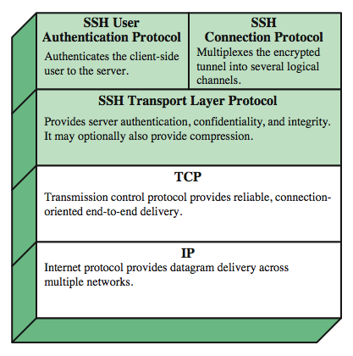
SSH Protocol Stack
Notes:
SSH is organized as three protocols that typically run on top of TCP (Stallings Figure 16.8):
• Transport Layer Protocol: Provides server authentication, data confidentiality, and data integrity with forward secrecy (i.e., if a key is compromised during one session, the knowledge does not affect the security of earlier sessions). The transport layer may optionally provide compression.
• User Authentication Protocol: Authenticates the user to the server.
• Connection Protocol: Multiplexes multiple logical communications channels over a single underlying SSH connection.

Slide 31
SSH Transport Layer Protocol
server authentication occurs at transport layer, based on server/host key pair(s)
  server authentication requires clients to know host keys in advance
packet exchange
  establish TCP connection
  can then exchange data
    identification string exchange, algorithm negotiation, key exchange, end of key exchange, service request
  using specified packet format
Notes:
Server authentication occurs at the transport layer, based on the server possessing a public/private key pair. The server host key is used during key exchange to authenticate the identity of the host. For this to be possible, the client must have a priori knowledge of the server's public host key.
Next, consider events in the SSH Transport Layer Protocol. First, a client establishes a TCP connection to the server. Once the connection is established, the client and server exchange data, referred to as packets, in the data field of a TCP segment. Each packet has the format shown in Stallings Figure 16.10 and described in the text.
The SSH Transport Layer packet exchange consists of a sequence of steps. The first step, the identification string exchange, begins with the client sending a packet with an identification string. Next comes algorithm negotiation. Each side sends an SSH_MSG_KEXINIT containing lists of supported algorithms, one list for each type of cryptographic algorithm, in the order of preference to the sender. For each category, the algorithm chosen is the first algorithm on the client's list that is also supported by the server. The next step is key exchange. The specification allows for alternative methods of key exchange, but at present only two versions of Diffie-Hellman key exchange are specified. As a result of these steps, the two sides now share a master key K. In addition, the server has been authenticated to the client. The end of key exchange is signaled by the exchange of SSH_MSG_NEWKEYS packets. At this point, both sides may start using the keys generated from K, as discussed subsequently. The final step is service request. The client sends an SSH_MSG_SERVICE_REQUEST packet to request either the User Authentication or the Connection Protocol. Subsequent to this, all data is exchanged as the payload of an SSH Transport Layer packet, protected by encryption and MAC.

Slide 32
SSH User Authentication Protocol
authenticates client to server
three message types:
  SSH_MSG_USERAUTH_REQUEST
  SSH_MSG_USERAUTH_FAILURE
  SSH_MSG_USERAUTH_SUCCESS
authentication methods used
  public-key, password, host-based
Notes:
The User Authentication Protocol provides the means by which the client is authenticated to the server. Three types of messages are always used in the User Authentication Protocol. Authentication requests from the client have type SSH_MSG_USERAUTH_REQUEST. If the server either (a) rejects the authentication request, or (b) accepts the request but requires one or more additional authentication methods, the server sends a SSH_MSG_USERAUTH_FAILURE message that includes a list of methods that may productively continue the dialog. If the server accepts authentication then it sends a single byte message, SSH_MSG_USERAUTH_SUCCESS.
The server may require one or more of the following authentication methods:
publickey - client sends a message to the server that contains the client's public key, with the message signed by the client's private key
password - client sends a message containing a plaintext password, protected by TLS encryption
hostbased - authentication is performed on the client's host, rather than the client itself

Slide 33
SSH Connection Protocol
runs on SSH Transport Layer Protocol
assumes secure authentication connection
used for multiple logical channels
  SSH communications use separate channels
  either side can open with unique id number
  flow controlled
  have three stages:
    opening a channel, data transfer, closing a channel
  four types:
    session, x11, forwarded-tcpip, direct-tcpip.
Notes:
The SSH Connection Protocol runs on top of the SSH Transport Layer Protocol and assumes that a secure authentication connection is in use. That secure authentication connection, referred to as a tunnel is used by the Connection Protocol to multiple a number of logical channels. All types of communication using SSH, such as a terminal session, are supported using separate channels. Either side may open a channel. For each channel, each side associates a unique channel number, which need not be the same on both ends. Channels are flow controlled using a window mechanism. No data may be sent to a channel until a message is received to indicate that window space is available. The life of a channel progresses through three stages: opening a channel, data transfer, and closing a channel. Four channel types are recognized in the SSH Connection Protocol specification:
session - remote execution of a program
x11 - X Window System display traffic
forwarded-tcpip - remote port forwarding
direct-tcpip - local port forwarding

Slide 34
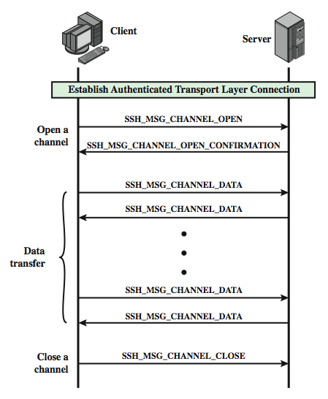
SSH Connection Protocol Exchange
Notes:
Stallings Figure 16.11 provides an example of Connection Protocol Exchange.

Slide 35
Summary
Have discussed:
  Need for web security
  SSL/TLS transport layer security protocols
  HTTPS
  Secure shell (SSH)
Notes:
Chapter 16 summary.

Slide 36
Next lecture topics
Our course “Network Security” finishes here.
We will revise the entire course of network security in next two lectures, i.e., Lecture 31 and 32.

Slide 37
The End

