Slide 1
Network Security
Lecture 3
Presented by: Dr. Munam Ali Shah

Slide 2
Summary of the previous lecture
Hackers and Attackers
Threats, Risks, Vulnerabilities and Attacks
Why is Security difficult to achieve
Threat Modelling and Risk Assessment

Slide 3
Outlines
Security tradeoffs
Protection, Detection and Reaction
How to Test Security

Slide 4
Objectives
To describe the security tradeoffs.
To understand why is it difficult to achieve full security.
To understand how different security tools be used.

Slide 5
Why security is difficult to achieve?
Security in computer systems – even harder:
  great complexity
  dependency on the Operating System,
  File System, network, physical access etc.
Software/system security is difficult to measure
  there are no security metrics
How to test security?
Deadline pressure
Clients don’t demand security
… and can’t sue a vendor

Slide 6
Threat Modeling and Risk Assessment
Secure against what and from whom?
  who will be using the application?
  what does the user (and the admin) care about?
  where will the application run?
  (on a local system as Administrator/root? An intranet application? As a web service available to the public? On a mobile phone?)
  what are you trying to protect and against whom?
Steps to take
  Evaluate threats, risks and consequences
  Address the threats and mitigate the risks

Slide 7
How much security?
Total security is unachievable
A trade-off: more security often means
  higher cost
  less convenience / productivity / functionality
Security measures should be as invisible as possible
  cannot irritate users or slow down the software (too much)
  example: forcing a password change everyday
  users will find a workaround, or just stop using it
Choose security level relevant to your needs

Slide 8
Testing Security
Penetration Testing:
Penetration test is a proactive and authorized attempt to evaluate the security of an IT infrastructure by safely attempting to exploit system vulnerabilities, including OS, service and application flaws, improper configurations, and even risky end-user behavior. Such assessments are also useful in validating the efficacy of defensive mechanisms, as well as end-users’ adherence to security policies. –
See more at: http://www.coresecurity.com/penetration-testing-overview#sthash.B23EFh9Z.dpuf

Slide 9



Penetration Testing Tools
Aircrak:
802.11 WEP and WPA-PSK keys cracking program
Angry IP Scanner:
It scans IP addresses and ports as well as has many other features. It is widely used by network administrators
BackBox:
BackBox is an Ubuntu-based distribution developed to perform penetration tests and security assessments for desktop environments
More details on : https://www.concise-courses.com/hacking-tools/

Slide 10
How to get secure?
Protection, detection, reaction
Know your enemy: types of attacks, typical tricks,
commonly exploited vulnerabilities
Attackers don’t create security holes and vulnerabilities
  they exploit existing ones
Software security:
  Two main sources of software security holes:
  architectural flaws and implementation bugs
  Think about security in all phases
  of software development
  Follow standard software development procedures

Slide 11
Protection, detection, reaction
An ounce of prevention is worth a pound of cure
  better to protect that to recover
Detection is necessary because total prevention
is impossible to achieve
Without some kind of reaction, detection is useless
  like a burglar alarm that no-one listens and responds to

Slide 12
Protection, detection, reaction
Each and every of the three elements is very important
Security solutions focus too often on prevention only
(Network/Host) Intrusion Detection Systems –
tools for detecting network and system level attacks
For some threats, detection (and therefore reaction)
is not possible, so strong protection is crucial
  example: eavesdropping on Internet transmission

Slide 13
Is a particular security measure good?
(Questions proposed by Bruce Schneier)
What problem does it solve?
  whether it really solves the problem you have
How well does it solve the problem?
  will it work as expected?
What new problems does it add?
  it adds some for sure
What are the economic and social costs?
  cost of implementation, lost functionality or productivity
Given the above, is it worth the costs?

Slide 14
There is never a free lunch
Means don’t go for free software, free wallpapers etc.
No one is going to give you anything free

Slide 15
Security through obscurity … ?
Security through obscurity – hiding design
or implementation details to gain security:
  keeping secret not the key, but the encryption
  algorithm,
  hiding a DB server under a name different from “db”, etc.
The idea doesn’t work
  it’s difficult to keep secrets (e.g. source code gets stolen)
  if security of a system depends on one secret, then,
  once it’s no longer a secret, the whole system is compromised
  secret algorithms, protocols etc. will not get reviewed → flaws won’t be spotted and fixed → less security
Systems should be secure by design, not by obfuscation
Security AND obscurity

Slide 16
Aspects of Security
Security attack
  Any action that compromises the security of information owned by an organization.
Security mechanism
  A process that is designed to detect, prevent or recover from a security attack.
Security service
  Services that enhances the security of the data processing systems and the information transfers of an organization.
  These services are intended to counter security attacks, and they make use of one or more security mechanisms to provide the service.
Notes:
The OSI security architecture focuses on security attacks,mechanisms,and services.

Slide 17
OSI Security Architecture
International Telecommunication Union (ITU-T) recommends X.800, the security architecture for OSI
Defines a systematic way of defining and providing security requirements
Notes:
International telecommunication union (ITU) telecommunication standardization sector (ITU-T)

Slide 18
Security Attacks Classification
Any action that compromises the security of information owned by an organization
Information security is about how to prevent attacks, or failing that, to detect attacks
Classification according to X.800
  Passive attack
  Active attack
Notes:
A threat is a possible potential danger that might exploit a vulnerability.
Is a sequence of commands that take advantage of a vulnerability in order to cause
vulnerability is applied to a weakness in a system which allows an attacker to violate the integrity of that system.

Slide 19
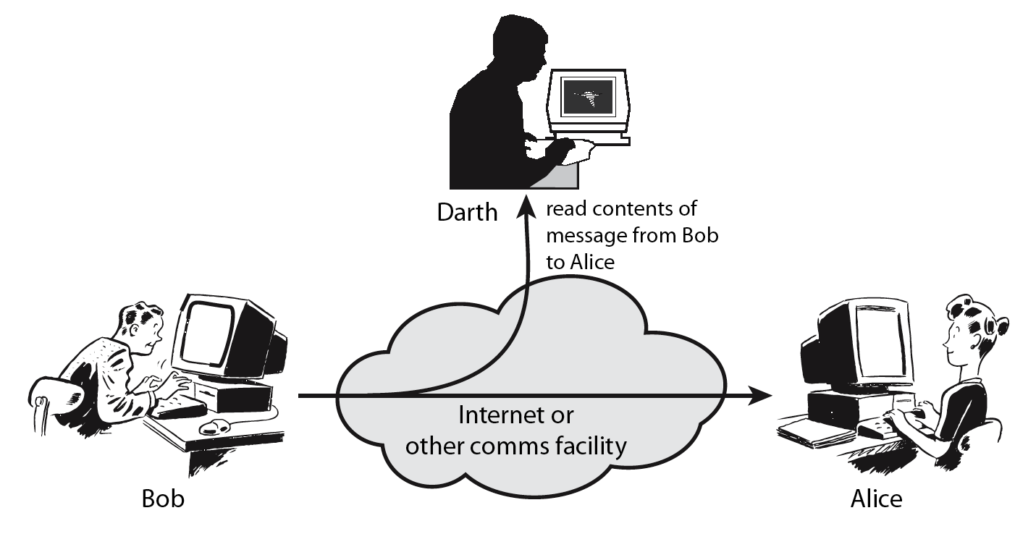
Passive attack
Obtaining message content
Traffic analysis
Notes:
Passive attacks attempt to learn or make use of information from the system but does not affect system resources.
By eavesdropping on, or monitoring of, transmissions to:
+ obtain message contents or
+ monitor traffic flows ( … opponent could determine the frequency and length of messages being exchange this kind of information maybe helpful in determining the nature of communication that was taking place)
Are difficult to detect because they do not involve any alteration of the data.

Slide 20
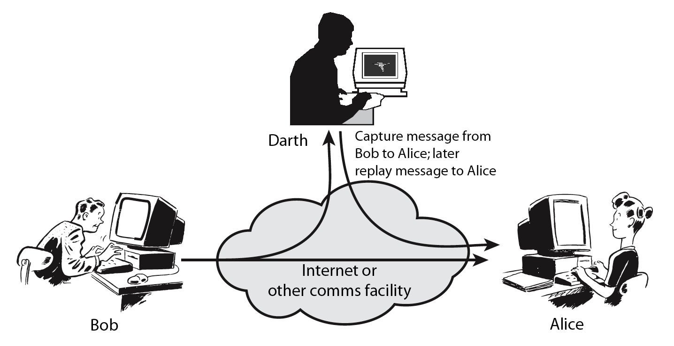
Active attack
Masquerade
Replay previous messages
Modify messages in transit
Denial of service
Notes:
Active attacks attempt to alter system resources or affect their operation.
By modification of data stream to:
+ masquerade of one entity as some other
+ replay previous messages (as shown above in Stallings Figure 1.4b)
+ modify messages in transit
+ denial of service
Active attacks present the opposite characteristics of passive attacks. Whereas passive attacks are difficult to detect, measures are available to prevent their success. On the other hand, it is quite difficult to prevent active attacks absolutely, because of the wide variety of potential physical,software,and network vulnerabilities. Instead, the goal is to detect active attacks and to recover from any disruption or delays caused by them.

Slide 21
Security Service
Enhance security of data processing systems and information transfers of an organization
Intended to counter security attacks
Using one or more security mechanisms
X.800 defines a security service as
“a service provided by a protocol layer of communicating open systems, which ensures adequate security of the systems or of data transfers”

Slide 22
Protection
In one protection model, computer consists of a collection of objects, hardware or software
Each object has a unique name and can be accessed through a well-defined set of operations
Protection problem - ensure that each object is accessed correctly and only by those processes that are allowed to do so

Slide 23
Principles of Protection
Guiding principle – principle of least privilege
  Programs, users and systems should be given just enough privileges to perform their tasks
  Limits damage if entity has a bug, gets abused
  Can be static (during life of system, during life of process)
  Or dynamic (changed by process as needed) – domain switching, privilege escalation
  “Need to know” a similar concept regarding access to data
Must consider “grain” aspect
  Rough-grained privilege management easier, simpler, but least privilege now done in large chunks
  Fine-grained management more complex, more overhead, but more protective
    File ACL lists, RBAC
Domain can be user, process, procedure

Slide 24
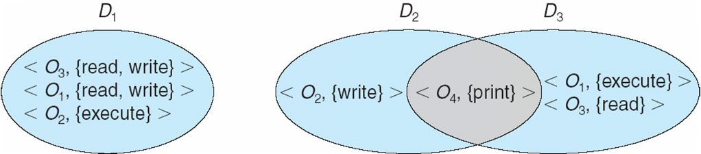
Domain Structure
Access-right = <object-name, rights-set>
where rights-set is a subset of all valid operations that can be performed on the object
Domain = set of access-rights

Slide 25
Access Matrix
View protection as a matrix (access matrix)
Rows represent domains
Columns represent objects
Access(i, j) is the set of operations that a process executing in Domain_{i} can invoke on Object_{j}

Slide 26
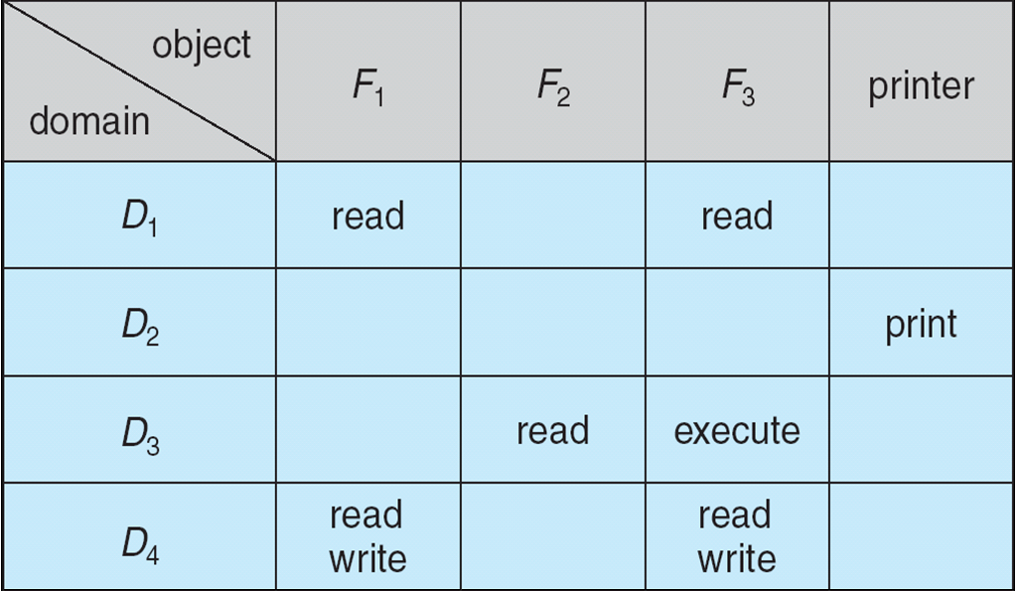
Access Matrix

Slide 27
Use of Access Matrix
If a process in Domain D_{i} tries to do “op” on object O_{j}, then “op” must be in the access matrix
User who creates object can define access column for that object
Can be expanded to dynamic protection
  Operations to add, delete access rights
  Special access rights:
    owner of O_{i}
    copy op from O_{i} to O_{j} (denoted by “*”)
    control – D_{i} can modify D_{j} access rights
    transfer – switch from domain D_{i} to D_{j}
  Copy and Owner applicable to an object
  Control applicable to domain object

Slide 28
Use of Access Matrix (Cont.)
Access matrix design separates mechanism from policy
  Mechanism
    Operating system provides access-matrix + rules
    If ensures that the matrix is only manipulated by authorized agents and that rules are strictly enforced
  Policy
    User dictates policy
    Who can access what object and in what mode
But doesn’t solve the general confinement problem

Slide 29
Each column = Access-control list for one object
Defines who can perform what operation
Domain 1 = Read, Write
Domain 2 = Read
Domain 3 = Read
Each Row = Capability List (like a key)
For each domain, what operations allowed on what objects
      Object F1 – Read
      Object F4 – Read, Write, Execute
      Object F5 – Read, Write, Delete, Copy

Slide 30
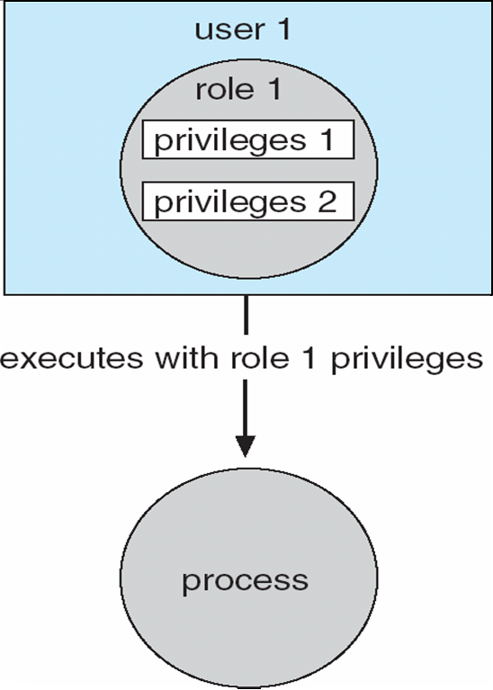
Role-based Access Control in Solaris 10

Slide 31
Summary of today’s lecture
In today’s lecture, we talked about why is it difficult to achieve absolute security and what are the security tradeoffs.
We also discussed the phenomenon of Detection, Protection and Reaction.

Slide 32
Next lecture topics
Firewall Concept. How could firewalls be implemented through software and hardware
We will have some more discussion on Security and Protection

Slide 33
The End

