Slide 1
Network Security
Lecture 29
Presented by: Dr. Munam Ali Shah

Slide 2
Part 3
Internet Security
(Last Part)

Slide 3
Summary of the Previous Lecture
We talked about what Internet security is and how to ensure security while browsing through the Internet.
We also looked at what spyware are and how do they look like.
We discussed few methods that can be used to avoid spywares.
Lastly, we explored some examples of Phishing on the Internet

Slide 4
Outlines of today’s lecture
  Email Security
  Pretty Good Privacy
    Why PGP is famous
    PGP Operating
    Message generation
    Message Reception
  Secure/Multipurpose Internet Mail Extensions (S/MIME)

Slide 5
Objectives
You would be able to present an understanding of how to secure Email over the Internet.
You would be able demonstrate knowledge about PGP and its operation.

Slide 6
Email Security
email is one of the most widely used and regarded network services
currently message contents are not secure
  may be inspected either in transit
  or by suitably privileged users on destination system
Notes:
In virtually all distributed environments, electronic mail is the most heavily used network-based application. But current email services are roughly like "postcards”, anyone who wants could pick it up and have a look as its in transit or sitting in the recipients mailbox.

Slide 7
Email Security Enhancements
With the explosively growing reliance on electronic mail for every conceivable purpose, there grows a demand for authentication and confidentiality services. What we want is something more akin to standard mail (contents protected inside an envelope) if not registered mail (have confidence about the sender of the mail and its contents). That is, the “classic” security services listed are desired.
confidentiality
  protection from disclosure
authentication
  of sender of message
message integrity
  protection from modification
non-repudiation of origin
  protection from denial by sender
Notes:
With the explosively growing reliance on electronic mail for every conceivable purpose, there grows a demand for authentication and confidentiality services. What we want is something more akin to standard mail (contents protected inside an envelope) if not registered mail (have confidence about the sender of the mail and its contents). That is, the “classic” security services listed are desired.

Slide 8
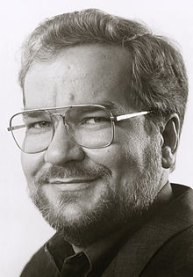
Pretty Good Privacy (PGP)
Pretty Good Privacy (PGP) is a data encryption and decryption computer program that provides cryptographic privacy and authentication for data communication.
PGP is a remarkable phenomenon. Largely the effort of a single person, Phil Zimmermann, PGP provides a confidentiality and authentication service that can be used for electronic mail and file storage applications. In essence, Zimmermann has done the following:
Notes:
The Pretty Good Privacy (PGP) secure email program, is a remarkable phenomenon, has grown explosively and is now widely used. Largely the effort of a single person, Phil Zimmermann, who selected the best available crypto algorithms to use & integrated them into a single program, PGP provides a confidentiality and authentication service that can be used for electronic mail and file storage applications. It runs on a wide range of systems, in both free & commercial versions.

Slide 9
Pretty Good Privacy (PGP)
1. Selected the best available cryptographic algorithms as building blocks.
2. Integrated these algorithms into a general-purpose application that is independent of operating system and processor and that is based on a small set of easy-to-use commands.
3. Made the package and its documentation, including the source code, freely available via the Internet, bulletin boards, and commercial networks such as AOL (America On Line).
4. Entered into an agreement with a company (Viacrypt, now Network Associates) to provide a fully compatible, low-cost commercial version of PGP.
Notes:
The Pretty Good Privacy (PGP) secure email program, is a remarkable phenomenon, has grown explosively and is now widely used. Largely the effort of a single person, Phil Zimmermann, who selected the best available crypto algorithms to use & integrated them into a single program, PGP provides a confidentiality and authentication service that can be used for electronic mail and file storage applications. It runs on a wide range of systems, in both free & commercial versions.

Slide 10
Why is PGP famous
1. It is available free worldwide in versions that run on a variety of platforms, including Windows, UNIX, Macintosh, and many more.
2. It is based on algorithms that have survived extensive public review and are considered extremely secure. Specifically, the package includes RSA, DSS, and Diffie-Hellman for public-key encryption; CAST-128, IDEA, and 3DES for symmetric encryption; and SHA-1 for hash coding.
3. It has a wide range of applicability, from corporations that wish to select and enforce a standardized scheme for encrypting files and messages to individuals who wish to communicate securely with others worldwide over the Internet and other networks.
4. It was not developed by, nor is it controlled by, any governmental or standards organization. For those with an instinctive distrust of “the establishment,” this makes PGP attractive.
5. PGP is now on an Internet standards track (RFC 3156; MIME Security with OpenPGP). Nevertheless, PGP still has an aura of an antiestablishment endeavor.

Slide 11
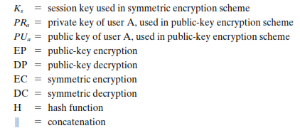

PGP Notations
Most of the notation used in this chapter has been used before, but a few terms are new. It is perhaps best to summarize those at the beginning. The following symbols are used.

Slide 12
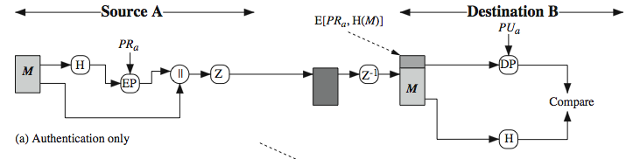
PGP Operation – Authentication
sender creates message
make SHA-1160-bit hash of message
attached RSA signed hash to message
receiver decrypts & recovers hash code
receiver verifies received message hash
Notes:
The actual operation of PGP, as opposed to the management of keys, consists of four services: authentication, confidentiality, compression, and e-mail compatibility. Stallings Figure 18.1a illustrates the digital signature service provided by PGP. This is the digital signature scheme discussed in Chapter 13 and illustrated in Figure 13.2. The sequence is as listed. Note this assumes use of RSA digital signatures, created using the sender's private key, and verified with the sender's public key. Recent PGP versions also support the use of DSS signatures. Signatures can also be detached from a message/file and sent/stored separately. This can be useful to maintain a separate signature log of all messages sent or received; or on an executable program to detect subsequent virus infection, or when more than one party must sign a document.

Slide 13
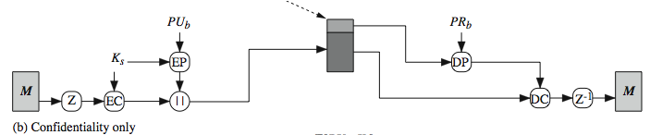
PGP Operation – Confidentiality
sender forms 128-bit random session key
encrypts message with session key
attaches session key encrypted with RSA
receiver decrypts & recovers session key
session key is used to decrypt message
Notes:
Another basic service provided by PGP is confidentiality, provided by encrypting messages to be transmitted or to be stored locally as files, using symmetric encryption algorithms CAST-128, IDEA or 3DES in 64-bit cipher feedback (CFB) mode. The randomly chosen session key used for this is sent encrypted using the recipient’s public RSA key. The steps used in this process are as listed. Stallings Figure 18.1b illustrates the sequence. Recent PGP versions also support the use of ElGamal (a Diffie-Hellman variant) for session-key exchange.

Slide 14
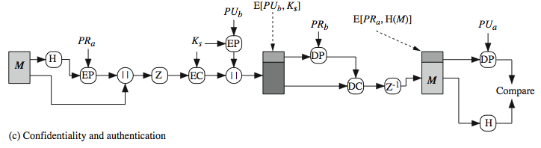
PGP Operation : Confidentiality & Authentication
can use both services on same message
  create signature & attach to message
  encrypt both message & signature
  attach RSA/ElGamal encrypted session key
Notes:
As Stallings Figure 18.1c illustrates, both confidentiality & authentication services may be used for the same message. Firstly a signature is generated for the plaintext message and prepended to the it. Then the plaintext message plus signature is encrypted using CAST-128 (or IDEA or 3DES), and the session key is encrypted using RSA (or ElGamal). This sequence is preferable to the opposite: encrypting the message and then generating a signature for the encrypted message. It is generally more convenient to store a signature with a plaintext version of a message. Furthermore, for purposes of third-party verification, if the signature is performed first, a third party need not be concerned with the symmetric key when verifying the signature. In summary, when both services are used, the sender first signs the message with its own private key, then encrypts the message with a session key, and then encrypts the session key with the recipient's public key.

Slide 15
PGP Operation – Compression
by default PGP compresses message after signing but before encrypting
  so can store uncompressed message & signature for later verification
  & because compression is non deterministic
uses ZIP compression algorithm
Notes:
By default PGP compresses the message after applying the signature but before encryption. This has the benefit of saving space both for e-mail transmission and for file storage. The signature is generated before compression for the reasons shown. The compression algorithm used is ZIP, and is indicated by Z for compression and Z–1 for decompression in Figure 18.1. It is described in Online Appendix O.

Slide 16
PGP Operation – Email Compatibility
when using PGP will have binary data to send (encrypted message etc)
however email was designed only for text
hence PGP must encode raw binary data into printable ASCII characters
uses radix-64 algorithm
  maps 3 bytes to 4 printable chars
  also appends a CRC
PGP also segments messages if too big
Notes:
When PGP is used, at least part of the block to be transmitted is encrypted, and thus consists of a stream of arbitrary 8-bit octets. However many electronic mail systems only permit the use of ASCII text. To accommodate this restriction, PGP provides the service of converting the raw 8-bit binary stream to a stream of printable ASCII characters. It uses radix-64 conversion, in which each group of three octets of binary data is mapped into four ASCII characters. The use of radix 64 expands a message by 33%. Fortunately, the session key and signature portions of the message are relatively compact, and the plaintext message has been compressed, often by more than enough to compensate for the radix-64 expansion. This format also appends a CRC to detect transmission errors. See Stallings Appendix 18A for a description.
PGP also automatically subdivides a message that is too large for a single email, into segments that are small enough to send.

Slide 17
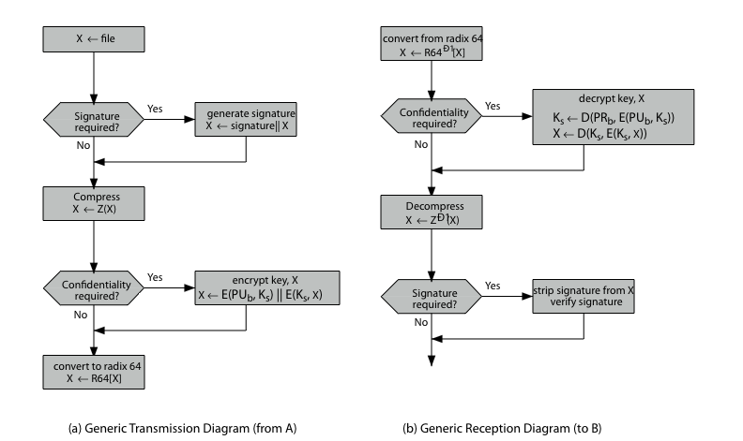
PGP Operation – Summary
Notes:
Stallings Figure 18.2 illustrates the general operation of PGP, and the relationship between the services discussed. On transmission, if it is required, a signature is generated using a hash code of the uncompressed plaintext. Then the plaintext, plus signature if present, is compressed. Next, if confidentiality is required, the block (compressed plaintext or compressed signature plus plaintext) is encrypted and pre-pended with the public-key-encrypted symmetric encryption key. Finally, the entire block is converted to radix-64 format.
On reception, the incoming block is first converted back from radix-64 format to binary. Then, if the message is encrypted, the recipient recovers the session key and decrypts the message. The resulting block is then decompressed. If the message is signed, the recipient recovers the transmitted hash code and compares it to its own calculation of the hash code.

Slide 18
PGP Session Keys
need a session key for each message
  of varying sizes: 56-bit DES, 128-bit CAST or IDEA, 168-bit Triple-DES
generated using ANSI X12.17 mode
uses random inputs taken from previous uses and from keystroke timing of user
Notes:
PGP makes use of four types of keys: one-time session symmetric keys, public keys, private keys, and passphrase-based symmetric keys.
Each session key is associated with a single message and is used only for the purpose of encrypting and decrypting that message, using a symmetric encryption algorithm, such as CAST-128 and IDEA with 128-bit keys; or 3DES with a 168-bit key. Random numbers are generated using the ANSI X12.17 generator, with inputs based on keystroke input from the user, where both the keystroke timing and the actual keys struck are used to generate a randomized stream of numbers. Stallings Online Appendix P discusses PGP random number generation techniques in more detail.

Slide 19
PGP Public & Private Keys
since many public/private keys may be in use, need to identify which is actually used to encrypt session key in a message
  could send full public-key with every message
  but this is inefficient
rather use a key identifier based on key
  is least significant 64-bits of the key
  will very likely be unique
also use key ID in signatures
Notes:
Since many public/private keys may be in use with PGP, there is a need to identify which key is actually used to encrypt the session key for any specific message. You could just send the full public-key with every message, but this is inefficient. Rather PGP use a key identifier based on the least significant 64-bits of the key, which will very likely be unique. Then only the much shorter key ID would need to be transmitted with any message. A key ID is also required for the PGP digital signature.

Slide 20
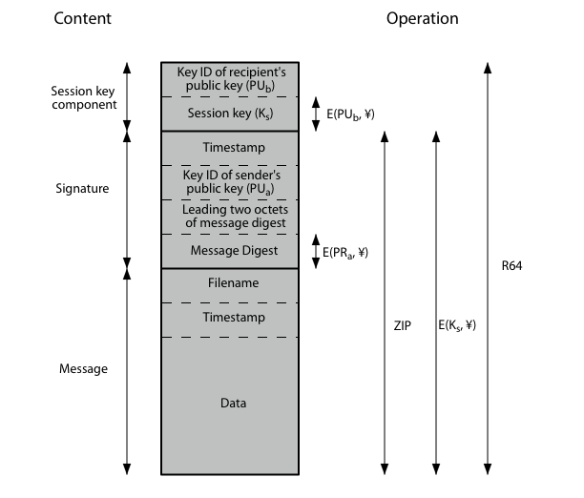
PGP Message Format
Notes:
Stallings Figure 18.3 shows the format of a transmitted PGP message. A message consists of three components: the message component, a signature (optional), and a session key component (optional). The message component includes the actual data to be stored or transmitted, as well as a filename and a timestamp that specifies the time of creation. The signature component includes a timestamp, encrypted SHA-1 message digest, leading two digest octets for verification, and the Key ID of the sender’s public key. The session key component includes the session key and the identifier of the recipient's public key that was used by the sender to encrypt the session key. The entire block is usually encoded with radix-64 encoding.

Slide 21
PGP Key Rings
each PGP user has a pair of keyrings:
  public-key ring contains all the public-keys of other PGP users known to this user, indexed by key ID
  private-key ring contains the public/private key pair(s) for this user, indexed by key ID & encrypted keyed from a hashed passphrase
security of private keys thus depends on the pass-phrase security
Notes:
Keys & key IDs are critical to the operation of PGP. These keys need to be stored and organized in a systematic way for efficient and effective use by all parties. PGP uses a pair of data structures, one to store the users public/private key pairs - their private-key ring; and one to store the public keys of other known users, their public-key ring. The private keys are kept encrypted using a block cipher, with a key derived by hashing a pass-phrase which the user enters whenever that key needs to be used. As in any system based on passwords, the security of this system depends on the security of the password, which should be not easily guessed but easily remembered.

Slide 22
PGP Message Generation
Key rings are used in message transmission to implement the various PGP crypto services (ignoring compression and radix-64 conversion for simplicity). The sending PGP entity performs the following steps:
1. Signing the message:
a. PGP retrieves the sender's private key from the private-key ring using your_userid as an index. If your_userid was not provided in the command, the first private key on the ring is retrieved.
b. PGP prompts the user for the passphrase to recover the unencrypted private key.
c. The signature component of the message is constructed.
2. Encrypting the message:
a. PGP generates a session key and encrypts the message.
b. PGP retrieves the recipient's public key from the public-key ring using her_userid as an index.
c. The session key component of the message is constructed.
Notes:
Stallings Figure 18.5 illustrates how these key rings are used in message transmission to implement the various PGP crypto services (ignoring compression and radix-64 conversion for simplicity). The sending PGP entity performs the following steps:
1. Signing the message:
a. PGP retrieves the sender's private key from the private-key ring using your_userid as an index. If your_userid was not provided in the command, the first private key on the ring is retrieved.
b. PGP prompts the user for the passphrase to recover the unencrypted private key.
c. The signature component of the message is constructed.
2. Encrypting the message:
a. PGP generates a session key and encrypts the message.
b. PGP retrieves the recipient's public key from the public-key ring using her_userid as an index.
c. The session key component of the message is constructed.

Slide 23
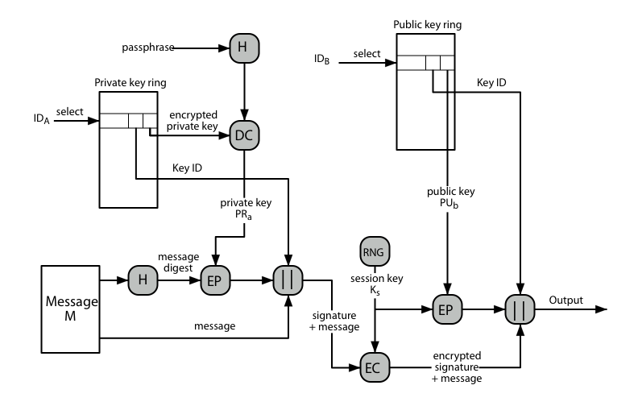
PGP Message Generation
Notes:
Stallings Figure 18.5 illustrates how these key rings are used in message transmission to implement the various PGP crypto services (ignoring compression and radix-64 conversion for simplicity). The sending PGP entity performs the following steps:
1. Signing the message:
a. PGP retrieves the sender's private key from the private-key ring using your_userid as an index. If your_userid was not provided in the command, the first private key on the ring is retrieved.
b. PGP prompts the user for the passphrase to recover the unencrypted private key.
c. The signature component of the message is constructed.
2. Encrypting the message:
a. PGP generates a session key and encrypts the message.
b. PGP retrieves the recipient's public key from the public-key ring using her_userid as an index.
c. The session key component of the message is constructed.

Slide 24
PGP Message Reception
Key rings are used in message reception to implement the various PGP crypto services (again ignoring compression and radix-64 conversion for simplicity). The receiving PGP entity performs the following steps:
1. Decrypting the message:
a. PGP retrieves the receiver's private key from the private-key ring, using the Key ID field in the session key component of the message as an index.
b. PGP prompts the user for the passphrase to recover the unencrypted private key.
c. PGP then recovers the session key and decrypts the message.
2. Authenticating the message:
a. PGP retrieves the sender's public key from the public-key ring, using the Key ID field in the signature key component of the message as an index.
b. PGP recovers the transmitted message digest.
c. PGP computes the message digest for the received message and compares it to the transmitted message digest to authenticate.
Notes:
Stallings Figure 18.6 then illustrates how these key rings are used in message reception to implement the various PGP crypto services (again ignoring compression and radix-64 conversion for simplicity). The receiving PGP entity performs the following steps:
1. Decrypting the message:
a. PGP retrieves the receiver's private key from the private-key ring, using the Key ID field in the session key component of the message as an index.
b. PGP prompts the user for the passphrase to recover the unencrypted private key.
c. PGP then recovers the session key and decrypts the message.
2. Authenticating the message:
a. PGP retrieves the sender's public key from the public-key ring, using the Key ID field in the signature key component of the message as an index.
b. PGP recovers the transmitted message digest.
c. PGP computes the message digest for the received message and compares it to the transmitted message digest to authenticate.

Slide 25
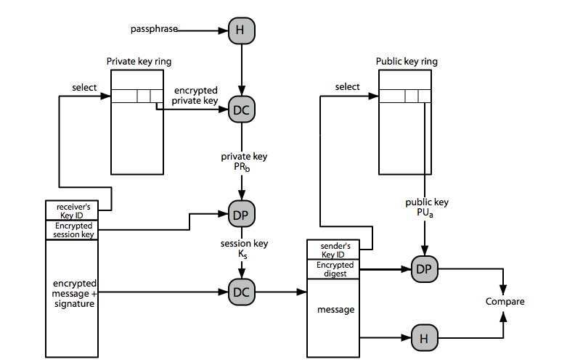
PGP Message Reception
Notes:
Stallings Figure 18.6 then illustrates how these key rings are used in message reception to implement the various PGP crypto services (again ignoring compression and radix-64 conversion for simplicity). The receiving PGP entity performs the following steps:
1. Decrypting the message:
a. PGP retrieves the receiver's private key from the private-key ring, using the Key ID field in the session key component of the message as an index.
b. PGP prompts the user for the passphrase to recover the unencrypted private key.
c. PGP then recovers the session key and decrypts the message.
2. Authenticating the message:
a. PGP retrieves the sender's public key from the public-key ring, using the Key ID field in the signature key component of the message as an index.
b. PGP recovers the transmitted message digest.
c. PGP computes the message digest for the received message and compares it to the transmitted message digest to authenticate.

Slide 26
PGP Key Management
rather than relying on certificate authorities
in PGP every user is own CA
  can sign keys for users they know directly
forms a “web of trust”
  trust keys have signed
  can trust keys others have signed if have a chain of signatures to them
key ring includes trust indicators
users can also revoke their keys
Notes:
The PGP documentation notes that “This whole business of protecting public keys from tampering is the single most difficult problem in practical public key applications”. Its solution is to support a variety of formal and informal environments, in which any user can act as a “CA” to certify another user’s public key, and then act as a “trusted introducer” to other users, thus forming a “web of trust”. PGP provides a convenient means of using trust, associating trust with public keys, and exploiting trust information. The key ring is regularly processed to derive trust indicators for keys in it. Associated with each such entry is a key legitimacy field that indicates the extent to which PGP will trust that this is a valid public key for this user; the higher the level of trust, the stronger is the binding of this user ID to this key. PGP allows a user to revoke their current public key, either because compromise is suspected or simply to avoid the use of the same key for an extended period.

Slide 27
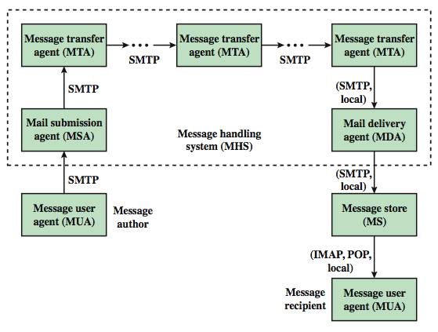
Internet Mail Architecture
Notes:
To understand to operation of DKIM, it is useful to have a basic grasp of the Internet mail architecture, as illustrated in Stallings Figure 18.9. At its most fundamental level, the Internet mail architecture consists of a user world in the form of Message User Agents (MUA), and the transfer world, in the form of the Message Handling Service (MHS), which is composed of Message Transfer Agents (MTA). A MUA is usually housed in the user's computer, and referred to as a client email program, or on a local network email server. The MHS accepts a message from one User and delivers it to one or more other users, creating a virtual MUA-to-MUA exchange environment. The MSA accepts the message submitted by an MUA and enforces the policies of the hosting domain and the requirements of Internet standards. This function may be co-located with the MUA or be a separate functional model. In the latter case, the Simple Mail Transfer Protocol (SMTP) is used between the MUA and the MSA. The MTA relays mail for one application-level hop. Relaying is performed by a sequence of MTAs, until the message reaches a destination MDA. The MDA is responsible for transferring the message from the MHS to the MS. An MS can be located on a remote server or on the same machine as the MUA. Typically, an MUA retrieves messages from a remote server using POP (Post Office Protocol) or IMAP (Internet Message Access Protocol). Also an administrative management domain (ADMD) is an Internet email provider. The Domain Name System (DNS) is a directory lookup service that provides a mapping between the name of a host on the Internet and its numerical address.

Slide 28
Email Threats
see RFC 4684- Analysis of Threats Motivating DomainKeys Identified Mail (DKIM)
describes the problem space in terms of:
  range: low end, spammers, fraudsters
  capabilities in terms of where submitted, signed, volume, routing naming etc
  outside located attackers
Notes:
RFC 4684 (Analysis of Threats Motivating DomainKeys Identified Mail) describes the problem space being addressed by DKIM in terms of the characteristics, capabilities, and location of potential attackers. It characterizes the range of attackers on a spectrum of three levels of threat: low end attackers who simply want to send email that a recipient does not want to receive, often with falsified sender addresses. At the next level are professional senders of bulk spam mail. The most sophisticated and financially motivated senders of messages are those who stand to receive substantial financial benefit, such as from an email-based fraud scheme. The RFC then lists a range of capabilities that an attacker might have in terms of where submitted, signed, volume, routing naming etc (see text). DKIM focuses primarily on attackers located outside of the administrative units of the claimed originator and the recipient.

Slide 29
Summary
In today’s lecture, we discussed why emails need to be secured and how does PGP offer confidentiality, authentication and privacy of our emails.
We discuss the operation of PGP in detail

Slide 30
Next lecture topics
Our discussion on more interesting topics on Internet security will continue.
We will talk about Tools and techniques to protect data during the transmission over the Internet

Slide 31
The End

