Slide 1
Network Security
Lecture 28
Presented by: Dr. Munam Ali Shah

Slide 2
Summary of the Previous Lecture
In previous lecture we discussed in detail the payment processing in SET
We have seen following three phases are involved in SET.
  Purchase request
      Initiate request
      Initiate response
      Purchase request
      Purchase response
  Payment authorization
      Payment Block
      Authorization block
  Payment capture

Slide 3
Part 3
Internet Security
(Last Part)

Slide 4
Outlines of today’s lecture
We will talk about what Internet security is and how to ensure security while browsing through the Internet.
We will also see what spyware are and how do they look like.
We will also discuss few methods that can be used to avoid spywares.
We will also see a couple of examples of Phishing on the Internet

Slide 5
Objectives
You would be able to present an understanding of what does it take to become secure while connecting to the Internet.
You would be able demonstrate knowledge about different spywares and phishing and the countermeasures that are used to avoid them.

Slide 6

What is Internet Security
Internet security is a tree branch of computer security specifically related to the Internet, often involving browser security but also network security on a more general level as it applies to other applications or operating systems on a whole.
https://en.wikipedia.org/wiki/Internet_security

Slide 7
What is Internet Security
The Internet provides a wealth of information and services. Many activities in our daily lives now rely on the Internet, including various forms of communication, shopping, financial services, entertainment and many others. The growth in the use of the Internet, however, also presents certain risks. Just think about all the information you send over the Internet, such as personal messages, bank account information, photographs, etc.
As a typical Internet user, you have the reasonable expectation that your communications and transactions are private and secure. When you make a video call to a family member, you expect that nobody else is watching. When you buy something online with a credit card, you expect that nobody else can get access to your credit card details.

Slide 8
What is Internet Security
Using the Internet presents a number of security issues. Being aware of these will make your Internet use safer and more enjoyable. Some of the most serious threats include computer viruses, spyware and other harmful programs. You should use antivirus and spyware management software to protect your computer system.

Slide 9


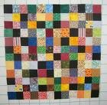








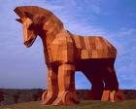
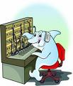

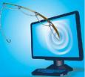
Internet Security
pass
word
fire
patch
spam
wall
key
logger
virus
war
driving
Trojan horse
worm
phishing
proxy

Slide 10
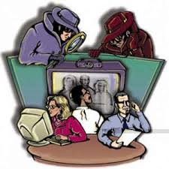
Spyware and Internet Security
Spyware is a type of malware that is installed on a computer without the knowledge of the owner in order to collect the owner's private information. Spyware is often hidden from the user in order to gather information about internet interaction, keystrokes (also known as keylogging), passwords, and other valuable data.
On the Internet (where it is sometimes called a spybot or tracking software), spyware is programming that is put in someone's computer to secretly gather information about the user and relay it to advertisers or other interested parties.

Slide 11
Different Types of Spyware
Spyware
Adware
Embedded Programs
Trojan Horse
Browser Hijackers
Dialers
Malware

Slide 12
Why do people make Spyware?
Profit
A challenge
Malice
Boredom
Business

Slide 13
How do I know if I’ve got Spyware?
Computer is running slower than normal
Popups (on or off the internet)
New toolbars
Home page changes
Search results look different
Error messages when accessing the web

Slide 14
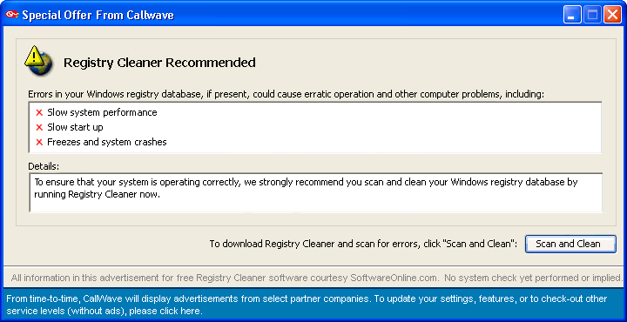
What does Spyware look like?

Slide 15
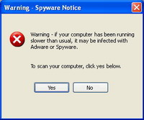
What does Spyware look like?

Slide 16
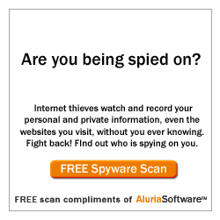
What does Spyware look like?

Slide 17
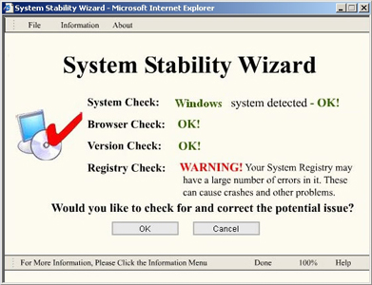
What does Spyware look like?

Slide 18
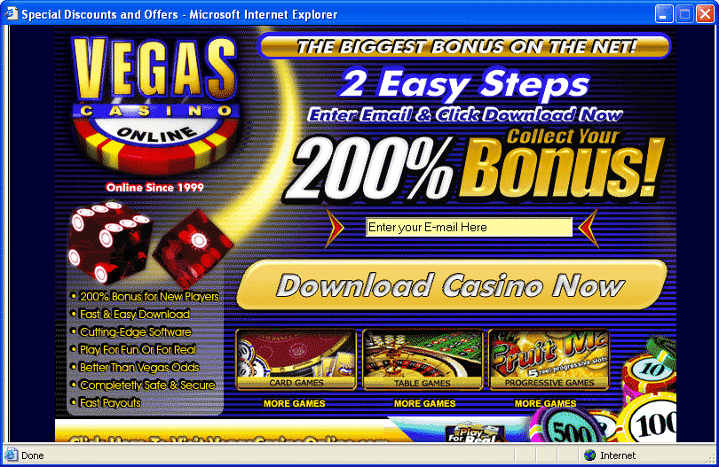
What does Spyware look like?

Slide 19

What does Spyware look like?

Slide 20
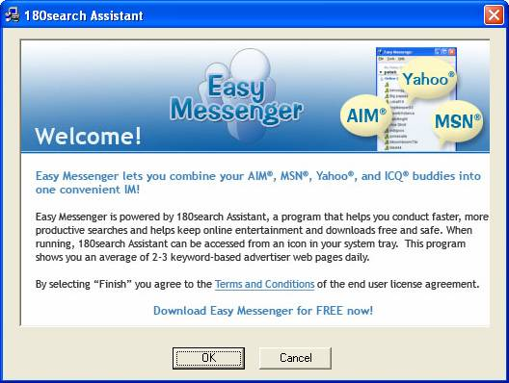
What does Spyware look like?

Slide 21
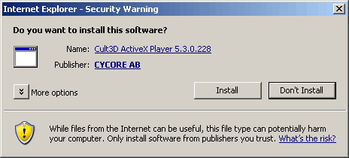
What does Spyware look like?

Slide 22
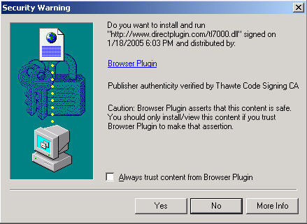
What does Spyware look like?

Slide 23
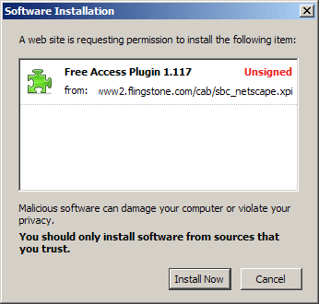
What does Spyware look like?

Slide 24
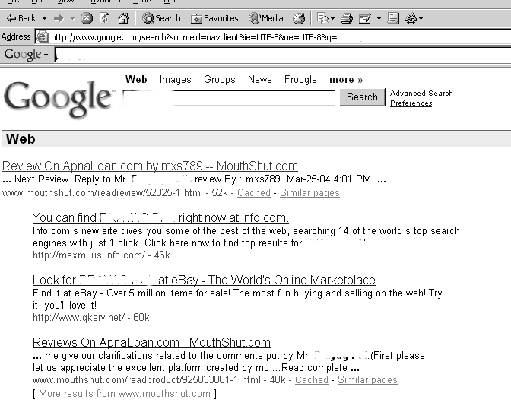
What does Spyware look like?

Slide 25
How do I get rid of Spyware?
Use a legitimate spyware removal program
We suggest Spybot Search and Destroy in combination with Microsoft Antispyware (now called Defender)
Ad-aware is a good program and is free for home use but is no longer free for educational use.

Slide 26
How do I get rid of Spyware?
Avoid viruses
Use strong passwords
Don't reveal too much
Check for secure sites
Consider your location

Slide 27
Steps in Spyware Removal
Add and Remove Programs Menu
Reboot
Run a Spybot Scan
Reboot
Run a Microsoft Antispyware Scan
Reboot
If still having problems manually remove registry and startup entries (Do NOT do this yourself)

Slide 28
How do I prevent Spyware?
Be conscious of what you are clicking on/downloading
Some pop-ups have what appears to be a close button, but will actually try to install spyware when you click on it. Always look for the topmost right red X.
Remember that things on the internet are rarely free. “Free” Screensavers etc. generally contain ads or worse that pay the programmer for their time.

Slide 29
The Least Wanted List
Weatherbug (GAIN or Claria)
Hotbar
180 Search Assistant
MyWebSearch
Popular Screensavers
Comet Cursors
A Better Internet (Aurora)
Kazaa / Morpheus
GameSpy Arcade
WhenUSave
New.Net
Starware Toolbar
MySearch
Begin2Search
180Solutions
Zango
CoolWebSearch
DyFuCA
BonzaiBuddy
BargainBuddy
Dashbar
Gator
WeatherScope
Best Offers Network
Precision Time
FunWeb

Slide 30
Phishing
Most commonly an Email stating your account Information needs updating
Watch for URL’s that are numeric or different from the link you clicked on
Best thing to do is to type in the URL and check your account directly without following any links in the Email
Many legitimate emails no longer contain a link (Paypal)

Slide 31
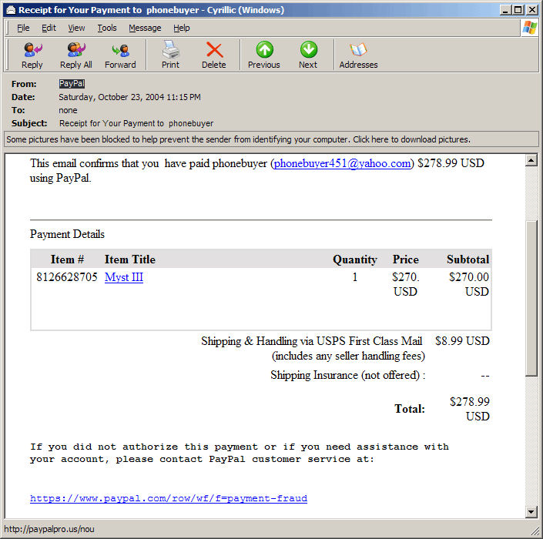
Phishing Examples

Slide 32
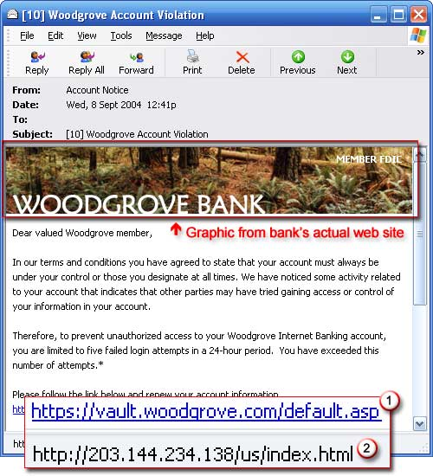
Phishing Examples

Slide 33
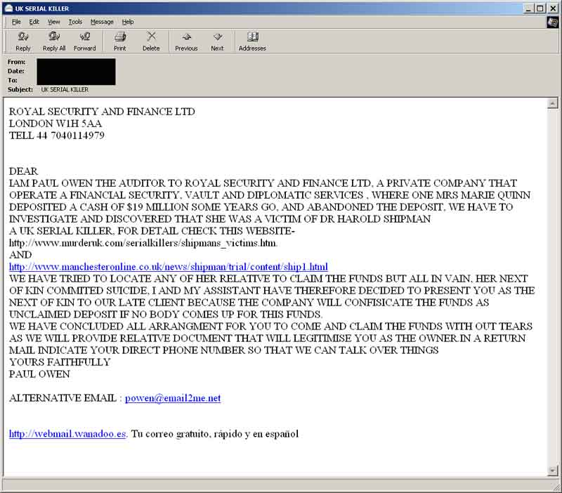
Phishing Examples

Slide 34
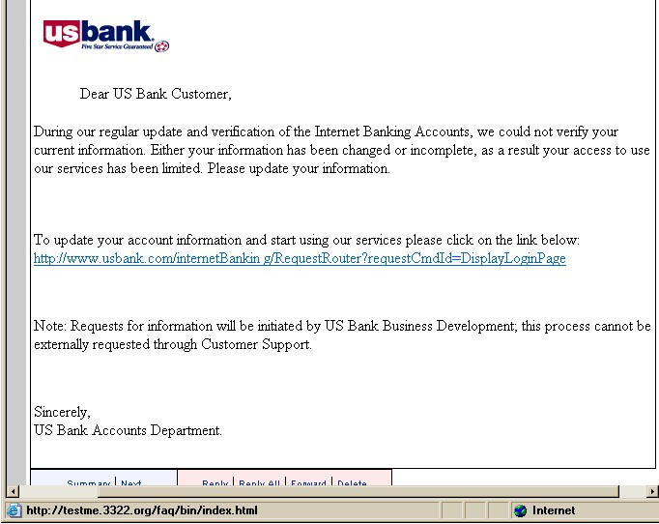
Phishing Examples

Slide 35
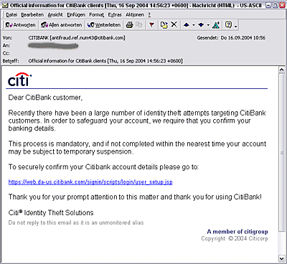
Phishing Examples

Slide 36
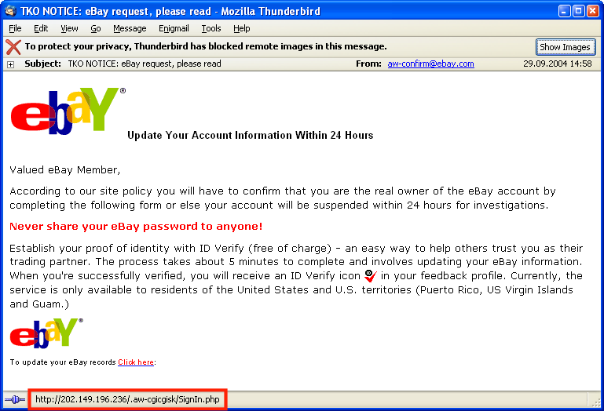
Phishing Examples

Slide 37
How secure do you need to be?
Be Prudent (careful) not Paranoid (unreasonable)
Did you initiate the action?
Why is this free?
Is the source trustworthy?
When in doubt Google it

Slide 38
Safer Alternatives
Download.com – All programs are adware/spyware free
Freesaver.com – Screensavers from this site are safe DO NOT click on ads
KFOR or News9
Cleansoftware.org

Slide 39
The Bottom Line
It is safe to install these programs:
  Microsoft AntiSpyware (Defender)
  Spybot Search & Destroy
  SpywareBlaster
  SpywareGuard
If you are running a different Spyware program contact your Technology Specialist to make sure it is not a rogue

Slide 40
Summary
There's so much to discover and enjoy in the online world. By taking a few simple precautions, you can feel safer while you're exploring the web.

Slide 41
Next lecture topics
Our discussion on more interesting topics on Internet security will continue.
We will talk about Tools and techniques to protect data during the transmission over the Internet

Slide 42
The End

