Slide 1
Network Security
Lecture 27
Presented by: Dr. Munam Ali Shah

Slide 2
Summary of the Previous Lecture
We talked about SET (Secure Electronic Transaction)
SET
    Participants
    Requirements
    Features
Dual Signature
Signature verification

Slide 3
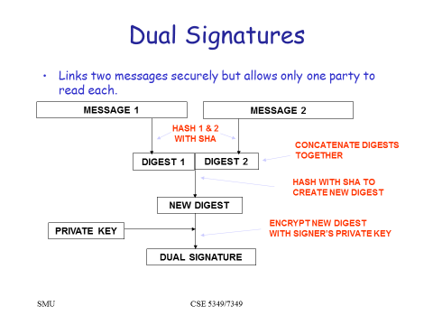
Summary of the Previous Lecture

Slide 4
Summary of the Previous Lecture
WHY Dual Signatures
Suppose that customers send the merchant two messages:
    The signed order information (OI).
    The signed payment information (PI).
    In addition, the merchant passes the payment information (PI) to the bank.
If the merchant can capture another order information (OI) from this customer, the merchant could claim this order goes with the payment information (PI) rather than the original.

Slide 5
Outlines of today’s lecture
We will continue our discussion on SET and explore the following
Payment Processing in SET
  Purchase request
  Payment authorization
  Payment capture

Slide 6
Objectives
You would be able to present an understanding of transaction that is carried out over the Internet.
You would be able demonstrate knowledge about different entities and their role in a SET and how the actual payment is processed in SET

Slide 7
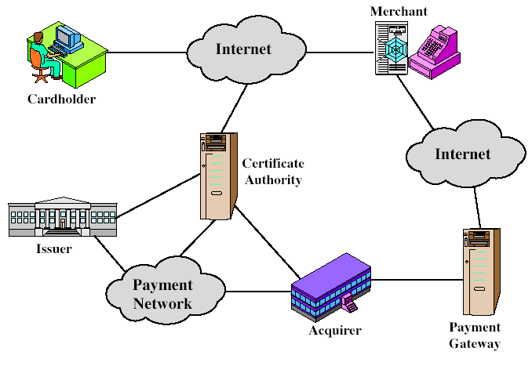
SET Participants
Must have relationship with acquirer
issue X.509v3 public-key certificates for cardholders, merchants, and payment gateways
e.g. a Bank
Provides authorization to merchant that given card account is active and purchase does not exceed card limit
Interface b/w SET and bankcard payment network

Slide 8
SET Requirements
Provide confidentiality
Ensure the integrity
Provides authentication that card holder is a legitimate user of a card and account:
Ensure the best security practices

Slide 9
SET Key features
Confidentiality of information
Integrity of data
Card holder account authentication
Merchant authentication
Facilitate interoperability among software and hardware providers

Slide 10
SET supported Transactions
      card holder registration
      merchant registration
      purchase request
      payment authorization
      payment capture
      certificate query
      purchase inquiry
      purchase notification
      sale transaction
      authorization reversal
      capture reversal
      credit reversal

Slide 11
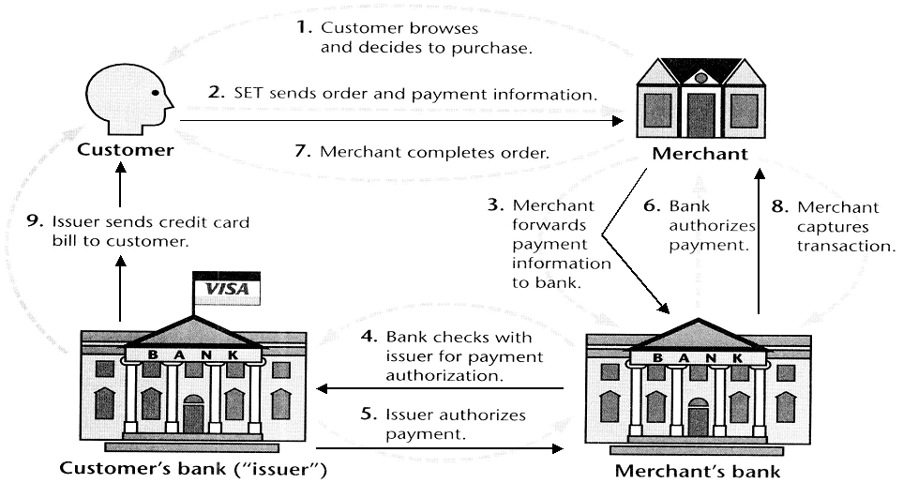
SET Transaction

Slide 12
Payment Processing
Purchase request
Payment authorization
Payment capture

Slide 13
A. SET Purchase Request
SET purchase request exchange consists of four messages
  Initiate Request – includes brand of card, ID by customer and a nonce_A sent to merchant, get certificates of merchant and payment gateway
  Initiate Response – merchant signed response, includes nonce_A, nonce_B, transaction ID, certificate of merchant and payment gateway
  Purchase Request – creates OI & PI
  Purchase Response

Slide 14
A. Purchase Request
Purchase related information: will be forwarded to the payment gateway by the merchant (includes PI, DS , OIMD) encrypted with key K_{S} and K_{S} is encrypted with Bank’s Public key
Order related information: needed by the merchant (includes OI, DS, PIMD)
Cardholder certificate: need by the merchant and the payment gateway

Slide 15
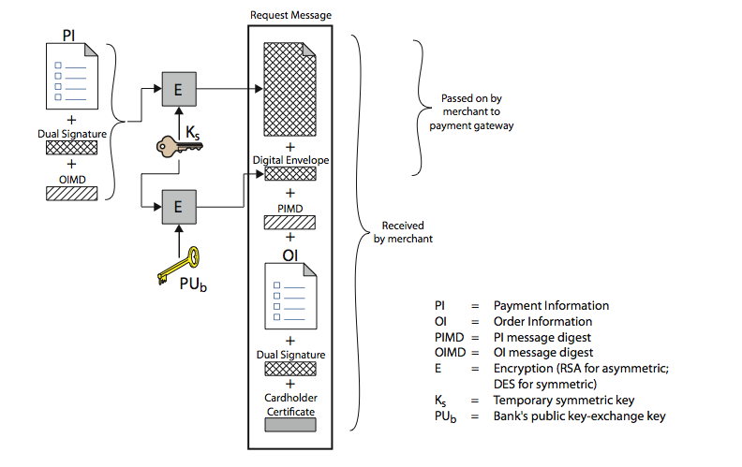
Structure of Purchase Request

Slide 16
Purchase Request – Verification by Merchant
Verifies cardholder certificates using CA sigs
Verifies dual signature using customer's public signature key to ensure order has not been tampered with in transit & that it was signed using cardholder's private signature key
Processes order and forwards the payment information to the payment gateway for authorization (described later)
Sends a purchase response to cardholder

Slide 17
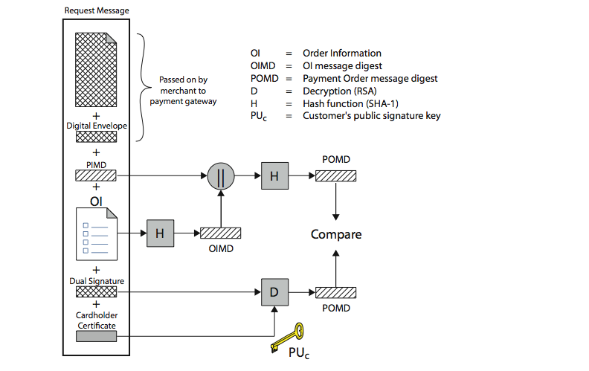
Purchase Request – Merchant

Slide 18
Purchase response
Merchant prepares a response block that includes
  acknowledge of order
  transaction number
  The block signed by the merchant using its private key
Merchant sent to customer
  the response block
  Signature on block
  Merchant’s signature certificate

Slide 19
B. Payment Authorization
The merchant authorized the transaction with the payment gateway.
The payment gateway authorization ensures that the transaction was approved by the issuer
This will guarantees that merchant will receive the payment

Slide 20
Authorization request
Purchase related information: obtained from the customer and consists of
  Payment block E(Ks, [PI, DS, OIMD]) and digital envelop
Authorization related information: generated by the merchant, consists of
  Authorization block: transaction ID signed with merchant private key, encrypted with symmetric key generated by merchant
  Digital envelop: encrypting the symmetric key with the payment gateway’s public key-exchange key

Slide 21
Authorization request
Certificates:
  Cardholder’s signature key certificate (verify the dual sig)
  Merchant signature key certificate (verify merchant sig)
  Merchant key exchange certificate (needed in response)

Slide 22
Payment Gateway Authorization
verifies all certificates
decrypts digital envelope of authorization block to obtain symmetric key & then decrypts authorization block
verifies merchant's signature on authorization block
decrypts digital envelope of payment block to obtain symmetric key & then decrypts payment block
verifies dual signature on payment block
verifies that transaction ID received from merchant matches that in PI received (indirectly) from customer
requests & receives an authorization from issuer
sends authorization response back to merchant

Slide 23
C. Payment Capture
Merchant sends payment gateway a payment capture request (payment amount, transaction ID, Capture token info sign and encrypted by the merchant)
Gateway checks request
Then create and sent the clearing request to the issuer that causes funds to be transferred to merchants account
Notifies merchant using capture response

Slide 24
SET Overheads
A Simple purchase transaction:
    Four messages between merchant and customer
    Two messages between merchant and payment gateway
    6 digital signatures
    9 RSA encryption/decryption cycles
    4 DES encryption/decryption cycles
    4 certificate verifications
    Multiple servers need copies of all certificates

Slide 25
Summary
In today’s lecture, we talked about SET (Secure Electronic Transaction)
We have seen its functionality and how different entities are involved to make a transaction secure and successful.

Slide 26
Next lecture topics
Our discussion on more interesting topics on incorporating security in networks will continue.
We will proceed to the last part of the course. The main concepts that will be discussed in this part are:
Tools and techniques to protect data during the transmission over the Internet, Sobig F. worm, grappling Hook attack, Morris Internet worm, Overview of the Internet security protocols such as https and ssh.

Slide 27
The End

