Slide 1
Network Security
Lecture 26
Presented by: Dr. Munam Ali Shah

Slide 2
Part – 2 (e):
Incorporating security in other parts of the network

Slide 3
Summary of the Previous Lecture
In previous lecture we continued our discussion on Authentication Applications and more precisely we talked about Kerberos in detail
Kerberos versions, threats and vulnerabilities were explored
We also talked about X.509 which makes use of certificates Issued by a Certification Authority (CA), containing: version, serial number, signature algorithm identifier, issuer X.500 name (CA), name of the CA that created and singed this certificate and period of validity etc.
We also talked about one way, two way and three way authentication in X.509

Slide 4
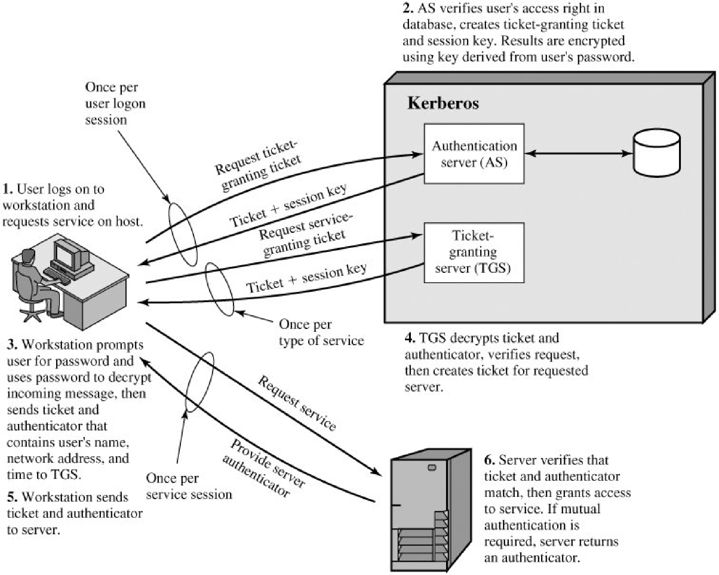
Summary of the Previous Lecture

Slide 5
Outlines of today’s lecture
We will talk about SET (Secure Electronic Transaction)
SET
    Participants
    Requirements
    Features
Dual Signature
Signature verification

Slide 6
Objectives
You would be able to present an understanding of transaction that is carried out over the Internet.
You would be able demonstrate knowledge about different entities and their role in a SET

Slide 7
Secure Electronic Transactions (SET)
Open encryption & security specification
To protect Internet credit card transactions
Developed in 1996 by Mastercard, Visa
Not a payment system
Rather a set of security protocols & formats
  secure communications amongst parties
  Provides trust by the use of X.509v3 certificates
  Privacy by restricted info to those who need it

Slide 8
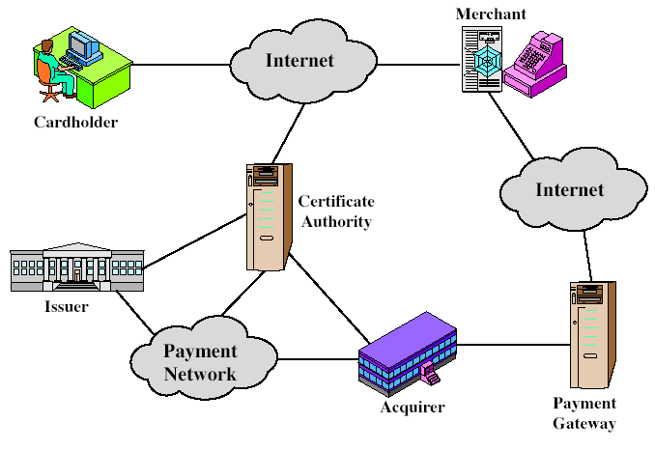
SET Participants
Must have relationship with acquirer
issue X.509v3 public-key certificates for cardholders, merchants, and payment gateways
e.g. a Bank
Provides authorization to merchant that given card account is active and purchase does not exceed card limit
Interface b/w SET and bankcard payment network

Slide 9
SET Requirements
Provide confidentiality of payment and ordering data. (SET uses encryption to provide confidentiality)
Ensure the integrity of all transmitted data: (DS are used to provide integrity)
Provides authentication that card holder is a legitimate user of a card and account: (A mechanism that links the card holder to a specific account no. reduces the incident of fraud. Uses DS and certificate for verification)
Facilitate and encourage interoperability among software and hardware providers

Slide 10
Cont.
Provides authentication that a merchant can accept credit card transactions through its relationship with a financial institution: cardholders should be able to identify merchant. DS and certificates can be used.
Ensure the best security practices and system design techniques to protect all legitimate parties
Create a protocol that neither depends upon the transport security mechanism nor prevents their uses

Slide 11
SET Key features
Confidentiality of information
Integrity of data
Card holder account authentication
Merchant authentication

Slide 12
SET Transaction
Customer opens account such as MasterCard or Visa
Customer receives a certificate
  After verification receive an X.509v3 certificate sign by bank
  Establish relation between the customer's key pair and his or her credit card
Merchants have their own certificates
  Two certificates, for signing message and for key exchange
  Also has the payment gateway's public-key certificate
Customer places an order
  Browsing Merchant's Web site to select items and determine price
  customer then sends a list of the items to be purchased to the merchant
  Merchant returns an order form containing the list of items, their price, a total price, and an order number

Slide 13
Cont.
Merchant is verified (by customer)
  a) With Order form, merchant sends a copy of its certificate
  b) Customer can verify that he/she is dealing with a valid store through that certificate
Order and payment are sent (with customer’s certificate)
  Customer sends both order and payment information to the merchant with the customer's certificate
  Order confirms the purchase of the items in the order form and payment contains credit card details.
  The payment information is encrypted, cannot be read by the merchant.
  Customer's certificate enables merchant to verify customer.
Merchant requests payment authorization
  a) Merchant sends the payment information to the payment gateway requesting for authorization

Slide 14
Cont.
Merchant confirms order
  Merchant sends confirmation of the order to the customer
Merchant provides goods or service
Merchant requests payment

Slide 15
Dual Signature
Customer creates dual messages
  order information (OI) for merchant
  payment information (PI) for bank
Neither party needs details of other
But must know they are linked
Use a dual signature for this
  signed concatenated hashes of OI & PI
    DS=E(PR_{c}, [H(H(PI)||H(OI))])
where PR_{c} Customer Private Key

Slide 16
Why dual signature
Suppose that the customers send the merchant two messages
  a signed OI and a signed PI,
The merchant passes the PI on to the bank.
If the merchant can capture another OI’ from this customer, the merchant could claim that this OI’ goes with the PI rather than the original OI.
The linkage in dual signature prevents this

Slide 17
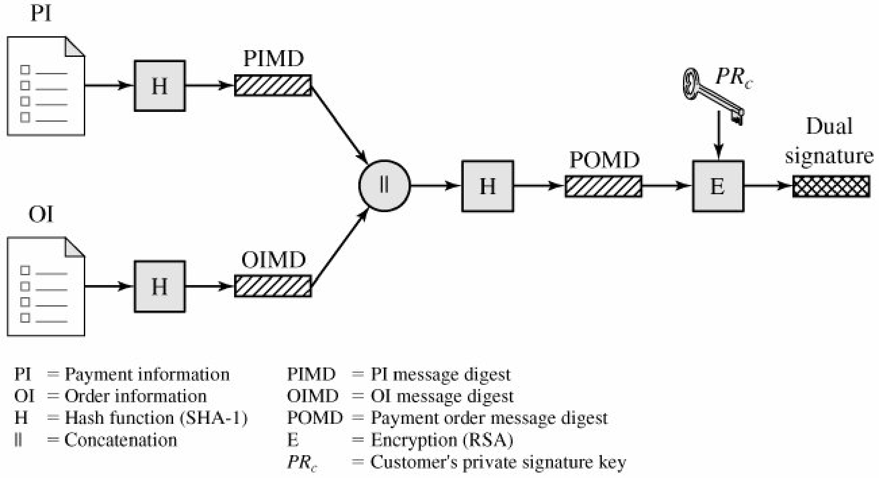
Construction of Dual Signature

Slide 18
Signature verification
Merchant possess DS, OI, message digest of PI (PIMD) and public key of customer, can compare the following two quantities
H(PIMS||H[OI]) and D(PUc, DS)
If both are equal merchant has verified the signature
Bank possess DS, PI, message digest of OI (OIMD) and customer public key, can compute
H(H[OI]||OIMD) and D(PUc, DS)
    DS=E(PR_{c}, [H(H(PI)||H(OI))])

Slide 19
Payment Processing
Purchase request
Payment authorization
Payment capture

Slide 20
Summary
In today’s lecture, we talked about SET (Secure Electronic Transaction)
We have seen its functionality and how different entities are involved to make a transaction secure and successful.

Slide 21
Next lecture topics
Our discussion on SET will continue and we will discuss
Purchase request
Payment authorization
Payment capture

Slide 22
The End

