Slide 1
Network Security
Lecture 25
Presented by: Dr. Munam Ali Shah

Slide 2
Part – 2 (e):
Incorporating security in other parts of the network

Slide 3
Summary of the Previous Lecture
In previous lecture we explored talked about Needham-Schroeder Protocol and will see how does it work
Digital Signature Standard (DSS) and Digital Signature Algorithm (DSA) were discussed
We briefly talked about authentication applications
And studied Kerberos (which is an authentication service)

Slide 4
Outlines of today’s lecture
We will continue our discussion on Authentication Applications and more precisely we will talk about Kerberos in detail
Kerberos versions, threats and vulnerabilities will also be discussed

Slide 5
Objectives
You would be able to present an understanding Authentication Application.
You would be able demonstrate knowledge about Kerberos and how it could be deployed in the network to achieve secuirty

Slide 6
Authentication Applications
Kerberos
X.509

Slide 7
Kerberos
Authentication service developed at MIT
Uses trusted key server system
Provides centralised private-key third-party authentication in a distributed network
  allows users access to services distributed through network
  without needing to trust all workstations
  rather all trust a central authentication server
two versions in use: 4 & 5

Slide 8
Threat in distributed environment
A user
  gain access to a workstation and pretend to be another user from that workstation
  alter the network addr. of workstation, so that request sent will be appear from impersonate system
  may evasdrop on exchanges and use the replay attack to gain entrance to the server or to disrupt the operations
Authentication at each server ??
Kerberos is used to authenticate user to servers and servers to users

Slide 9
Three approaches for security
Rely on client workstation to ensure the identity of its users and rely on each server to enforce a security policy based on user id.
Require the client system to authentication themselves to servers, but trust the client system concerning the id of users.
Require the user to prove its id for each service invoked. Also require that servers prove their id to clients

Slide 10
Kerberos Requirements
Its first report identified requirements as:
  Secure: opponent should not be able to get information to impersonate a user
  Reliable: should be reliable and provides a distributed server architecture
  Transparent: ideally user should not be aware of authentication service
  Scalable: system should be capable of supporting large number of clients

Slide 11
Kerberos Requirements
Kerberos server must have UserID and hashed password of all the users in its database
All server share a secret key with Kerberos server

Slide 12
Kerberos v4 Dialogue
obtain ticket granting ticket from AS
  once per session
obtain service granting ticket from TGS
  for each distinct service required
client/server exchange to obtain service
  on every service request

Slide 13
Kerberos v4
A simple authentication Dialogue
C→AS : ID_{C}||P_{C}||ID_{V}
AS→C : Ticket
C →V : ID_{C}||Ticket
Ticket = E(K_{v} , [ID_{C}||AD_{C}||ID_{V}])
An opponent could capture the ticket and transmit it from different workstation, the AD (network address) is use to cop this problem
Two problem needs to be address
  Minimize the No. of time user enter a password
  Avoid plaintext transmission of password

Slide 14
Vulnerabilities
Life time associate with ticket-granting ticket
small lifetime : user need to enter password repeatedly
long lifetime : opponent has great opportunity for reply
opponent copy the ticket granting ticket
waits for the legitimate user to logout
forge the legitimate user network address and send message of step 3 to the TGS
A network service (TGS) must be able to prove that the person using a ticket is the same person to whom that ticket was issued
Server to authenticate themselves to users
false server would be in position to act as a real server and capture any information from the user

Slide 15
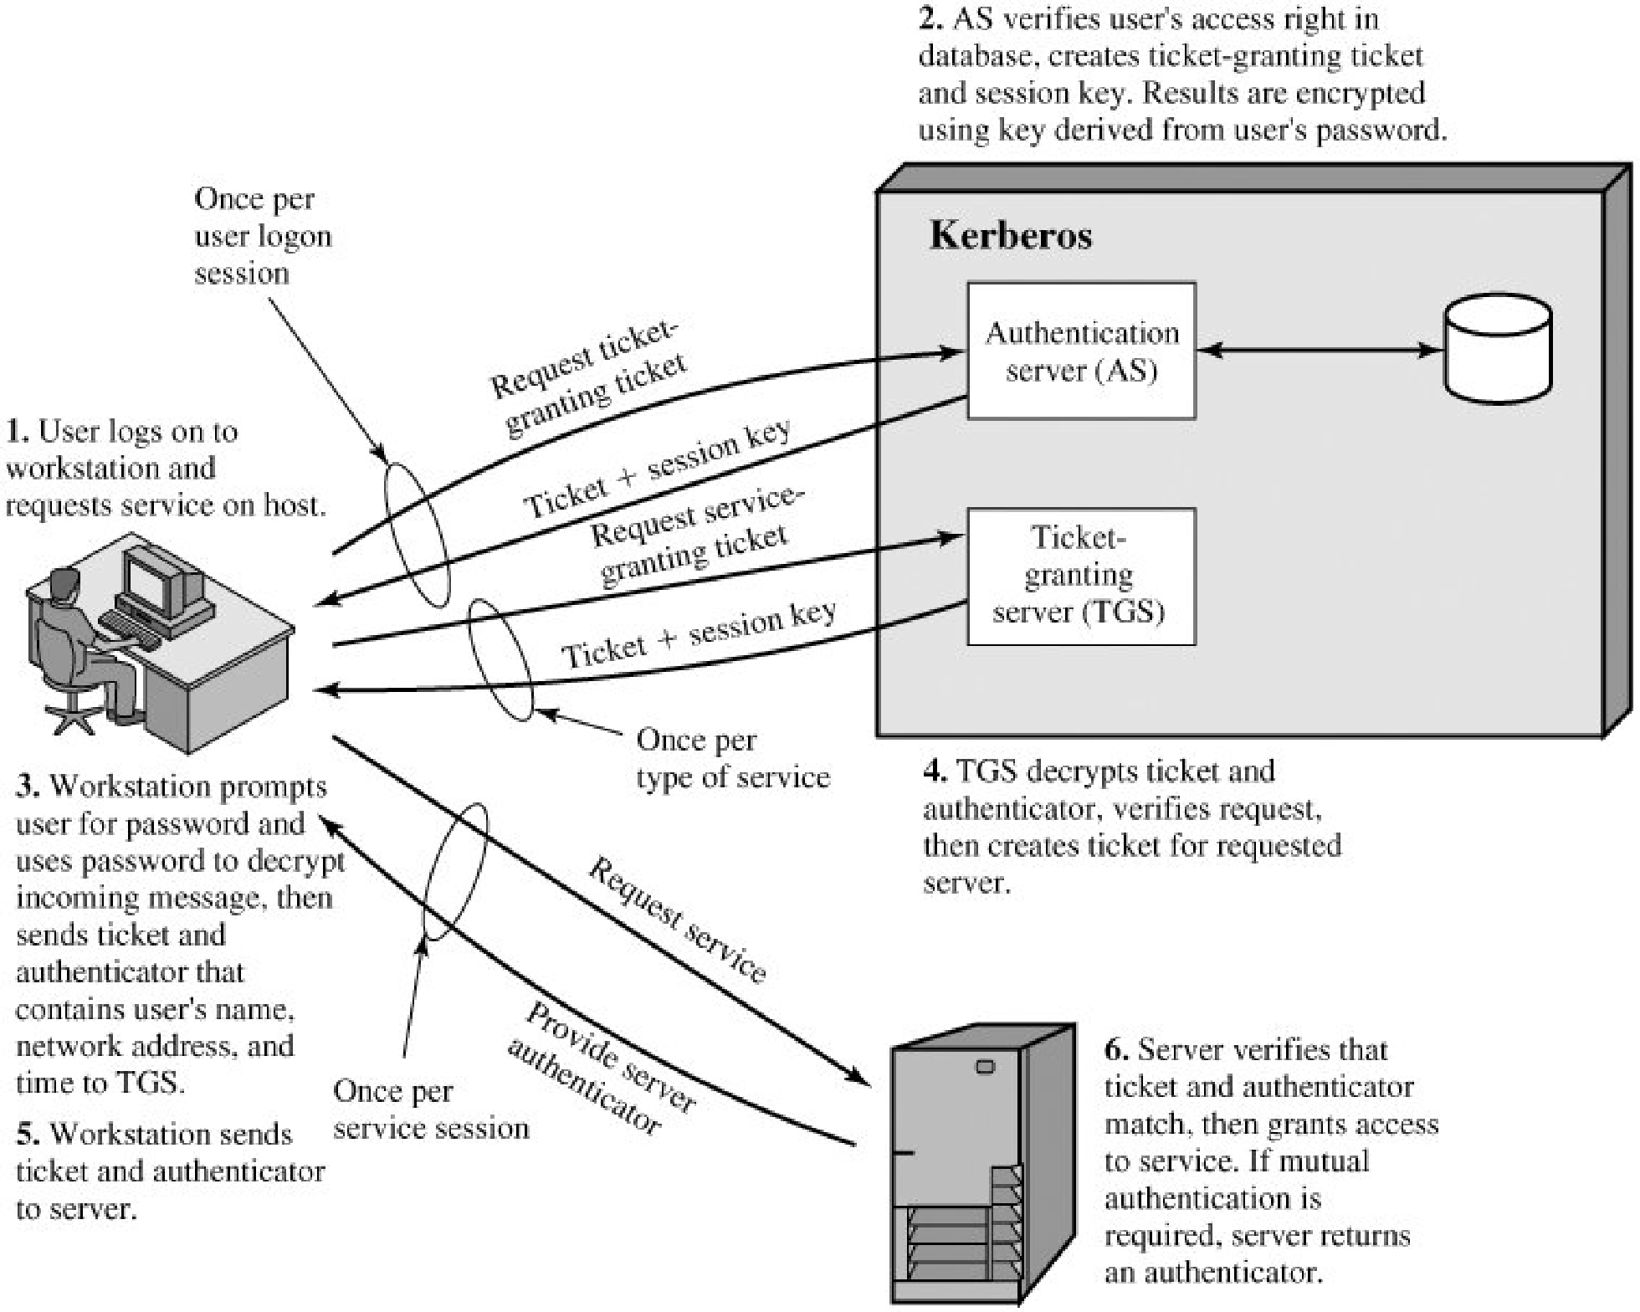
Kerberos Overview

Slide 16
Kerberos v4 Message Exchanges
Authentication Service Exchange to obtain ticket-granting ticket
The problem of captured ticket-granting tickets and the need to determine that the ticket presenter is the same as the client for whom the ticket was issued
To get around this problem, the AS provide both the client and the TGS with a secret piece of information (K_{c,tgs}) in a secure manner
The client can prove its identity to the TGS by revealing the secret information, again in a secure manner

Slide 17
Cont.
Authenticator is used only once and has short lifetime
TGS decrypts the ticket with key that it shares with the AS (K_{tgs}). Ticket indicates that user C has a session key Kc,tgs.
The ticket says "Anyone who uses K_{c,tgs} must be C.“
The TGS uses the session key K_{c,tgs} to decrypt the authenticator
C has a reusable service-granting ticket for V.

Slide 18
Rationale for the Elements of the Kerberos v4 Protocol
Message (1) Client requests ticket-granting ticket
IDC: Tells AS identity of user from this client
IDtgs: Tells AS that user requests access to TGS
TS1 : Allows AS to verify that client's clock is synchronized with that of AS
Message (2) AS returns ticket-granting ticket
Kc: Encryption is based on user's password, enabling AS and client to verify password, and protecting contents of message (2)
Kc,tgs: session key accessible AS to permit secure exchange between client and TGS
IDtgs: Confirms that this ticket is for the TGS
TS2: Informs client of time this ticket was issued
Lifetime2: Informs client of the lifetime of this ticket
Tickettgs: Ticket to be used by client to access TGS

Slide 19
Kerberos Realms
A Kerberos environment consists of:
    a Kerberos server
    a number of clients, all registered with server
    application servers, sharing keys with server
this is termed a realm typically a single administrative domain
if have multiple realms,
    Kerberos servers must have the user ID and hashed passwords of all participating users in its database.
    The Kerberos server must share a secret key with each server
    The Kerberos server in each interoperating realm shares a secret key with the server in the other realm. The two Kerberos servers are registered with each other

Slide 20
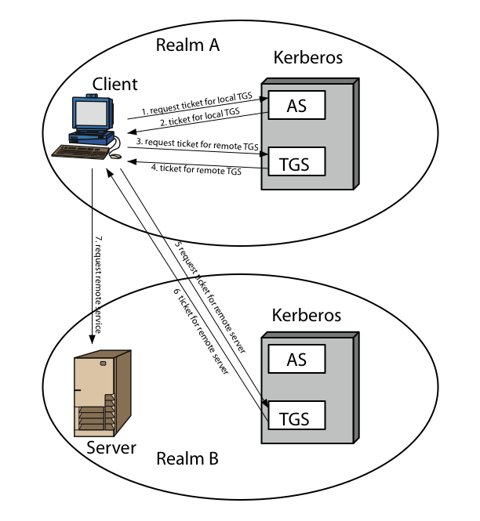
Kerberos Realms

Slide 21
Kerberos Version 5
Provides improvements over v4
addresses environmental shortcomings
    Encryption Algo: v4 uses DES, v5 uses any encryption technique
    Internet protocol: v4 uese IP address, v5 allows any addr. types
    Message byte order: v4 user define, v5 uses (Abstract Syntax Notation) ASN.1 & Basic Encoding Rules (BER)
    Ticket lifetime: v4 uses 8 bits (unit of 5 min) 2⁸ *5 = 1280 min
    v5 includes start time and end time explicitly
    Authentication forwarding: v5 allows a client to issue a request to print server that then accesses the client’s file from a file server
    Interrealm auth: v4 requires on order of N² kerberos to kerberos relationships, v5 requires fewer relationships

Slide 22
X.509 Authentication Service
X.509 certificates are widely used
X.509 certificate associates public key with its user
defines framework for authentication services
  directory may store public-key certificates
  with public key of user signed by certification authority
uses public-key crypto & digital signatures
  algorithms not standardised, but RSA recommended

Slide 23
X.509 Certificates
Issued by a Certification Authority (CA), containing:
  version (1, 2, or 3) :
  serial number (unique within CA) identifying certificate:
  signature algorithm identifier:
  issuer X.500 name (CA):
  period of validity (from - to dates)

Slide 24
X.509 Certificates
  subject X.500 name (name of owner):
  subject public-key info (algorithm, parameters, key) :
  issuer unique identifier (v2+):
  subject unique identifier (v2+)
  extension fields (v3)
  signature (of hash of all fields in certificate):

Slide 25
Obtaining a Certificate
Any user with access to the public key CA can get any certificate from it
Only the CA can modify a certificate
Because cannot be forged, certificates can be placed in a public directory

Slide 26
CA Hierarchy
If both users share a common CA then they are assumed to know its public key
Otherwise CA's must form a hierarchy
Each client trusts parents certificates
Enable verification of any certificate from one CA by users of all other CAs in hierarchy

Slide 27
Certificate Revocation
Certificates have a period of validity
May need to revoke before expiry, eg:
  user's private key is compromised
  user is no longer certified by this CA
  CA's certificate is compromised
CA’s maintain list of revoked certificates
  the Certificate Revocation List (CRL)
Users should check certificates with CA’s CRL

Slide 28
Authentication Procedures
X.509 includes three alternative (all use public-key signatures) authentication procedures:
  One-Way Authentication
  Two-Way Authentication
  Three-Way Authentication
Assumed that two parties know each other's public key, through certificates or directory

Slide 29
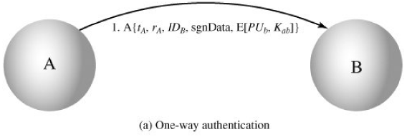
One-Way Authentication
One message ( A->B) used to establish
  the identity of A and that message is from A
  message was intended for B
  integrity & originality of message
Message must include timestamp, nonce, B's identity and is signed by A
Only identity of initiator is verified
may include additional info for B
  e.g. session key

Slide 30
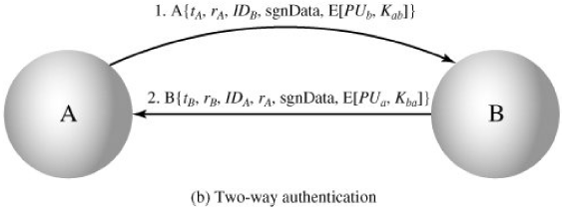
Two-Way Authentication
Two messages (A->B, B->A) which also establishes in addition:
  the identity of B and that reply is from B
  that reply is intended for A
  integrity & originality of reply
reply includes original nonce from A, also timestamp and nonce from B
may include additional info for A

Slide 31
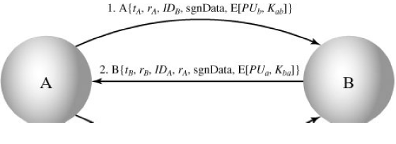

Three-Way Authentication
Three messages (A->B, B->A, A->B) which enables above authentication without synchronized clocks
a final message from A to B is included, which contains a signed copy of the nonce r_{B}
means that timestamps need not be checked or relied upon

Slide 32
Summary
In today’s we talked about Kerberos as an authentication application.
Its different versions were also discussed.
We talked about one way, two way, and three way authentication in X.509
We also glanced how certificates are issued by CA.

Slide 33
Next lecture topics
Our discussion on more interesting topics on incorporating security in networks will continue.

Slide 34
The End

