Slide 1
Network Security
Lecture 24
Presented by: Dr. Munam Ali Shah

Slide 2
Part – 2 (e):
Incorporating security in other parts of the network

Slide 3
Summary of the Previous Lecture
In previous lecture we explored problems in message authentication
We studied how digital signatures could be used to address message authentication problem.
We talked about Direct Digital Signature and Arbitrated Digital signature.
We also explored an example of message authentication protocol, i.e., Needham-Schroeder Protocol

Slide 4
Outlines of today’s lecture
We will continue our discussion on Needham-Schroeder Protocol and will see how does it work
Digital Signature Standard (DSS) and Digital Signature Algorithm (DSA) will be discussed
We will talk about authentication applications
And will study Kerberos which is an authentication service developed at MIT

Slide 5
Objectives
You would be able to present an understanding of the higher level message authentication mechanism.
You would be able demonstrate knowledge about different applications used for message authentication

Slide 6
Recall the problem in message authentication
Message authentication protect two parties from third party, will it protect two parties from each ??
Alice sends authenticated message to Bob (msg+MAC)
  Bob may forge a different message and claims that it comes from Alice
  Alice can deny sending the message to Bob later on
hence include authentication function with additional capabilities
The solution is Digital Signature and Authentication Protocols

Slide 7
Authentication Protocols
Used to convince parties of each other's identity and to exchange session keys
May be one-way or mutual
key issues of authenticated key exchange are
  confidentiality – to prevent masquerading and to protect session keys (secret or public key are used)
  timeliness – to prevent replay attacks

Slide 8
Needham-Schroeder Protocol
The term Needham–Schroeder protocol can refer to one of the two protocols intended for use over an insecure network, both proposed by Roger Needham and Michael Schroeder. These are:
  The Needham–Schroeder Symmetric Key Protocol is based on a symmetric encryption algorithm. It forms the basis for the Kerberos protocol. This protocol aims to establish a session key between two parties on a network, typically to protect further communication.
  The Needham–Schroeder Public-Key Protocol, based on public-key cryptography. This protocol is intended to provide mutual authentication between two parties communicating on a network, but in its proposed form is insecure.

Slide 9
Needham-Schroeder Protocol
Here, Alice (A) initiates the communication to Bob (B). S is a server trusted by both parties. In the communication:
A and B are identities of Alice and Bob respectively
K_{AS} is a symmetric key known only to A and S
K_{BS} is a symmetric key known only to B and S
N_{A} and N_{B} are nonces generated by A and B respectively
K_{AB} is a symmetric, generated key, which will be the session key of the session between A and B

Slide 10
Needham-Schroeder Protocol
The protocol can be specified as follows in security protocol notation:
Alice sends a message to the server identifying herself and Bob, telling the server she wants to communicate with Bob.
The server generates and sends back to Alice a copy encrypted under for Alice to forward to Bob and also a copy for Alice. Since Alice may be requesting keys for several different people, the nonce assures Alice that the message is fresh and that the server is replying to that particular message and the inclusion of Bob's name tells Alice who she is to share this key with.

Slide 11
Alice forwards the key to Bob who can decrypt it with the key he shares with the server, thus authenticating the data.
Bob sends Alice a nonce encrypted under to show that he has the key.
Alice performs a simple operation on the nonce, re-encrypts it and sends it back verifying that she is still alive and that she holds the key.

Slide 12
Needham-Schroeder Protocol
Used to securely distribute a new session key for communications between A & B
It is vulnerable to a replay attack if an old session key has been compromised
Modifications to address this require:
    timestamps (Denning 81)
    using an extra nonce (Neuman 93)
    (Both are improved protocols)

Slide 13
Public key encryption Approches
Have a range of approaches based on the use of public-key encryption
Need to ensure have correct public keys for other parties
Using a central authentication server (AS)
Various protocols exist using timestamps or nonces

Slide 14
Denning Protocol
In Denning 81, session key is chosen by A,
AS just provide public key certificate
timestamps prevent replay but require synchronized clocks

Slide 15
One way authentication
Required when sender & receiver are not in communications at same time (e.g., email)
Have header in clear so can be delivered by email system
Email system has two requirements:
  Protected body contents: Email messages should be encrypted and mail-handling system should not be in possession of decrypting key
  Sender authenticated: recipient wants some assurance that message is from alleged sender

Slide 16
Digital Signature Standard (DSS)
US Govt approved signature scheme
Designed by NIST & NSA in early 90's
Published as FIPS-186 in 1991
Revised in 1993, 1996 & then 2000
Uses the SHA hash algorithm
DSS is the standard, DSA is the algorithm
FIPS 186-2 (2000) includes alternative RSA & elliptic curve signature variants

Slide 17
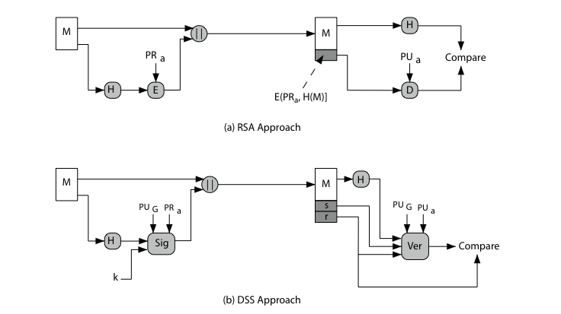
DSS Approach vs. RSA Approach

Slide 18
Digital Signature Algorithm (DSA)
Global public key
  q: A 160 bit prime number is chosen
  p: is selected with length between 512 and 1024 bits such that q divides (p-1)
  g: = h^{(p-1)q} mod p, h is integer between 1 to (p-1) and g > 1
Each user generate a private and public key with these numbers
Private key is x: randomly chosen number from 1 to (p-1)
Public key is y: y = g^{x} mod p

Slide 19
DSA Signature Creation
To sign a message M the sender:
  generates a random signature key k, k<q
  k must be random, be destroyed after use, and never be reused
Then computes signature pair:
  r = (g^{k} mod p)mod q
  s = [k⁻¹(H(M)+ xr)] mod q
Sends signature (r,s) with message M

Slide 20
DSA Signature Verification
Having received M & signature (r,s)
To verify a signature, recipient computes:
  w = s⁻¹ mod q
  u1= [H(M)w ]mod q
  u2= (rw)mod q
  v = [(g^{u1} y^{u2})mod p ]mod q
If v=r then signature is verified

Slide 21
Authentication Applications
Kerberos
X.509

Slide 22
Kerberos
Authentication service developed at MIT
Uses trusted key server system
Provides centralised private-key third-party authentication in a distributed network
  allows users access to services distributed through network
  without needing to trust all workstations
  rather all trust a central authentication server
two versions in use: 4 & 5

Slide 23
Threat in distributed environment
A user
  gain access to a workstation and pretend to be another user from that workstation
  alter the network addr. of workstation, so that request sent will be appear from impersonate system
  may evasdrop on exchanges and use the replay attack to gain entrance to the server or to disrupt the operations
Authentication at each server ??
Kerberos is used to authenticate user to servers and servers to users

Slide 24
Summary
In today’s we talked about Digital signature and authentication protocols
The difference between Digital Signature Standard (DSS) and Digital Signature Algorithm (DSA) was also explored.
We also studied Kerberos an authentication application

Slide 25
Next lecture topics
Our discussion on Kerberos will continue and we will explore its other versions
We will also discuss certificates and Certification Authority (CA).

Slide 26
The End

