Slide 1
Network Security
Lecture 22
Presented by: Dr. Munam Ali Shah

Slide 2
Part – 2 (e):
Incorporating security in other parts of the network

Slide 3
Summary of the Previous Lecture
In previous lecture we continued our discussion on Confidentiality using symmetric encryption
We talked about Master Key/Session Key
We also talked about Key storage, key hierarchy, key renewal and lifetime of a session key
We also explored the issues with centralized and decentralized key distribution.

Slide 4
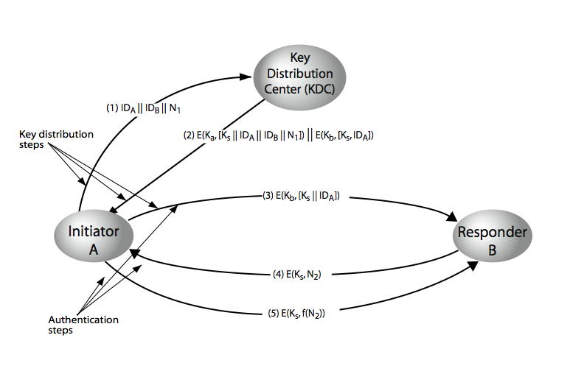
Summary of the previous lecture
A key distribution scenario

Slide 5
Outlines of today’s lecture
Some discussion on Decentralized Key Control
Message Authentication Mechanism
    Message encryption
    MAC
    Hash

Slide 6
Objectives
You would be able to present an understanding of the confidentiality and message authentication mechanism.
You would be able demonstrate knowledge about different functions and protocols used for message authentication

Slide 7
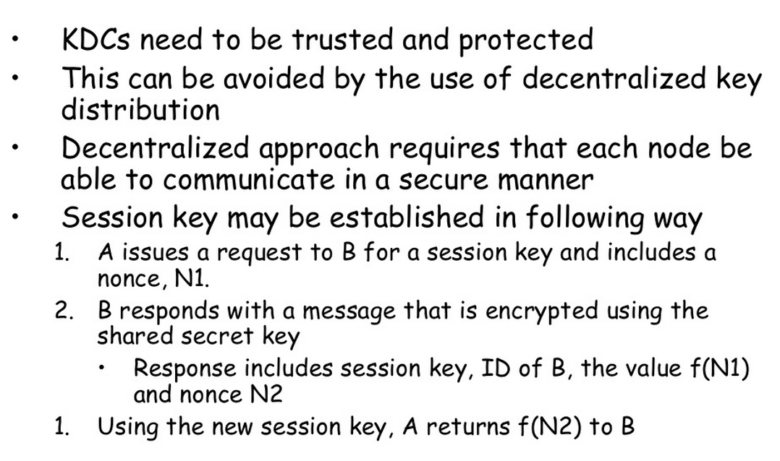
Decentralized Key Control

Slide 8
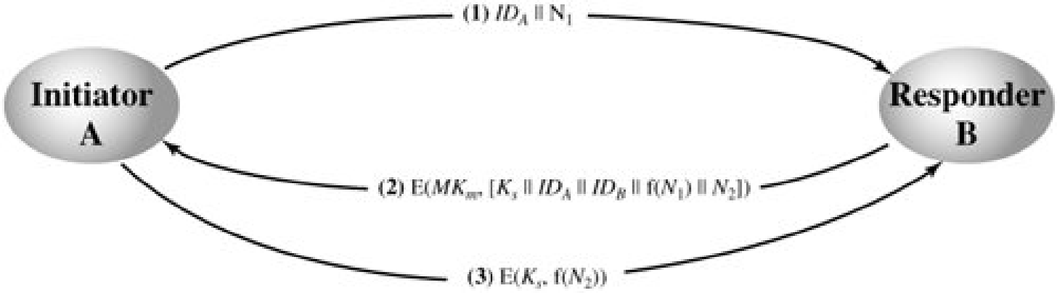
Decentralized Key Control
For n end system, [n(n-1)]/2 master keys are required.
message send using master key are short, crypt analysis is difficult,
session are used for limited time

Slide 9
Controlling key usage
Can define different types of key on the basis of usage
  Data encryption key: for general communication
  PIN-encryption key: for PIN transfer
  File encrypting key: for file transfer
Needs a control in systems that limit the ways in which the key is used
Simple plan: attached 8 bit tag with each 64 bit key
  One bit indicate whether the key is session or master
  One bit indicate whether the key is used for encryption
  One bit indicate whether the key is used for decryption
  Remaining bits are spare for future use

Slide 10
A key distribution scenario
Let us assume that user A wishes to establish a logical connection with B and requires a one-time session key to protect the data transmitted over the connection. A has a master key, Ka, known only to itself and the KDC; similarly, B shares the master key Kb with the KDC.
The steps occurred are given in the figure (in next slide)

Slide 11
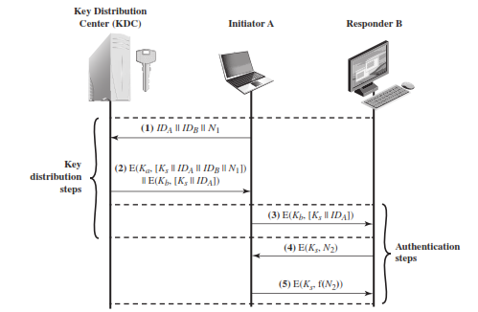
A key distribution scenario

Slide 12
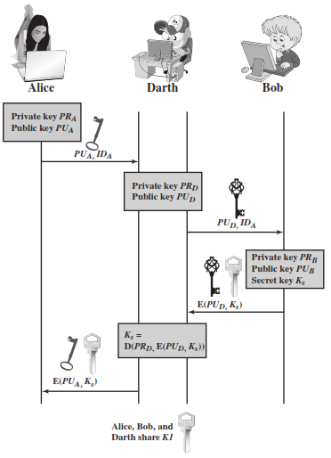
Man-in-the middle attack

Slide 13
Message Authentication

Slide 14
Confidentiality and Authentication
So far we have talked about confidentiality only
  Classical ciphers
  Block ciphers
  Stream ciphers
Authentication is the second most important goal of cryptography
  Provided by authentication functions
  Digital signatures provide authentication as well as non-repudiation

Slide 15
Authentication Functions
Two levels of message authentication mechanism
  Lower level: Authentication function
  Higher level: Authentication protocol
Authentication functions have 3 classes
  Message encryption
  Message Authentication Code (MAC)
  Hash function

Slide 16
Message Encryption
In a way, message encryption can provide authentication
  But not reliable
  Small changes in ciphertext may not be detected
Done in two ways
  Symmetric (private key) encryption
  Asymmetric (public key) encryption

Slide 17
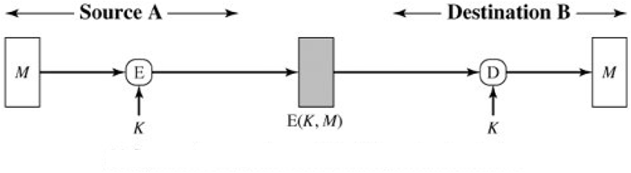
  Message Encryption
Symmetric encryption: confidentiality and authentication

Slide 18
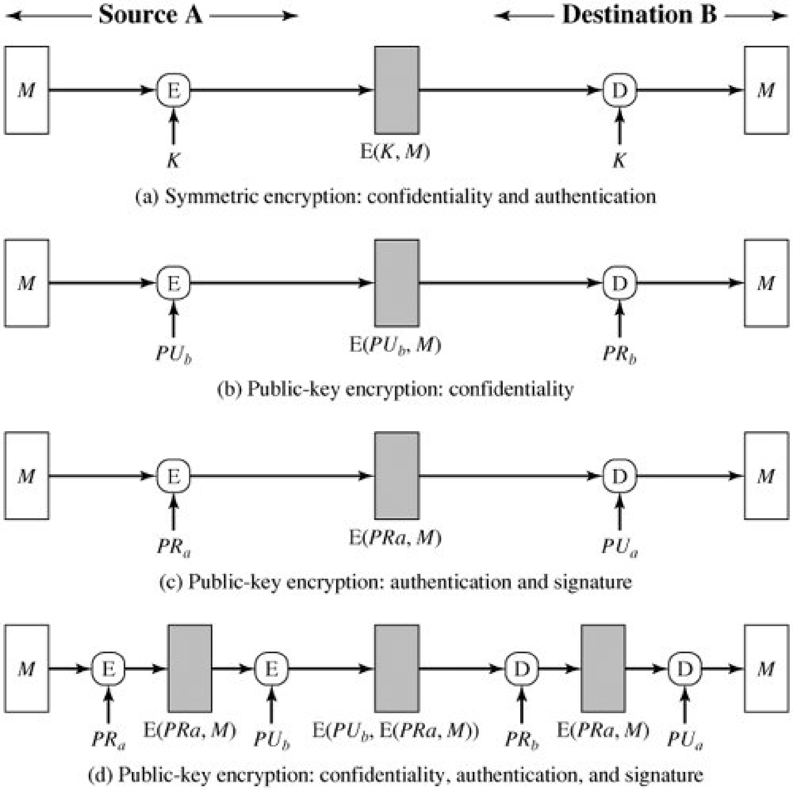
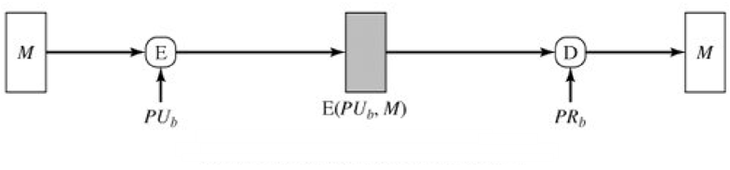
Message Encryption
Public-key encryption: confidentiality

Slide 19
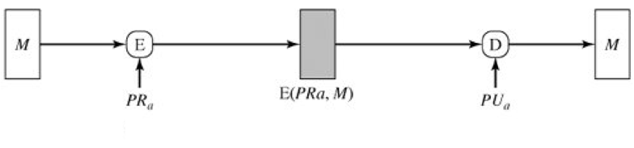
Message Encryption
Public-key encryption: authentication and non-repudiation

Slide 20
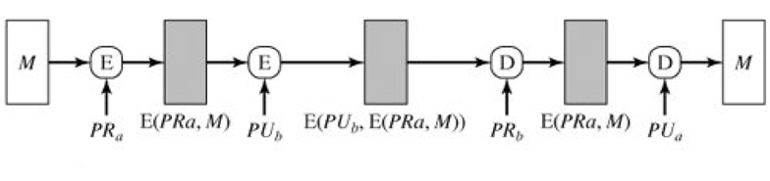
Message Encryption
Public-key encryption: confidentiality, authentication and non-repudiation

Slide 21
Message Authentication Code (MAC)
MAC = C(K,M)
  M: Input message
  C: MAC function
  K: Shared secret key
Message + MAC are sent to the intended recipient
Recipient calculates MAC’ = C(K,M’)
  If MAC = MAC’ then accept else reject

Slide 22
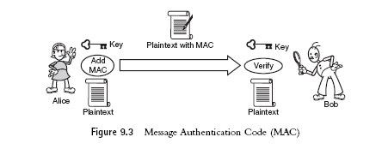
Properties of MAC
MAC function need not be reversible (in contrast to decryption function)
MAC input: arbitrary length
MAC output: fixed length (typically much smaller than message length)
MAC is many-to-one function

Slide 23
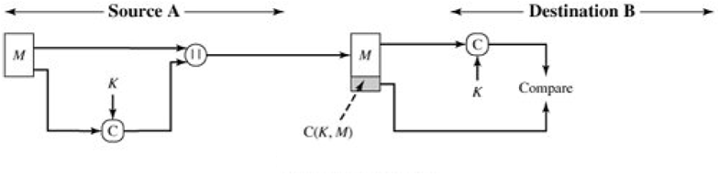
Message Authentication Code
Authentication

Slide 24
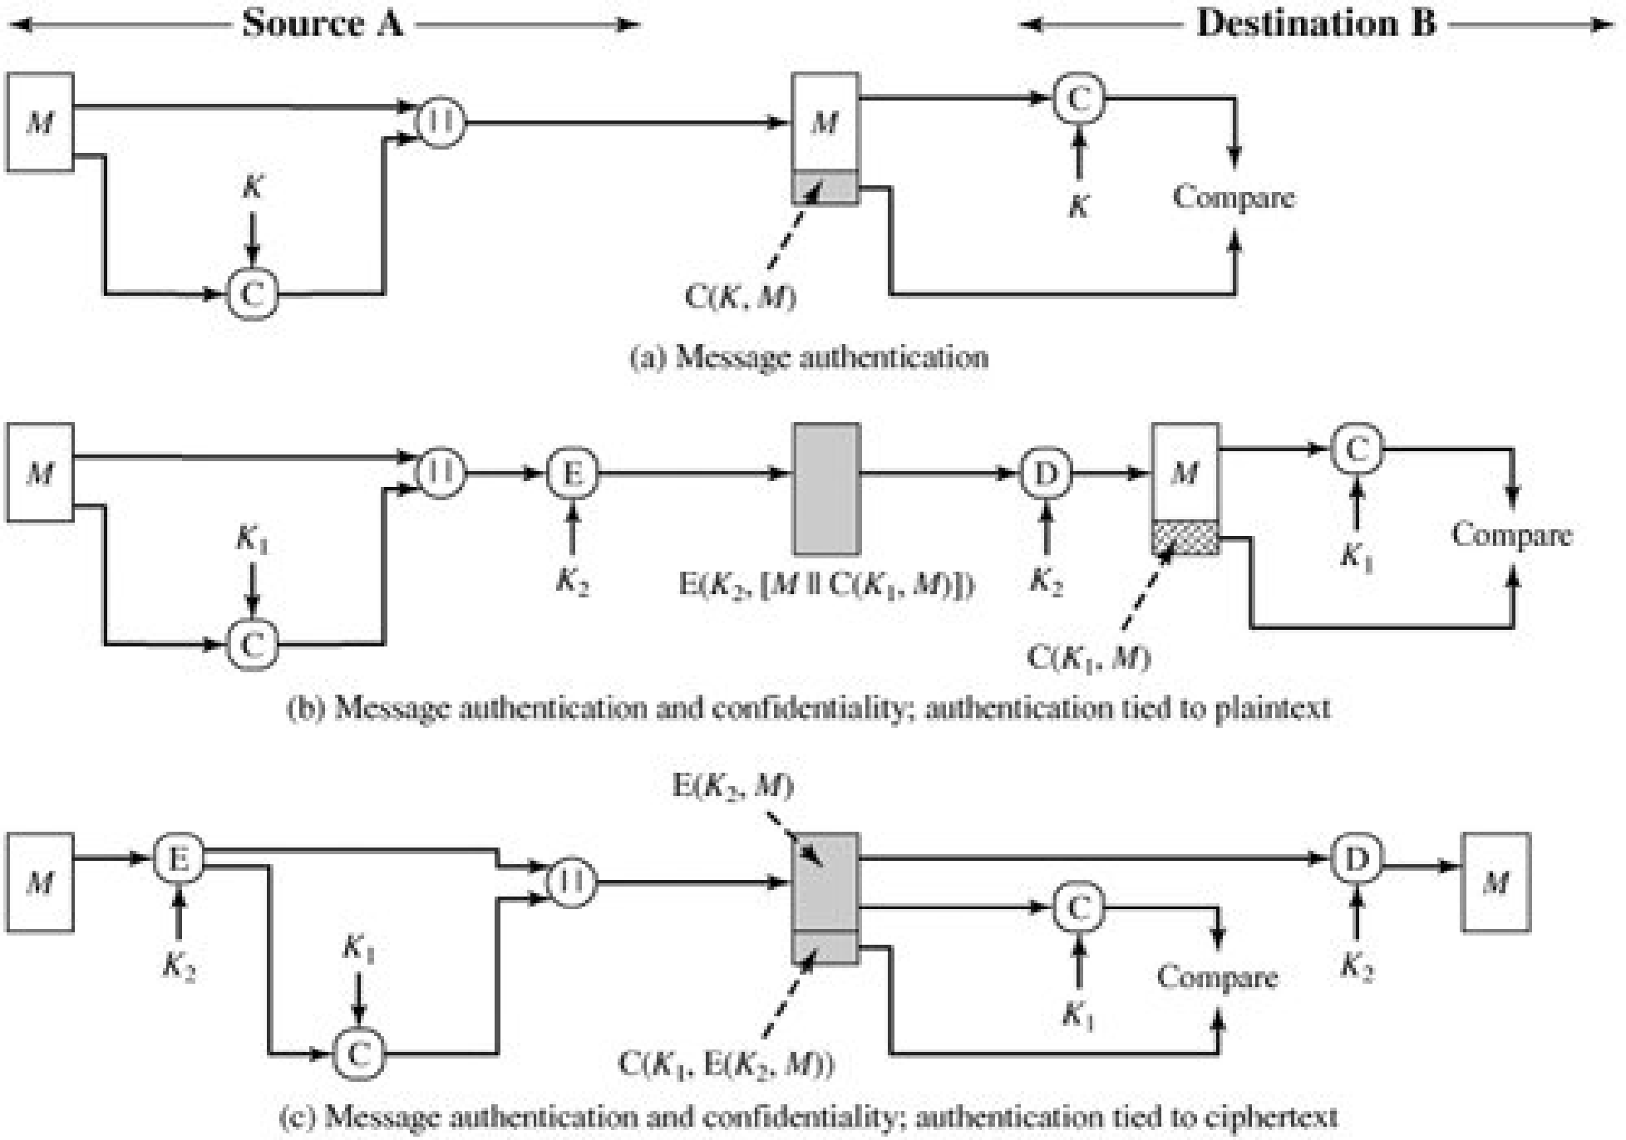
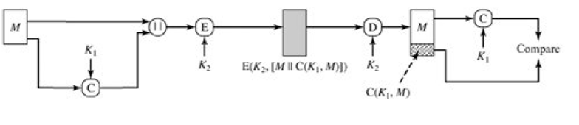
Message Authentication Code
Authentication and confidentiality; authentication tied to plaintext

Slide 25
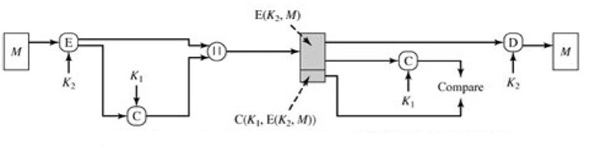
Message Authentication Code
Authentication and confidentiality; authentication tied to ciphertext

Slide 26
Hash Function
A variation of MAC
Does not need a key
h = H(M)
  h is called hash code/hash value/message digest

Slide 27
Requirements of Hash Function
Arbitrary length input
Fixed length output
H(x) is easy to compute
Given h, computationally hard to find x such that H(x) = h (called onewayness)
Given x, computationally hard to find y ≠ x such that H(x) = H(y) (called weak collision resistance)
Comp hard to find a pair x,y such that H(x) = H(y) (called strong collision resistance)

Slide 28
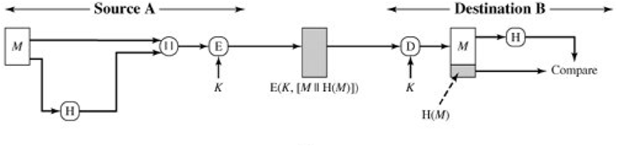
Hash Function
Confidentiality and authentication

Slide 29
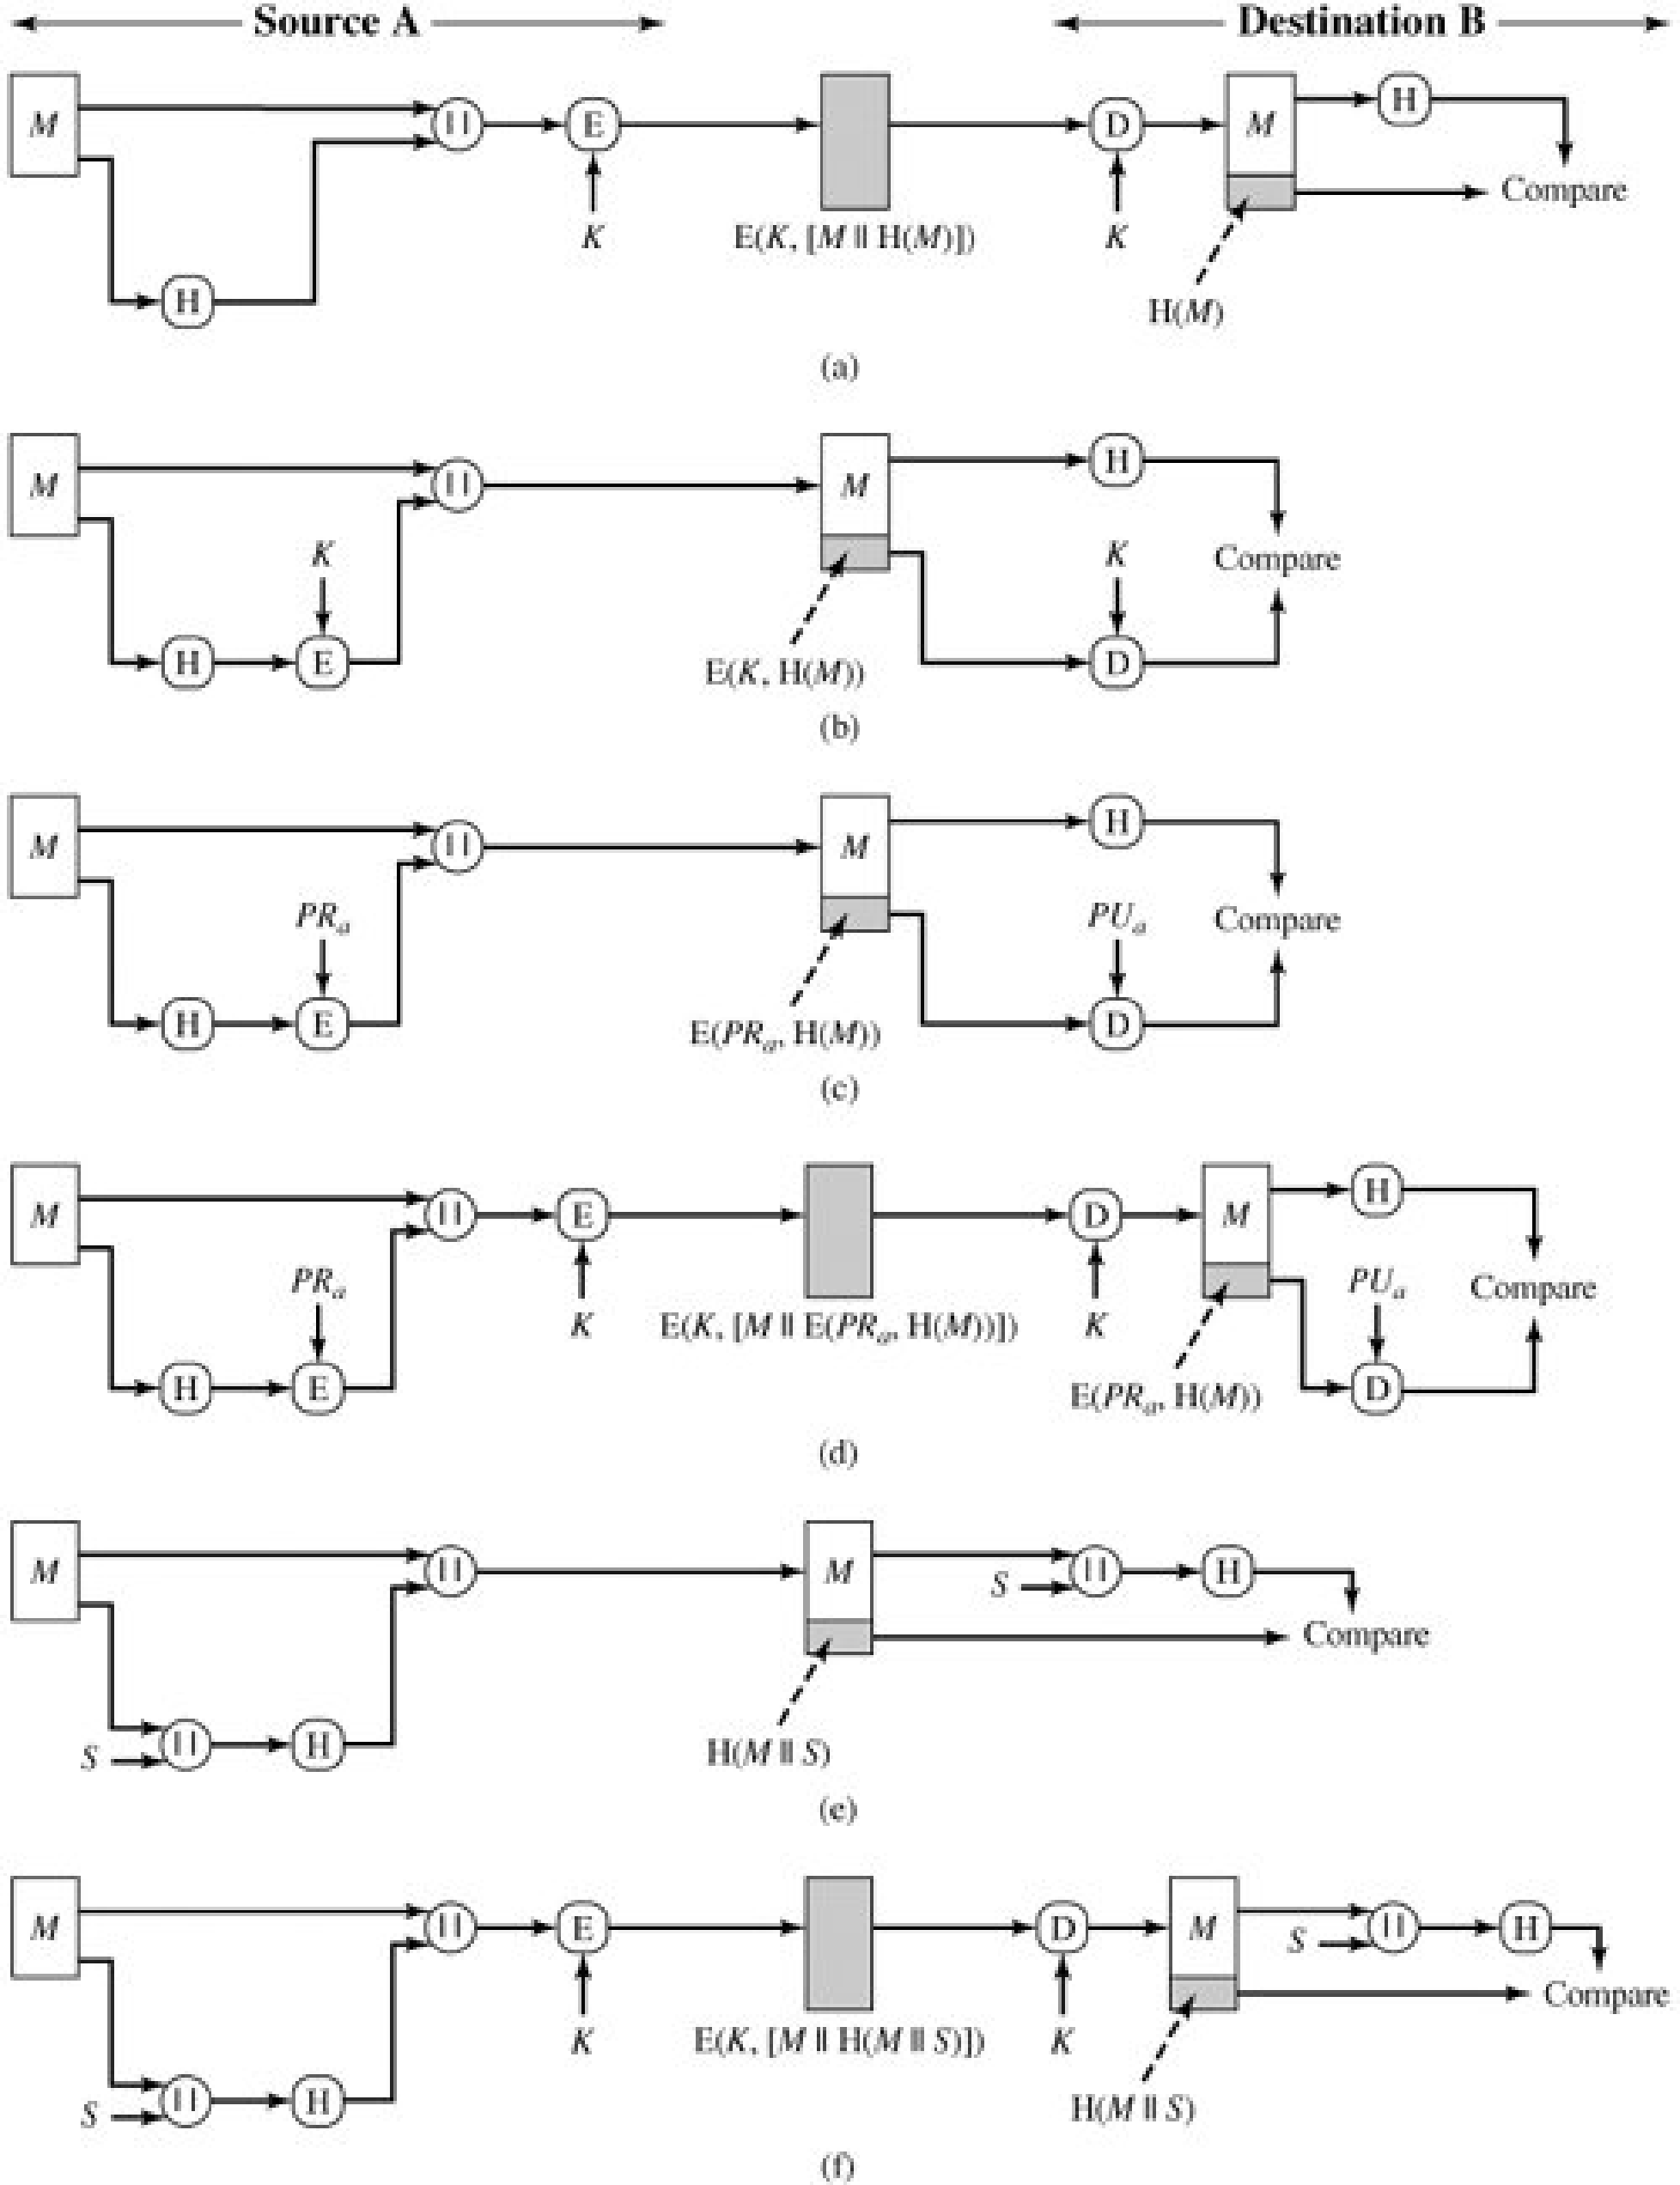
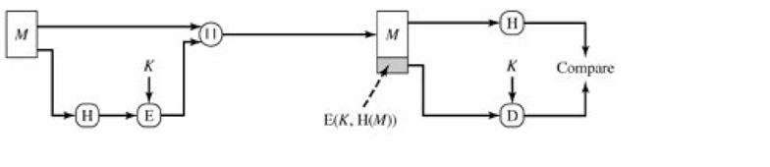
Hash Function
Authentication

Slide 30
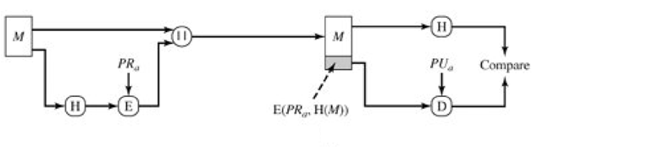
Hash Function
Authentication and non-repudiation

Slide 31
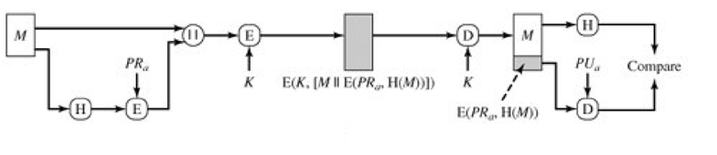
Hash Function
Confidentiality, authentication and non-repudiation

Slide 32
Summary
In today’s we explored the limitations of the centralized key distribution and have explored key distribution in a decentralized fashion.
Message Authentication Mechanism
    Message encryption
    MAC
    Hash

Slide 33
Next lecture topics
We will talk about authentication through digital signatures

Slide 34
The End

