Slide 1
Network Security
Lecture 21
Presented by: Dr. Munam Ali Shah

Slide 2
Part – 2 (e):
Incorporating security in other parts of the network

Slide 3
Summary of the Previous Lecture
In previous lecture talked about achieving Confidentiality using symmetric encryption
We also explored Link vs. end to end encryption

Slide 4
Summary of the previous lecture
have two major placement alternatives
link encryption
  vulnerable links are equipped with encryption device
  En/decryption occurs independently on every link
  requires many devices in a large network
  User has no control over security of these devices
  Many keys must be provided
end-to-end encryption
  encryption occurs between original source and final destination
  need devices at each end with shared keys
  Authentication

Slide 5
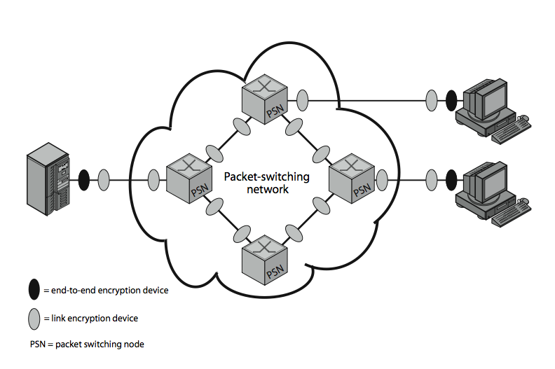
Summary of the previous lecture

Slide 6
Outlines of today’s lecture
Key Distribution mechanism will be discuss in detail
The role of a KDC (key distribution center)
Key Distribution design constraints will be explored

Slide 7
Objectives
You would be able to present an understanding of the confidentiality using symmetric encryption .
You would be able demonstrate knowledge about the Key distribution.

Slide 8
Key Distribution
symmetric schemes require both parties to share a common secret key
issue is how to securely distribute this key
often secure system failure due to a break in the key distribution scheme

Slide 9
Key Distribution
Given parties A and B have various key distribution alternatives:
  A can select key and physically deliver to B
  third party can select & deliver key to A & B
  if A & B have communicated previously can use previous key to encrypt a new key
  if A & B have secure communications with a third party C, C can relay key between A & B

Slide 10
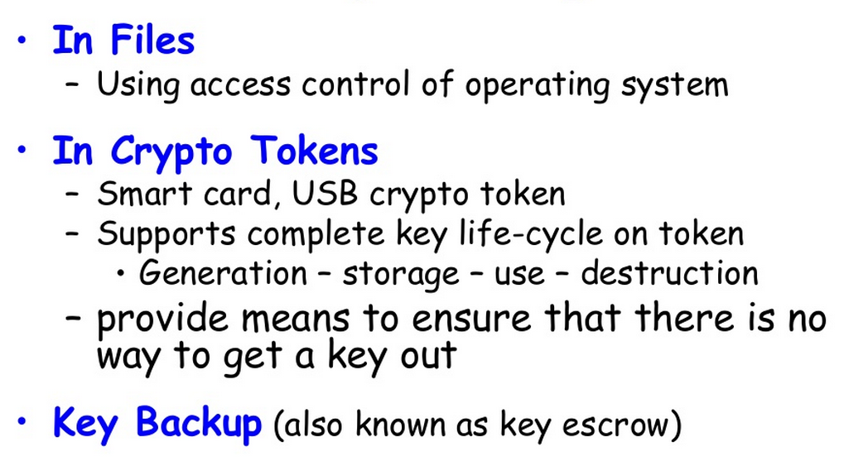
Key Storage

Slide 11

Master Key & Session Key
Master Key/ Encrypting Key: A pre-shared key is used to encrypt a randomly generated and insecurely communicated Working Key (called the "Session" key). The Working Key is then used for encrypting data to be exchanged.
This technique still finds widespread use in the financial industry. It is routinely used between corporate parties such as issuers, acquirers, switches.
Its advantage is simplicity, but it suffers the disadvantage of having to communicate the pre-shared Key Exchange Key, which can be difficult to update in the event of compromise.

Slide 12
Key Hierarchy
The use of a key distribution center is based on the use of a hierarchy of keys. At a minimum, two levels of keys are used: a session key, used for the duration of a logical connection; and a master key shared by the key distribution center and an end system or user and used to encrypt the session key.
Typically have a hierarchy of keys
Session key
  temporary key
  used for encryption of data between users
  for one logical session then discarded
Master key
  used to encrypt session keys
  shared by user & key distribution center
Notes:
The use of a key distribution center is based on the use of a hierarchy of keys. At a minimum, two levels of keys are used: a session key, used for the duration of a logical connection; and a master key shared by the key distribution center and an end system or user and used to encrypt the session key.

Slide 13
Key Hierarchy
The use of a key distribution center is based on the use of a hierarchy of keys.
At a minimum, two levels of keys are used: a session key, used for the duration of a logical connection; and a master key shared by the key distribution center and an end system or user and used to encrypt the session key.

Slide 14
No. of keys
encryption is done at a network or IP level
  if there are N hosts, the number of required keys is [N(N-1)]/2
If encryption is done at the application level
  a key is needed for every pair of users or processes that require communication
A network using node-level encryption with 1000 nodes would conceivably need to distribute as many as half a million keys

Slide 15
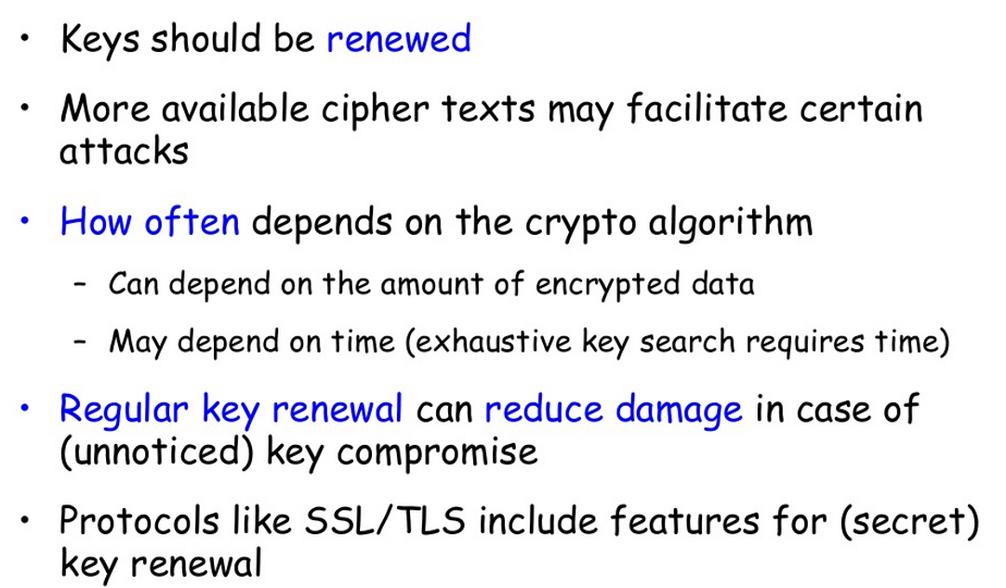
Key Renewal

Slide 16
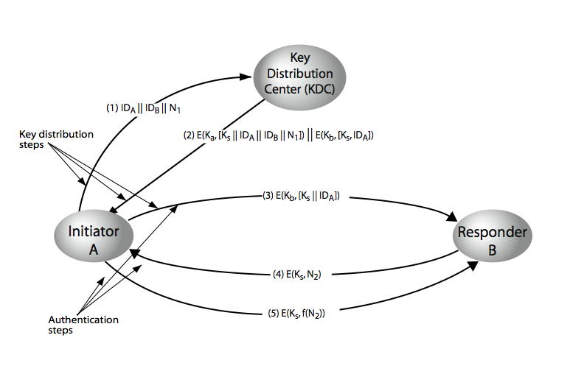
Key Distribution Scenario

Slide 17
hierarchies of KDC’s required for large networks, but must trust each other
  Minimize the effort of distributing master keys as most master keys are those shared hosts with their local KDC
Session key life time
  The more frequently session key are exchanged, the more secure they are, (opponent has less ciphertext for any given session key)
  Distributing session key delays the start of exchange and increases network traffic
  Connection oriented protocol: one session key for one session
  Connectionless protocol: use new key for each exchange.

Slide 18
Transparent key control scheme
Session Security Module (SSM): performs end to end encryption and Obtains session keys on behalf of its host
Works as follows
  host sends packet requesting connection
  SSM buffers packet, it ask KDC for session key
  KDC distribute session key to both host
  Buffered packet is
  transmitted

Slide 19
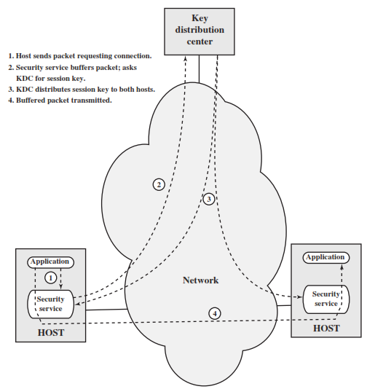
Transparent key control scheme
Communication between KDC and SSM is encrypted by master key, shared between KDC and SSM

Slide 20
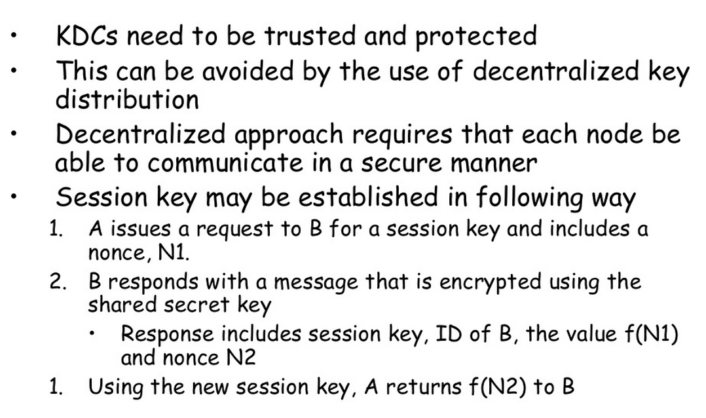
Decentralized Key Control

Slide 21
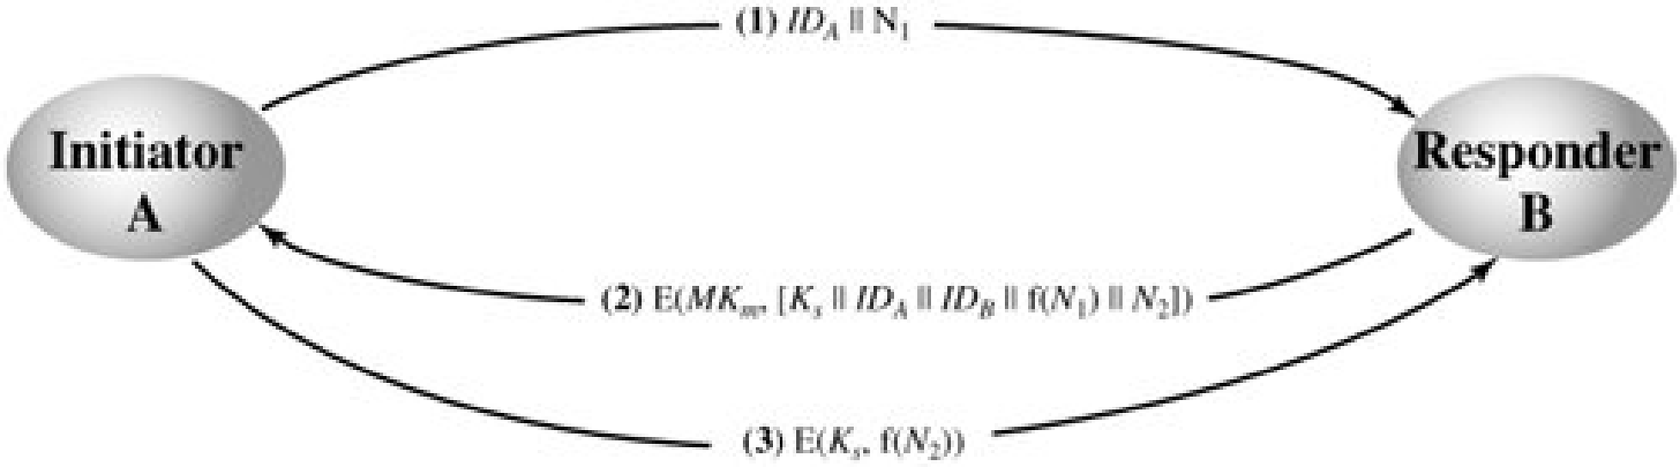
Decentralized Key Control
Not practical for large network,
Requirement: each end system able to perform secure communication with other end system for session key distribution
For n end system, [n(n-1)]/2 master keys are required.
message send using master key are short, crypt analysis is difficult,
session are used for limited time

Slide 22
Summary
In today’s we continued our discussion about Confidentiality using symmetric encryption
Key exchange is a challenging task in symmetric key cryptography. We discussed the role of KDC
The design constraints for Key Distribution was also explored

Slide 23
Next lecture topics
We will talk about user authentication in computer networks

Slide 24
The End

