Slide 1
Network Security
Lecture 20
Presented by: Dr. Munam Ali Shah

Slide 2
Summary of the Previous Lecture
In previous lecture we talked about the random numbers and the random number generators
We have also discussed random numbers and pseudorandom numbers.
The design constraints were also discussed

Slide 3
Summary of the previous lecture
Random number are the basis for many cryptographic applications.
There is no reliable “independent” function to generate random numbers.
Present day computers can only approximate random numbers, using pseudo-random numbers generated by Pseudo Random Number Generators (PRNG)s.
Attacks on many cryptographic applications are possible by attacks on PRNGs.
Computer applications are increasingly turning towards using physical data (external/internal) for getting truly random numbers.

Slide 4
Part – 2 (e):
Incorporating security in other parts of the network

Slide 5
Outlines of today’s lecture
We will talk about Confidentiality using symmetric encryption
We will also explore Link vs. end to end encryption
Key Distribution design constraints will be explored

Slide 6
Objectives
You would be able to present an understanding of deploying security in other parts of the networks.
You would understand the potential locations in the network through which attack could be launched

Slide 7
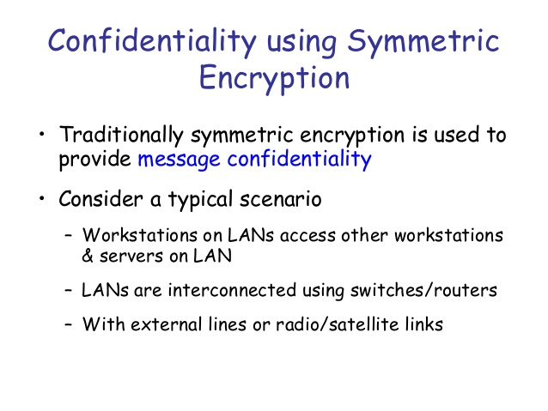

Slide 8
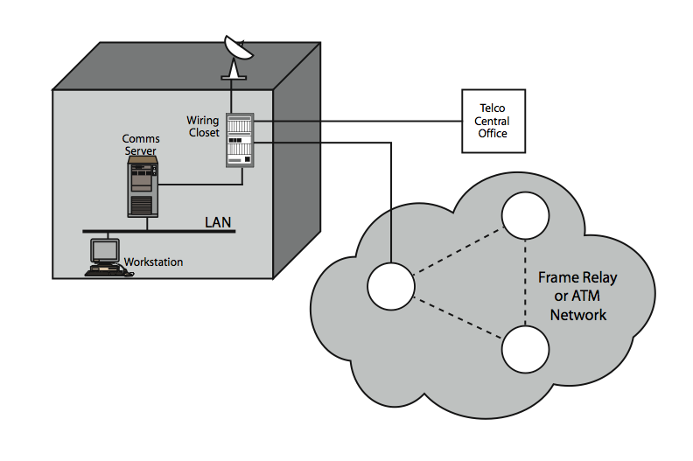
Potential locations for confidentiality attacks
Insider: eavesdropping the LAN
Outsider: from server or host with dial up facility
Patch panel is vulnerable if intruder access it physically: (can use low power radio transmitter)
Attack through transmission medium
  Wired (coaxial, twisted pair, fibre optic)
  Wireless(microwave, satellite)

Slide 9
Link vs. end to end encryption
have two major placement alternatives
link encryption
  vulnerable links are equipped with encryption device
  En/decryption occurs independently on every link
  requires many devices in a large network
  User has no control over security of these devices
  Many keys must be provided
end-to-end encryption
  encryption occurs between original source and final destination
  need devices at each end with shared keys
  Authentication

Slide 10
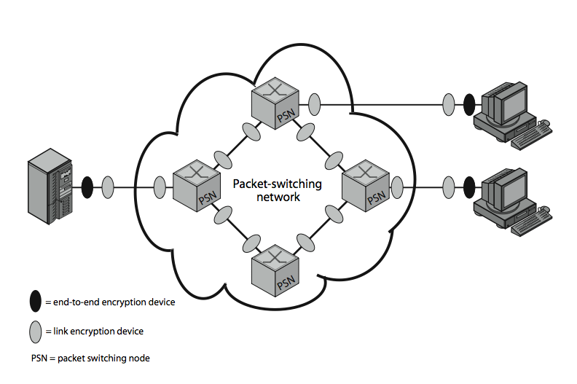

Slide 11
Needs both
when using end-to-end encryption must leave headers in clear
  so network can correctly route information
hence although contents protected, traffic pattern flows are not
ideally want both at once
  end-to-end protects data contents over entire path and provides authentication
  link protects traffic flows from monitoring

Slide 12
Placement of end to end Encryption
can place encryption function at various layers in OSI Reference Model
  link encryption occurs at layers physical or link layer
  end-to-end can occur at layers network layer:
    all user process and application within end system would employ the same encryption scheme with same key.

Slide 13
Cont.
End to end encryption at network layer provides end to end security for traffic within integrated internetwork
Such scheme cannot deliver necessary service for traffic that crosses internetwork boundaries e.g. email, ftp
Solution: End to end encryption at application layer
Transport and network connection ends up at each mail gateway, which setups new setup new transport and network connection to the other end system

Slide 14
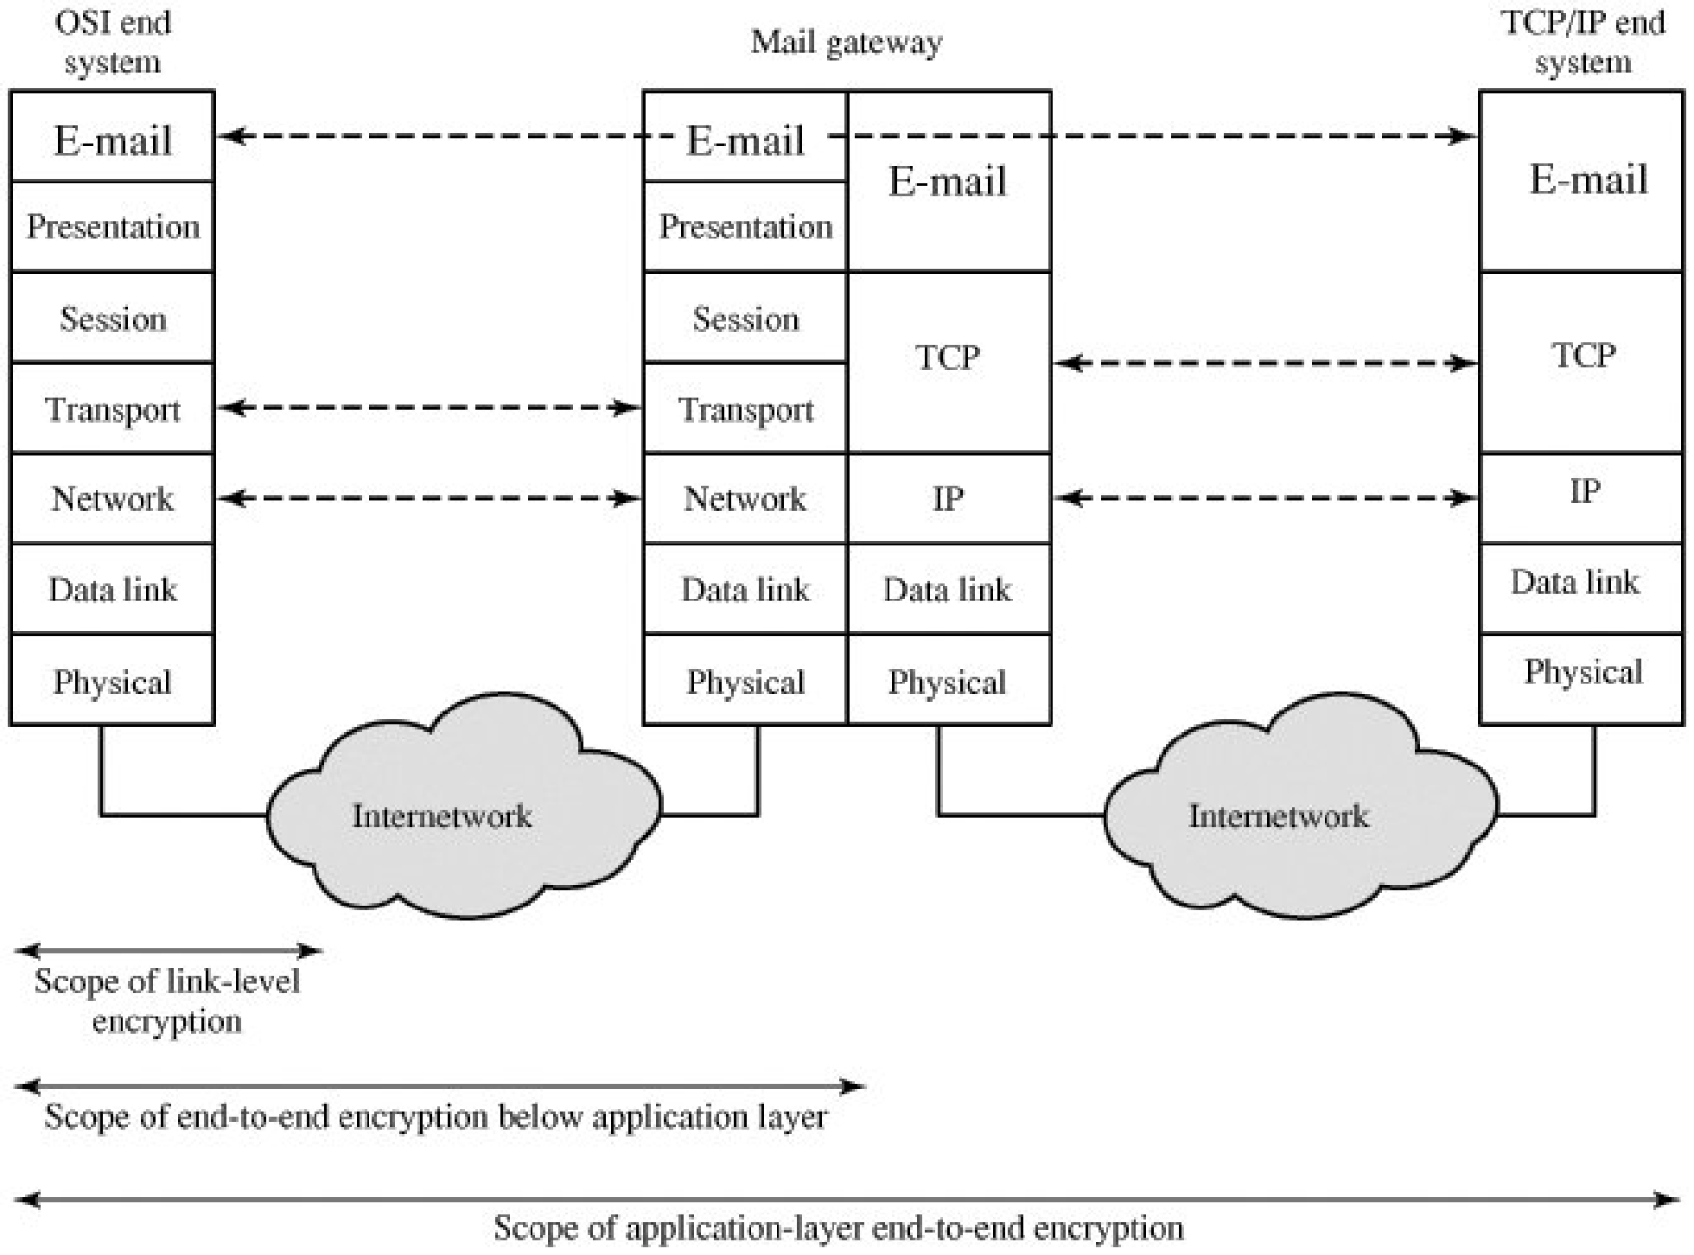
Encryption Coverage Implications of Store-and-Forward Communications

Slide 15
Drawback
A network that support hundred of hosts may support thousands of users and processes. Many secret keys are need to be generated and distributed

Slide 16
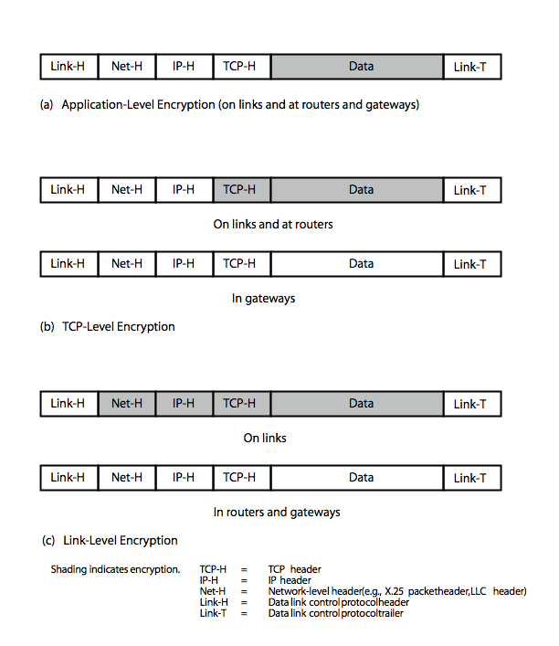
Encryption vs. protocol
Application level
TCP level
  User data and TCP header are encrypted
  IP header need by the router
  At gateway: TCP connection is terminated and a new transport connection is open for next hop
Link level
  Entire data unit except for the link (h & T)
  Entire data unit is cleared at each router and gateway

Slide 17
Traffic Analysis
is monitoring of communications flows between parties
  useful both in military & commercial spheres
Following information can be derived from traffic analysis
  Identities of partners
  Frequency of communication
  Message pattern, length and quantity that suggest important information of message
  Helpful for covert channel: is a type of computer security attack that creates a capability to transfer information objects between processes that are not supposed to be allowed to communicate by the computer security policy

Slide 18
Traffic Confidentiality
link encryption obscure header details
  but overall traffic volumes in networks and at end-points is still visible
traffic padding can further obscure flows
End to end Encryption
  Application layer: communicating entities are visible
  Transport layer: network address and traffic patterns are visible
  Uniform Padding deny an opponent knowledge of data exchange between user and secure the traffic patterns

Slide 19
Key Distribution
symmetric schemes require both parties to share a common secret key
issue is how to securely distribute this key
often secure system failure due to a break in the key distribution scheme

Slide 20
Key Distribution
Given parties A and B have various key distribution alternatives:
  A can select key and physically deliver to B
  third party can select & deliver key to A & B
  if A & B have communicated previously can use previous key to encrypt a new key
  if A & B have secure communications with a third party C, C can relay key between A & B

Slide 21
Summary
In today’s lecture we talked about Confidentiality using symmetric encryption
We explored Link vs. end to end encryption
The design constraints for Key Distribution was also explored

Slide 22
Next lecture topics
We will talk about incorporating and ensuring network security through other aspects

Slide 23
The End

