Slide 1
Network Security
Lecture 19
Presented by: Dr. Munam Ali Shah

Slide 2
Summary of the Previous Lecture
We have discussed public/ asymmetric key cryptography in detail and RSA was discussed as an example.
  RSA Algorithm
We have explored the TRNG and PRNG
  Introduction to Pseudorandom Numbers
  Some Pseudorandom Number Generators

Slide 3
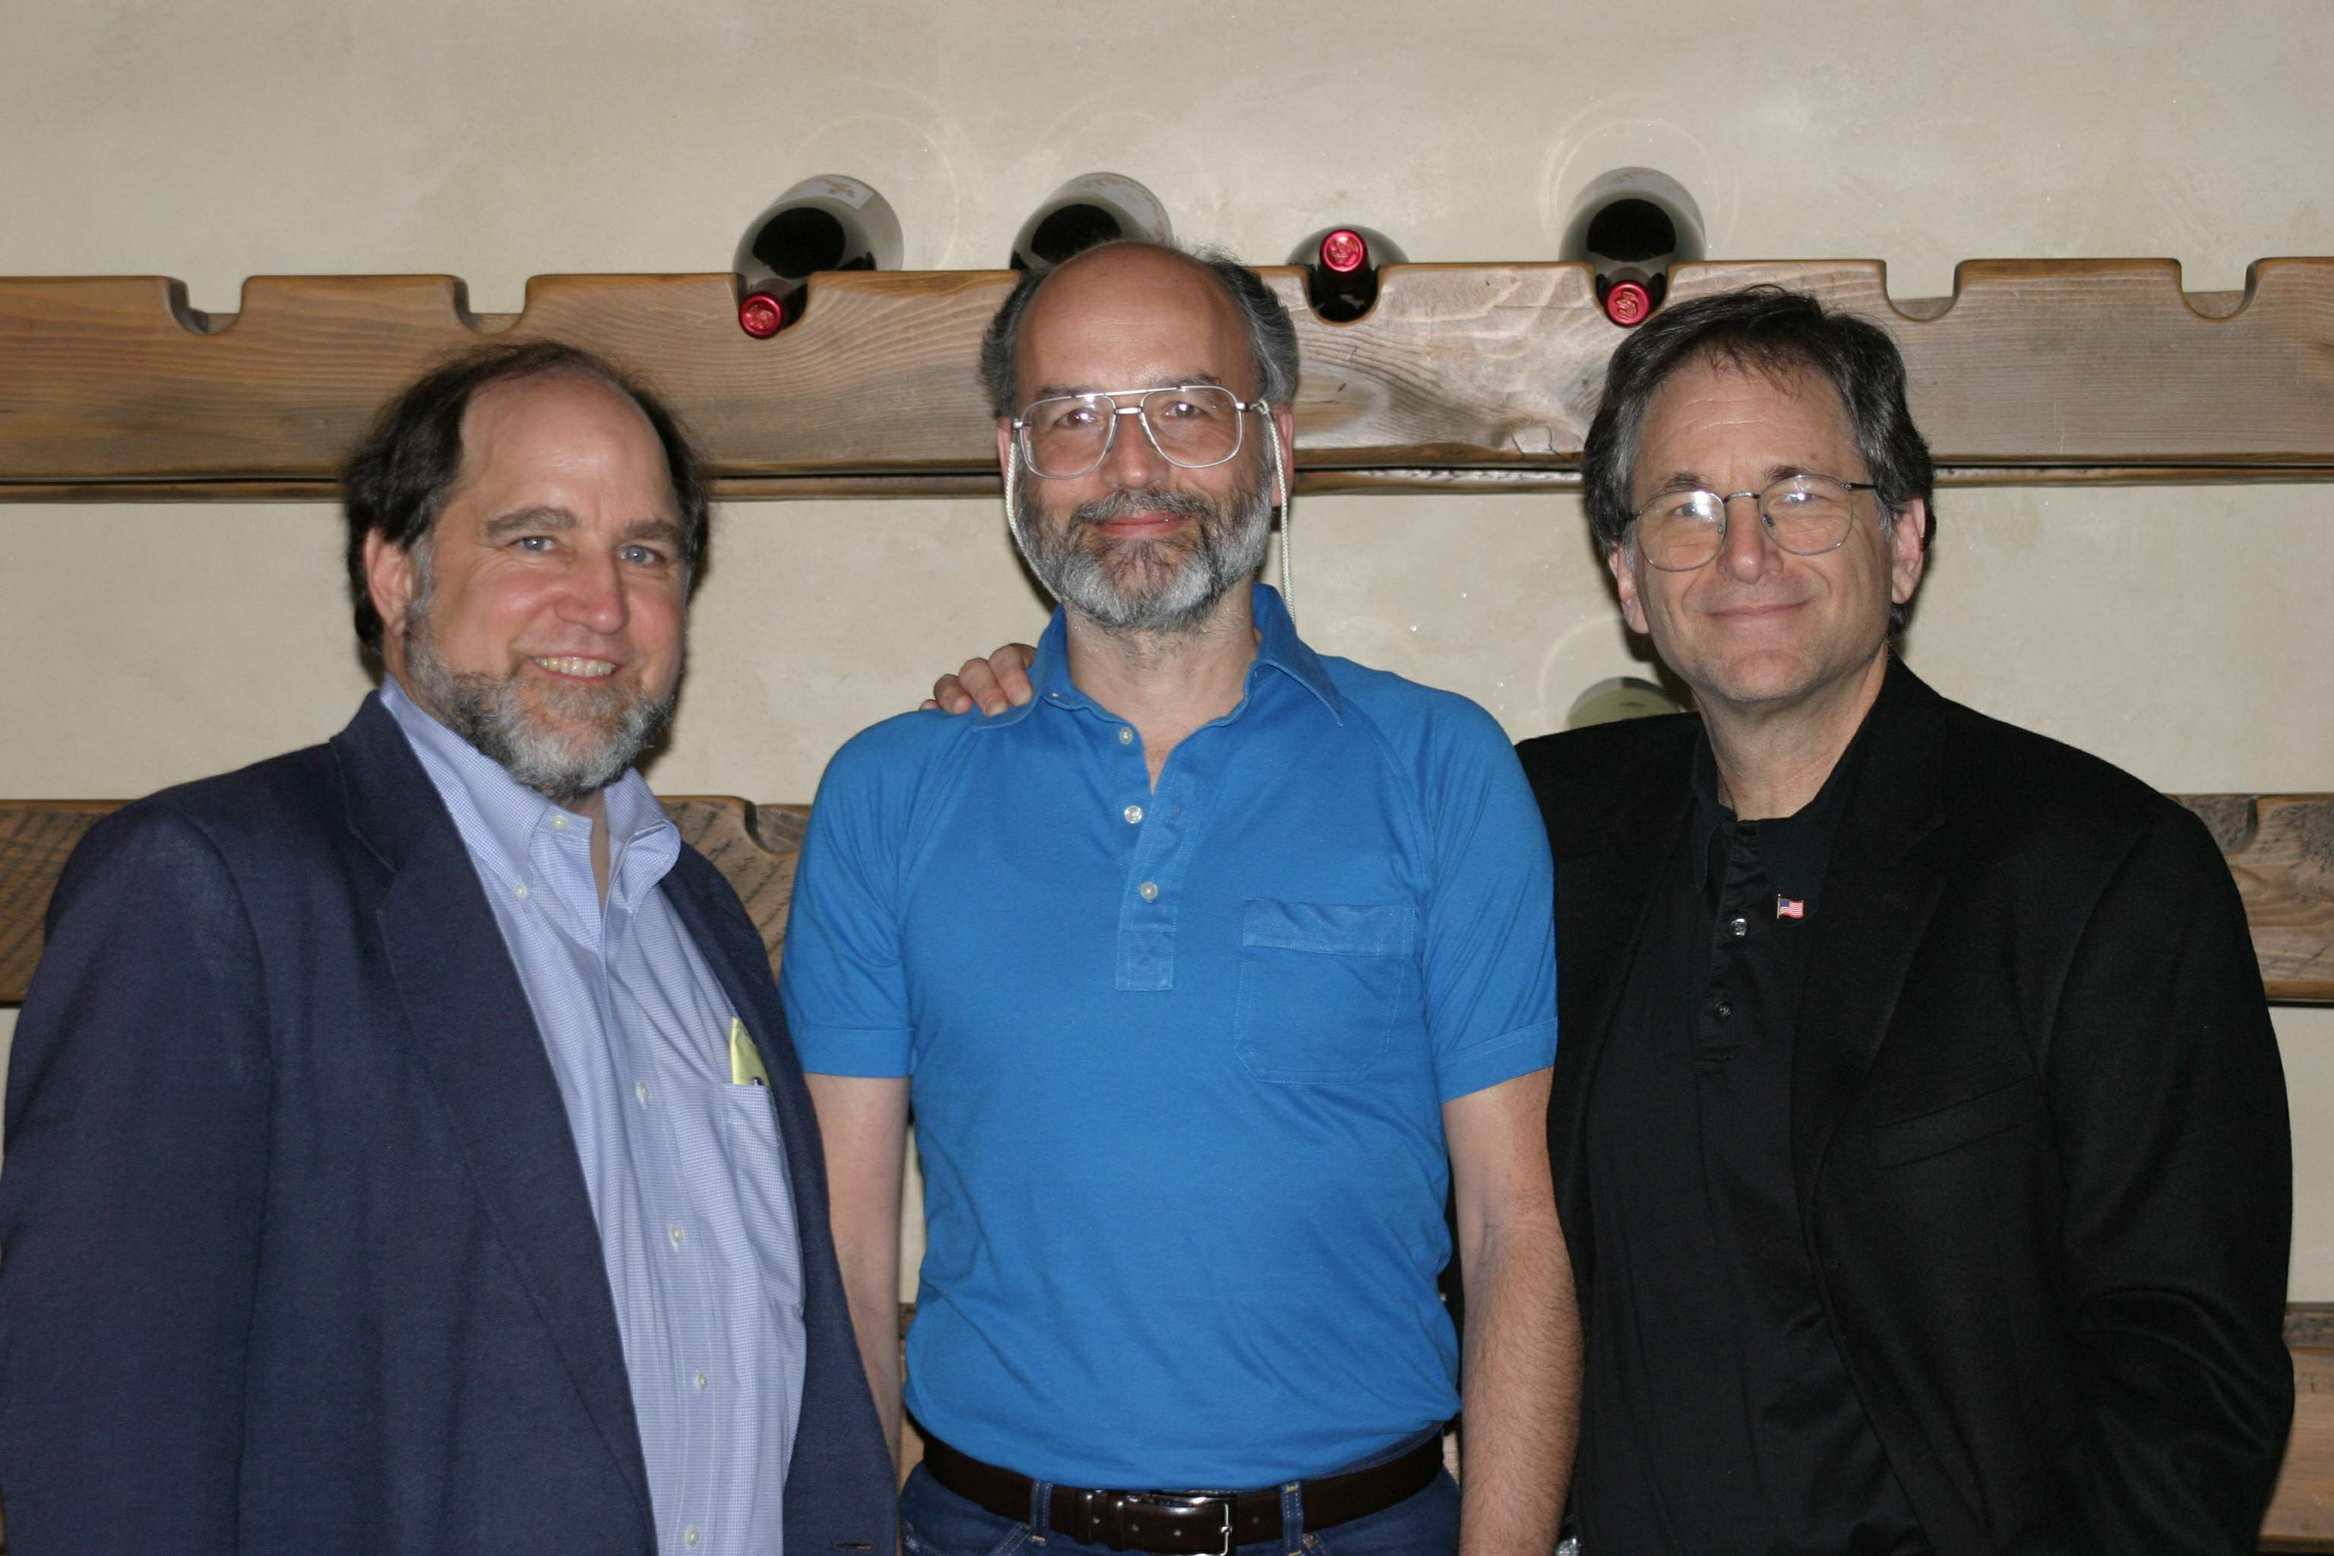
Summary of the Previous Lecture
by Rivest, Shamir & Adleman of MIT in 1977
best known & widely used public-key scheme
Block cipher scheme: plaintext and ciphertext are integer between 0 to n-1 for some n
Use large integers e.g. n = 1024 bits

Slide 4
Summary of the Previous Lecture
sample RSA encryption/decryption is:
given message M = 88 (nb. 88<187)
encryption:
  C = 88⁷ mod 187 = 11
decryption:
  M = 11²³ mod 187 = 88

Slide 5
Outlines of today’s lecture
Attacks on Pseudorandom generators
Tests for pseudorandom functions
True Random generators

Slide 6
Objectives
You would be able to present an understanding of the random numbers and pseudorandom numbers .
You would be able understand the use and implementation of TRNG, PRNG and PRF

Slide 7
True Random number generator (TRNG)
A random number generator (RNG) is a computational or physical device designed to generate a sequence of numbers or symbols that lack any pattern, i.e. appear random. The many applications of randomness have led to the development of several different methods for generating random data

Slide 8
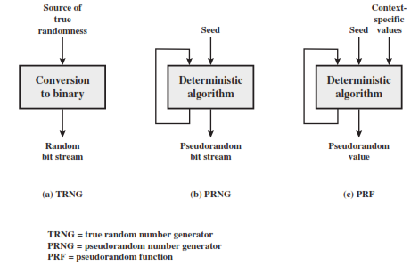

Slide 9
Introduction
Usage
  Almost all network security protocols rely on the randomness of certain parameters
    Nonce - used to avoid replay
    session key
    Unique parameters in digital signatures
  Monte Carlo Simulations -
    is a mathematical technique for numerically solving differential equations. Randomly generates scenarios for collecting statistics.

Slide 10
Introduction
(Desirable) Properties of Pseudorandom Numbers
  Uncorrelated Sequences - The sequences of random numbers should be serially uncorrelated
  Long Period - The generator should be of long period (ideally, the generator should not repeat; practically, the repetition should occur only after the generation of a very large set of random numbers).
  Uniformity - The sequence of random numbers should be uniform, and unbiased. That is, equal fractions of random numbers should fall into equal ``areas'' in space. Eg. if random numbers on [0,1) are to be generated, it would be poor practice were more than half to fall into [0, 0.1), presuming the sample size is sufficiently large.
  Efficiency - The generator should be efficient. Low overhead for massively parallel computations.

Slide 11
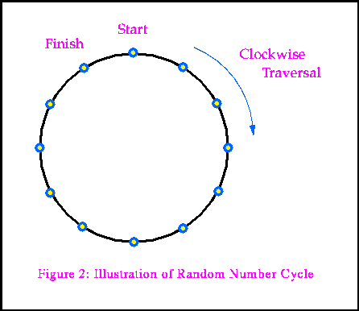
The Random Number Cycle
Almost all random number generators have as their basis a sequence of pseudorandom integers
The integers or ``fixed point'' numbers are manipulated arithmetically to yield floating point or ``real'' numbers.
The Nature of the cycle
  the sequence has a finite number of integers
  the sequence gets traversed in a particular order
  the sequence repeats if the period of the generator is exceeded
  the integers need not be distinct; that is, they may repeat.

Slide 12
Testing Pseudorandom generators
  clever algorithms have been developed which generate sequences of numbers which pass every statistical test used to distinguish random sequences from those containing some pattern or internal order.
  Tests to check the different properties discusses above.
  Tests include mean and variance checks. Mean should be close to 0.5 and variance 1/12 = 0.08 for uniformly distributed pseudorandom numbers.

Slide 13
Shuffling Numbers
Sometimes it is desirable to randomize a small set of numbers so that a non-repeating sequence is obtained.
  Games
  Oceanographic RAFOS float
It is Important not to repeat numbers. Taking the modulus of a generator like r250 will not work as the numbers could repeat.
One way to do this would be to put the value to be shuffled into an array and to use a random number generator to generate indices into the array to actually shuffle the numbers. The array is then accessed sequentially.

Slide 14
Quasi Random Numbers
For some applications pseudo random numbers are a little too random.
Some portions of the domain are relatively under sampled and other portions are over sampled.
Quasi Random number generators maintain a uniform density of coverage over the entire domain by giving up serial independence of subsequenctly generated value in order to obtain a uniform coverage of the domain.

Slide 15
Quasi Random Numbers
Low-discrepancy sequences are also called quasi-random or sub-random sequences, due to their common use as a replacement of uniformly distributed random numbers.
The "quasi" modifier is used to denote more clearly that the values of a low-discrepancy sequence are neither random nor pseudorandom.
Such sequences share some properties of random variables and in certain applications such as the quasi-Monte Carlo method .

Slide 16
Cryptanalytic Attacks on Random Number Generators
Examples of random parameters in cryptography:
  Session keys
  Numbers to be hashed with passwords
  Parameters in digital signatures
  Nonces
    (In security engineering, a nonce is an arbitrary number used only once in a cryptographic communication. It is similar in spirit to a nonce word, hence the name. It is often a random or pseudo-random number issued in an authentication protocol to ensure that old communications cannot be reused in replay attacks)
Most of the above are approximated using PRNGs

Slide 17
Classes of Attacks on PRNGs:
Direct Cryptanalytic Attack:
  When the attacker can directly distinguish between PRNG numbers and random numbers (cryptanalyze the PRNG).
Input Based Attack:
  When the attacker is able to use knowledge and control of PRNG inputs to cryptanalyze the PRNG.
State Compromise Extension Attacks:
  When the attacker can guess some information due to an earlier breach of security. The advantage of a previous attack is extended.

Slide 18
Direct Cryptanalytic Attacks:
When the attacker can directly cryptanalyze the PRNG.
Applicable to most PRNGs
Not applicable when the attacker is not able to directly see the output of the PRNG.
  Eg A PRNG used to generate triple-DES keys. Here the output of the PRNG is never directly seen by an attacker.

Slide 19
Input Based Attacks:
When an attacker used knowledge or control of the inputs to cyptanalyze the PRNG output.
Types:
  Known Input
    If the inputs to the PRNG, that are designed to be difficult for a user to guess, turn out to be easily deducible. Eg disk latency time. When the user is accessing a network disk, the attacker can observe the latency time.
  Chosen input
    Practical against smartcards, applications that feed incoming messages (username/password etc) to the PRNG as entropy samples.
  Replayed Input
    Similar to chosen input, except it requires less sophistication on the part of the attacker.

Slide 20
State Compromise Extension Attacks:
Attempts to extend the advantages of a temporary security breach
These breaches can be:
  Inadvertent leak
  Previous cryptographic success
This attack is successful when:
  The attacker learns the internal state of the system at state S and it’s:
  Able to recover unknown PRNG outputs from before S was compromised. OR
  Recover outputs from after a PRNG has collected a sequence of inputs that an attacker cannot otherwise guess.
These attacks usually succeed when the system is started in guessable state (due to lack of entropy):

Slide 21
State Compromise Extension Attacks (cont):
These attacks are classified as:
  Backtracking attacks
    Uses the compromise of PRNG state S to learn about all previous PRNG outputs.
  Permanent compromise attack
    Once S has been compromised, all future and past outputs of the PRNG are vulnerable.
  Iterative guessing attacks
    Uses the knowledge of state S that was compromised at time t and the intervening PRNG outputs to guess the state S’ at time t+Δ.
  Meet-in-the-middle attacks
    Combination of iterative guessing and backtracking.

Slide 22
Some Examples:
X 9.17 PRNG:
  Vulnerable to Input based attack and state compromise extension attacks.
DSA PRNG:
  Vulnerable only to state compromise extension attacks.
RSAREF PRNG:
  Vulnerable to Input based attack and state compromise extension attacks.

Slide 23
Tests for Randomness in Random Numbers:
Quantitative tests:
  Χ² tests:
  Lagged Correlation:
Qualitative tests:
  Scatter Plots
    Plot pairs of random numbers.
    Clumps of numbers, gaps and patterns are easily visible.
  Random Walk

Slide 24
Conclusions:
Random number are the basis for many cryptographic applications.
There is no reliable “independent” function to generate random numbers.
Present day computers can only approximate random numbers, using pseudo-random numbers generated by Pseudo Random Number Generators (PRNG)s.
Attacks on many cryptographic applications are possible by attacks on PRNGs.
Computer applications are increasingly turning towards using physical data (external/internal) for getting truly random numbers.

Slide 25
Summary
We explored an example of PKC, i.e., RSA.
In today’s lecture we talked about the random numbers and the random number generators
We have also discussed random numbers and pseudorandom numbers.
The design constraints were also discussed.

Slide 26
Next lecture topics
We will talk about Confidentiality using symmetric encryption
We will also explore Link vs. end to end encryption
Key Distribution design constraints will be explored

Slide 27
The End

