Slide 1
Network Security
Lecture 18
Presented by: Dr. Munam Ali Shah

Slide 2
Summary of the Previous Lecture
We have discussed public/ asymmetric key cryptography in detail
We have explored how confidentiality, authentication and integrity could be achieved through public key cryptography

Slide 3
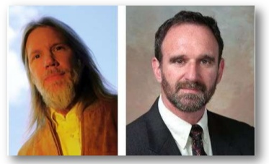
Different names
Public key cryptography
Asymmetric key cryptography
2 key cryptography
  Presented by Diffie & Hallman (1976)
    New directions in cryptography

Slide 4
Essential steps
Each user
  generates its pair of keys
  Places public key in public folder
  Bob encrypt the message using Alice’s public key for secure communication
  Alice decrypts it using her private key

Slide 5
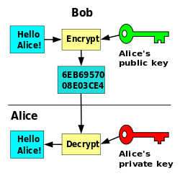

Slide 6
Outlines of today’s lecture
RSA Algorithm
Introduction to Pseudorandom Numbers
Some Pseudorandom Number Generators
Attacks on Pseudorandom generators
Tests for pseudorandom functions
True Random generators

Slide 7
Objectives
You would be able to understand the a public key cryptography algorithm.
You would be able to present an understanding of the random numbers and pseudorandom numbers .
You would be able understand the use and implementation of PRNG.

Slide 8
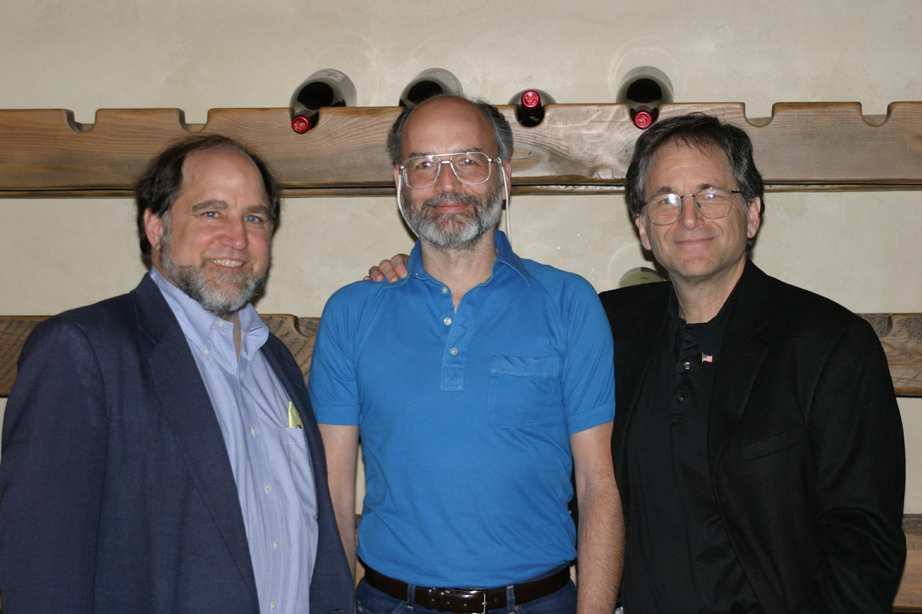
The RSA Algorithm
by Rivest, Shamir & Adleman of MIT in 1977
best known & widely used public-key scheme
Block cipher scheme: plaintext and ciphertext are integer between 0 to n-1 for some n
Use large integers e.g. n = 1024 bits

Slide 9
RSA Key Setup
each user generates a public/private key pair by:
selecting two large primes at random - p, q
Computing
  n=p.q
  ø(n)=(p-1)(q-1)
selecting at random the encryption key e
    where 1<e<ø(n), gcd(e,ø(n))=1
solve following equation to find decryption key d
  e.d=1 mod ø(n) and 0≤d≤n
publish their public encryption key: PU={e,n}
keep secret private decryption key: PR={d,n}

Slide 10
RSA Encryption / Decryption
to encrypt a message M the sender:
  obtains public key of recipient PU={e,n}
  computes: C = Me mod n, where 0≤M<n
to decrypt the ciphertext C the owner:
  uses their private key PR={d,n}
  computes: M = C^{d} mod n

Slide 11
RSA Example - Key Setup
Select primes: p=17 & q=11
Compute n = pq =17 x 11=187
Compute ø(n)=(p–1)(q-1)
=16 x 10=160
4. Select e: gcd(e,160)=1; choose e=7
5. Determine d:
d.e=1 mod 160 and
d < 160 Value is d=23 since 23x7=161
= 161 mod 160 = 1
Publish public key PU={7,187}
Keep secret private key PR={23,187}

Slide 12
RSA Example - En/Decryption
sample RSA encryption/decryption is:
given message M = 88 (nb. 88<187)
encryption:
  C = 88⁷ mod 187 = 11
decryption:
  M = 11²³ mod 187 = 88

Slide 13
True Random number generator (TRNG)
A random number generator (RNG) is a computational or physical device designed to generate a sequence of numbers or symbols that lack any pattern, i.e. appear random. The many applications of randomness have led to the development of several different methods for generating random data

Slide 14
Pseudorandom number generator (PRNG)
A pseudorandom number generator (PRNG), also known as a deterministic random bit generator (DRBG), is an algorithm for generating a sequence of numbers whose properties approximate the properties of sequences of random numbers.
The PRNG-generated sequence is not truly random, because it is completely determined by a relatively small set of initial values, called the PRNG's seed (which may include truly random values).
Although sequences that are closer to truly random can be generated using hardware random number generators, pseudorandom number generators are important in practice for their speed in number generation and their reproducibility

Slide 15
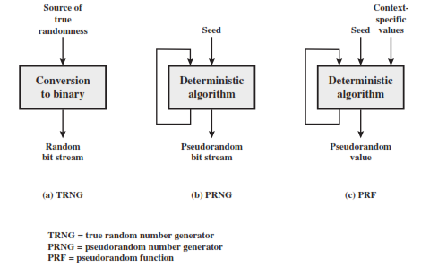

Slide 16
Introduction
Truly random - is defined as exhibiting ``true'' randomness, such as the time between ``tics'' from a Geiger counter exposed to a radioactive element
Pseudorandom - is defined as having the appearance of randomness, but nevertheless exhibiting a specific, repeatable pattern.
numbers calculated by a computer through a deterministic process, cannot, by definition, be random

Slide 17
Introduction
Given knowledge of the algorithm used to create the numbers and its internal state (i.e. seed), you can predict all the numbers returned by subsequent calls to the algorithm, whereas with genuinely random numbers, knowledge of one number or an arbitrarily long sequence of numbers is of no use whatsoever in predicting the next number to be generated.
Computer-generated "random" numbers are more properly referred to as pseudorandom numbers, and pseudorandom sequences of such numbers.

Slide 18
Summary
We explored an example of PKC, i.e., RSA.
In today’s lecture we talked about the random numbers and the random number generators
We have also discussed random numbers and pseudorandom numbers.
The design constraints were also discussed.

Slide 19
Next lecture topics
Attacks on Pseudorandom generators
Tests for pseudorandom functions
True Random generators

Slide 20
The End

