Slide 1
Network Security
Lecture 17
Presented by: Dr. Munam Ali Shah

Slide 2
Summary of the Previous Lecture
We discussed stream ciphers and its working
We explored how stream ciphers are efficient when compared to block ciphers in terms of performance
Some examples of stream ciphers such as RC4, RC5 and blowfish etc. were explored

Slide 3
Summary of the previous Lecture
Stream Cipher Properties some design considerations are:
  long period with no repetitions
  statistically random
  depends on large enough key
  large linear complexity
  use of highly non-linear boolean functions
  C_{i} = M_{i} XOR StreamKey_{i}
Notes:
Criteria from Rueppel

Slide 4
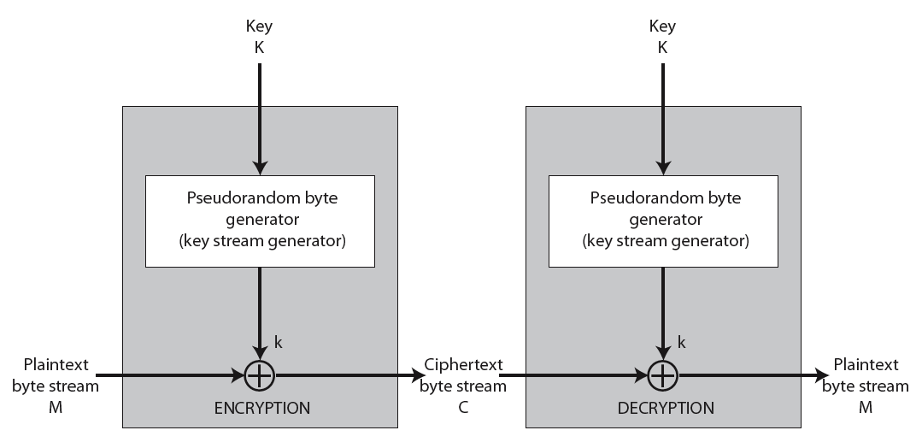
Stream Cipher Illustration

Slide 5
Summary of the Previous Lecture (RC4)
a proprietary cipher owned by RSA another Ron Rivest design, simple but effective
variable key size (1-256 bytes)
byte-oriented stream cipher
widely used (web SSL/TLS, wireless WEP)
key forms random permutation of all 8-bit values
uses that permutation to scramble input info processed a byte at a time
Remained trade secret till 1994

Slide 6
Part 2 (d)
Asymmetric Key Cryptography

Slide 7
Outlines of today’s lecture
We will explore the need, features and characteristics of public key cryptography
The working/function of a public key cryptography scheme will be discussed in detail
RSA, as an example, will be explained

Slide 8
Objectives
You would be able to present an understanding of the public key cryptography.
You would be able use and implement the RSA technique.

Slide 9
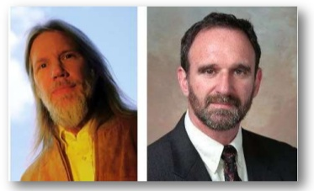
Different names
Public key cryptography
Asymmetric key cryptography
2 key cryptography
  Presented by Diffie & Hallman (1976)
    New directions in cryptography

Slide 10
Why Public-Key Cryptography?
Key distribution under symmetric encryption requires
  Two communicants already share a key
  The use of Key Distribution Center (KDC)
Whitfield Diffie & Martin Hellman reasoned
  2nd requirement neglected the essence of cryptography, i.e. the ability to maintain total secrecy over your own communication
  how to verify a message comes intact from the claimed sender?

Slide 11
Private-Key Cryptography
traditional private/secret/single key cryptography uses one key
shared by both sender and receiver
if this key is disclosed communications are compromised
also is symmetric, parties are equal
hence does not protect sender from receiver forging a message & claiming is sent by sender

Slide 12
Public-Key Cryptography
involves the use of two keys:
  a public-key, which may be known by anybody, and can be used to encrypt messages, and verify signatures
  a private-key, known only to the recipient, used to decrypt messages, and sign (create) signatures
is asymmetric because
  those who encrypt messages or verify signatures cannot decrypt messages or create signatures

Slide 13
Public-Key Characteristics
Public-Key algorithms rely on two keys where:
  it is computationally infeasible to find decryption key knowing only algorithm & encryption key
  it is computationally easy to en/decrypt messages when the relevant (en/decrypt) key is known
  either of the two related keys can be used for encryption, with the other used for decryption

Slide 14
Essential steps
Each user
  generates its pair of keys
  Places public key in public folder
  Bob encrypt the message using Alice’s public key for secure communication
  Alice decrypts it using her private key

Slide 15
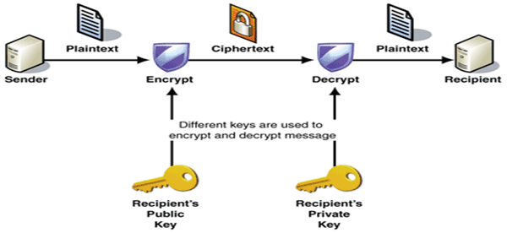

Slide 16
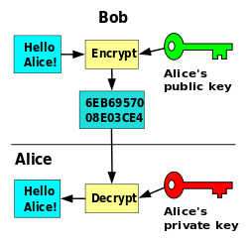

Slide 17
Asymmetric Key Cryptography
In symmetric cryptography:
  If Alice and Bob are physically apart and communicate, they have to agree on a key
    Meet personally, or
    Use trusted couriers
  Alice needs one secret key for Bob, one for Carol, one for Dave and so on
    Storage of so many secret keys is not feasible

Slide 18
Asymmetric Key Cryptography
In Asymmetric Key Cryptography:
  2 people who never met can communicate securely
  Alice can securely communicate with all her friends by storing just a single private key
  2 keys are used
    Public: known to everyone (for encryption or signature verification)
    Private: known to receiver only (for decryption or signature generation)

Slide 19
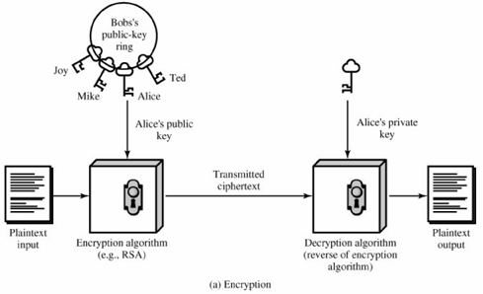
Public-Key Cryptography

Slide 20
Public-Key Cryptography
Plaintext
Encryption algorithm
Public and private keys
Ciphertext
Decryption algorithm

Slide 21
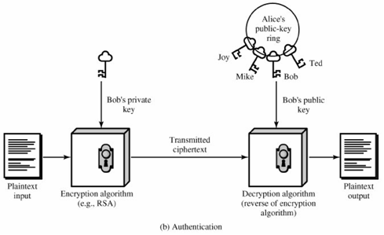
Public-Key Cryptography

Slide 22
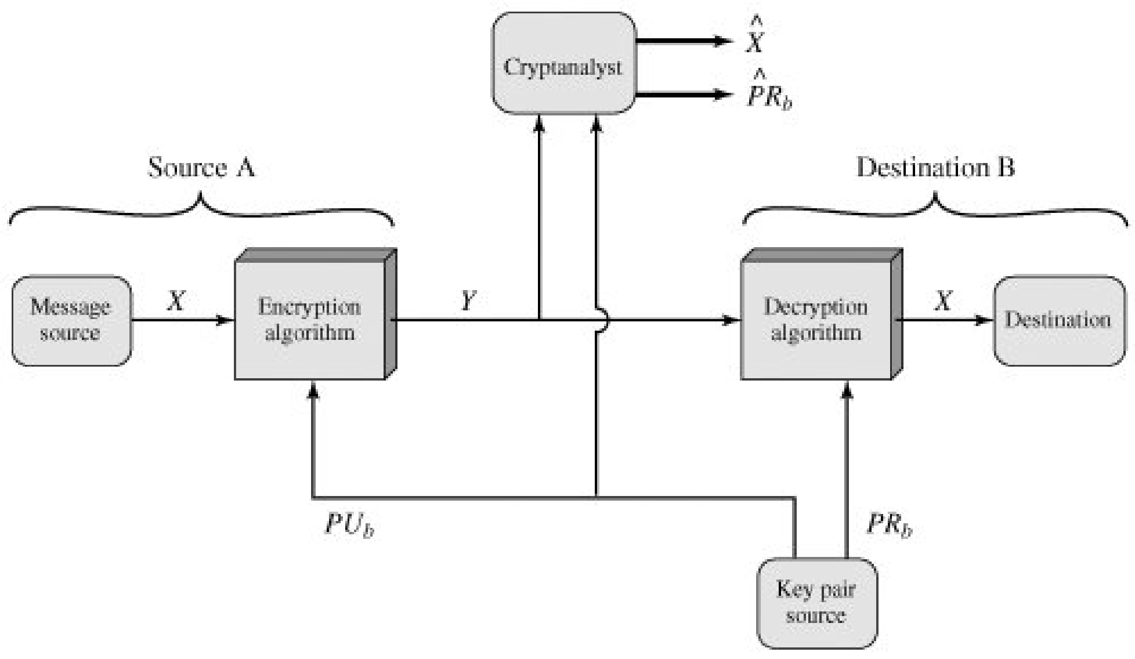
Confidentiality
Y = E(PU_{b}, X )
X = D(PR_{b}, Y )
Adversary can access PU_{b} and Y, attempt to recover X or PR_{b}

Slide 23
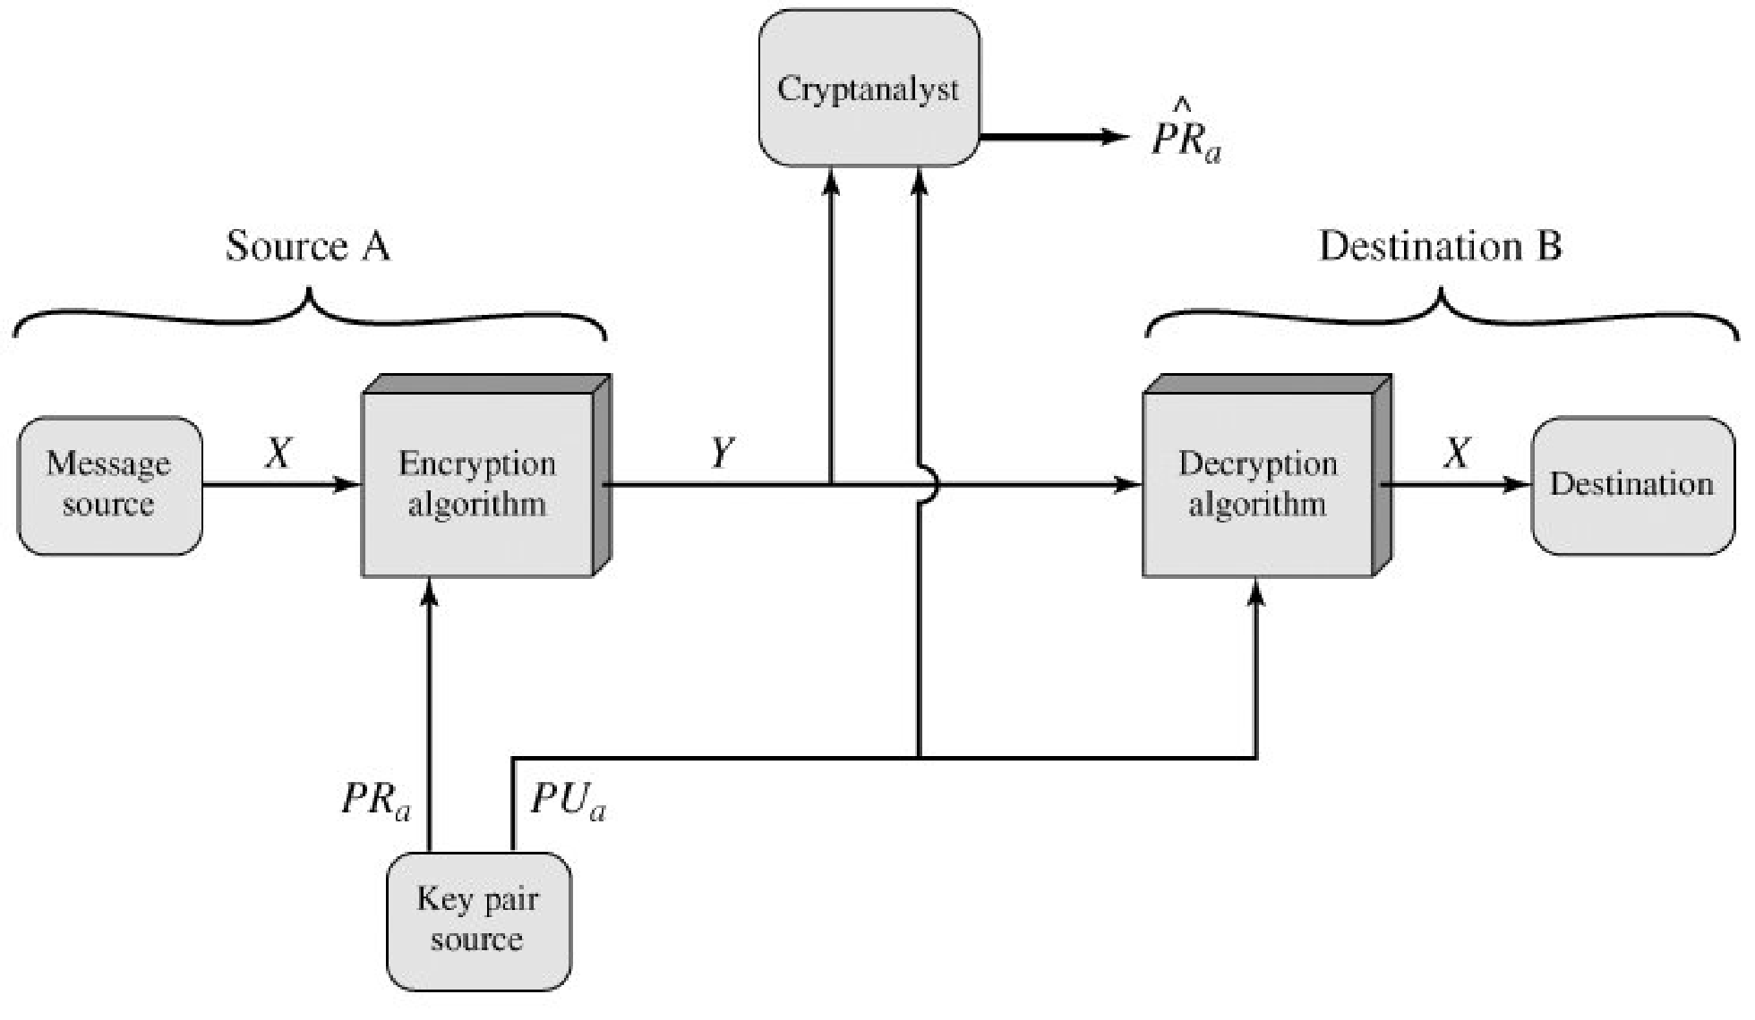
Integrity
Impossible to alter the message without access to A’s private key
Authenticate the source
Ensure data integrity

Slide 24
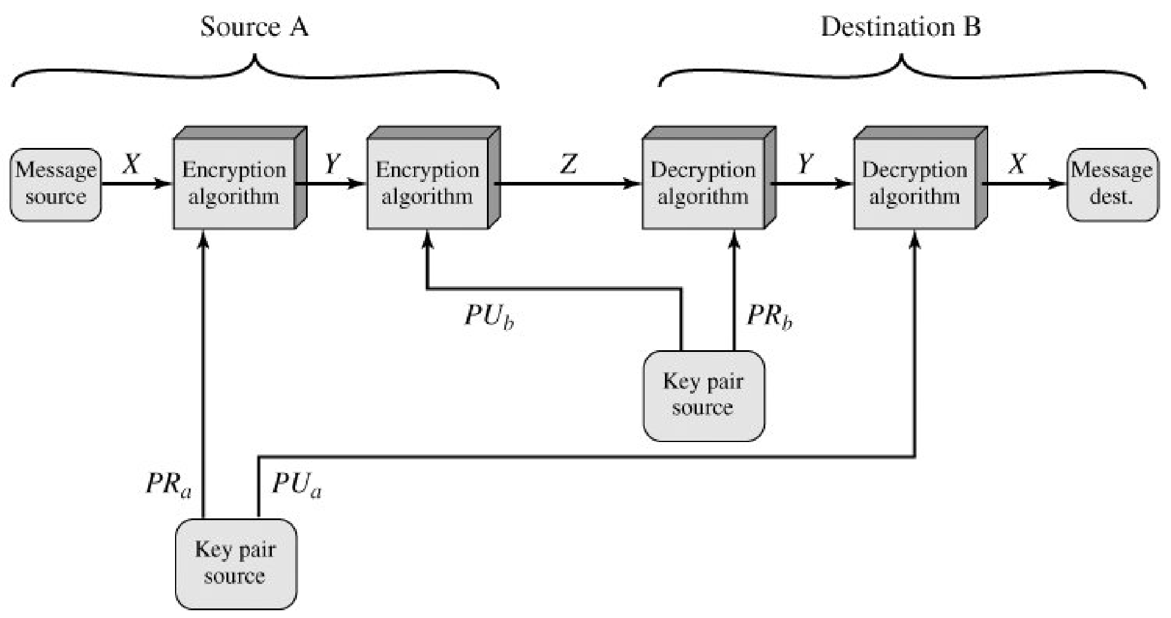
Authentication and Confidentiality
Z = E(PUb, E(PRa, X))
X = D(PUa, E(PRb, Z))
Overhead: public key algorithm executed four times

Slide 25
Public-Key Applications
can classify uses into 3 categories:
  encryption/decryption (provide secrecy)
  digital signatures (provide authentication)
  key exchange (of session keys)
Algorithm | En/decryption | Digital signature | Key exchange
RSA | Yes | Yes | Yes
Elliptic curve | Yes | Yes | Yes
Diffie Hellman | No | No | Yes
DSS | No | Yes | No

Slide 26
Requirements for Public key cryptography
Computationally easy
  for B to generate a pair of key (public and private)
  for sender A, knowing the public key and the message M to generate the ciphertext
  C = E(PU_{b}, M)
  for receiver B, to decrypt the ciphertext using its private key to recover M
  M = D(PR_{b}, C) = D(PR_{b}, E(PU_{b}, M) )
Computationally infeasible for an adversary
  knowing the PU_{b} to determine the private key PR_{b}
  knowing the PU_{b} and ciphertext C to recover M

Slide 27
Security of Public Key Schemes
like private key schemes brute force exhaustive search attack is always theoretically possible
keys used are too large (>512bits)
security relies on a large enough difference in difficulty between easy (en/decrypt) and hard (cryptanalyse) problems
requires the use of very large numbers
hence is slow compared to private/symmetric key schemes

Slide 28
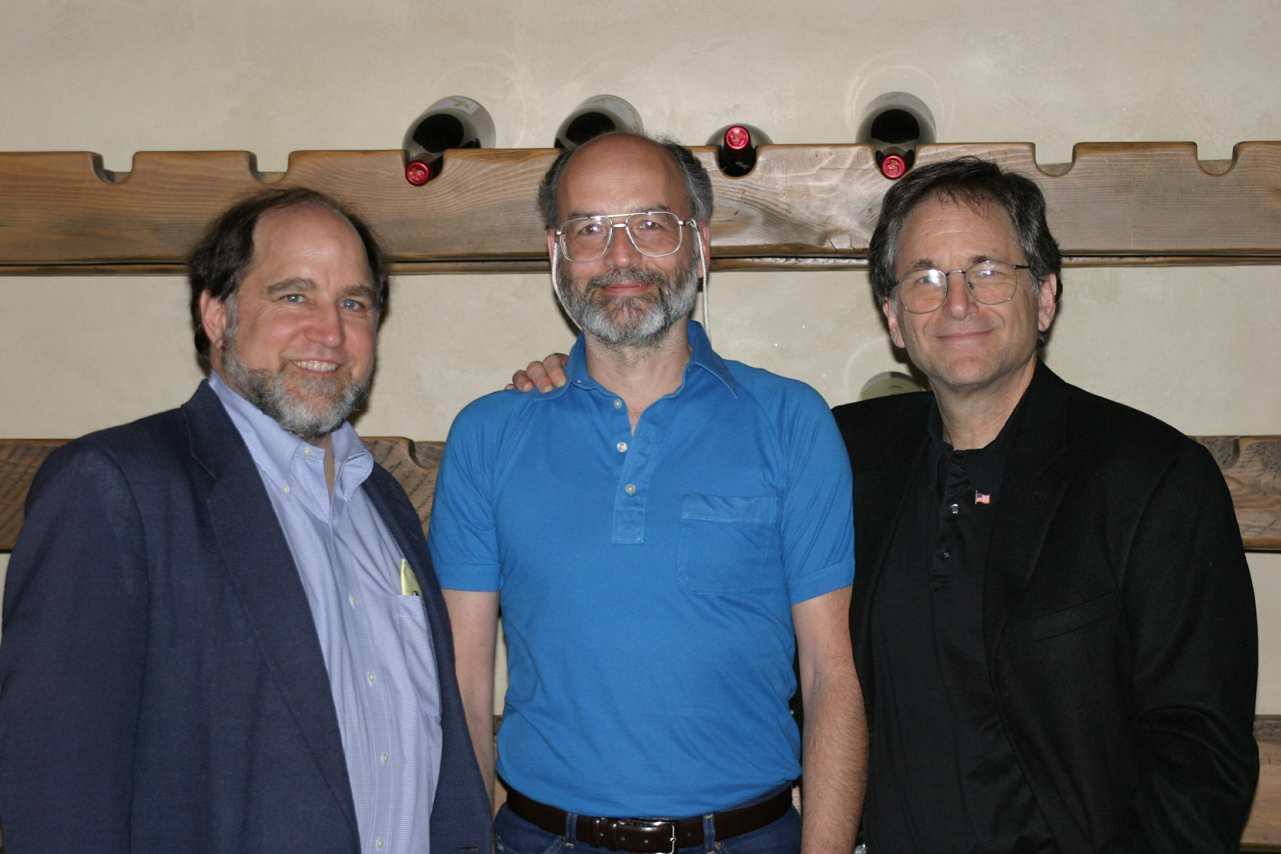
The RSA Algorithm
by Rivest, Shamir & Adleman of MIT in 1977
best known & widely used public-key scheme
Block cipher scheme: plaintext and ciphertext are integer between 0 to n-1 for some n
Use large integers e.g. n = 1024 bits

Slide 29
RSA Key Setup
each user generates a public/private key pair by:
selecting two large primes at random - p, q
Computing
  n=p.q
  ø(n)=(p-1)(q-1)
selecting at random the encryption key e
    where 1<e<ø(n), gcd(e,ø(n))=1
solve following equation to find decryption key d
  e.d=1 mod ø(n) and 0≤d≤n
publish their public encryption key: PU={e,n}
keep secret private decryption key: PR={d,n}

Slide 30
RSA Encryption / Decryption
to encrypt a message M the sender:
  obtains public key of recipient PU={e,n}
  computes: C = Me mod n, where 0≤M<n
to decrypt the ciphertext C the owner:
  uses their private key PR={d,n}
  computes: M = C^{d} mod n

Slide 31
RSA Example - Key Setup
Select primes: p=17 & q=11
Compute n = pq =17 x 11=187
Compute ø(n)=(p–1)(q-1)
=16 x 10=160
4. Select e: gcd(e,160)=1; choose e=7
5. Determine d:
d.e=1 mod 160 and
d < 160 Value is d=23 since 23x7=161
= 161 mod 160 = 1
Publish public key PU={7,187}
Keep secret private key PR={23,187}

Slide 32
RSA Example - En/Decryption
sample RSA encryption/decryption is:
given message M = 88 (nb. 88<187)
encryption:
  C = 88⁷ mod 187 = 11
decryption:
  M = 11²³ mod 187 = 88

Slide 33
Summary
We have discussed public/ asymmetric key cryptography in detail
We have explored how confidentiality, authentication and integrity could be achieved through public key cryptography

Slide 34
Next lecture topics
An example of RSA algorithm was discussed.
We will talk about random numbers.
The design constraints for random numbers and pseudo random numbers will be explored

Slide 35
The End

