Slide 1
Network Security
Lecture 16
Presented by: Dr. Munam Ali Shah

Slide 2
Part 2 (c)
Symmetric Key Cryptography
Stream Ciphers

Slide 3
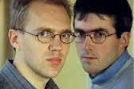
Summary of the Previous Lecture
Discussed AES which was designed by Rijmen and Daemen in Belgium
has 128/192/256 bit keys, 128 bit data
processes data as block of 4 columns
operates on entire data block in every round
designed to be:
  resistant against known attacks
  speed and code compactness on wide range of platforms
  design simplicity

Slide 4
AES Stages
Four stages of AES: (Permutation, Substitution)
  Substitute Byte : Each byte of the block is replaced by its substitution
  Shift Rows : 1-byte circular shift is performed
  Mix columns : each byte of a column is mapped in to a new value.
  Add round key: The block is XOR with subkey

Slide 5
Outlines of today’s lecture
Stream Cipher features and characteristics
We will explore RC4, RC5, Blowfish and Triple DES

Slide 6
Objectives
You would be able to present an understanding of the principles for stream and block ciphers.
You would be able use and understand the different techniques used for stream ciphers.

Slide 7
Block Cipher Characteristics
features seen in modern block ciphers are:
  variable key length / block size / no rounds
  mixed operators, data/key dependent rotation
  key dependent S-boxes
  more complex key scheduling
  operation of full data in each round
  varying non-linear functions

Slide 8
Stream Ciphers
process the message bit by bit (as a stream)
typically have a (pseudo) random stream key
combined (XOR) with plaintext bit by bit
randomness of stream key completely destroys any statistically properties in the message
  C_{i} = M_{i} XOR StreamKey_{i}
Keystream is XORed with plaintext bit by bit
but must never reuse stream key
  otherwise can remove effect and recover messages

Slide 9
Stream Cipher Properties
some design considerations are:
  long period with no repetitions
  statistically random
  depends on large enough key
  large linear complexity
  use of highly non-linear boolean functions
Notes:
Criteria from Rueppel

Slide 10
Stream Ciphers
Message is processed bit by bit or byte by byte as a stream
A key stream is used which is generated using a pseudo random number generator

Slide 11

Stream Ciphers
Randomness of keystream completely destroys statistical properties in message
C_{i} = M_{i} Keystream_{i}

Slide 12
Stream Ciphers
The basic idea is borrowed from One Time Pad
C_{i} = P_{i} K_{i}
P_{i} = C_{i} K_{i}
The main difference is random vs pseudorandom key stream
Basic idea of all stream ciphers is:
  Generate a key stream from a key
  Combine (XOR) the key stream with the plaintext
The most popular stream cipher is RC4

Slide 13
Stream Ciphers
The key stream appears to be random
  Number of 0s and 1s approximately equal
  All byte values approximately equal
Properly designed, can be as secure as a block cipher with same size key
Stream ciphers are much faster and simpler than block ciphers but key cannot be reused

Slide 14
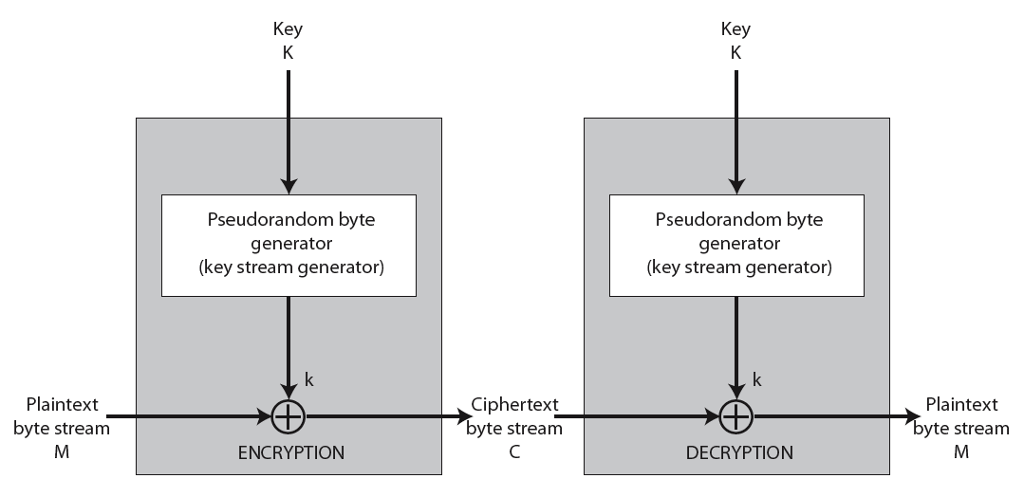
Stream Cipher Illustration

Slide 15
RC4
a proprietary cipher owned by RSA another Ron Rivest design, simple but effective
variable key size (1-256 bytes)
byte-oriented stream cipher
widely used (web SSL/TLS, wireless WEP)
key forms random permutation of all 8-bit values
uses that permutation to scramble input info processed a byte at a time
Remained trade secret till 1994

Slide 16
RC4 Working
Initialize state vector S
Permute S
Generate key stream

Slide 17
RC4 Working
Initialize S
  for i = 0 to 255 do
    S[i] = i
    T[i] = K[i mod keylen]
    where K and T are vectors representing the key and the cascaded key, respectively

Slide 18
RC4 Working
Permute S
  j = 0
  for i = 0 to 255 do
    j = (j + S[i] + T[i])(mod 256)
    swap (S[i], S[j])

Slide 19
RC4 Working
Generate Key Stream
  i = j = 0
  for each message byte M_{i}
    i = (i + 1) (mod 256)
    j = (j + S[i]) (mod 256)
    swap(S[i], S[j])
    t = (S[i] + S[j]) (mod 256)
    C_{i} = M_{i} XOR S[t]

Slide 20
RC4 Security
Key should not be reused
No practical attacks reported
Attack against WEP using RC4 is reported but it is due to key handling rather than RC4 itself

Slide 21
Triple DES
clear a replacement for DES was needed
  theoretical attacks that can break it
  demonstrated exhaustive key search attacks
AES is a new cipher alternative
prior to this alternative was to use multiple encryption with DES implementations
Triple-DES is the chosen form

Slide 22
Triple-DES with Two-Keys
Uses 3 encryptions
  would seem to need 3 distinct keys
but can use 2 keys with E-D-E sequence
  C = E_{K1}[D_{K2}[E_{K3}[P]]]
  encrypt & decrypt equivalent in security
  if K1=K2 then can work with single DES
standardized in ANSI X9.17 & ISO8732
no current known practical attacks
Notes:
Triple-DES with two keys is a popular alternative to single-DES, but suffers from being 3 times slower to run.
Although there are no practical attacks, have some indications of attack approaches.
Hence some are now adopting Triple-DES with three keys for greater sucurity.

Slide 23
Triple-DES with Three-Keys
although are no practical attacks on two-key Triple-DES have some indications
can use Triple-DES with Three-Keys to avoid even these
has been adopted by some Internet applications, eg PGP, S/MIME
Triple-DES with two keys is a popular alternative to single-DES, but suffers from being 3 times slower to run.
Although there are no practical attacks, have some indications of attack approaches.
Hence some are now adopting Triple-DES with three keys for greater security.

Slide 24

Blowfish
a symmetric block cipher designed by Bruce Schneier in 1993/94
characteristics
  fast implementation on 32-bit CPUs
  compact in use of memory
  simple structure eases analysis/implementation
  variable security by varying key size
has been implemented in various products

Slide 25
Blowfish Key Schedule
uses a 32 to 448 bit key
used to generate
  18 32-bit subkeys stored in K-array K_{j}
  four 8x32 S-boxes stored in S_{i,j}
key schedule consists of:
  initialize P-array and then 4 S-boxes using pi
  XOR P-array with key bits (reuse as needed)
  loop repeatedly encrypting data using current P & S and replace successive pairs of P then S values
  requires 521 encryptions, hence slow in rekeying

Slide 26
Discussion
key dependent S-boxes and subkeys, generated using cipher itself, makes analysis very difficult
changing both halves in each round increases security
provided key is large enough, brute-force key search is not practical, especially given the high key schedule cost

Slide 27
RC5
a proprietary cipher owned by RSADSI
designed by Ronald Rivest (of RSA fame)
used in various RSADSI products
can vary key size / data size / no rounds
very clean and simple design
easy implementation on various CPUs
yet still regarded as secure

Slide 28
RC5 Ciphers
RC5 is a family of ciphers RC5-w/r/b
  w = word size in bits (16/32/64) nb data=2w
  r = number of rounds (0..255)
  b = number of bytes in key (0..255)
nominal version is RC5-32/12/16
  i.e., 32-bit words so encrypts 64-bit data blocks
  using 12 rounds
  with 16 bytes (128-bit) secret key

Slide 29
RC5 Key Expansion
RC5 uses 2r+2 subkey words (w-bits)
subkeys are stored in array S[i], i=0..t-1
then the key schedule consists of
  initializing S to a fixed pseudorandom value, based on constants e and phi
  the byte key is copied (little-endian) into a c-word array L
  a mixing operation then combines L and S to form the final S array

Slide 30
RC5 Encryption
split input into two halves A & B
  L₀ = A + S[0];
  R₀ = B + S[1];
each round is like 2 DES rounds
note rotation is main source of non-linearity
need reasonable number of rounds (eg 12-16)

Slide 31
RC5 Modes
RFC2040 defines 4 modes used by RC5
  RC5 Block Cipher, is ECB mode
  RC5-CBC, is CBC mode
  RC5-CBC-PAD, is CBC with padding by bytes with value being the number of padding bytes
  RC5-CTS, a variant of CBC which is the same size as the original message, uses ciphertext stealing to keep size same as original

Slide 32
RC4 Security
claimed secure against known attacks
  have some analyses, none practical
result is very non-linear
since RC4 is a stream cipher, must never reuse a key
have a concern with WEP, but due to key handling rather than RC4 itself
Notes:
RC4 is widely used, in SSL for secure web transactions amongst other uses. Currently its regarded as quite secure, if used correctly.

Slide 33
Summary
We have discussed stream ciphers and have explored how they work. Some symmetric stream ciphers were discussed in detail such as:
    RC4
    Triple DES
    RC5
    Blowfish

Slide 34
Next lecture topics
We will move to the part (d) i.e.,
Public key cryptography

Slide 35
The End

