Slide 1
Network Security
Lecture 15
Presented by: Dr. Munam Ali Shah

Slide 2
Part 2 (c)
Symmetric Key Cryptography

Slide 3
Summary of the previous lecture
We had a discussion on block cipher and stream cipher.
We discussed in detail the symmetric key cryptography.
We explored Feistel Cipher and its structure
The DES was also discussed in detail

Slide 4
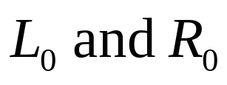

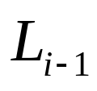
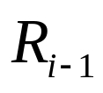
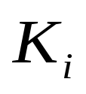

Feistel Cipher
The plaintext is divided into two halves
The two halves pass through n rounds of processing then combine to produce the cipher block.
Each round has as input and derived from the previous round as well as a sub-key derived from the overall
All rounds have the same structure
A substitution is performed on the left half of the data. This is done by applying a round function F to the right half of the data followed by the XOR of the output of that function and the left half of the data.

Slide 5
Design Features of Feistel Network
Block Size: (larger block means greater security) 64 bits.
Key Size:56-128 bits.
Number of Rounds: a single round offers inadequate security, a typical size is 16 rounds.
Sub-key Generation Algorithms: greater complexity should lead to a greater difficulty of cryptanalysis.
Round function: Again, greater complexity generally means greater resistance to cryptanalysis.

Slide 6
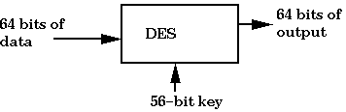
A simple way to represent DES

Slide 7
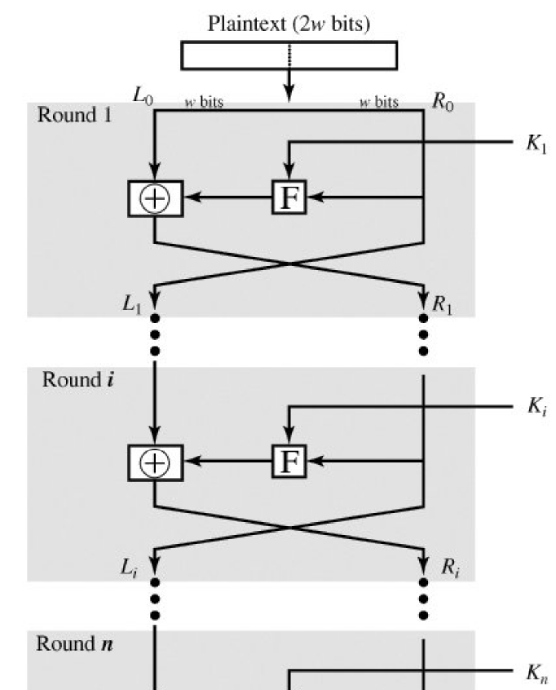
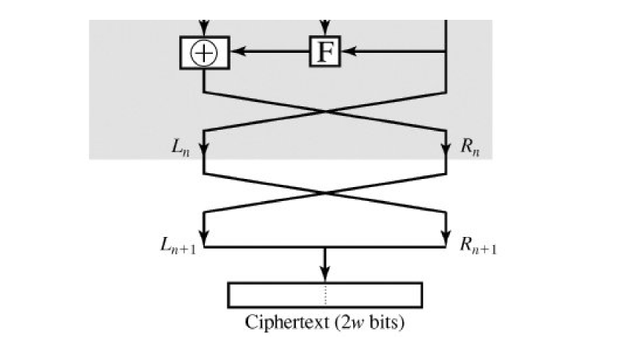
Classical Feistel
Network

Slide 8
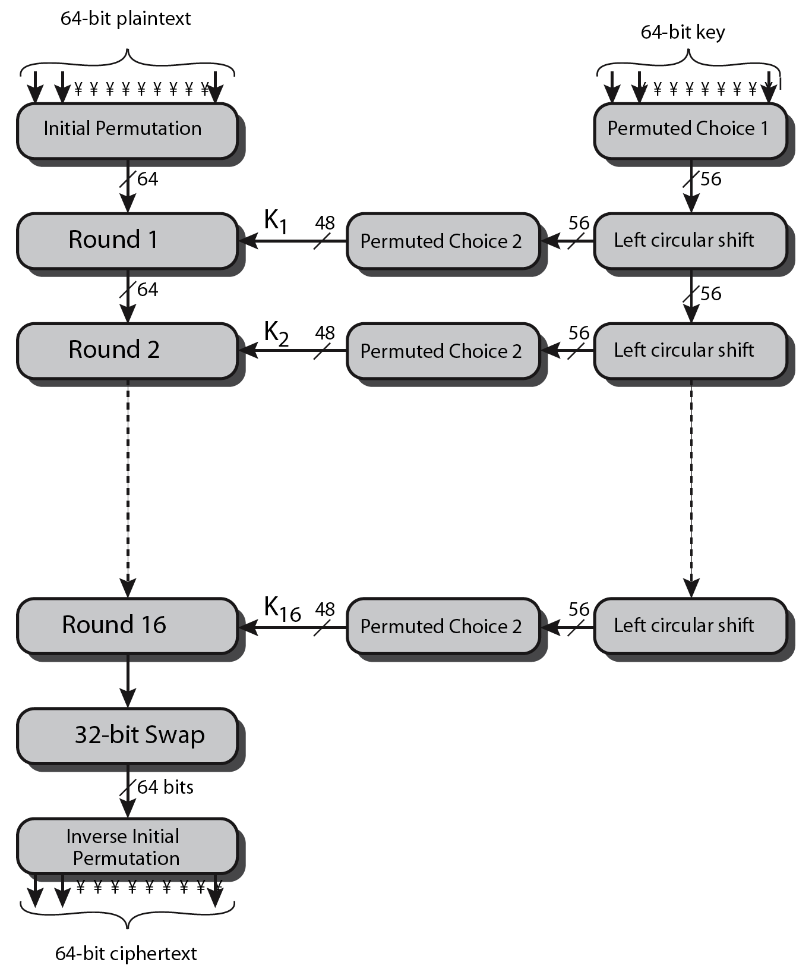

Slide 9
Outlines of today’s lecture
Block Cipher Principles
We will explore the limitations of DES
Another symmetric key cryptography that is Advanced Encryption Standard (AES) will also be discussed.

Slide 10
Objectives
You would be able to present an understanding of Symmetric Key Cryptography.
You would be able use understand the phases involved in DES.

Slide 11
Block Cipher Principles
Most symmetric block ciphers are based on a Feistel Cipher Structure
Input: n bits plaintext block
Output: n bits ciphertext block
For 2 bits, there are 2^{n} possible plaintext block
Reversible mapping
Plaintext | Ciphertext
00 | 11
01 | 10
10 | 00
11 | 01
Irreversible mapping
Plaintext | Ciphertext
00 | 11
01 | 10
10 | 00
11 | 10
Notes:
Most symmetric block encryption algorithms in current use are based on a structure referred to as a Feistel block cipher. A block cipher operates on a plaintext block of n bits to produce a ciphertext block of n bits. An arbitrary reversible substitution cipher for a large block size is not practical, however, from an implementation and performance point of view. In general, for an n-bit general substitution block cipher, the size of the key is n x 2^{n}. For a 64-bit block, which is a desirable length to thwart statistical attacks, the key size is 64 x 2⁶⁴ = 2⁷⁰ = 10²¹ bits. In considering these difficulties, Feistel points out that what is needed is an approximation to the ideal block cipher system for large n, built up out of components that are easily realizable.

Slide 12
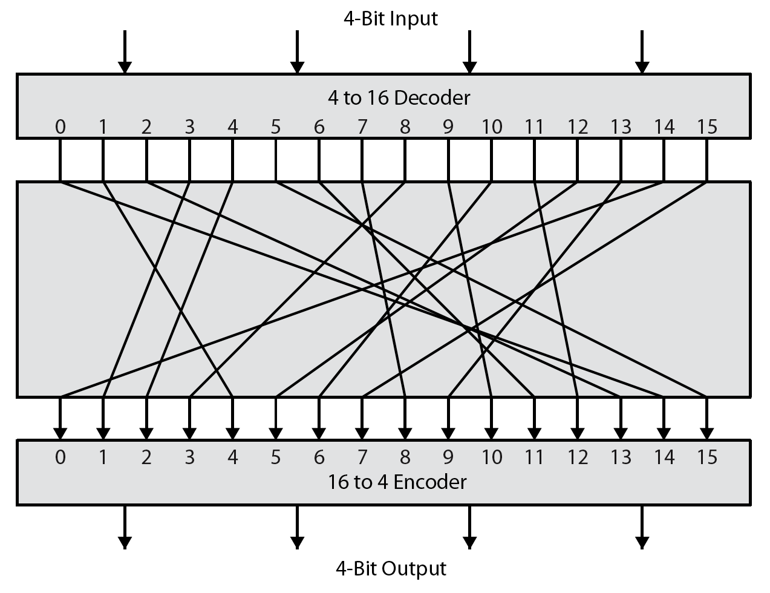
Ideal Block Cipher
Notes:
Feistel refers to an n-bit general substitution as an ideal block cipher, because it allows for the maximum number of possible encryption mappings from the plaintext to ciphertext block. A 4-bit input produces one of 16 possible input states, which is mapped by the substitution cipher into a unique one of 16 possible output states, each of which is represented by 4 ciphertext bits. The encryption and decryption mappings can be defined by a tabulation, as shown in Stallings Figure 3.1. It illustrates a tiny 4-bit substitution to show that each possible input can be arbitrarily mapped to any output - which is why its complexity grows so rapidly.

Slide 13
Ideal Block Cipher: Practical problem
Small block size e.g. n = 4 is used => equivalent to classical substitution cipher
Vulnerable to statistical analysis attack
Weakness is not in substitution but rather in small block size
n should be sufficiently large and substitution is reversible then Statistical characteristics of plaintext are masked so that cryptanalysis is infeasible
Notes:
Then the

Slide 14
Ideal block cipher: key length
Mapping from plaintext to ciphertext constitutes the key
For n = 4, the required length of key is
  4 bits x 2^{n} rows = 64 bits
For n = 64, the required key length is
  64 x 2⁶⁴ = 2⁷⁰

Slide 15
Advanced Encryption Standard
A new standard was needed primarily because DES has a relatively small 56-bit key which was becoming vulnerable to brute force attacks.
In addition, the DES was designed primarily for hardware and is relatively slow when implemented in software.
While Triple-DES avoids the problem of a small key size, it is very slow even in hardware; it is unsuitable for limited-resource platforms; and it may be affected by potential security issues connected with the (today comparatively small) block size of 64 bits.

Slide 16
Origins: AES
Clearly a replacement for DES was needed
  have theoretical attacks that can break it
  have demonstrated exhaustive key search attacks
can use Triple-DES – but slow, has small blocks
US NIST issued call for ciphers in 1997
15 candidates accepted in Jun 98
5 were shortlisted in Aug-99
Rijndael was selected as the AES in Oct-2000
Issued as FIPS PUB 197 standard in Nov-2001

Slide 17
AES Requirements
Private key symmetric block cipher
128-bit data, 128/192/256-bit keys
Stronger & faster than Triple-DES
Active life of 20-30 years
Provide full specification & design details
Both C & Java implementations

Slide 18
AES Evaluation Criteria
Security
  Effort required to crypt-analyze an algorithm
  Since key size is 128 bits so cryptanalysis other than brute force is considered
Cost
  Must have high computational efficiency
Algorithm and implementation characteristics
  Suitable for software and hardware implementation
  Simplicity: which will make an analysis of security more straightforward

Slide 19

The AES Cipher - Rijndael
Designed by Rijmen and Daemen in Belgium
has 128/192/256 bit keys, 128 bit data
processes data as block of 4 columns
operates on entire data block in every round
designed to be:
  resistant against known attacks
  speed and code compactness on wide range of platforms
  design simplicity

Slide 20
Overview
Open call for the algorithm by NIST
Standardized in May 26, 2002
Winner: Rijndael algorithm
  Developed by two Belgian Cryptographers
    Dr. Joan Daemen
    Dr. Vincent Rijmen
3DES Problems
  In-efficient
  Used only 64 bit block
Fixed block size of 128 bits
Key size of 128, 192 or 256 bits

Slide 21
AES Stages
Four stages of AES: (Permutation, Substitution)
  Substitute Byte : Each byte of the block is replaced by its substitution
  Shift Rows : 1-byte circular shift is performed
  Mix columns : each byte of a column is mapped in to a new value.
  Add round key: The block is XOR with subkey

Slide 22
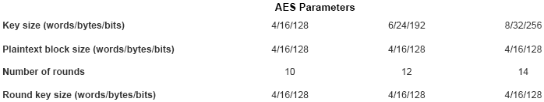
AES Structure
For Both encryption and decryption the cipher begins with
  An add round key stage
  Nine rounds that each include four stages
  Tenth round of three stages (excluding mix columns)

Slide 23
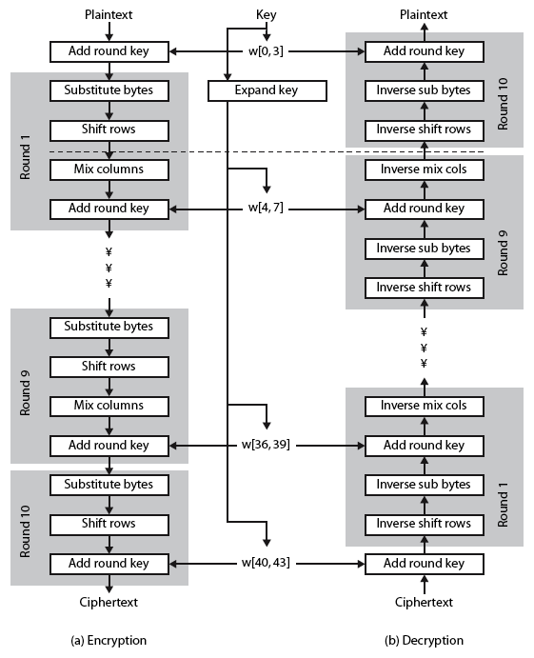

Slide 24
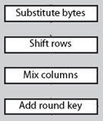
1- Substitute Byte Transformation
AES defines a 16 x 16 matrix of byte values called S-box.
Each individual byte of the state is mapped into new byte as follows
  Leftmost 4 bits are used as row value
  Right most 4 bits are used as column values
Note: rows and column values serve as indexes into the S-box to a selected 8-bit value

Slide 25
2- Shift Row Transformation
87 | F2 | 4D | 97
EC | 6E | 4C | 90
4A | C3 | 46 | E7
8C | D8 | 95 | A6
87 | F2 | 4D | 97
6E | 4C | 90 | EC
46 | E7 | 4A | C3
A6 | 8C | D8 | 95
First row in the state is not altered
1 byte circular shift is performed for second row
2 byte cicular shift is performed with third row
3 byte circular shift is performed with fourth row
Forward shift row transformation --- left shift
Inverse shift row transformation --- right shift

Slide 26
3- Mix Column Transformation
Each byte (new) in the column is a function of all four bytes in the column
Each 128 bit block would be multiply
with
Each element in the product matrix is the sum of the product of the elements of one row and column of other matrix.
Multiplication with 2 is one bit left shift
  If leftmost bit of original value is 1, a bitwise XOR with 0001 1011 will be performed
02 | 03 | 01 | 01
01 | 02 | 03 | 01
01 | 01 | 02 | 03
03 | 01 | 01 | 02

Slide 27
4- Add Round key
128 bits of the block are XORed with 128 bits of round key
47 | 40 | A3 | 4C
37 | D4 | 70 | 9F
94 | E4 | 3A | 42
ED | A5 | A6 | BC
AC | 19 | 28 | 57
77 | FA | D1 | 5C
66 | DC | 29 | 00
F3 | 21 | 41 | 6A
EB | 59 | 8B | 1B
40 | 2E | A1 | C3
F2 | 38 | 13 | 42
1E | 84 | E7 | D2
⊕
=
Key expansion algorithm takes input 4 words (16 byte) and produce 44 words (156 byte)
4 words round key is used for each round.

Slide 28
AES Process
Plain text
Cipher key
⊕
Initial round
Add round key
Substitute byte
Shift rows
Mix columns
Round key
⊕
9 rounds
Add round key
Substitute byte
Shift rows
Round key
final rounds
Add round key
⊕
Cipher text

Slide 29
Key Expansion 1/2
Input is cipher key = 128 bits = 16 bytes = 4 words
Output = 1248 bits = 156 bytes = 44 words
The key expansion algorithm reduced cryptoanalysis attacks, it eliminates the symmetry.
Cipher key is used in initial round.

Slide 30

Cipher Example
Input = 32 43 f6 a8 88 5a 30 8d 31 31 98 a2 e0 37 07 34
Cipher Key = 2b 7e 15 16 28 ae d2 a6 ab f7 15 88 09 cf 4f 3c
Round
Number
Start of
Round
After
Sub Bytes
After
Shift Rows
After
Mix Columns
Round Key
Value
32
a4
eb
88
68
59
31
6b
8b
e0
02
1b
e9
e9
cb
cb
3d
3d
af
af
2b
d0
28
c9
ab
e1
09
b6
43
9c
40
5a
9f
2e
31
5b
a1
37
6a
c3
09
09
31
31
32
32
2e
2e
7e
14
ae
ee
f7
3f
cf
63
Input
2nd
10th
=
f6
7f
f2
30
35
38
98
ea
13
07
50
42
89
89
07
07
7d
7d
2c
2c
15
f9
d2
25
15
0c
4f
0c
a8
f2
1e
8d
2b
84
a2
43
e7
34
49
d2
72
72
5f
5f
94
94
b5
b5
16
a8
a6
89
88
c8
32
a6
39
19
02
a0
dc
9a
19
e9
d4
d4
e0
e0
b8
b8
1e
1e
04
e0
48
28
a0
88
23
2a
25
3d
dc
f4
11
c6
6a
f8
27
27
bf
bf
b4
b4
41
41
66
cb
f8
06
fa
54
a3
6c
=
Output
1st
84
e3
09
e2
85
8d
0b
48
11
11
98
98
5d
5d
52
52
81
19
d3
26
fe
2c
39
76
1d
be
fb
2b
97
2a
32
08
ae
ae
f1
f1
e5
e5
30
30
e5
9a
7a
4c
17
b1
39
05
Notes:
30

Slide 31
Implementation Aspects
can efficiently implement on 8-bit CPU
  byte substitution works on bytes using a table of 256 entries
  shift rows is simple byte shift
  add round key works on byte XOR’s
  mix columns requires matrix multiply in GF(28) which works on byte values, can be simplified to use table lookups & byte XOR’s
Notes:
31
The Rijndael proposal [DAEM99] provides some suggestions for efficient implementation on 8- bit processors, typical for current smart cards, and on 32-bit processors, typical for PCs.
AES can be implemented very efficiently on an 8-bit processor.
AddRoundKey is a bytewise XOR operation.
ShiftRows is a simple byte shifting operation.
SubBytes operates at the byte level and only requires a lookup of a 256 byte table S.
MixColumns (matrix multiply) can be implemented as byte XOR’s & table lookups with a 2nd 256 byte table X2, using the formulae shown in Stallings equation 5.9.

Slide 32
Implementation Aspects
  can efficiently implement on 32-bit CPU
  redefine steps to use 32-bit words
  can precompute 4 tables of 256-words
  then each column in each round can be computed using 4 table lookups + 4 XORs
  at a cost of 4Kb to store tables
  designers believe this very efficient implementation was a key factor in its selection as the AES cipher
Notes:
32
AES can also be very efficiently implemented on an 32-bit processor, by rewriting the stage transformation to use 4 table lookups & 4 XOR’s per column of state. These tables can be computed in advance using the formulae shown in the text, and need 4Kb to store.
The developers of Rijndael believe that this compact, efficient implementation was probably one of the most important factors in the selection of Rijndael for AES.

Slide 33
Summary of today’s lecture
We discussed the Block Cipher Principles
We also explored the limitations of DES
Another symmetric key cryptography that is Advanced Encryption Standard (AES) will discussed in detail .

Slide 34
Next lecture topics
Our discussion on symmetric key cryptography will continue and we will see some example of stream ciphers such as RC4.

Slide 35
The End

