Slide 1
Network Security
Lecture 14
Presented by: Dr. Munam Ali Shah

Slide 2
Summary of the previous lecture
We discussed another technique of Substitution Cipher, i.e., Vigenere Cipher in which we have key and plain text of same size. We use rows and columns and create cipher text
We also discussed OTP and have seen that the security is unbreakable but it is impractical because
    Generating large quantities of random keys is an issue
    Key cannot be repeated
    Distribution of keys is an even bigger issue
Lastly, we discussed Transposition Cipher and two techniques, i.e., Rail Fence Cipher and Row Cipher with examples were discussed .

Slide 3
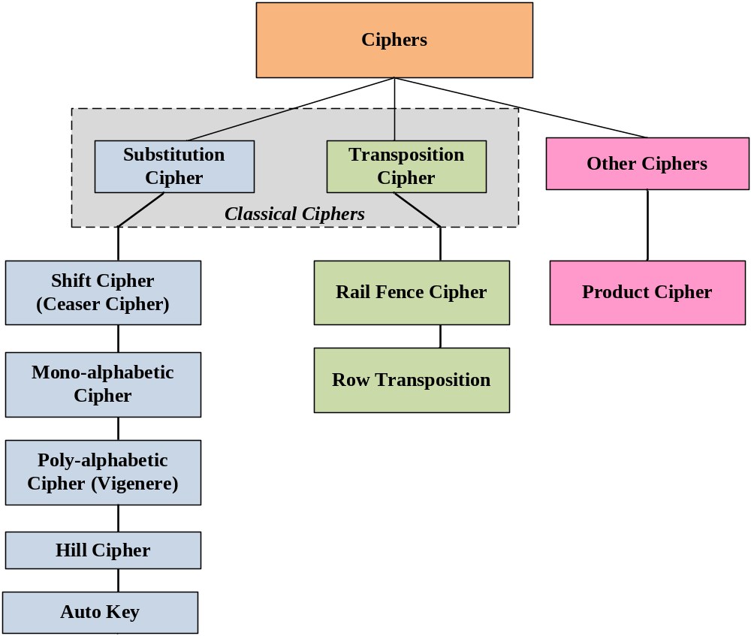

Slide 4
Part 2 (c)
Symmetric Key Cryptography

Slide 5
Outlines of today’s lecture
We will explore block ciphers and stream ciphers with some examples.
Second dimension of the cryptography
What is Fesitel Structure and why is it used will also be part of today’s lecture
Importantly, we will discuss Data Encryption Standard (DES)

Slide 6
Objectives
You would be able to present an understanding of Symmetric Key Cryptography.
You would be able use understand the phases involved in DES.

Slide 7
Symmetric Key Cryptography
Symmetric key
  Encryption and Decryption keys are the same, or
  Decryption key can be easily calculated from encryption key
  Examples:
    Classical ciphers
    DES
    AES
Also called, Classical Encryption, Private key cryptography, single key cryptography

Slide 8
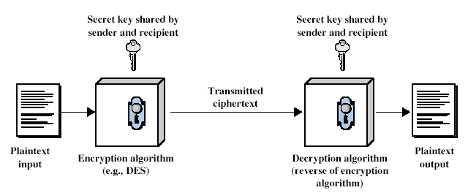
Symmetric Key Cryptography

Slide 9
Symmetric Key Cryptography
Mathematically, we represent encryption process by
  C = E_{K}(P) or C = E(K,P)
and decryption process by
  P = D_{K}(C) or P = D(K,C)
where
    P: Plaintext,
    C: Ciphertext,
    K:Symmetric key,
    E: Encryption algorithm,
    D: Decryption algorithm

Slide 10
Block Ciphers
The most widely used block cipher is Data Encryption Standard (DES)
Structure of symmetric block ciphers is very complex as compared to asymmetric ciphers

Slide 11
Stream Vs Block Ciphers
A stream cipher is one that encrypts a digital data stream one bit or one byte at a time.
  Examples are Vernam cipher; RC-4; SEAL
A block cipher is one in which a block of plaintext is treated as a whole
  Examples are DES, AES, 3DES, IDEA, Blowfish, Twofish.

Slide 12
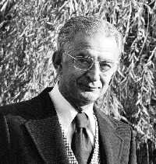
Feistel Cipher
Horst Feistel was a German-born cryptographer who worked on the design of ciphers at IBM, initiating research that culminated in the development of the Data Encryption Standard in the 1970s
Horst Feistel devised the feistel cipher
  based on concept of invertible product cipher

Slide 13
Feistel Cipher Structure
Partitions input block into two halves
  process through multiple rounds which:
  perform a substitution on left data half
  based on round function of right half & sub key
  then have permutation swapping halves

Slide 14
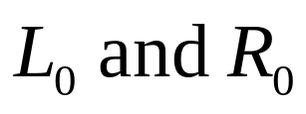

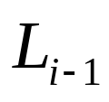
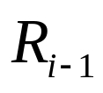
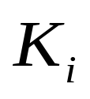

Feistel Cipher Structure (1973)
Virtually all conventional block encryption algorithms including data encryption standard (DES) are based on Feistel Cipher Structure.
The plaintext is divided into two halves
Then the two halves pass through n rounds of
processing then combine to produce the cipher
block.
Each round has as input and derived from the previous round as well as a sub-key derived from the overall

Slide 15

Feistel Cipher Structure (1973)
All rounds have the same structure
A substitution is performed on the left half of the data. This is done by applying a round function to the right half of the data followed by the XOR of the output of that function and the left half of the data.

Slide 16
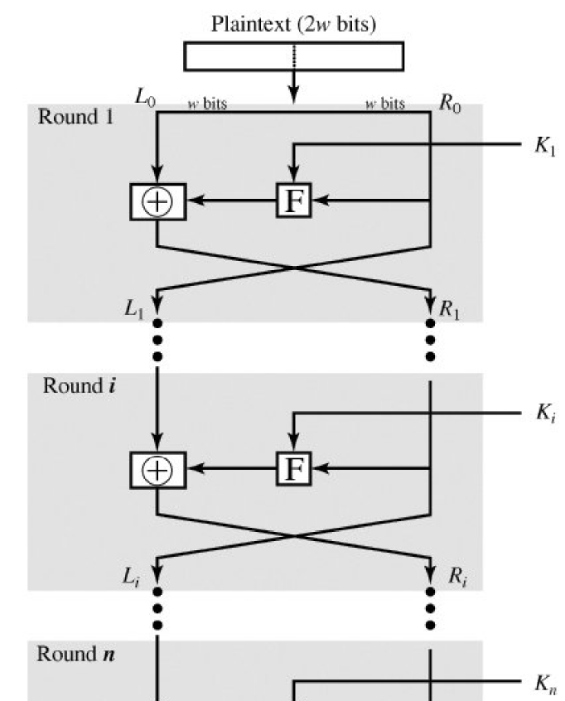
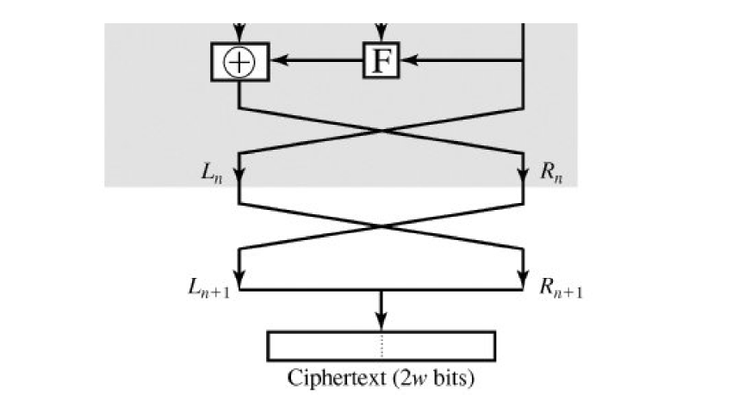
Classical Feistel
Network

Slide 17
Design Features of Feistel Network
Block Size: (larger block means greater security) 64 bits.
Key Size:56-128 bits.
Number of Rounds: a single round offers inadequate security, a typical size is 16 rounds.
Sub-key Generation Algorithms: greater complexity should lead to a greater difficulty of cryptanalysis.
Round function: Again, greater complexity generally means greater resistance to cryptanalysis.

Slide 18
Design Features of Feistel Network
Round function: Again, greater complexity generally means greater resistance to cryptanalysis.
Fast Software encryption/Decryption: the speed of execution of the algorithm is important.
Ease of Analysis: to be able to develop a higher level of assurance as to its strength
Decryption: use the same algorithm with reversed keys.

Slide 19
Feistel Decryption
Decryption works the same way with same number of steps and same key but in inverse order.

Slide 20
Data Encryption Standard
The Data Encryption Standard used to be a predominant symmetric-key algorithm for the encryption of electronic data.
It was highly influential in the advancement of modern cryptography in the academic world.
Developed in the early 1970s at IBM and based on an earlier design by Horst Feistel, the algorithm was submitted to the National Bureau of Standards (NBS) for the protection of sensitive, unclassified electronic government data.

Slide 21
A Brief History of DES
In 1974, IBM proposed "Lucifer", an encryption algorithm that uses 64-bit keys. Two years later, NBS (in consultation with NSA) made a modified version of that algorithm into a standard.
DES takes in 64 bits of data, employs a 56-bit key, and executes 16 cycles of substitution and permutation before outputting 64 bits of encrypted data.

Slide 22
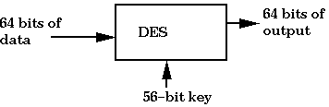
A simple way to represent DES

Slide 23
A Brief History of DES
In the summer of 1998, the Electronic Frontier Foundation (EFF) built a DES cracker machine at a cost of $250,000
It had 1536 chips, worked at a rate of 88 billion keys per second, and was able to break a DES encrypted message in 56 hours
One year later, with the cracker working in tandem with 100,000 PCs over the Internet, a DES encrypted message was cracked in only 22 hours.
One common way to make DES more secure today is to encrypt three times using DES.
  triple-DES (3DES).
  3DES is extremely slow, so a better algorithm was needed.

Slide 24
Simplified DES (S-DES)
Developed by Prof. Edward Schaefer of Santa Clara University 1996.
Takes 8 bit block of plain text and 10 bit key as input and produce an 8 bit block cipher text output.
The encryption algorithm involves 5 functions:
    initial permutation (IP);
    a complex function f_{k} which involves substitution and permutation depends on the key;
    simple permutation function (switch) SW;
    the function f_{k} again
    and final inverse of the initial permutation( IP⁻¹).

Slide 25

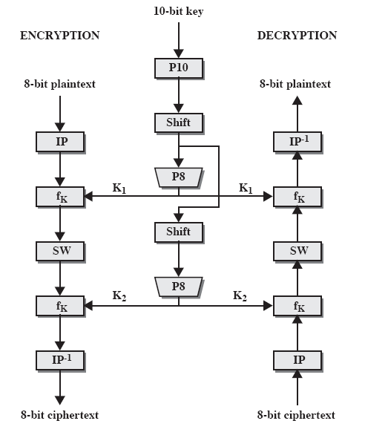
Simplified DES Scheme

Slide 26
DES Example
Let M be the plain text message
M = 0123456789ABCDEF, hexadecimal format.
M in binary format,
M = 0000 0001 0010 0011 0100 0101 0110 0111
1000 1001 1010 1011 1100 1101 1110 1111
L = 0000 0001 0010 0011 0100 0101 0110 0111
R = 1000 1001 1010 1011 1100 1101 1110 1111
The first bit of M is "0". The last bit is "1". We read from left to right.

Slide 27
DES operates on the 64-bit blocks using key sizes of 56- bits
The keys are actually stored as being 64 bits long, but every 8th bit in the key is not used (i.e. bits numbered 8, 16, 24, 32, 40, 48, 56, and 64)
Example: Let K be the hexadecimal key
K = 133457799BBCDFF1
K = 00010011 00110100 01010111 01111001
10011011 10111100 11011111 11110001

Slide 28
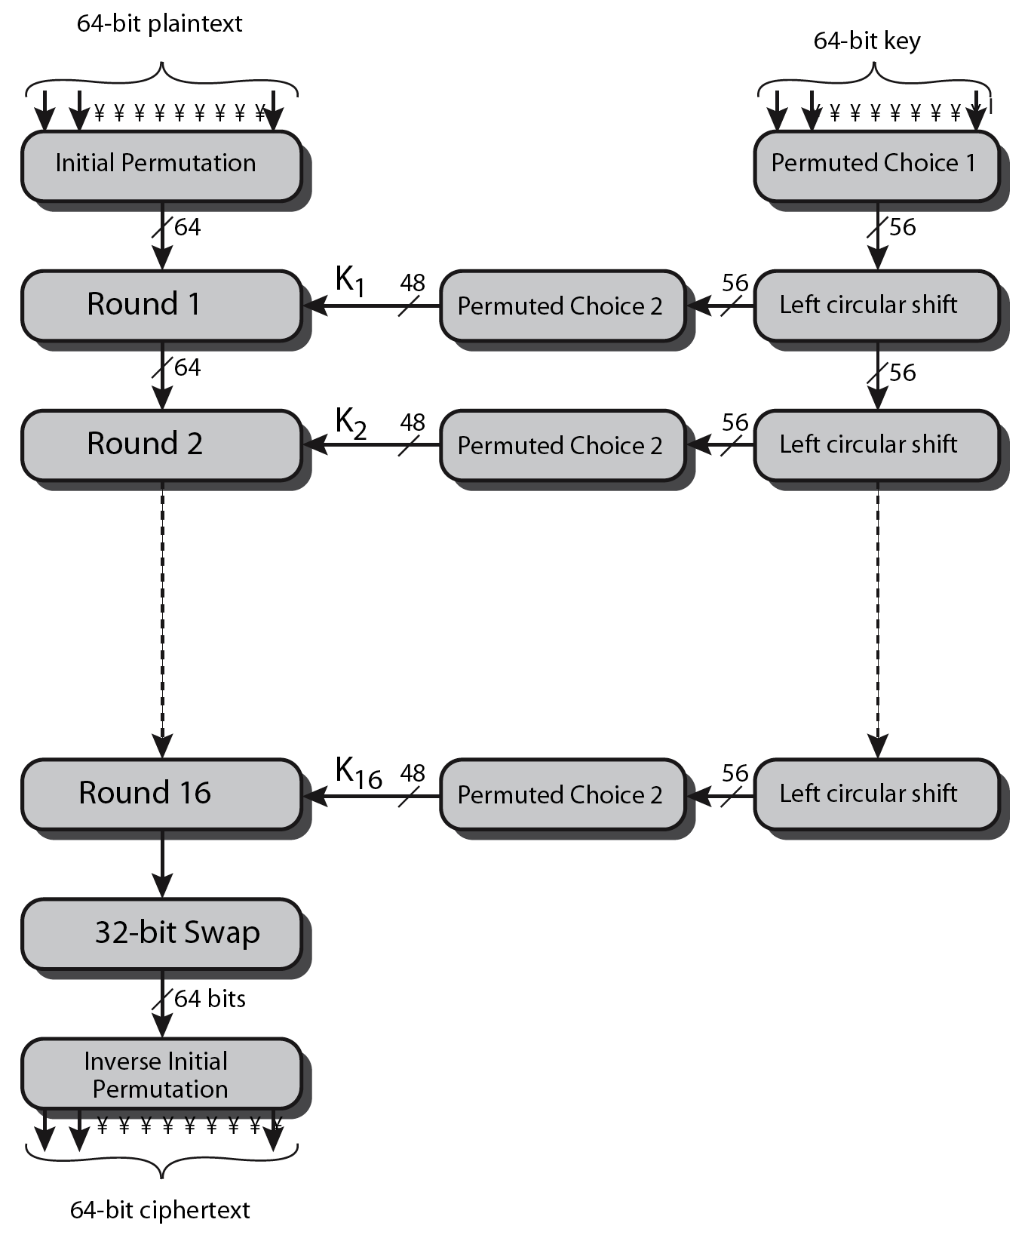

Slide 29
IP⁻¹ = 10000101 11101000 00010011 01010100 00001111 00001010 10110100 00000101 which in hexadecimal format is
85E813540F0AB405.
This is the encrypted form of
M = 0123456789ABCDEF: namely,
C = 85E813540F0AB405.
Decryption is simply the inverse of encryption, following the same steps as above, but reversing the order in which the subkeys are applied.

Slide 30
Summary of today’s lecture
We discussed symmetric key cryptography
We also discussed Fiestel Structure which is the basis of DES
Data Encryption Standard (DES) is a type of symmetric key cryptography which uses certain steps to obtain the cipher text through plain text.

Slide 31
Next lecture topics
Our discussion on symmetric key cryptography and will talk about Advanced Encryption Standard

Slide 32
The End

