Slide 1
Network Security
Lecture 13
Presented by: Dr. Munam Ali Shah

Slide 2
Part 2 (b)
Cryptography as a Network Security Tool

Slide 3
Summary of the previous lecture
We discussed more examples of Shift/Ceaser Cipher
We also discussed examples of mono-alphabetic cipher and poly-alphabetic cipher
More precisely, we explored how strong or weak a certain cryptographic scheme/algorithm can be.

Slide 4
Outlines of today’s lecture
Our discussion on more cryptographic schemes will continue.
Poly-alphabetic cipher will also be discussed
We will explore One Time Pad and OTP.
The security and practicality of OTP will also be discussed.
Transposition Cipher with an example of Rail Fence Cipher will form part of our today’s lecture.

Slide 5
Objectives
You would be able to present an understanding of transposition cipher.
You would be able use Rail Fence cipher

Slide 6
Polyalphabetic Ciphers
Improve security using different cipher letters for different occurrences of same plaintext letter
Make cryptanalysis harder with more letters to guess and flatter frequency distribution
Use a key to select which cipher letter is used for each letter of the message
Repeat from start after end of key is reached

Slide 7
Vigenère Cipher
Simplest polyalphabetic substitution cipher
Effectively multiple Caesar ciphers
Key is multiple letters long K = k₁ k₂ ... k_{d}
i^{th} letter specifies i^{th} alphabet to use
Repeat from start after d letters in message
Decryption simply works in reverse

Slide 8
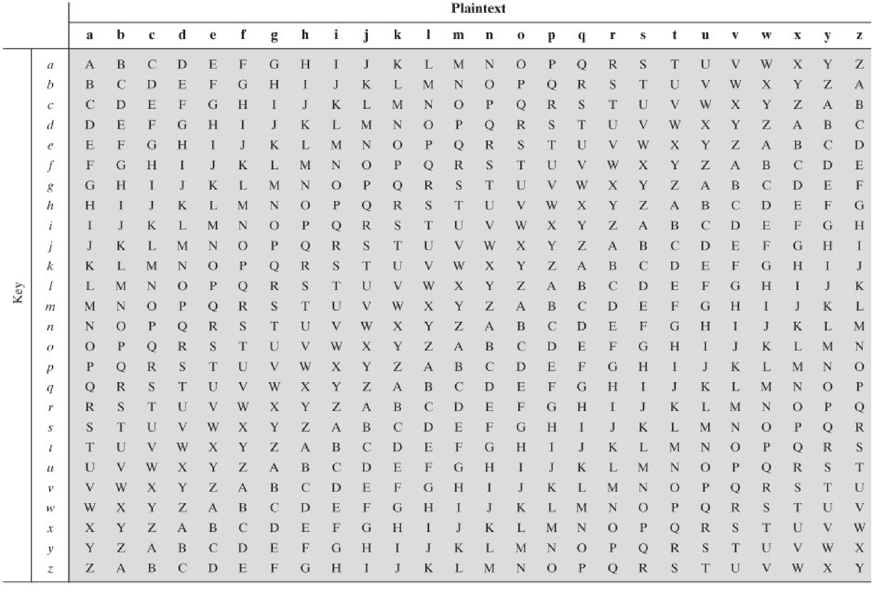

Slide 9
Example of Vigenère Cipher
Write the plaintext out
Write the keyword repeated
Use each key letter as a Caesar cipher key
Encrypt the corresponding plaintext letter
Eg using keyword deceptive
  plaintext: wearediscoveredsaveyourself
  key: deceptivedeceptivedeceptive
  ciphertext: zicvtwqngrzgvtwavzhcqyglmgj

Slide 10
Security of Vigenère Cipher
Much more secure than the ciphers we discussed earlier
Have multiple ciphertext letters for each plaintext letter
Hence letter frequencies are obscured
But not totally lost

Slide 11
Security of Vigenère Ciphers
Need to determine key size, since then can attack each Caesar cipher
Repetitions in ciphertext give clues to period
Find same plaintext an exact period apart which results in the same ciphertext
E.g, repeated “VTW” in previous example is at a distance of 9 (zicvtwqngrzgvtwavzhcqyglmgj)

Slide 12
One-Time Pad
If a truly random key as long as the message is available, we can build an unbreakable cipher called a one-time pad
It is unconditionally secure since ciphertext bears no statistical relationship to the plaintext

Slide 13
One-Time Pad: Example
Suppose that we are using a Vigenère scheme with 27 characters
Twenty-seventh character is the space character
The table of Vigenere cipher must be expanded to
27 x 27

Slide 14
One-Time Pad: Example
Ciphertext: ankyodkyurepfjbyojdsplreyiunofdoiuerfpluyts
Key:
pxlmvmsydofuyrvzwc tnlebnecvgdupahfzzlmnyih
Plaintext:
mr mustard with the candlestick in the hall
Ciphertext: ankyodkyurepfjbyojdsplreyiunofdoiuerfpluyts
Key: pftgpmiydgaxgoufhklllmhsqdqogtewbqfgyovuhwt
Plaintext:
miss scarlet with the knife in the library

Slide 15
Security of One Time Pad
Suppose that a cryptanalyst had managed to find these two keys
How to decide which is the correct key?
If the actual key were produced in a truly random fashion, none is more likely than the other
Given any plaintext of equal length to the ciphertext, there is a key that produces that plaintext

Slide 16
Security of One Time Pad
An exhaustive search of all possible keys ends up in many legible plaintexts, with no way of knowing which was the intended plaintext
Therefore, the code is unbreakable

Slide 17
Problems with OTP
Key must be as long as the plaintext
  Generating large quantities of random keys is an issue
Key cannot be repeated
  Distribution of keys is an even bigger issue
So, OTP is unbreakable but impractical

Slide 18
Transposition Ciphers
Transposition Ciphers hide the message by rearranging the letter order
No substitution takes place
Relative letter frequency remains unchanged so these are good candidates for frequency analysis attack

Slide 19
Rail Fence Cipher
Write message letters out diagonally over a number of rows
Then read off cipher row by row
Eg. Write message “Meet me after the toga party” as:
  m e m a t r h t g p r y
  e t e f e t e o a a t
Giving ciphertext
  mematrhtgpryetefeteoaat
  key=?
    Depth of rail fence (no. of rows)
  Easy to attack using frequency analysis

Slide 20
Row Transposition Ciphers
A more complex transposition
Write letters of message out in rows over a specified number of columns
Then reorder the columns according to some key and read column by column
  Key: 3 4 2 1 5 6 7
  Plaintext : attack postponed until two am
  Plaintext: a t t a c k p
  o s t p o n e
  d u n t i l t
  w o a m x y z
  Ciphertext: ttnaaptmtsuoaodwcoixknlypetz

Slide 21
Product Ciphers
Ciphers using either substitutions or transpositions are not secure because of language characteristics
We can use combinations
  Two substitutions make a more complex substitution
  Two transpositions make more complex transposition
  But a substitution followed by a transposition makes a new much harder cipher (product cipher)
This is bridge from classical to modern ciphers

Slide 22
Autokey cipher
Keyword is concatenated with plaintext
key: deceptivewearediscoveredsav
Also vulnerable to cryptanalysis
  Keyword and plaintext share the same frequency of letter
  Statistical technique can be applied

Slide 23
Hill Cipher
Encryption algo takes m plaintext letter and substitute for them m ciphertext letters
The system can be describe as
C = KP mod 26
P = K⁻¹C mod 26

Slide 24



Example
Consider the message 'ACT', and the key below (or GYBNQKURP in letters):
Since 'A' is 0, 'C' is 2 and 'T' is 19, the message is the vector:
Thus the enciphered vector is given by:
which corresponds to a ciphertext of 'POH‘.

Slide 25
Row transposition
Write message row by row in rectangle and read message column by column, but permute the order of column.
4 | 3 | 1 | 2 | 5 | 6 | 7
m | e | e | t | m | e | a
f | t | e | r | t | h | e
t | o | g | a | p | a | r
t | y | v | w | x | y | z
Ciphertext: eegv traw etoy mftt mtpx ehay aerz

Slide 26
Row transposition
More than one stage of transposition is more secure
Ciphertext: eegv traw etoy mftt mtpx ehay aerz
4 | 3 | 1 | 2 | 5 | 6 | 7
e | e | g | v | t | r | a
w | e | t | o | y | m | f
t | t | m | t | p | x | e
h | a | y | a | e | r | z

Slide 27
Summary of today’s lecture
We discussed transposition ciphers and a couple of examples such as Rail Fence Cipher was discussed.
We have also explored the Hill Cipher and have seen how this technique can ensure security.

Slide 28
Next lecture topics
Our discussion on public key cryptography will continue and we will see some real life examples of this technique
We will explore block ciphers and stream ciphers with some examples.

Slide 29
The End

