Slide 1
Network Security
Lecture 11
Presented by: Dr. Munam Ali Shah

Slide 2
Part 2 (b)
Cryptography as a Network Security Tool

Slide 3
Summary of the previous lecture
We had overviewed what cryptography is and how can we use this tool to incorporate security
We discussed different terminologies such as Alice, Bob, Eve, Key, cryptanalysis, steganography etc.
We also reviewed how encryption and decryption using keys work.
4 types of cryptanalysis

Slide 4
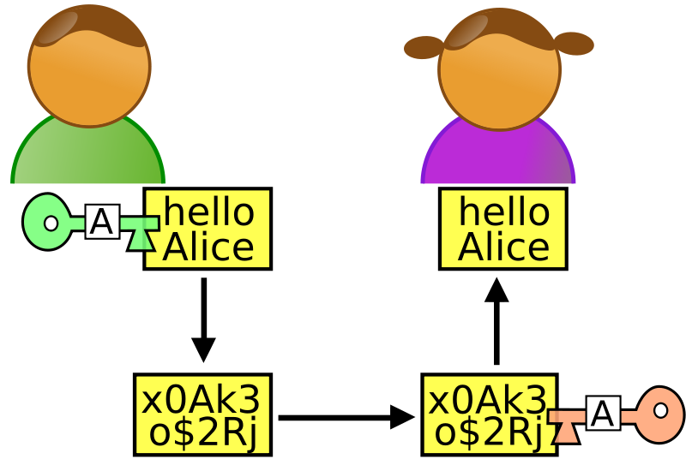
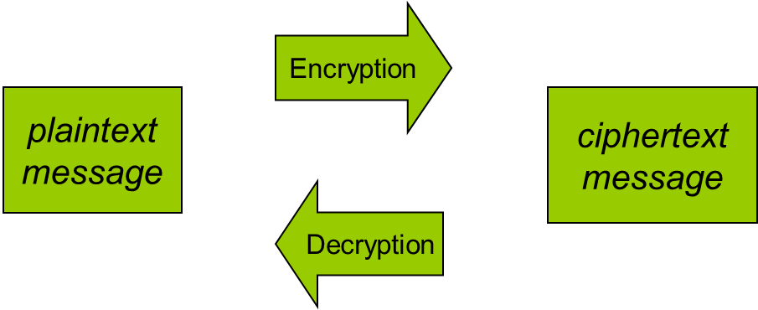
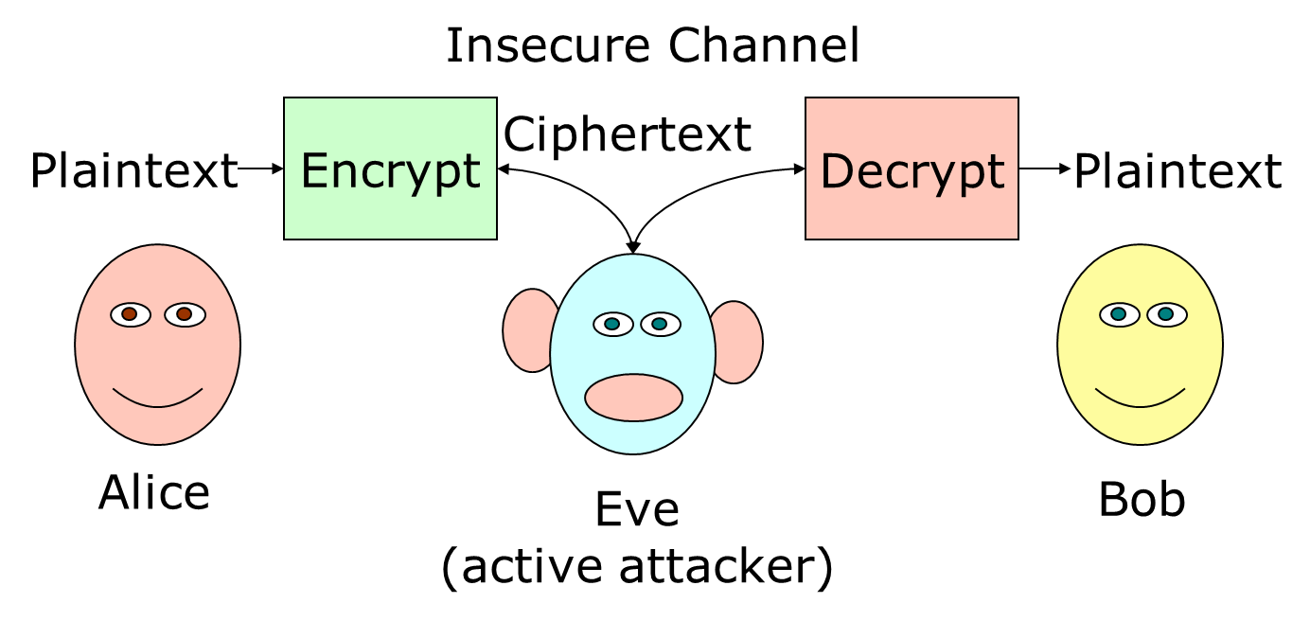
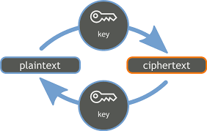
Summary of the previous lecture

Slide 5
Outlines of today’s lecture
We will talk about :
3-Dimesions of Cryptography
Cryptanalysis and Brute Force Attacks
Classical Ciphers
    Substitution Cipher
    Transposition Cipher

Slide 6
Objectives
You would be able to understand and explain basic cryptography techniques
Understand and practice the basics phenomenon to perform cryptanalysis

Slide 7
Cryptography
Cryptographic systems are characterized along three independent dimensions:
    The type of operations used for transforming plaintext to ciphertext.
    The number of keys used.
    The way in which the plaintext is processed.

Slide 8
3- Dimensions of cryptography
1- The type of operations used for transforming plaintext to ciphertext.
All encryption algorithms are based on two general principles: substitution, in which each element in the plaintext (bit, letter, group of bits or letters) is mapped into another element, and transposition, in which elements in the plaintext are rearranged. The fundamental requirement is that no information be lost (i.e., that all operations are reversible). Most systems, referred to as product systems, involve multiple stages of substitutions and transpositions.

Slide 9
3- Dimensions of cryptography
2- The number of keys used.
If both sender and receiver use the same key, the system is referred to as symmetric, single-key, secret-key, or conventional encryption. If the sender and receiver use different keys, the system is referred to as asymmetric, two-key, or public-key encryption.

Slide 10
3- Dimensions of cryptography
3- The way in which the plaintext is processed.
A block cipher processes the input one block of elements at a time, producing an output block for each input block. A stream cipher processes the input elements continuously, producing output one element at a time, as it goes along.

Slide 11
Unconditional Security Vs Computational Security
Unconditional Security
  The cipher cannot be broken no matter how much computer power or time is available
  The only example is OTP (one time passwords)
Computational Security
  The cipher cannot be broken given limited computing resources
  The examples are DES, AES, RC4, etc.

Slide 12
Kerckhoff’s Principle
Adversary always knows the method
In modern cryptography, the assumptions are
  Algorithm is public (known to Eve)
  Key is secret

Slide 13
Secret Vs Public Algorithm
Benefits of having algorithm secret
  Two levels of secrecy
Benefits of having algorithm public
  Peer review, evaluation and cryptanalysis

Slide 14
Cryptanalysis and Brute-Force Attack
Typically, the objective of attacking an encryption system is to recover the key in use rather than simply to recover the plaintext of a single ciphertext. There are two general approaches to attacking a conventional encryption scheme:

Slide 15
Cryptanalysis
Cryptanalytic attacks rely on the nature of the algorithm plusperhaps some knowledge of the general characteristics of the plaintext oreven some sample plaintext–ciphertext pairs.
This type of attack exploits the characteristics of the algorithm to attempt to deduce a specific plaintext or to deduce the key being used.

Slide 16
Brute-force attack
The attacker tries every possible key on a piece of ciphertext until an intelligible translation into plaintext is obtained. On average, half of all possible keys must be tried to achieve success.

Slide 17
Brute Force Attack
Try every possible combination until you find the result
Key Size (bits) | Number of Alternative Keys | Time required at 1 decryption/µs | Time required at 10⁶ decryptions/µs
32 | 2³² = 4.3 × 10⁹ | 2³¹ µs = 35.8 minutes | 2.15 milliseconds
56 | 2⁵⁶ = 7.2 × 10¹⁶ | 2⁵⁵ µs = 1142 years | 10.01 hours
128 | 2¹²⁸ = 3.4 × 10³⁸ | 2¹²⁷ µs = 5.4 × 10²⁴ years | 5.4 × 10¹⁸ years
168 | 2¹⁶⁸ = 3.7 × 10⁵⁰ | 2¹⁶⁷ µs = 5.9 × 10³⁶ years | 5.9 × 10³⁰ years
26 characters (permutation) | 26! = 4 × 10²⁶ | 2 × 10²⁶ µs = 6.4 × 10¹² years | 6.4 × 10⁶ years

Slide 18
Concepts
A private key cipher is composed of two algorithms
  encryption algorithm E
  decryption algorithm D
The same key K is used for encryption & decryption
K has to be distributed beforehand

Slide 19
Classical Ciphers
Substitution Ciphers
Transposition Ciphers

Slide 20
Substitution Ciphers
Substitution Ciphers
  Shift Ciphers (Caesar Cipher)
  Monoalphabetic
  Polyalphabetic
Letters of plaintext are replaced by other letters, numbers or symbols

Slide 21
The Caesar cipher (e.g)
The Caesar cipher is a substitution cipher, named after Julius Caesar.
Operation principle:
each letter is translated into the letter a fixed number of positions after it in the alphabet table.
The fixed number of positions is a key both for encryption and decryption.

Slide 22
The Caesar cipher
K=3
Outer: plaintext
Inner: ciphertext

Slide 23
An example
For a key K=3,
plaintext letter: ABCDEF...UVWXYZ
ciphtertext letter: DEF...UVWXYZABC
Hence
TREATY IMPOSSIBLE
is translated into
WUHDWB LPSRVVLEOH

Slide 24
Caesar Cipher (Another example)
Earliest known substitution cipher (shift cipher)
Replaces each letter by 3rd next letter
Transformation can be defined as:
a b c d e f g h i j k l m n o p q r s t u v w x y z
d e f g h i j k l m n o p q r s t u v w x y z a b c

Slide 25
Caesar Cipher
If each letter is assigned a number (a=0, z=25), Encryption/Decryption defined as:
  C = E(p) = (P + 3) mod (26)
  P = D(c) = (C – 3) mod (26)
Example:
  meet me after the toga party
  phhw ph diwhu wkh wrjd sduwb

Slide 26
Summary of today’s lecture
We discussed some examples of applying cryptography
We also practiced how cryptanalysis can break the secret
The classical ciphers such as substitution was discussed with example

Slide 27
Next lecture topics
Our discussion will continue on symmetric and asymmetric cryptography
We will also explore more examples of cryptography such as Playfair cipher

Slide 28
The End

