Slide 1
Network Security
Lecture 10
Presented by: Dr. Munam Ali Shah

Slide 2
Part 2 (b)
Cryptography as a Network Security Tool

Slide 3
Summary of the previous lecture
We talked about how device security, traffic security and barrier security can help us achieving mobile device security strategy.
We also discussed, the RSN and IEEE802.11i standard to ensure more security in our WLAN. 5 phases operation in 11i was also part pf previous lecture discussion
And lastly, we discussed the Model for Network Security.

Slide 4
Outlines of today’s lecture
We will talk about :
What Cryptography is and why is it used
Some basic terminologies such as plain text, cipher text, cryptanalysis will also form part of todays lecture discussion
Types of cryptography attacks

Slide 5
Objectives
You would be able to present an overview of cryptography and how this tool can ensure the network security.
Understand the basics phenomenon to deploying cryptography in different environments

Slide 6
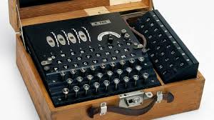
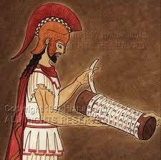
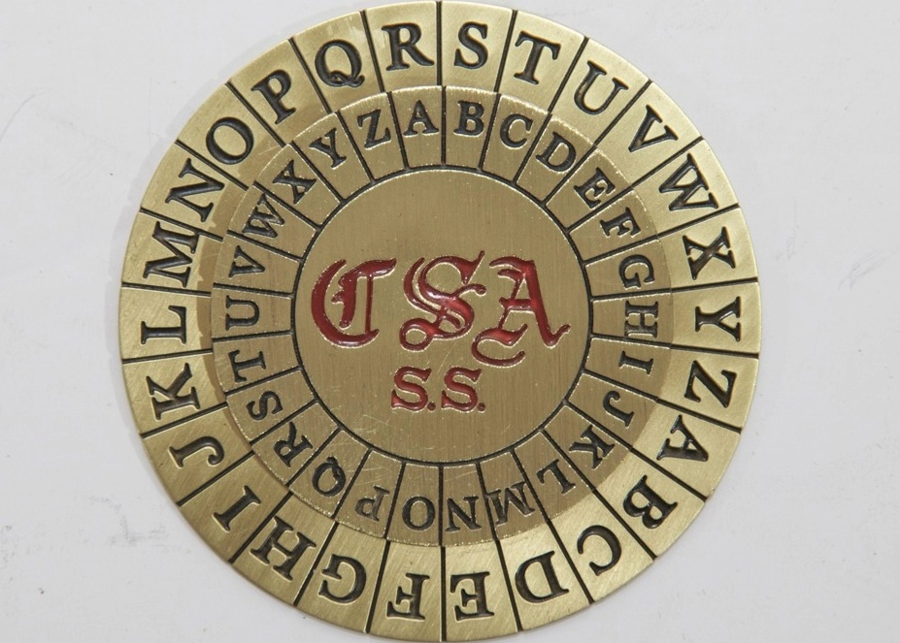
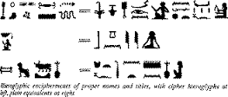
Cryptography
The art of secret writing

Slide 7
Cryptography
Cryptography is the art and science of secrecy
Hiding one’s secrets has always been human’s desire
Historically, cryptography has been associated with military
  But now its everywhere
Notes:
So! What is Cryptography? There can be many definitions. Actually I am not able to find a definition that portrays the whole picture covering all the goals and features of Cryptography. Most of the definitions talk only about data hiding which is just one aspect of Crypto but it has many more aspects such as data integrity, authentication and non-repudiation to name a few. Anyway this is one of the definitions of Crypto found in literature. It says “Cryptography is the art and science of secrecy”. Why an art? Because traditionally, crypto has been all about innovation and artistic thinking. Creating a new cipher or code is in a way similar to writing a new poem or to create a new musical composition. Starting from the Caesar’s cipher till the ciphers used in the last century, there was no scientific or mathematical proof of security. You find some innovative way to convert plaintext into ciphertext, you keep your key and you cipher/algorithm secret and you believe that it is extremely difficult for anyone having access to the ciphertext to find the corresponding plaintext without knowing your secret key; and that its. Obviously, without any mathematical proof, there are good chances that your belief about the security of your cipher is totally wrong. Actually we have a saying in Cryptography which is attributed to Bruce Schenier, who btw is an important guy in crypto being the author of books like “Applied Crypto” and coauthor (with Neil Ferguson) of “Practical Crypto” and an inventor of the block ciphers like BlowFish (one of the 5 finalists for AES). Anyway the saying is sometimes called Schenier’s Law and it states “Everyone can create a cipher that he thinks no one can break”. So you can see that this is the main problem with non-mathematical crypto that you may get a false sense of security which is obviously not desired.
In 1976, Whitfield Diffie and Martin Hellman presented their ground breaking work in IEEE Transactions on Information Theory namely “New Directions in Cryptography”. This paper is considered to be the most important paper in the area of cryptography. This gave the concept of “public key cryptography” which we will talk about in detail later today and it has made ground for making modern crypto stand on solid mathematical foundations. Modern crypto is a science with proofs of security based on known mathematical problems. We will also talk about these problems in the coming sessions.
And then historically crypto has been associated with military apps only. The earliest instance of cryto usage is known to be the one by julius ceasar to communicate with his troops then in the recent past, crypto was used extensively in WW1 and WW2. The most famous story being that how the codes of German Enigma machine were broken by the allies.
But today crypto is no more associated with military only. Its extensively used in ecommerce, credit card usage, internet banking, emails, social networking, mobile communication, audio and video communication, home and office security, you name it, its everywhere.

Slide 8
Cryptography
3 interrelated terms
  Cryptology
  Cryptography
  Cryptanalysis

Slide 9
What is cryptology?
Cryptology – science of hiding
  Cryptography, Cryptanalysis – hide meaning of a message
  Steganography, Steganalysis – hide existence of a message
Cryptography – secret writing
Cryptanalysis – analyzing (breaking) secrets
  Cryptanalysis is what attacker does
  Decipher or Decryption is what legitimate receiver does

Slide 10
Terminology
Characters
  Alice
  Bob
  Eve
  Trent
  ………
Plaintext/message
Ciphertext

Slide 11
Terminology
Key
  Single/secret/symmetric key
  Two/public/asymmetric key
Encryption/encipherment
    The conversion of data into ciphertext, that cannot be easily understood by unauthorized people.
Decryption/decipherment
    The process of converting encrypted data back into its original form so that it can be understood.

Slide 12
Modern cryptography is based on
  Mathematics
  Computer science
  Cleverness and creativity

Slide 13
Cryptography
Encryption
plaintext
message
ciphertext
message
Decryption
Encrypted(Information) cannot be read
Decrypted(Encrypted(Information)) can be

Slide 14
Cryptography
Insecure Channel
Encrypt
Ciphertext
Decrypt
Plaintext
Plaintext
Alice
Eve
(active attacker)
Bob

Slide 15
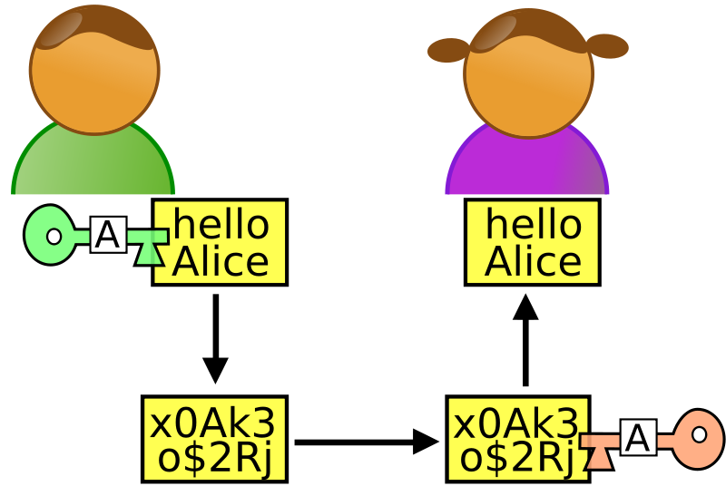
A simple example

Slide 16
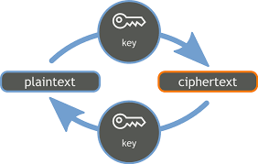
More simple example

Slide 17
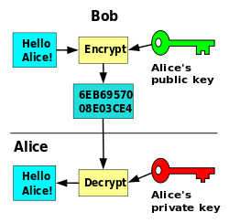
Another way to represent the concept of Cryptography

Slide 18
4 types of cryptanalysis
Depending on what a cryptanalyst has to work with, attacks can be classified into
  ciphertext only attack
  known plaintext attack
  chosen plaintext attack
  chosen ciphertext attack (most severe)

Slide 19
4 types of attacks
Ciphertext only attack
  the only data available is a target ciphertext
Known plaintext attack
  a target ciphertext
  pairs of other ciphertext and plaintext (say, previously broken or guessing)

Slide 20
4 types of attacks
Chosen plaintext attacks
  a target ciphertext
  can feed encryption algorithm with plaintexts and obtain the matching ciphertexts
Chosen ciphertext attack
  a target ciphertext
  can feed decryption algorithm with ciphertexts and obtain the matching plaintexts

Slide 21
Goals of the Adversary
Get the key (ideally)
Get the message
Get part of the message/some information about the message

Slide 22
Model for Network Security
This general security model shows that there are four basic tasks in designing a particular security service:
  Design an algorithm for performing the security-related transformation. The algorithm should be such that an opponent cannot defeat its purpose.
  Generate the secret information to be used with the algorithm.
  Develop methods for the distribution and sharing of the secret information.
  Specify a protocol to be used by the two principals that makes use of the security algorithm and the secret information to achieve a particular security service.

Slide 23
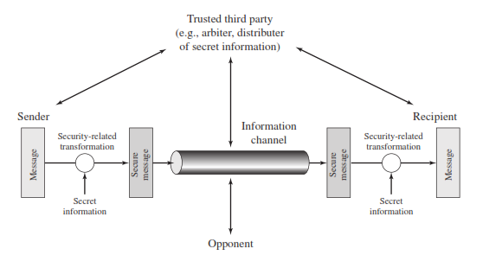
Model for Network Security

Slide 24
Network Access Security Model
Programs can present two kinds of threats
  Information access threats: Intercept or modify data on behalf of users who should not have access to that data.
  Service threats: Exploit service flaws in computers to inhibit use by legitimate users.

Slide 25
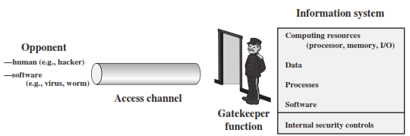
Network Access Security Model

Slide 26
Summary of today’s lecture
We discussed the basic concept of cryptography
Some terminologies such as plain text, ciphertext and key were also discussed.
We have seen how keys can be used to encrypt and decrypt the message

Slide 27
Next lecture topics
Our discussion on cryptography. Classical ciphers with some examples will be discussed
We will also discuss symmetric and asymmetric cryptography

Slide 28
The End

