Slide 1
CSC 322 Operating Systems Concepts
Lecture - 8:
by
Ahmed Mumtaz Mustehsan
Special Thanks To:
Tanenbaum, Modern Operating Systems 3 e, (c) 2008 Prentice-Hall, Inc. (Chapter-1)
Notes:
1

Slide 2
Advantages; Implementing Threads in kernel space
No run-time system is needed
Also, there is no thread table in each process.
Threads do not require any new, non-blocking system calls.
Context switching to threads is still possible in case of blocking system calls or event of page fault.

Slide 3
Implementing threads in kernel space
In addition to process table, kernel maintains thread-table, to keep track of all the threads in the system.
To create a new or destroy existing thread, it makes a kernel call, which does the creation or destruction by updating the kernel thread table.
All calls that might block a thread are implemented as system calls.
If thread blocks, kernel just picks another one
  Not necessarily from same process!
To save time recycling of threads is possible.
Expensive to manage the threads in the kernel and takes valuable kernel space

Slide 4
Do Kernel Level Threads solve all the Problems?
kernel threads do not solve all problems!
What happens when a multithreaded process forks (creates a child process)?
  Should child have the same number of threads?
Signals are sent to processes, not to threads.
  When a signal comes in, which thread should handle it?
  The thread that register that?
  What if it clashes with another thread?

Slide 5
Implementing Threads; Hybrid approach.
How do we get the advantages of both approaches, without the disadvantages?
Multiplex user-level threads onto kernel level threads
Programmer determines how many user level and how many kernel level threads to use. The threads expected to issue blocking system call could be made kernel level thread
Kernel is aware of kernel threads only
User level threads are scheduled, created destroyed independently by RTS without the involvement of kernel.

Slide 6
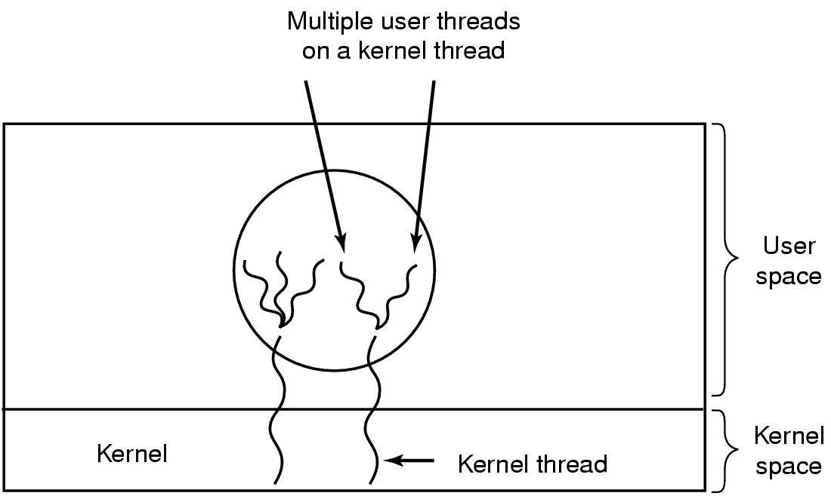
Hybrid approach

Slide 7
Scheduler activations-Upcalls
kernel threads are better but are indisputably slower.
The scheduler activation mimic the functionality of kernel threads, in user space.
No special non-blocking system calls or check safe calls required.
The kernel assigns a certain number of virtual processors to each process and lets the (user-space) run-time system allocate threads to processors.
Mechanism can also be used on a multiprocessor where the virtual processors may be real CPUs.
The user-space run-time system can block the synchronizing thread and schedule a new one by itself.
Notes:
This offends the religious zealots because it violates layering

Slide 8
Scheduler activations (upcalls)
Virtual processors allocation could be initially one, but the process can dynamically request and release.
When any thread executes a blocking system call the control traps to the kernel.
Kernel notifies the run time system that
    a thread has blocked
    passes info to RTS (thread id…)and start RTS
    RTS can start any thread from ready state.
Up-call violates the fundamental principal of Layered System
Notes:
This offends the religious zealots because it violates layering

Slide 9
Popup Threads
How to handle message arrivals in distributed systems?
Could use thread which blocks on a receive system call and processes messages when they arrive.
Restore the history of the thread each time a message arrives and execute thread.
Instead of restoring thread create a new thread to handle message. The newly created thread is called Pop ups threads.
Pop up thread does not requires restoring history and hence faster

Slide 10
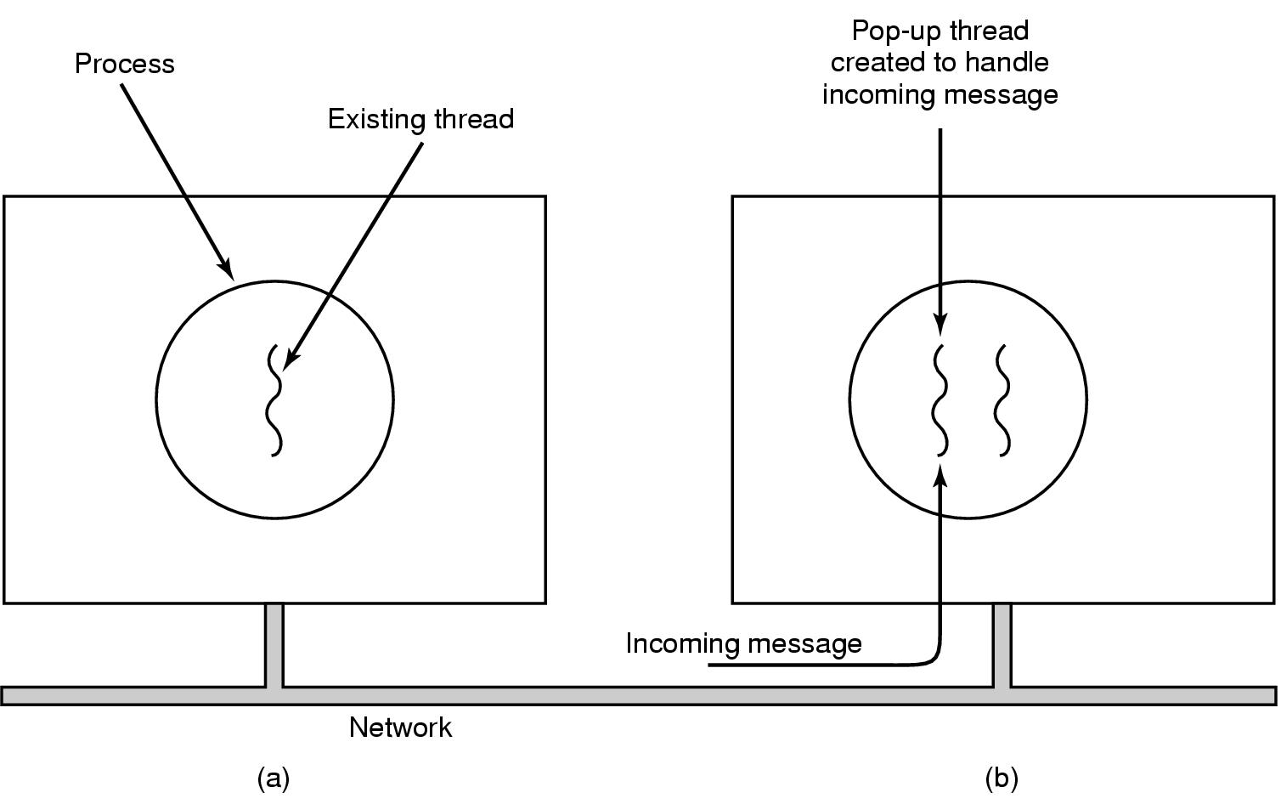
Pop-Up Threads
Create a new thread when a message arrives

Slide 11
Making Single Threaded Code Multithreaded
Many existing programs were written for single-threaded processes. Converting these to multithreading is tricky and pose the following problems:
How do we implement variables which should be global to a thread but not to the entire program?
  Example:
  Thread wants access to a file, Unix grants access via global errno, thread -1 and thread-2 uses errno
Race condition cause thread-1 to get the wrong permission because thread-2 over-writes it.

Slide 12
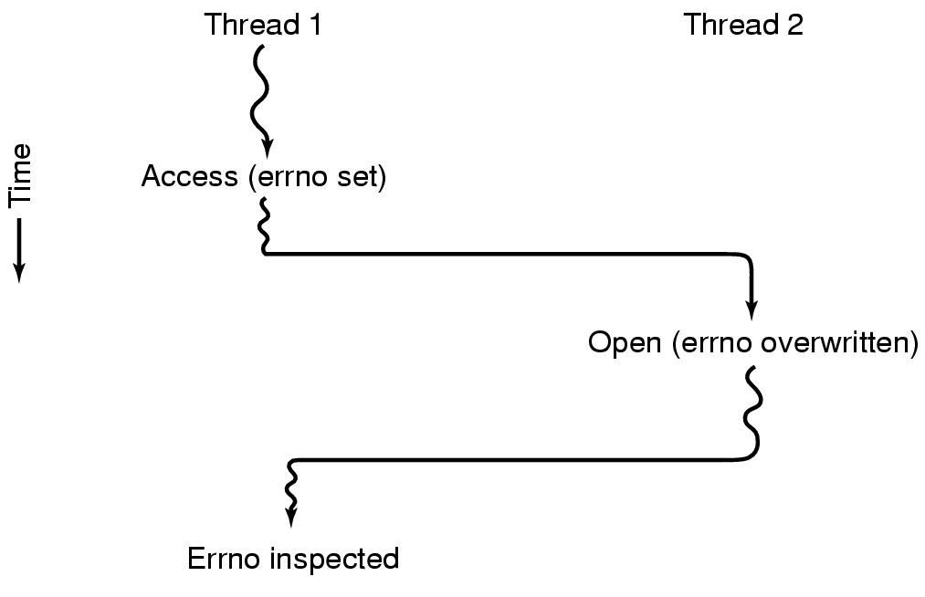
Thread 1 gets the wrong permission
Solutions:
Prohibit global variables altogether; But it conflicts with existing software.
Assign each thread its own private global variables.

Slide 13
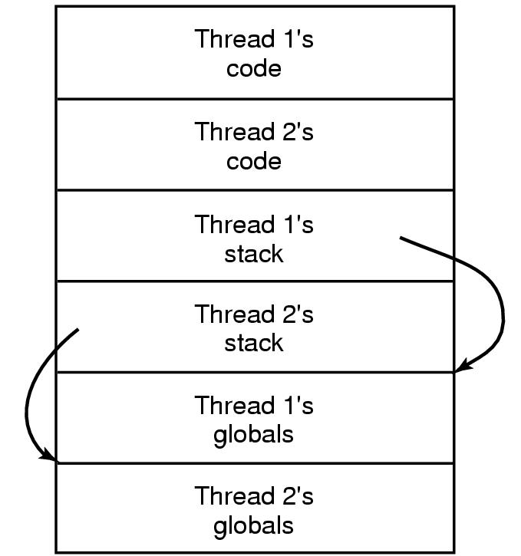
Solution-Create private global variables

Slide 14
How?
New library procedures can be introduced to create, set, and read these thread wide global variables.
    Create_global ("bufptr");
    set_global ("bufptr", &buf);
    bufptr = read_global("bufptr");
Global is then unique to each thread

Slide 15
Single thread to Multithread; More problems
Library routine which is not reentrant. (Not designed to call again when previous call is incomplete)
    Example: Sending a message; one thread puts message in a buffer, context switch takes place, new thread appears and over writes message.
Memory allocation programs may be (temporarily) in an inconsistent state when context switching takes place.
    Example: malloc is busy updating , link list to maintain memory chunks, may tem­porarily be in an inconsistent state, with pointers that point nowhere while another thread access that!

Slide 16
Single thread to Multithread; More problems
How do we implement signals which are thread specific ?
    If threads are in user space, kernel can’t address right thread to pass the signal.
  Keyboard signals are not thread specific! Who should catch that? One thread? All threads? Or newly created popup thread?
  What will happen when one thread wants to catch signal through (Ctrl- C) and other wants to terminate the process using (Ctrl- C)?
  Signals are difficult to handle in a single thread! More complex handling them with multithread environment.
  Same issue with stack dynamic growth.

Slide 17
MORAL OF THE STORY
Need to rework the semantics of system calls and library routines are to be rewritten in order to add threads to a system
Must be done in such a way as to remain backward compatible with exist­ing programs

Slide 18
Inter-process Communication
Three problems
      How to actually do it
      How to deal with process conflicts (2 airline reservations for same seat)
      How to do correct sequencing when dependencies are present. Aim the gun before firing it
SAME ISSUES FOR THREADS AS FOR PROCESSES SAME SOLUTIONS AS WELL

Slide 19
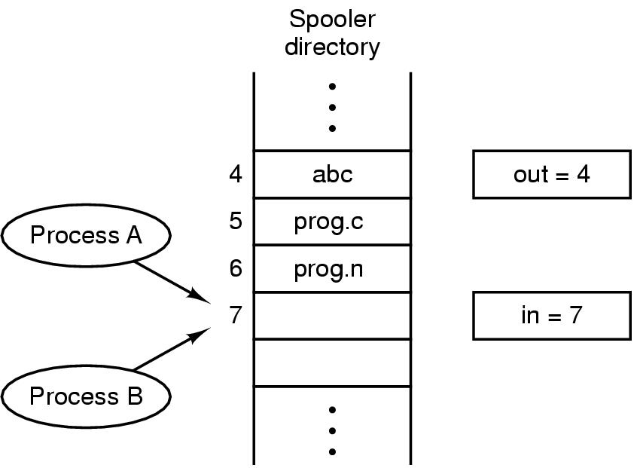
Race Conditions
In is local variable containing pointer to next free slot
Out is local variable pointing to next file to be printed
Notes:
Printer daemon prints processes and spooler directory contains files

Slide 20
How to avoid Races Conditions
Mutual exclusion: only one process at a time can use a shared variable/file
Critical Regions: Define shared memory which leads to race conditions
Solution: Ensure that two processes can’t be in the Critical Region at the same time

Slide 21
Properties of a good solution
No two processes may be simultaneously inside their critical regions.
No assumptions may be made about speeds or the number of CPUs.
No process running outside its critical region may block other processes to enter critical region.
No process should have to wait forever to enter its critical region.

Slide 22
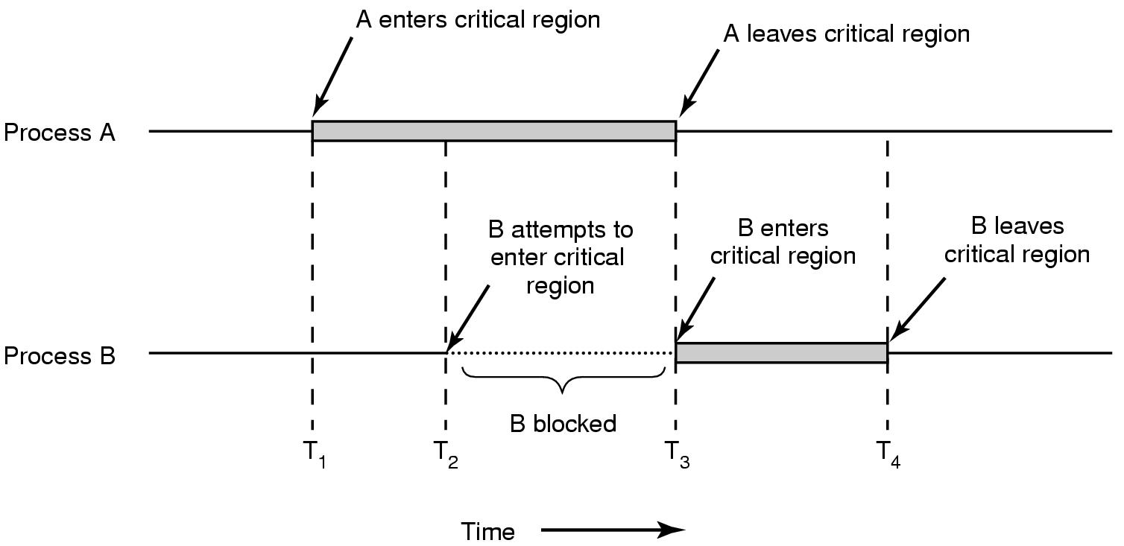
What we are trying to do

Slide 23
Solutions based upon Busy Waiting
Examine various proposals for achieving mutual exclusion, so that while one process is busy updating shared memory in its critical region, no other process will enter the critical region:
Disabling interrupts
Lock variables
Strict alternation
Peterson's solution
The TSL instruction

Slide 24
Disabling Interrupts
Idea: Process disables interrupts, enters Critical Region, enables interrupts when it leaves Critical Region
Problems
  Process DI then might never enable interrupts, crashing system
  Won’t work on multicore chips as Disabling Interrupts only effects one CPU at a time

Slide 25
Lock variables
A software solution everyone shares a lock
  When lock is 0, process turns it to 1 and enters Critical Region
  When exit Critical Region, turn lock to 0
Problem: Race condition.
How?

Slide 26
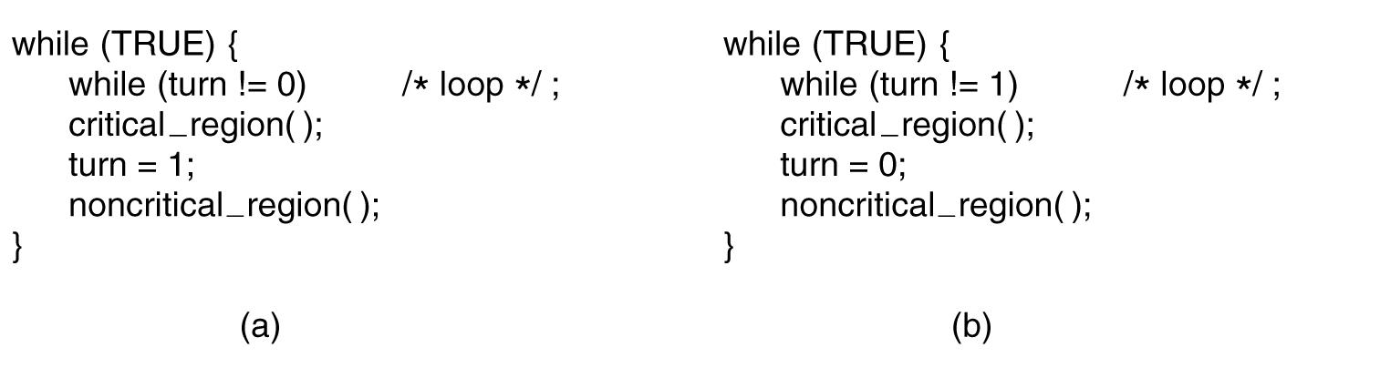
Strict Alternation
A proposed solution to the critical region problem.
  Process 0.
  Process I. In both cases, be sure to note the semicolons terminating the while statements.

Slide 27
Problems with strict alternation
Employs busy waiting; while waiting for the Critical Region, a process spins.
If one process is outside the Critical Region and it is its turn, then other process has to wait until outside process finishes both outside AND inside (Critical Region ) work

Slide 28
Problems with strict alternation
Process 0
Process 1
Critical Region
Critical Region

Slide 29
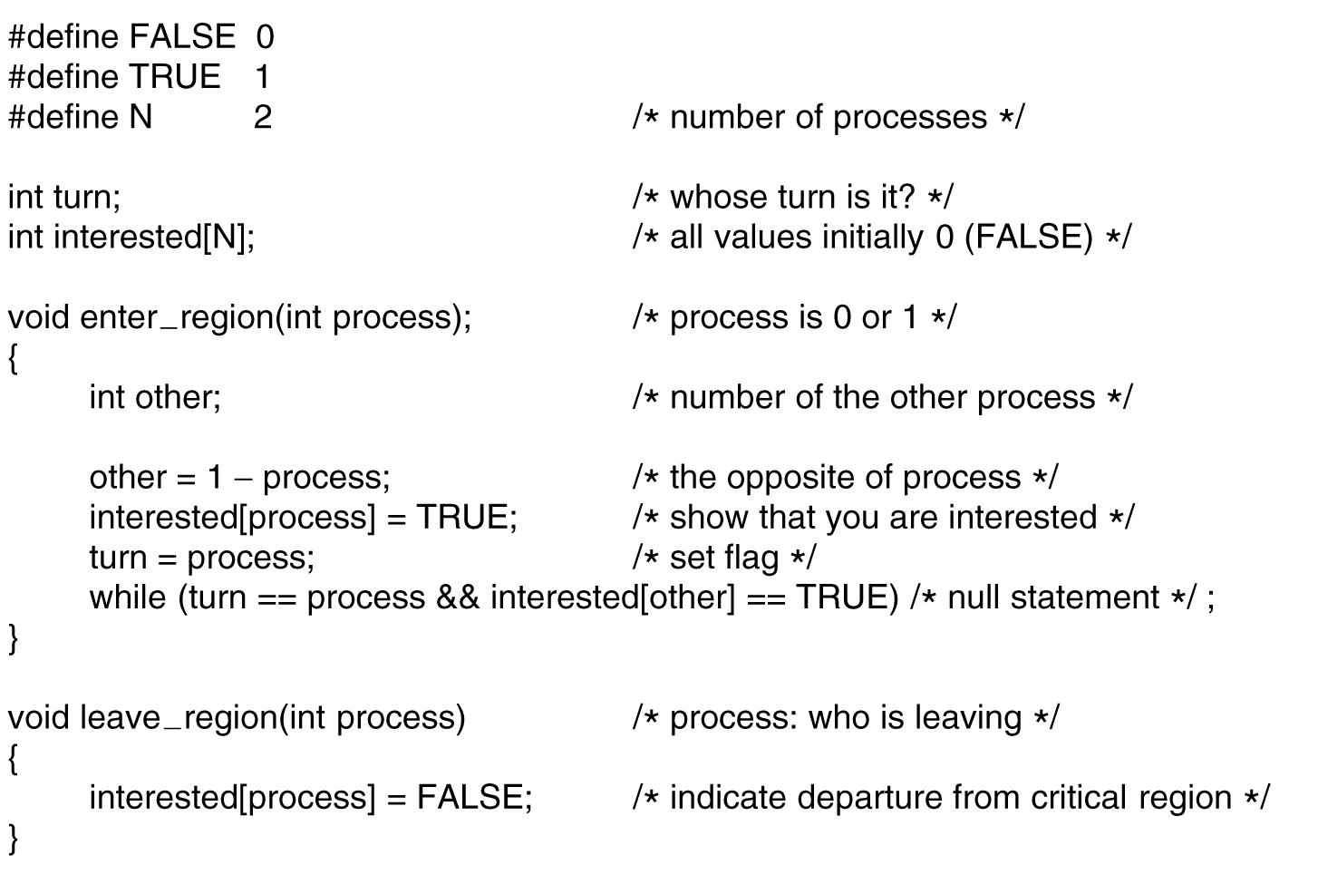
Peterson's Solution
.

Slide 30
Peterson
Process 0 & 1 try to get in simultaneously
Last one in sets turn: say it is process 1
Process 0 enters (turn= = process is False)

Slide 31
TSL
TSL reads lock into register and stores NON ZERO VALUE in lock (e.g. process number)
Instruction is atomic: done by freezing access to bus line (bus disable)

Slide 32
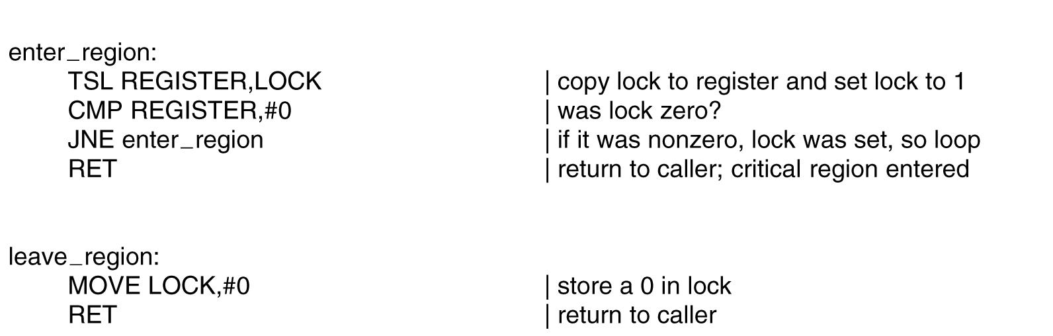
Using TSL
TSL reads lock into register and stores NON ZERO VALUE in lock (e.g. process number)
TSL Instruction is atomic: done by freezing access to bus line (bus disable)

Slide 33
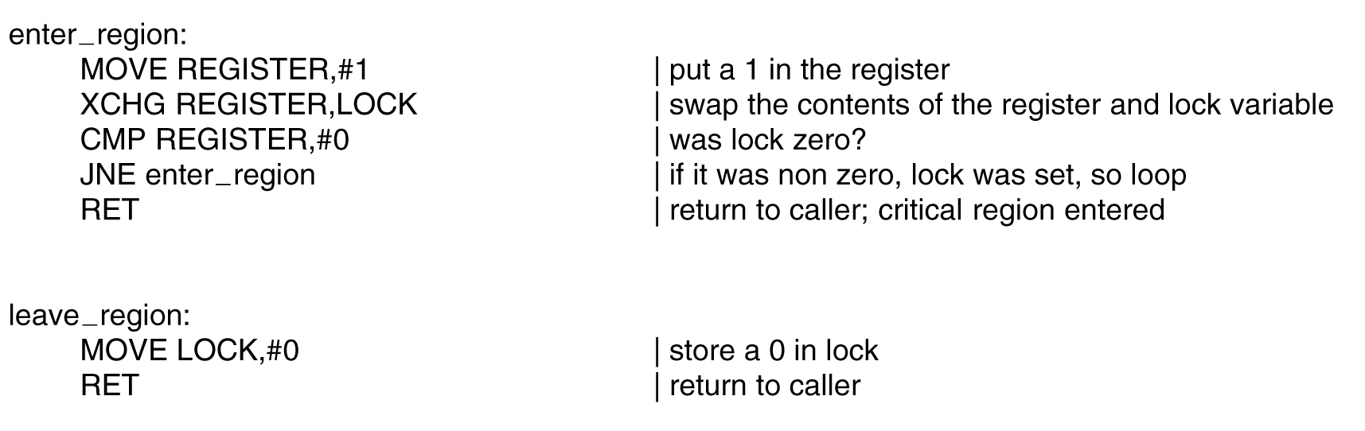
XCHG instruction
xchg a,b exchanges a & b

Slide 34
What’s wrong with Peterson, TSL ,XCHG?
Both Peterson's solution and the solutions using TSL or XCHG are correct, but both requiring busy waiting.
  A process to enter critical region, checks if allowed, enters CR otherwise sits in a tight loop waiting until allowed to enter CR.
Problem:
  Wastage of CPU resource.
  Priority Inversion Problem.
Solution: Replace busy waiting by blocking system calls
  Sleep blocks process
  Wakeup unblocks process

