Slide 1
CSC 322 Operating Systems Concepts
Lecture - 7:
by
Ahmed Mumtaz Mustehsan
Special Thanks To:
Tanenbaum, Modern Operating Systems 3 e, (c) 2008 Prentice-Hall, Inc. (Chapter-1)
Notes:
1

Slide 2
Process and Thread
Process has an address space and a sin­gle thread of control.
Processes may have multiple threads of control in the same address space running in quasi-parallel, like (almost) separate processes.
Threads are Processes with in process
Threads are lightweight processes share the same address space and resources allocated to process.
Process share the resources offered by operating system among other processes

Slide 3
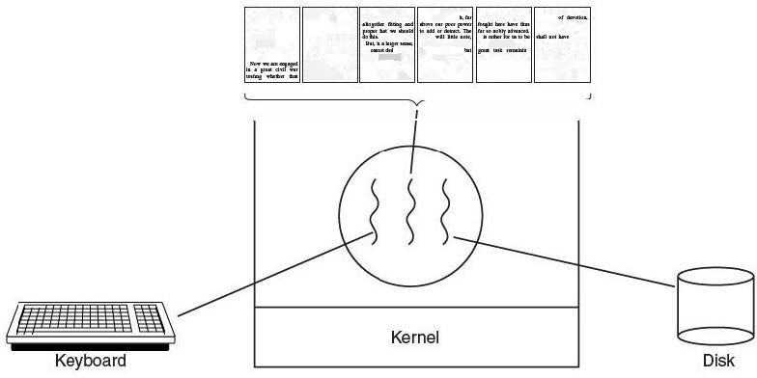
Usage of Threads
Example:
Processing a large document, having threads for, Interactive users, background formatter and backup file on disk

Slide 4
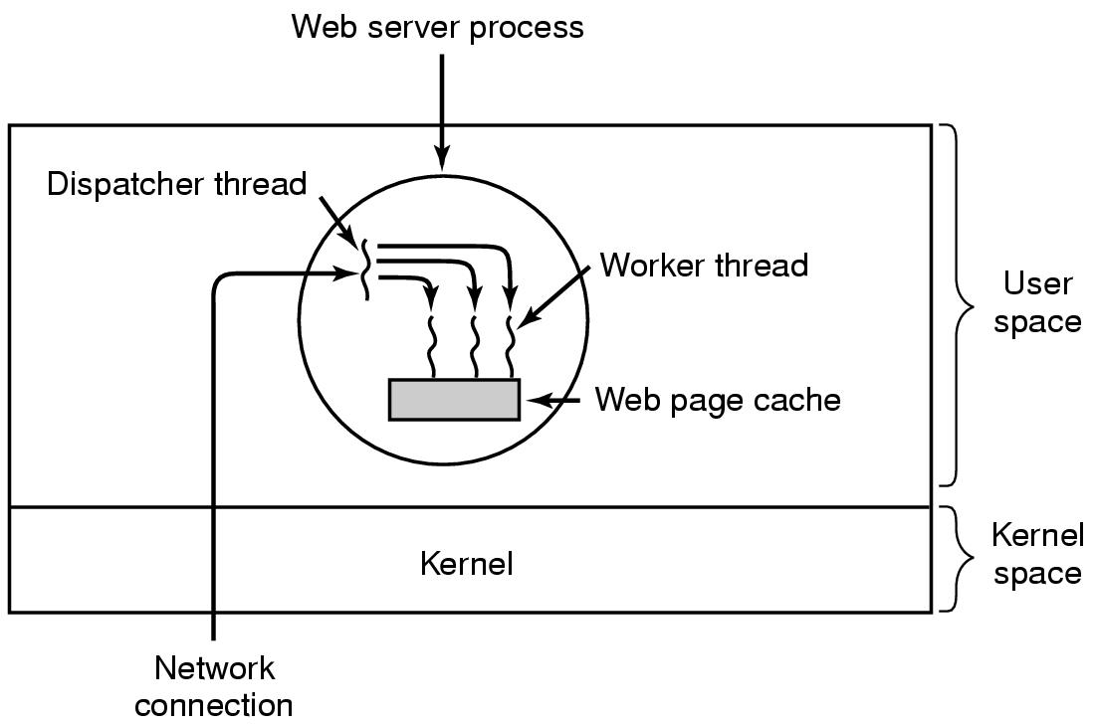
Thread Example-web server
.
This model allows the server to be written as a collection of sequential threads.
.

Slide 5
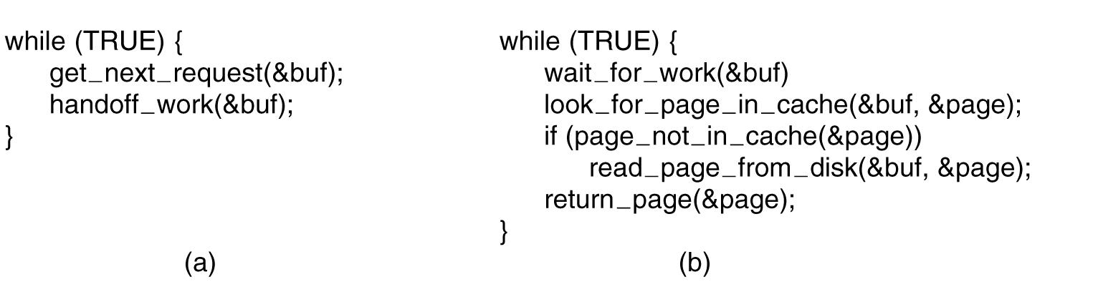
Web server code
(a) Dispatcher thread. (b) Worker thread.

Slide 6
Web server with single thread of control
In the absence of threads, web process operates as a single thread.
If page is not there, then thread blocks
CPU does nothing while it waits for page
Server can handle fewer requests of the clients as compared to multithreaded implementation.
Wastage of CPU time if the server is a dedicated web server

Slide 7
Web Server using Finite-State-Machine
If page is not there, the server switches to another event/request (use a non-blocking call)
The state of the computation must be saved and restored in the table every time the server switches from one request to another.
The next event may be a request for new work or a reply received through Interrupt-Signal from the disk about a previous operation.
If it is new work, it is started, otherwise the relevant information is fetched from table and reply is processed.
A design where process information is saved and set of events change the state is called a Finite-State-Machine.
Implementation of threads in a hard way.

Slide 8
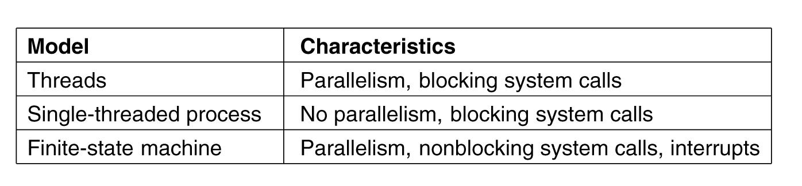
Three ways to build the server

Slide 9
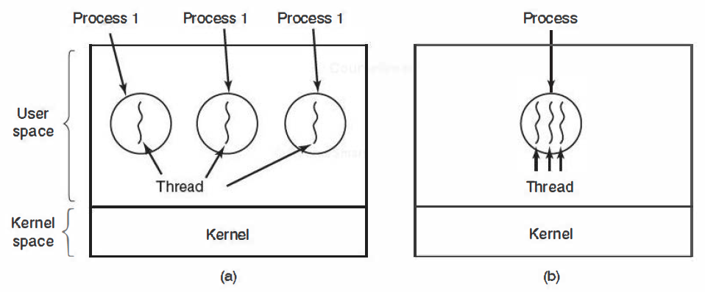
The Classical Thread Model
a). Three Processes each with one thread
b). One process with three threads

Slide 10
Reasons to use threads
Enables parallelism (web server) with blocking system calls
Threads are faster to create and destroy then processes
Natural for multiple cores (Multiprocessors)
Easy programming model
  The process could be structured with an:
  The input thread; reads data into an input buffer.
  The processing thread; takes data out of the input buffer, processes them, and puts the results in an output buffer.
  The output thread; writes these re­sults back to disk.

Slide 11
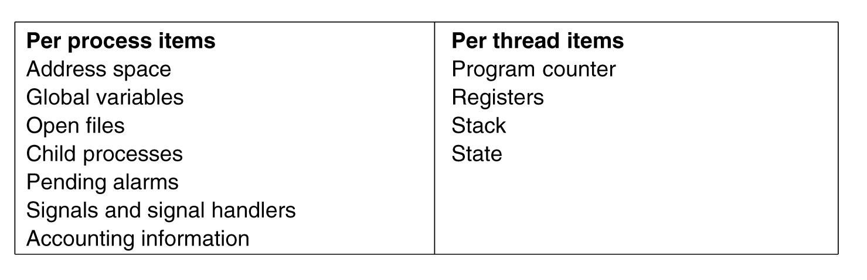
Threads are lightweight
threads are not as independent as processes.
All threads have the same address space, and share global variables.
one thread can read, write, or even wipe out an­ other thread's stack.
There is no protection between threads because
    it is im­possible ( why ?)
    it should not be necessary. (Why ?)

Slide 12
Threads are like processes
Have same states; Running, Ready and Blocked
Share the CPU time quantum allocated to their process
Have their own stacks ; same as processes
Stacks contain:
  frames for (unreturned) procedure calls
    Local variables
    Return address to use when procedure comes back, hence maintains the history of calling sequence.
  Example, if proce­dure X calls procedure Y and Y calls procedure Z, then while Z is executing, the frames for X and Y will all be on the stack.

Slide 13
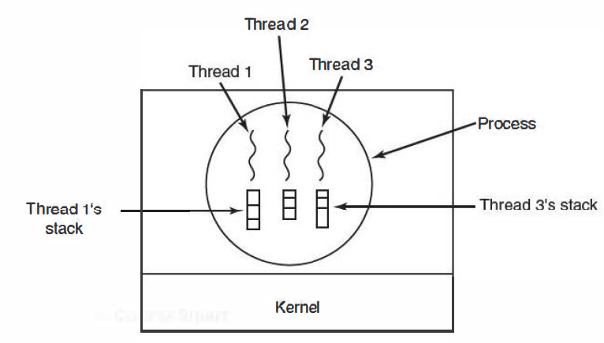
Threads are like processes
Each Thread has its own stack

Slide 14
How do threads work?
Execution start with one thread in a process that creates new threads
Thread contains (id, registers, attributes)
Use library call to create, and manage new threads. Thread_create takes parameter indicating what procedure to run and returns thread identifier/name
  Thread_exit causes thread to exit and disappear (no longer schedulable)
  Thread_join causes thread to block until another thread finishes its work
  Thread_yield volun­tarily give up the CPU to let another thread run

Slide 15
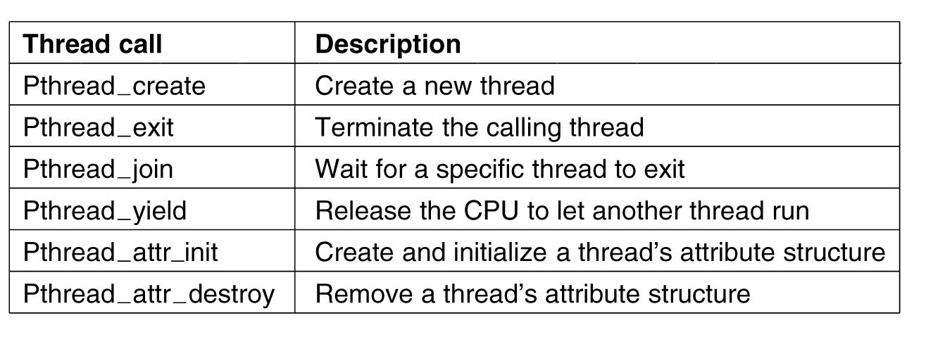
POSIX Threads (Pthreads)
Pthreads are IEEE UNIX standard library calls

Slide 16
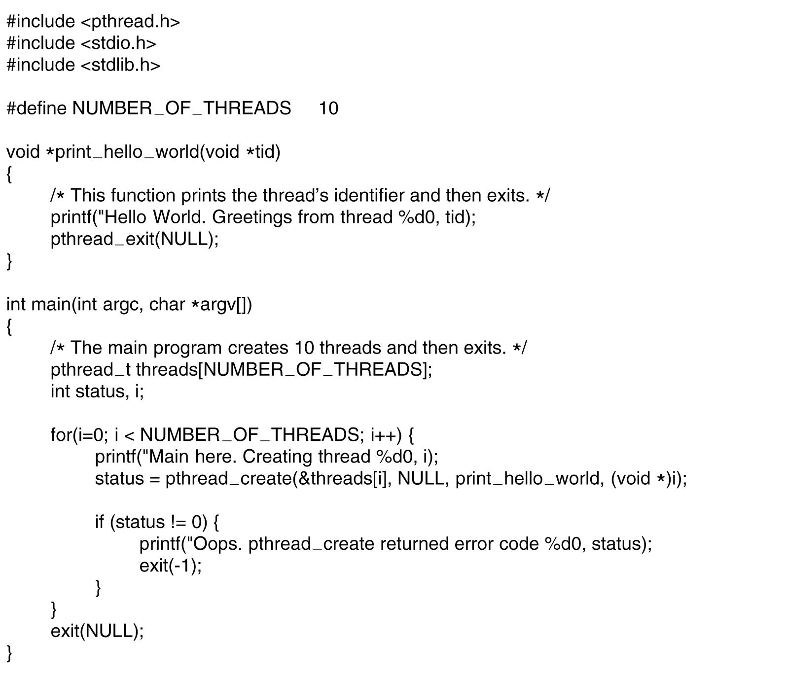
A Pthreads example “Hello, world”
. . .
.

Slide 17
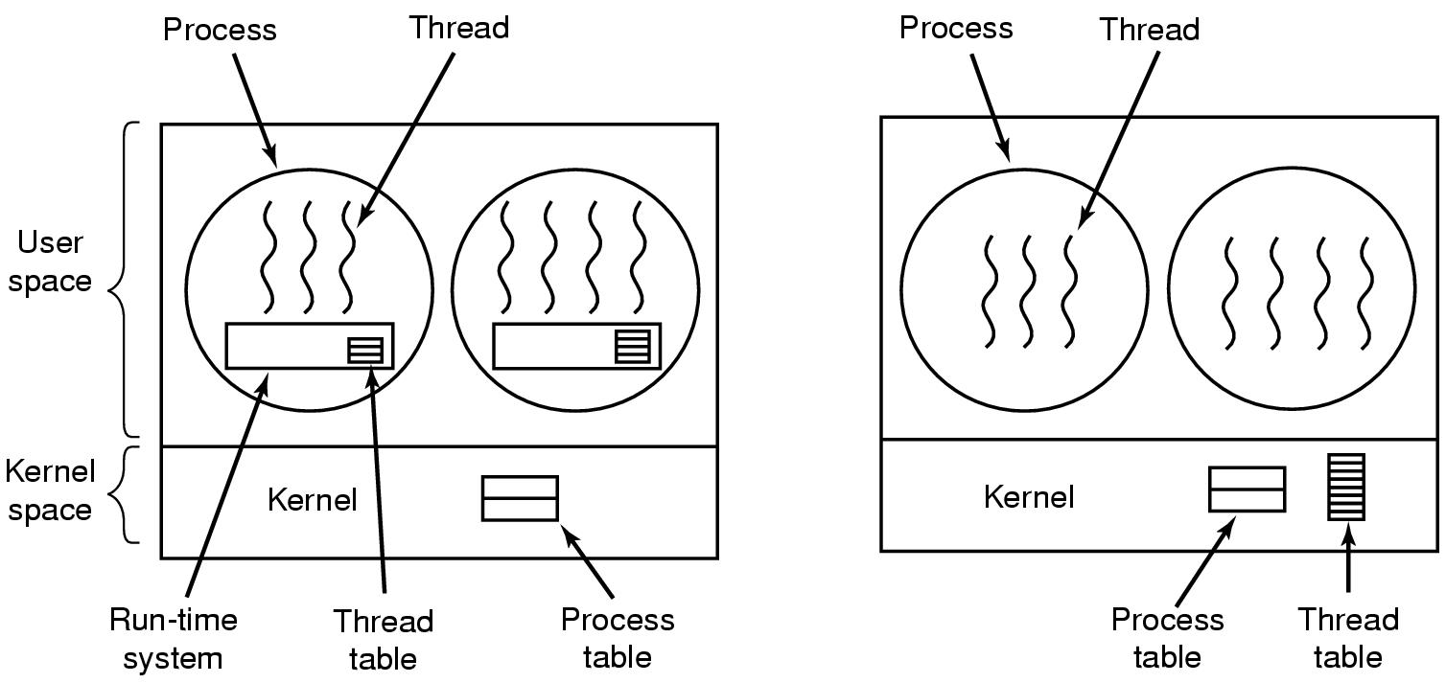
Implementing Threads
(a) (b)
Implementation of threads in user space.
Implementation of threads in kernel space.
Choice is moderately Controversial

Slide 18
Implementing Threads in user space
Can be implemented on an operating system that does not support threads.
The threads are implemented by a library procedures called Run Time Library. (RTL)
  Example: pthread_create, pthread_exit, pthread_join, and pthread_yield,
Process needs its own private Thread-table, contains thread's program counter, stack pointer, registers, state, and so.
Information used and managed by RTL
Context switching takes places either a thread execute thread_exit or call thread_yield

Slide 19
Advantages of implementing Threads in user space
If thread blocks, and control is still Retained by RTL and not transferred to the kernel then RTL saves thread info in table and picks up new thread to run.
State saving and scheduling are invoked faster then kernel call (no trap, no cache flush) change of state is managed by RTS:
  As soon as the stack pointer and program counter have been switched, the new thread comes to life again automat­ically.
  each process can have its own customized scheduling algorithm

Slide 20
Difficulty of implementing Threads in user space
Retained : Can’t let a thread to execute system call which will trap to kernel who will block the process and hence all of the threads within the process.
No elegant solution
  Requires changes in the system library to avoid blocking calls ( e.g. keep reading keyboard until the data is typed in)
  Could use select system calls. ( UNIX code placed around system call to do the checking weather the system call is safe or not! is called a jacket or wrapper.

Slide 21
Disadvantages; implementing Threads in user space
Threads don’t voluntarily give up CPU
  Could interrupt periodically to give control to run time system using clock timer.
  clock timer is very inefficient if repeated periodically and secondly it my clash with the clock timer requested by the process. Hence overhead of this solution is a problem…..
Page fault by a thread blocks the process hence all threads.

Slide 22
Implementing threads in kernel space
In addition to process table, kernel maintains thread-table, to keep track of all the threads in the system.
To create a new or destroy existing thread, it makes a kernel call, which does the creation or destruction by updating the kernel thread table.
All calls that might block a thread are implemented as system calls.
If thread blocks, kernel just picks another one
  Not necessarily from same process!
To save time recycling of threads is possible.
Expensive to manage the threads in the kernel and takes valuable kernel space

