Slide 1
CSC 322 Operating Systems Concepts
Lecture - 6:
by
Ahmed Mumtaz Mustehsan
Special Thanks To:
Tanenbaum, Modern Operating Systems 3 e, (c) 2008 Prentice-Hall, Inc. (Chapter-1)
Notes:
1

Slide 2
What is a process?
Process: is an abstraction of a running program.
Multitasking /Multiprogramming: The ability of OS to handle concurrent operation with only one CPU.
Example:
Web server: Serving Web pages to many clients.
If requested page is available in the cache it is sent otherwise start a disk process to read page.
When the system is booted, many processes are created, e.g a process for incoming e-mail, process for up dating virus definitions of antivirus, process for printing files and process for burning a CD­ ROM, etc.

Slide 3
Multiprogramming
Process is an instance of a program, associated with registers, variables, and a program counter.
It has a program, input, output and a state
A computer manages many computations concurrently need an abstraction to describe how it does that,
In multiprogramming system, CPU switches from process to process quickly, running each process for tens or hundreds of milliseconds. However at any instant of time, the CPU is running only one process, but giving the illusion of parallelism Some times called pseudo parallelism

Slide 4
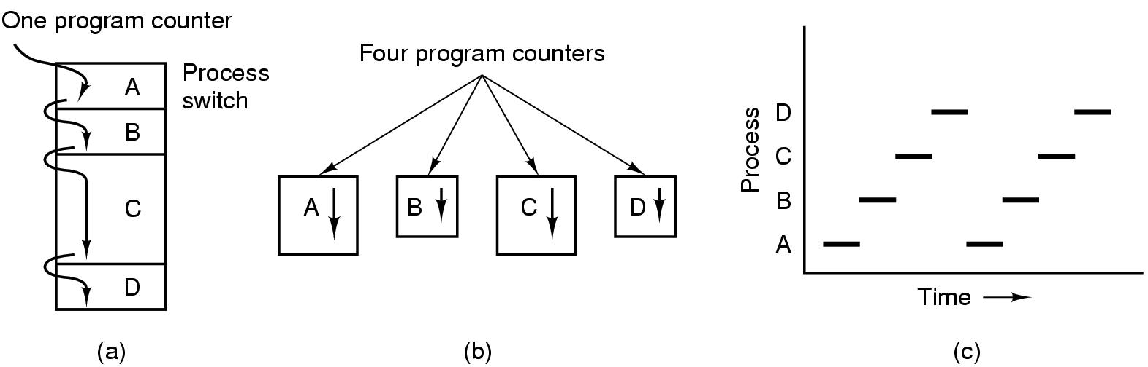
Multiprogramming
Multiprogramming of four programs.
Conceptual model of four independent, sequential processes.
Only one program is active at once.

Slide 5
Process Creation
Events which can cause process creation:
System initialization, while booting operating system.
Execution of a process creation system call by a running process.
A user request to create a new process.
Initiation of a batch job.
List the current processes use:
ps command in UNIX
Task Manager in windows

Slide 6
Process creation while booting OS
When an operating system is booted, several processes are created. Two categories:
Foreground processes;
Process that interact with users, such UNIX tty processes
Background processes;
Process not associated with particular users, but instead have some specific function, such as e-mail, web pages, news, printing, and so on, these processes are called daemons

Slide 7
Process creation with system calls
Processes can be created by running process issuing system calls.
Useful when the work could be formulated among several related, but independent processes.
Example:
If a large amount of data to be fetched over a network for processing, it may be convenient to create one process to fetch the data and put them in a shared buffer while a second process removes the data items and processes them. On a multiprocessor, environment, each process may run on a different CPU and make the job go faster.

Slide 8
Process creation by interactive users
In interactive systems, users can create a new process by typing a command or (double) clicking an icon.
Both of these actions starts a new process and runs the selected program in it.
In command based UNIX systems running X, new process takes over the window in which it was started.
In Microsoft Windows, when a process is started it does not have a window, but it can create one.
Using the mouse, the user can select a window and interact with the process, for example, providing input when needed.

Slide 9
Process creation by initiating batch job
The processes are created for batch systems usually found on large mainframes.
users can submit batch jobs to the system (possibly remotely).
When the operating system decides that it has the resources to run another job, it creates a new process and runs the next job from the input queue in it.

Slide 10
Process creation in UNIX and windows
In all the cases, a new process is created by an existing process executing a system call. The process may be a user process, a system process or a batch manager process.
In UNIX a new process is created through fork() system call. That creates a child which is a clone of parent. Then child execute execve or a similar system call to change its memory image and run a new program.
In Windows, in contrast, a single Win32 function call, CreateProcess, hand­les both process creation and loading the correct program into the new process.
In both environment after creation of child process it has its independent address space w.r.t its parent.

Slide 11
Process Termination
Events which cause process termination:
  Normal exit (voluntary).
  Error exit (voluntary).
  Fatal error (involuntary).
  Killed by another process (involuntary).

Slide 12
Process Termination
Normal exit (voluntary).
  Process completed its given task. e.g. compile a code. The process execute exit() in UNIX and ExitProcess in windows.
  Screen-oriented programs support voluntary termination. Word processors, Internet browsers and similar programs have an icon that the user can click to tell the process to remove all files and then terminate.

Slide 13
Process Termination
Error exit (voluntary).
  process discovers an error for example, if a user types the command cc foo.c and the file foo.c does not exists. the compiler simply exits.
  Screen-oriented interactive processes generally do not exit when given bad pa­rameters. Instead they pop up a dialog box and ask the user to try again.

Slide 14
Process Termination
Fatal error (involuntary).
  The third reason for termination is an error caused by the process, often due to a program bug.
  Examples include executing an illegal instruction, referencing nonexistent memory, or dividing by zero.
  In UNIX, a process can tell the operating system that it can handle certain errors by itself, in that case the process is signaled (interrupted) instead of terminated.

Slide 15
Process Termination
Killed by another process (involuntary).
  A process might terminate due to the reason that some process executes a system call telling the operating system to kill some other process.
  In UNIX this call is kill. The corresponding Win32 function is TerminateProcess.
  In both cases, the killer must have the necessary authorization to do the killing .

Slide 16
Process Hierarchies
UNIX :
a process creates another process, called a child process which can further creates more processes, forming a process hierarchy.
UNIX initializes a special process, called init, is present in the boot image. Which then forks off one new process per terminal.
Windows :
No process hierarchy all processes are equal.
The hierarchy created when a process creates a child. The parent is given a special token (called a handle) to control the child. However, it is free to pass this token to some other process, thus invalidate­ the hierarchy.

Slide 17
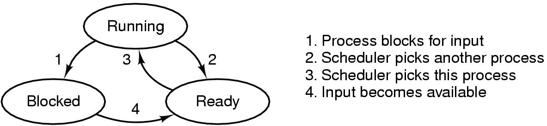
Process States
Running:
  Actually using the CPU at that instant.
Ready:
  Runnable, temporarily stopped to let other process run.
Blocked:
  Unable to run until some external event happens.
Transitions between these states.

Slide 18
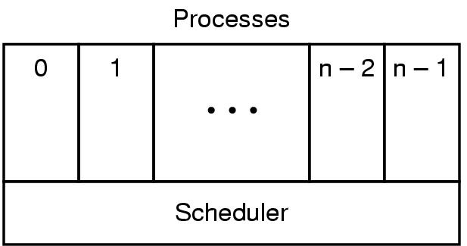
Implementation of Processes
Instead of interrupts, think about user processes, disk processes, terminal processes, (sequential processes), which block when they wait for something
The lowest layer of a process structured operating system handles interrupts and scheduling.

Slide 19
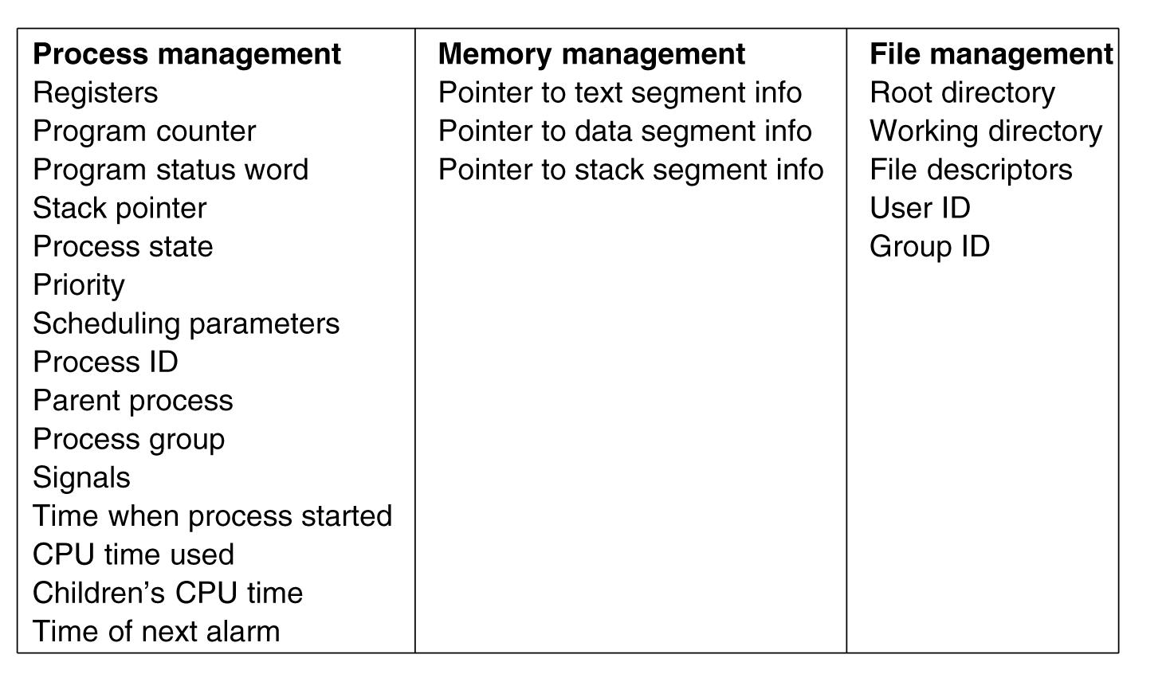
Structure of Processes Table (Process Control Block PCB)
Some of the fields of a typical Process Table entry.

Slide 20
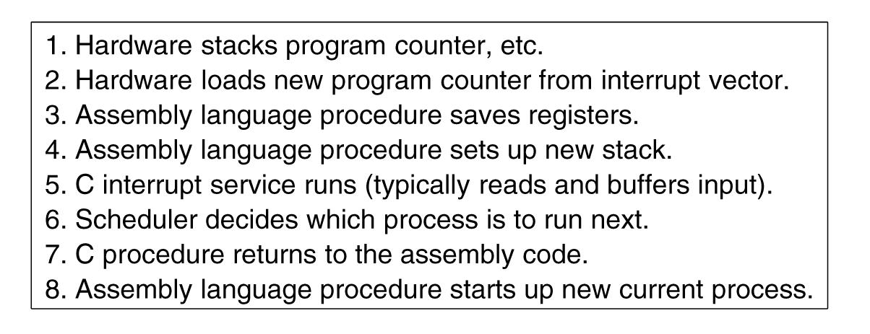
  OS processes an interrupt
Skeleton of what the lowest level of the operating system does when an interrupt occurs.

Slide 21
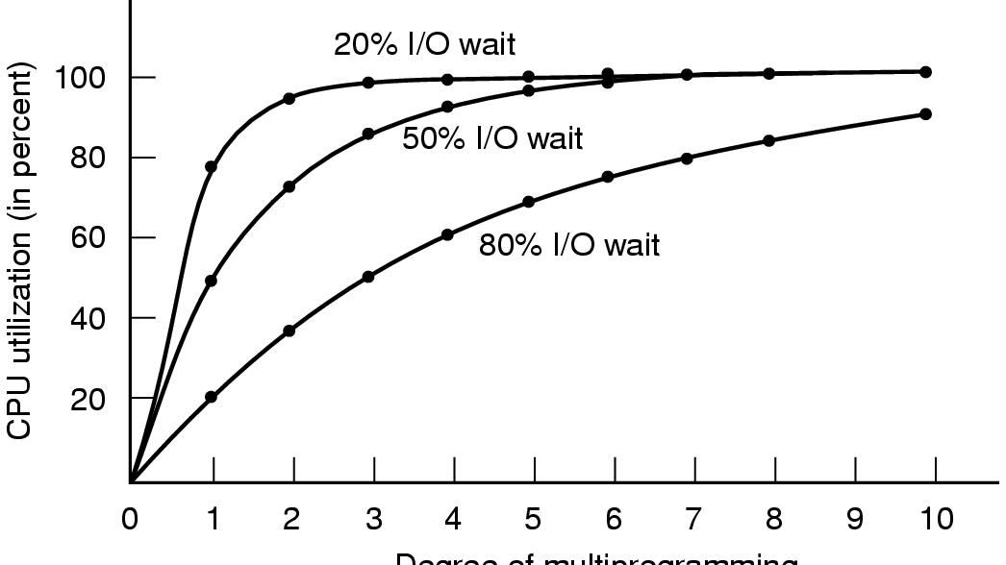
How multiprogramming performs
CPU utilization as a function of the number of processes in memory.

Slide 22
Process and Thread
Process has an address space and a sin­gle thread of control.
Processes may have multiple threads of control in the same address space running in quasi-parallel, like (almost) separate processes.
Threads are Processes with in process
Threads are lightweight processes share the same address space and resources allocated to process.
Process share the resources offered by operating system among other processes

Slide 23
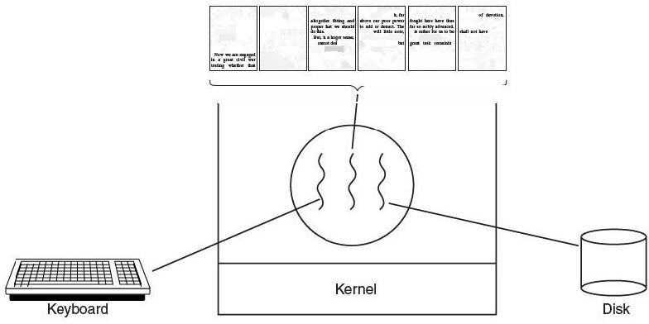
Usage of Threads
Example:
Processing a large document, having threads for, Interactive users, background formatter and backup file on disk

Slide 24
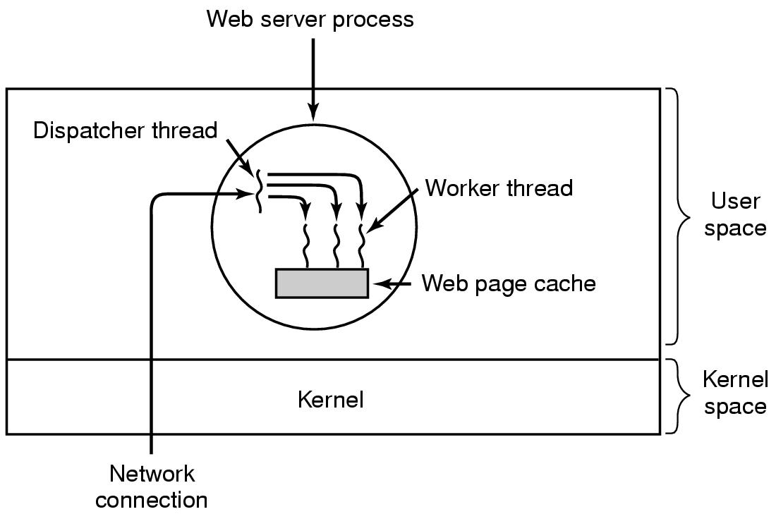
Thread Example-web server
.
This model allows the server to be written as a collection of sequential threads.
.

