Slide 1
CSC 322 Operating Systems Concepts
Lecture - 4:
by
Ahmed Mumtaz Mustehsan
Special Thanks To:
Tanenbaum, Modern Operating Systems 3 e, (c) 2008 Prentice-Hall, Inc. (Chapter-1)
Notes:
1

Slide 2
Operating Systems Structure
Monolithic Systems
Layered System
Microkernel
Client Server Model
Virtual Machines
Exokernel

Slide 3
Monolithic Systems
“The Big Mess.” no structure, collection of procedures that can call each other.
Compiles all procedures, and binds them into a single object file.
No information hiding, every procedure is visible to every other procedure.
Even in monolithic systems, there is a little structure.
The services (system calls) provided by the operating system are requested by putting the parameters in a well-defined place (e.g., on the stack) and then executing a trap instruction.

Slide 4
Monolithic Systems …
The TRAP instruction switches the machine from user mode to kernel mode and transfers control to the operating system.
The operating system then fetches the parameters and determines which system call is to be carried out.
After that, it indexes into a table that contains in slot k a pointer to the procedure that carries out system call k

Slide 5
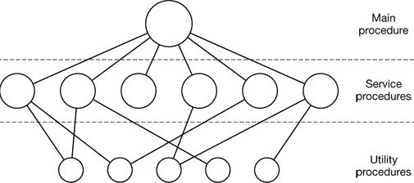
Monolithic Systems …
A simple structuring model for a monolithic system.
A main program that invokes the requested service procedure.
A set of service procedures that carry out the system calls.
A set of utility procedures that help the service procedures.

Slide 6
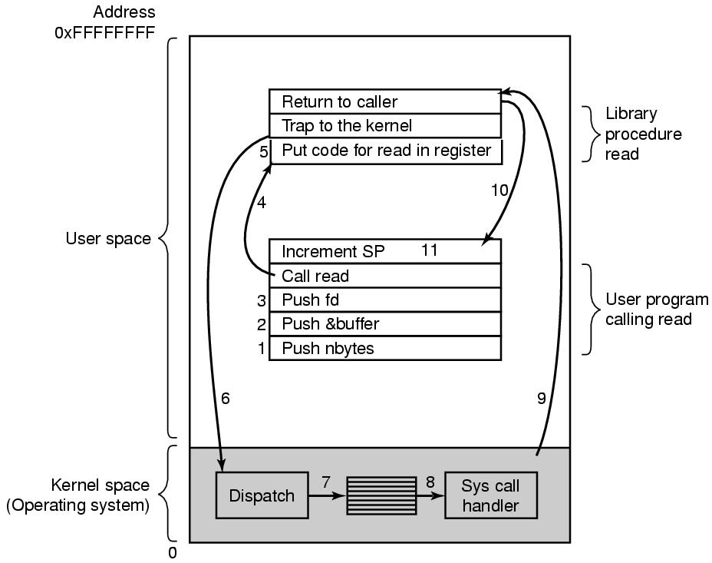
System Calls

Slide 7
Layered System
Generalization approach of monolithic system to organize the OS in a hierarchy of layers, each one constructed upon the one below it.
The first system constructed in this way was the THE system built at Netherlands by E. W. Dijkstra and his students.
The THE system was a simple batch system which had 32K of 27-bit word. The system had 6 layers,

Slide 8
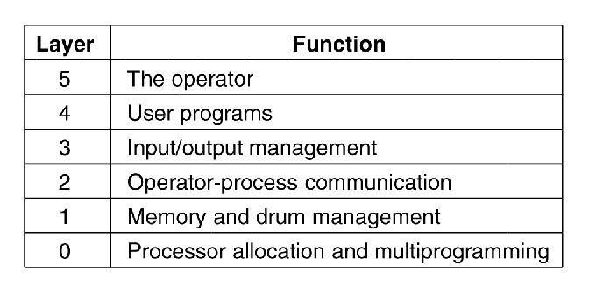
Layered Systems-THE operating system
Dijkstra’s the author

Slide 9
Layered System
Laye-0: Dealt with allocation of the processor, switching between processes when interrupts occurred or timers expired. The basic multi programming of the CPU.
Layer-1: The memory management. Allocated space for processes in main memory and part of process (Pages) on a 512K word drum processes.
Layer-2: Handled communication between each process and the operator console. Each process effectively had its own operator console.
Layer-3: Managing the I/O devices and buffering. dealt with abstract I/O devices.

Slide 10
Layered System
Layer-4 For user programs. They did not have to worry about process, memory, console, or I/O management.
Layer-5: The system operator process
MULTICS system.
Instead of layers, a series of concentric rings, the inner ones more privileged than the outer ones
The entire operating system was part of the address space of each user process. The hardware made it possible.
The ring mechanism can easily be extended to structure user subsystems.

Slide 11
Microkernels
The basic idea of microkernel design is to achieve high reliability by splitting the operating system into small, well-defined modules, only the-microkernel runs in kernel mode and the rest run as ordinary user processes.
Small number of processes are allowed in the kernel
Minimizes effects of bugs, Don’t want bug in driver to crash system
Mechanism in kernel and policy outside the kernel
  Mechanism: Schedule processes by priority scheduling
  Policy: Assign process priorities in user space

Slide 12
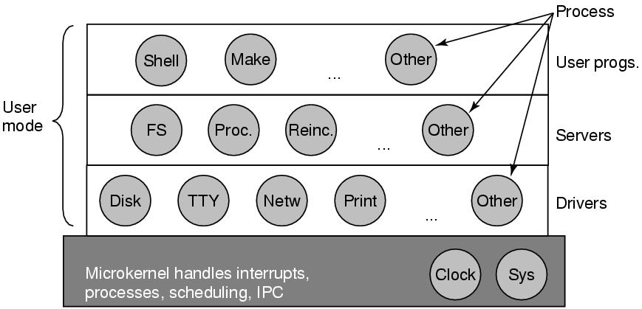
Microkernels : Structure of the MINIX 3 system.
The device driver for the clock in the kernel because the scheduler interacts closely with it.

Slide 13
Microkernels
Above layer containing the servers, do the job of OS e.g. FS manage the file, the process manager creates, destroys, and manages processes, and so on.
Process communicate through messages.
Reincarnation server checks that all services are running
The lowest layer contains the device drivers. Since they run in user mode, they do not have physical access to the I/O port s.
The driver builds a structure telling which values to write to which I/O ports and makes a kernel call.
kernel checks that the driver is writing to allowed port

Slide 14
Client-Server Model
Two classes of processes, the servers which provides service, and the clients, which use the services.
Communication between clients and servers is by message passing.
To obtain a service, a client process constructs a message saying what it wants and sends it to the appropriate server.
The clients need not know whether the messages are handled locally on their own machines, or whether they are sent across a network to servers on a remote machine.
The server then does the work and sends back the answer in both cases.

Slide 15
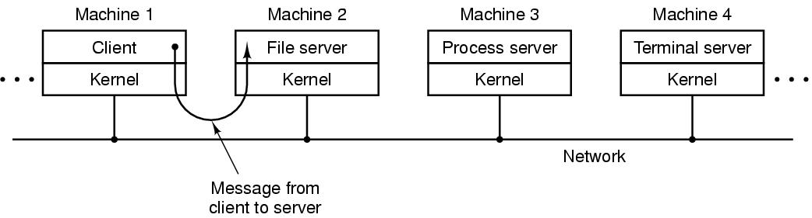
Client-Server Model
The client-server model over a network
Generalization: That the clients and servers run on different computers, connected by a local or wide area network,
The typical use of the client-server model in a network is client sends a request for a Web page to the server and server returns the Web page back to the client.

Slide 16
Virtual Machines
This system, originally called CP/CMS and later VM/370 based on a timesharing system provides:
Multiprogramming
Extended machine with a convenient interface than the bare hardware.
The essence of VM/370 is to completely separate these two functions
.

Slide 17
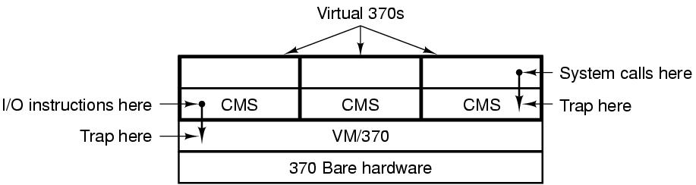
Virtual Machines
The virtual machine monitor, runs on the bare hardware does multiprogramming, provide several virtual machines to the next layer up.
Virtual Machines are not extended machines, Instead, are exact copies of the bare hardware, have kernel/user mode, I/O, interrupts, and everything else the real machine has.

Slide 18
Virtual Machines
Each one can run any operating system that will run directly on the bare hardware.
Different virtual machines can, run different OS such as OS/360, CMS (Conversational Monitor System)
When a CMS program executed a system call, the call is trapped to the op­erating system in its own virtual machine, not by VM/370.
CMS then issued the normal hardware I/0 instructions for whatever was needed to carry out the call.

Slide 19
Virtual Machines
These I/O instructions are then trapped by VM/370, which then performed them as part of its simulation of the real hardware.
By completely sep­arating the functions of multiprogramming and providing an extended machine, each of the function could be much simpler, more flexible, and much easier to maintain.

Slide 20
Virtual Machines Rediscovered
IBM and some other companies, had a virtual machine for long, HP, have recently added virtual machine support to their high-end enterprise servers.
The idea of virtualization has largely been ignored in the PC world until recently.
Past few years, new software, and new techno­logies have combined to make it a hot topic.
Many companies have run their mail servers, Web servers, FTP servers, and other servers on separate computers, sometimes with different operating systems.
Through Virtualization they can run all on the same machine without having a crash of one server bring down the rest.

Slide 21
Virtual Machines Rediscovered
Virtualization also popular in the Web hosting world.
Web host­ing customers were forced to choose between shared hosting (a login account on server, but no control over the server software) and dedicated hosting (own machine, flexi­ble but not cost effective)
Web hosting on virtual machines at rent, a single physical machine can run many virtual machines, each of which appears to be a complete machine.
Customers can run any operating system and software at a fraction of the cost of a dedicated server.
Also through virtualization end users are able to run two or more operating systems at the same time, say Windows and Linux,

Slide 22
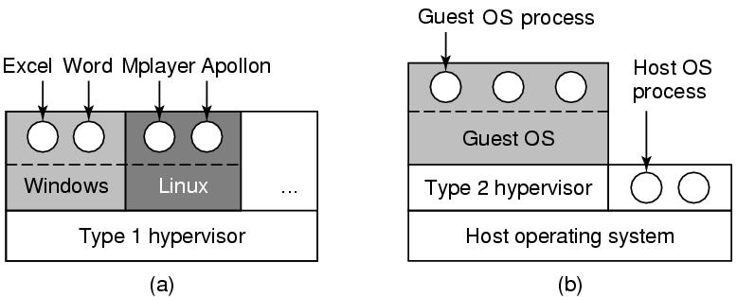
Virtual Machines Rediscovered
A type 1 hypervisor. (b) A type 2 hypervisor.
A Virtual Machine Monitor also called hypervisor
  Type 1 hypervisor running on bare hardware
  Type 2 hypervisor runs on Application Program

Slide 23
Exokernel
Rather than cloning the actual machine, like virtual machines, another strategy is to partitioning the recourses.
Allocate each user a subset of the resources.
Thus one virtual machine might get disk blocks 0 to 1023, the next one might get blocks 1024 to 2047, and so on.
At the bottom layer, running in kernel mode, is a program called the exokernel

Slide 24
Exokernel
Its job is to allocate resources to virtual machines and then check any attempts to use them by un au athorised user. Make sure no machine is trying to use somebody else's resources.
Each user level virtual machine can run its own operating system, as on VM/370 except that each one is restricted to the resources it has been allocated.
The advantage of the exokemel scheme is that it saves a layer of mapping.

