Slide 1
CSC 322 Operating Systems Concepts
Lecture - 4:
by
Ahmed Mumtaz Mustehsan
Special Thanks To:
Tanenbaum, Modern Operating Systems 3 e, (c) 2008 Prentice-Hall, Inc. (Chapter-1)
Notes:
1

Slide 2
Processes
A process is a Program in execution.
A process is fundamentally a container that holds all the information needed to run a program.
It requires a system call to create and delete a process.
Address space of a process (0 to maximum memory a process can access. )
Address space contains:
The instructions, the data, stack, a set of resources, registers (including PC and SP), a list of open files, set alarms, lists of related processes, and other information needed to run the program.

Slide 3
Processes
Process Table: (Data structure one per process)
Operating system table called the process table, which is an array (or linked list) of structures,
One for each process currently in existence.
Keeps info about process other than the contents of its own address space
Context Switching:
OS stops one process and starts another
When a process is suspended temporarily, it must later be restarted in exactly the same state it had when it was stopped.

Slide 4
Inter Process Communication (IPC)
A process can communicate with another process called Inter process communications. (IPC)
process can communicate with each other on the same computer or across the network.
Different methods exists for IPC.
Process has a UID’s and group ID’s (GID) that uniquely identifies each project.

Slide 5
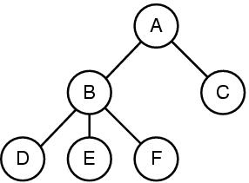
A Process Tree
Shell (command interpreter)
Reads command from terminal; creates processes
Process creates child processes. e.g. Process A created B and C processes.
Process C Creates D, E and F
The parent and child processes organized in a Tree structure
Notes:
5

Slide 6
File System
OS hides the peculiarities of the disks and other I/O devices and present the programmer with a nice, clean abstract model of device independent files
Directory as a way of grouping files together.
Directory hierarchy can be specified by giving its path name from the top of the directory called the root directory.
Absolute path names consist of the list of directories that must be traversed from the root directory to get to the file, with slashes separating the components
Requires system calls to create a file, delete a file, open and close a file.

Slide 7
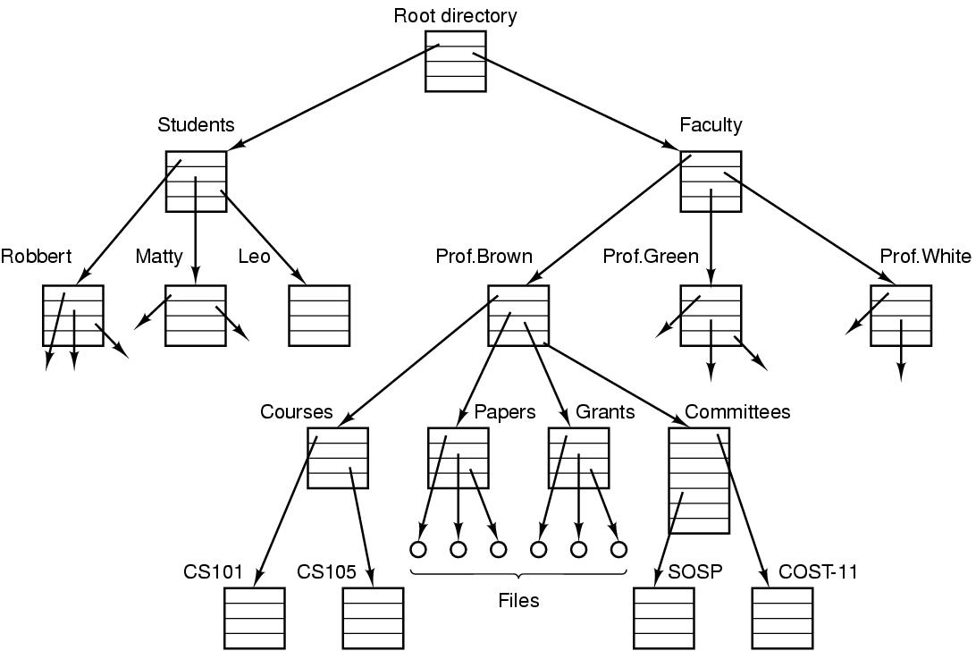
File directory
The directory is organized as a tree
Root directory at the top. Path proceeds from the root (e.g. faculty/prof brown/courses)

Slide 8
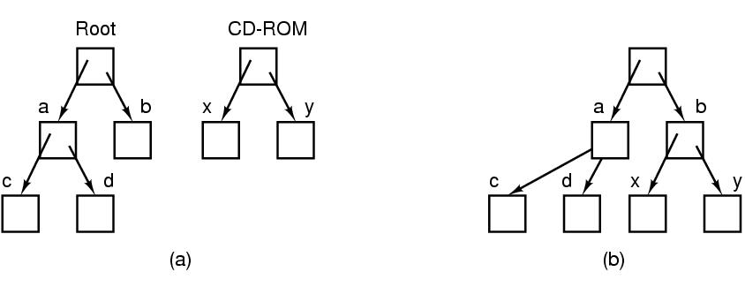
Mounting Files in UNIX
A CD-ROM is mounted on directory b.

Slide 9
Special files
  Special files are provided in order to make I/O devices look like files
  Use same calls for I/O as for files, OS treats them as files.
  Block special files (disks)
  Character special files (line printers, modems)
  Example: UNIX mount command
  mount at location or address /dev
  e.g. /dev/lp is line printer

Slide 10
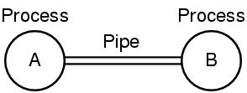
UNIX Pipe
Processes communicate by writing into/reading from a file in Unix
A pipe is a sort of pseudo file used to connect two Processes.
Implementation of a pipe is like a file.
When process A wants to send data to process B, it writes on the pipe as if writing to output file.
Process B can read the data by reading from the pipe as if reading from an input file.
A and B write into the pipe and read from the pipe.

Slide 11
I/O, Protection/Shell
File/ data protection in UNIX
uses rwx bits for each file
  3 bits for owner, 3 for group, 3 for everyone else
  rwxrwxrwx
  rwxr-x--x
  r-xr-xr-x
  rwx------

Slide 12
  Shell (command interpreter)
  UNIX has flavors such as (sh, bash, csh, ssh )
  sort <file1 >file2
It invokes the sort program with input taken from file1 and output sent to file2.
  cat file 1 file 2 file3 | sort > /dev/lp
Invokes the cat program to concatenate three files and send the output to sort to arrange all the lines in alphabetical order. The output of sort is redirected to the file /dev/lp, typically the printer.
  cat file1 file2 file3 | sort >/dev/lp &
Starts up the sort as a background job

Slide 13
System Calls
Interface between user programs and OS
Varies from Operating system to operating system
call is issued by user program
Call uses a library procedure of the same name
Library routine puts machine into kernel modes (by issuing a special instruction)
Finds actual routine for system call in a table
Does the work involved in the call
Returns to user program

Slide 14
UNIX Read System Call
  count = read (fd, buffer, nbytes)
  fd is a file descriptor. When a file is opened, permissions are checked. If access is allowed, a number (fd) is returned. Then file can be read/written
  nbytes is number of bytes in file
  buffer is where read deposits the bytes
  (call be reference)

Slide 15
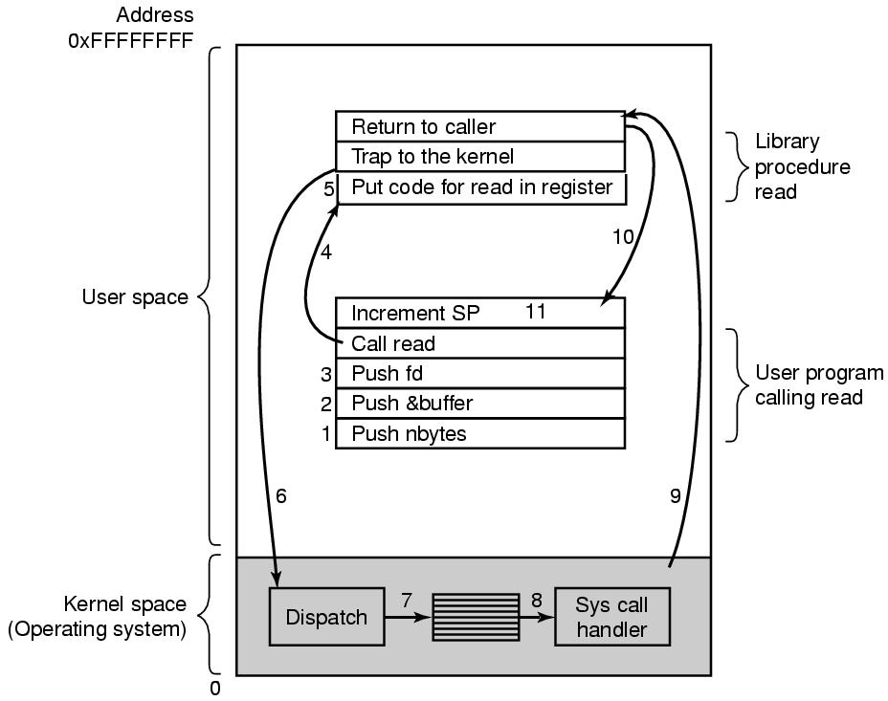
System Calls
read (fd, buffer, nbytes).

Slide 16
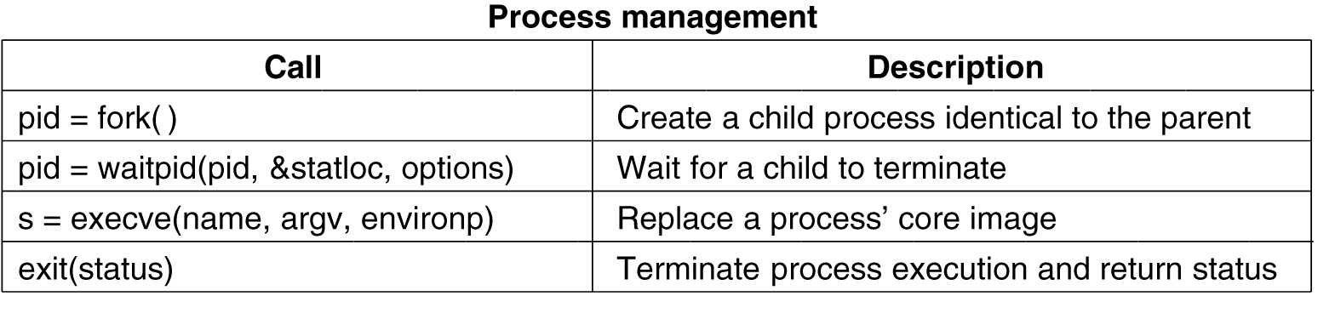
System Calls for Process Management

Slide 17
System Calls for File Management
.

Slide 18
File mode
System keeps track of it
  Regular, special
  Date of creation
  Size
  Access status of file via stat command

Slide 19
System Calls for Directory and File Management
.

Slide 20
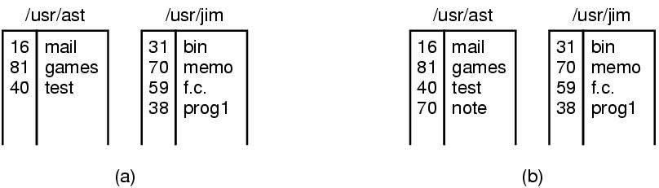
Linking
In Unix, each file is identified by an i-number
i-number indexes into i-node table
  Link creates a new directory entry with same i-number
  Has a new name (note instead of memo)

Slide 21
Mount System Call
mount(“/dev/fd0”, “/mnt”, 0) is system call
File comes from drive 0 and is mounted on binary file /mnt.
Third parameter tells if it is read or read-write
Result is that file on drive zero can be accessed from a directory
Saw this example before with CD-same mechanism for memory sticks and portions of hard drives

Slide 22
Other System Calls

Slide 23
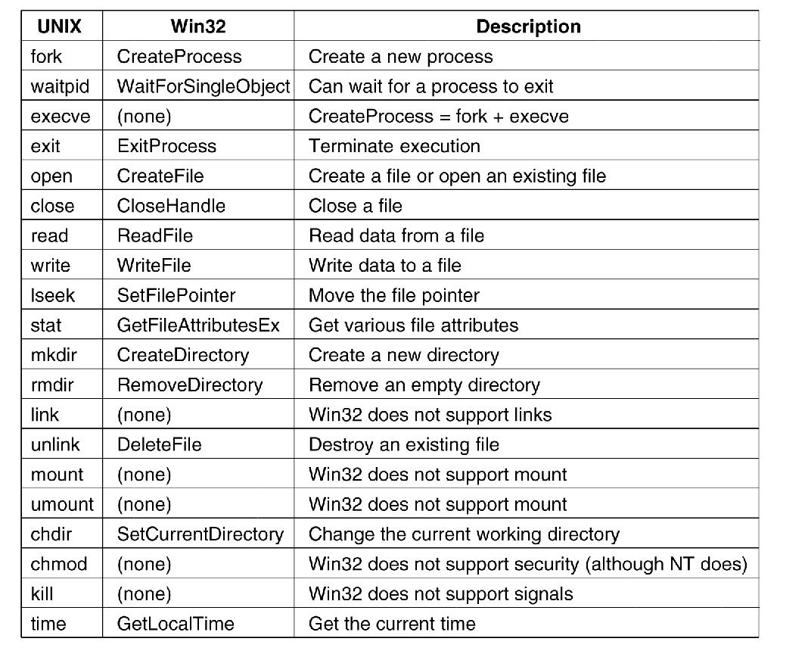
Windows Win32 API
The Win32 API calls that roughly correspond to the UNIX calls

Slide 24
Operating Systems Structure
Monolithic Systems
Layered System
Microkernel
Client Server Model
Virtual Machines
Exokernel

