Slide 1
CSC 322 Operating Systems Concepts
Lecture - 31:
by
Ahmed Mumtaz Mustehsan
Special Thanks To:
S.M. Sarwar, R. Koretsky and S.A. Sarwar, Linux – The Textbook, Operating Systems, by Addison Wesley, 1st ed, 2002
Notes:
1

Slide 2
Case study: Linux

Slide 3
Features of modern OS
Provide a user interface
Organize files on disk
Allocating resource to different users with security control
Co-ordinate programs to work with devices and other programs

Slide 4
Before Linux
  In 80’s, Microsoft’s DOS was the dominated OS for PC
  Apple MAC is better, but expensive
  UNIX is much better, but much much expensive. Only for minicomputer for commercial applications
  People were looking for a UNIX based system, which is cheaper and can run on PC
  Both DOS, MAC and UNIX are proprietary, i.e., the source code of their kernel is protected
    No modification is possible without paying high license fees

Slide 5
GNU project
  Established in 1984 by Richard Stallman, who believes that software should be free from restrictions against copying or modification in order to make better and efficient computer programs
  GNU is a recursive acronym for “GNU's Not Unix”
  Aim at developing a complete Unix-like operating system which is free for copying and modification
  Companies make their money by maintaining and distributing the software, e.g. optimally packaging the software with different tools (Redhat, Slackware, Mandrake, SuSE, etc)
  Stallman built the first free GNU C Compiler in 1991. But still, an OS was yet to be developed

Slide 6

Beginning of Linux
  A famous professor Andrew Tanenbaum developed Minix, a simplified version of UNIX that runs on PC
  Minix is for class teaching only. No intention for commercial use
  In Sept 1991, Linus Torvalds, a second year student of Computer Science at the University of Helsinki, developed the preliminary kernel of Linux, known as Linux version 0.0.1
  It was put to the Internet and received enormous response from worldwide software developers
  By December came version 0.10. Still Linux was little more than in skeletal form.

Slide 7
Confrontation and Development
  Message from Professor Andrew Tanenbaum
    " I still maintain the point that designing a monolithic kernel in 1991 is a fundamental error. Be thankful you are not my
    student. You would not get a high grade for such a design :-)“ "Linux is obsolete".
  (Remark made by Andrew Tanenbaum)

Slide 8
Confrontation and Development
  But work went on. Soon more than a hundred people joined the Linux camp. Then thousands. Then hundreds of thousands
  It was licensed under GNU General Public License, thus ensuring that the source codes will be free for all to copy, study and to change.

Slide 9
Linux Today
  Linux has been used for many computing platforms
    PC, PDA, Supercomputer,…
  Current kernel version 2.4.20. 2.5 is coming
  Not only character user interface but graphical user interface, thanks to the X-Window technology
  Commercial vendors moved in Linix itself to provide freely distributed code. They make their money by compiling up various software and gathering them in a distributable format
    Red Hat, Slackware, etc
  Chinese distribution of Linux also appeared in Taiwan and China - CLE, Red Flag Linux

Slide 10
Linux Pros and Cons
Advantages over Windows
  It's almost free to relatively inexpensive
  Source code is included
  Bugs are fixed quickly and help is readily available through the vast support in Internet
  Linux is more stable than Windows

Slide 11
Linux Pros and Cons
Advantages over Windows contd…
  Linux is truly multi-user and multi-tasking
    Multiuser: OS that can simultaneously serve a number of users
    Multitasking: OS that can simultaneously execute a number of programs
  Linux runs on equipment that other operating systems consider too underpowered, e.g. 386 systems, PDA, etc
More than 75% current network servers are developed based on Linux or Unix systems
  Due to the relatively high reliability

Slide 12
Linux Pros and Cons
Disadvantages compared with Windows
  My program cannot run on Linux
  Isn't as popular as Windows
  No one commercial company is responsible for Linux
  Linux is relatively hard to install, learn and use

Slide 13
Linux System Architecture

Slide 14
Linux System Architecture
Applications: Compilers, word processors, X-based GUI
AUI
LINUX Shell: Bourne Again (bash), TC, Z, etc.
Language libraries
API
System call interface
Memory management
File management
Process Management
Kernel
Device Drives
BIOS
Computer Hardware

Slide 15
Linux System Architecture
Kernel
  The part of an OS where the real work is done
System call interface
  Comprise a set of functions (often known as API) that can be used by the applications and library routines to use the services provided by the kernel
Application User’s Interface
  Interface between the kernel and user
  Allow user to make commands to the system
  Divided into text based and graphical based

Slide 16
User interface

Slide 17
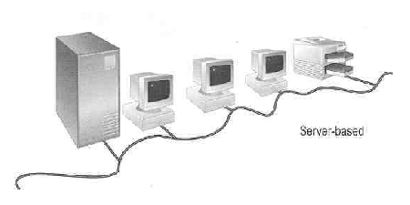
Linux User Login
Linux is a multiuser OS
Allow multiple users to use the resource of a computer at the same time
Every user needs to login the system with the password provided to identify their right in using the resource
Require for both client-server based system or desktop
Linux Server
Paul
Mary
Peter
:
Peter: admin
Paul : general
Mary : intruder
Client-server based system

Slide 18
User interface
Traditional Linux (Unix also) uses command-driven interface (or text-based interface)
  User needs to type lines of command to instruct the computer to work, similar to DOS
  Advantage: fast in speed. Very few resource is required for its implementation
  Suitable for expert users and for the systems that interaction with user is not frequent, such as servers
  Disadvantages: user needs to type, hence can easily make error. Besides, user needs to memorize all commands

Slide 19
User interface
By adopting the X-Window technology, graphical user interface (GUI) is available for Linux:
Uses pointing devices (e.g. mouse) to control the system, similar to Microsoft’s Windows
Provide menu-driven and/or icon-driven interfaces
menu-driven: user is provided with a menu of choices. Each choice refers to a particular task
icon-driven: tasks are represented by pictures (icon) and shown to user. Click on an icon invokes one task
Advantages: No need to memorize commands. Always select task from menus or icons
Suitable for general users and systems, such as PC
Disadvantages: Slow and require certain resource for its implementation

Slide 20
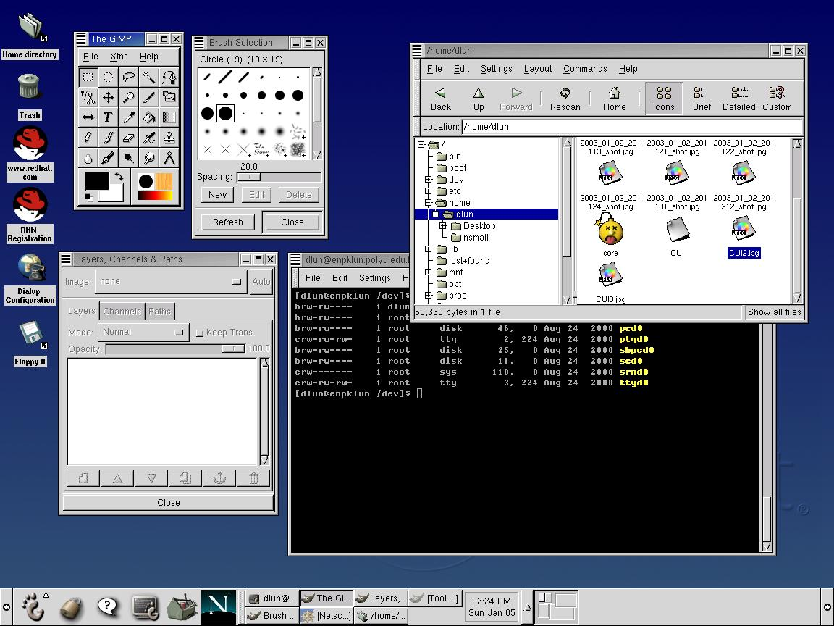
User interface
A typical Linux GUI based on GNOME
Similar to Microsoft’s Windows, however, different window systems can be chosen (e.g. GNOME, KDE, etc)

Slide 21
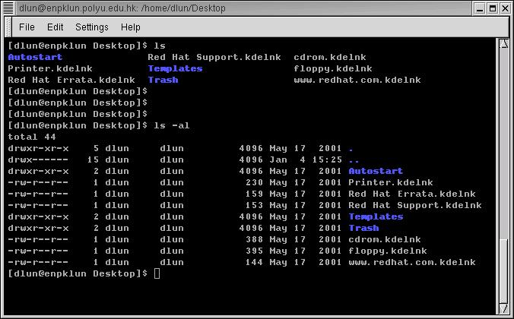
User interface
Linux text-based interface
command to show the content of current directory
The prompt $ shows that bash shell is using
command to show the content of current directory with option -al

Slide 22
Linux Shell
  Shell interprets the command and request service from kernel
  Similar to DOS but DOS has only one set of interface while Linux can select different shell
  Bourne Again shell (Bash), TC shell (Tcsh), Z shell (Zsh)
whoami
ls
pwd
Bash, Tcsh, Zsh
Kernel
  Different shell has similar but different functionality
  Bash is the default for Linux
  Graphical user interface of Linux is in fact an application program work on the shell

Slide 23
Linux Shell
Frequently used commands available in most shells:
  ls : to show the names of the file in the current directory
  cd : change directory,
    e.g. cd / change to the root directory
    cd .. change to the parent of that directory
  cp : copy one file to another
    e.g. cp abc.txt xyz.txt (copy abc.txt to xyz.txt)
  rm : remove a file
  man : ask for the manual (or help) of a command
  man cd ask for the manual of the command cd
  pwd : show the name of the current directory
  cat : to show the content of a text file
    e.g. cat abc.txt (show the content of abc.txt)
  whoami : to show the username of the current user

Slide 24
File Management

Slide 25
Linux File Management
In Linux, file is defined as simply the thing that deals with a sequence of bytes
Hence everything are files
  An ordinary file is a file; a directory is also file; a network card, a hard disk, any device are also files since they deal with a sequence of bytes
Linux supports five types of files
  simple/ordinary file (text file, c++ file, etc)
  directory
  symbolic (soft) link
  special file (device)
  named pipe (FIFO)

Slide 26
Linux File Management
The concept of simple file and directory is similar to DOS
Names in blue are directories, indicated by a letter d at the beginning of the line

Slide 27
Linux File Management
Symbolic (soft) link
  Not a real file, just a link to another file
  Allow giving another name to a file without actually duplicates it – hence save memory space
Special file (device)
  Each hardware device, e.g. keyboard, hard disk, CD-ROM, etc is associated with at least one file
  Usually store in /dev directory
  Applications can read and write any devices by reading and writing their associate file – hence the access method is known as device independent
  Divide into two types: character special files, e.g. keyboard, and block special files, e.g. disk

Slide 28
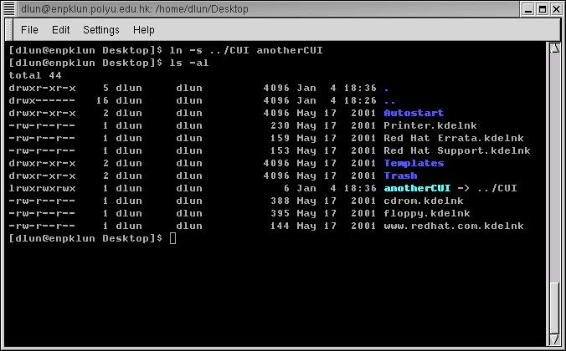
Linux File Management
Command that sets a symbolic link to a file called CUI to anotherCUI
File size is only 6 bytes
A symbolic link begins with a letter l

Slide 29
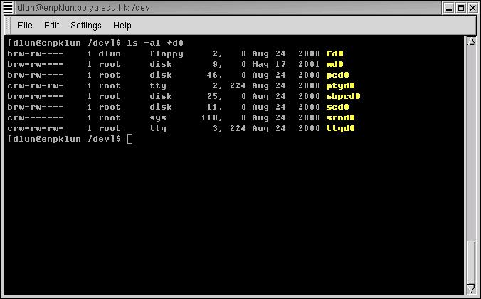
Linux File Management
Some of the special device files in /dev
fd0 – floppy disk
md0 – CD-Rom
Both of them are block devices, hence start with a letter b
Some are character devices, hence start with a letter c

Slide 30
Linux File System Structure
According to the File System Standard (FSSTND) proposed in 1994, every LINUX system should contain a set of standard files and directories
root /
directories
bin
lib
lost+found
mnt
opt
root
sbin
var
boot
dev
etc
proc
home
tmp
usr
file
…
dlun
guest
bin
lib
local
fd
hd
hd
group
passwd

Slide 31
Linux File System Structure
Root Directory ( / )
  Top of the file system. Similar to \ in DOS
/bin
  Contain the binary (executable code) of most essential Linux commands, e.g. bash, cat, cp, ln, ls, etc.
/boot
  Contain all the files needed to boot the Linux system, including the binary of the Linux kernel. E.g., on Red Hat Linux 6.1, the kernel is in /boot/vmlinux-2.2.5-15 file
/dev
  Contain the special files for devices, e.g. fd0, hd0, etc.

Slide 32
Linux File System Structure
/etc
Contain host-specific files and directories, e.g. information about system configuration
/etc/passwd
This file contains login information of users in the system
For every user, one line of record is stored in the following format:
login_name : dummy_or_encrypted_password : user_ID : group_ID : user_info : home_directory : login_shell

Slide 33
Linux File System Structure
E.g. davis:x:134:105:James A Davis:/home/davis:/bin/bash
  davis : login name
  x : means that it is a dummy password. The encrypted password is stored in /etc/shadow. This field can also be used to store the actual encrypted password. In any case, the original (unencrypted) password cannot be seen by anyone, including the administrator

Slide 34
Linux File System Structure
E.g. davis:x:134:105:James A Davis:/home/davis:/bin/bash
  134 : a user id given to that user. Range from 0 to 65535. 0 is assigned to super-user. 1 to 99 are reserved
  105 : a group id given to that user to indicate which group he belongs to. Range from 0 to 65535. 0 to 99 reserved
  James A Davis : user info, usually user’s full name
  /home/davis : home directory of the user
  /bin/bash : the location of the shell the user is using

Slide 35
Linux File System Structure
/home
  Contain the home directories of every user in the system, e.g. dlun, guest, etc
/lib
  Store all essential libraries for different language compilers
/lost+found
  Contain all the files on the system not connected to any directory.
  System administrator should determine the fate of the files in this directory

Slide 36
/mnt
  Use by system administrator to mount file systems temporarily by using the mount command
  Before using any devices, they have to be mounted to the system for registration
  For example, after mounting a CD-ROM, the file system in it will be mapped to /mnt/cdrom directory
  User can then read and write files in the CD-ROM by accessing this directory
  Similar to mapping a drive letter to a CD-ROM in Windows
  Different from the special file in /dev. Special file is only a place where data of the CD-ROM is transferred or stored. No file system concept

Slide 37
Linux File System Structure
  /opt
  Use to install add-on software packages, e.g. star office, etc.
  /proc
  Contain process and system information
  /root
  Home directory of the user root, usually the administrator
  /sbin
  The directories /sbin, /usr/sbin, and /usr/local/sbin contain system administration tools, utilities and general root only commands, such as halt, reboot and shutdown

Slide 38
/tmp
  Contain temporary files. Usually files in this directory will be deleted from time to time to avoid the system fills with temp files
/usr
  One of the largest sections of the Linux file system
  Contain read-only data that are shared between various users, e.g. the manual pages needed for the command man. Stored in /usr/man direcrtory
/var
  Contain data that keeps on changing as the system is running. E.g. /var/spool/mail directory keeps the mail of user

Slide 39
Linux File Access Privilege
Linux is a multiuser system, the files of all users are stored in a single file structure
Mechanism is required to restrict one user to access the files of another user, if he is not supposed to
User can impose access permission to each file to restrict its access
The term “access permission” refers to
  read permission
  write permission
  execute permission

Slide 40
Linux File Access Privilege
The file access permission can be seen by using the command ls –l or ls -al

Slide 41
Linux File Access Privilege
File last modified date
Hard link no
Owner’s group
Owner
d rwx r-x r-x 2 dlun dlun 4096 May 17 2001 Autostart
file size
file name
It is a directory
The directory can be read, written and executed by the user dlun
The directory can be read and executed but not written by other users in the same group of dlun
The directory can be read and executed but not written by other users in different group of dlun
The group of a user is assigned by the administrator when a user is added to the system

Slide 42
Linux File Access Privilege
Access permission can also be assigned to a directory
Directory is also a file that contains the attributes of the files inside it
If read permission is not given to a directory
  cannot show the structure of this directory
  e.g. cannot use ls
If write permission is not given to a directory
  cannot modify anything of the directory structure
  e.g. cannot copy a file into this directory since it will modify the directory structure by adding one more file
If execute permission is not given to a directory
  nearly nothing can be done with this directory, even cd

Slide 43
Linux File Access Privilege
The access permission of a file or directory can be changed by using the command
chmod xyz filename/directory name
xyz refers 3 digit in octal form
E.g.
660 : 110 110 000
⇒ rw- rw- ---
545 : 101 100 101
⇒ r-x r-- r-x

Slide 44
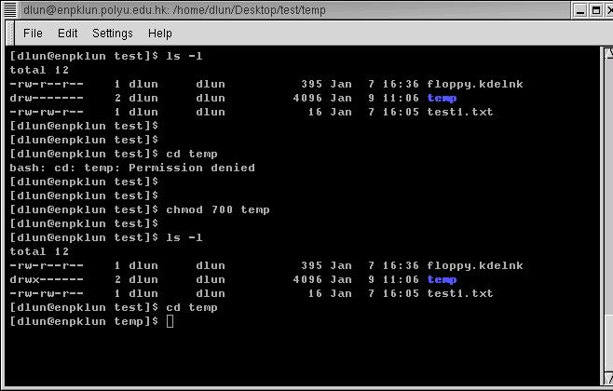
Linux File Access Privilege
temp does not have execution right
even cd is not workable
execution right is added
now we can change the directory to temp

Slide 45
File Storage in Linux
Data storage on hard disk
  Data in a hard disk are stored on a magnetic flat plate
  Disk’s surface needs to be partitioned and labeled so that computer can go directly to a specific point on it
  Achieve by low level formatting the disk
    Create magnetic concentric circles called tracks
    Each track is split into smaller parts called sectors and numbered
Each sector: hold 512 bytes data
  E.g. 80 tracks (from outer to inner 0 .. 79), 18 sectors disk can store 80x18x512 bytes data.

Slide 46

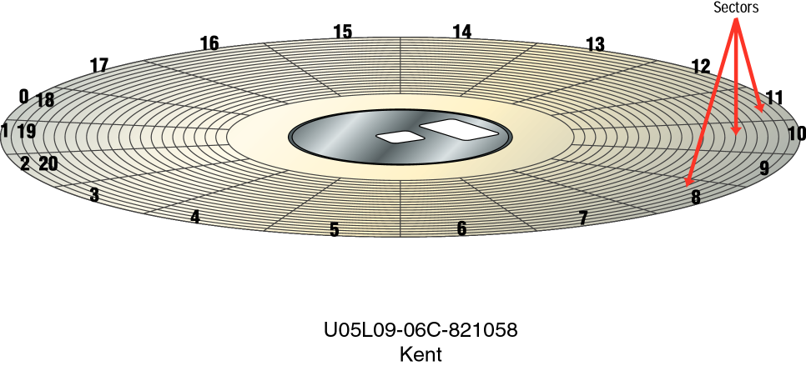
Formatted Disk
Density of data is higher for inner tracks than outer tracks
Sector
Track

Slide 47
Formatted Disk
Must read or write whole sector at a time
OS allocates groups of sectors called cluster to files
Files smaller than the cluster will still be allocated the whole cluster, but the rest left unused
In Linux, every file is associated with an inode that records its location in the disk
The inode of all files are put together in a data structure called inode table
In the directory, every file is associated with a inode number that points to an entry of the inode table

Slide 48
Formatted Disk
Contents of the directory /home/dlun
1076 | …
2083 | …
13059 | lab1.c
17488 | lab2.c
18995 | lab3.c
Number of links
File mode
User ID
Time created
Time last updated
:
Location on disk
Lab3.c
:
Lab2.c
Lab1.c
:

Slide 49
Process management

Slide 50
Linux Process Management
Linux is a multitasking system
Multiple programs can be executed at the same time
Ultimately, a program needs to be executed by a CPU
If there is only one CPU, how multiple programs can be executed at the same time? By time sharing
That is, all programs are claimed to be executing. In fact, most of them are waiting for the CPU

Slide 51
Linux Process Management
A program that is claimed to be executing is called a process
For a multitasking system, a process has at least the following three states:
Start execution
Ready
Running
Finish execution
Sleeping

Slide 52
Linux Process Management
Ready state
  All processes that are ready to execute but without the CPU are at the ready state
  If there is only 1 CPU in the system, all processes except one are at the ready state
Running state
  The process that actually possesses the CPU is at the running state
  If there is only 1 CPU in the system, at most there is only one process is at the running state
Sleeping state
  The process that is waiting for other resources, e.g. I/O, is at the sleeping state

Slide 53
Linux Process Management
Processes will alternatively get into the CPU one after the other (called the round robin scheme)
A process will be “in” a CPU for a very short time (quantum)
  For Linux, each quantum is about 100msec
At the time that a process is selected to be “in” the CPU; It goes from ready state to running state
After that, it will be swapped out; It goes from running state back to ready state
Or it may due to the waiting of an I/O device, e.g. mouse
  It goes from running state to sleeping state; When obtaining the required resource
  It goes from sleeping state to ready state

Slide 54
Linux Process Management

Slide 55
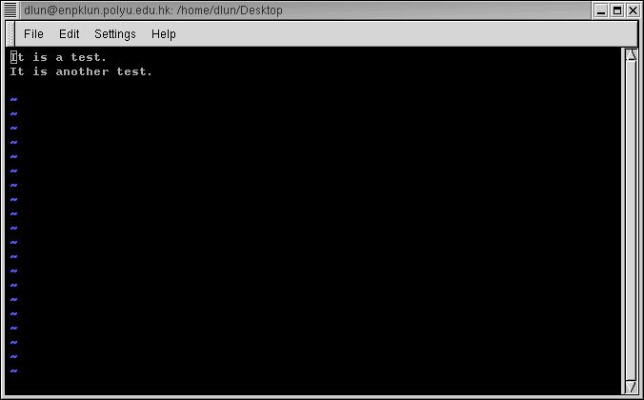
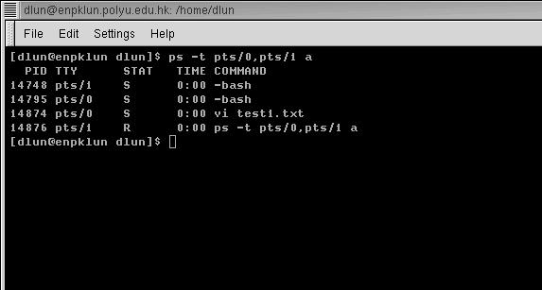
Linux Process Management
Terminal pts/0 has the editor vi running
Terminal pts/1 is executing ps to see the processes of both terminals
The processes of a system can be seen by using the command
ps

Slide 56
Linux Process Management
PID TTY STAT TIME COMMAND
14748 pts/1 S 0:00 –bash
pts/0 S 0:00 –bash
14974 pts/0 S 0:00 vi test1.txt
14876 pts/1 R 0:00 ps …
How much time the process is continuously executing
Process ID
State:
S – Sleeping
(waiting for input)
R – Running
Terminal name

Slide 57
Linux Process Management
For the example above, both bash processes, which are the shell of both terminals, are waiting for the input of user. They must be in the sleeping state
The vi process, which is an editor, is also waiting for the input of user. Hence it is also in sleeping state
When ps reporting the processes in the system, it is the only process that is running. Hence it is in running state

Slide 58
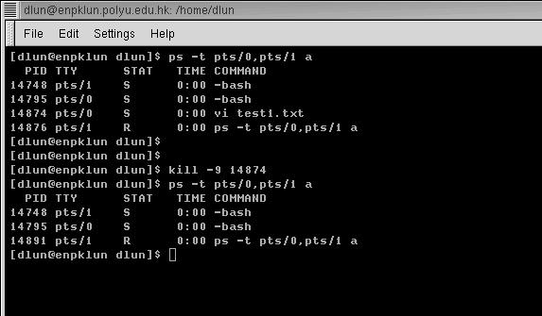
Linux Process Management
A process can be forced to terminate by using the command kill -9 PID
The vi process is terminated by using the command
kill -9 14874

