Slide 1
CSC 322 Operating Systems Concepts
Lecture - 30:
by
Ahmed Mumtaz Mustehsan
Special Thanks To:
Tanenbaum, Modern Operating Systems 3 e, (c) 2008 Prentice-Hall, Inc. (Chapter-11)
Operating Systems (Third Edition) Deitel, Deitel and Choffnes Prentice Hall, 2004, (Chapter-21)
Notes:
1

Slide 2
Case Study
Windows VISTA
Chapter 11

Slide 3
Windows Vista
History
Programming Windows Vista
Operating System Structure
Process and Thread Management
Thread Scheduling
Memory Management
Input/Output in Vista
File System (NTFS )
Security
Interprocess Communication

Slide 4
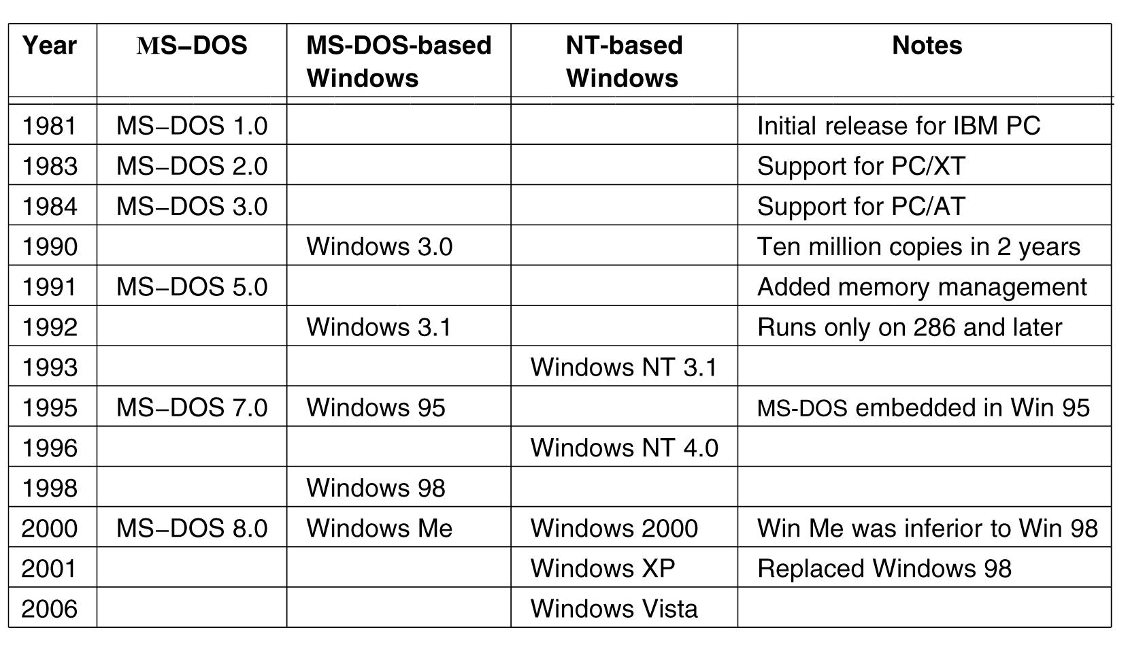
History of Microsoft OS Platforms
Major releases in the history of Microsoft operating systems for desktop PCs.

Slide 5
History of Microsoft OS Platforms
1976 Bill Gates and Paul Allen founded Microsoft
1981 MS-DOS 1.0 (Known as CP/M)
    16-bit addressing
    8 KB memory resident code
1985 Windows 1.0
    First Microsoft GUI operating system
1990 Windows 3.1 and Windows for Workgroups 3.1
    Added network support (LANs)
1992 Windows NT 3.1
    NTFS
    32-bit addressing
1995 Windows 95
    32-bit addressing
    DirectX
    Simulates direct access to hardware through API

Slide 6
History of Microsoft OS Platforms
1996 Windows NT 4.0
    Moved graphics driver into kernel
1998 Windows 98
    Bundled Internet Explorer into operating system
2000 Windows ME
    Does not boot in DOS mode
2000 Windows 2000
    Active Directory
    Database of users, computers and services
2001 Windows XP
    64-bit support
2006 Windows Vista

Slide 7
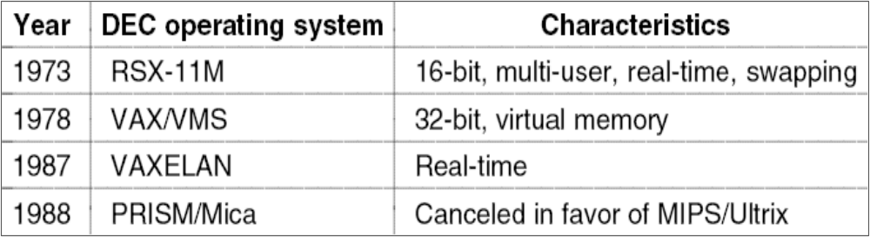
2000s: NT-based Windows
DEC Operating Systems developed by Dave Cutler
NT was inspired from VMS operating system
DEC (Digital Equipment Company), a minicomputer maker was sold in 1998 to Compaq which was bought by HP
NT was also jointly developed as OS/2 for IBM

Slide 8
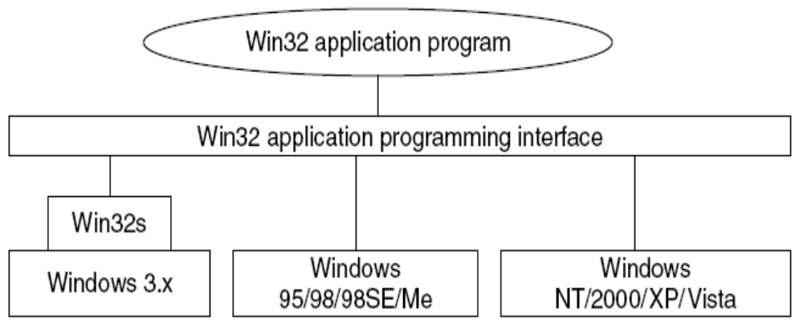
2000s: NT-based Windows
The Win32 API allows programs to run on almost all versions of Windows.

Slide 9
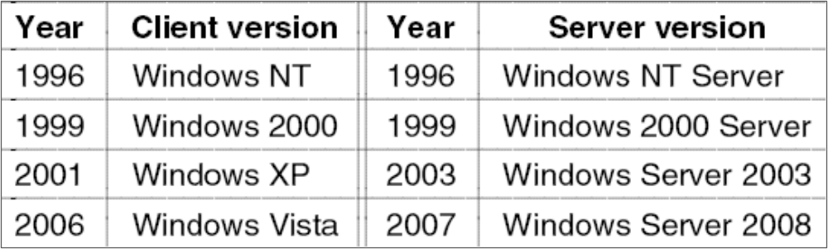
2000s: NT-based Windows
Split client and server releases of Windows.

Slide 10
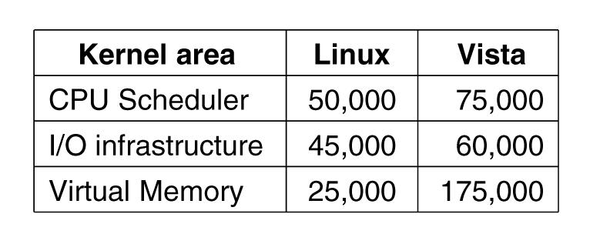
Size of Code Windows Vista vs LINUX
Comparison of lines of code for selected
kernel-mode modules in Linux and Windows (from Mark Russinovich, co-author of Microsoft Windows Internals).

Slide 11
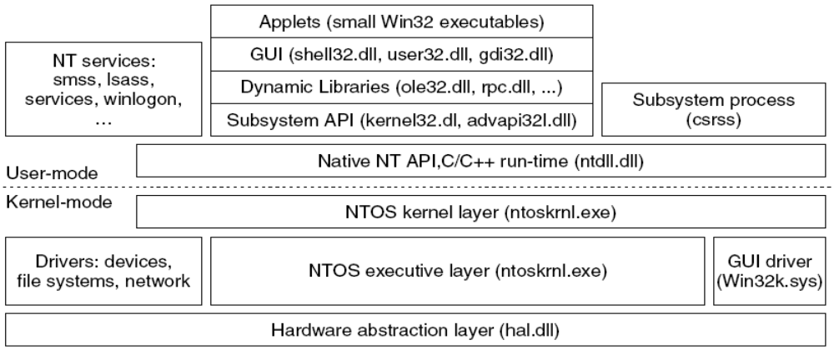
Programming Windows Vista
The programming layers in Windows
Beneath the applets and GUI layers we have the API
These are dynamic link libraries (DLLs)
NTOS is the kernel mode program which provides the system call interface for Microsoft programmers (not open to public)

Slide 12
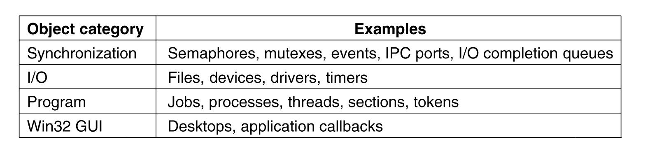
The Native NT Application
Programming Interface
Common categories of kernel-mode object types.

Slide 13
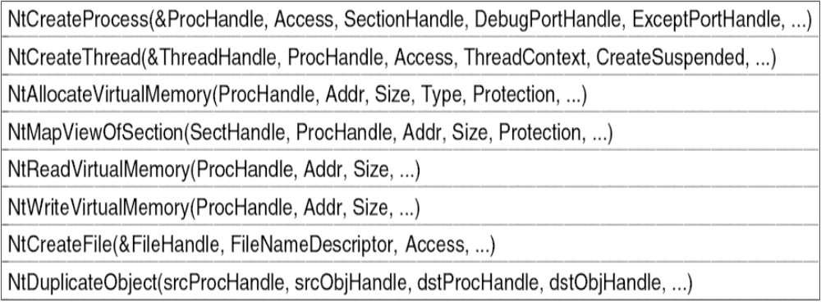
The Native NT Application
Programming Interface (2)
Examples of native NT API calls that use handles to manipulate objects across process boundaries.

Slide 14
The Win32 Application; Programming Interface
Win32 API : Interface for developing applications
Fully documented and publicly disclosed
The API is a library of procedures that either wrap (use and call somehow) the native NT system calls or do the work themselves
Two special execution environments are also provided
  WOW32 (Windows-on-Windows) which is used on 32-bit x86 systems to run 16-bit Windows 3.x applications by mapping system calls and parameters between the 16-bit and 32-bit worlds
  WOW64 does the same thing for 32-bit applications to work on x64 systems
  Previously there were OS2 and POSIX environments but not anymore

Slide 15
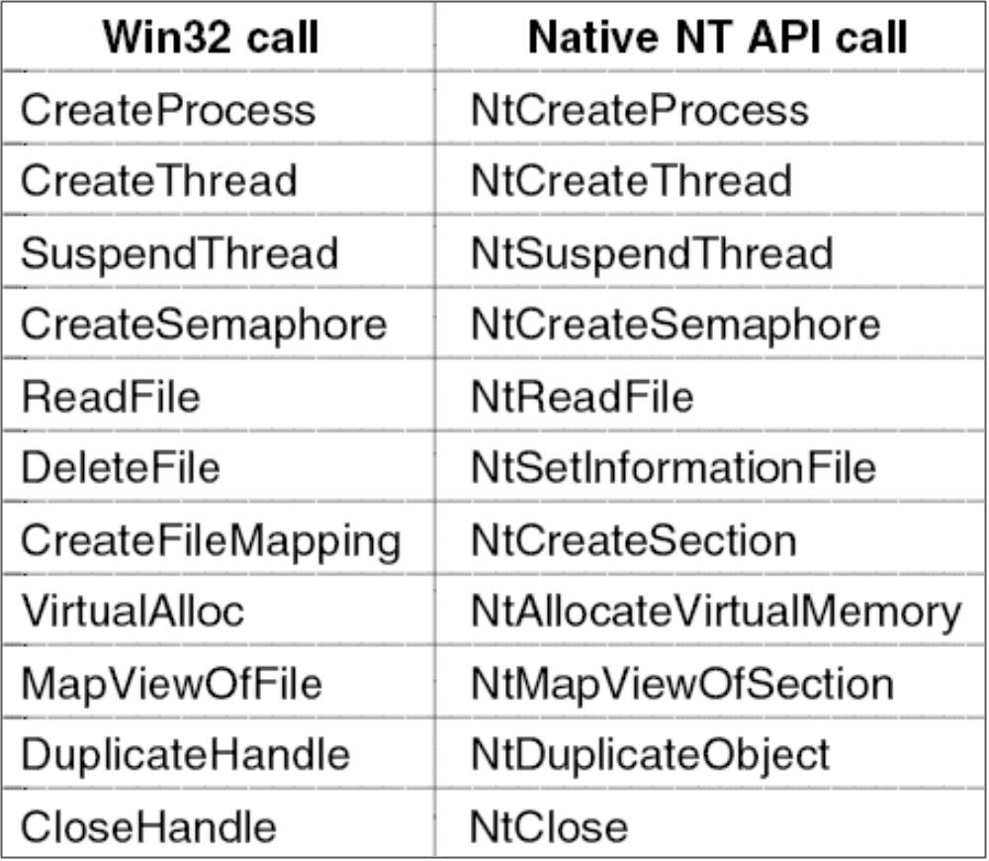
The Win32 Application : Programming Interface
Examples of Win32 API calls and the native NT API calls that they wrap.

Slide 16
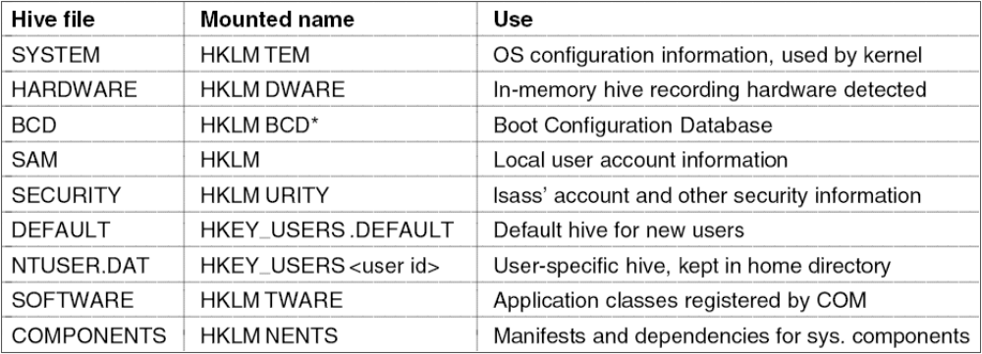
The Windows Registry
The registry hives in Windows Vista. HKLM is a short-hand for HKEY_LOCAL_MACHINE.
Registry is a special file system to record the details of system configuration
The registry is organized into separate volumes called hives
When the system is booted the SYSTEM hive is loaded into memory

Slide 17
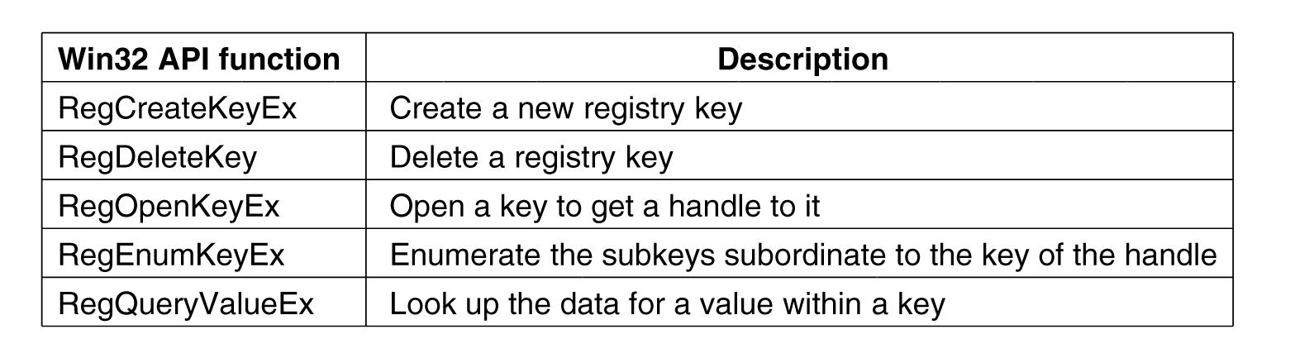
The Windows Registry (Win32 API Functions)
Some of the Win32 API calls for using the registry
Before the registry, older Windows versions kept configuration information in .ini (initialization) files scattered all around the disk
Regedit is a program to inspect and modify the registry but be carefull

Slide 18
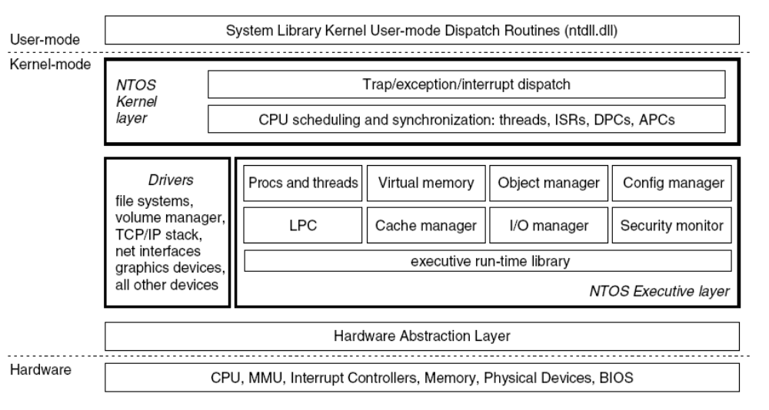
Operating System Structure
Windows kernel-mode organization.

Slide 19
Operating System Kernel
The system library (ntdll.dll) executing at user-mode contains compiler run-time and low-level libraries
NTOS kernel layer: thread scheduling, synchronization abstractions, trap handlers, interrupts etc.
NTOS executive layer contains the services such as management services for virtual memory, cache, I/O etc.
HAL (Hardware Abstraction Layer)
  Interacts with hardware, drives device components on main board
  Abstracts hardware specifics the difference between systems of the same architecture (such as different CPUs)
Device drivers are used for any kernel-mode activities which are not a part of NTOS or HAL (such as file system, network protocols and antivirus software)

Slide 20
Booting Windows Vista
On power on, BIOS loads a small bootstrap loader found at the beginning of the disk drive partitions
Bootstrap loader loads BootMgr program from the root directory
If hibernated or in stand-by mode WinResume.exe is loaded
    else Winload.exe is loaded for a fresh boot.
    This program loads:
  Ntoskrnl.exe
  Hal.dll
  SYSTEM hive
  Win32k.sys (kernel-mode parts of Win32 subsystem)
  Other boot drivers

Slide 21
Process and Thread Management
Processes (containers for threads. Process Environment Block PEB)
Threads (Basic scheduling unit. Normally executes in user-mode. Thread Environment Block TEB )
Jobs
  Group processes together as a unit
  Manage resources consumed by these processes (e.g., CPU time, memory consumption, etc.)
  Terminate all processes at once

Slide 22
Process and Thread Organization
Fibers
  Unit of execution (like a thread)
  Scheduled by thread that creates them, not microkernel.
  Thread must convert itself into a fiber to create fibers
  Advantage is in fast switching: Thread switching requires entry and exit to kernel. A fiber switch saves and restores a few registers withou changing modes at all
  Used rarely

Slide 23
Process and Thread Organization
Thread pools
  Worker threads that sleep waiting for work items
  Each process gets a thread pool
  Useful in certain situations
    Fulfilling client requests
    Asynchronous I/O
    Combining several threads that sleep most of the time
  Memory overhead and less control for the programmer

Slide 24
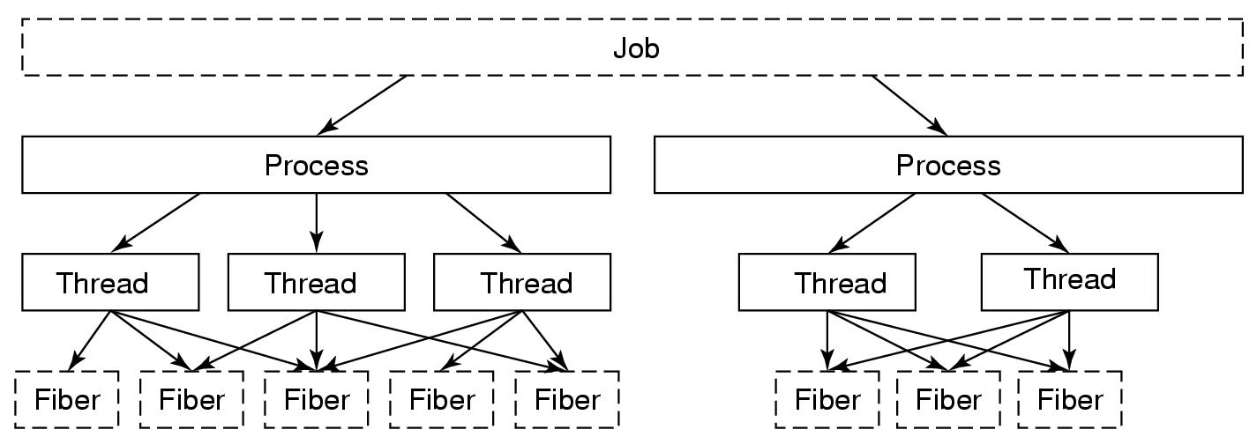
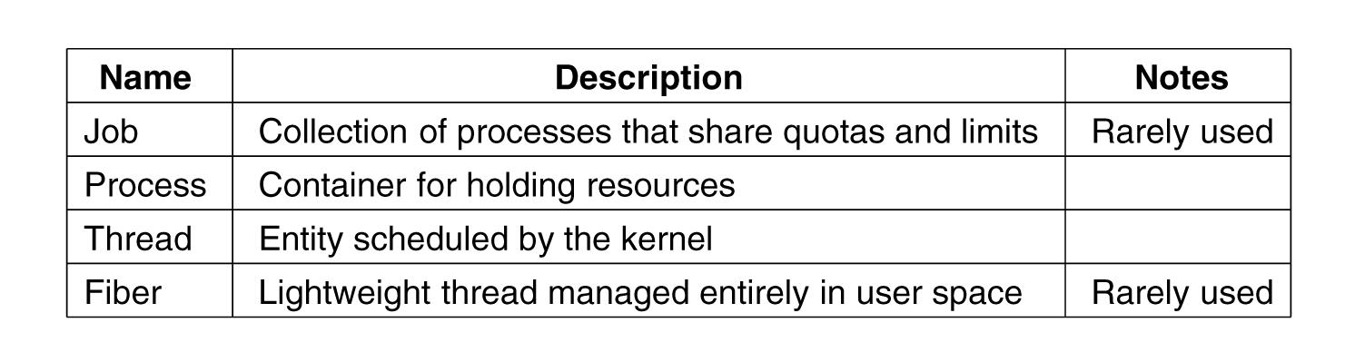
Processes and Threads
  The relationship between jobs, processes, threads and fibers. Jobs and fibers are optional; not all processes are in jobs or contain fibers.
Basic concepts used for CPU and resource management.

Slide 25
Thread Synchronization
Dispatcher objects
Event object
  Signaled when event occurs;
  unsignaled either when one thread awakens or all threads awaken (choice determined by event’s creator)
Mutex object
  One owner
  Acquire – unsignaled; release – signaled
Semaphore object
  Counting semaphore
  Signaled while count > 0; unsignaled when count 0
  Can be acquired multiple times by same thread

Slide 26
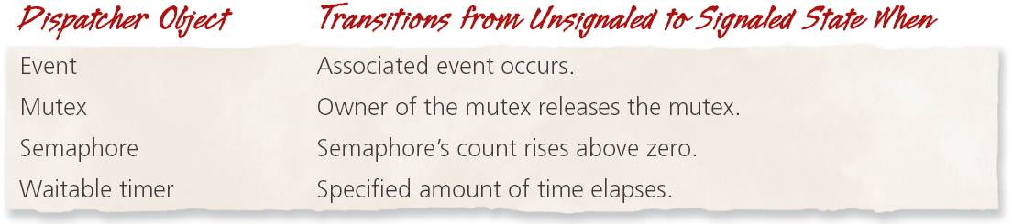
Thread Synchronization
Dispatcher objects (cont.)
  Waitable timer object
  Signaled when time elapses
  Manual reset vs. auto reset
  Single user vs. periodic
  Examples: Objects that can act as dispatcher objects;
  Process, thread, console input

Slide 27
Thread Synchronization
Kernel mode locks
  Spin lock
  Queued spin lock
    More efficient than spin lock
    Guarantees FIFO ordering of requests
Fast mutex
  Like a mutex, but more efficient
  Cannot specify maximum wait time
  Reacquisition by owning thread causes deadlock
Executive resource lock
    One lock holder in exclusive mode
    Many lock holders in shared mode
    Good for readers and writers

Slide 28
Thread Synchronization skip
Other synchronization tools
  Critical section object
    Like a mutex, but only for threads of the same process
    Faster than a mutex
    No maximum wait time
  Timer-queue timer
    Waitable timer objects combined with a thread pool
  Interlocked variable access
    Atomic operations on variables
  Interlocked singly-linked lists
    Atomic insertion and deletion

Slide 29
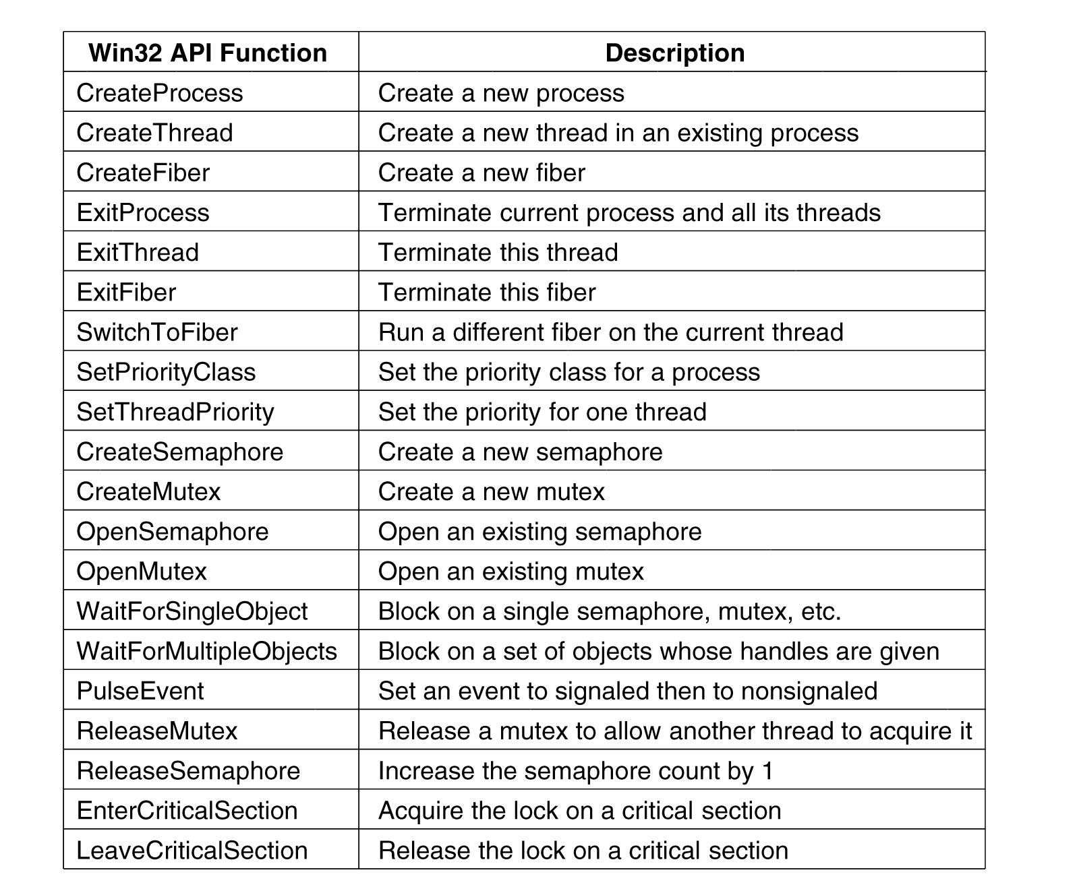
Synchronization skip
Some of the Win32 calls for managing processes, threads, and fibers.

Slide 30
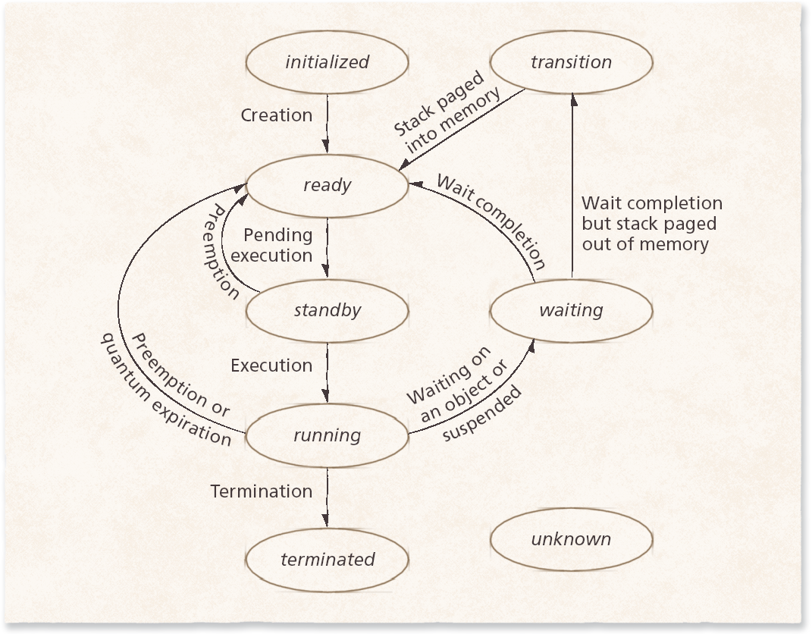
Thread Scheduling
Thread States
  Initialized
  Ready
  Standby
  Running
  Waiting
  Transition
  Terminated
  Unknown

Slide 31
Thread Scheduling
Windows kernel does not have a central scheduling thread. Instead, when a thread can not run any more, the thread enters kernel-mode and calls into the scheduler itself to see which thread to switch to

Slide 32
Thread Scheduling (3)
The following conditions cause the currently running thread to execute the scheduler code:
  The currently running thread blocks on a semaphore, mutex, event, I/O, etc.
  The thread signals an object (e.g., does an up on a semaphore or causes an event to be signaled).
  The quantum expires.
The scheduler is also called under two other conditions:
  An I/O operation completes.
  A timed wait expires.

Slide 33
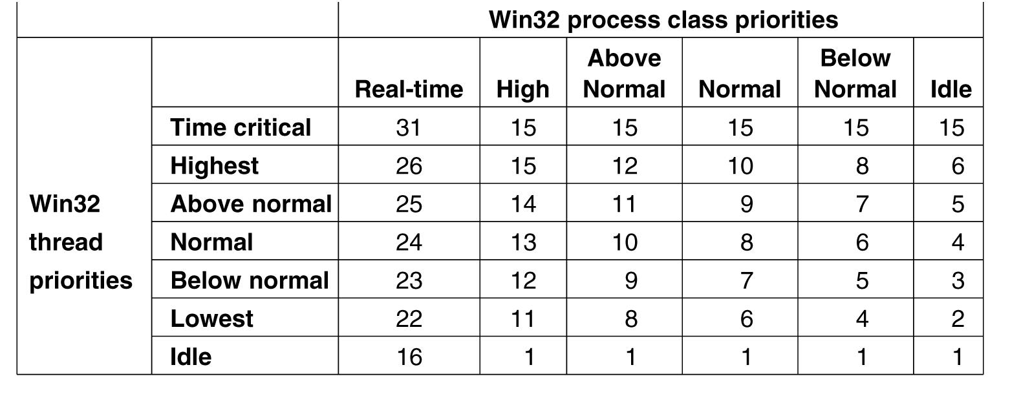
Thread Scheduling
Mapping of Win32 thread priorities to
Windows Process class priorities.

Slide 34
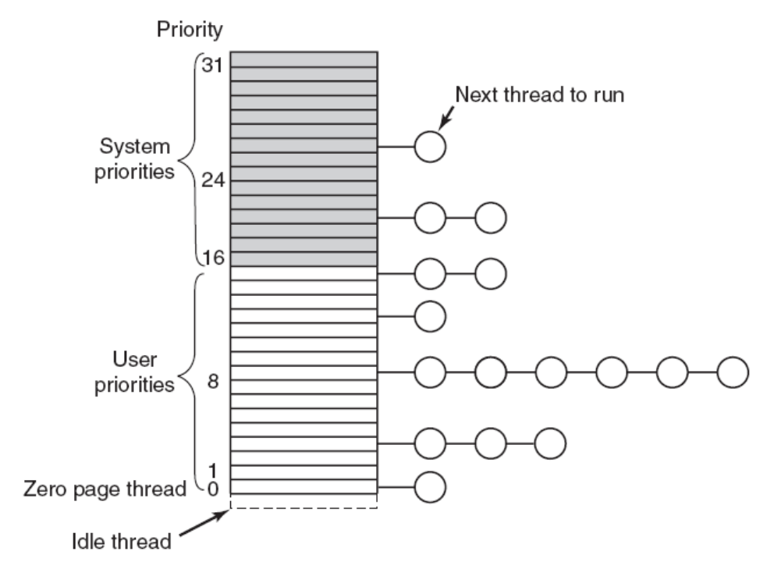
Thread Scheduling (4) skip
Windows Vista supports 32 priorities for threads.
Round-robin for highest-priority non-empty ready queue

Slide 35
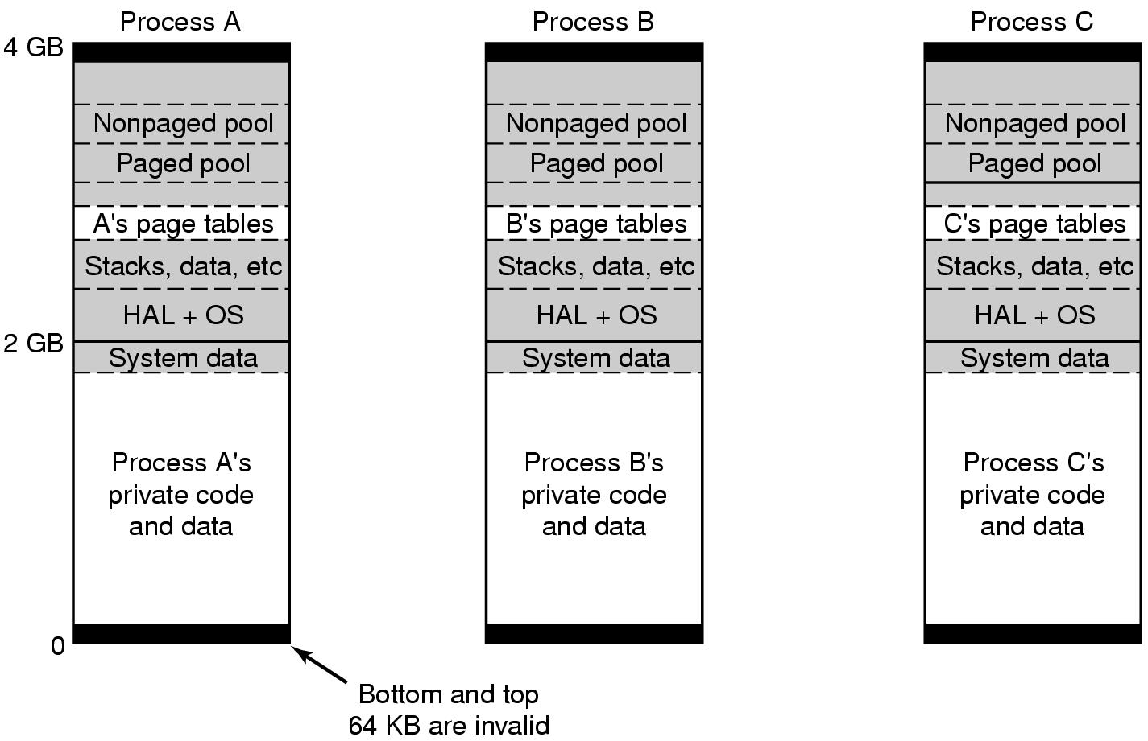
Memory Management
Virtual address space layout for three user processes on the x86. The white areas are private per process. The shaded areas are shared among all processes.
Explanation next slide

Slide 36
Memory Management (2)
Bottom and top 64 KB are intentionally unmapped
64 KB – 2 GB: User’s private code and data
2 GB – 4 GB (less 64 KB) : Operating system kernel virtual memory containing code, data, paged and nonpaged pools as well as process page table.
Kernel virtual memory is shared by all processes and is only accessible while running in kernel mode
For x86 and x64 systems virtual address space is demand paged with 4 KB sized pages (No segmentation)

Slide 37
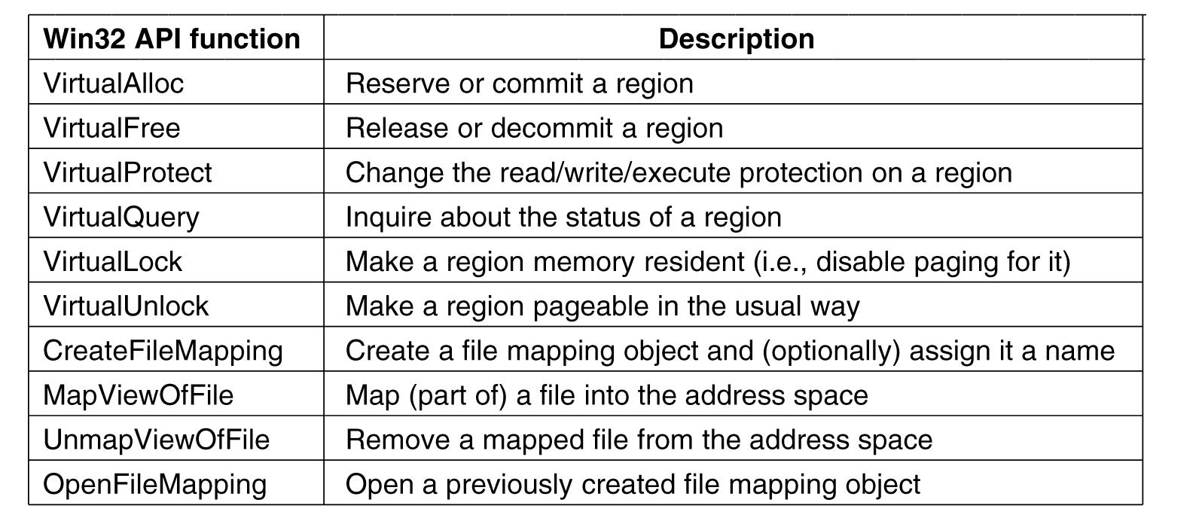
Memory Management System Calls
The principal Win32 API functions for managing virtual memory in Windows.

Slide 38
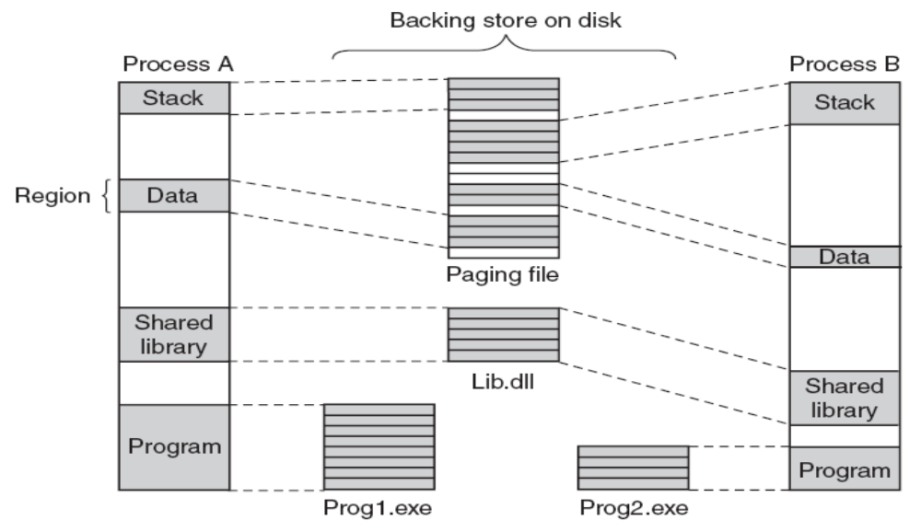
Implementation of Memory Management
Mapped regions with their shadow pages on disk. The lib.dll file mapped into two address spaces at same time.

Slide 39
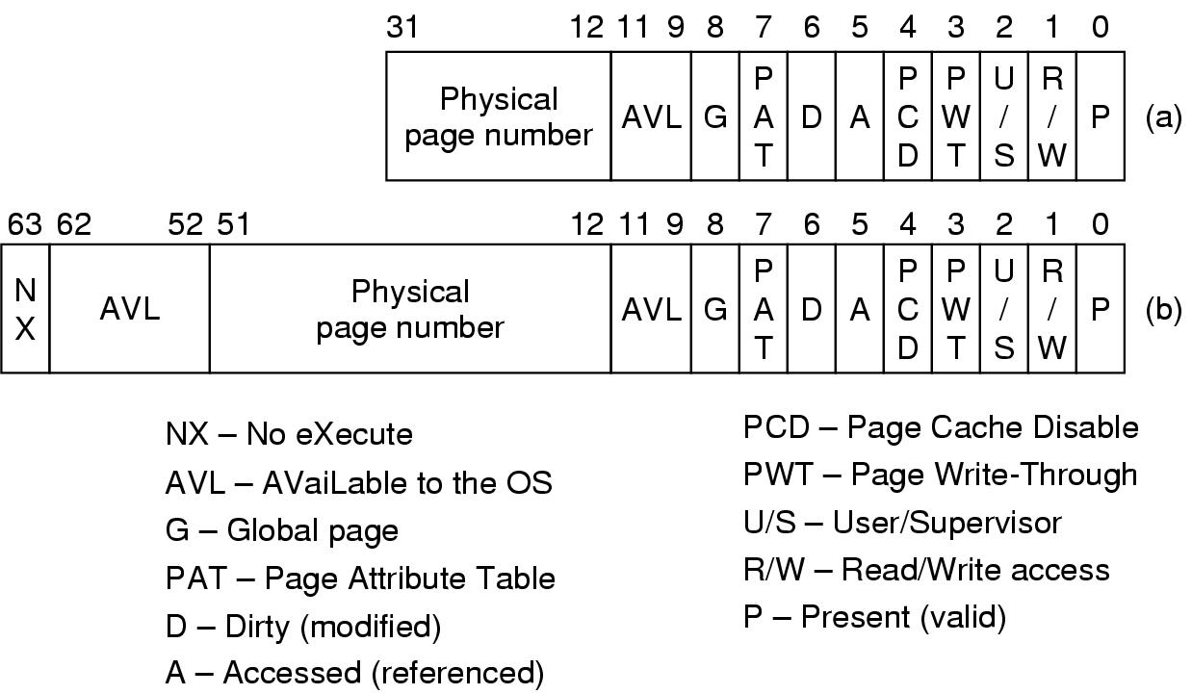
Page Fault Handling skip
Figure 11-33. A page table entry (PTE) for a mapped page on the (a) Intel x86 and (b) AMD x64 architectures.
D and A bits are used to implement a LRU (Least Recently Used) style page replacement algorithm

Slide 40
Page Fault Handling (2)
Each page fault can be considered as being in one of five categories:
  The page referenced is not committed (program error – page has not been assigned to a process or in memory).
  Attempted access to a page in violation of the permissions (program error).
  A shared copy-on-write page was about to be modified.
  The stack needs to grow.
  The page referenced is committed but not currently mapped in (normal page fault in a paged system).

Slide 41
Page Replacement Algorithm (1)
The working set concept is used
Each process (not each thread) has a working set
Each working set has two parameters:
    A minimum size (initally 20 to 50 pages)
    A maximum size (initially 45 to 345 pages)
    Every process starts with the same minimum and maximum but these bounds can change over time

Slide 42
Page Replacement Algorithm (2)
Working sets only come into play when physical memory gets low
Otherwise, processes can exceed the maximum of their working set
The working set manager runs periodically based on a timer and does the following:
  When lot of memory is available, it uses the access bits to compute an age for each page
  When memory gets tight, the working set is fixed and oldest pages are replaced when a new page is needed
  When memory is tight, the working sets are trimmed below their maximum by removing the oldest pages

Slide 43
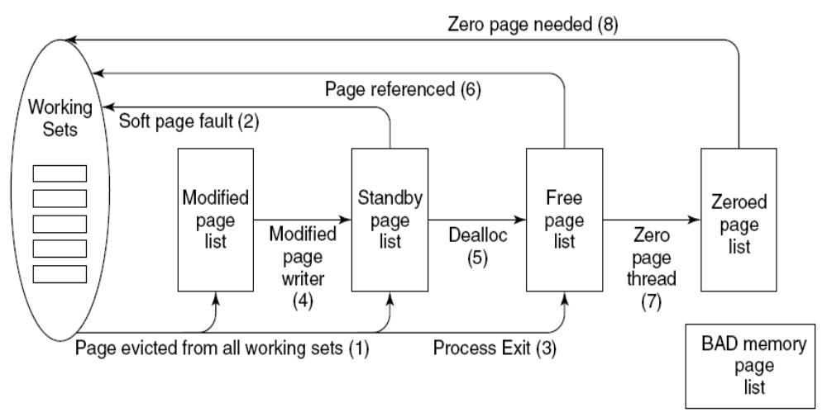
Physical Memory Manager (1)
The various page lists and the transitions between them.

Slide 44
Physical Memory Manager (2)
Pages removed from a working set are put on either modified page list or standby page list (pages which are not modified)
The pages on these two lists are in memory so if a page fault occurs and one of these pages is needed, they are put back to the working set with no disk I/O (A soft page fault)
When a process exits all nonshared pages of the working set, modified pages and standby pages are returned to the free page list

Slide 45
Physical Memory Manager (3)
A modified page writer thread wakes up periodically and writes modified pages to disk and move them to the standby list if there are not enough clean pages
When a page is not needed by a process, it goes to the free page list
At a page fault (hard fault) a free page is taken from the free page list
Whenever the CPU is idle, a lowest priority thread, the ZeroPage thread resets free pages to zeros and puts them on zeroed page list
When a zeroed page is needed for security reasons, pages are taken from the zeroed page list

Slide 46
Input/Output in Vista
The I/O system consists of
  Plug-and-play services
  The power manager
  The Input/Output manager
  Device drivers

Slide 47
Plug-and-Play Services
Buses such as PCI, USB, EIDE, and SATA had been designed in such a way that the plug-and-play manager can send a request to each slot and ask the device there to identify itself
After identification PnP manager allocates hardware resources, such as interrupt levels, locates the appropriate drivers, and loads them into memory
As each driver is loaded, a driver object is created

Slide 48
Power Manager
The power manager adjusts the power state of the I/O devices to reduce system power consumption when devices are not in use
This is very important when laptops are on battery power
Two special modes of power saving:
  Hibernation mode: all of the physical memory is copied to disk and power consumption is reduced to a minimum level
  Standby mode: power is reduced to the lowest level enough to refresh the dynamic RAM

Slide 49
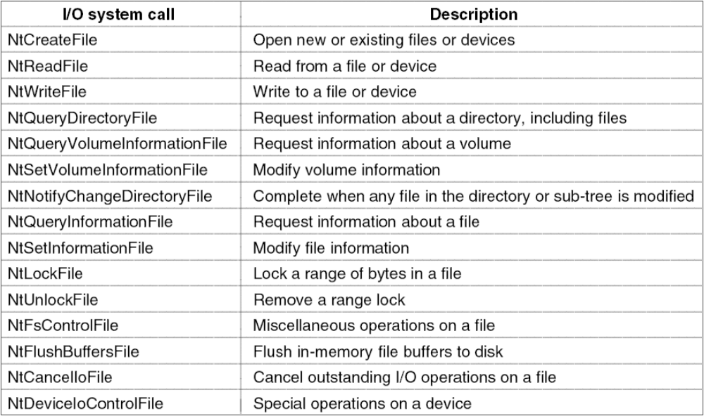
Input/Output Manager
Handles I/O system calls and IRP (I/O Request Packet) based operations
Native NT API calls for performing I/O

Slide 50
Device Drivers
All drivers must conform to the WDM (Windows Driver Model) standarts for compatibility reasons with the older windows versions
Devices in Windows are represented by device objects which are used to represent
  Hardware, such as buses
  Software abstractions like file systems, network protocol engines and kernel extensions, like antivirus filter drivers

Slide 51
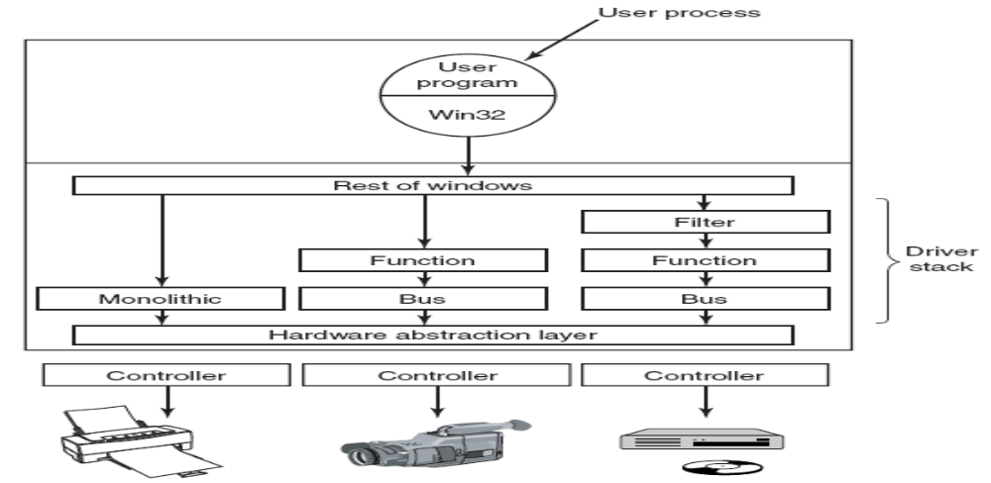
Device Stacks
Windows allows drivers to be stacked to work with a specific instance of a device. The stacking is represented by device objects.
  A driver may do the work by itself like a printer driver
  Some drivers are stacked, meaning that requests pass through a sequence of drivers

Slide 52
File Systems
Three driver layers
Volume drivers
  Low level drivers
  Interact with data storage hardware devices
  2. File system drivers
  NTFS
  FAT16 (16 bit disk addresses with disk partitions at the most 2 GB)
  FAT32 (32 bit disk addresses and supports partitions up to 2 TB, not secure and used mainly for transportable media, such as flash disks, nowadays
  3. File system filter drivers
  Perform high-level functions
  Virus scanning
  Encryption

Slide 53
File System and Disk I/O
Typical Disk I/O
  User-mode thread passes file handle to object manager
  Object manager passes file pointer to file system driver
  File system driver passes request to device driver stack
  Eventually request reaches disk
  Disk performs requested I/O

Slide 54
Windows NT File System NTFS
NTFS overview
Windows NT file system
More secure than FAT
Scales well to large disks
  Cluster size depends on disk size
  64-bit file pointers
  Can address up to 16 exabytes of disk
Multiple data streams
Compression and encryption

Slide 55
Powers of 10 & 2 - Side Remark skip
Prefix | Symbol | Power of 10 | Power of 2
Kilo | K | 10³ | 2¹⁰
Mega | M | 10⁶ | 2²⁰
Giga | G | 10⁹ | 2³⁰
Tera | T | 10¹² | 2⁴⁰
Peta | P | 10¹⁵ | 2⁵⁰
Exa | E | 10¹⁸ | 2⁶⁰
Zetta | Z | 10²¹ | 2⁷⁰
Yotta | Y | 10²⁴ | 2⁸⁰
64 bits for addressing = 16 Exa bytes

Slide 56
File System Structure
Each NTFS volume (e.g., disk partition) contains files, directories, bitmaps, and other data structures
Each volume is organized as a linear sequence of blocks (called as clusters) usually 4 KB in size (can be 512 bytes to 64 KB) and pointed by 64 bit pointers
The main data structure in each volume is the MFT (Master File Table) which is a linear sequence of 1 KB records

Slide 57
NTFS Master File Table (1)
Each MFT record describes one file or directory and contains file attributes (file name, block addresses, timestamps etc.)
The MFT is a file itself and can be placed anywhere within the volume thus eliminating the problem of defective sectors in the first track
MFT can grow dynamically up to a maximum size of 2⁴⁸ records
The first 16 MFT records are reserved for NTFS metadata files which contain volume related system data to describe the volume

Slide 58
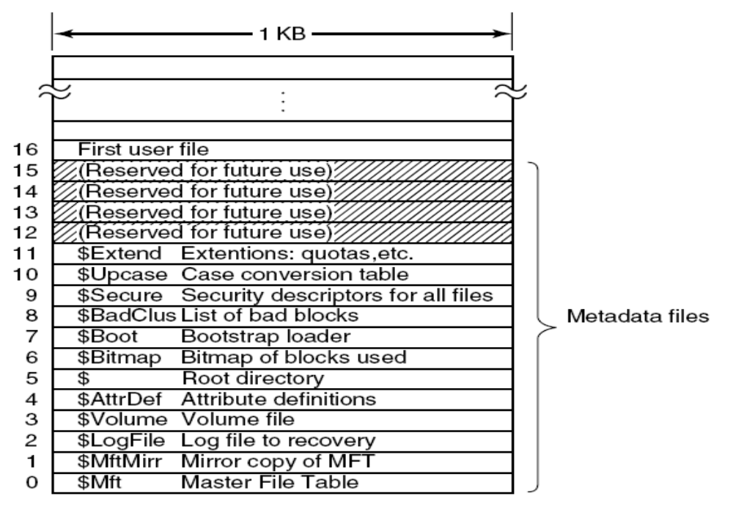
NTFS Master File Table

Slide 59
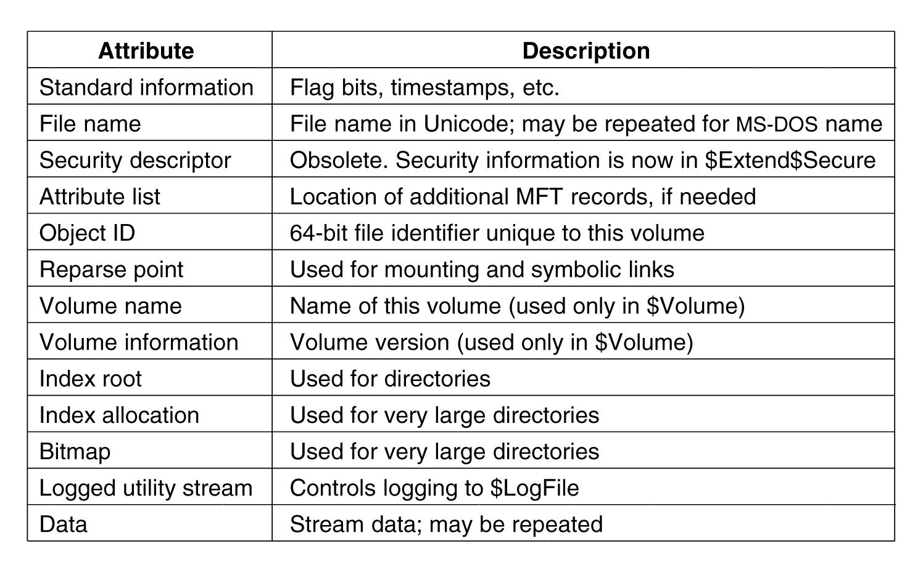
Attributes Used in MFT Records
Each record consists of a sequence of (attribute header – name & length, value) pairs
If attribute is small it is kept in the record, if it is long it is put in another block on disk and pointed here

Slide 60
Security
Security properties inherited from the original security design of NT:
Secure login with anti-spoofing measures (prevents login screen to be imitated)
Discretionary access controls (owner has the rights)
Privileged access controls (superuser can override)
Address space protection per process
New pages must be zeroed before being mapped in
Security auditing (log of several security related events)

Slide 61
Interprocess Communication
Data oriented
  Pipes
  Mailslots (message queues)
  Shared memory
Procedure oriented / object oriented
  Remote procedure calls
  Microsoft COM (Component Object-Model) objects
  Clipboard
  GUI drag-and-drop capability

Slide 62
Pipes
Manipulated with file system calls
Read
Write
Open
Pipe server
Process that creates pipe
Pipe clients
Processes that connect to pipe
Modes
  Read: pipe server receives data from pipe clients
  Write: pipe server sends data to pipe clients
  Duplex: pipe server sends and receives data

Slide 63
Pipes skip
Anonymous Pipes
  Unidirectional
  Between local processes
  Synchronous
  Pipe handles, usually passed through inheritance
Named Pipes
  Unidirectional or bidirectional
  Between local or remote processes
  Synchronous or asynchronous
  Opened by name
  Byte stream vs. message stream
  Default mode vs. write-through mode

Slide 64
IPC ---- Mailslots
Mailslot server: creates mailslot
Mailslot clients: send messages to mailslot
Communication
  Unidirectional
  No acknowledgement of receipt
  Local or remote communication
  Implemented as files
  Two modes
    Datagram: for small messages
    Server Message Block (SMB): for large messages

Slide 65
Other Features
Cookie management
Certificates
Trusted Internet Zones
Automatic Update
  Notifies users of security patches
  Can download and install patches automatically

