Slide 1
CSC 322 Operating Systems Concepts
Lecture - 3:
by
Ahmed Mumtaz Mustehsan
Special Thanks To:
Tanenbaum, Modern Operating Systems 3 e, (c) 2008 Prentice-Hall, Inc. (Chapter-1)
Notes:
1

Slide 2
I/O Devices
The I/O devices Interact heavily with the OS. Generally consist of two parts:
  Controller (Having its own processor)
  The I/O Device itself.
  The physical control of the device is with its controller.
  Controller accepts commands from OS and executes.
  Controller has its own registers which are used to communicate with the driver
  Commands are complex and device dependent.

Slide 3
I/O Devices
Example:
Controller gets a command to read sector x on disk y.
it converts the sector address into cylinder no., head no., and sector no. on the track .
Moves the arm to correct cylinder position.
Waits for the sector to rotate under the head.
Reads and store bits coming off the drive.
compute checksum.
Store the bits by converting them to words in the memory

Slide 4
Device Driver
Is a software, part of OS; that talks to the controller gives commands and accepts responses.
The controller manufacturer supplies the DD for each OS
Becomes the part of OS by
Re-link, make an entry, or on-the-fly
It runs in kernel mode
I/O address space either the part of memory address space or separate I/O address space. If separate address space then requires separate instructions to read and write.
Three modes of communication
      1. Polling 2. Interrupts 3. DMA

Slide 5
I/O by Polling device
A user program invoke a system call
Transfer control from user space to kernel space.
The driver then starts the I/O and sits in a tight loop continuously polling the device to see if it is done
  (Some bit that indicates that the device is still busy)
CPU busy waiting, big use of CPU
When the I/O has completed, the driver puts the data where they are needed and sets the required bit indicating that the task is completed.
It is called programmed I/O, not really used any more as big wastage of CPU time.

Slide 6
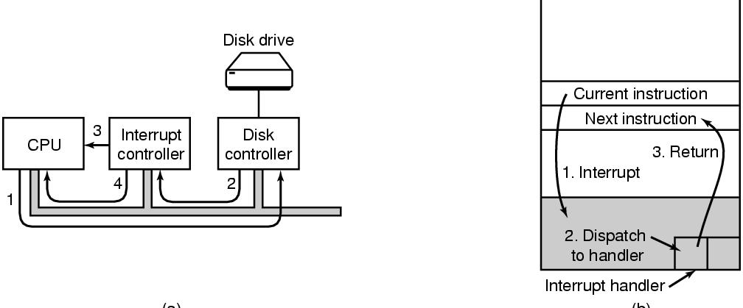
I/O using Interrupt hardware aspect.
The driver request the controller for I/O by writing into its device registers.
The controller then starts the device.
Controller after finishing reading or writing signals the interrupt controller chip using certain bus lines.
If controller accepts the interrupt then it puts the device on the bus so the CPU can read it from the device ready for service.

Slide 7
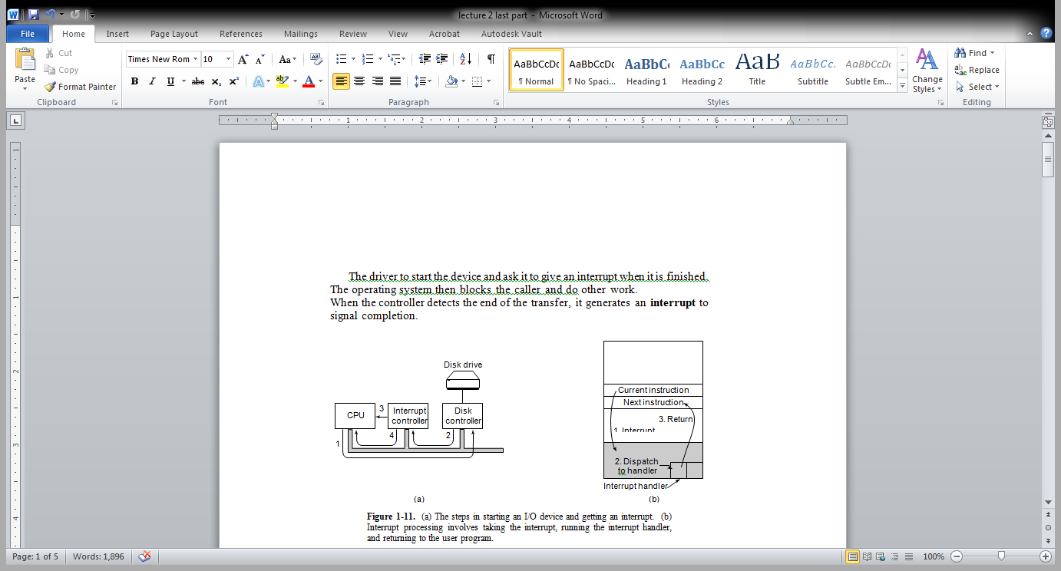
The I/O using Interrupt processing s/w aspect
Once the CPU calls the
interrupt
The PC and PSW and other registers and data then pushed/saved into the stack.
CPU switched into kernel mode. And starts the handler.
When the handler completes I/O, CPU returns back to the previously running user program.

Slide 8
I/O by DMA
Special (controller) chip called Direct Memory Access (DMA)
Avoids using the CPU as part of the transfer to or from the memory
The CPU sets up the DMA chip, telling it how many bytes to transfer, the device and memory addresses involved.
DMA Chip does the job and interrupts CPU when it is finished.
Spares the CPU to do some useful tasks.

Slide 9
The bus hierarchy
In the beginning there was only one bus
ISA (Industry Standard Architecture ):
  It couldn’t handle the traffic when CPU and memories got faster and bigger.
A hierarchy of faster and specialized buses introduced.
PCI (Peripheral Component Interconnect)
    SCSI (Small Computer System Interface)
    USB (Universal Serial Bus)

Slide 10
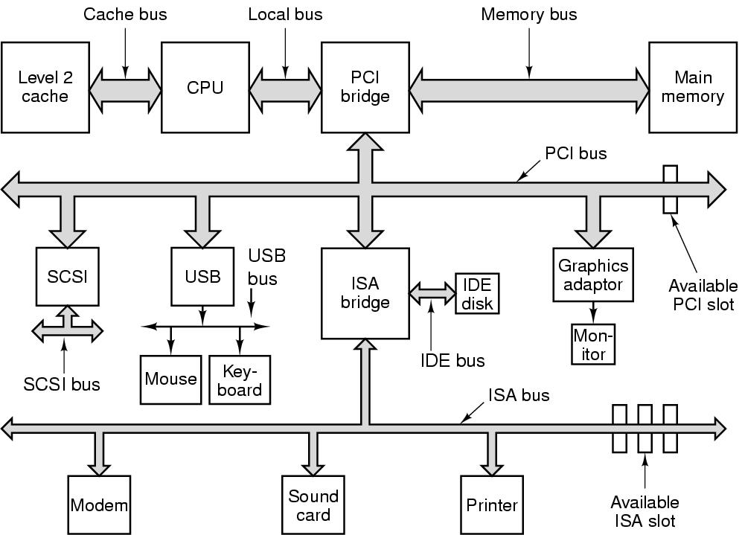
Pentium System Buses
The structure of a large Pentium system

Slide 11
Boot Sequence of a Computer
Typical Pentium boot process:
On the Parent-board/ motherboard is a program called the System BIOS (Basic Input Output System)
The BIOS contains low level I/O software, including procedures to read the keyboard, write to the screen, and do disk I/O, etc. (Now BIOS is held in a flash RoM)
When the computer is booted, the BIOS is started.
Which checks RAM, keyboard and other basic devices.
Then starts scanning ISA and PCI buses to detect all the devices attached, These devices are recorded.
The plug and play devices are also recorded.
If the devices present are different from when the system was last booted, the new devices are configured.

Slide 12
Boot Sequence of a Computer
The BIOS then determines the boot device
The first sector of the boot device is read and executed.
This sector contains a program that normally examines the partition table at the end of the boot sector to determine which partition is active.
A secondary boot loader is read from active partition.
This loader reads in the operating system from the active partition and starts that.
The OS queries the BIOS to get the configuration info.
For each device, it checks its device driver.
OS then loads all the device drivers, into the kernel.
OS initializes its tables, creates background processes and starts up a login program or GUI.

Slide 13
The Operating System Zoo
Mainframe operating systems
Big thousands of disks….
Lots of jobs with lots of I/O
Services-batch (payroll) transactions (airline reservations, timesharing (query database)
IBM/360, Elderly-Unix, Linux replacing them

Slide 14
The Operating System Zoo
Server operating systems
Large computers, workstations, or even mainframes. They serve multiple users over network
Share resources e.g. File, print, web services
Examples: FreeBSD, Linux and Windows Server 200x.
Multiprocessor operating systems
Connect multiple CPUs into a single system
called parallel computers, multi computers, or multiprocessors
They need special operating systems, which are variant of server operating systems
Popular OS are Windows and LINUX

Slide 15
The Operating System Zoo
PC operating systems
Provide good support to a single user but modern OS also support multiprogramming.
Examples: Linux, FreeBSD, Windows Vista, and the Macintosh operating system
Smart phone operating systems
A handheld computer or PDA (Personal Digital Assistant)
Only differ from PC in size, weight, and user interface.
    No hard disk
    Examples of computers : Android, iPhone, Blackberry
    Examples of OS : Palm, Symbian

Slide 16
The Operating System Zoo
Embedded operating systems
Computers that control devices but are not generally considered as computers
TV sets, cars, DVDs, MP3s
  Everything is in ROM (no apps can run on it)
  QNx, Vxworks

Slide 17
The Operating System Zoo
Real time operating systems
  Hard real-time system; Found in industrial process control, avionics, military, and similar application areas.
  These systems must provide absolute guarantees that a certain action will occur by a certain time.
  Soft real-time system; in which missing an occasional deadline is acceptable. Digital audio or multimedia
  The categories of handhelds, embedded systems, and real-time systems greatly overlap.
  Example of real-time system is e-Cos.

Slide 18
The Operating System Zoo
Smart card OS ;
The smallest operating systems run on smart cards, which are credit card sized devices containing a CPU chip.
Have severe processing and memory constraints.
Powered by contacts with reader when inserted.
Some smart cards are Java oriented. i.e ROM on the smart card holds an interpreter for the Java Virtual Machine (JVM). Java applets (small programs) are downloaded to the card and are interpreted by the JVM interpreter.
Resource management and protection becomes issue when two or more applets are present simultaneously.

Slide 19
Operating System Concepts
The Operating System concept revolves around some basic fundamental concepts related to :
  Processes
  Address spaces
  Files
  System Call
  I/O devices and protection mechanisum
Will be discussed in details.
Very brief introduction now.

