Slide 1
CSC 322 Operating Systems Concepts
Lecture - 29:
by
Ahmed Mumtaz Mustehsan
Special Thanks To:
Tanenbaum, Modern Operating Systems 3 e, (c) 2008 Prentice-Hall, Inc. (Chapter-6) Silberschatz, Galvin and Gagne 2002, Operating System Concepts,
www.sju.edu/~ggrevera/cscSystems/cscSystems-3-deadlock.ppt‎
Notes:
1

Slide 2
Chapter 6
Deadlock

Slide 3
Ways of Handling Deadlock
Deadlock Detection (studied)
Deadlock Recovery (studied)
Deadlock Avoidance (Today)
Deadlock Prevention (Today)

Slide 4
Deadlock Avoidance
Allow the chance of deadlock to occur, but avoid it happening when it is going to happen!!!
Check whether the next state (change in system) may end up in a deadlock situation; avoid it.
Plotting of Graph (Next Slide) Explains the idea!!!

Slide 5
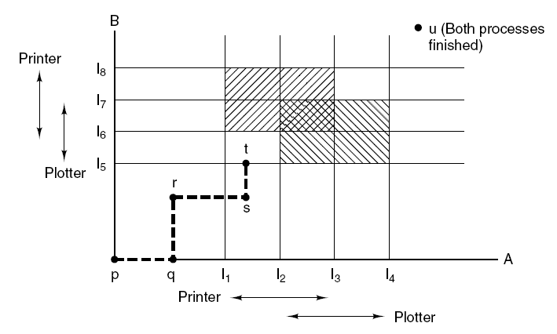
Deadlock Avoidance
Two process resource trajectories.

Slide 6
Deadlock avoidance
Safe state = NO deadlock! there exists some scheduling order in which every process can run to completion even if all of them suddenly request their max number of resources immediately
Unsafe != deadlocked

Slide 7
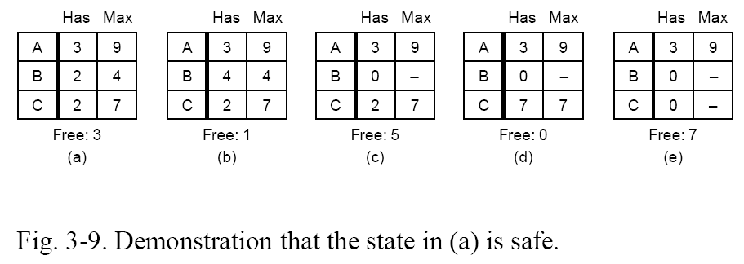
Safe states

Slide 8
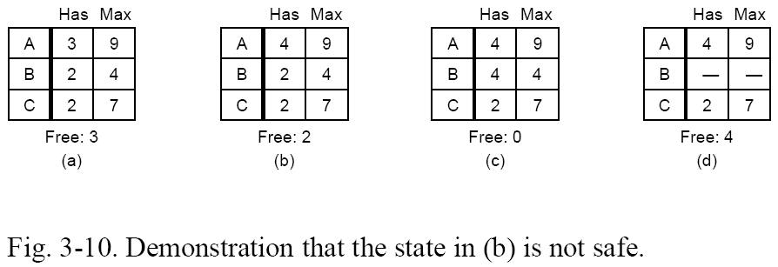
Unsafe states
With only 4 free, neither A nor C can be completely satisfied.

Slide 9
Banker’s algorithm for single resource (SR) type

Slide 10
Dijkstra's Banker's Algorithm
Definitions
      Each process has a LOAN, MAXIMUM NEED, CLAIM
        LOAN: current number of resources held
        MAXIMUM NEED: total number resources needed to complete
        CLAIM: = (MAXIMUM - LOAN)

Slide 11
Assumptions
Establish a LOAN ceiling (MAXIMUM NEED) for each process
  MAXIMUM NEED < total number of resources available (ie., capital)
Total loans for a process must be less than or equal to MAXIMUM NEED
Loaned resources must be returned back in finite time; Assume immediately after completion.
Total resources available are much less than the total committed accumulative resources .

Slide 12
Algorithm
1. Search for a process with a claim that can be satisfied using the current number of remaining resources (ie., tentatively grant the claim)
2. If such a process is found then assume that it will return all the loaned resources.
3. Update the number of remaining resources
4. Repeat steps 1-3 for all processes and mark them completed.

Slide 13
DO NOT GRANT THE CLAIM if at least one process can not be marked to completion.
Implementation
  A resource request is only allowed if it results in a SAFE state
  The system is always maintained in a SAFE state so eventually all requests will be filled

Slide 14
Advantages
  It works
  Allows jobs to proceed where a prevention algorithm wouldn't
Problems
  Requires that there are a fixed number of resources
  What happens if a resource goes down?
  Does not allow the process to change its Maximum need while processing

Slide 15
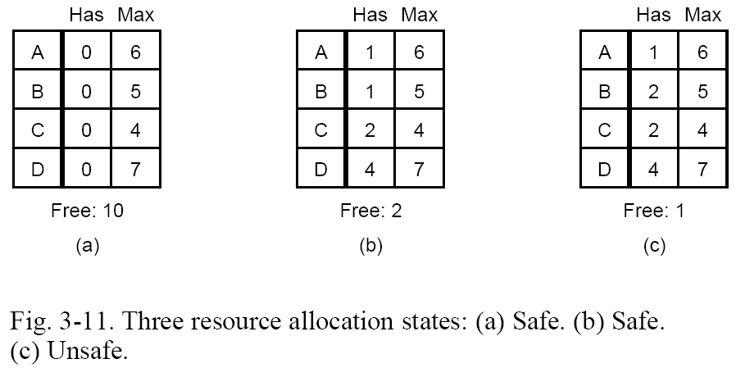
Banker’s algorithm (SR)
  Grant only those requests that lead to safe states.
  Requires future information.

Slide 16
Banker’s algorithm (SR)
Issue2 get back 4
Free =4
  (b) is safe because from (b) we can give C 2 more (free=0) then C completes (free=4) then give either B or D . . .

Slide 17
Banker’s algorithm (SR)
Issue 1 to B
Free =1
No max could be served now
  (c) is unsafe because no max can be satisfied

Slide 18
Banker’s algorithm for multiple resource (MR) types

Slide 19
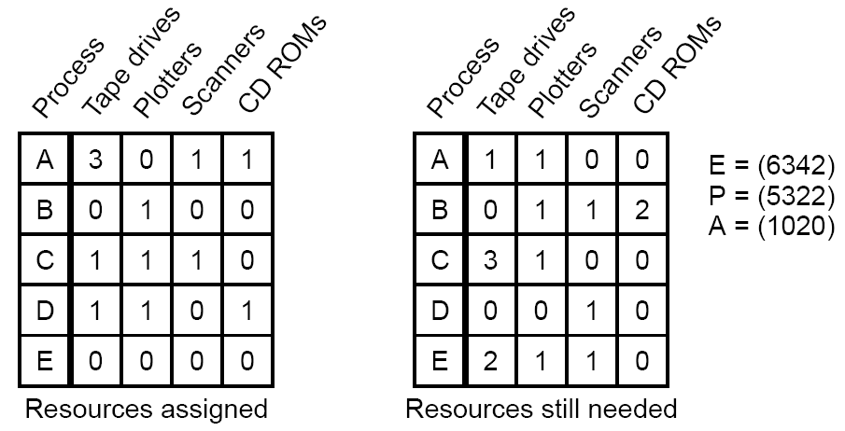
Banker’s algorithm (MR)
N:
(need)
E=existing (total); constant
P=possessed (allocated/held)
A=available (free)
∑

Slide 20
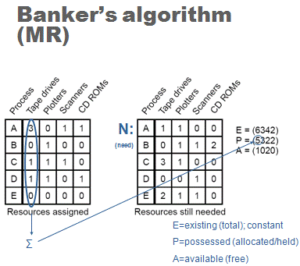
Banker’s algorithm (MR)
  To check for a safe state:
  Look for a row, R, in N <= A.
  Assume the chosen process of the row requests all resources, runs to completion, and terminates (giving back all of its resources to A).
  Repeat steps 1 and 2 until either all processes run to completion or terminate (indicating that the initial state is safe) or deadlock occurs.

Slide 21
Banker’s algorithm (MR)
To check for a safe state:
  Look for a row, R, in N <= A.
A (available) can completely satisfy D’s needs.

Slide 22
Banker’s algorithm (MR)
Previous:
E=(6342)
P=(5322)
A=(1020)
To check for a safe state:
  Look for a row, R, in N <= A.
  Assume the process of the chosen row requests all resources, runs to completion, and terminates (giving back all of its resources to A).
After D terminates:
E=(6342)
P=(4221)
A=(2121)

Slide 23
Banker’s algorithm (MR)
Previous:
E=(6342)
P=(5322)
A=(1020)
To check for a safe state:
  Look for a row, R, in N <= A.
E=(6342)
P=(4221)
A=(2121)

Slide 24
Banker’s algorithm (MR)
Previous:
E=(6342)
P=(4221)
A=(2121)
To check for a safe state:
  Look for a row, R, in N <= A.
  Assume the process of the chosen row requests all resources, runs to completion, and terminates (giving back all of its resources
After A terminates:
E=(6342)
P=(1210)
A=(5132)

Slide 25
Banker’s algorithm (MR)
Previous:
E=(6342)
P=(4221)
A=(2121)
To check for a safe state:
  Look for a row, R, in N <= A.
E=(6342)
P=(1210)
A=(5132)

Slide 26
Banker’s algorithm (MR)
Previous:
E=(6342)
P=(1210)
A=(5132)
To check for a safe state:
  Look for a row, R, in N <= A.
E=(6342)
P=(1110)
A=(5232)

Slide 27
Banker’s algorithm (MR)
Previous:
E=(6342)
P=(1210)
A=(5132)
To check for a safe state:
  Look for a row, R, in N <= A.
E=(6342)
P=(1110)
A=(5232)

Slide 28
Deadlock prevention

Slide 29
Deadlock Prevention
Remove the possibility of deadlock occurring by denying one of the four necessary conditions:
      Mutual Exclusion (Can we share everything?)
      Hold & Wait
      No preemption
      Circular Wait

Slide 30
Deadlock prevention: Attack mutex
Example: Use spooling instead of mutex on printer
Not all problems lend themselves to spooling
Still have contention for disk space with spooling

Slide 31
Deadlock prevention: attack hold & wait
Request (and wait for) all resources prior to process execution
Problems:
        We may not know in advance the requirements of resources.
        We tie up resources for entire time.
Before requesting a resource, we must first temporarily release all allocated resources and then try to acquire all of them again.

Slide 32
Denying the “Hold & Wait”
Implementation
  A process is given its resources on a "ALL or NONE" basis
  Either a process gets ALL its required resources and proceeds or it gets NONE of them and waits until it can

Slide 33
Denying the “Hold & Wait”
Advantages
  It works
  Reasonably easy to code
Problems
  Resource wastage
  Possibility of starvation

Slide 34
Denying “No pre-emption”
Tricky at best.
Impossible at worst.
Implementation
  Resources may be removed from a process before it is finished with them. Forcefully preempt the resource.

Slide 35
Denying “No pre-emption”
Advantages
  It works
  Possibly better resource utilisation
Problems
  The cost of removing a process's resources
  The process is likely to lose work it has done. (How often does this occur?)
  Possibility of starvation

Slide 36
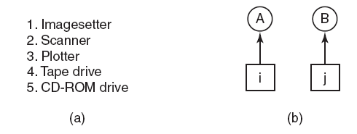
Attacking the Circular Wait Condition
(a) Numerically ordered resources. (b) A resource graph.
Processes can request resources whenever they want to, but all requests must be made in numerical order.
Example: A process may request first a printer and then a tape drive, but it may not request first a plotter and then a printer.

Slide 37
Deadlock prevention: attack circular wait
Only allow one resource at a time.
Request all resources in (some globally assigned) numerical order.
    But no numerical ordering may exist!
Implementation
  Resources are uniquely numbered
  Processes can only request resources in linear ascending order
  Thus preventing the circular wait from occurring

Slide 38
Deadlock prevention: attack circular wait
Advantages
  It works
  Has been implemented in some OS
Problems
  Resources must be requested in ascending order of resource number rather than as needed
  Resource numbering must be maintained by someone and must reflect every addition to the OS
  Difficult to sit down and write just write code

Slide 39
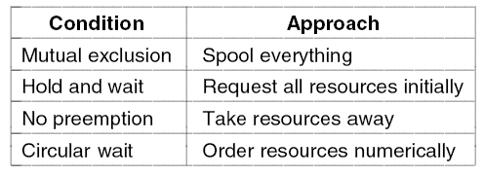
Approaches to Deadlock Prevention
Summary of approaches to deadlock prevention.

Slide 40
Other Issues
Two-phase locking
    Commonly used in databases.
    First phase: lock all the needed resources. If locking succeeds, go to second phase, else release all the locks.
    Second phase: do the read or write operation.
Communication deadlocks
Livelock
Starvation

Slide 41
Two-phase locking
Two-phase locking
    Commonly used in databases.
    First phase: lock all the needed resources. If locking succeeds, go to second phase, else release all the locks; go to First Phase.
    Second phase: do the read or write operation. And release the records

Slide 42
Communication Deadlocks
Example:
Suppose process A sends a request message to process B, and then blocks until B sends back a reply message.
Suppose that the request message gets lost. A is blocked waiting for the reply.
B is blocked waiting for a request asking it to do something.
We have a deadlock! Not the classical resource deadlock. This situation is called a communication deadlock.

Slide 43
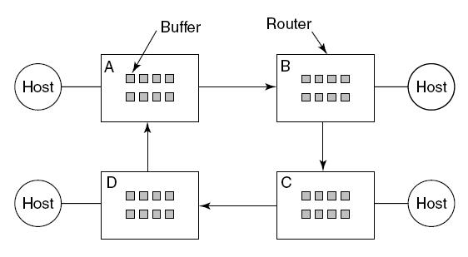
Communication Deadlocks
In a communication system a node is either computer or Router having finite buffers ( 8 in example)
If no buffer available we have a resource deadlock in a network.

Slide 44
Communication Deadlocks
Example:
Suppose that all the packets at router A need to go to B and all the packets at B need to go to C and all the packets at C need to go to D and all the packets at D need to go to A.
No packet can move because there is no buffer at the other end and we have a classical resource deadlock, in the middle of a communications system.

Slide 45
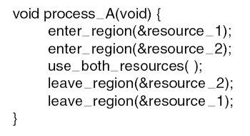
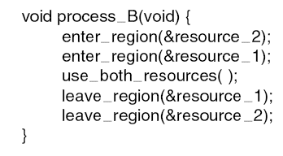
Livelock
Busy waiting that can lead to livelock.

Slide 46
Livelock
Example:
In some situations, polling (busy waiting) is used to enter a critical region or access a resource. This strategy is often used when the mutual exclusion will be used for a very short time and the overhead of suspension is large compared to doing the work.
Consider an atomic primitive in which the calling process tests a mutex and either grabs it or returns fail.
We do not have a deadlock (because no process is blocked) but we have functionally equivalent to deadlock but livelock.

