Slide 1
CSC 322 Operating Systems Concepts
Lecture - 28:
by
Ahmed Mumtaz Mustehsan
Special Thanks To:
Tanenbaum, Modern Operating Systems 3 e, (c) 2008 Prentice-Hall, Inc. (Chapter-6) Silberschatz, Galvin and Gagne 2002, Operating System Concepts,
www.sju.edu/~ggrevera/cscSystems/cscSystems-3-deadlock.ppt‎
Notes:
1

Slide 2
Chapter 6
Deadlock

Slide 3
What is Deadlock?
Process Deadlock
    A process is deadlocked when it is waiting on an event which will never happen
System Deadlock
    A system is deadlocked when one or more processes are deadlocked

Slide 4
The Deadlock: How it happens?
A Computing example:
Scanned document to be Recorded on CD
System has 1 scanner and 1 CD Recorder
2 processes each need both devices.
P₀ acquires scanner and waits for CD
P₁ acquires CD and waits for scanner
P₀ will not release scanner until catch hold the CD
P₁ will not release CD until catch hold the scanner
Result: Deadlock

Slide 5
How can this happen?
Process A
  Down x
  Gets x
  Down y
  Blocks
Process B
  Down y
  Gets y
  Down x
  Blocks
Both are blocked forever!

Slide 6
Preemptable and Non Preemptable Resources
Things for which we request exclusive access.
Examples: Databases, files, shared memory, printer, cd/dvd writer, tape drive, etc.
Types
  Preemptable – can be taken away w/out ill effects
  Non preemptable – cannot be take away w/out causing a failure!

Slide 7
Resource examples
Memory – preemptable
CPU – preemptable
CD writing – non preemptable
Printing – non preemptable
We will only consider non preemptable (the harder problem).

Slide 8
Deadlock caused by Nonpreemptable Resources
Sequence of events required to use a resource:
  Request the resource.
  Use the resource.
  Release the resource.

Slide 9
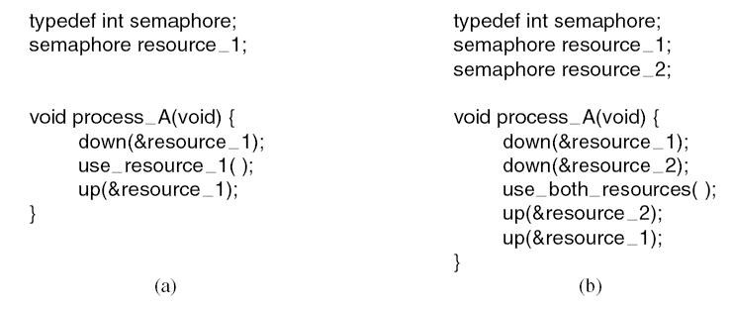
Resource Acquisition
Using a semaphore to protect resources.
Code without deadlock.
(a) One resource.
  (b) Two resources.

Slide 10
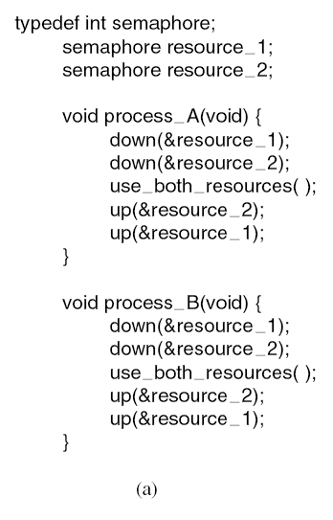
Resource Acquisition
(a) Deadlock-free code.

Slide 11
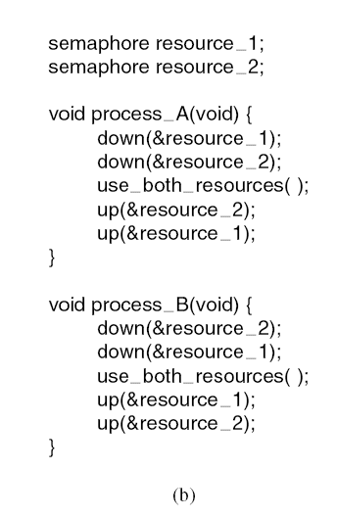
Resource Acquisition (3)
(b) Code with a potential deadlock.

Slide 12
Introduction To Deadlocks
Deadlock can be defined formally as follows:
A set of processes is deadlocked if each process in the set is waiting for an event that only another process in the set can cause.

Slide 13
Conditions for Resource Deadlocks
The following four conditions are necessary for a deadlock to occur:
Mutual exclusion condition
Hold and wait condition.
No preemption condition.
Circular wait condition.

Slide 14
Resource Allocation Graphs
Process
Resource
Request a Resource
Hold a Resource
Deadlock
A
R
A
R
A
A
R
R
S
B

Slide 15
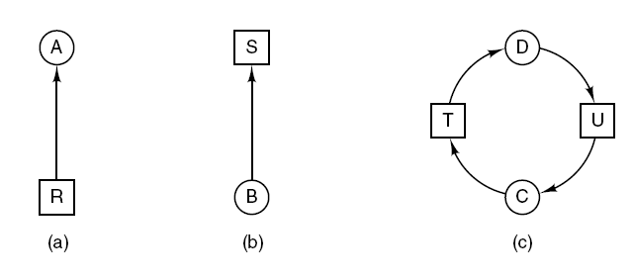
Deadlock Modeling (1)
Process
Resource
Resource allocation graphs.
  (a) Process A Holding a resource R.
  (b) Process B Requesting a resource S.
  (c) Deadlock for resources T & U among Process C & D

Slide 16
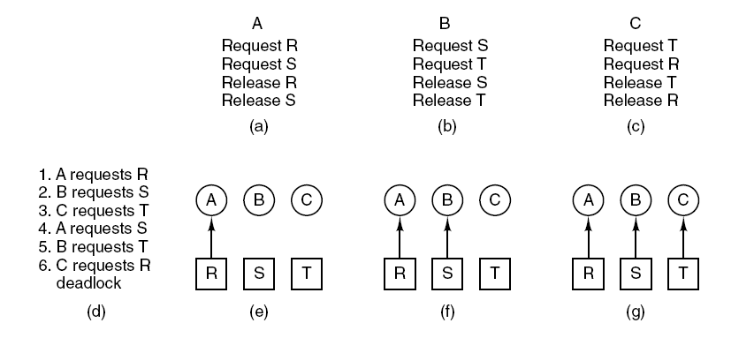
Deadlock Modeling (2)
An example of how deadlock occurs and how it can be avoided.

Slide 17
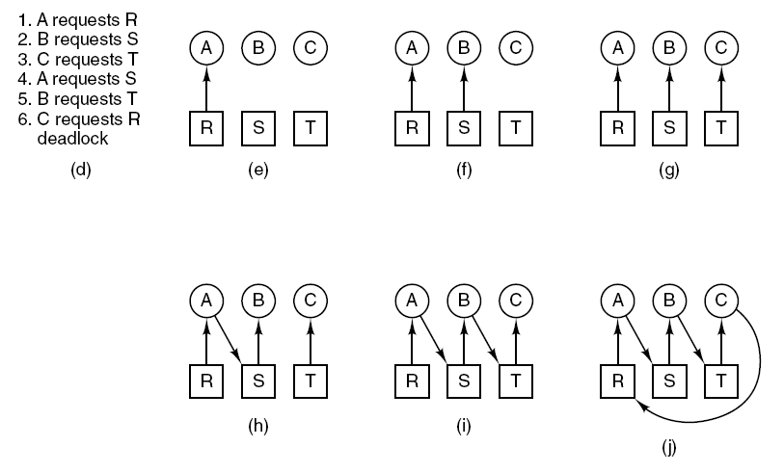
Deadlock Modeling
An example of how deadlock occurs and how it can be avoided.

Slide 18
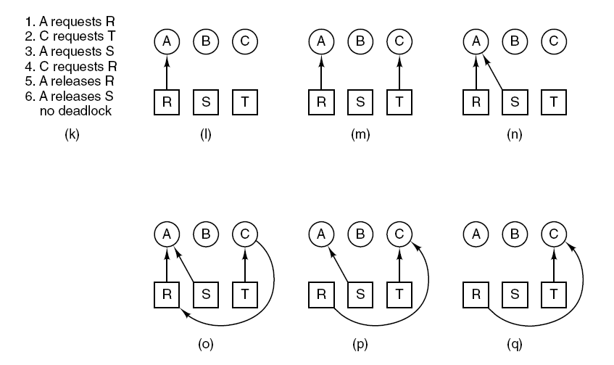
Deadlock Modeling
An example of how deadlock occurs and how it can be avoided.

Slide 19
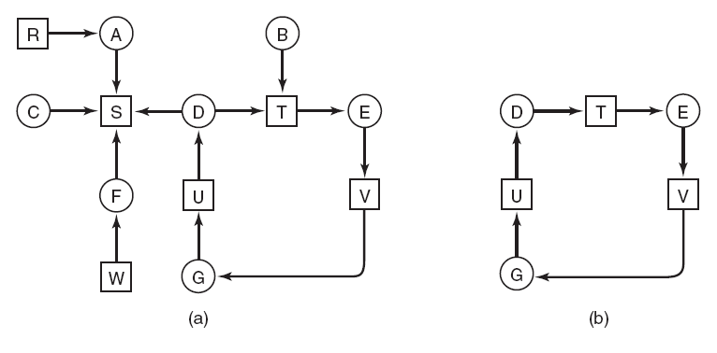
Deadlock Detection with
One Resource of Each Type
Process A holds R and wants S.
Process B holds nothing but wants T.
Process C holds nothing but wants S.
Process D holds U and wants S and T.
Process E holds T and wants V.
Process F holds W and wants S.
Process G holds V and wants U.
  (a) A resource graph.
  (b) A cycle extracted from (a).

Slide 20
Deadlock Detection with One Resource of Each Type
Algorithm for detecting deadlock:
For each node, N in the graph, perform the following five steps with N as the starting node.
Initialize L to the empty list, designate all arcs as unmarked.
Add current node to end of L, check to see if node now appears in L two times. If it does, graph contains a cycle (listed in L), algorithm terminates.
From given node, see if any unmarked outgoing arcs. If so, go to step 5; if not, go to step 6.
Pick an unmarked outgoing arc at random and mark it. Then follow it to the new current node and go to step 3.
If this is initial node, graph does not contain any cycles, algorithm terminates. Otherwise, dead end. Remove it, go back to previous node, make that one current node, go to step 3.

Slide 21
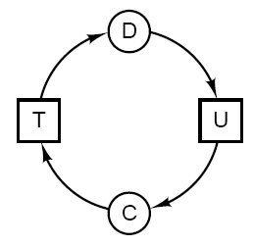
(Directed) Graphs
A graph G = (V,E) where
  V = vertex set and
  E = edge set
    Ordered pairs of vertices
Ex. Let G = (V,E) where
  V = { C, D, T, U } and
  E = { <D,U>, <U,C>, <C,T>, <T,D> }

Slide 22
Deadlock Dealing Strategies
Strategies for dealing with deadlocks:
Just ignore the problem.
Detection and recovery. Let deadlocks occur, detect them, take action.
Dynamic avoidance by careful resource allocation.
Prevention, by structurally negating one of the four required conditions.

Slide 23
Ignore the Problem: Ostrich Problem
May not occur very often
May not have serious consequences if it does happen
May be difficult / expensive to detect.

Slide 24

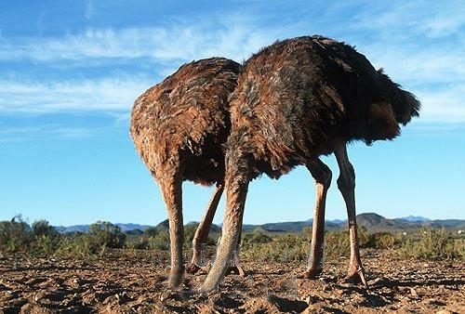
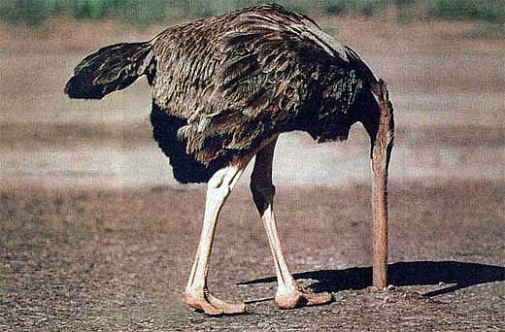
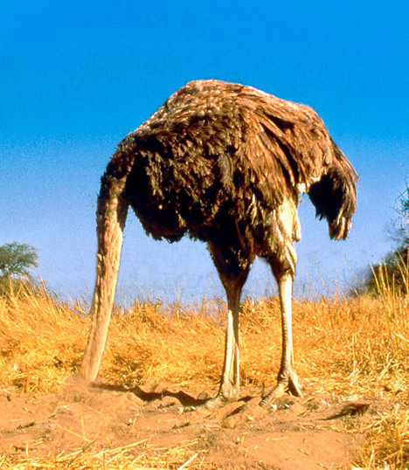
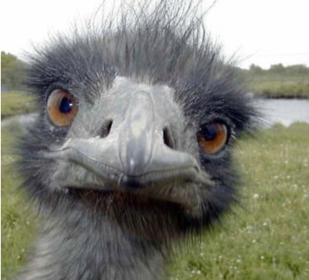
Ostrich algorithm
Ignore it; pretend it doesn’t happen!

Slide 25
Ways of Handling Deadlock
  Deadlock Detection
  Deadlock Recovery
  Deadlock Avoidance
  Deadlock Prevention

Slide 26
2. Detect and recover
Detection with one resource of each type
Detection with multiple resources of each type

Slide 27
Detection with one resource of each type
Detect cycle in digraph
For each vertex v in graph,
  search the subtree rooted at v
  see if we visit any vertex twice (by keeping a record of already visited vertices).

Slide 28
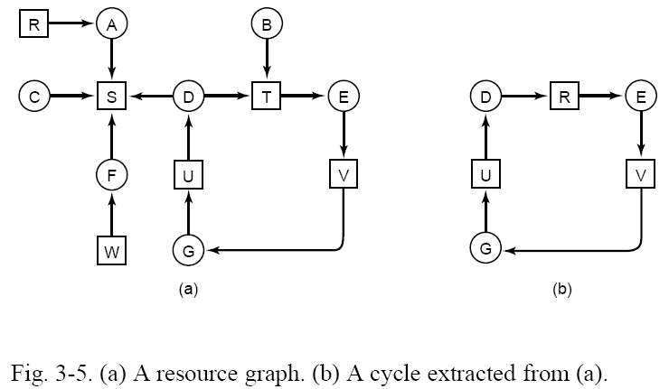
T

Slide 29
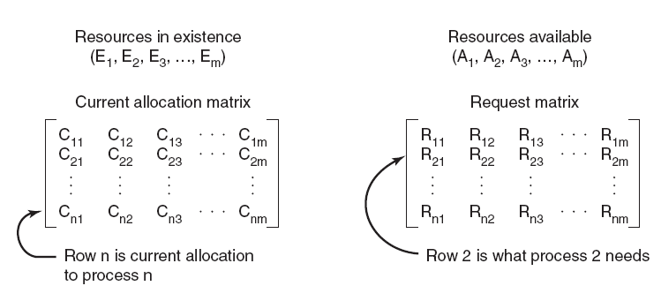
Deadlock Detection with Multiple Resources
Four data structures used by the deadlock detection algo.
i denote type of resources in Ei and Ai
Ei and Ai denote the number of resources of type i
Example, if class 1 is tape drives, then E1 = 2 means the system has two tape drives.

Slide 30
Deadlock Detection with Multiple Resources
Deadlock detection algorithm:
Look for an unmarked process, P_{i} , for which the i-th row of R is less than or equal to A.
If such a process is found, add the i-th row of C to A, mark the process, and go back to step 1.
If no such process exists, the algorithm terminates.

Slide 31
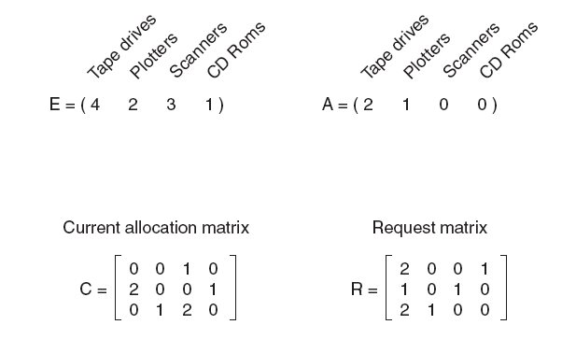
Deadlock Detection with Multiple Resources
An example for the deadlock detection algorithm.

Slide 32
Recovery
Preemption
Rollback (using checkpoints)
Kill process

Slide 33
Recovery: preemption
Temporarily take back needed resource
Ex. Printer
  Pause at end of page k
  Start printing other job
  Resume printing original job starting at page k+1

Slide 34
Recovery: Rollback
Checkpoint – save entire process state (typically right before the resource was allocated)
When deadlock is detected, we kill the check pointed process, freeing the resource, and then later restart the killed process starting at the checkpoint.
    Requires apps that can be restarted in this manner.

Slide 35
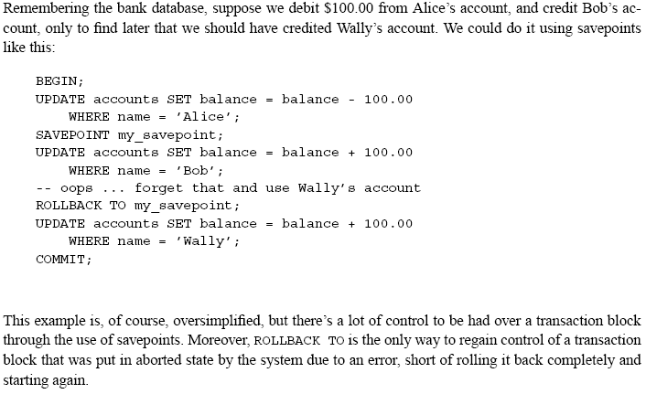
Rdb’s & commit/rollback
From p. 62, http://www.postgresql.org/files/documentation/pdf/8.0/postgresql-8.0-US.pdf

Slide 36
Recovery: kill process
Requires apps that can be restarted from the beginning.

Slide 37
Deadlock Avoidance
Allow the chance of deadlock to occur, but avoid it happening when it is going to happen!!!
Check whether the next state (change in system) may end up in a deadlock situation; avoid it.
Plotting of Graph (Next Slide) Explains the idea!!!

Slide 38
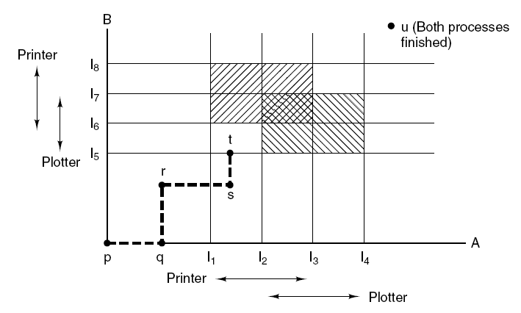
Deadlock Avoidance
Two process resource trajectories.

Slide 39
Deadlock avoidance
Safe state = NO deadlock! there exists some scheduling order in which every process can run to completion even if all of them suddenly request their max number of resources immediately
Unsafe != deadlocked

Slide 40
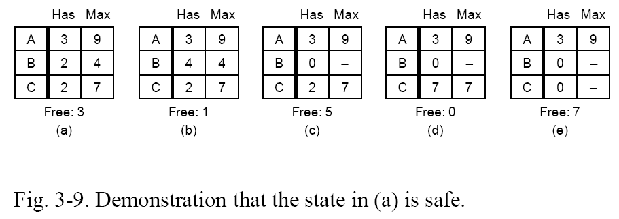
Safe states

Slide 41
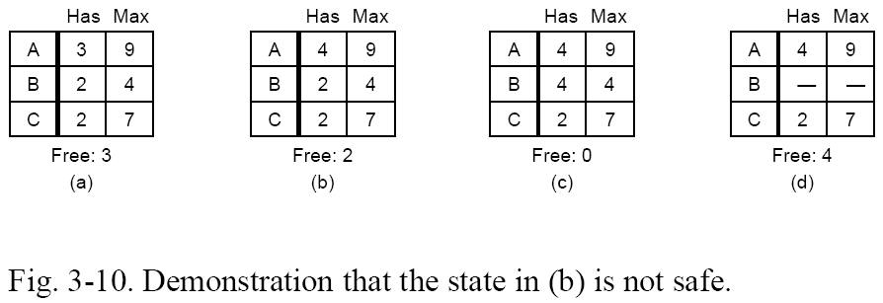
Unsafe states
With only 4 free, neither A nor C can be completely satisfied.

