Slide 1
CSC 322 Operating Systems Concepts
Lecture - 27:
by
Ahmed Mumtaz Mustehsan
Special Thanks To:
Tanenbaum, Modern Operating Systems 3 e, (c) 2008 Prentice-Hall, Inc. (Chapter-5) Silberschatz, Galvin and Gagne 2002, Operating System Concepts,
Notes:
1

Slide 2
Chapter 5
Input/ Output
Hardware
Magnetic Disk …..
CD/ CD-ROM /DVD

Slide 3
Stable Storage
RAIDS can protect against sectors going bad
Can’t protect against write operations spitting out garbage or crashes during writes
Stable storage: either correct data is laid down or old data remains in place
Necessary for some apps-data can’t be lost or go bad

Slide 4
Assumptions
Can detect a bad write on subsequent reads via ECC (Error Correction Code)
Probability of having bad data in sector on two different disks is negligible
If CPU fails, it stops along with any write in progress at the time. Bad data can be detected later via ECC during read operation

Slide 5
The idea and the operations
Use 2 identical disks-do the same thing to both disks
Use 3 operations
Stable writ
First write, then read back and compare.
If they are the same write to second disk.
If write fails, try up to n times to get it to succeed.
  After n failures keep using spare sectors until it succeeds. Then go to disk 2.

Slide 6
The idea and the OPS
Stable read
read from disk 1 n times until get a good ECC, otherwise read from disk 2 (assumption that probability of both sectors being bad is negligible)
Crash recovery
read both copies of blocks and compare them. If one block has an ECC error, overwrite it with the good block. If both pass the ECC test, then pick either

Slide 7
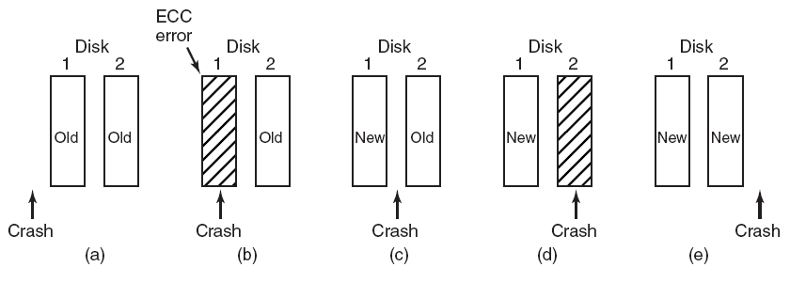
CPU Crashes
  (a) Crash happens before write
  (b) Crash happens during write to 1
  (c) Crash happens after 1 but before 2
  (d) During 2, after 1
  (e) Both are the same

Slide 8
Summary
I/O architecture is the system’s interface to the outside world
I/O functions are generally broken up into a number of layers
    A key aspect of I/O is the use of buffers that are controlled by I/O utilities rather than by application processes
    Buffering smoothes out the differences between the speeds
    The use of buffers also decouples the actual I/O transfer from the address space of the application process
    Disk I/O has the greatest impact on overall system performance
    Two of the most widely used approaches are disk scheduling and the disk cache
    A disk cache is a buffer, usually kept in main memory, that functions as a cache of disk block between disk memory and the rest of main memory
Notes:
The computer system’s interface to the outside world is its I/O architecture. This
architecture is designed to provide a systematic means of controlling interaction
with the outside world and to provide the operating system with the information it
needs to manage I/O activity effectively.
The I/O function is generally broken up into a number of layers, with lower
layers dealing with details that are closer to the physical functions to be performed
and higher layers dealing with I/O in a logical and generic fashion. The result is that
changes in hardware parameters need not affect most of the I/O software.
A key aspect of I/O is the use of buffers that are controlled by I/O utilities
rather than by application processes. Buffering smoothes out the differences
between the internal speeds of the computer system and the speeds of I/O devices.
The use of buffers also decouples the actual I/O transfer from the address space
of the application process. This allows the operating system more flexibility in
performing its memory-management function.
The aspect of I/O that has the greatest impact on overall system performance
is disk I/O. Accordingly, there has been greater research and design effort in this
area than in any other kind of I/O. Two of the most widely used approaches to
improve disk I/O performance are disk scheduling and the disk cache.
At any time, there may be a queue of requests for I/O on the same disk. It is
the object of disk scheduling to satisfy these requests in a way that minimizes the
mechanical seek time of the disk and hence improves performance. The physical
layout of pending requests plus considerations of locality come into play.
A disk cache is a buffer, usually kept in main memory, that functions as a
cache of disk blocks between disk memory and the rest of main memory. Because
of the principle of locality, the use of a disk cache should substantially reduce the
number of block I/O transfers between main memory and disk.

Slide 9
Chapter 5
Input/ Output
Hardware
CD/ CD-ROM /DVD

Slide 10
CD
Optical disks have higher density then magnetic disks
Used for distributing commercial software and reference works (books)
Cheap because of high production volume and consumption (for music CDs)
First used for playing music digitally

Slide 11
CD
Laser burns holes on a master (coated glass) disk
Mold is made with bumps where holes were Polycarbonate resin (sticking) poured into – has same pattern of holes as glass disk
Aluminum coated put on top of Polycarbonate resin
Pits (depressions) and lands (unburned area) are arranged in spirals
Laser is used to read the pits and lands and convert them into bits (0 and 1)

Slide 12
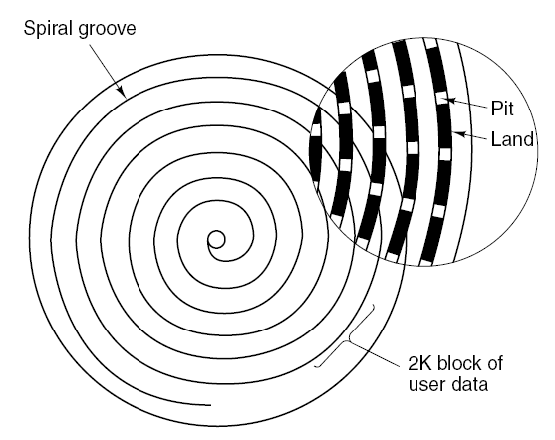
CD
Recording structure of a compact disc or CD-ROM.

Slide 13
CD-ROM
CD’s can be used to store data as well as audio
Enter the CD-ROM
Needed to improve the error-correcting ability of the CD
Encode each byte (8 bits) in a 14 bit symbol with 6 bits of ECC
42 symbols form a frame
Group 98 frames into a CD-ROM per sector
Extra error-correcting code is attached to sector

Slide 14
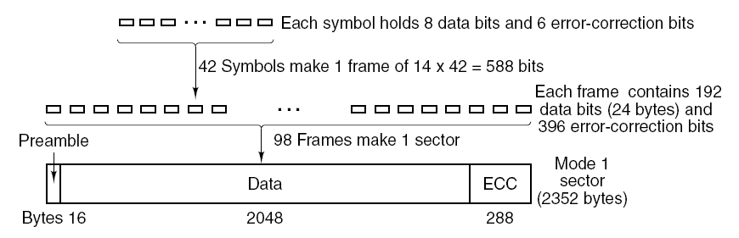
CD-ROMs Sector Layout
Each symbol = 14 bits (8 data 6 ecc)
42 symbols makes 1 frame (192 data bits, 396 ecc bits)
98 frames makes 1 sector (2352 Bytes)

Slide 15
CD-ROM Performance
650 MB capacity vs 150 GB SCSI disk capacity
150 KB/sec in mode 1, (1 x)
up to 5 MB/sec for 32 x CD-ROM
SCSI-2 magnetic disk transfers at 10 MB/sec
Bottom line:
  CD drives can’t compare to SCSI disk drives

Slide 16
CD-ROM
Added graphics, video, data
File system standards agreed upon
High Sierra for file names of 8 characters, file type 3 characters
Rock ridge for longer names and extensions
CD-ROM’s used for publishing games, movies, commercial software, reference works
Why? Cheap to manufacture and large capacity

Slide 17
CD-Recordable
Cheaper manufacturing process led to cheaper CD-ROM (CD-R)
Used as backup to disk drives
Small companies can use to make masters which they give to high volume plants to reproduce

Slide 18
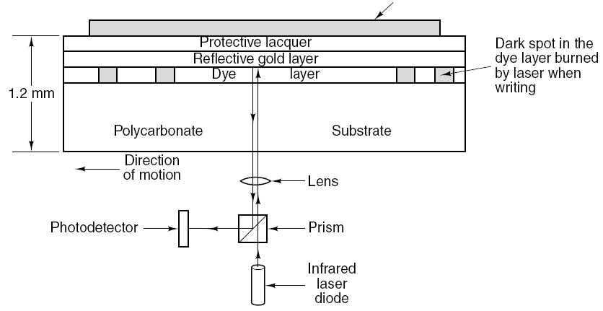
CD-Recordable
Cross section of a CD-R disk and laser. A silver
CD-ROM has similar structure, except without dye layer and with pitted aluminum layer instead of gold layer.

Slide 19
DVD (Digital Video Disk; Digital Versatile Disk)
DVD use same design as CD with a few improvements
Smaller pits
(0.4 microns versus 0.8 microns for CDs).
A tighter spiral
(0.74 microns between tracks versus 1.6 microns for CDs).
A red laser
(at 0.65 microns versus 0.78 microns for CDs).

Slide 20
DVD (Digital Versatile Disk)
This led to much bigger capacity ~ 5 Gbyte (seven fold increase in capacity)
Can put a standard movie on the DVD (133 minutes)
Hollywood wants more movies on the same disk, so have 4 formats

Slide 21
DVD
DVD Formats
Single-sided, single-layer (4.7 GB).
Single-sided, dual-layer (8.5 GB).
Double-sided, single-layer (9.4 GB).
Double-sided, dual-layer (17 GB).

Slide 22
DVD: next generation
Blu-ray
HD
Computer industry and Hollywood have not agreed on formats yet!!

Slide 23
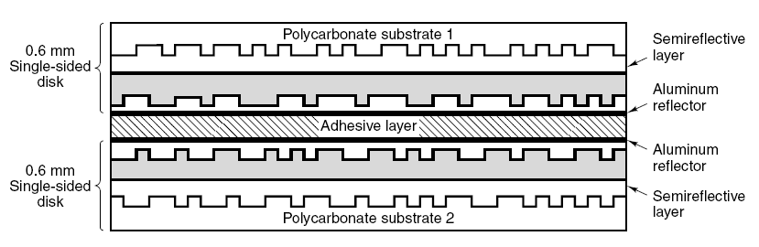
DVD
A double-sided, dual-layer DVD disk.

Slide 24
Clock Hardware
  50 Hz clocks (1 interrupt (clock tic) per voltage cycle)
    Simple, cheap, not very accurate, not very functional
    High precision clocks (5-100 MHz, or higher)
    Contain a quarts oscillator
    Steers a counter counting down
    Generates an interrupt when counter reaches 0
    Counter is eventually reloaded from a programmable register
    One chip normally implements multiple clocks

Slide 25
Chapter 5
Input/ Output
Hardware
Clock (Hardware and software)

Slide 26
Clock Hardware
    One shot mode:
    clock counts down from register value once and waits for software to start it again
    Block wave mode:
    counter is automatically reloaded (generates clock tics)
    Ranges:
    e.g. 1000 MHz clock with a 16 bits register can fix time intervals between 1 nanosecond and 65,535 microseconds.

Slide 27
Clock Hardware
Pulse from 5 to 300 MHz
Crystal Oscillator
Decrement counter
when == 0
generate interrupt
Holding register to
load counter
Can control clock ticks
Time of day to time quantum

Slide 28
Clock Software
Typical duties of a clock driver
Maintaining the time of day.
Preventing processes from running longer than they are allowed to.
Accounting for CPU usage.
Handling alarm system call made by user processes.
Providing watchdog timers for parts of the system itself.
Doing profiling, monitoring, statistics gathering.

Slide 29
Clock Software
Software is responsible for the semantics behind the clock tics:
Time of the day
  1/1/1970
  Is an easy task, just calculate the exact time between two tics and adjust the clock on each interrupt

Slide 30
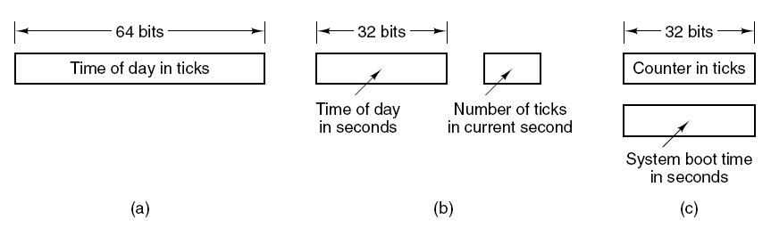
Clock Software
Three ways to maintain the time of day.
Size of the time register may cause a problem:
32 bits register overflows after 2 years storing 60 Hz tics
64 bits is more expensive, but lasts forever
Store seconds in stead of tics (2³² seconds is 136 years)
Use another reference in stead of 1/1/1970 (start time)

Slide 31
Clock Software
2. Administration of process time slices
  Each running process has “time left” counter
  This counter is decremented at each interrupt
3. Administration of CPU usage
  Counter starts when process starts
  Counter is part of the “Process environment”
  Is stopped while handling an interrupt
  Field in the process table can be used directly (through pointer to running process)
  Interrupts cause problems

Slide 32
Clock Software
4. Simulating Multiple Timers
SLEEP system call (UNIX)
  e.g. late ack of package sent, sleeping e-student
Clock driver has a limited number of hardware clocks
  Implements virtual clocks
  Uses a table with all times for the hanging timers and one variable with the next signal time
  In case of a heavy clock-usage, the signal times may be kept in a well ordered linked list (e.g. 4203,4307,4213)

Slide 33
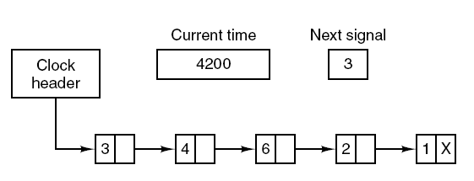
Clock Software
Simulating multiple timers with a single clock.

Slide 34
Soft Timers
Soft timers succeed according to rate at which kernel entries are made because of:
System calls.
TLB misses.
Page faults.
I/O interrupts.
The CPU going idle.

Slide 35
Clock Software
Watchdog timers
Floppy disk drive
  Start motor
  Wait for 500 milliseconds
  -> better to wait for 3 seconds after I/O operation, just in case a new request arrives
  Watchdog timers start user specified routine after the time has elapsed within the code of the caller
6. Doing profiling, monitoring, statistics gathering.
  For program performance analysis
  Information where the CPU time is spent on

