Slide 1
CSC 322 Operating Systems Concepts
Lecture - 26:
by
Ahmed Mumtaz Mustehsan
Special Thanks To:
Tanenbaum, Modern Operating Systems 3 e, (c) 2008 Prentice-Hall, Inc. (Chapter-5) Silberschatz, Galvin and Gagne 2002, Operating System Concepts,
Notes:
1

Slide 2
Chapter 5
Input/ Output
Hardware
Disk (Magnetic / Optical )

Slide 3
Disks
Called Magnetic (hard) disk
  Reads and writes are equally fast
  Good for storing file systems
  Disk arrays are used for reliable storage (RAID)
Optical disks (CD-ROM, CD-Recordable, DVD) used for program distribution

Slide 4
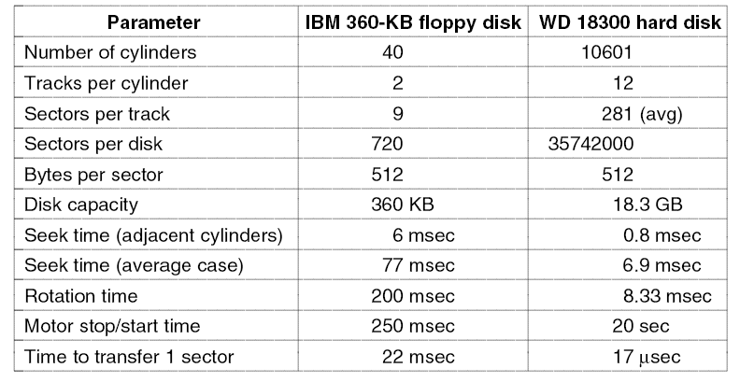
Floppy vs hard disk (20 years apart)
Seek time is 7x better, transfer rate is 1300 x better, capacity is 50,000 x better.

Slide 5
Disks-more stuff
Some disks have microcontrollers which do bad block re-mapping, track caching
Some disk controllers are capable of doing more then one seek at a time, i.e. they can read on one disk while writing on another
Real disk geometry is different from geometry used by driver, since controller has to re-map request for (cylinder, head, sector) onto actual disk
Disks are divided into zones, with fewer sector at the inner side, gradually progressing to more on the outer side

Slide 6
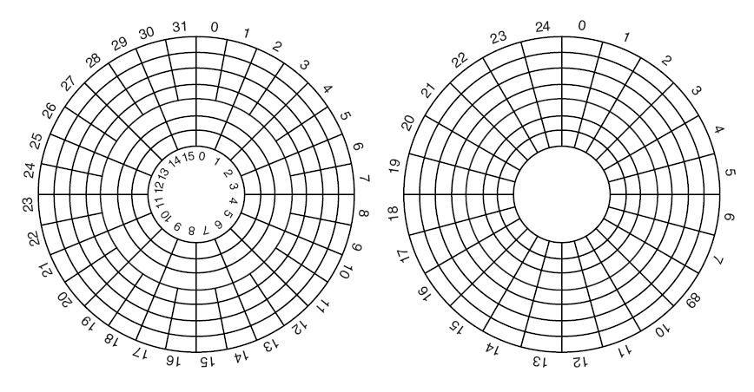
Disk Zones
(a) Physical geometry of a disk with two zones.
(b) A possible virtual geometry for this disk.

Slide 7
Redundant Array of Inexpensive Disks (RAID)
Parallel I/O to improve performance and reliability
  vs SLED, Single Large Expensive Disk
RAID; A bunch of disks which appear like a single disk to the OS
SCSI disks often used-cheap, 7 disks per controller
SCSI is set of standards to connect CPU to peripherals
Different architectures-level 0 through level 6

Slide 8
RAID
Design architectures share three characteristics:
RAID is a set of physical disk drives viewed by the operating system as a single logical drive
data are distributed across the physical drives of an array in a scheme known as striping
redundant disk capacity is used to store parity information, which guarantees data recoverability in case of a disk failure
Integrated
Redundancy
Performance
Redundant Array of Independent Disks
Consists of seven levels, zero through six
Notes:
With the use of multiple disks, there is a wide variety of ways in which the data
can be organized and in which redundancy can be added to improve reliability. This
could make it difficult to develop database schemes that are usable on a number of
platforms and operating systems. Fortunately, industry has agreed on a standardized
scheme for multiple-disk database design, known as RAID (redundant array of
independent disks). The RAID scheme consists of seven levels, 2 zero through six.
These levels do not imply a hierarchical relationship but designate different design
architectures that share three common characteristics:
1. RAID is a set of physical disk drives viewed by the operating system as a single
logical drive.
2. Data are distributed across the physical drives of an array in a scheme known
as striping, described subsequently.
3. Redundant disk capacity is used to store parity information, which guarantees
data recoverability in case of a disk failure.

Slide 9
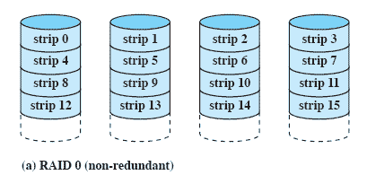
RAID Level 0
Not a true RAID because it does not include redundancy to improve performance or provide data protection
User and system data are distributed across all of the disks in the array
Logical disk is divided into strips
Notes:
RAID level 0 is not a true member of the RAID family, because it does not include
redundancy to improve performance or provide data protection. However, there
are a few applications, such as some on supercomputers in which performance
and capacity are primary concerns and low cost is more important than improved
reliability.
For RAID 0, the user and system data are distributed across all of the disks
in the array. This has a notable advantage over the use of a single large disk: If two
different I/O requests are pending for two different blocks of data, then there is a
good chance that the requested blocks are on different disks. Thus, the two requests
can be issued in parallel, reducing the I/O queuing time.
But RAID 0, as with all of the RAID levels, goes further than simply distributing
the data across a disk array: The data are striped across the available disks.
This is best understood by considering Figure 11.8 . All user and system data are
viewed as being stored on a logical disk. The logical disk is divided into strips; these
strips may be physical blocks, sectors, or some other unit. The strips are mapped
round robin to consecutive physical disks in the RAID array. A set of logically
consecutive strips that maps exactly one strip to each array member is referred
to as a stripe . In an n -disk array, the first n logical strips are physically stored as
the first strip on each of the n disks, forming the first stripe; the second n strips
are distributed as the second strips on each disk; and so on. The advantage of this
layout is that if a single I/O request consists of multiple logically contiguous strips,
then up to n strips for that request can be handled in parallel, greatly reducing the
I/O transfer time.

Slide 10
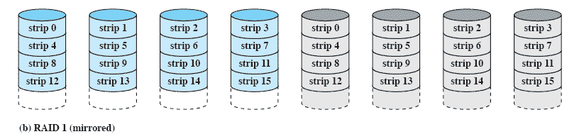
RAID Level 1
Redundancy is achieved by the simple expedient of duplicating all the data
There is no “write penalty”
When a drive fails the data may still be accessed from the second drive
Principal disadvantage is the cost
Notes:
RAID 1 differs from RAID levels 2 through 6 in the way in which redundancy is
achieved. In these other RAID schemes, some form of parity calculation is used
to introduce redundancy, whereas in RAID 1, redundancy is achieved by the simple
expedient of duplicating all the data. Figure 11.8b shows data striping being
used, as in RAID 0. But in this case, each logical strip is mapped to two separate
physical disks so that every disk in the array has a mirror disk that contains the
same data. RAID 1 can also be implemented without data striping, though this is
less common.
There are a number of positive aspects to the RAID 1 organization:
1. A read request can be serviced by either of the two disks that contains the
requested data, whichever one involves the minimum seek time plus rotational
latency.
2. A write request requires that both corresponding strips be updated, but this
can be done in parallel. Thus, the write performance is dictated by the slower
of the two writes (i.e., the one that involves the larger seek time plus rotational
latency). However, there is no “write penalty” with RAID 1. RAID levels
2 through 6 involve the use of parity bits. Therefore, when a single strip is
updated, the array management software must first compute and update the
parity bits as well as updating the actual strip in question.
3. Recovery from a failure is simple. When a drive fails, the data may still be
accessed from the second drive.
The principal disadvantage of RAID 1 is the cost; it requires twice the disk
space of the logical disk that it supports. Because of that, a RAID 1 configuration
is likely to be limited to drives that store system software and data and other highly
critical files. In these cases, RAID 1 provides real-time backup of all data so that in
the event of a disk failure, all of the critical data is still immediately available.
In a transaction-oriented environment, RAID 1 can achieve high I/O request
rates if the bulk of the requests are reads. In this situation, the performance of RAID
1 can approach double of that of RAID 0. However, if a substantial fraction of the I/O
requests are write requests, then there may be no significant performance gain over
RAID 0. RAID 1 may also provide improved performance over RAID 0 for data
transfer intensive applications with a high percentage of reads. Improvement occurs
if the application can split each read request so that both disk members participate.

Slide 11
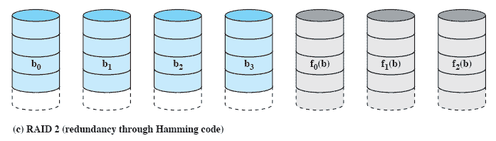
RAID Level 2
Makes use of a parallel access technique
Data striping is used
Typically a Hamming code is used
Effective choice in an environment in which many disk errors occur
Notes:
RAID levels 2 and 3 make use of a parallel access technique. In a parallel access
array, all member disks participate in the execution of every I/O request. Typically,
the spindles of the individual drives are synchronized so that each disk head is in the
same position on each disk at any given time.
As in the other RAID schemes, data striping is used. In the case of RAID 2
and 3, the strips are very small, often as small as a single byte or word. With RAID 2,
an error-correcting code is calculated across corresponding bits on each data disk,
and the bits of the code are stored in the corresponding bit positions on multiple
parity disks. Typically, a Hamming code is used, which is able to correct single-bit
errors and detect double-bit errors.
Although RAID 2 requires fewer disks than RAID 1, it is still rather costly.
The number of redundant disks is proportional to the log of the number of data
disks. On a single read, all disks are simultaneously accessed. The requested data
and the associated error-correcting code are delivered to the array controller. If
there is a single-bit error, the controller can recognize and correct the error instantly,
so that the read access time is not slowed. On a single write, all data disks and parity
disks must be accessed for the write operation.
RAID 2 would only be an effective choice in an environment in which many
disk errors occur. Given the high reliability of individual disks and disk drives,
RAID 2 is overkill and is not implemented.

Slide 12
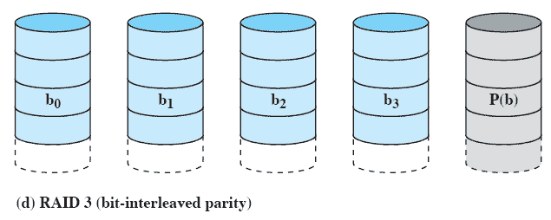
RAID Level 3
Requires only a single redundant disk, no matter how large the disk array
Employs parallel access, with data distributed in small strips
Can achieve very high data transfer rates
Notes:
RAID 3 is organized in a similar fashion to RAID 2. The difference is that RAID 3
requires only a single redundant disk, no matter how large the disk array. RAID 3
employs parallel access, with data distributed in small strips. Instead of an error correcting
code, a simple parity bit is computed for the set of individual bits in the
same position on all of the data disks.
REDUNDANCY In the event of a drive failure, the parity drive is accessed and data
is reconstructed from the remaining devices. Once the failed drive is replaced, the
missing data can be restored on the new drive and operation resumed.
Data reconstruction is simple. Consider an array of five drives in which X0
through X3 contain data and X4 is the parity disk. The parity for the i th bit is
calculated as follows:
X4(i) = X3(i) X2(i) X1(i) X0(i)
where is exclusive-OR function.
Suppose that drive X1 has failed. If we add X4(i) X1(i) to both sides of the
preceding equation, we get
X1(i) = X4(i) X3(i) X2(i) X0(i)
Thus, the contents of each strip of data on X1 can be regenerated from the contents
of the corresponding strips on the remaining disks in the array. This principle is true
for RAID levels 3 through 6.
In the event of a disk failure, all of the data are still available in what is referred
to as reduced mode. In this mode, for reads, the missing data are regenerated on the
fly using the exclusive-OR calculation. When data are written to a reduced RAID 3
array, consistency of the parity must be maintained for later regeneration. Return to
full operation requires that the failed disk be replaced and the entire contents of the
failed disk be regenerated on the new disk.
PERFORMANCE Because data are striped in very small strips, RAID 3 can achieve
very high data transfer rates. Any I/O request will involve the parallel transfer of
data from all of the data disks. For large transfers, the performance improvement is
especially noticeable. On the other hand, only one I/O request can be executed at a
time. Thus, in a transaction-oriented environment, performance suffers.

Slide 13
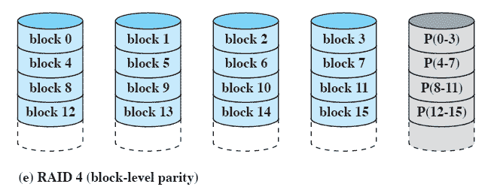
RAID Level 4
Makes use of an independent access technique
A bit-by-bit parity strip is calculated across corresponding strips on each data disk, and the parity bits are stored in the corresponding strip on the parity disk
Involves a write penalty when an I/O write request of small size is performed
Notes:
RAID levels 4 through 6 make use of an independent access technique. In an independent
access array, each member disk operates independently, so that separate
I/O requests can be satisfied in parallel. Because of this, independent access arrays
are more suitable for applications that require high I/O request rates and are relatively
less suited for applications that require high data transfer rates.
As in the other RAID schemes, data striping is used. In the case of RAID
4 through 6, the strips are relatively large. With RAID 4, a bit-by-bit parity strip
is calculated across corresponding strips on each data disk, and the parity bits are
stored in the corresponding strip on the parity disk.
RAID 4 involves a write penalty when an I/O write request of small size is performed.
Each time that a write occurs, the array management software must update
not only the user data but also the corresponding parity bits. Consider an array of
five drives in which X0 through X3 contain data and X4 is the parity disk. Suppose
that a write is performed that only involves a strip on disk X1. Initially, for each bit
i , we have the following relationship:
X4(i) = X3(i) X2(i) X1(i) X0(i) (11.1)
After the update, with potentially altered bits indicated by a prime symbol:
X4=(i) = X3(i) X2(i) X1=(i) X0(i)
= X3(i) X2(i) X1=(i) X0(i) X1(i) X1(i)
= X3(i) X2(i) X1 (i) X0(i) X1(i) X1=(i)
= X4(i) X1(i) X1=(i)
The preceding set of equations is derived as follows. The first line shows that
a change in X1 will also affect the parity disk X4. In the second line, we add the
terms [ X1(i) X1(i)] . Because the exclusive-OR of any quantity with itself
is 0, this does not affect the equation. However, it is a convenience that is used to
create the third line, by reordering. Finally, Equation ( 11.1 ) is used to replace the
first four terms by X4( i ).
To calculate the new parity, the array management software must read the old
user strip and the old parity strip. Then it can update these two strips with the new
data and the newly calculated parity. Thus, each strip write involves two reads and
two writes.
In the case of a larger size I/O write that involves strips on all disk drives, parity
is easily computed by calculation using only the new data bits. Thus, the parity drive
can be updated in parallel with the data drives and there are no extra reads or writes.
In any case, every write operation must involve the parity disk, which therefore
can become a bottleneck.

Slide 14
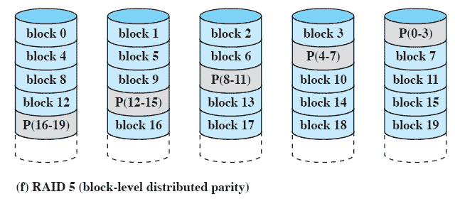
RAID Level 5
Similar to RAID-4 but distributes the parity bits across all disks
Typical allocation is a round-robin scheme
Has the characteristic that the loss of any one disk does not result in data loss
Notes:
RAID 5 is organized in a similar fashion to RAID 4. The difference is that RAID
5 distributes the parity strips across all disks. A typical allocation is a round-robin
scheme, as illustrated in Figure 11.8f . For an n -disk array, the parity strip is on a
different disk for the first n stripes, and the pattern then repeats.
The distribution of parity strips across all drives avoids the potential I/O
bottleneck of the single parity disk found in RAID 4. Further, RAID 5 has the
characteristic that the loss of any one disk does not result in data loss.

Slide 15
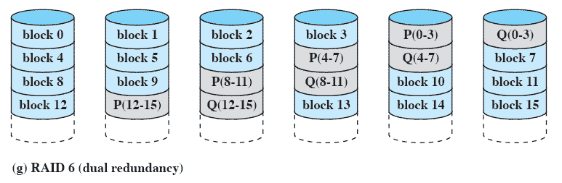
RAID Level 6
Two different parity calculations are carried out and stored in separate blocks on different disks
Provides extremely high data availability
Incurs a substantial write penalty because each write affects two parity blocks
Notes:
RAID 6 was introduced in a subsequent paper by the Berkeley researchers
[KATZ89]. In the RAID 6 scheme, two different parity calculations are carried out
and stored in separate blocks on different disks. Thus, a RAID 6 array whose user
data require N disks consists of N + 2 disks.
Figure 11.8g illustrates the scheme. P and Q are two different data check algorithms.
One of the two is the exclusive-OR calculation used in RAID 4 and 5. But
the other is an independent data check algorithm. This makes it possible to regenerate
data even if two disks containing user data fail.
The advantage of RAID 6 is that it provides extremely high data availability.
Three disks would have to fail within the MTTR (mean time to repair) interval to
cause data to be lost. On the other hand, RAID 6 incurs a substantial write penalty,
because each write affects two parity blocks. Performance benchmarks [EISC07]
show a RAID 6 controller can suffer more than a 30% drop in overall write performance
compared with a RAID 5 implementation. RAID 5 and RAID 6 read
performance is comparable.

Slide 16
Raid Levels
Raid level 0 uses strips of k sectors per strip.
  Consecutive strips are on different disks
  Write/read on consecutive strips in parallel
  Good for big enough requests
Raid level 1 duplicates the disks
  Writes are done twice, reads can use either disk
  Improves reliability
Level 2 works with individual words, spreading word + ecc over disks.
  Need to synchronize arms to get parallelism

Slide 17
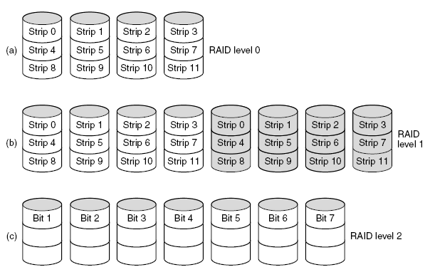
RAID Levels 0,1,2
Backup and parity drives are shown shaded.

Slide 18
Raid Levels 3, 4 and 5
Raid level 3 works like level 2, except all parity bits go on a single drive
Raid 4 and 5 work with strips. Parity bits for strips go on separate drive (level 4) or several drives (level 5)
Raid 6, High Data availability, two different parity computed on different disks, write expensive.

Slide 19
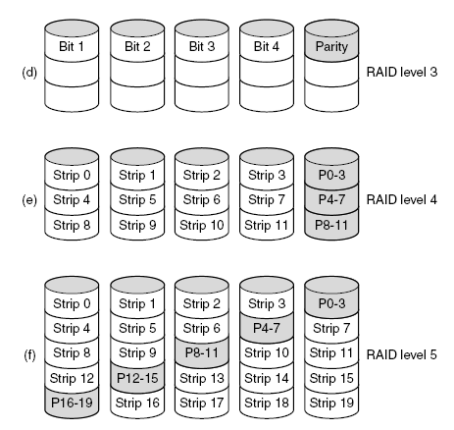
RAID
Backup and parity drives are shown shaded.

Slide 20
RAID Levels
Notes:
We now examine each of the RAID levels. Table 11.4 provides a rough
guide to the seven levels. In the table, I/O performance is shown both in terms of
data transfer capacity, or ability to move data, and I/O request rate, or ability to
satisfy I/O requests, since these RAID levels inherently perform differently relative
to these two metrics. Each RAID level’s strong point is highlighted in color.
Of the seven RAID levels described, only four are commonly used: RAID
levels 0, 1, 5, and 6.

Slide 21
Hard Disk Formatting
Low level format-software lays down tracks and sectors on empty disk (picture next slide)
High level format is done next-partitions

Slide 22
Sector Format
The preamble starts with a certain bit pattern that allows the hardware to recognize the start of the sector. Also contains the cylinder and sector numbers and:
512 bit sectors standard
ECC for recovery from errors

Slide 23
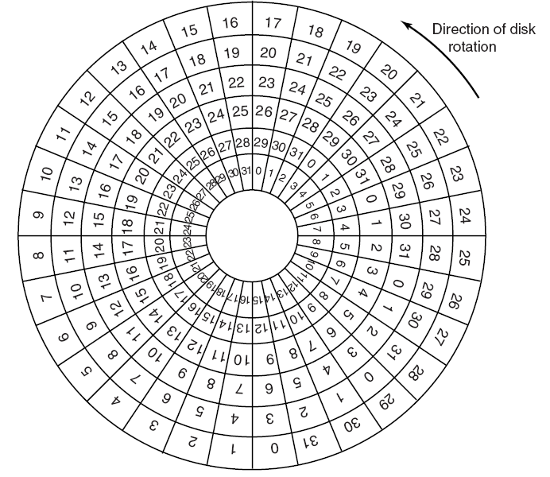
Low level Format Cylinder Skew:
Position of sector 0 is Offset from one track to next one in order to get consecutive sectors

Slide 24
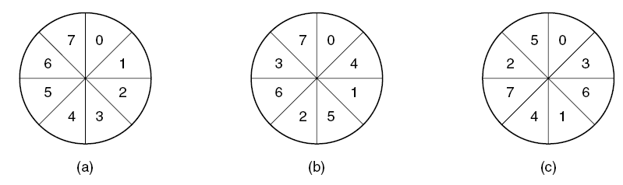
Interleaved sectors
Copying to a buffer takes time; could wait a disk rotation before head reads next sector. So interleave sectors to avoid this (b,c)

Slide 25
High level format
Partitions
  For more then one OS on same disk
Pentium
  sector 0 has master boot record with partition table and code for boot block
Pentium has 4 partitions: can have both Windows (C:, D:, E:m F:) and Unix (/dev/disk0)
In order to be able to boot, one partition has to be marked as active

Slide 26
High level format for each partition
Master Boot Record in sector 0
boot block program
free storage admin (bitmap or free list)
Root directory created
Empty file system created
Indicates which file system is in the partition (in the partition table)

Slide 27
When Power Switched on
BIOS reads in master boot record
Boot program checks which partition is active
Reads in boot sector from active partition
Boot sector loads bigger boot program which looks for the OS kernel in the file system
OS kernel is loaded and executed

Slide 28
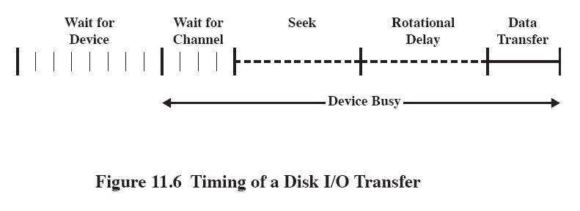
Disk Performance Parameters
The actual details of disk I/O operation depend on the:
      computer system
      operating system
      nature of the I/O channel and disk controller hardware
Notes:
The actual details of disk I/O operation depend on the computer system, the operating
system, and the nature of the I/O channel and disk controller hardware. A
general timing diagram of disk I/O transfer is shown in Figure 11.6 .

Slide 29
Positioning the Read/Write Heads
When the disk drive is operating, the disk is rotating at constant speed
To read or write the head must be positioned at the desired track and at the beginning of the desired sector on that track
Track selection involves moving the head in a movable-head system or electronically selecting one head on a fixed-head system
On a movable-head system the time it takes to position the head at the track is known as seek time
The time it takes for the beginning of the sector to reach the head is known as rotational delay
The sum of the seek time and the rotational delay equals the access time
Notes:
When the disk drive is operating, the disk is rotating at constant speed. To
read or write, the head must be positioned at the desired track and at the beginning
of the desired sector on that track. 1 Track selection involves moving the head in a
movable-head system or electronically selecting one head on a fixed-head system.
On a movable-head system, the time it takes to position the head at the track is
known as seek time . In either case, once the track is selected, the disk controller
waits until the appropriate sector rotates to line up with the head. The time it takes
for the beginning of the sector to reach the head is known as rotational delay , or
rotational latency. The sum of the seek time, if any, and the rotational delay equals
the access time , which is the time it takes to get into position to read or write. Once
the head is in position, the read or write operation is then performed as the sector
moves under the head; this is the data transfer portion of the operation; the time
required for the transfer is the transfer time .
In addition to the access time and transfer time, there are several queuing
delays normally associated with a disk I/O operation. When a process issues an
I/O request, it must first wait in a queue for the device to be available. At that
time, the device is assigned to the process. If the device shares a single I/O channel
or a set of I/O channels with other disk drives, then there may be an additional
wait for the channel to be available. At that point, the seek is performed to begin
disk access.
In some high-end systems for servers, a technique known as rotational
positional sensing (RPS) is used. This works as follows: When the seek command
has been issued, the channel is released to handle other I/O operations. When
the seek is completed, the device determines when the data will rotate under
the head. As that sector approaches the head, the device tries to reestablish the
communication path back to the host. If either the control unit or the channel is
busy with another I/O, then the reconnection attempt fails and the device must
rotate one whole revolution before it can attempt to reconnect, which is called
an RPS miss. This is an extra delay element that must be added to the time line
of Figure 11.6 .

Slide 30
Disk Arm Scheduling Algorithms
Read/write time factors has not improved w.r.t. other parameters. So seek time requires attention:
  Seek time (the time to move the arm to the proper cylinder).
  Rotational delay (the time for the proper sector to rotate under the head).
  Actual data transfer time.
Driver keeps list of requests (cylinder number, time of request)
Try to optimize the seek time

Slide 31
Table 11.3 Disk Scheduling Algorithms
Notes:
Table 11.3 Disk Scheduling Algorithms

Slide 32
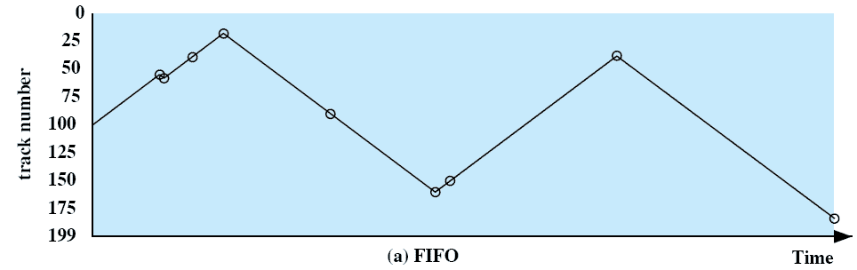
First-In, First-Out (FIFO)
Processes in sequential order
Fair to all processes
Approximates random scheduling in performance if there are many processes competing for the disk
Notes:
The simplest form of scheduling is first-in-first-out (FIFO)
scheduling, which processes items from the queue in sequential order. This strategy
has the advantage of being fair, because every request is honored and the requests are
honored in the order received. Figure 11.7a illustrates the disk arm movement with
FIFO. This graph is generated directly from the data in Table 11.2a . As can be seen,
the disk accesses are in the same order as the requests were originally received.
With FIFO, if there are only a few processes that require access and if many
of the requests are to clustered file sectors, then we can hope for good performance.
However, this technique will often approximate random scheduling in performance,
if there are many processes competing for the disk. Thus, it may be profitable to
consider a more sophisticated scheduling policy. A number of these are listed in
Table 11.3 and will now be considered.

Slide 33
Priority (PRI)
Control of the scheduling is outside the control of disk management software
Goal is not to optimize disk utilization but to meet other objectives
Short batch jobs and interactive jobs are given higher priority
Provides good interactive response time
Longer jobs may have to wait an excessively long time
A poor policy for database systems
Notes:
With a system based on priority (PRI), the control of the scheduling is
outside the control of disk management software. Such an approach is not intended
to optimize disk utilization but to meet other objectives within the operating system.
Often short batch jobs and interactive jobs are given higher priority than longer jobs
that require longer computation. This allows a lot of short jobs to be flushed through
the system quickly and may provide good interactive response time. However, longer
jobs may have to wait excessively long times. Furthermore, such a policy could lead
to countermeasures on the part of users, who split their jobs into smaller pieces to
beat the system. This type of policy tends to be poor for database systems.

Slide 34
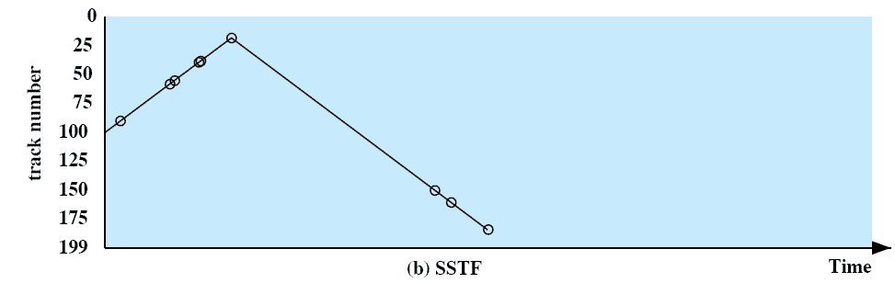
Shortest Service Time First (SSTF)
Select the disk I/O request that requires the least movement of the disk arm from its current position
Always choose the minimum seek time
Notes:
The shortest-service-time-first (SSTF) policy
is to select the disk I/O request that requires the least movement of the disk arm
from its current position. Thus, we always choose to incur the minimum seek time.
Of course, always choosing the minimum seek time does not guarantee that the
average seek time over a number of arm movements will be minimum. However,
this should provide better performance than FIFO. Because the arm can move in
two directions, a random tie-breaking algorithm may be used to resolve cases of
equal distances.
Figure 11.7b and Table 11.2b show the performance of SSTF on the same
example as was used for FIFO. The first track accessed is 90, because this is the
closest requested track to the starting position. The next track accessed is 58 because
this is the closest of the remaining requested tracks to the current position of 90.
Subsequent tracks are selected accordingly.

Slide 35
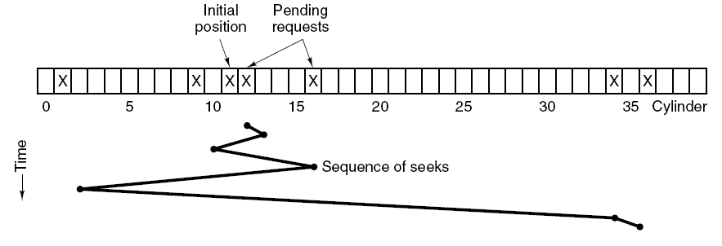
SSF (Shortest Seek Time First)
While head is on cylinder 11, requests for 1,36,16,34,9,12 come in
FCFS would result in (10,35,20,18,25,3) 111 cylinders
SSF would require 1,3,7,15,33,2 movements for a total of 61 cylinders

Slide 36
SCAN- Elevator algorithm
It is a greedy algorithm-the head could get stuck in one part of the disk if the usage was heavy
Elevator-keep going in one direction until there are no requests in that direction, then reverse direction
Real elevators sometimes use this algorithm
Variation on a theme-first go one way, then go the other

Slide 37
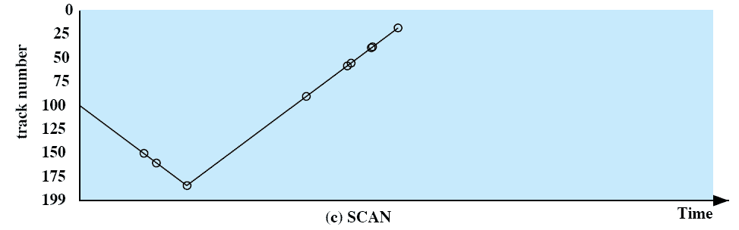
SCAN (Elevator algorithm)
Also known as the Elevator algorithm
Arm moves in one direction only
        satisfies all outstanding requests until it reaches the last track in that direction then the direction is reversed
  Favors jobs whose requests are for tracks nearest to both innermost and outermost tracks
Notes:
With the exception of FIFO, all of the policies described so far can leave
some request unfulfilled until the entire queue is emptied. That is, there may always
be new requests arriving that will be chosen before an existing request. A simple
alternative that prevents this sort of starvation is the SCAN algorithm, also known
as the elevator algorithm because it operates much the way an elevator does.
With SCAN, the arm is required to move in one direction only, satisfying all
outstanding requests en route, until it reaches the last track in that direction or until
there are no more requests in that direction. This latter refinement is sometimes
referred to as the LOOK policy. The service direction is then reversed and the scan
proceeds in the opposite direction, again picking up all requests in order.
Figure 11.7c and Table 11.2c illustrate the SCAN policy. Assuming that the
initial direction is of increasing track number, then the first track selected is 150,
since this is the closest track to the starting track of 100 in the increasing direction.
As can be seen, the SCAN policy behaves almost identically with the SSTF
policy. Indeed, if we had assumed that the arm was moving in the direction of lower
track numbers at the beginning of the example, then the scheduling pattern would
have been identical for SSTF and SCAN. However, this is a static example in which
no new items are added to the queue. Even when the queue is dynamically changing,
SCAN will be similar to SSTF unless the request pattern is unusual.
Note that the SCAN policy is biased against the area most recently traversed.
Thus it does not exploit locality as well as SSTF.
It is not difficult to see that the SCAN policy favors jobs whose requests are
for tracks nearest to both innermost and outermost tracks and favors the latest arriving
jobs. The first problem can be avoided via the C-SCAN policy, while the
second problem is addressed by the N-step-SCAN policy.

Slide 38
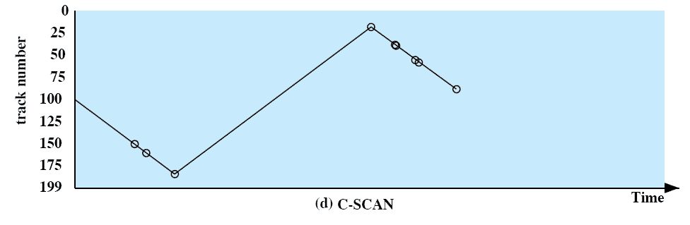
C-SCAN (Circular SCAN)
Restricts scanning to one direction only
When the last track has been visited in one direction, the arm is returned to the opposite end of the disk and the scan begins again
Notes:
The C-SCAN (circular SCAN) policy restricts scanning to one direction
only. Thus, when the last track has been visited in one direction, the arm is returned
to the opposite end of the disk and the scan begins again. This reduces the maximum
delay experienced by new requests. With SCAN, if the expected time for a scan
from inner track to outer track is t , then the expected service interval for sectors at
the periphery is 2 t. With C-SCAN, the interval is on the order of t + s max , where
s max is the maximum seek time.
Figure 11.7d and Table 11.2d illustrate C-SCAN behavior. In this case the first
three requested tracks encountered are 150, 160, and 184. Then the scan begins
starting at the lowest track number, and the next requested track encountered is 18.

Slide 39
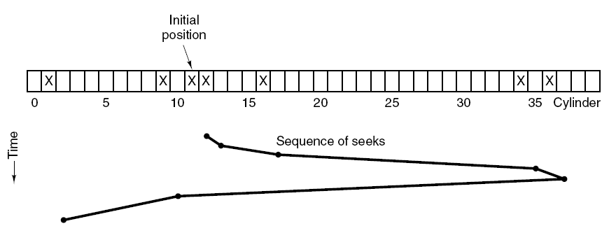
The Elevator
Uses 60 cylinders, usually slightly worst then SSF, but better/fair in service.

Slide 40
N-Step-SCAN
Segments the disk request queue into sub-queues of length N
Sub-queues are processed one at a time, using SCAN
While a queue is being processed new requests must be added to some other queue
If fewer than N requests are available at the end of a scan, all of them are processed with the next scan
Notes:
With SSTF, SCAN, and C-SCAN, it is possible that
the arm may not move for a considerable period of time. For example, if one or a
few processes have high access rates to one track, they can monopolize the entire
device by repeated requests to that track. High-density multisurface disks are more
likely to be affected by this characteristic than lower-density disks and/or disks with
only one or two surfaces. To avoid this “arm stickiness,” the disk request queue
can be segmented, with one segment at a time being processed completely. Two
examples of this approach are N -step-SCAN and FSCAN.
The N -step-SCAN policy segments the disk request queue into subqueues of
length N. Subqueues are processed one at a time, using SCAN. While a queue is
being processed, new requests must be added to some other queue. If fewer than N
requests are available at the end of a scan, then all of them are processed with the
next scan. With large values of N , the performance of N -step-SCAN approaches
that of SCAN; with a value of N = 1 , the FIFO policy is adopted.
FSCAN is a policy that uses two subqueues. When a scan begins, all of the
requests are in one of the queues, with the other empty. During the scan, all new
requests are put into the other queue. Thus, service of new requests is deferred until
all of the old requests have been processed.

Slide 41
FSCAN
Uses two sub-queues
When a scan begins, all of the requests are in one of the queues, with the other empty
During scan, all new requests are put into the other queue
Service of new requests is deferred until all of the old requests have been processed
Notes:
FSCAN is a policy that uses two subqueues. When a scan begins, all of the
requests are in one of the queues, with the other empty. During the scan, all new
requests are put into the other queue. Thus, service of new requests is deferred until
all of the old requests have been processed.

Slide 42
Disk Controller Cache
Disk controllers have their own cache
Cache is separate from the OS cache
OS caches blocks independently of where they are located on the disk
Controller caches blocks which were easy to read but which were not necessarily requested

Slide 43
Disk Cache
when an I/O request is made for a particular sector, a check is made to determine if the sector is in the disk cache
if YES
the request is satisfied via the cache
if NO
the requested sector is read into the disk cache from the disk
Cache memory is used to apply to a memory that is smaller and faster than main memory and that is interposed between main memory and the processor
Reduces average memory access time by exploiting the principle of locality
Disk cache is a buffer in main memory for disk sectors
Contains a copy of some of the sectors on the disk
Notes:
In Section 1.6 and Appendix 1A, we summarized the principles of cache memory.
The term cache memory is usually used to apply to a memory that is smaller and
faster than main memory and that is interposed between main memory and the
processor. Such a cache memory reduces average memory access time by exploiting
the principle of locality.
The same principle can be applied to disk memory. Specifically, a disk cache
is a buffer in main memory for disk sectors. The cache contains a copy of some of
the sectors on the disk. When an I/O request is made for a particular sector, a check
is made to determine if the sector is in the disk cache. If so, the request is satisfied
via the cache. If not, the requested sector is read into the disk cache from the disk.
Because of the phenomenon of locality of reference, when a block of data is fetched
into the cache to satisfy a single I/O request, it is likely that there will be future
references to that same block.

Slide 44
Bad Sectors-the controller approach
Manufacturing defect-that which was written does not correspond to that which is read (back)
Controller or OS deals with bad sectors
If controller deals with them the factory provides a list of bad blocks and controller remaps good spares in place of bad blocks
Substitution can be done when the disk is in use-controller “notices” that block is bad and substitutes

Slide 45
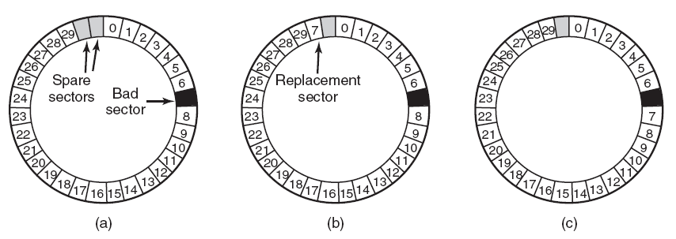
Error Handling
  (a) A disk track with a bad sector.
  (b) Substituting a spare for the bad sector.
  (c) Shifting all the sectors to bypass the bad one.

Slide 46
Bad Sectors-the OS approach
Gets messy if the OS has to do it
OS needs lots of information-which blocks are bad or has to test blocks itself

