Slide 1
CSC 322 Operating Systems Concepts
Lecture - 25:
by
Ahmed Mumtaz Mustehsan
Special Thanks To:
Tanenbaum, Modern Operating Systems 3 e, (c) 2008 Prentice-Hall, Inc. (Chapter-4) Silberschatz, Galvin and Gagne 2002, Operating System Concepts,
Notes:
1

Slide 2
Chapter 5
Input/ Output
Principals of I/O Software
Hardware
Disk

Slide 3
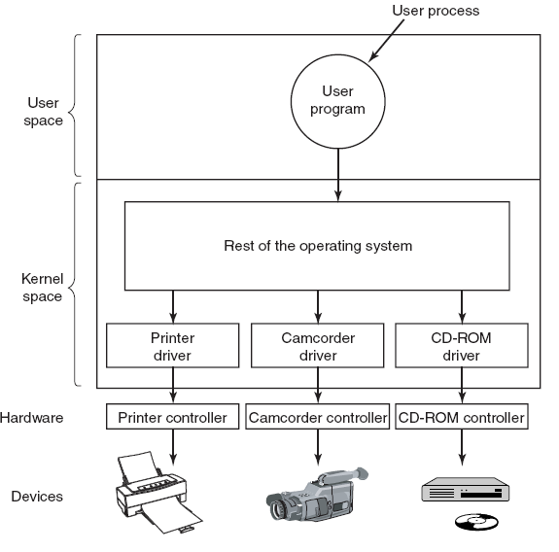
Device Drivers
Logical positioning of device drivers. In reality all communication between drivers and device controllers goes over the bus.

Slide 4
Device Drivers-Act 1
Driver contains code specific to the device
Supplied by manufacturer
Installed in the kernel (Rebuild binaries, or Plug n play, run in user space)
User space might be better place
Why? Bad driver can mess up kernel
Need interface to OS
      block and character interfaces
      procedures which OS can call to invoke driver (e.g. read a block)

Slide 5
Device drivers Act 2
Checks input parameters for validity
Abstract to concrete translation (block number to cylinder, head, track, sector)
Check device status. Might have to start it (switch on).
Puts commands in device controller’s registers
Driver blocks itself until interrupt arrives
Might return data to caller
Does return status information
The end
Drivers should be re-entrant (multiple copies in parallel)
OS adds devices when system is running (and therefore driver)

Slide 6
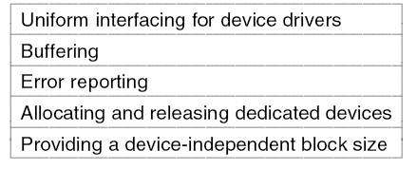
Device-Independent I/O Software

Slide 7
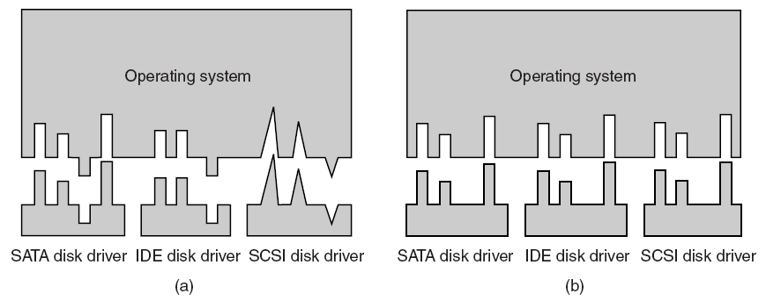
Why the OS needs a standard interface
Driver functions differ for different drivers
Kernel functions that each driver needs are different for different drivers
Too much work to have new interface for each new device type

Slide 8
Interface : Driver functions
OS defines functions for each class of devices which it MUST supply, e.g. read, write, turn on, turn off……..
Driver has a table of pointers to functions
OS just needs table address to call the functions
OS maps symbolic device names onto the right driver (Next Slide)

Slide 9
Interface : Names and protection
OS maps symbolic device names onto the right driver
Unix: /dev/disk0 maps to an i-node which contains the major and minor device numbers for disk0
    Major device number locates driver, (e.g. disk)
    Minor device number passes locates device unit (e.g. 0,1,2,3 …)
    Protection: In Unix and Windows devices appear as named objects therefore may apply the same rule as that of file protection system (e.g.rwxrwxrwx)

Slide 10
Buffering
Perform input transfers in advance of requests being made
Perform output transfers some time after the request is made
Block-oriented device
stores information in blocks that are usually of fixed size
transfers are made one block at a time
possible to reference data by its block number
disks and USB keys are examples
Stream-oriented device
transfers data in and out as a stream of bytes
no block structure
terminals, printers, communications ports, and most other devices that are not secondary storage are examples
Notes:
The same considerations apply to an output operation. If a block is being
transferred from a user process area directly to an I/O module, then the process is
blocked during the transfer and the process may not be swapped out.
To avoid these overheads and inefficiencies, it is sometimes convenient to
perform input transfers in advance of requests being made and to perform output
transfers some time after the request is made. This technique is known as buffering.
In this section, we look at some of the buffering schemes that are supported by
operating systems to improve the performance of the system.
In discussing the various approaches to buffering, it is sometimes important
to make a distinction between two types of I/O devices: block oriented and stream
oriented. A block-oriented device stores information in blocks that are usually of
fixed size, and transfers are made one block at a time. Generally, it is possible to
reference data by its block number. Disks and USB keys are examples of block oriented
devices. A stream-oriented device transfers data in and out as a stream of
bytes, with no block structure. Terminals, printers, communications ports, mouse
and other pointing devices, and most other devices that are not secondary storage
are stream oriented.

Slide 11
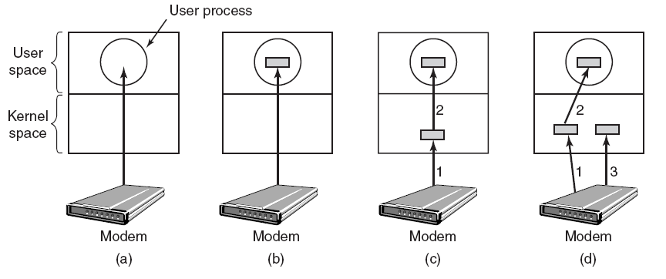
Buffering
  (a) Un-buffered input.
  (b) Buffering in user space not in kernel.
  (c) Buffering in the kernel followed by copying to user space.
  (d) Double buffering in the kernel.

Slide 12
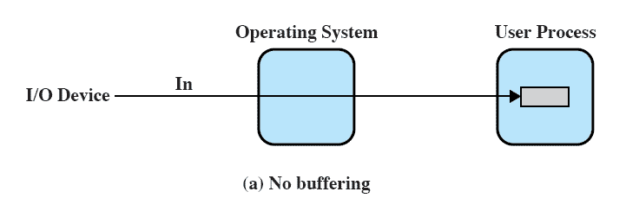
No Buffer in Kernel
Without a buffer in kernel (OS) process directly accesses the device when it needs and buffers data in user space.
Notes:
Without a buffer, the OS directly accesses the device when it needs to.

Slide 13
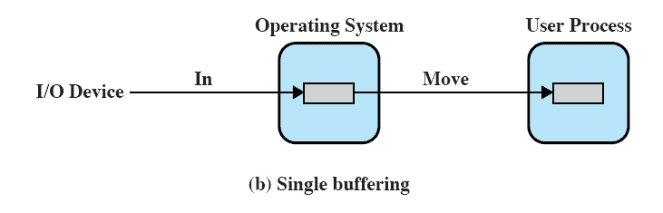
Single Buffer
Operating system assigns a buffer in main memory for an I/O request
Notes:
The simplest type of support that the operating system can provide is single buffering
( Figure 11.5b ). When a user process issues an I/O request, the OS assigns a buffer in
the system portion of main memory to the operation.
In the case of line-at-a-time I/O, the buffer can be used to hold a single line.
The user process is suspended during input, awaiting the arrival of the entire line.
For output, the user process can place a line of output in the buffer and continue
processing. It need not be suspended unless it has a second line of output to send
before the buffer is emptied from the first output operation. In the case of byte-at-a-time
I/O, the interaction between the OS and the user process follows the producer/
consumer model discussed in Chapter 5 .

Slide 14
Block-Oriented Single Buffer
Input transfers are made to the system buffer
Reading ahead/anticipated input
        is done in the expectation that the block will eventually be needed
        when the transfer is complete, the process moves the block into user space and immediately requests another block
    Generally provides a speedup compared to the lack of system buffering
    Disadvantage:
        Complicates the logic in the operating system
Notes:
For block-oriented devices, the single buffering scheme can be described
as follows: Input transfers are made to the system buffer. When the transfer is
complete, the process moves the block into user space and immediately requests
another block. This is called reading ahead, or anticipated input; it is done in the
expectation that the block will eventually be needed. For many types of computation,
this is a reasonable assumption most of the time because data are usually
accessed sequentially. Only at the end of a sequence of processing will a block be
read in unnecessarily.
This approach will generally provide a speedup compared to the lack of system
buffering. The user process can be processing one block of data while the next block
is being read in. The OS is able to swap the process out because the input operation
is taking place in system memory rather than user process memory. This technique
does, however, complicate the logic in the operating system. The OS must keep
track of the assignment of system buffers to user processes. The swapping logic is
also affected: If the I/O operation involves the same disk that is used for swapping,
it hardly makes sense to queue disk writes to the same device for swapping the process
out. This attempt to swap the process and release main memory will itself not
begin until after the I/O operation finishes, at which time swapping the process to
disk may no longer be appropriate.
Similar considerations apply to block-oriented output. When data are being
transmitted to a device, they are first copied from the user space into the system
buffer, from which they will ultimately be written. The requesting process is now
free to continue or to be swapped as necessary.
[KNUT97] suggests a crude but informative performance comparison between
single buffering and no buffering. Suppose that T is the time required to input one
block and that C is the computation time that intervenes between input requests.
Without buffering, the execution time per block is essentially T + C . With a single
buffer, the time is max [C, T] + M , where M is the time required to move the data
from the system buffer to user memory. In most cases, execution time per block is
substantially less with a single buffer compared to no buffer.

Slide 15
Stream-Oriented Single Buffer
Line-at-a-time operation
  appropriate for scroll-mode terminals (dumb terminals)
  user input is one line at a time with a carriage return signaling the end of a line
  output to the terminal is similarly one line at a time
    Byte-at-a-time operation
used on forms-mode terminals
when each keystroke is significant
Other peripherals such as sensors and controllers
Notes:
For stream-oriented I/O, the single buffering scheme can be used in a line-at-
a-time fashion or a byte-at-a-time fashion. Line-at-a-time operation is appropriate
for scroll-mode terminals (sometimes called dumb terminals). With this form
of terminal, user input is one line at a time, with a carriage return signaling the end
of a line, and output to the terminal is similarly one line at a time. A line printer is
another example of such a device. Byte-at-a-time operation is used on forms-mode
terminals, when each keystroke is significant, and for many other peripherals, such
as sensors and controllers.
In the case of line-at-a-time I/O, the buffer can be used to hold a single line.
The user process is suspended during input, awaiting the arrival of the entire line.
For output, the user process can place a line of output in the buffer and continue
processing. It need not be suspended unless it has a second line of output to send
before the buffer is emptied from the first output operation. In the case of byte-at-atime
I/O, the interaction between the OS and the user process follows the producer/
consumer model discussed in Chapter 5 .

Slide 16
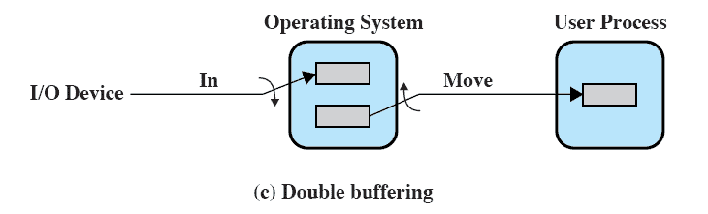
Double Buffer
Use two system buffers instead of one
A process can transfer data to or from one buffer while the operating system empties or fills the other buffer
Also known as buffer swapping
Notes:
An improvement over single buffering can be had by assigning two system buffers to
the operation ( Figure 11.5c ). A process now transfers data to (or from) one buffer
while the operating system empties (or fills) the other. This technique is known as
double buffering or buffer swapping .
For block-oriented transfer, we can roughly estimate the execution time as
max [ C , T ]. It is therefore possible to keep the block-oriented device going at full
speed if C … T . On the other hand, if C 7 T , double buffering ensures that the
process will not have to wait on I/O. In either case, an improvement over single
buffering is achieved. Again, this improvement comes at the cost of increased
complexity.
For stream-oriented input, we again are faced with the two alternative modes
of operation. For line-at-a-time I/O, the user process need not be suspended for
input or output, unless the process runs ahead of the double buffers. For byte-at-atime
operation, the double buffer offers no particular advantage over a single buffer
of twice the length. In both cases, the producer/consumer model is followed.

Slide 17
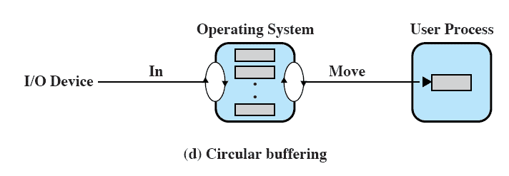
Circular Buffer
Two or more buffers are used
Each individual buffer is one unit in a circular buffer
Used when I/O operation must keep up with process
Notes:
A double-buffer scheme should smooth out the flow of data between an I/O device
and a process. If the performance of a particular process is the focus of our concern,
then we would like for the I/O operation to be able to keep up with the process.
Double buffering may be inadequate if the process performs rapid bursts of I/O. In
this case, the problem can often be alleviated by using more than two buffers.
When more than two buffers are used, the collection of buffers is itself referred
to as a circular buffer ( Figure 11.5d ), with each individual buffer being one unit in
the circular buffer. This is simply the bounded-buffer producer/consumer model
studied in Chapter 5 .

Slide 18
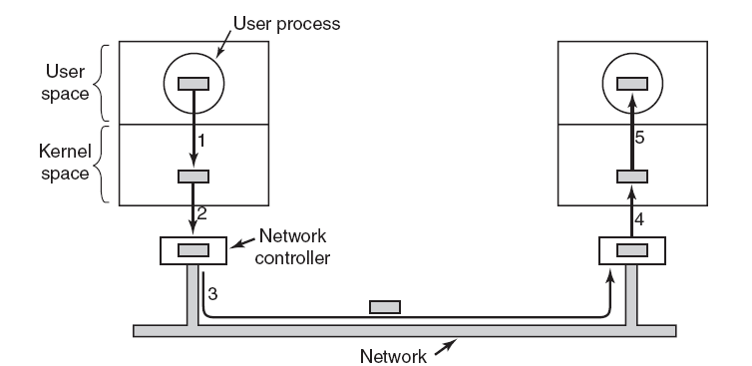
Buffering
Networking may involve many copies of a packet.
Kernel does not directly write to bus? ( why 3?)

Slide 19
Summary: Buffering
  Un-buffered input.
  Process: tries to read ch; blocked, interrupted when ch arrives, read ch, block again. Poor performance not used
  Buffering in user space.
  Process: defined buffer in user space, tries to read ch, blocked, kernel copies data to user buffer, un block process. What if buffer paged out?
  Buffering in the kernel followed by copying to user space.
  Process: tries to read ch, blocked, data copied to user buffer from kernel buffer. What if while copying data fresh data arrives?
  Double buffering in the kernel. Use one buffer to read from device, one to write to user buffer, then swap. Circular buffering

Slide 20
The Utility of Buffering
Technique that smooth out peaks in I/O demand
    with enough demand eventually all buffers become full and their advantage is lost
When there is a variety of I/O and process activities to service, buffering can increase the efficiency of the OS and the performance of individual processes
Notes:
Buffering is a technique that smoothes out peaks in I/O demand. However, no
amount of buffering will allow an I/O device to keep pace with a process indefinitely
when the average demand of the process is greater than the I/O device can
service. Even with multiple buffers, all of the buffers will eventually fill up and the
process will have to wait after processing each chunk of data. However, in a multiprogramming
environment, when there is a variety of I/O activity and a variety of
process activity to service, buffering is one tool that can increase the efficiency of
the operating system and the performance of individual processes.

Slide 21
More Functions of Independent Software
Error reporting
programming errors (the user asks for the wrong thing write to input, read from output device), hardware problems (bad disk) are reported if they can’t be solved by the driver
Allocate share and dedicated devices
Allocates and releases devices which can only be used by one user at a time (CD-ROM players)
    Block the user and Queues their requests or
    Regret (device not available) Device open fail
Device independent block size
OS does not have to know the details of the devices e.g. combine sectors into blocks

Slide 22
User Space I/O Software
Library routines in user space but are involved with I/O
These routines makes system calls. (pass parameters)
Do formatting while reading and writing for example.(printf, scanf )
Spooling systems
keep track of requests made by users on shared devices
  Example Print Demon, Network Demon
    User generates file, puts it in a spooling directory.
    Print Daemon process monitors the directory, printing the user file
    Network demon monitors the spooling directory and transfers file over network.

Slide 23
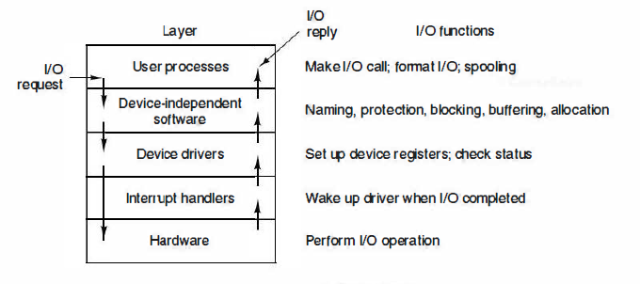
Example Flow through layers
User wants to read a block, asks OS
Device independent software looks for block in cache
If not there, invokes device driver to request block from disk hardware
Transfer finishes, interrupt is generated by handler
Device driver unblocks and returns the data to device independent software
User process is awakened and goes back to work

