Slide 1
CSC 322 Operating Systems Concepts
Lecture - 24:
by
Ahmed Mumtaz Mustehsan
Special Thanks To:
Tanenbaum, Modern Operating Systems 3 e, (c) 2008 Prentice-Hall, Inc. (Chapter-5) Silberschatz, Galvin and Gagne 2002, Operating System Concepts,
Notes:
1

Slide 2
Chapter 5
Input/ Output
Principals of I/O Hardware (contd…)
Principals of I/O Software

Slide 3
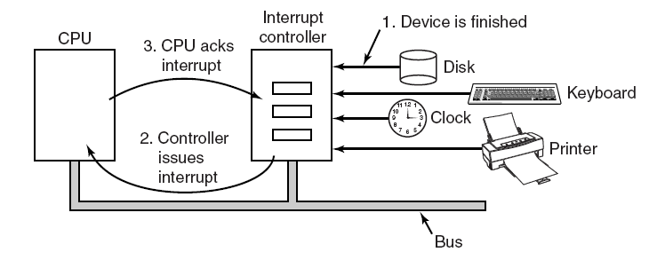
PC interrupt structure
The connections between the devices and the interrupt controller use interrupt lines on the bus rather than dedicated wires. (sets interrupt bit)

Slide 4
Interrupt processing
Each devise asserts a signal on a bus assigned until attended by Interrupt controller.
Controller detects and distinguish the interrupt signal by the device.
If no other interrupt pending it immediately process the interrupt. Otherwise process high priority interrupt, and ignores the interrupt.
Controller puts number on address line telling CPU which device wants attention
Table (interrupt vector) points to interrupt service routine
Number on address line acts as index into interrupt vector
Interrupt vector contains PC which points to start of service routine

Slide 5
Interrupt processing
Interrupt service routine acknowledge interrupt
Saves information about interrupted program
Where to save information
  User process stack, kernel stack are both possibilities
  Both have problems
  User process, stack pointer might me illegal may cause fatal error or stack pointer at the end of page may cause page fault, interrupt causing interrupt, difficult to handle that where to save state?
  Save to kernel stack, legal stack pointer, but trap to kernel space, change MMU, will invalidate TLB and cache, reloading all these is time consuming

Slide 6
The precise (ideal) interrupt
PC (Program Counter) is saved in a known place.
All instructions before the one pointed to by the PC have fully executed.
No instruction beyond the one pointed to by the PC has been executed.
Execution state of the instruction pointed to by the PC is known.

Slide 7
Imprecise Interrupts
Can we save the PC and PSW?
Sure, if we don’t use pipelined or superscalar CPU’s. But we do use them.
In both cases, we can’t assume that all instructions up to the interrupt point and including interrupted instruction have been executed
  Pipeline
    Bunch of instructions are partially completed
  Superscalar
    instructions are decomposed and can execute out of order

Slide 8
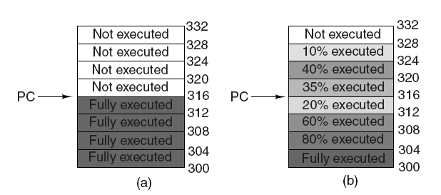
Precise and Imprecise Interrupts (2)
(a) A precise interrupt.
(b) An imprecise interrupt.

Slide 9
How to process an imprecise interrupt
With great difficulty
Either Need complicated hardware logic to re-start after interrupt (Pentium)
Or have complicated processing in the OS

Slide 10
Input/ Output
Principals of I/O Software

Slide 11
I/O Software-Goals
Device independence
  Don’t have to specify the device when accessing the device e.g. HD, CD-ROM or USB.
Uniform naming
Name should not depend on device type, name of device, directory and file should be the same.
Example: In UNIX a USB stick can be mounted on top of the directory /usr/ast/backup so that copying a file to /usr/ast/backup/monday copies the file to the USB stick.
Error handling
  Do it as close to the device as possible (e.g. controller should be the first to fix error, followed by the driver, and followed by OS)

Slide 12
I/O Software-Goals
Blocking I/O operation
OS needs to make I/O operations blocking (e.g. program blocks until data arrives on a read) because it is easy to write blocking ops
synchronous (blocking) versus asynchronous (interrupt-driven) transfers, may looked to end users blocking.
Buffering
The data read from the device is to be buffered to ensure avoid data loss due to non availability of system bus or non synchronization of speed.
Shared vs dedicated devices allocation.
Shared devices (disks) and un-shared devices (tapes) must be handled in a way to avoid problems.

Slide 13
Evolution of the I/O Function
1
Processor directly controls a peripheral device
2
A controller or I/O module is added
3
Same configuration as step 2, but now interrupts are employed
4
5
6
The I/O module is given direct control of memory via DMA
The I/O module is enhanced to become a separate processor, with a specialized instruction set for I/O
The I/O module has a local memory of its own and is, in fact, a computer in its own right
Notes:
As computer systems have evolved, there has been a pattern of increasing
complexity and sophistication of individual components. Nowhere is this more
evident than in the I/O function. The evolutionary steps can be summarized as
Follows:
1. The processor directly controls a peripheral device. This is seen in simple
microprocessor-controlled devices.
2. A controller or I/O module is added. The processor uses programmed I/O
without interrupts. With this step, the processor becomes somewhat divorced
from the specific details of external device interfaces.
3. The same configuration as step 2 is used, but now interrupts are employed. The
processor need not spend time waiting for an I/O operation to be performed,
thus increasing efficiency.
4. The I/O module is given direct control of memory via DMA. It can now move
a block of data to or from memory without involving the processor, except at
the beginning and end of the transfer.
5. The I/O module is enhanced to become a separate processor, with a
specialized instruction set tailored for I/O. The central processing unit
(CPU) directs the I/O processor to execute an I/O program in main
memory. The I/O processor fetches and executes these instructions without
processor intervention. This allows the processor to specify a sequence of
I/O activities and to be interrupted only when the entire sequence has been
performed.
6. The I/O module has a local memory of its own and is, in fact, a computer
in its own right. With this architecture, a large set of I/O devices can be
controlled, with minimal processor involvement. A common use for such an
architecture has been to control communications with interactive terminals.
The I/O processor takes care of most of the tasks involved in controlling the
terminals.
As one proceeds along this evolutionary path, more and more of the I/O
function is performed without processor involvement. The central processor is
increasingly relieved of I/O-related tasks, improving performance. With the last
two steps (5 and 6), a major change occurs with the introduction of the concept of
an I/O module capable of executing a program.
A note about terminology: For all of the modules described in steps 4
through 6, the term direct memory access is appropriate, because all of these
types involve direct control of main memory by the I/O module. Also, the I/O
module in step 5 is often referred to as an I/O channel , and that in step 6 as an
I/O processor ; however, each term is, on occasion, applied to both situations. In
the latter part of this section, we will use the term I/O channel to refer to both
types of I/O modules.

Slide 14
Types of I/O Operations
Three ways to carry out I/O operations
1. Programmed I/O
    The processor issues an I/O command on behalf of a process to an I/O module; that process then busy waits for the operation to be completed before proceeding
  2. Interrupt Driven I/O
  The processor issues an I/O command on behalf of a process
    If non-blocking – processor continues to execute instructions from the process that issued the I/O command
    If blocking – the next instruction the processor executes is from the OS, which will put the current process in a blocked state and schedule another process

Slide 15
Types of I/O Operations
  3. I/O using DMA
    A DMA module controls the exchange of data between main memory and an I/O module

Slide 16
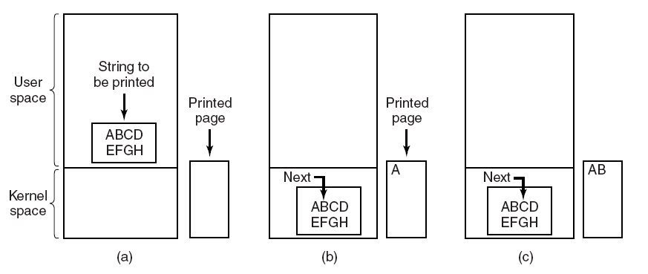
Example: Programmed I/O
Steps in printing a string.

Slide 17
Steps: Programmed I/O
Steps in printing a string:
First the data are copied to the kernel.
Then the operating system enters a tight loop outputting the characters one at a time.
After outputting a character, the CPU continuously polls the device to see if it is ready to accept another one.
This behavior is often called polling or busy waiting.

Slide 18
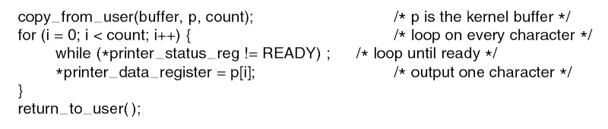
Sample: Programmed I/O
After outputting a character, on printer, the CPU continuously polls the printer to see if it is ready to accept another one.
Busy Waiting; Wastage of CPU time.

Slide 19
Programmed I/O : Good vs Bad
The good:
Simple idea, OK if the CPU is not a constraint., e.g. embedded systems.
The bad:
If the CPU has other work to do, busy waiting is inefficient.

Slide 20
Interrupt Driven I/O
Idea: If a printer prints 100 chs/sec means 1 ch/10 msec. It is sufficient time for context switching and undertake another process. So:
block process which requests I/O, and schedule another process
Return to calling process when I/O is done
Printer generates interrupt when a character is printed.
Keeps interrupting and printing until the end of the string.
Re-instantiate calling process once printing is completed.

Slide 21
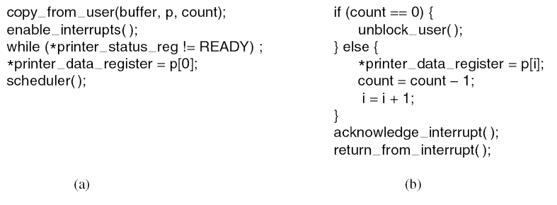
Sample: Interrupt-Driven I/O
(a) Code executed at the time the print system call is made.
(b) Interrupt service procedure for the printer.

Slide 22
DMA
Use DMA controller to send characters to printer instead of using the CPU.
DMA is programmed I/O, only with the DMA controller doing all the work, instead of the main CPU.
CPU is only interrupted when the buffer is printed out instead of printing each character.
DMA is worth it if :
    DMA controller can drive the device as fast as the CPU could drive it
    There is enough data to make it worthwhile

Slide 23
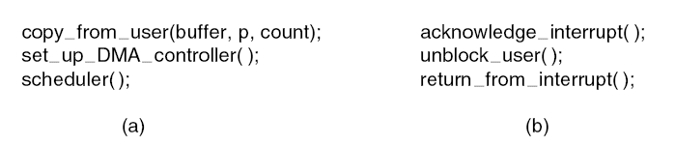
Sample: I/O Using DMA
// copy data from user to kernel space
// Assign the job to DMA controller
// schedule another task
// controller undertake the Task
// unblock the user after completion
// schedule another task
  Code executed when the print system call is made.
  Interrupt service procedure.

Slide 24
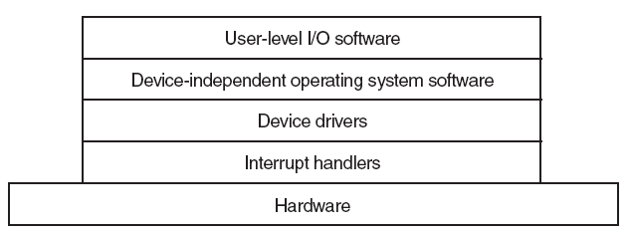
I/O Software Layers
Layers of the I/O software system.
  Interrupt handler
  Device Drivers
  Device Independent OS software
  Use Level I/O Software

Slide 25
Interrupt Handlers
The idea:
Driver starting the I/O, Blocks until interrupt happens when I/O finishes
Handler processes interrupt
Wakes up driver when processing is finished
Drivers are kernel processes with their own
      Stacks
      PCs
      states

Slide 26
Interrupt processing details
Save registers not already saved by interrupt hardware.
Set up a context for the interrupt service procedure.
Set up a stack for the interrupt service procedure.
Acknowledge the interrupt controller. If there is no centralized interrupt controller, re-enable interrupts.
Copy the registers from where they were saved to the process table.

Slide 27
Interrupt processing details
Run the interrupt service procedure.
Choose which process to run next.(may be hi-priority process)
Set up the MMU context for the process to run next.
Load the new process’ registers, including its PSW.
Start running the new process.

