Slide 1
CSC 322 Operating Systems Concepts
Lecture - 23:
by
Ahmed Mumtaz Mustehsan
Special Thanks To:
Tanenbaum, Modern Operating Systems 3 e, (c) 2008 Prentice-Hall, Inc. (Chapter-5) Silberschatz, Galvin and Gagne 2002, Operating System Concepts,
Notes:
1

Slide 2
Chapter 5
Input/ Output

Slide 3
Overview
OS controls I/O devices =>
  Issue commands,
  handles interrupts,
  handles errors
Provide easy to use interface to devices
  Hopefully device independent
First look at hardware, then software
  Emphasize software
  Software structured in layers
  Look at disks

Slide 4
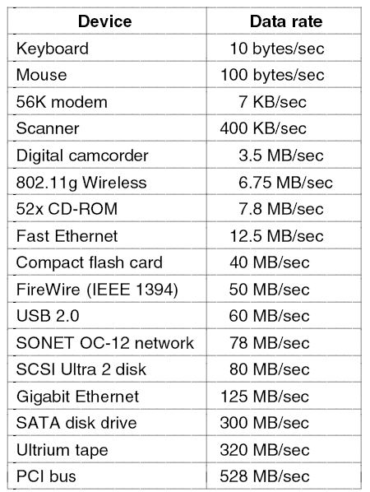
I/O Devices
Some typical device network, and bus data rates.

Slide 5
Overview
Two types of I/O devices- block, character
Block
  Can read blocks independently of one another
    Hard disks, CD-ROMs, USB sticks
    512 to 32,768 bytes
Character
  Accepts stream of characters without block structure
    Printers, mice, network interfaces
Not everything fits, e.g. clocks don’t fit
Division allows for OS to deal with devices in device independent manner
    File system deals with blocks

Slide 6
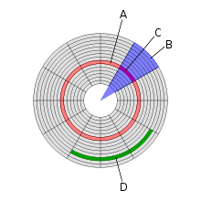
Disk geometry
A is track, B is sector, C is geometrical sector, D is cluster

Slide 7
Device Controllers
I/O unit has 2 components-mechanical, electronic (controller)
Controller is a chip with a connector which plugs into cables to device sometimes more than one of identical devices like SCSI controllers can handle 8 drives including (CD drive)
Disk
  Disk might have 10,000 sectors of 512 bytes per track or different spec.
  Serial bit stream comes off drive
  Has preamble 4096 bits/sector, error correcting code
  Preamble has sector number, cylinder number, sector size….

Slide 8
Device Controllers
Controller assembles block from bit stream, does error correction, puts into buffer in controller
Blocks are what are sent from a disk

Slide 9
Memory Mapped I/O
Controller has registers which OS can write and read
Write- means OS gives command to device
Read- means OS learns device status……
Devices have data buffer which OS can read/write (e.g. video RAM, used to display pixels on a screen)
How does CPU communicate with registers and buffers?

Slide 10
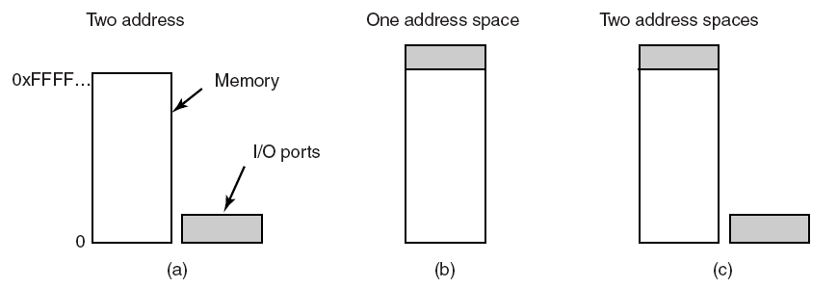
Memory-Mapped I/O
Separate I/O ports and memory space. (e.g. IBM-360)
Memory-mapped I/O. (e.g. PDP-11)
Memory mapped data buffers and separate ports hybrid approach (e.g. Pentium, 0 to 64K I/O ports and 64K to1MB device data buffer)

Slide 11
How CPU addresses registers and buffers
First scheme (Separate memory and I/O space)
  When CPU wants to read from memory or I/O port, it :
  Puts read on control line
  Puts address on address line
  Puts I/O space or memory space on separate 2nd signal line to differentiate Read from memory space or I/O space
  It requires special I/O instructions (IN/OUT assembly language) to read and write device registers
Memory mapped approach
  Put address on address line and let memory and I/O devices compare address with the ranges they serve and respond accordingly.

Slide 12
Memory mapped advantages
Don’t need special instructions to read/write control registers=> can write a device driver in C
Don’t need special protection to keep users from doing I/O directly.
Put each device drivers on different address space, on different pages, avoid conflict.
Allocate driver pages to user address space, hene:
  Reduce kernel size
  Avoid device drivers interfering with others.
  Avoid crash of OS due to buggy driver.

Slide 13
Memory mapped advantages contd…
Every instruction that can reference memory can reference control registers as well.
Example:
  LOOP TEST PORT_4 //check if port 4 is zero
  BEQ READY //it is zero, go to ready
  BRACCH LOOP //otherwise, continue testing
  READY:
If no memory map I/O instruction just references registers, the registers are to be loaded in CPU, then tested, need more instructions to do the test-read
Slowing down the response of detecting idle devices.

Slide 14
Memory mapped disadvantage
Caching a device control Register:
caching device status memory words, which means that old memory value (e.g. for port 4) could remain in cache , no status update, loop forever.
  Solution: Hardware should be able to disable caching when it is worthwhile
I/O devices and memory have to respond to memory references:
Works with single bus because both memory and I/O look at address on bus and decide which one to respond?
Harder with multiple buses because I/O devices can’t see their addresses referred to the buses not connected with.

Slide 15
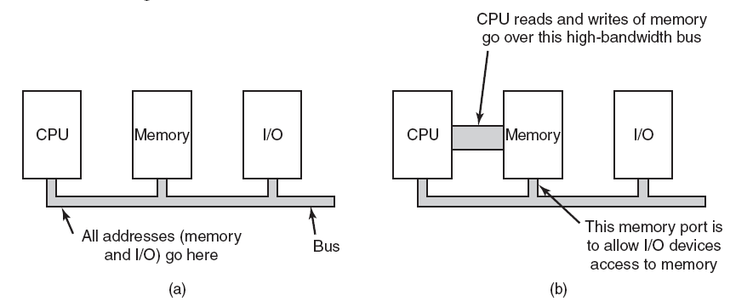
Memory-Mapped I/O
(a) A single-bus architecture.
(b) A dual-bus memory architecture.

Slide 16
Memory-Mapped I/O
Solution-1: Try I/O devices if memory bus not respond
CPU to try memory first. If it does not get a response then it tries I/O devices.
Solution-2: Put Snooping device.
The snoopy device pass all addresses of potent5ial interest of I/o devices.
I/O devices may not be able to match the speed of memory bus.
Solution-3: Filter addresses (Pentium approach)
Filter addresses e.g. 640K to 1MB could be marked as non memory range forwarded to PCI bus instead of memory.
Main point-have to complicate hardware to make this work

Slide 17
DMA
CPU COULD request data one byte at a time from I/O controller.
Big waste of CPU time, use DMA
DMA controller on mother-board; normally one controller for multiple devices
CPU reads/writes to registers in DMA controller:
  Memory address register
  Byte count register
  Control registers
    I/O port, direction of transfer, transfer units (byte/word), transfer mode, number of bytes to transfer in a burst

Slide 18
When DMA is not used
Controller reads a block into its memory buffer
Computes checksum (e.g. ECC )
Interrupts OS
Now OS reads byte at a time or word at a time from controllers buffers and stores it in to the main memory

Slide 19
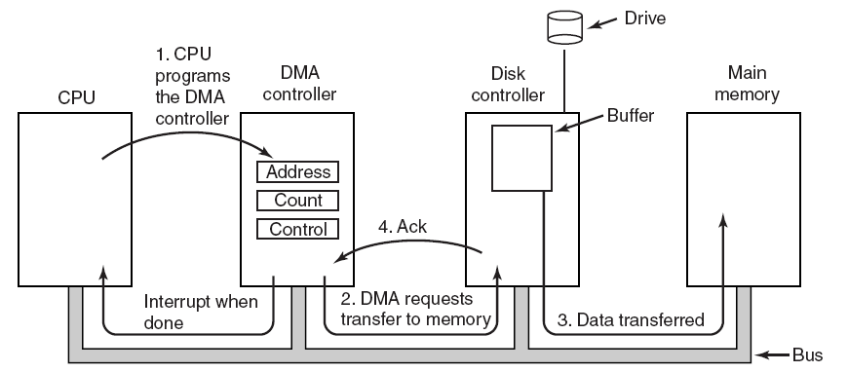
How does DMA work?
Operation of a DMA transfer.

Slide 20
How does DMA work?
Step-1:CPU programs the DMA controller registers what and where to transfer. It also instructs DC to read the data from disk into its buffer and perform checksum.
Step-2: DMA controller issues a read request over a bus to disk controller. The DC reads the memory address to write,
Step-3: Write to memory is another bus cycle.
Step-4: After memory write, DC send ack. to DMA over the bus.
DMA increment memory address and decrement word count , if count > 0 repeat step-1 to step-4.
Otherwise, If byte count is zero, DMA interrupt CPU that memory transfer is complete.

Slide 21
DMA controller modes
Cycle stealing mode-transfer goes on word at a time, competing with CPU for bus cycles. Idea is that CPU loses the occasional cycle to the DMA controller called cycle stealing.
Burst mode-DMA controller grabs bus and sends a block
Fly by mode-DMA controller tells device controller to send word to it instead of memory. Can be used to transfer data between devices. (e.g. memory to memory)

Slide 22
Quiz
Why buffer data in controllers?
  Can do check-sum
  Bus may be busy-need to store data someplace
Is DMA really worth it?
  Not if :
  don’t have too much data to transfer.
  CPU is much faster than DMA controller and can do the job faster.
  Embedded system CPU is free; can be used for data transfer

Slide 23
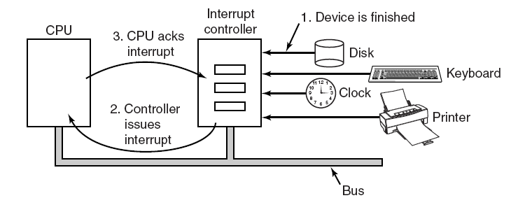
PC interrupt structure
The connections between the devices and the interrupt controller use interrupt lines on the bus rather than dedicated wires. (sets interrupt bit)

Slide 24
Interrupt processing
Each devise asserts a signal on a bus assigned until attended by Interrupt controller.
Controller detects and distinguish the interrupt signal by the device.
If no other interrupt pending it immediately process the interrupt. Otherwise process high priority interrupt, and ignores the interrupt.
Controller puts number on address line telling CPU which device wants attention
Table (interrupt vector) points to interrupt service routine
Number on address line acts as index into interrupt vector
Interrupt vector contains PC which points to start of service routine

Slide 25
Interrupt processing
Interrupt service routine acks interrupt
Saves information about interrupted program
Where to save information
  User process stack, kernel stack are both possibilities
  Both have problems
  User process, stack pointer might me illegal may cause fatal error or stack pointer at the end of page may cause page fault, interrupt causing interrupt, difficult to handle that where to save state?
  Save to kernel stack, legal stack pointer, but trap to kernel space, change MMU, will invalidate TLB and cache, reloading all these is time consuming

Slide 26
Can we save the PC and PSW?
Sure, if we don’t use pipelined or superscalar CPU’s. But we do use them.
Can’t assume that all instructions up to and including given instruction have been executed
  Pipeline-bunch of instructions are partially completed
  Superscalar
    instructions are decomposed and can execute out of order

