Slide 1
CSC 322 Operating Systems Concepts
Lecture - 22:
by
Ahmed Mumtaz Mustehsan
Special Thanks To:
Tanenbaum, Modern Operating Systems 3 e, (c) 2008 Prentice-Hall, Inc. (Chapter-4) Silberschatz, Galvin and Gagne 2002, Operating System Concepts,
Notes:
1

Slide 2
Chapter 4
File System
File System Management
Example File System

Slide 3
File System Management and Optimization
Disk space management
  Manage Free Blocks (Discussed in the last lecture)
  Manage Disk quota
File System Backups
File System Consistency
File System Performance

Slide 4
Disk Quotas (A fair distribution of disk space)
Multiuser OS enforce Disk Quota and ensure that the users do not exceed their quota.
Entry in open file table points to quota table
One entry for each open file
Places limits (soft, hard) on users disk quota
System start warning the users exceeding soft limit
User may ignore soft limit till number of warnings left after that the user is not allowed to login. (hard limit)
Quota imposed on Blocks as well as on files.
Illustration on next slide

Slide 5
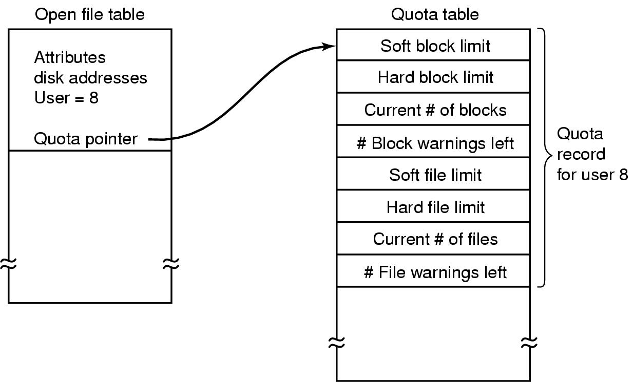
Disk Quotas
Quotas are kept track of on a per-user basis in a quota table.
When user logins within soft limit a warning message to delete files before logging out.

Slide 6
File System Backups
Take Disk Backup on Tape
Backups to tape are generally made to handle any of two potential problems:
  Recover from disaster (e.g. disk crash, nature)
  Recover from stupidity (e.g. Delete file by mistake)
Tapes hold hundreds of gigabytes and are very cheap

Slide 7
File System Backups
What to Backup?
Don’t want to back up whole file system
    Can get binaries from manufacturer’s CD’s
    Temporary files don’t need to be backed up
    Special files (I/O) don’t need it

Slide 8
Back up Incrementally
How to Backup?
Complete dump weekly/monthly and daily dump of modified files since big dump
=>to restore FS need to start with full dump and include modified files => need better algorithms
Problem; If you want to compress data before dumping it, it will optimize the space but if part of the tape is bad…..( you will Loose everything)
Problem; It is hard to dump when system is being used. Snapshot algorithms are available to run backup

Slide 9
Dumping strategies
Physical-dump the whole thing.
it is simple to implement
Don’t want to dump
    Unused blocks => program needs access to the unused block list and must write block number for used blocks on tape
    Bad blocks; Handled by DC or Handled by OS
    If managed by Disk controller; it must detect and replace them; user are not aware; no backup, needed.
    If they are kept in a bad block area by the OS, then Backup procedure must take care and backup

Slide 10
Physical Dump; Good vs Bad
The Good-easy to implement
The bad
    Can’t skip a particular directory
    Can’t make incremental dumps
    Can’t restore individual files
So physical dump Not used
Use logical dumps

Slide 11
Logical Dumps
Starts at directory and recursively dumps all files/directories below it which have changed since a given time
Examine standard algorithm used by Unix. Dumps all directories lie on the path to modified file/directory because
    Can restore complete structure (paths) on different computer
    Have the ability to restore a single file

Slide 12
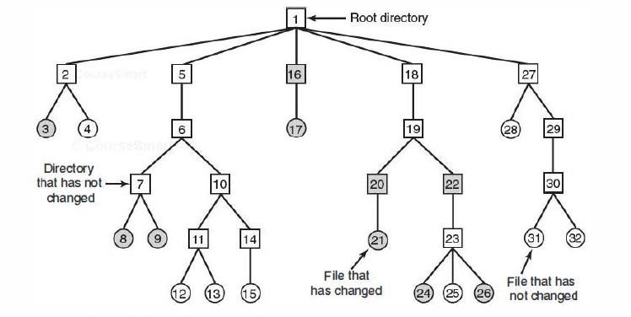
File System Backups
A file system to be dumped. Squares are directories, circles are files. Shaded items have been modified since last dump. Each directory and file is labeled by its i-node number.

Slide 13
Logical Dump Algorithm
Uses bitmap indexed by i-node
4 phases
  Phase 1-starts at root and marks bits for modified files and all directories (a)
  Phase 2-walks the tree, unmarks directories without modified files in/under them (b)
  Phase 3-go through i-nodes and dump marked directories (c)
  Phase 4-dump files (d)

Slide 14
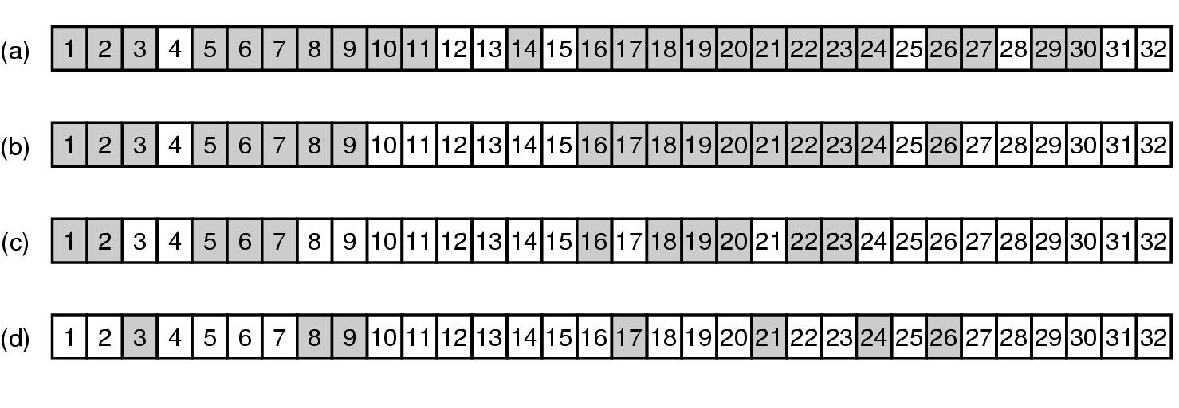
File System Backups
Bitmaps used by the logical dumping algorithm.

Slide 15
File System Backups
Algorithm

Slide 16
Restoring file on disk
Start with empty FS on disk
Restore most recent full dump. Directories first, then files.
Then do restore incremental dumps (they are in order on the tape)

Slide 17
Restoring file on disk-issues
Free block list must be reconstructed.
  Easy to do? it is the complement of the used blocks
Links to files have to be carefully restored
Files can have holes in them. Don’t want to restore files with lots of zeroes in them (Hole between data and stack segments)
Pipes can’t be dumped
Tape density is not increasing => need lots of tapes and robots to get at them. Soon will need disks to be the back-ups!!!

Slide 18
File System Consistency
Crash before blocks written out results in an inconsistent state=>
Need utility program to check for consistency in blocks and files
(fsck in Unix, scandisk in Windows)
Uses two tables
    How many times is block present in a file
    How many times block is present in free list
    Program then reads all the i-nodes of device, (ignoring FS) and increments counters in their respective tables. (Result next slide)

Slide 19
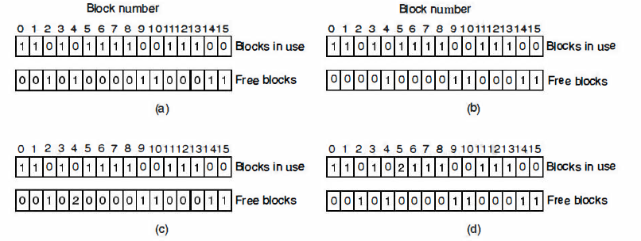
File System Consistency
File system states.
Consistent.
Missing block.
Duplicate block in free list.
Duplicate data block.

Slide 20
Solutions
If the file system is consistent, each block will have a 1 either in the first table or in the second table.
System crash result in missing block; No harm; just missing; solution: put block on free list.
Block occurs twice on free list; may happen with free list impossible with bitmap; solution: re-build free list
Block occurs twice on blocks in use; Problem; If either of files is removed, block will be put on free list, now block is in use and free at the same time. If both files are removed, the block will be twice on the free list. solution: allocate a free block, copy the contents of block into it, insert the copy to one of the files. The content of one files is unchanged; notify user.

Slide 21
File Consistency (consistency of directory system)
It, too, uses a table of counters, but these are per file, rather than per block.
Look at files instead of blocks
Use table of counters, one per file
Start at root directory, descend, increment counter each time file shows up in a directory
Compares counts with link counts from the i-nodes. Have to be the same to be consistent
  Problem: two kinds of errors can occur: the link count in the i-node can be high or it can be low.
  Solution: fixed by setting the link count in the i-node to the correct value.

Slide 22
File System Performance (FSP)
Read word from memory: 10 nsec
Read word from Disk: 5-10 msec seek + rotational delay 4- 6 msec + 100 MB/sec transfer
Cache blocks in memory
Hash table (device and disk address) to locate the desired address in the cache; for collisions use linked chain solution.
When a block is to be loaded in full cache; some block needs to be replaced. Need algorithm to replace cache blocks ; use paging algorithms, e.g FIFO, 2nd Chance Clock, LRU

Slide 23
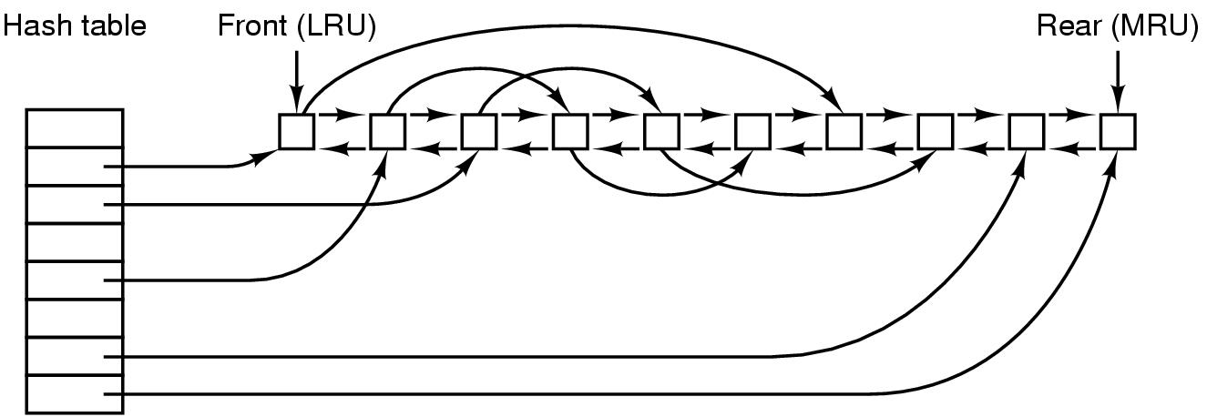
Caching (FSP)
The buffer cache data structures.

Slide 24
Replacement
Problem with LRU-some blocks are infrequently used, but have to be in memory
i-node-needs to be re-written to disk if modified. Crash could leave system in inconsistent state
Modify LRU
    Is block likely to be used again?
    Is block essential to consistency of file system?

Slide 25
Replacement
Use categories-i-nodes, indirect blocks, directory blocks, full data blocks, partial data blocks
Put ones that will be needed at the rear
If block is needed and is modified, write it to disk asap

Slide 26
Replacement
In order to put modified blocks on disk asap
    UNIX sync-forces all modified blocks to disk. Issued every 30 secs by update program
    Windows-modify block, write to disk immediately (Write through cache)

Slide 27
Block read ahead (FSP)
Block read-ahead-if read in block k to cache, read in k+1 if it is not already there
Only works for sequential files
Use a bit to determine if file is sequential or random. When system issue a seek, flip the bit.

Slide 28
Reducing arm motion (FSP)
Try to put blocks which are to be accessed sequentially close to one another.
Easy to do with a bitmap in memory, need to place blocks consecutively with free list
    Allocate storage from free list in 2 KB chunks when cache blocks are 1 KB
    Try to put consecutive blocks in same cylinder
  i-nodes-place them to reduce seek time (next slide)

Slide 29
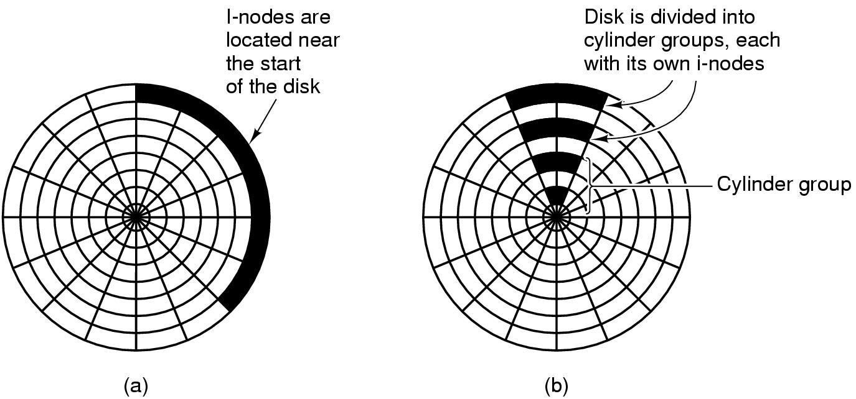
i-nodes-Reducing Disk Arm Motion
(a) I-nodes placed at the start of the disk.
(b) Disk divided into cylinder groups, each with its own blocks and i-nodes.

Slide 30
Defragging Disks (FSP)
In the beginning, files are placed contiguously on the disk
Over time holes appear
Windows defrag program to puts together disparate blocks of a file
Linux doesn’t get as many holes

Slide 31
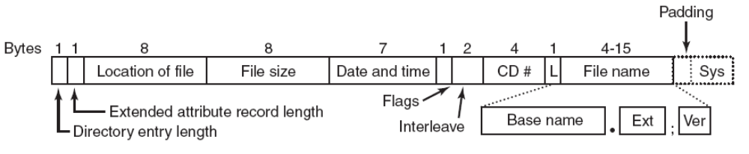
Example: The ISO 9660 File System
The ISO 9660 directory entry.

Slide 32
(Example- UNIX) : Rock Ridge Extensions
Rock Ridge extension fields:
PX - POSIX attributes.
PN - Major and minor device numbers.
SL - Symbolic link.
NM - Alternative name.
CL - Child location.
PL - Parent location.
RE - Relocation.
TF - Time stamps.

Slide 33
( Example - windows): Joliet Extensions
Joliet extension fields:
Long file names.
Unicode character set.
Directory nesting deeper than eight levels.
Directory names with extensions

Slide 34
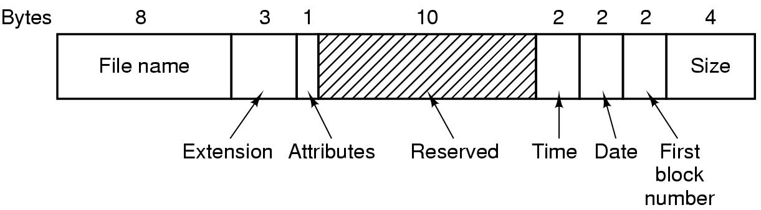
Example: The MS-DOS File System-directory entry
.

Slide 35
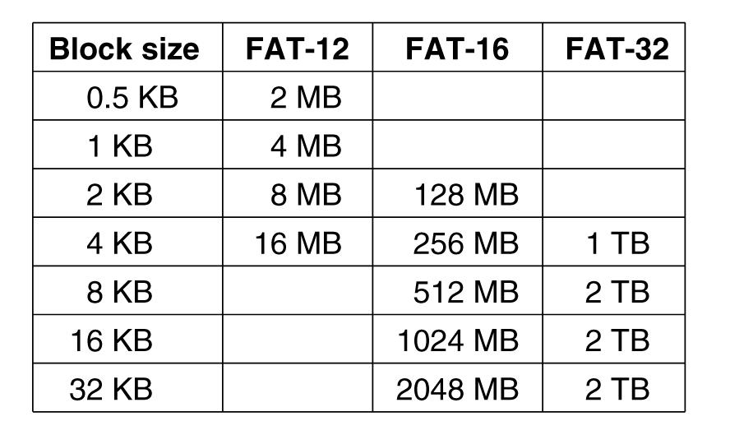
The MS-DOS File System –maximum partition size
Maximum partition size for different block sizes.
The empty boxes represent forbidden combinations.

Slide 36
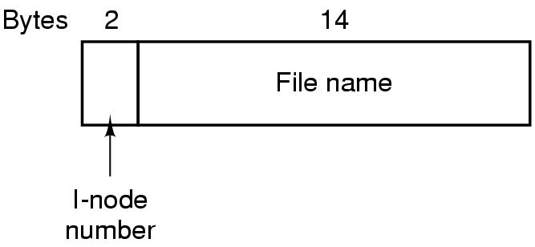
Example: The UNIX V7 File System
A UNIX V7 directory entry.

Slide 37
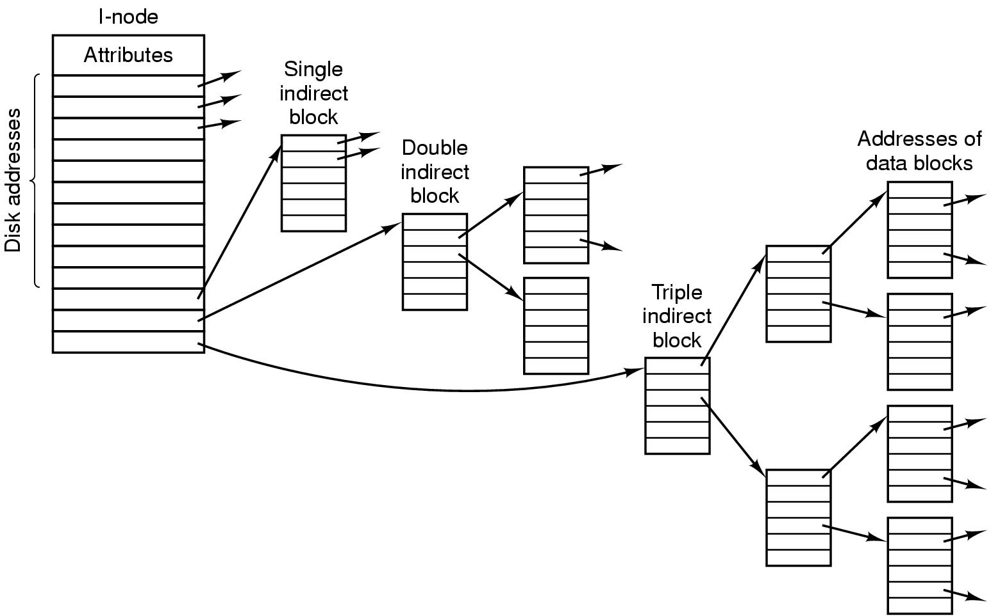
The UNIX V7 File System
A UNIX i-node.

Slide 38
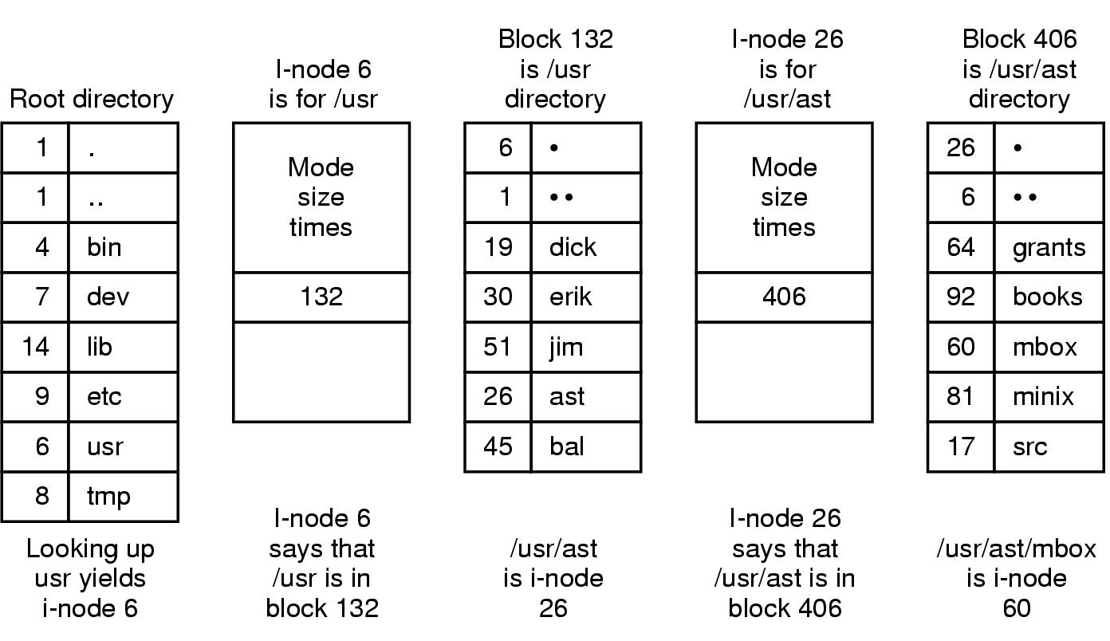
The UNIX V7 File System
The steps in looking up /usr/ast/mbox.

