Slide 1
CSC 322 Operating Systems Concepts
Lecture - 21:
by
Ahmed Mumtaz Mustehsan
Special Thanks To:
Tanenbaum, Modern Operating Systems 3 e, (c) 2008 Prentice-Hall, Inc. (Chapter-4) Silberschatz, Galvin and Gagne 2002, Operating System Concepts,
Notes:
1

Slide 2
Chapter 4
File System
File system Implementation (Contd)
File System Management

Slide 3
Implementing Directories
How do we deal with variable length names?
Problem is that names have become very long
Two approaches
    Fixed header followed by variable length names
    Heap-pointer points to names

Slide 4
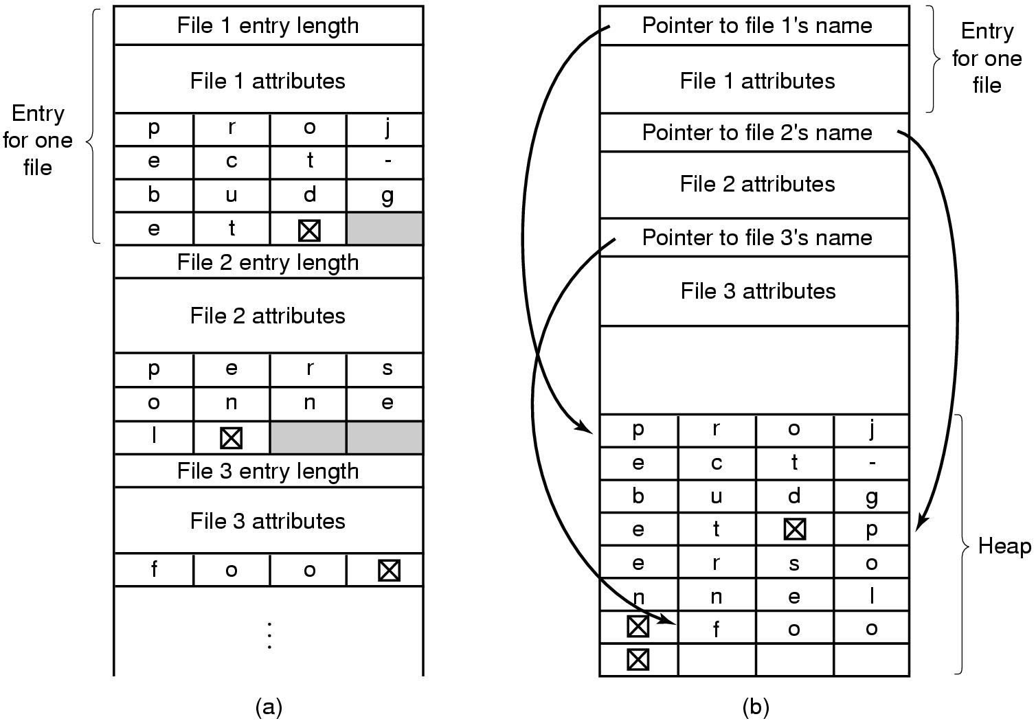
Implementing Directories
Two ways of handling long file names in a directory.
In-line.
In a heap.

Slide 5
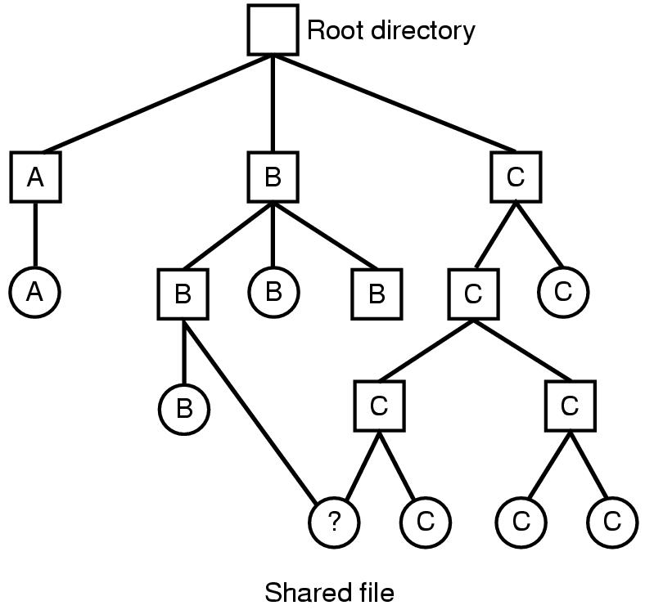
Shared Files
File system containing a shared file.
File systems is a Directed Acyclic Graph/tree (DAG)

Slide 6
Shared files
If B or C adds new blocks, how does other owner find out?
    Use special i-node for shared files
      indicates that file is shared
    Use symbolic link
      a special file put in B’s directory if C is the owner. Contains the path name of the file to which it is linked

Slide 7
I-node problem
If C removes file, B’s directory still points to i-node for shared file
If i-node is re-used for another file, B’s entry points to wrong i-node
Solution:
  Leave i-node and reduce number of owners

Slide 8
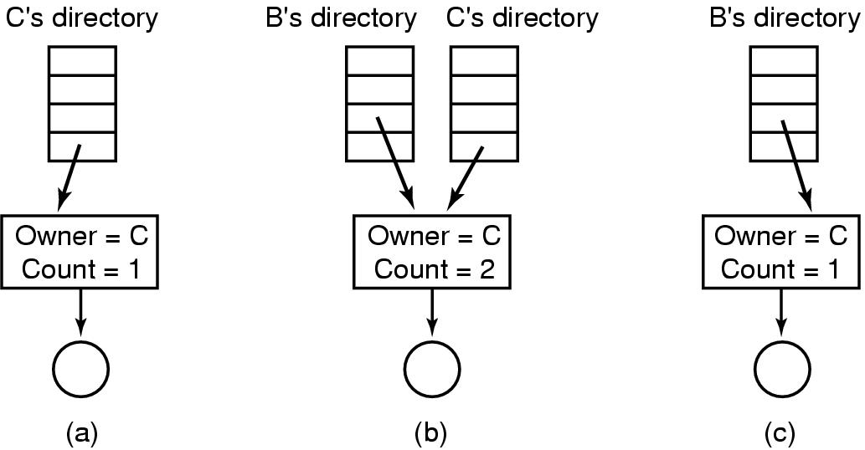
I node problem and solution
Situation prior to linking.
After the link is created.
After the original owner removes the file.

Slide 9
Symbolic links
Symbolic link solves problem
Can have too many symbolic links and they take time to follow
Backup programs must be intelligent. Otherwise will duplicate the linked files while backup and restore.
Big advantage ;
  Can point to files on other machines

Slide 10
Log Structured File System
CPU’s faster, disks and memories bigger (much) but disk seek time has not decreased
Caches bigger-can do reads from cache
Want to optimize writes because disk needs to be updated
Structure disk as a log-collect writes and periodically send them to a segment in the disk . Writes tend to be very small
Segment has summary of contents (i-nodes, directories….).
Keep i-node map on disk and cache it in memory to locate i-nodes

Slide 11
Log Structured File System
Cleaner thread compacts log. Scans segment for current i-nodes, discarding ones not in use and sending current ones to memory.
Writer thread writes current ones out into new segment.
Works well in Unix. Not compatible with most file systems, and hence very rarely used.

Slide 12
Journaling File Systems
The basic idea here is to keep a log of what the file system is going to do before it does it
Want to guard against lost files when there are crashes. Consider what happens when a file has to be removed.
Remove the file from its directory.
Release the i-node to the pool of free i-nodes.
Return all the disk blocks to the pool of free disk blocks
If there is a crash somewhere in this process, have a mess.

Slide 13
Journaling File Systems
Keep a journal (i.e. list) of actions before you take them, write journal to disk, then perform actions. Can recover from a crash!
Need to make operations idempotent. Must arrange data structures to do so.
    Mark block n as free is an idempotent operation.
    Adding freed blocks to the end of a list is not idempotent
  NTFS (Windows) and Linux use journaling

Slide 14
Virtual File Systems
Have multiple File Systems on same machine
Windows specifies FS (drives)
Unix integrates into VFS
    VFS calls from user (Top Level Interface)
    Lower calls to actual File System (Lower level interface)
Supports Network File System
  File can be on a remote machine

Slide 15
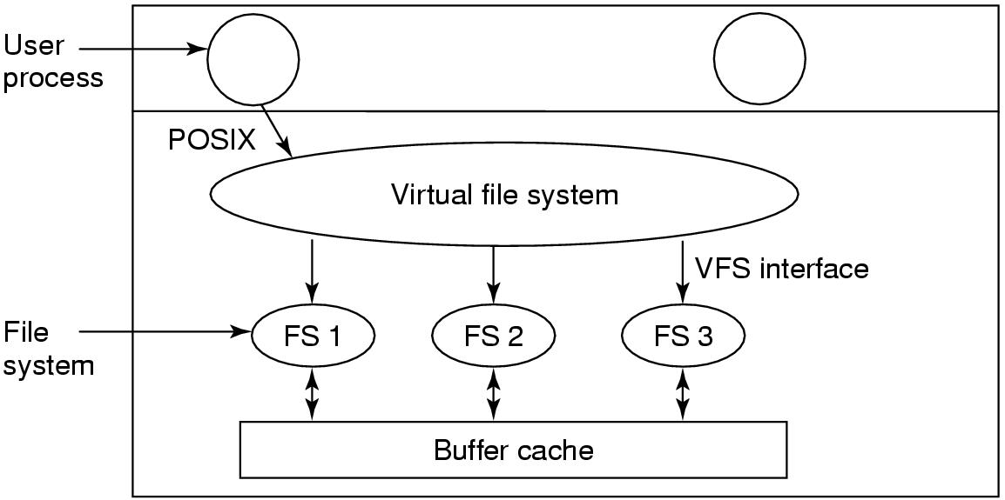
Virtual File Systems (1)

Slide 16
VFS-how it works
File system registers with VFS (e.g. at boot time)
At registration time, FS provides list of addresses of function calls the VFS wants
VFS gets info from the new FS i-node and puts it in a v-node
Makes entry in fd table for process
When process issues a call (e.g. read), function pointers point to concrete function calls

Slide 17
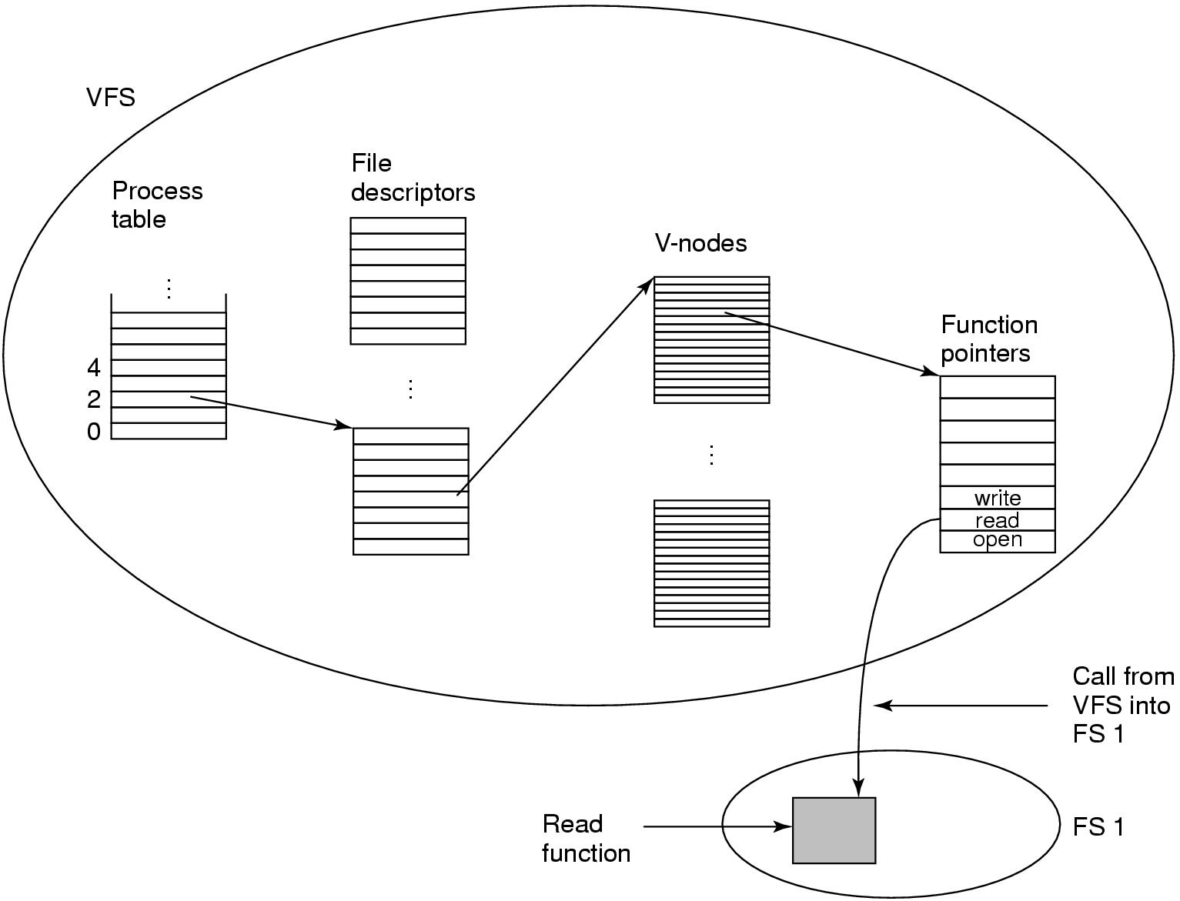
Virtual File Systems
A simplified view of the data structures and code used by the VFS and concrete file system to do a read.

Slide 18
VFS On Client Server Environment
UNIX file-system interface (based on the open, read, write, and close calls, and file descriptors)
Virtual File System (VFS) layer – distinguishes local files from remote ones, and local files are further distinguished according to their file-system types
  The VFS activates file-system-specific operations to handle local requests according to their file system types
      Calls the NFS protocol procedures for remote requests
    NFS service layer – bottom layer of the architecture
  Implements the NFS protocol

Slide 19
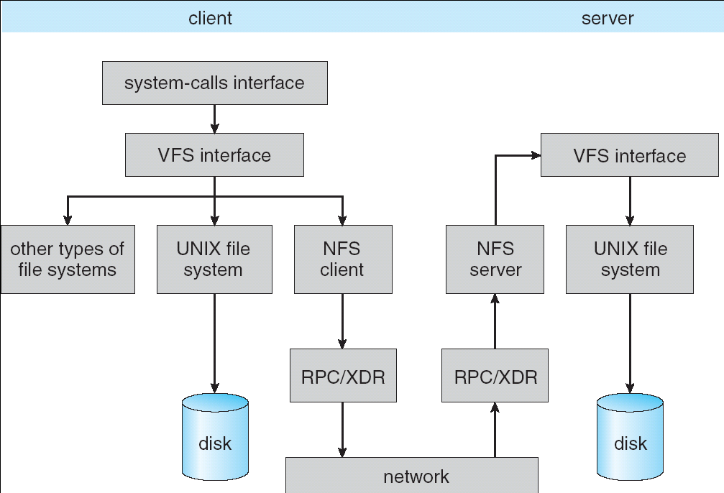
VFS On Client Server Environment

Slide 20
File System Management and Optimization
Disk space management
  Manage Free Blocks
  Manage Disk quota
File System Backups
File System Consistency
File System Performance

Slide 21
Disk Space Management
Major Concern of File system
Two Strategies, 1. Contiguous and 2. Non Contagious
    If stored as consecutive bytes and file grows it will have to be moved.
    Use fixed size blocks which don’t have to be adjacent
What is optimum (good) block size?
  Need information on file size distribution.
    Don’t have it when building file system.
    Let us do some data analysis!!!!

Slide 22
Disk Space Management Block Size
Percentage of files smaller than a given size (in bytes).

Slide 23
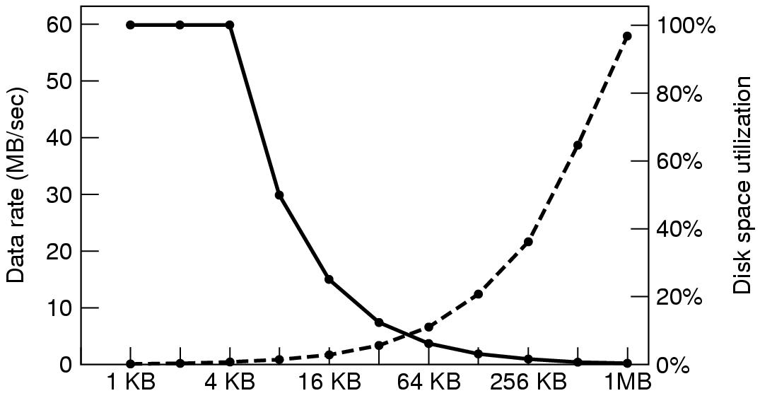
Disk Space Management Block Size (2)
Smaller the Block better the space utilization
Smaller the Block poorer the data rate
Block Size
(Left-hand scale) gives the data rate of a disk.
(Right-hand scale) gives the disk space efficiency.

Slide 24
Disk Space Management
Smaller block size results in better space utilization, but worse transfer utilization
trade-off is space vs data rate
There is no good answer
Might use large (64 KB) block size as disks are getting much bigger and space wastage is less important than to improve transfer rate.

Slide 25
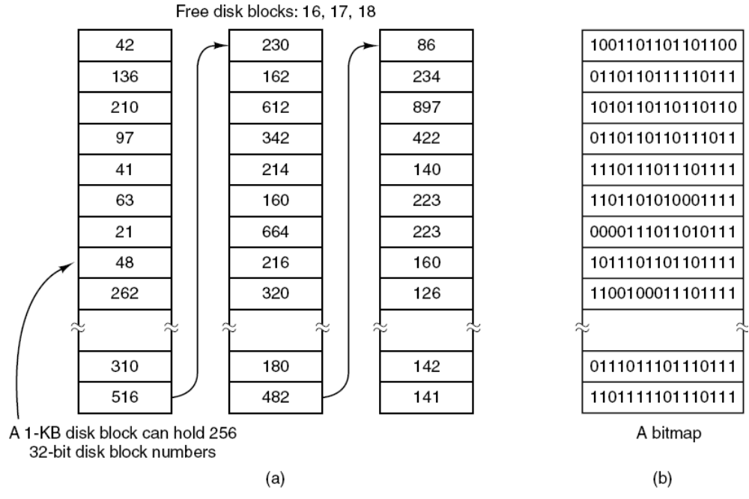
Keeping Track of Free Blocks
2 ¹⁰ = 2⁸ (256) Blocks of 2² bytes
(a) storing the free list on a linked list.
(b) A bitmap.

Slide 26
How to keep track of free blocks
Example: 500GB disk has 488 Million (1K) disk block:
To store links it need ~1.9 million blocks at the rate of 255 entries/block
It requires 488 millions Bit-map ~ need 60,000 blocks
Bit Map requires less space than links method.
If disk is nearly full runs method requires less space.
If free blocks come in consecutive, could keep track of beginning and block length. Need nature to cooperate for this to work.
If disk get severely fragmented runs become inefficient.
Only need one block of pointers in main memory at a time. Fills up block => go get another

Slide 27
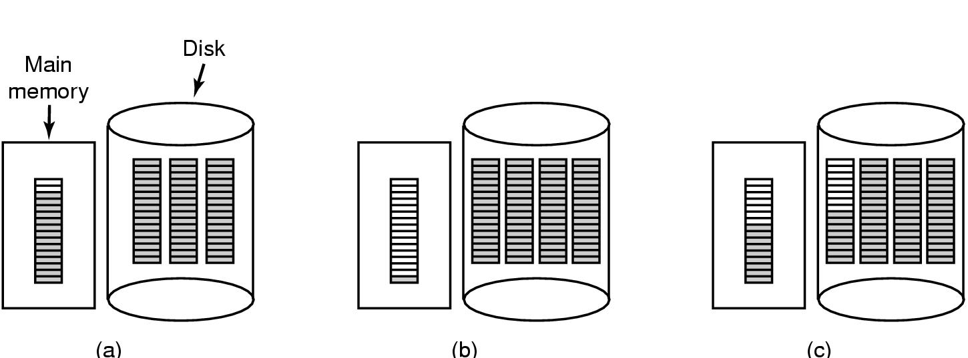
Keeping Track of Free Blocks (Free list)
An almost-full block of pointers to free disk blocks in memory and three blocks of pointers on disk.
Result of freeing a three-block file.
An alternative strategy for handling the three free blocks. The shaded entries represent pointers to free disk blocks.

Slide 28
Disk Quotas (A fair distribution of disk space)
Multiuser OS enforce Disk Quota and ensure that the users do not exceed their quota.
Entry in open file table points to quota table
One entry for each open file
Places limits (soft, hard) on users disk quota
System start warning the users exceeding soft limit
User may ignore soft limit till number of warnings left then the user is not allowed to login. (hard limit)
Quota on Blocks as well as on files.
Illustration on next slide

Slide 29
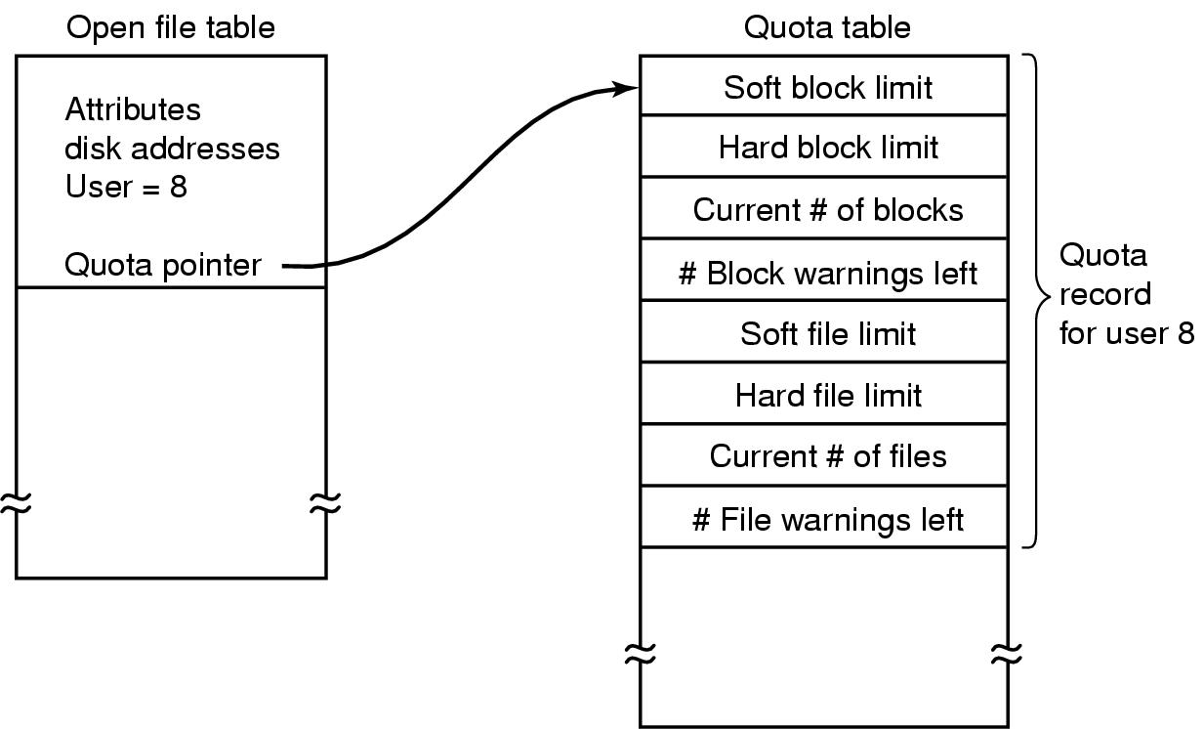
Disk Quotas
Quotas are kept track of on a per-user basis in a quota table.

Slide 30
File System Backups
Take Disk Backup on Tape
Backups to tape are generally made to handle one of two potential problems:
  Recover from disaster (e.g. disk crash, nature)
  Recover from stupidity (e.g. Delete file by mistake)
Tapes hold hundreds of gigabytes and are very cheap

Slide 31
File System Backups
What to Backup?
Don’t want to back up whole file system
    Can get binaries from manufacturer’s CD’s
    Temporary files don’t need to be backed up
    Special files (I/O) don’t need it

Slide 32
Back up Incrementally
How to Backup?
Complete dump weekly/monthly and daily dump of modified files since big dump
=>to restore FS need to start with full dump and include modified files => need better algorithms
Problem; If you want to compress data before dumping it, it will optimize the space but if part of the tape is bad…..( you will Loose everything)
Problem; hard to dump when system is being used. Snapshot algorithms are available to run backup

Slide 33
Dumping strategies
Physical-dump the whole thing.
it is simple to implement
Don’t want to dump
    unused blocks => program needs access to the unused block list and must write block number for used blocks on tape
    bad blocks. Disk controller must detect and replace them or the program must know where they are (If they are kept in a bad block area by the OS, then procedure must take care)

Slide 34
Good vs Bad
The good-easy to implement
The bad
    Can’t skip a particular directory
    Can’t make incremental dumps
    Can’t restore individual files
Not used
Use logical dumps

Slide 35
Logical Dumps
Starts at directory and recursively dumps all files/directories below it which have changed since a given time
Examine standard algorithm used by Unix. Dumps files/directories on path to modified file/directory because
    Can restore path on different computer
    Have the ability to restore a single file

Slide 36
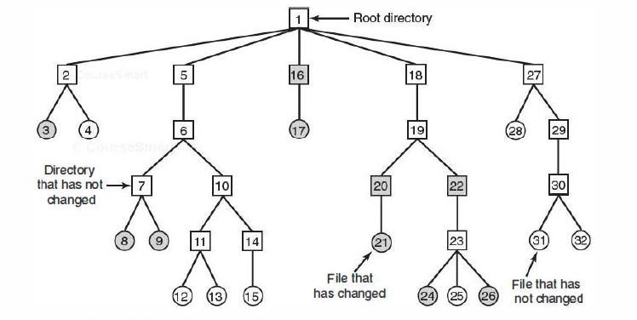
File System Backups
A file system to be dumped. Squares are directories, circles are files. Shaded items have been modified since last dump. Each directory and file is labeled by its i-node number.

Slide 37
Logical Dump Algorithm
Uses bitmap indexed by i-node
4 phases
  Phase 1-starts at root and marks bits for modified files and all directories (a)
  Phase 2-walks the tree, unmarks directories without modified files in/under them (b)
  Phase 3-go through i-nodes and dump marked directories (c)
  Phase 4-dump files (d)

Slide 38
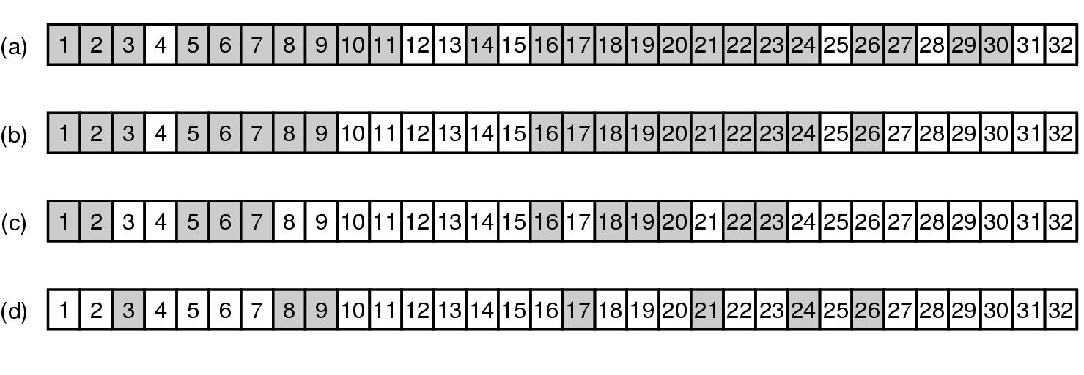
File System Backups
Bitmaps used by the logical dumping algorithm.

Slide 39
File System Backups
Algorithm

Slide 40
Restoring file on disk
Start with empty FS on disk
Restore most recent full dump. Directories first, then files.
Then do restore incremental dumps (they are in order on the tape)

Slide 41
Restoring file on disk-issues
Free block list must be reconstructed.
  Easy to do? it is the complement of the used blocks
Links to files have to be carefully restored
Files can have holes in them. Don’t want to restore files with lots of zeroes in them (Hole between data and stack segments)
Pipes can’t be dumped
Tape density is not increasing => need lots of tapes and robots to get at them. Soon will need disks to be the back-ups!!!

Slide 42
File System Consistency
Crash before blocks written out results in an inconsistent state=>
Need utility program to check for consistency in blocks and files
(fsck in Unix, scandisk in Windows)
Uses two tables
    How many times is block present in a file
    How many times block is present in free list
    Device then reads all of the i-nodes, increments counters

Slide 43
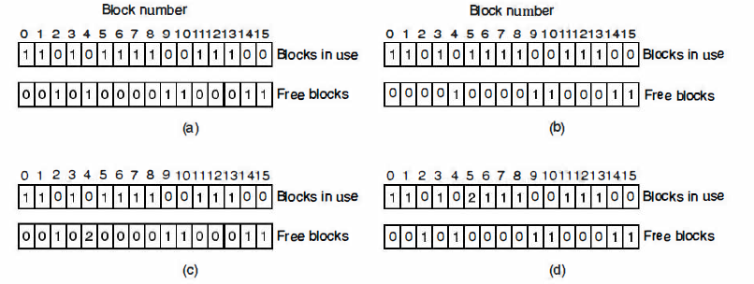
File System Consistency
File system states.
Consistent.
Missing block.
Duplicate block in free list.
Duplicate data block.

Slide 44
Solutions
If the file system is consistent, each block will have a 1 either in the first table or in the second table.
System crash result in missing block; No harm; just missing; solution: put on free list.
Block occurs twice on free list; may happen with free list impossible with bitmap; solution: re-build free list
Block occurs twice on blocks in use; Problem; If either of files is removed, block will be put on free list, now block is in use and free at the same time. If both files are removed, the block will be on the free list twice. solution: allocate a free block, copy the contents of block into it, insert the copy to one of the files. The content of one files is unchanged; notify user.

Slide 45
File Consistency (consistency of directory system)
It, too, uses a table of counters, but these are per file, rather than per block.
Look at files instead of blocks
Use table of counters, one per file
Start at root directory, descend, increment counter each time file shows up in a directory
Compares counts with link counts from the i-nodes. Have to be the same to be consistent
  Problem: two kinds of errors can occur: the link count in the i-node can be high or it can be low.
  Solution: fixed by setting the link count in the i-node to the correct value.

Slide 46
File System Performance
Read word from memory: 10 nsec
Read word from Disk: 5-10 msec seek + rotational delay 4- 6msec + 100 MB/sec transfer
Cache blocks in memory
Hash table (device and disk address) to locate the desired address in the cache; for collisions use linked chain solution.
When a block is to be loaded in full cache; some block needs to be replaced. Need algorithm to replace cache blocks- (like) use paging algorithms, e.g FIFO, 2nd Chance Clock, LRU

Slide 47
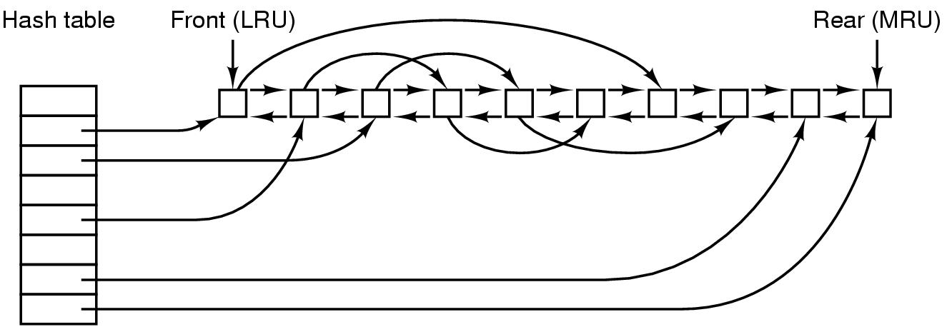
Caching (1)
The buffer cache data structures.

Slide 48
Replacement
Problem with LRU-some blocks are infrequently used, but have to be in memory
i-node-needs to be re-written to disk if modified. Crash could leave system in inconsistent state
Modify LRU
    Is block likely to be used again?
    Is block essential to consistency of file system?

Slide 49
Replacement
Use categories-i-nodes, indirect blocks, directory blocks, full data blocks, partial data blocks
Put ones that will be needed at the rear
If block is needed and is modified, write it to disk asap

Slide 50
Replacement
In order to put modified blocks on disk asap
    UNIX sync-forces all modified blocks to disk. Issued every 30 secs by update program
    Windows-modify block, write to disk immediately (Write through cache)

Slide 51
Block read ahead
Block read-ahead-if read in block k to cache, read in k+1 if it is not already there
Only works for sequential files
Use a bit to determine if file is sequential or random. When system issue a seek, flip the bit.

Slide 52
Reducing arm motion
Try to put blocks which are to be accessed sequentially close to one another.
Easy to do with a bitmap in memory, need to place blocks consecutively with free list
    Allocate storage from free list in 2 KB chunks when cache blocks are 1 KB
    Try to put consecutive blocks in same cylinder
  i-nodes-place them to reduce seek time (next slide)

Slide 53
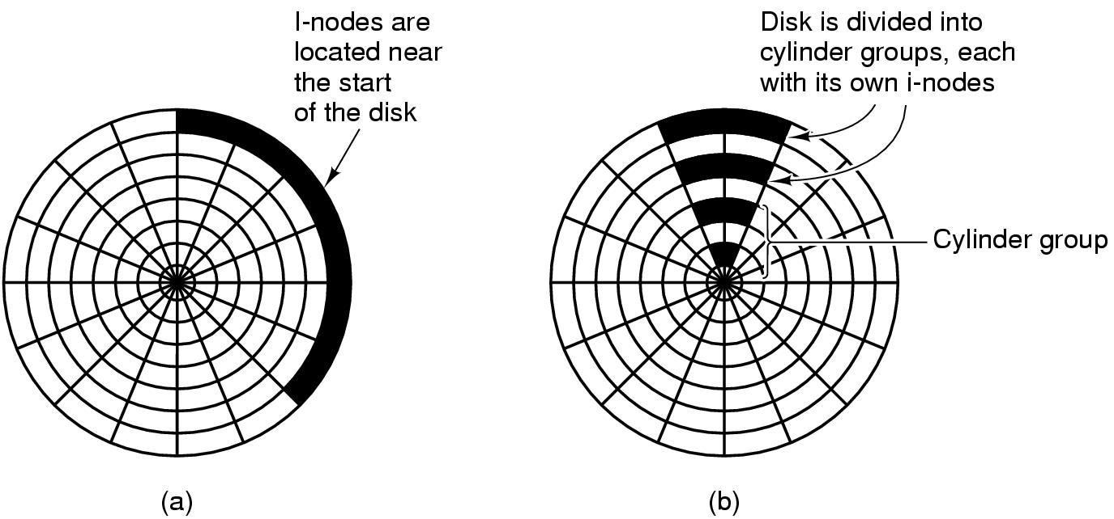
i-nodes-Reducing Disk Arm Motion
(a) I-nodes placed at the start of the disk.
(b) Disk divided into cylinder groups, each with its own blocks and i-nodes.

Slide 54
Defragging Disks
In the beginning, files are placed contiguously on the disk
Over time holes appear
Windows defrag program to puts together disparate blocks of a file
Linux doesn’t get as many holes

Slide 55
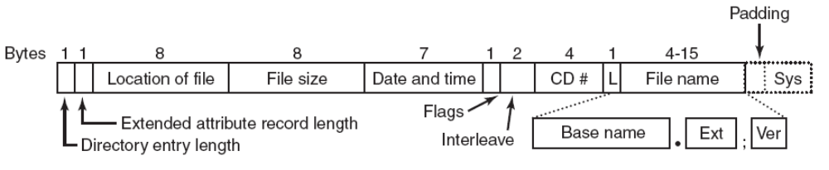
The ISO 9660 File System
The ISO 9660 directory entry.

Slide 56
Rock Ridge Extensions (UNIX)
Rock Ridge extension fields:
PX - POSIX attributes.
PN - Major and minor device numbers.
SL - Symbolic link.
NM - Alternative name.
CL - Child location.
PL - Parent location.
RE - Relocation.
TF - Time stamps.

Slide 57
Joliet Extensions (windows)
Joliet extension fields:
Long file names.
Unicode character set.
Directory nesting deeper than eight levels.
Directory names with extensions

Slide 58
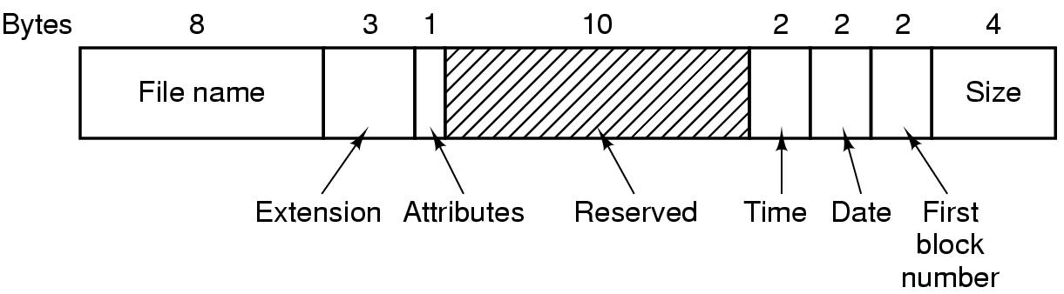
The MS-DOS File System-directory entry
.

Slide 59
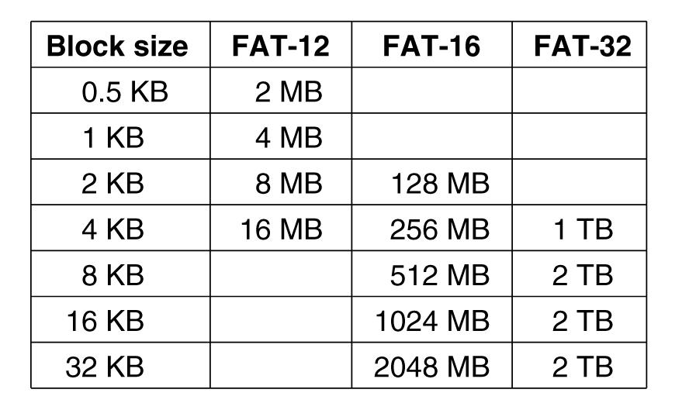
The MS-DOS File System –maximum partition size
Maximum partition size for different block sizes.
The empty boxes represent forbidden combinations.

Slide 60
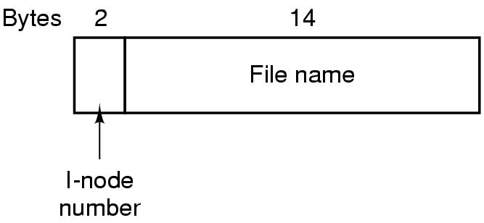
The UNIX V7 File System
A UNIX V7 directory entry.

Slide 61
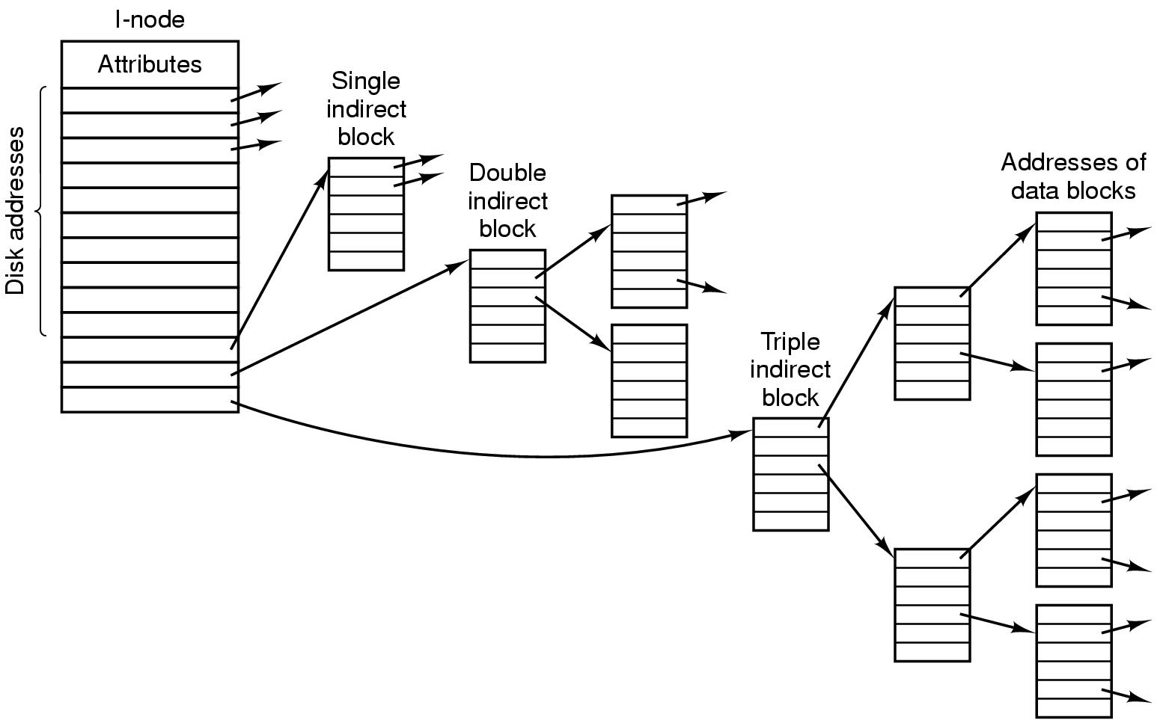
The UNIX V7 File System
A UNIX i-node.

Slide 62
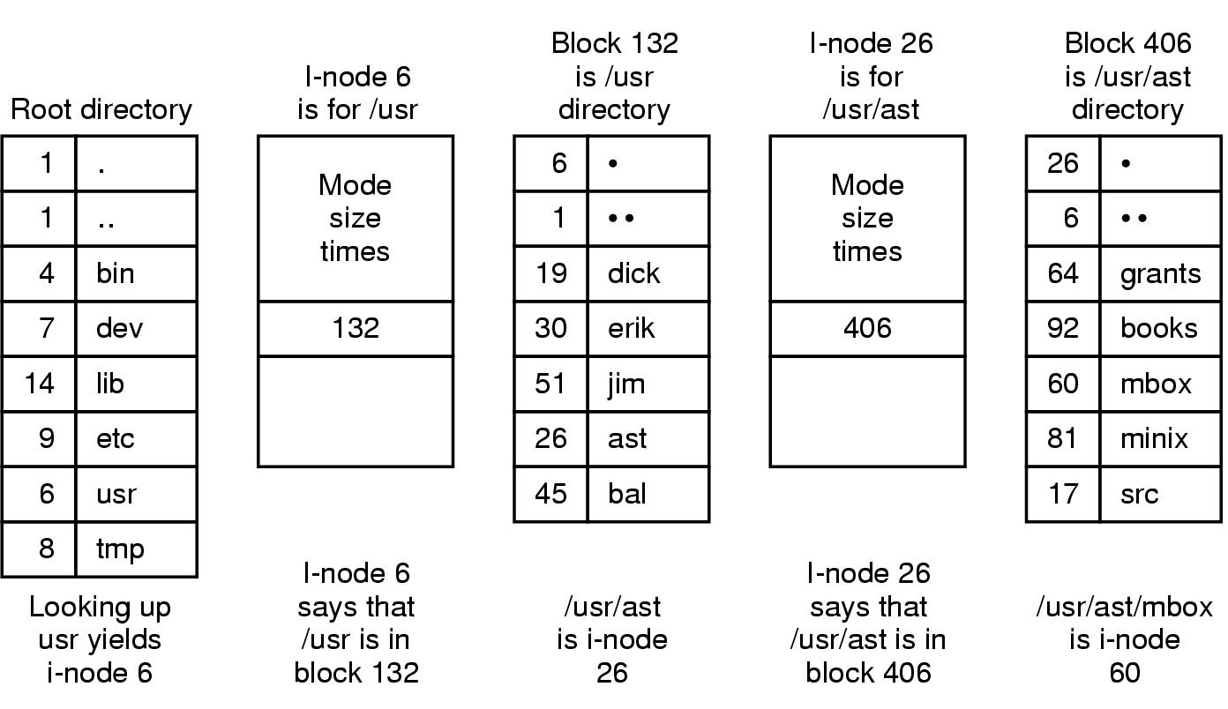
The UNIX V7 File System
The steps in looking up /usr/ast/mbox.

