Slide 1
CSC 322 Operating Systems Concepts
Lecture - 20:
by
Ahmed Mumtaz Mustehsan
Special Thanks To:
Tanenbaum, Modern Operating Systems 3 e, (c) 2008 Prentice-Hall, Inc. (Chapter-4) Silberschatz, Galvin and Gagne 2002, Operating System Concepts,
Notes:
1

Slide 2
Chapter 4
File System
File System Implementation

Slide 3
File Implementation
Files stored on disks. Disks broken up into one or more partitions, with separate File System on each partition
Sector 0 of disk is the Master Boot Record
Used to boot the computer
End of MBR has partition table. Has starting and ending addresses of each partition.
One of the partitions is marked active in the master boot table

Slide 4
File Implementation
Boot computer => BIOS reads/executes MBR
MBR finds active partition and reads in first block (boot block)
Program in boot block locates the OS for that partition and reads it in
All partitions start with a boot block

Slide 5
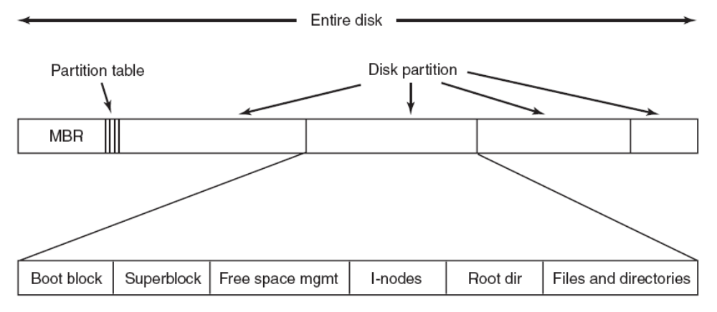
A Possible File System Layout

Slide 6
File System Layout
Superblock contains info about the File (e.g. type of File System, number of blocks, …)
i-nodes contain info about files

Slide 7
Allocating Blocks to files
Most important implementation issue
Methods
    Contiguous allocation
    Linked list allocation
    Linked list using table
    i-nodes

Slide 8
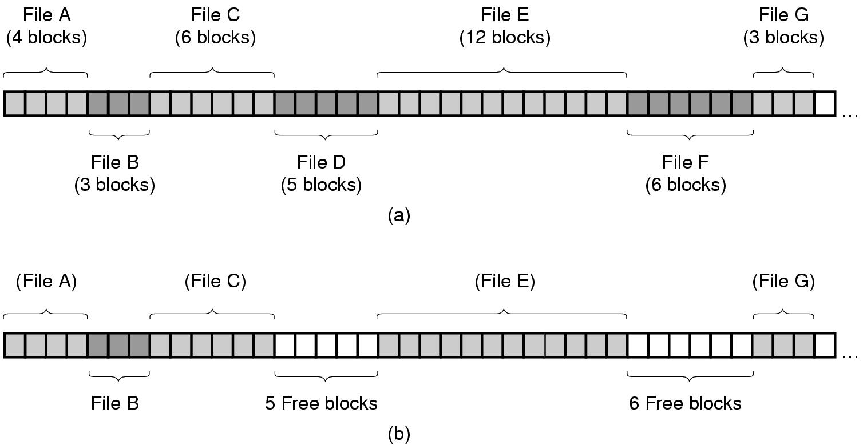
Contiguous Allocation
(a) Contiguous allocation of disk space for 7 files.
(b) The state of the disk after files D and F have been removed.

Slide 9
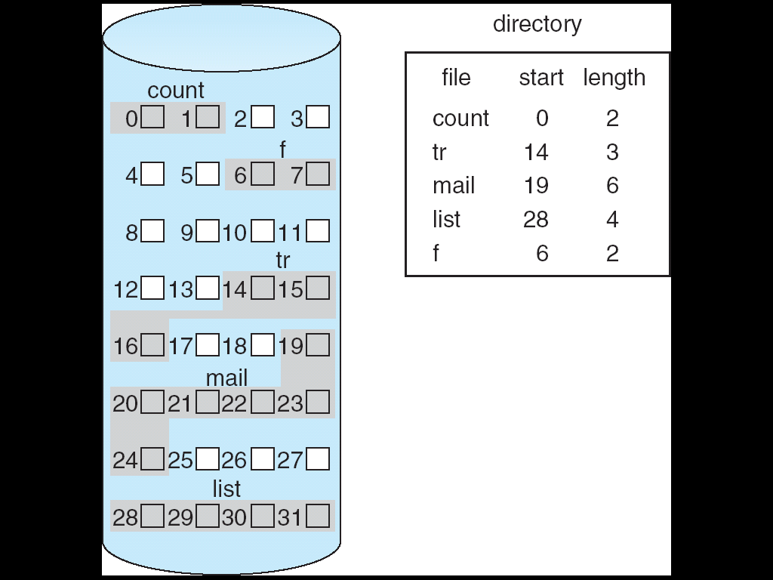
Contiguous Allocation
Each file occupies a set of contiguous blocks on the disk
Pros:
  Simple – only starting location (block #) and length (number of blocks) are required
  Random access
Cons:
  Wasteful of space (dynamic -allocation problem)
  External fragmentation: may need to compact space
  Files cannot grow

Slide 10
Contiguous Allocation
Mapping from logical address LA to physical address (B,D) with block number B and displacement D
Suppose block size is 512 bytes:
Quotation Q
        LA/512
                Remainder R
B = starting address + Q
D = R

Slide 11
Contiguous Allocation
Some newer file systems (i.e. high-performance ) use a modified contiguous allocation scheme
Extent-based file systems allocate disk blocks in extents
An extent is a contiguous chunk of blocks (similar to clusters)
  Extents are allocated when the file grows
  Extents are linked
  A file consists of one or more extents
  Extent size can be set by owner of file

Slide 12
Contiguous Allocation
The good
Easy to implement
Read performance is great. Only need one seek to locate the first block in the file. The rest is easy.
The bad-disk becomes fragmented over time
CD-ROM’s use contiguous allocation because the file size is known in advance
DVD’s are stored in a few consecutive 1 GB files because standard for DVD only allows a 1 GB file max
For DVD you have extents each of size maximum 1GB

Slide 13
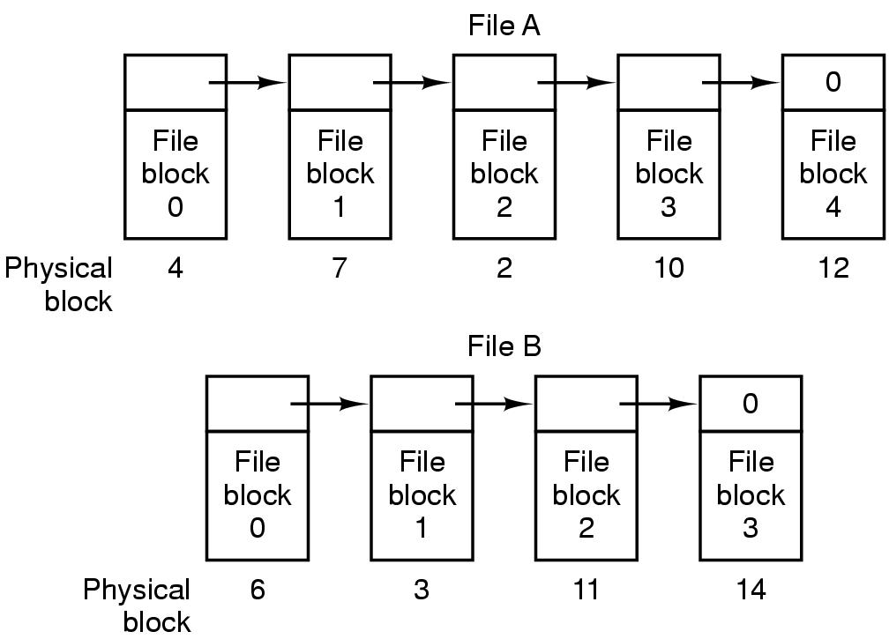
Linked List Allocation
Storing a file as a linked list of disk blocks.

Slide 14
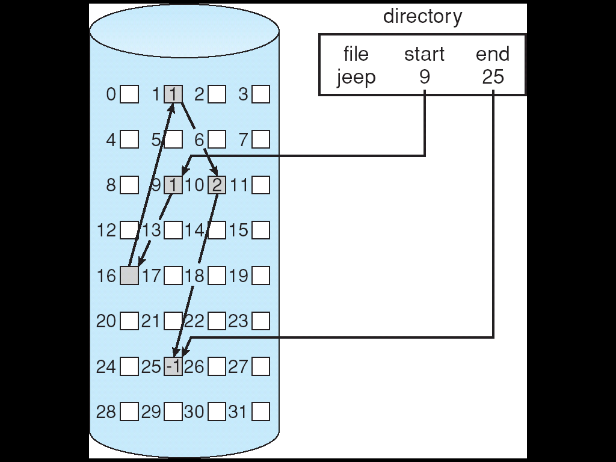
Linked List Allocation
Each file is a linked list of disk blocks
Blocks may be scattered anywhere on the disk
Pros:
  Simple – need only starting address
  Free-space management system no waste of space
Cons:
  No efficient random access
block =
pointer

Slide 15
Linked List Allocation
Mapping logical address LA to physical address (B,D) with block number B and displacement D
Suppose block size is 512 bytes and each block contains 4 bytes reserved for pointer to next block:
        Quotation Q
        LA/512
                Remainder R
B = Qth block in the linked chain of blocks
D = R + 4

Slide 16
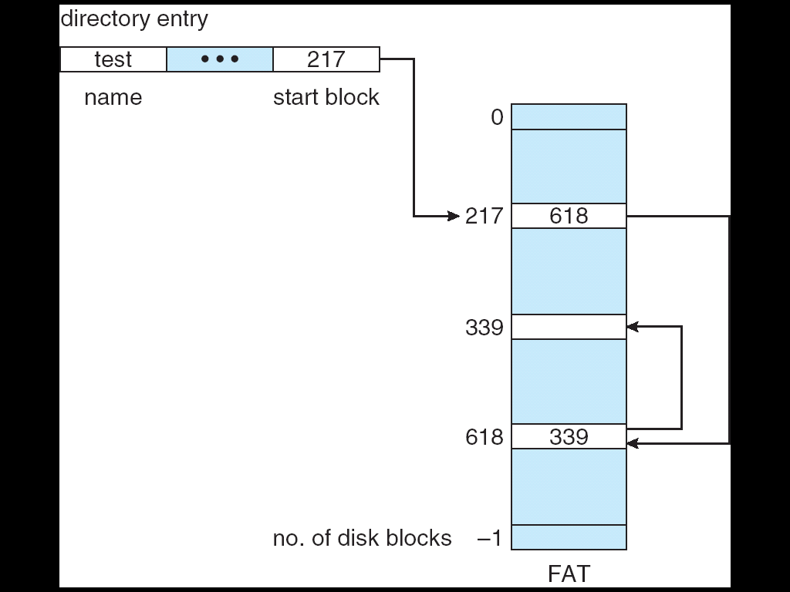
Linked List Allocation
Variation on linked list allocation
FAT is located in contiguous space on disk
Each entry corresponds to disk block number
Each entry contains a pointer to the next block or 0
Used by MS-DOS and OS/2

Slide 17
Linked Lists
The good
Gets rid of fragmentation
The bad
Random access is slow. Need to chase pointers to get to a block

Slide 18
Linked lists using a table in memory
Put pointers in table in memory
File Allocation Table (FAT)
Windows

Slide 19
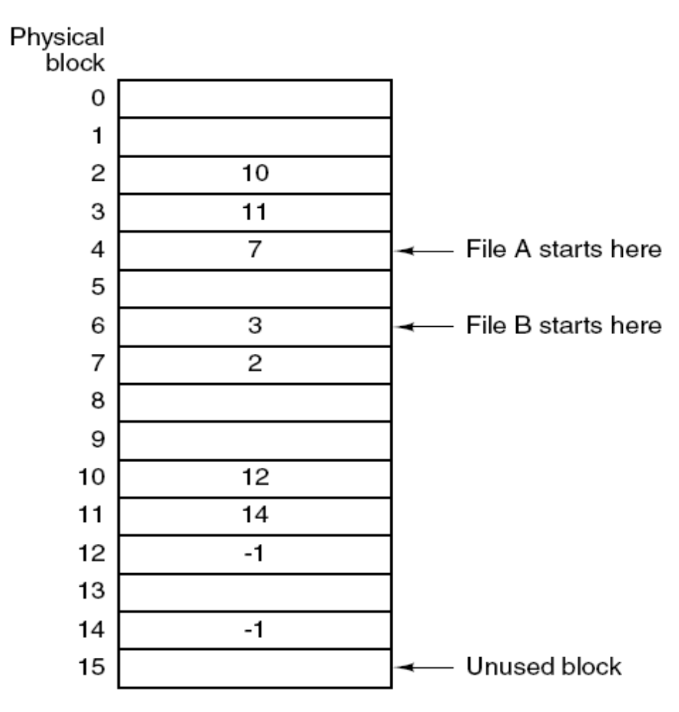
Linked List Allocation Using a Table in Memory
Linked list allocation using a file allocation table in main memory.

Slide 20
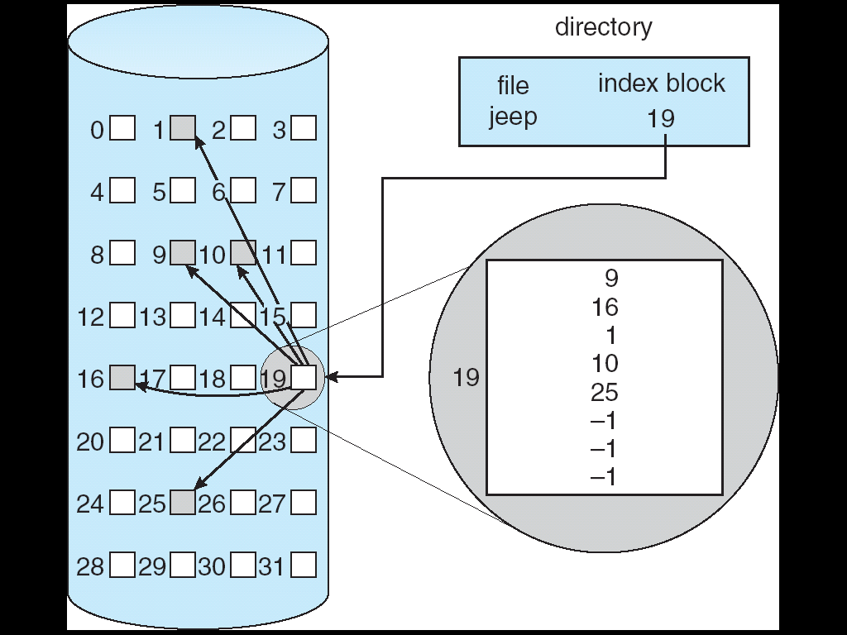
Linked List Allocation Using a Table in Memory
(Indexed Allocation)
Brings all pointers together into the index block
Pros:
  Efficient random access
  Dynamic access without external fragmentation
Cons:
  Index table storage overhead

Slide 21
Linked List Allocation Using a Table in Memory
(Indexed Allocation)
Mapping from logical address LA to physical address (B,D)
Assume block size of 512 bytes
  Need one block for index table with 128 pointers (assuming pointers of 4 bytes each)
  Files have maximum size of 64K bytes
4 x Q = displacement into the index table to obtain B
D = R = displacement into block
Q
LA/512
R

Slide 22
Linked lists using a table in memory
The bad
Table becomes really big
e.g 200 GB disk with 1 KB blocks needs a 600 MB table
  If 3 bytes per entry I used. However, for performance 4 Bytes /entry is used, Therefore, Table size is 800 MB
Growth of the table size is linear with the growth of the disk size
Increase the block size will waste storage within Block.

Slide 23
I-nodes
Keep data structure in memory only for active files
    Data structure lists disk addresses of the blocks and attributes of the files
K active files, N blocks per file => k*n blocks max!!
Solves the growth problem

Slide 24
I-nodes
How big is N?
Solution: Last entry in table points to disk block which contains pointers to other disk blocks

Slide 25
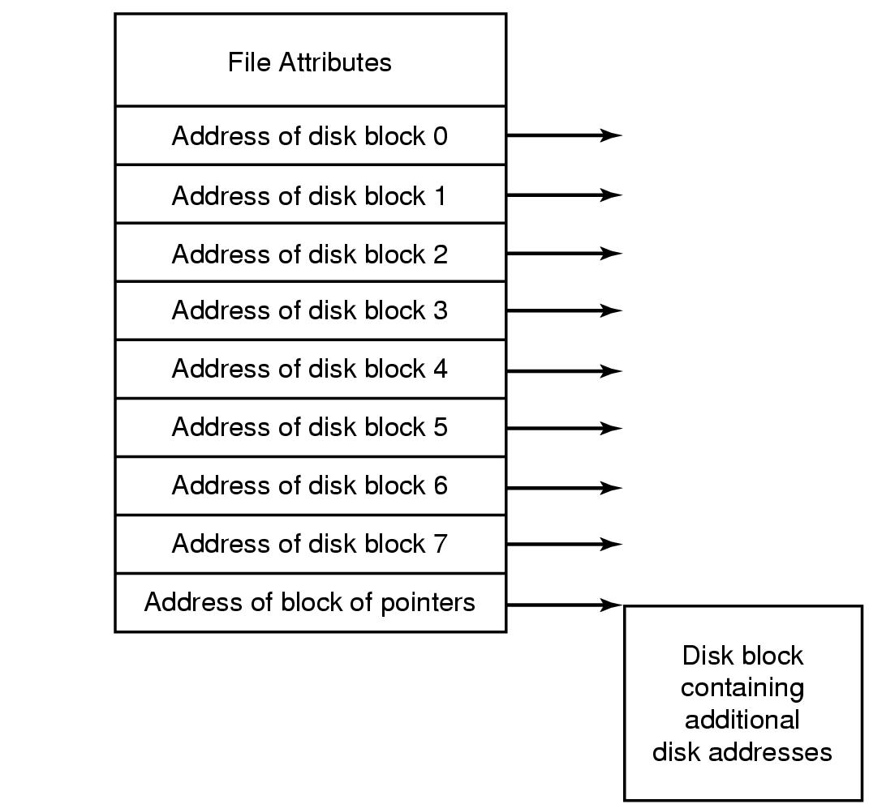
I-nodes
An example i-node.

Slide 26
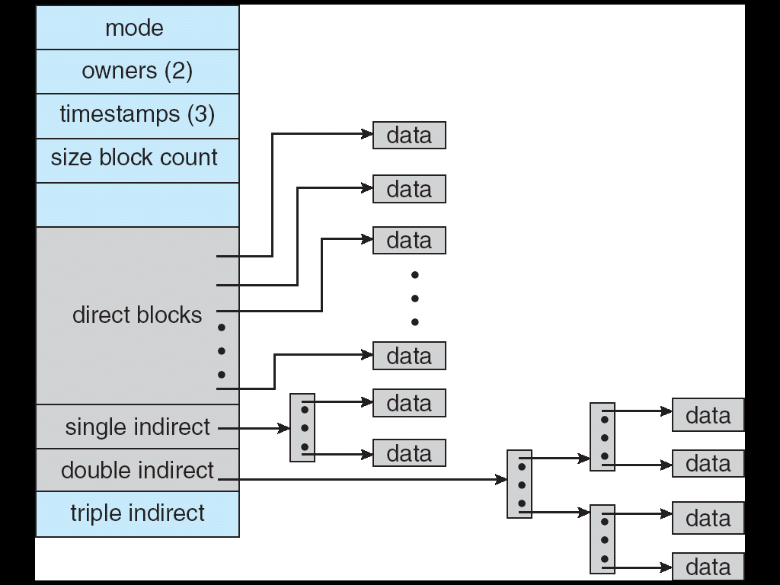
I-nodes (UNIX – 4KB per Block)
An example i-node.

Slide 27
Implementing Directories
In order to Open a file, the path name used to locate directory
Directory specifies block addresses by providing
    Address of first block (contiguous)
    Number of first block (linked)
    Number of i-node

Slide 28
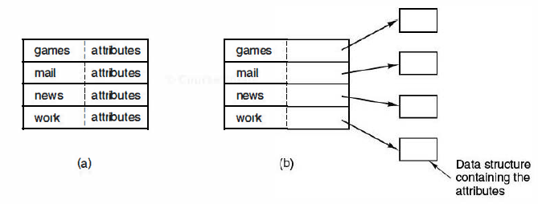
Implementing Directories
DOS, fixed-size entries with the disk addresses and attributes
Unix, Each entry refers to an i-node. Directory entry contains attributes.

Slide 29
Implementing Directories
How do we deal with variable length names?
Problem is that names have become very long
Two approaches
    Fixed header followed by variable length names
    Heap-pointer points to names

Slide 30
Implementing Directories
How do we deal with variable length names?
Problem is that names have become very long
Two approaches
    Fixed header followed by variable length names
    Heap-pointer points to names

Slide 31
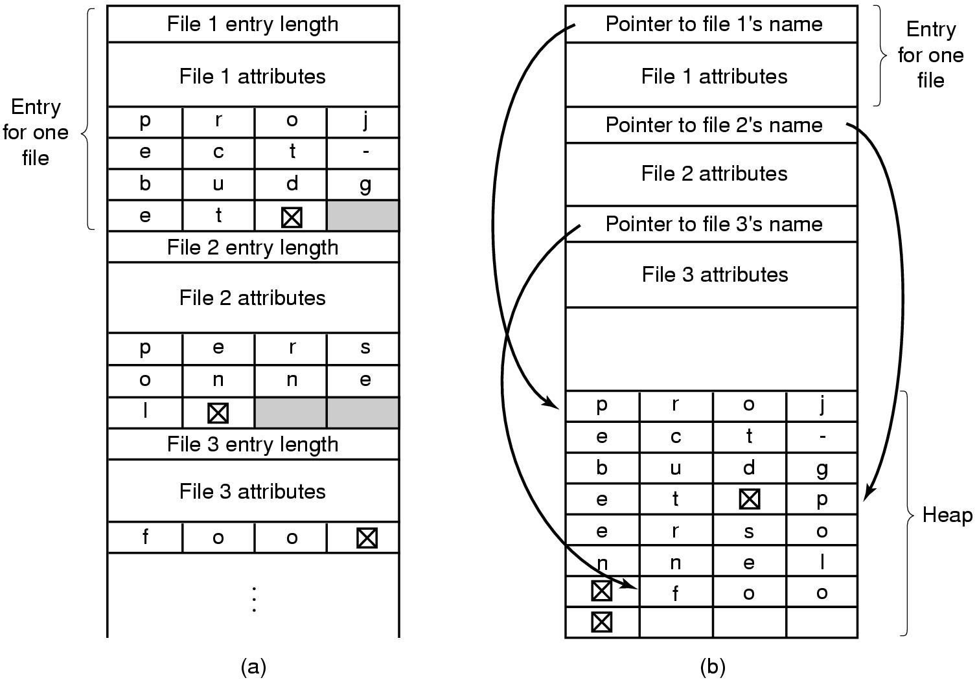
Implementing Directories
Two ways of handling long file names in a directory.
In-line.
In a heap.

Slide 32
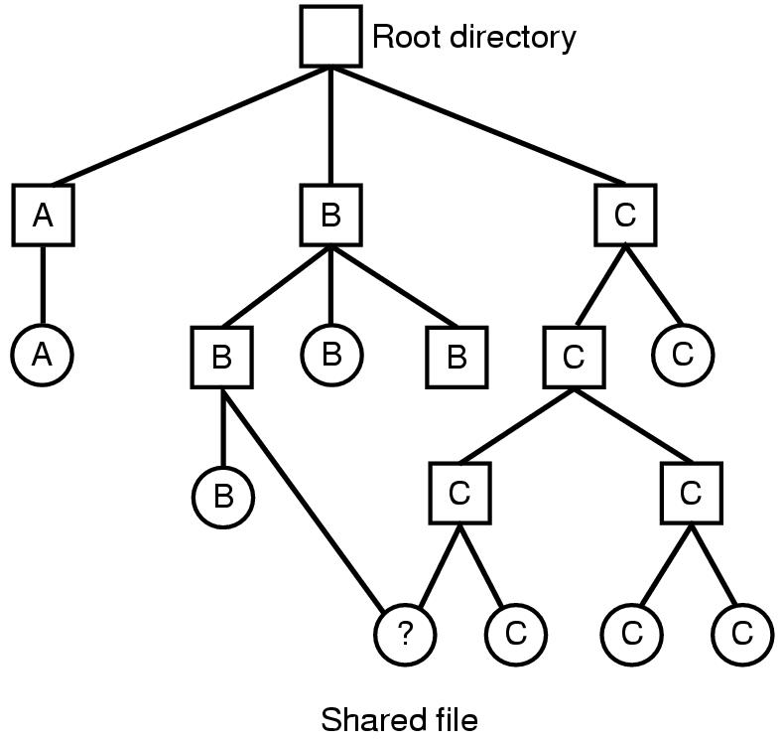
Shared Files
File system containing a shared file.
File systems is a Directed Acyclic Graph/tree (DAG)

