Slide 1
CSC 322 Operating Systems Concepts
Lecture -2:
by
Ahmed Mumtaz Mustehsan
Special Thanks To:
Tanenbaum, Modern Operating Systems 3 e, (c) 2008 Prentice-Hall, Inc. (Chapter-1)
Notes:
1

Slide 2
4th Generation (1980–Todate)
PC, Tablets, Phones
LSI (Large Scale Integration) circuits chips, thousands of transistors on a square centimeter, that produced PC initially called microcomputers
Performance like mini computers but very low in price.
In 1974, Intel introduced 8080, First 8-bit CPU, which needed OS, Intel asked Gary Kildall, to write one.
Kildall built a controller for 8-inch floppy disk and linked with 8080, then wrote a disk-based operating system called CP/M (Control Program for Microcomputers)
Kildall then formed a company, named Digital Research, to further develop and sell CP/M.
.
Notes:
MULTICS
Timesharing CTSS (MIT)
Multics
UNix

Slide 3
Features of 4th Generation computers
In 1977, Digital Research rewrote CP/M also for Zilog Z80, and other CPU chips and dominated the world of micro computing for about 5 years.
Early 1980s, IBM introduced PC and asked Bill Gates to license his BASIC interpreter and an OS to run on the PC, Gates proposed Digital Research’s CP/M but Kildall did not cash the opportunity.
IBM again asked Bill Gates for an OS, who formed Microsoft and bought DOS (Disk Operating System) from a local manufacturer, renamed it as MS-DOS (MicroSoft DOS) and Licensed to IBM PC.
.
Notes:
MULTICS
Timesharing CTSS (MIT)
Multics
UNix

Slide 4
Features of 4th Generation computers
MS-DOS used on 80386 and 80486, Initial version was primitive but later had adv. features taken from UNIX.
CP/M, MS-DOS, and other OS were commands based. In the 1960s, Stanford Research Institute invented GUI.
Steve Jobs, co-inventor of Apple, first introduced GUI based expensive Lisa, which failed commercially. He then introduced a cheaper and user friendly Apple Macintosh, which had a huge success.
Microsoft produced a GUI-based Windows 3.1, which ran on top of MS-DOS (Windows 3.1 was a shell than a true OS). From 1985 to 1993, Windows 3.1 was just a graphical environment on top of MS-DOS.
.
Notes:
MULTICS
Timesharing CTSS (MIT)
Multics
UNix

Slide 5
Features of 4th Generation computers
In 1995, MS introduced Windows 95, that incorporated many OS. Used MS-DOS system only for booting and running old MS-DOS Programs.
In 1998, introduced Windows 98 that still contain a large amount of 16-bit Intel assembly language.
Another Microsoft operating system was Windows NT (New Technology), Compatible with Windows 95, but was 32-bit system, with features from VMS.
First version of NT fizzled out but Windows NT 4.0 was successful among corporate networks. Version 5 of Windows NT was renamed Windows 2000.
.
Notes:
MULTICS
Timesharing CTSS (MIT)
Multics
UNix

Slide 6
Features of 4th Generation computers
Microsoft introduced another version of Windows 98 called Windows Me (Millennium edition).
The other major contender in the personal computer world is UNIX. which is strongest on workstations and other high-end computers, such as network servers.
UNIX systems support X Windows system produced at M.I.T. a complete GUI, such as Motif, is available to run on top of the X Windows system giving UNIX a look and feel like the Macintosh or Microsoft
.
Notes:
MULTICS
Timesharing CTSS (MIT)
Multics
UNix

Slide 7
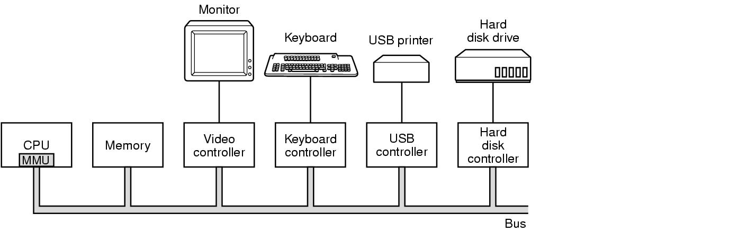
Computer Hardware Review
An operating system is tied to the hardware of the computer it runs on.
To work, it must know and interact with hardware such as; the CPU, memory, and I/O devices; all are connected by system bus and communicate with one another over it.

Slide 8
CPU The Processor
The ‘‘brain’’ of the computer is the CPU.
CPU Cycle: Fetch, decode, execute. (one by one)
Architecture of Computer, Instructions set, unique instructions for SPARC and Pentium.
Mnemonics, (OP-Code, operands)
    ADD AX, BX, INC CX, SHR, CX, 4
CPU Registers (GP; AX, BX, Special Registers, SP, PC )
    PC; Address of next Instruction to be executed
    SP, holds a procedure’s stack frame
PSW (Program Status Word). Contains the condition code bits, set by comparison instructions, the CPU priority, the mode (user or kernel), and various other control bits.

Slide 9
CPU The Processor
Time Multiplexing:
  CPU stop running one program (re)start another.
  Must save all the registers to be restored.
Pipeline Processing:
  A separate fetch, decode, and execute units, while executing instruction n, also decoding instruction n+1 and fetching instruction n + 2
  It expose the complexities of the machine difficulty for compiler and OS writers

Slide 10
CPU The Processor
A superscalar CPU
Multiple execution; Integer arithmetic, Floating-point arithmetic, and Boolean operations.
Two or more instructions are fetched, decoded, and placed into a holding buffer.
When execution unit is free, looks into holding buffer for an instruction, if there, removes it , and executes it.
Implication of this design; Instructions may execute out of order, hardware to make sure that the result produced is the same like a sequential implementation but too much complexity for OS.

Slide 11
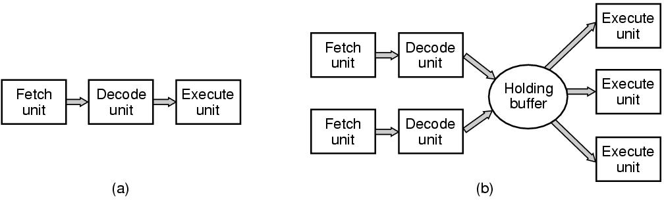
CPU Pipelining
(a) A three-stage pipeline. (b) A superscalar CPU.

Slide 12
CPU The Processor
CPU Modes; kernel Mode and User mode
kernel mode; Privileged , execute any instruction, access complete hardware.
User Mode; Protected mode, execute subset of instructions, I/O and memory protection inst. disallowed
System Call;
For a services from the OS, TRAP instruction switches user mode to kernel mode, after completing task control returned to the user at the instruction pointed by PC.
Other traps are caused by the hardware to warn an exceptional situation such as attempt to divide by 0 or a floating-point underflow.

Slide 13
CPU The Processor
Multithreaded or hyper-threading (intel)
Replicate not only functional units, but also control logic. Allow to hold two different threads and then switch back and forth in nanosecond time scale.
A thread is a kind of lightweight Process;
Multithreading has implications for on OS; each thread appears to the OS as a separate CPU.
A system with two actual CPUs, each with two threads. The operating system will see it as four CPUs.

Slide 14
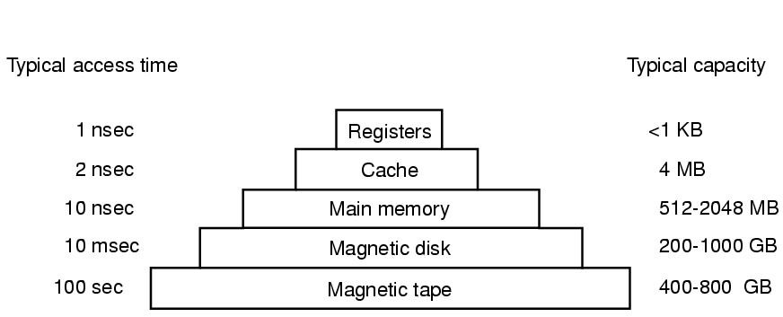
Memory Hierarchy
A typical memory hierarchy.
The numbers are very rough approximations.

Slide 15
Caches
Main memory is divided into cache lines(64 bytes)
    0-63 in line 1, 64-127 in line 2
When program reads a word-cache hardware checks to see if in cache.
    If so, then have a cache hit (2 cycles).
    Otherwise, make request of main memory over the bus (expensive)
Cache is expensive and is therefore limited in size
Can have cache hierarchies
Cache other things, like URL addresses

Slide 16
The 4 Cache Questions
When to put a new item into the cache? (on a cache miss)
Which cache line to put the new item in? (memory word determines which line)
Which item to remove from the cache when a slot is needed? (same line new data goes into)
Where to put a newly evicted item in main memory? (memory address determines this)

Slide 17
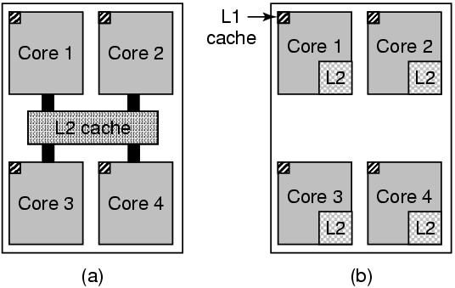
Multicore Chips
a) A quad-core chip with a shared L2 cache.
b) A quad-core chip with separate L2 caches.
CPU Multicore Chips:
CPU chips with two, four or more complete processors or cores on them. The multicore chips (mini-chips ) effectively carry its own CPU.

Slide 18
Main Memory
RAM (Random Access Memory) Volatile, core memory, hundreds of Mega Bytes to several Giga Bytes
ROM (Read Only Memory), Nonvolatile, programmed at factory, fast and inexpensive, keeps bootstrap OS loader, device controller for I/O cards
EEPROM (Electrically Erasable ROM) Nonvolatile, but can be erased and rewritten, writing them takes more time than RAM, used like ROM
Flash Memory, Portable, speed in between RAM and disk, used as portable disk, storage for digital cameras.
CMOS: volatile but low power consumption, used to hold the current time and date, also hold the configuration parameters, such as boot disk
.
Notes:
MULTICS
Timesharing CTSS (MIT)
Multics
UNix

Slide 19
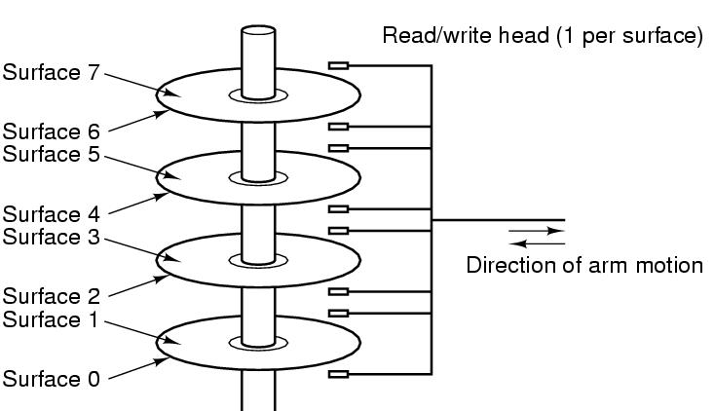
Disks
Compared to RAM: Much higher in capacity, cheaper but three times slower as it is a mechanical device,
Tracks are divided into sectors (512 bytes), Multiple tracks form a cylinder, Plates rotate at speed 5400, 7200, or 10,800 rpm

Slide 20
Disks
Seek Time,
Arm Positioning;
Moving the arm from one cylinder to another.
Rotational Delay
    Sector to rotate under the head,
Data Transfer
    Reading or writing
Concepts of virtual memory, MMU (Memory Management Unit), context switch,
will be discussed later
Tapes
Very Economical, Slow, used for backup purpose

