Slide 1
CSC 322 Operating Systems Concepts
Lecture - 19:
by
Ahmed Mumtaz Mustehsan
Special Thanks To:
Tanenbaum, Modern Operating Systems 3 e, (c) 2008 Prentice-Hall, Inc. (Chapter-3) Silberschatz, Galvin and Gagne 2002, Operating System Concepts,
Notes:
1

Slide 2
Chapter 4
File System

Slide 3
File Systems Introduction
Computers can store information on various storage media
The operating system abstracts from the physical properties of its storage devices to define a logical storage unit called a file
Files are mapped by the operating system onto non volatile physical devices
A file is a named collection of related information that is recorded on secondary storage

Slide 4
File Systems Introduction
For a user’s perspective, a file is the smallest allotment of logical secondary storage (i.e., data supposedly cannot be written to secondary storage unless written in a file)‏
Files commonly represent programs (both source and object code) and data
Data file contents may be numeric, alphabetic, alphanumeric, or binary
Files may be free form (e.g., text files) or rigidly formatted
In general, a file is a sequence of bits, bytes, lines, or records, whose meaning is defined by the file’s creator and user

Slide 5
File Systems
Many important applications need to store more information then have in virtual address space of a process
    Must store large amounts of data
    Gigabytes -> terabytes -> petabytes
The information must survive the termination of the process using it.
    Lifetime can be seconds to years
    Must have some way of finding it!
Multiple processes must be able to access the information concurrently.

Slide 6
File Systems
Disks are used to store files
Information is stored in blocks on the disks
Can read and write blocks

Slide 7
File Systems
Use file system as an abstraction to deal with accessing the information kept in blocks on a disk
Files are created by a process
Thousands of them on a disk
Managed by the OS

Slide 8
File Systems
OS structures them, names them, protects them
Two ways of looking at file system
    User point of view:
      How do we name a file, protect it, organize the files
    Implementation point of view
      How are they organized on a disk
Start with user, then go to implementation

Slide 9
File Systems
The user point of view
      Naming
      Structure
      File Type (directories)
      File Access

Slide 10
Naming File System and Operating Systems
    One to 8 letters in all current OS’s
    Unix and MS-DOS (Fat16) file systems
    Fat (16 and 32) were used in first Windows systems
    Latest Window systems use Native File System called (NTFS).
    All OS’s use suffix as part of name
    Unix does not always enforce a meaning for the suffixes
    DOS does enforce a meaning

Slide 11
Naming
Every file has at least one name
Important to be able to find files after they’re created
Name can be:
  Human-accessible: “foo.c”, “my photo”,
    “Go Panthers!”, “Budget Report 2013!”
  Machine-usable: 4502, 33481
Case may or may not matter; Depends on file system (matters in DOS not in UNIX)
Name may include information about the file’s contents
  Certainly does for the user (the name should make it easy to figure out what’s in it!)
  Computer may use part of the name to determine the file type

Slide 12
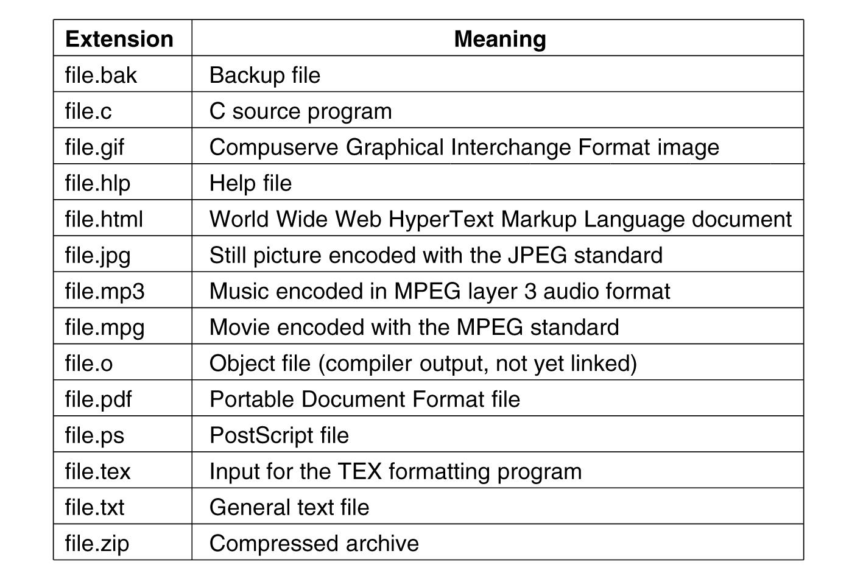
Naming (Suffix Examples)
.

Slide 13
File Structure
None - sequence of words, bytes
Simple record structure
  Lines
  Fixed length
  Variable length
Complex Structures
  Formatted document
  Relocatable load file
Can simulate last two with first method by inserting appropriate control characters
Who decides:
  Operating system
  Program

Slide 14
File Structure
  Byte sequences
    Maximum flexibility (can put anything in it.)
    Unix and Windows use this approach
  Fixed length records
    card images in the old days
  Tree of records
    uses key field to find records in the tree

Slide 15
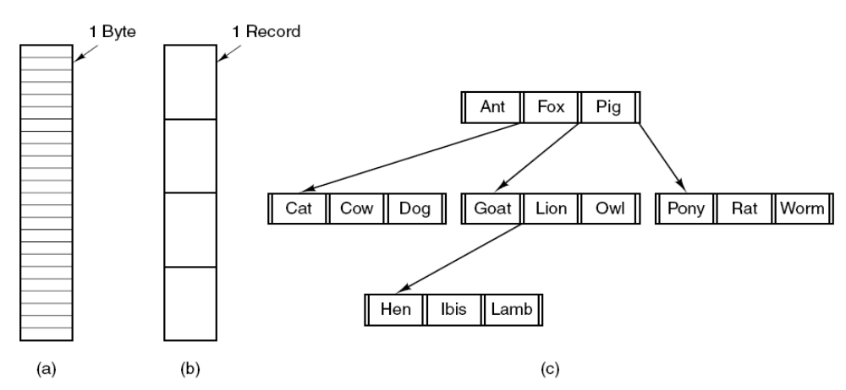
File Structure
Three kinds of files.
  Byte sequence.
  Record sequence. (fixed length)
  Tree of Records.

Slide 16
File Types
  Regular
    contains user information
    Directories
  Character special files
    model serial (e.g. printers) I/O devices
Block special files
    model disks

Slide 17
Regular Files
ASCII or binary
ASCII
    Printable
    Can use pipes to connect programs if they produce/consume ASCII
  Binary
    Two Unix examples
    Executable (magic field identifies file as being executable)
    Archive-compiled, not linked library procedures
Every OS must recognize its own executable

Slide 18
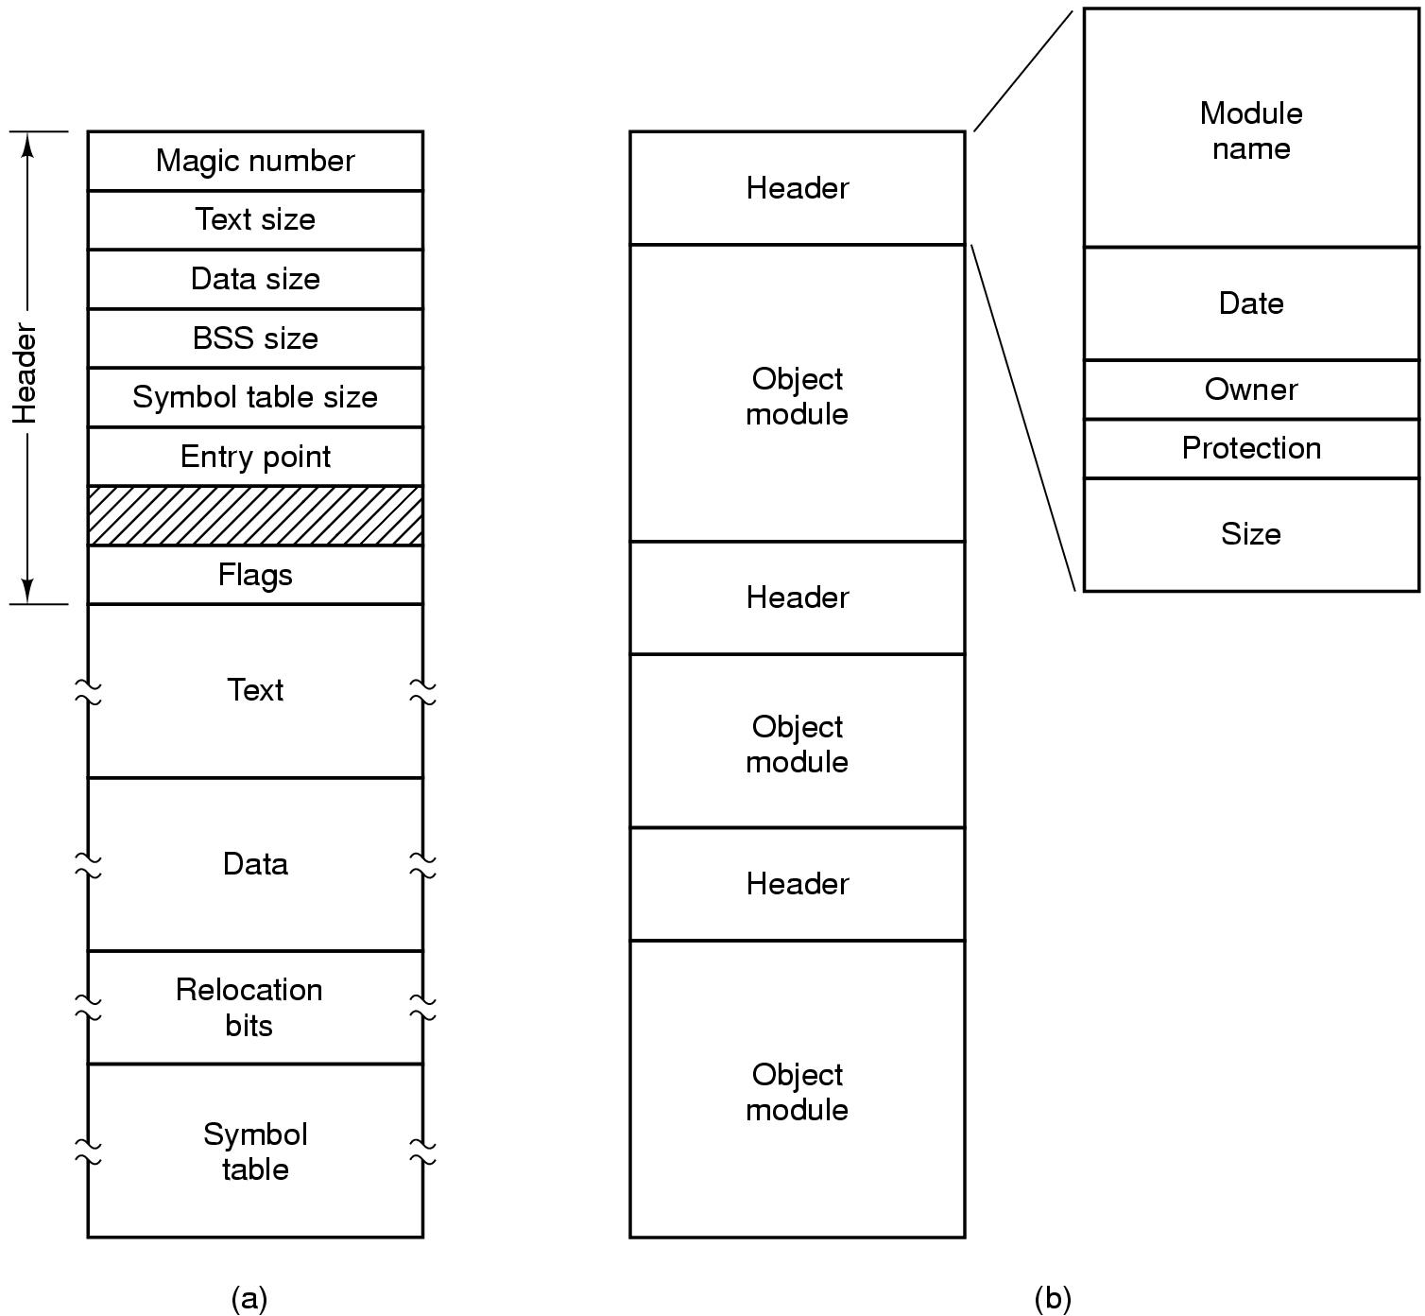
Binary File Types (Early Unix)
An executable file (magic # identifies it as an executable)
An archive-library procedures compiled but not linked

Slide 19
File Access
Sequential access- read all bytes/records from the beginning, can’t skip around
  Corresponds to magnetic tape
  May rewind or back up, however
  Often useful when whole file is needed
Random access- start where you want to start
  Came into play with disks
  Essential for database systems, Necessary for many applications, e.g. airline reservation system
    Bytes (or records) read in any order
    Read can be …Move file marker (seek), then read or …Read and then move file marker

Slide 20
File Access
Sequential access-
read next
write next
reset
no read after last write
(rewrite)
Random access
read n
write n
position to n
read next
write next
rewrite n
n = relative block number
start where you want to start
  Came into play with disks
  Essential for database systems, Necessary for many applications, e.g. airline reservation system
    Bytes (or records) read in any order
    Read can be …Move file marker (seek), then read or …Read and then move file marker

Slide 21
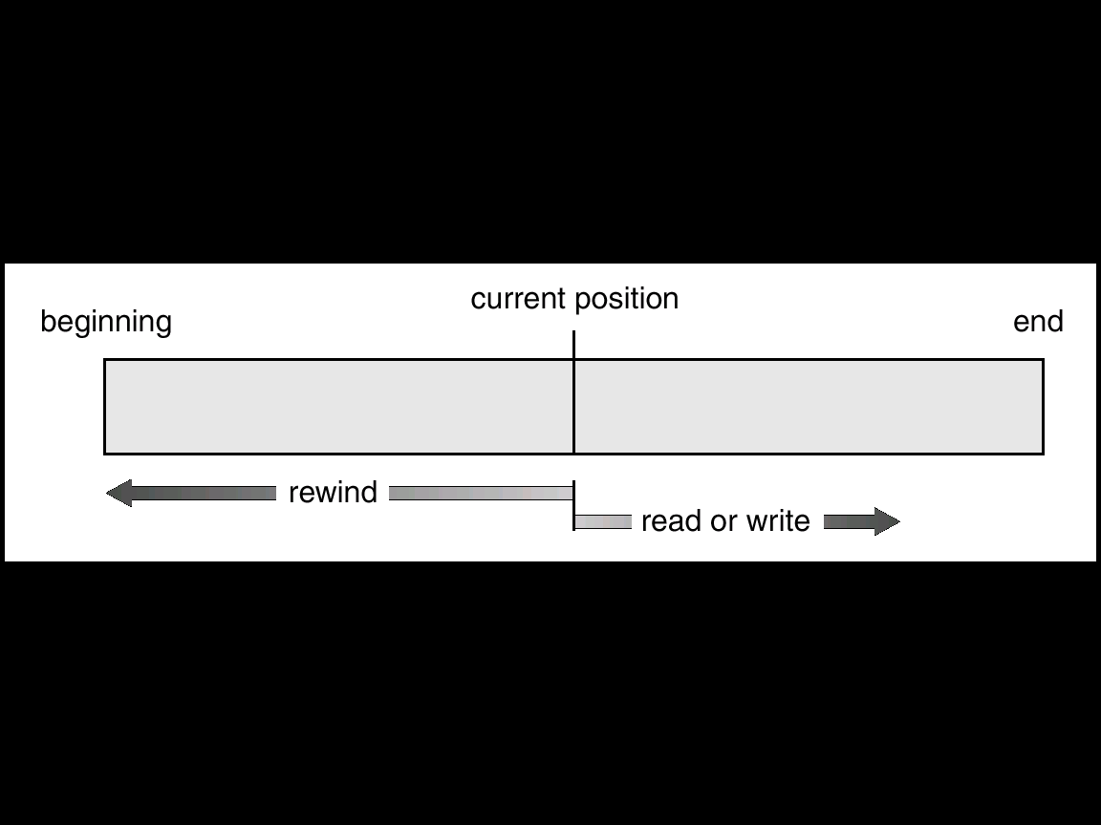
File Access
Sequential access

Slide 22
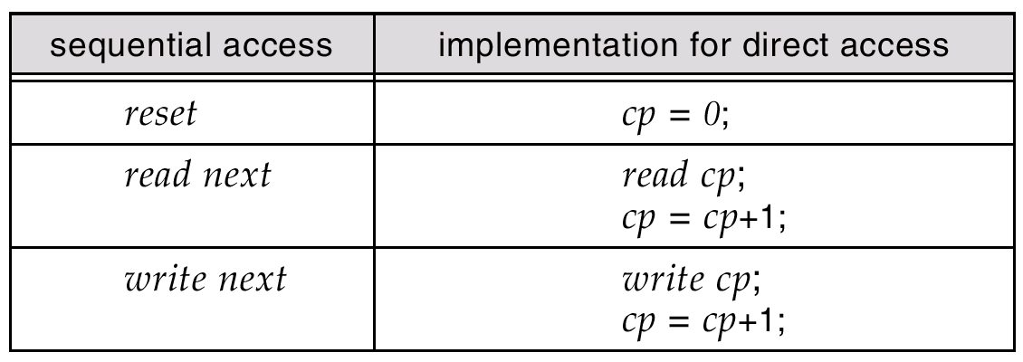
File Access
Sequential Access on a Random access File
Note: Cannot be otherwise.

Slide 23
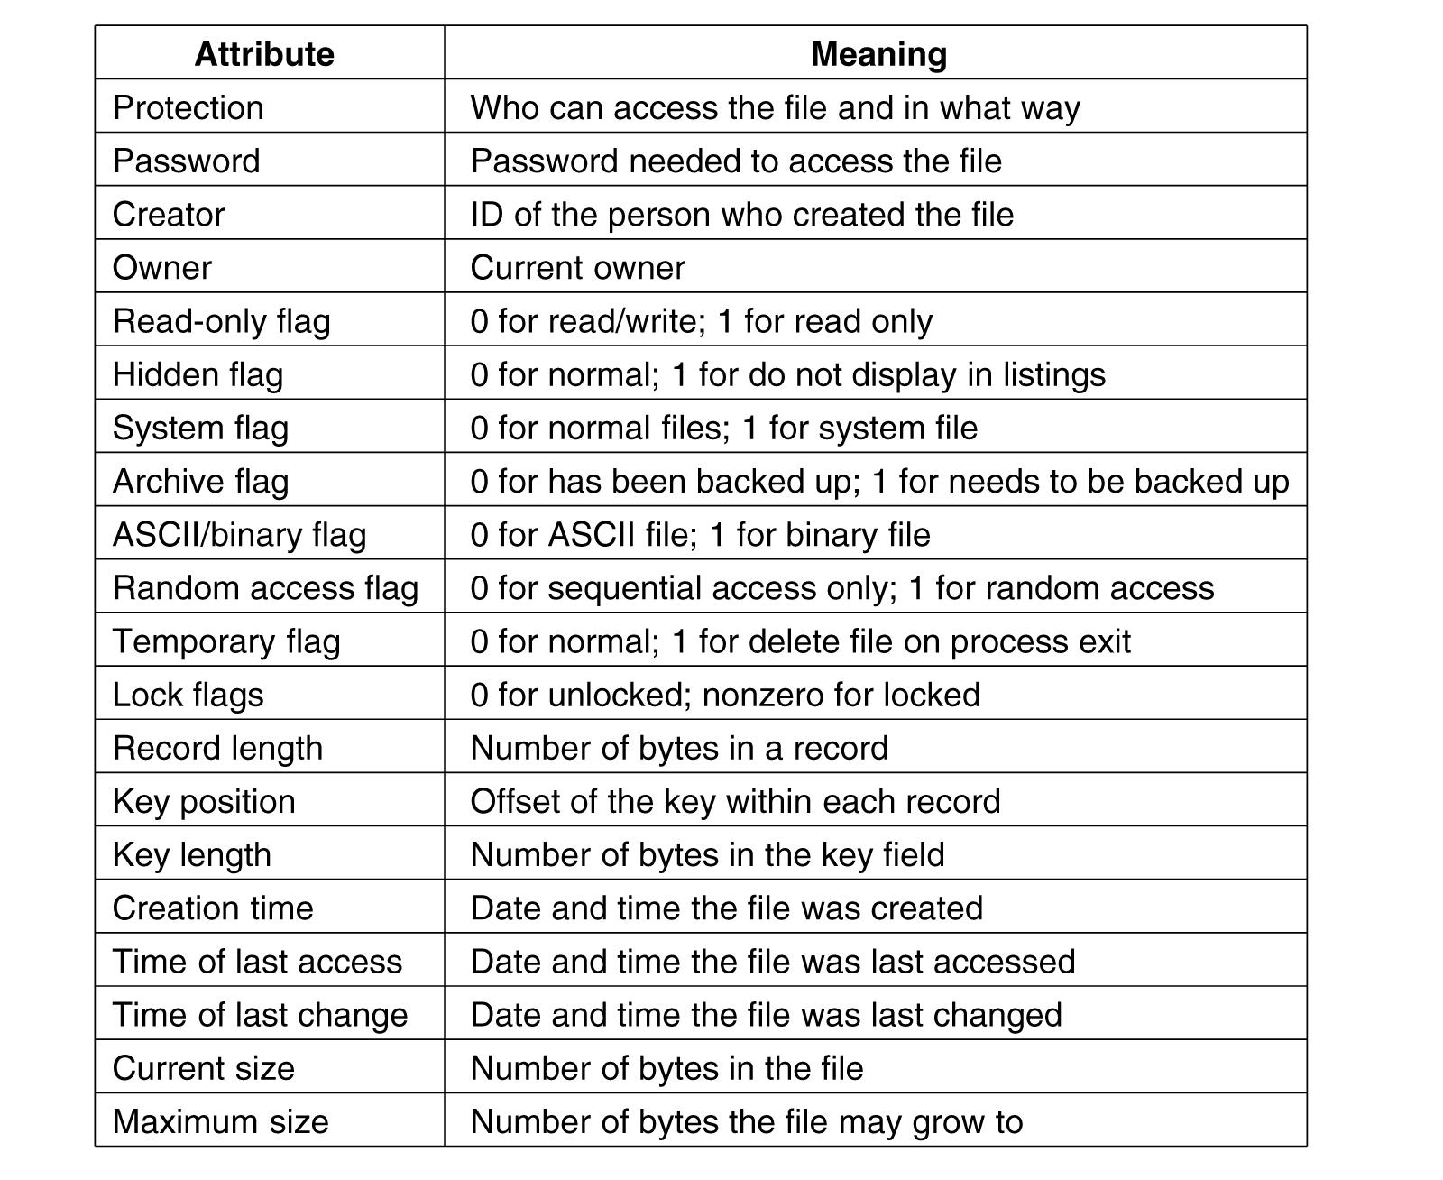
File Attributes (hypothetical OS)

Slide 24
Files Operations
Create: make a new file
Delete: remove an existing file
Open: prepare a file to be accessed
Close: indicate that a file is no longer being accessed
Read: get data from a file
Write: put data to a file
Append: like write, but only at the end of the file
Seek: move the “current” pointer elsewhere in the file
Get attributes: retrieve attribute information
Set attributes: modify attribute information
Rename: change a file’s name

Slide 25
Objectives of system calls for files
Create -with no data, sets some attributes
Delete-to free disk space
Open- after create, gets attributes and disk addresses into main memory
Close- frees table space used by attributes and addresses
Read-usually from current pointer position. Need to specify buffer into which data is placed
Write-usually to current position

Slide 26
Objectives of system calls for files (2)
Append- at the end of the file
Seek-puts file pointer at specific place in file. Read or write from that position on
Get Attributes-e.g. make needs most recent modification times to arrange for group compilation
Set Attributes-e.g. protection attributes
Rename; change the name of the file.

Slide 27
How can system calls be used?
An example (copyfile abc xyz)
Copies file abc to xyz
If xyz exists it is over-written
If it does not exist, it is created
Uses system calls (read, write)
Reads and writes in 4K chunks
Read (system call) into a buffer
Write (system call) from buffer to output file

Slide 28
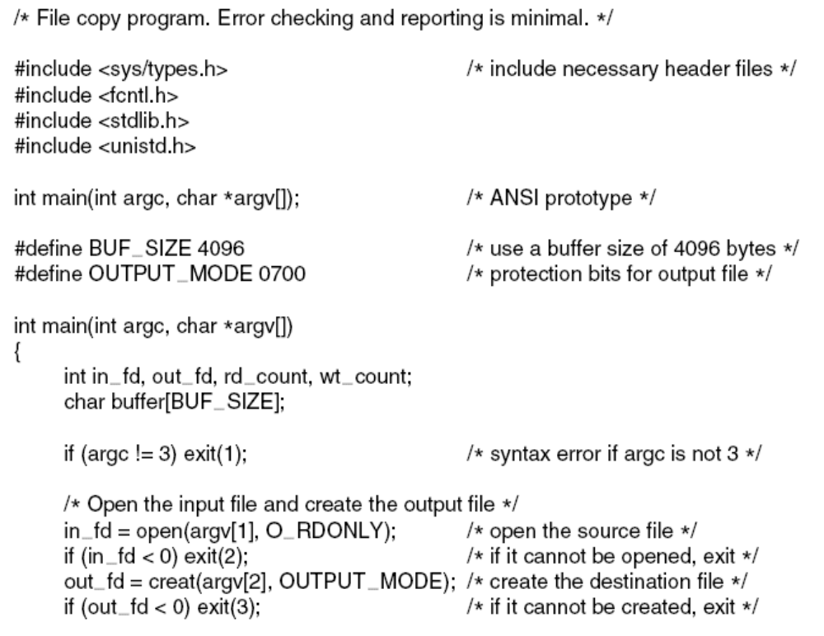
copyfile abc xyz
. . .

Slide 29
Copyfile abc xyz (2)
.

Slide 30
Directories
Files which are used to organize a collection of files
Naming is nice, but limited
Humans like to group things together for convenience
File systems allow this to be done with directories (sometimes called folders)
Grouping makes it easier to:
    Find files in the first place: remember the enclosing directories for the file
    Locate related files (or just determine which files are related)
.

Slide 31
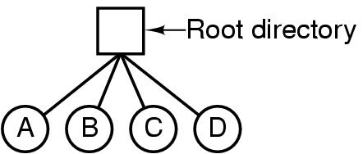
Single Level Directory Systems
A single-level directory system containing four files.

Slide 32
Two Level Directory Systems
Root
directory
A
B
C
A
foo
A
bar
B
foo
B
baz
C
bar
C
foo
C
blah
Solves naming problem: each user has her own directory
Multiple users can use the same file name
By default, users access files in their own directories
Extension: allow users to access files in others’ directories

Slide 33
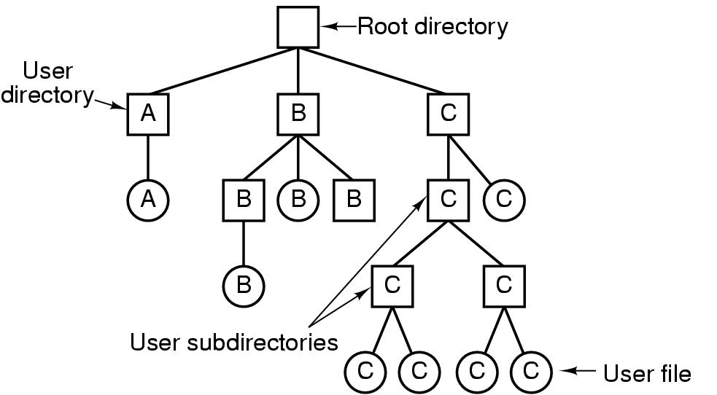
Hierarchical Directory Systems

Slide 34
Path names
Absolute /usr/carl/cs310/miderm/answers
Relative cs310/midterm/answers
. Refers to current (working) directory
.. Refers to parent of current directory

Slide 35
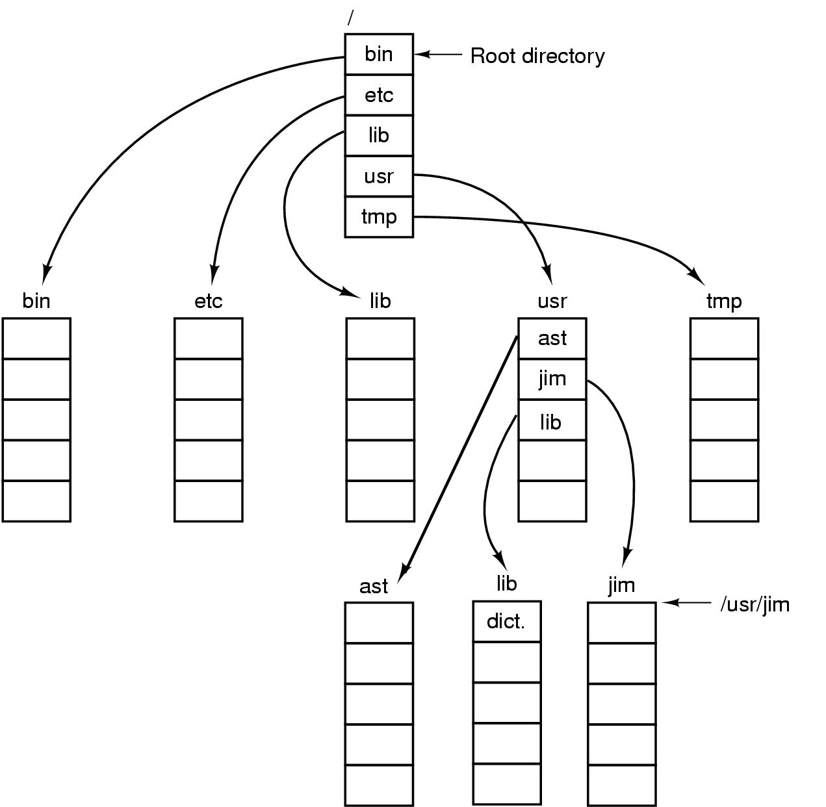
Path Names
A UNIX directory tree.

Slide 36
Unix cp commands involving dots
Cp ../lib/dictionary .
.. says go to parent (usr)
. says that target of the copy is current directory
cp /usr/lib/dictionary dictionary works
cp /usr/lib/dictionary /usr/ast/dictionary also works

Slide 37
Directory Operations
Create creates directory
Delete directory has to be empty to delete it
Opendir Must be done before any operations on directory
Closedir
Readdir returns next entry in open directory
Rename
Link links file to another directory
Unlink Gets rid of directory entry

Slide 38
Directory Operations
System calls for managing directories (from Unix)
Create: make a new directory
Delete: remove a directory (usually must be empty)
Opendir: open a directory to allow searching it
Closedir: close a directory (done searching)
Readdir-reads next entry in open directory
Rename
Link-links file to path. File can appear in multiple directories!
Unlink-what it sounds like. Only unlinks from pathname specified in call

