Slide 1
CSC 322 Operating Systems Concepts
Lecture - 18:
by
Ahmed Mumtaz Mustehsan
Special Thanks To:
Tanenbaum, Modern Operating Systems 3 e, (c) 2008 Prentice-Hall, Inc. (Chapter-3) Silberschatz, Galvin and Gagne 2002, Operating System Concepts,
Notes:
1

Slide 2
Chapter 3
Memory Management
Virtual memory
Segmentation

Slide 3
Segmentation
A compiler has many tables that are built up as compilation proceeds, possibly including:
The source text being saved for the printed listing (on batch systems).
The symbol table – the names and attributes of variables.
The table containing integer, floating-point constants used.
The parse tree, the syntactic analysis of the program.
The stack used for procedure calls within the compiler.

Slide 4
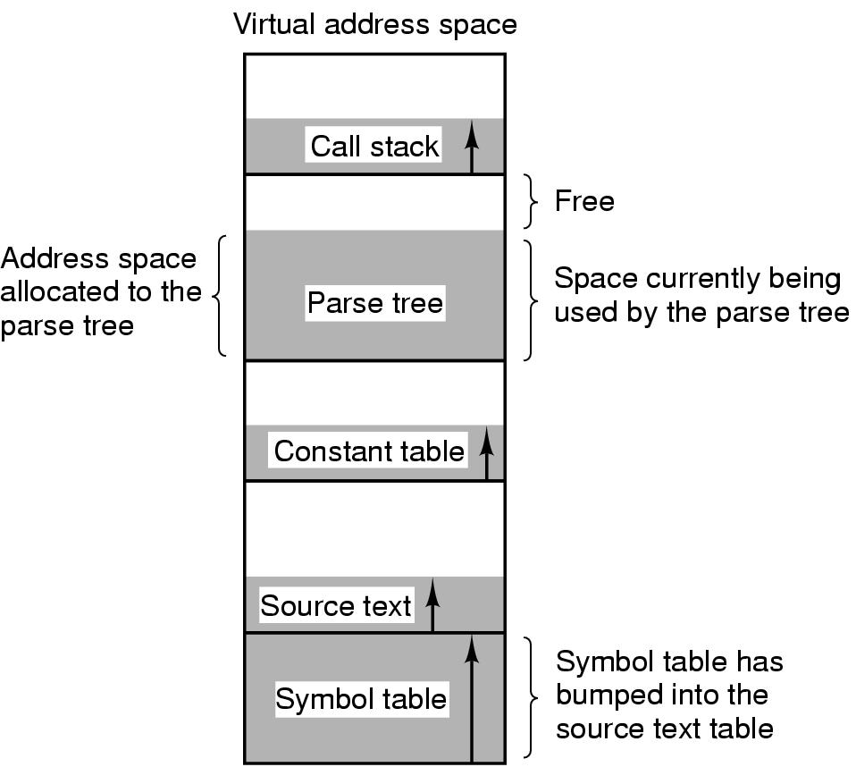
One dimensional address space
In a one-dimensional address space with growing tables, one table may bump into another.

Slide 5
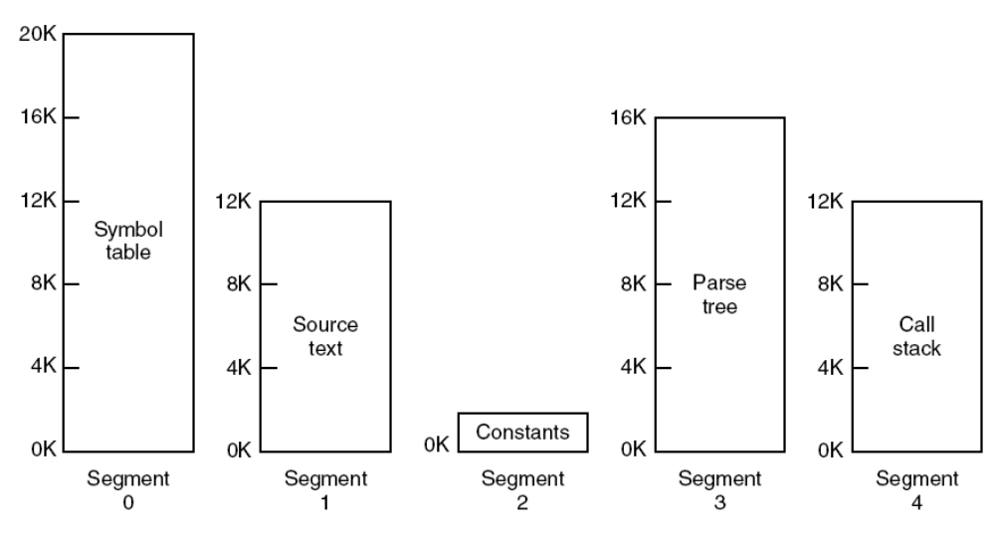
Segmentation
A segmented memory allows each table to grow or shrink independently of the other tables.

Slide 6
Advantages of Segmentation
Simplifies handling of data structures which are growing and shrinking
  Address space of segment n is of form (n,local address) where (n,0) is starting address
Can compile segments separately from other segments
Can put library in a segment and share it
Can have different protections (r,w,x) for different segments

Slide 7
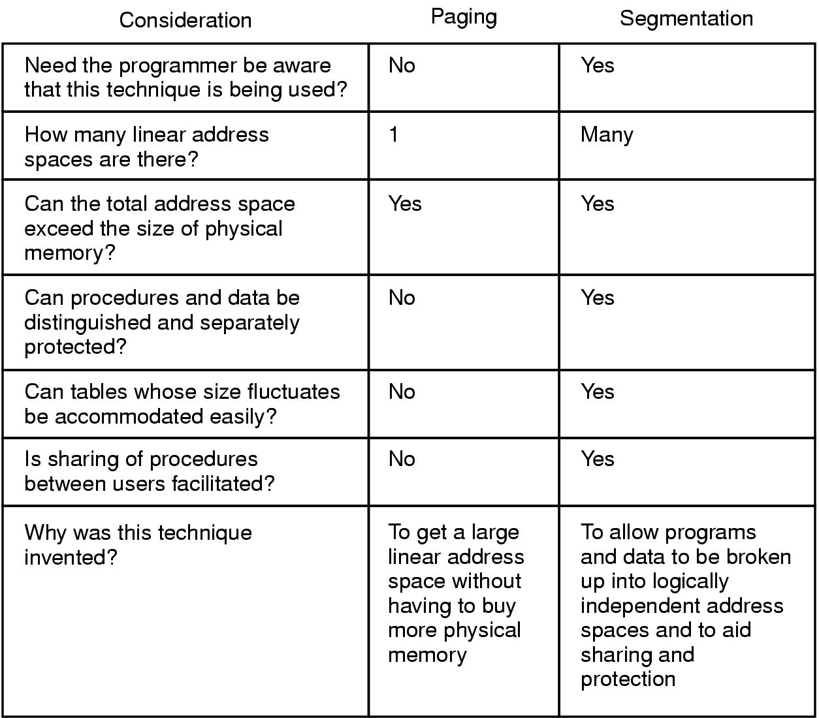
Comparison Paging vs Segmentation

Slide 8
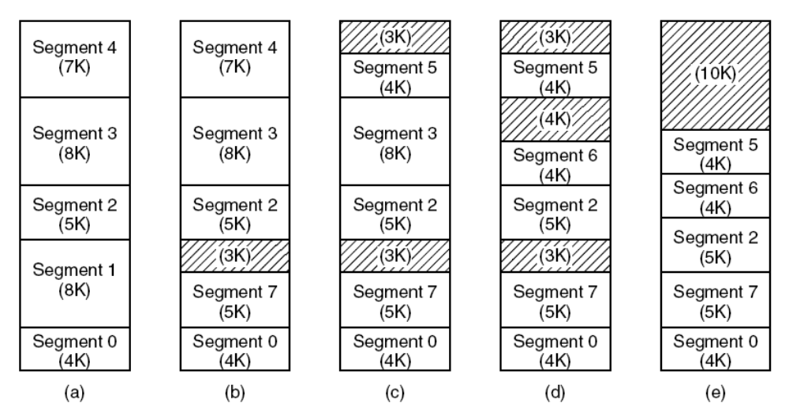
External fragging
(a)-(d) Development of checker boarding.
(e) Removal of the checker boarding by compaction.

Slide 9
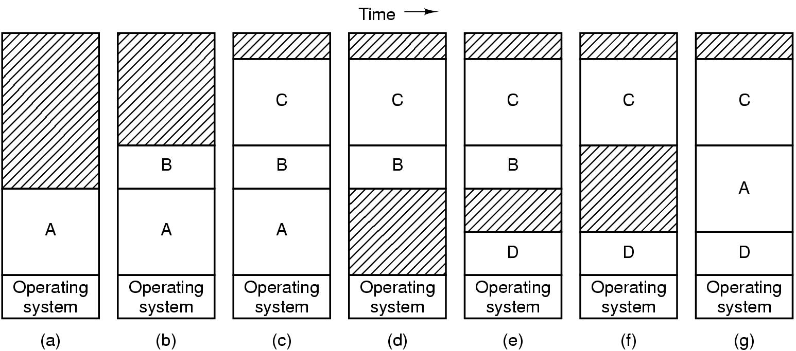
Swapping, a picture (Revisit)
Can compact holes by copying programs into holes
This takes too much time

Slide 10
Segmentation
Logical address consists of a two tuple:
<segment-number, offset>,
Segment table – maps two-dimensional physical Addresses; each table entry has:
  base – contains the starting physical address where the segments reside in memory.
  limit – specifies the length of the segment.
Segment-table base register (STBR) points to the segment table’s location in memory.
Segment-table length register (STLR) indicates number of segments used by a program; segment number s is legal if s < STLR.

Slide 11
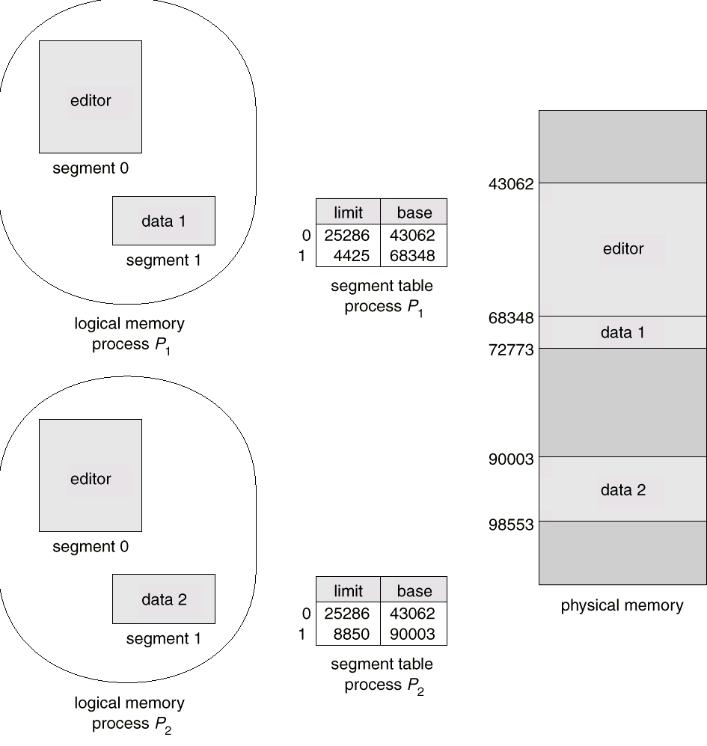
Sharing of Segmentation

Slide 12
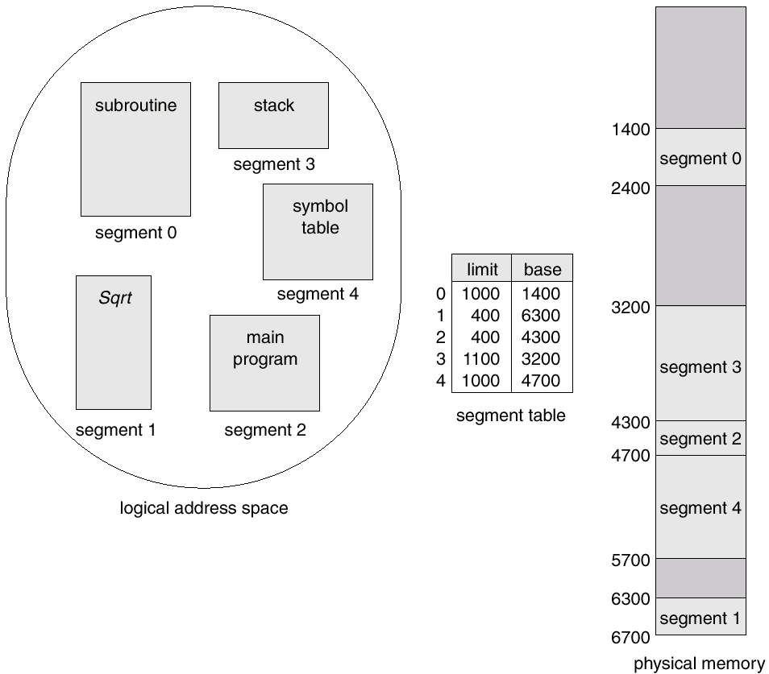
Example of Segmentation

Slide 13
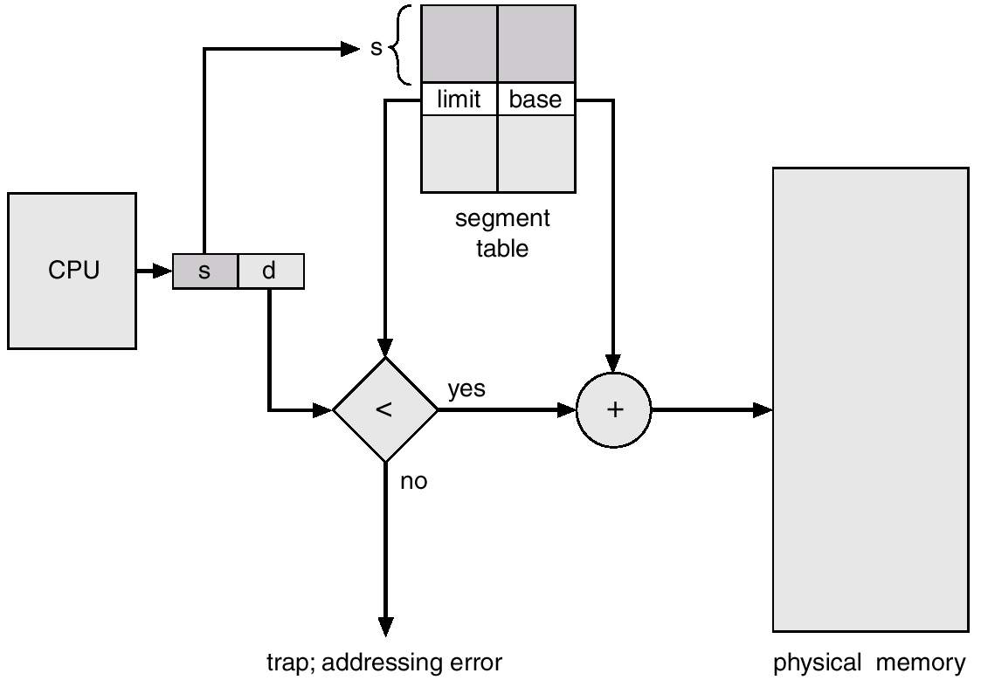
Segmentation H/w for Address Translation

Slide 14
Segmentation with Paging
Examine two systems
      Multics (the first)
      The Pentium
Honeywell 6000
2*¹⁸ segments, up to 65,538 (36 bit) words per segment
Each program has a segment table (paged itself) containing segment descriptors
Segment descriptor points to page table

Slide 15
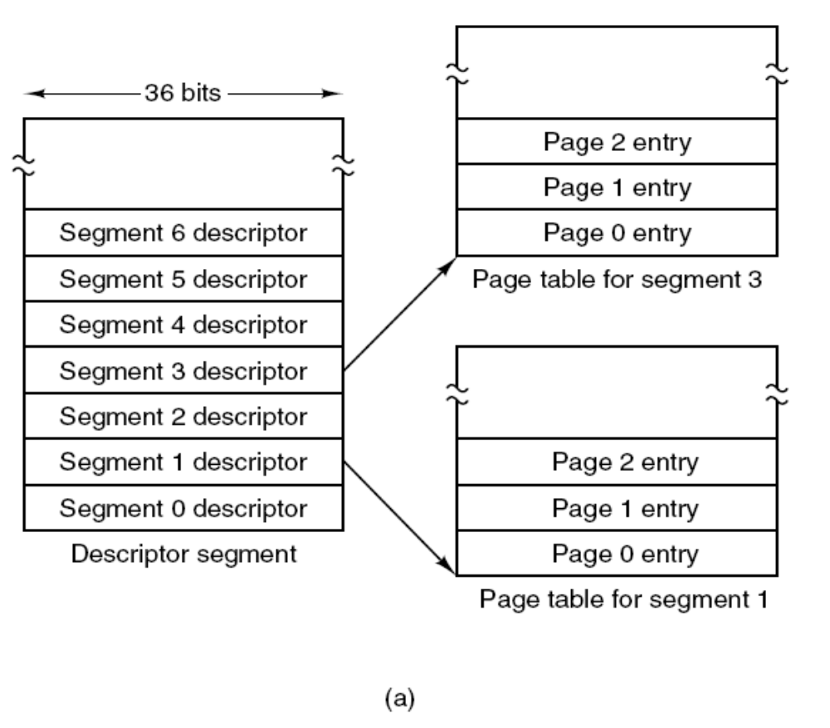
Segmentation with Paging: MULTICS
The MULTICS virtual memory.
(a) The descriptor segment points to the page tables.
Tanenbaum, Modern Operating Systems 3 e, (c) 2008 Prentice-Hall, Inc. All rights reserved. 0-13-6006639

Slide 16
Segmentation with Paging
Segment descriptor says whether segment is in main memory or not
If any part of segment is in memory, entire segment is considered to be in memory
Virtual Address is (segment number, page number, offset within page)

Slide 17
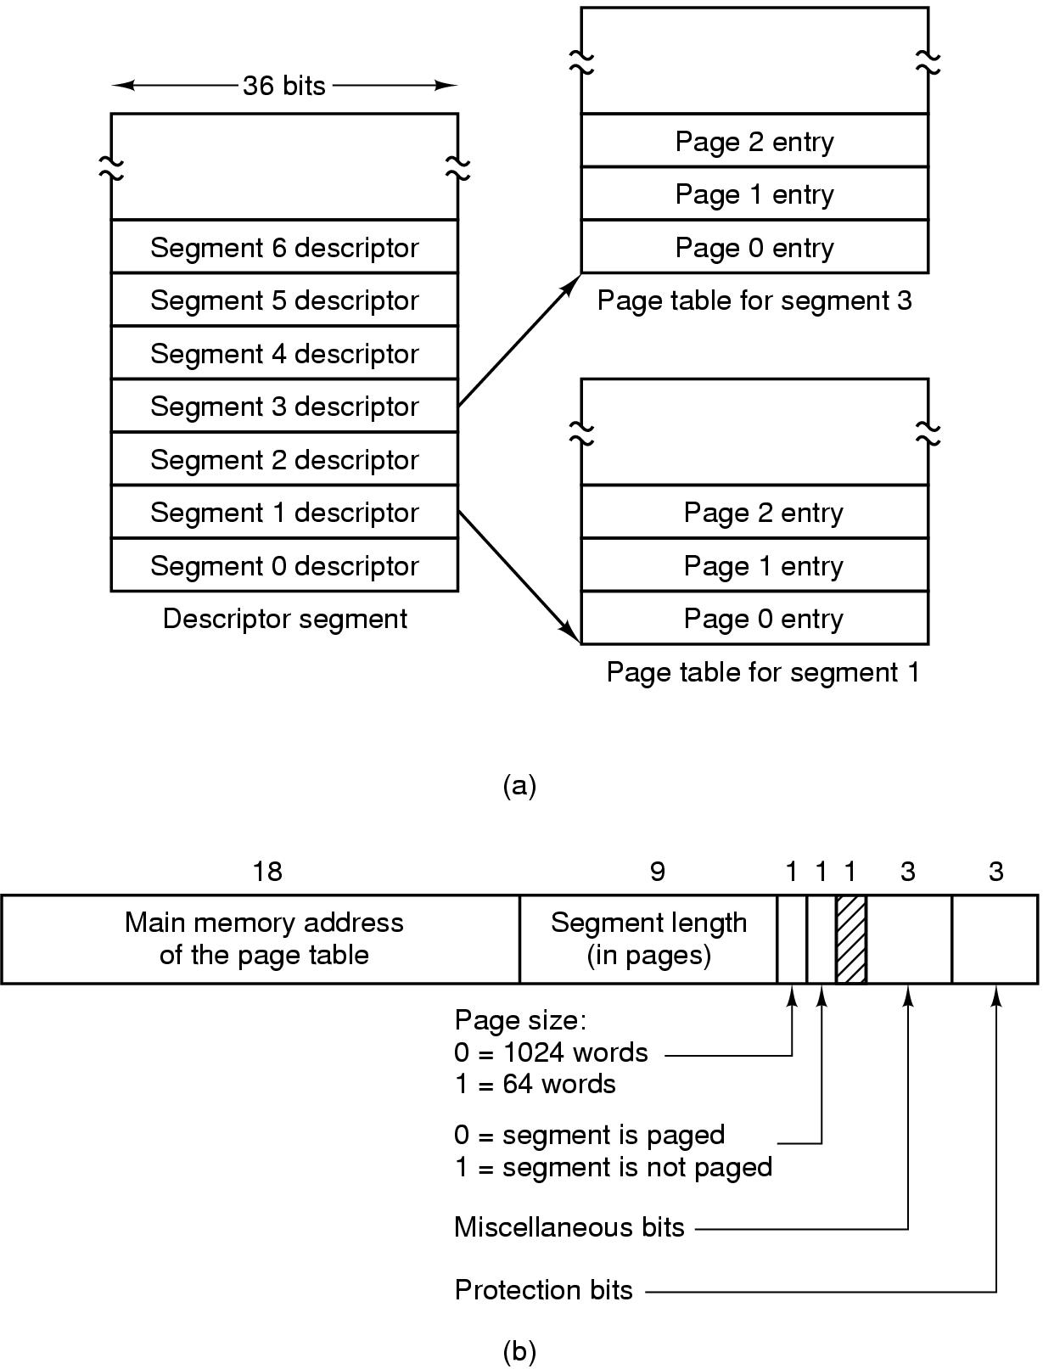
Segmentation with Paging: MULTICS
The MULTICS virtual memory.
(b) A segment descriptor. The numbers are the field lengths.

Slide 18
Segmentation with Paging: MULTICS
A 34-bit MULTICS virtual address.

Slide 19
Segmentation with Paging: MULTICS
When a memory reference occurs, the following algorithm is carried out:
The segment number used to find segment descriptor.
Check is made to see if the segment’s page table is in memory.
        If not, segment fault occurs.
        If there is a protection violation, a fault (trap) occurs.

Slide 20
Segmentation with Paging: MULTICS
Page table entry for the requested virtual page examined.
      If the page itself is not in memory, a page fault is triggered.
      If it is in memory, the main memory address of the start of the page is extracted from the page table entry
The offset is added to the page origin to give the main memory address where the word is located.
The read or store finally takes place.

Slide 21
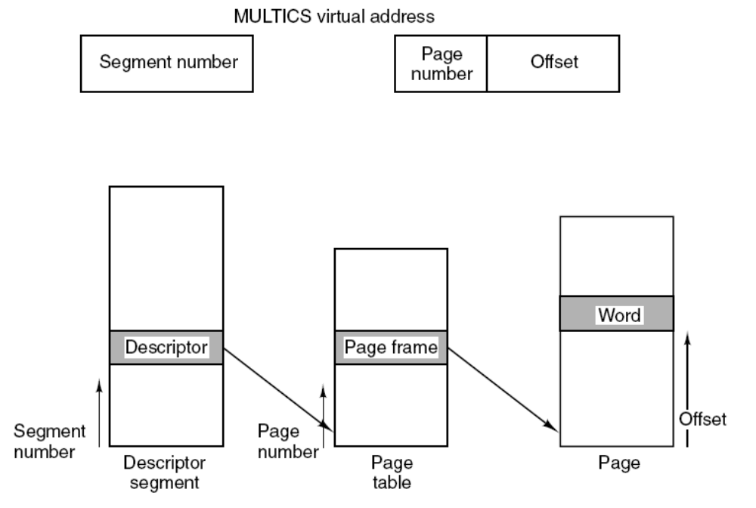
Segmentation with Paging: MULTICS
Conversion of a two-part MULTICS address into a main memory address.

Slide 22
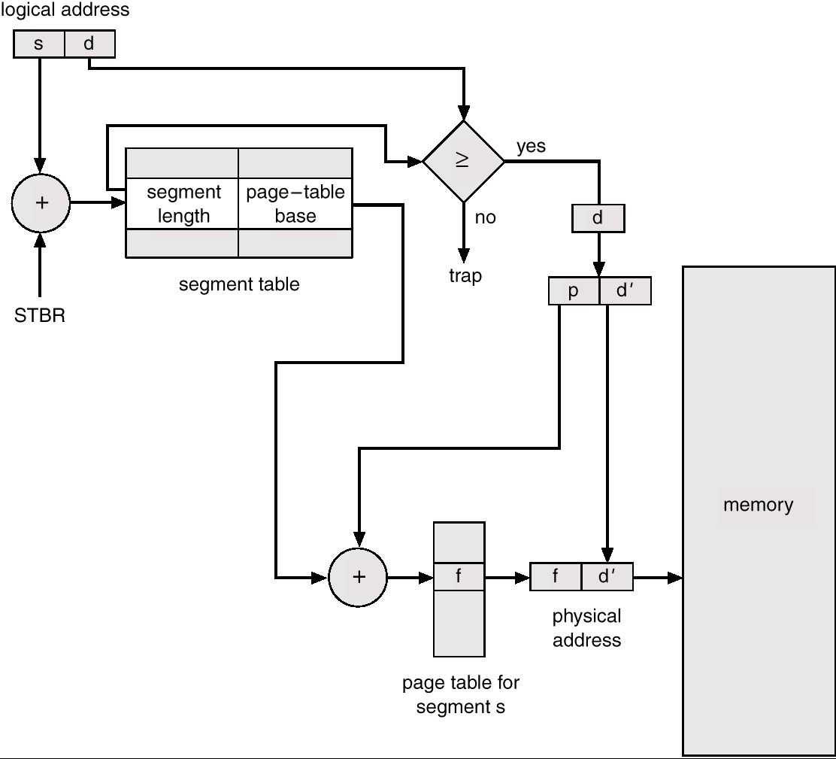
Segmentation with Paging: MULTICS
Conversion of a two-part MULTICS address into a main memory address.

Slide 23
MULTICS TLB
Too many references with algorithm
Use TLB (16 words)
Keep addresses of the 16 most recently referenced pages in TLB
Addressing hardware checks to see if address is in TLB
If so, gets address directly from TLB
If not, invoke algorithm (check descriptor…)

Slide 24
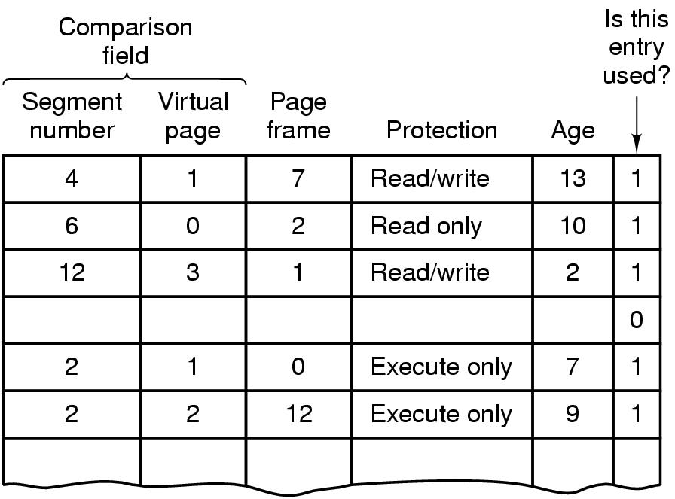
Segmentation with Paging: MULTICS (10)

Slide 25
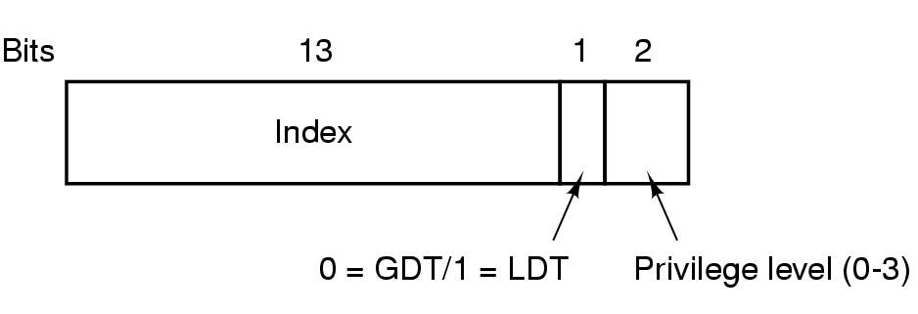
Segmentation with Paging: The Pentium
A Pentium selector.
The Pentium has 16K independent segments, each holding up to 1 billion 32-bit words
LDT (Local Descriptor Table); describes segments local to each program
GDT (Global Descriptor Table); describes system segments including OS

Slide 26
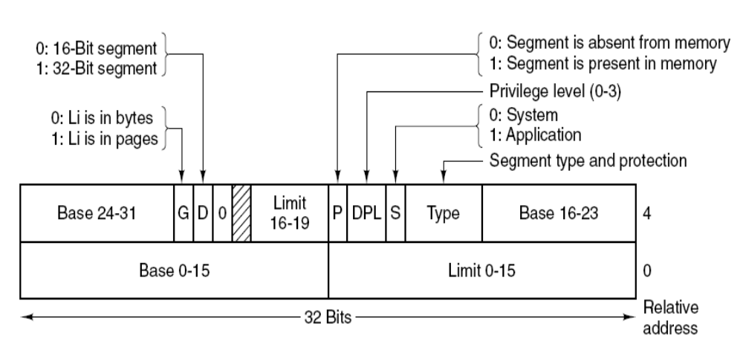
Segmentation with Paging: The Pentium
Pentium code segment descriptor.
Data segments differ slightly.

Slide 27
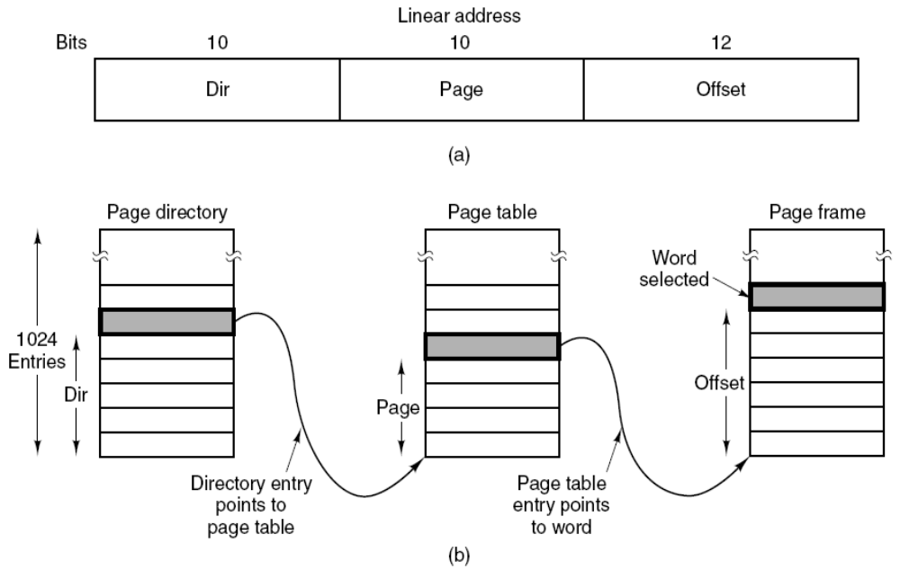
Segmentation with Paging: The Pentium (4)
Mapping of a linear address onto a physical address.

Slide 28
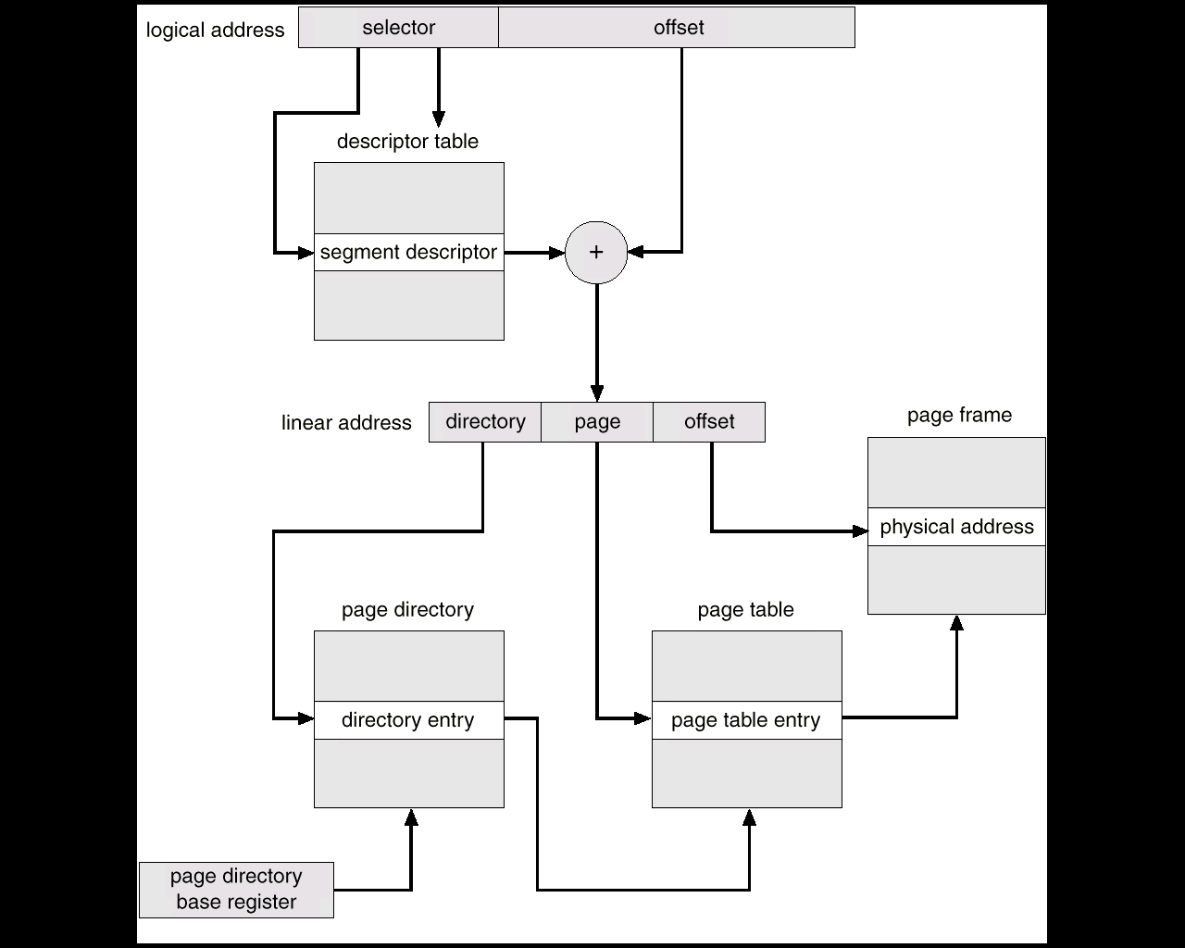
Segmentation with Paging: The Pentium (4)
Two level Conversion of address translation Pentium 386

Slide 29
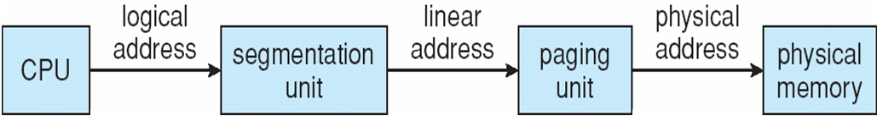
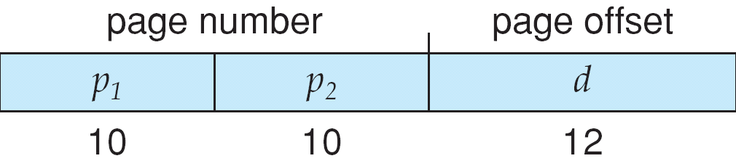
Logical to Physical Address Translation in Pentium

Slide 30
The Intel Pentium (Simplified Explanation)
Supports both segmentation and segmentation with paging:
CPU generates logical address
  Given to segmentation unit; Which produces linear addresses
  Linear address given to paging unit; Which generates physical address in main memory
    Paging units form equivalent of MMU

Slide 31
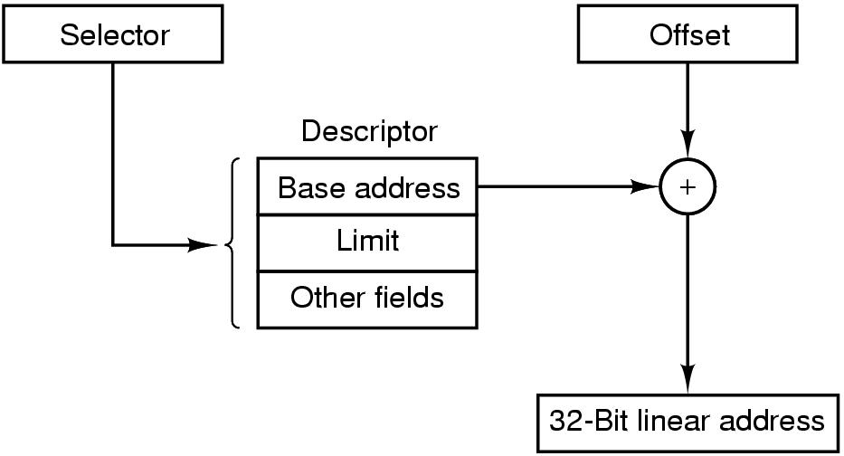
Segmentation without Paging: The Pentium
Conversion of a (selector, offset)
pair to a linear address.

Slide 32
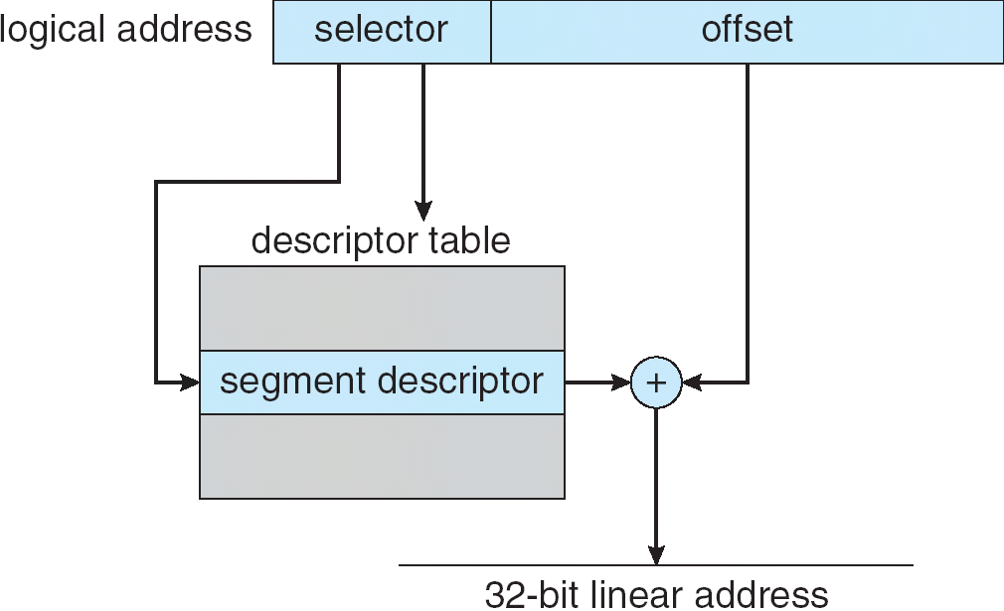
Segmentation without Paging: The Pentium

Slide 33
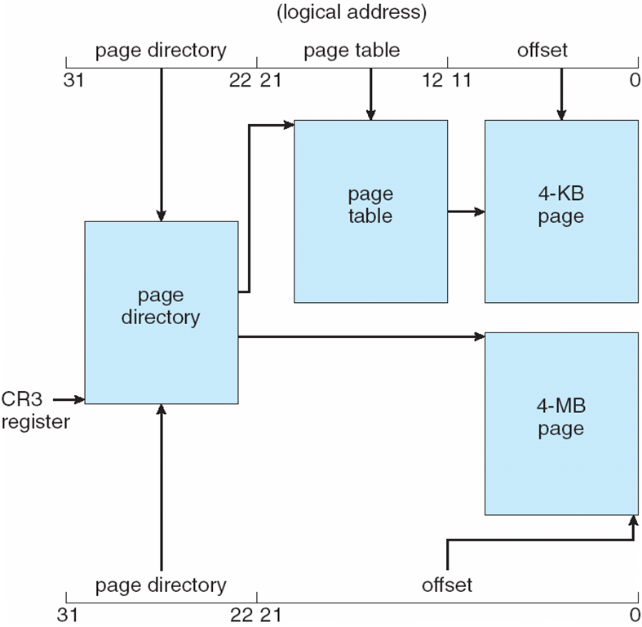
Pentium Paging Architecture with 4KB and 4 MB Page

Slide 34
Segmentation with Paging: Protection in Pentium
The Pentium supports four protection levels, with level 0 the most privileged and level 3 the least, indicated by a 2-bit field in its PSW
Attempts to access data at a higher level are permitted. Attempts to access data at a lower level are illegal and cause traps.
Attempts to call procedures at a different level (higher or lower) are allowed, but in a controlled way.
To make an inter level call, the CALL must contain a selector instead of an address. This selector designates a descriptor called a call gate, which gives the address of the procedure to be called. Thus it is not possible to jump into the middle of any code segment of any level.

Slide 35
Segmentation with Paging: The Pentium (6)
. Protection on the Pentium.

Slide 36
Operating System Examples
Windows XP
Solaris

Slide 37
Windows XP
Uses demand paging with clustering. Clustering brings in pages surrounding the faulting page.
Processes are assigned working set minimum and working set maximum.
Working set minimum is the minimum number of pages the process is guaranteed to have in memory.
A process may be assigned as many pages up to its working set maximum.
When the amount of free memory in the system falls below a threshold, automatic working set trimming is performed to restore the amount of free memory.
Working set trimming removes pages from processes that have pages in excess of their working set minimum.

Slide 38
Solaris
Maintains a list of free pages to assign faulting processes
Lotsfree – threshold parameter (amount of free memory) to begin paging
Desfree – threshold parameter to increasing paging
Minfree – threshold parameter to being swapping
Paging is performed by page out process
Pageout scans pages using modified clock algorithm
Scanrate is the rate at which pages are scanned. This ranges from slow scan to fast scan
Pageout is called more frequently depending upon the amount of free memory available

Slide 39
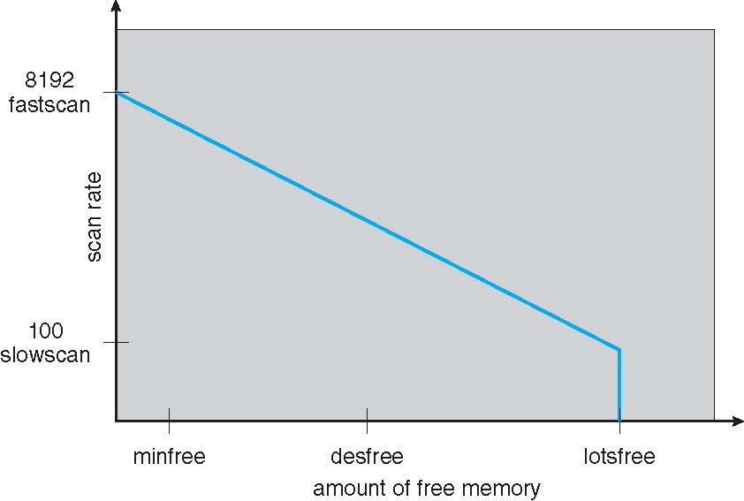
Solaris 2 Page Scanner

Slide 40
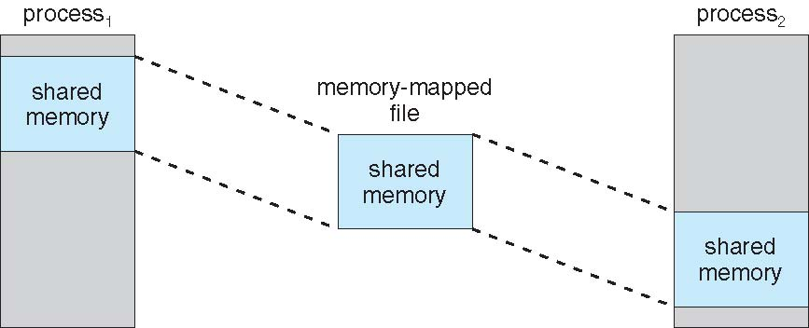
Memory-Mapped Shared Memory in Windows

