Slide 1
CSC 322 Operating Systems Concepts
Lecture - 17:
by
Ahmed Mumtaz Mustehsan
Special Thanks To:
Tanenbaum, Modern Operating Systems 3 e, (c) 2008 Prentice-Hall, Inc. (Chapter-3)
Notes:
1

Slide 2
Chapter 3
Memory Management
Virtual memory
Performance Issues
Implementation Issues

Slide 3
Performance Issues
Cleaning Policy; (If there is no free frame?)
Page Replacement
Allocation of Frames
Priority Allocation
How to increase TLB Reach ?

Slide 4
Cleaning Policy
Use a daemon to locate pages to evict before you need them instead of looking for victims when you need them
Daemon sleeps most of the time, periodically awakens If there are “too few” frames, kicks out frames
Make sure that they are clean before claiming them

Slide 5
Performance Issues
What happens if there is no free frame?
Page replacement – find some page in memory, but not really in use, swap it out
    algorithm
    performance – want an algorithm which will result in minimum number of page faults
Same page may be brought into memory several times

Slide 6
Performance Issues
Page Replacement
Prevent over-allocation of memory by modifying page-fault service routine to include page replacement
Use modify (dirty) bit to reduce overhead of page transfers – only modified pages are written to disk
Page replacement a complete separation between logical memory and physical memory – large virtual memory can be provided on a smaller physical memory

Slide 7
Performance Issues
Allocation of Frames
Each process needs minimum number of pages
Example: IBM 370 – 6 pages to handle SS MOVE instruction:
    instruction is 6 bytes, might span 2 pages
    2 pages to handle from (Source)
    2 pages to handle to (Destination)
Two major allocation schemes
    fixed allocation
    priority allocation

Slide 8
Performance Issues
Fixed Allocation
Equal allocation – For example, if there are 100 frames and 5 processes, give each process 20 frames. (OR)
Proportional allocation – Allocate according to the size of process

Slide 9
Performance Issues
Priority Allocation
Use a proportional allocation scheme using priorities rather than size
If process Pi generates a page fault,
    select for replacement one of its frames
    select for replacement a frame from a process with lower priority number

Slide 10
Other Issues – TLB Reach
TLB Reach - The amount of memory accessible from the TLB
TLB Reach = (TLB Size) X (Page Size)
Ideally, the working set of each process is stored in the TLB
    Otherwise there is a high degree of page faults
Increase the Page Size
    This may lead to an increase in fragmentation as not all applications require a large page size

Slide 11
Other Issues – TLB Reach
Another approach could be:
Provide Multiple Page Sizes
    This allows applications that require larger page sizes the opportunity to use them without an increase in fragmentation

Slide 12
Virtual Memory Interface
Virtual memory is transparent to processes and programmers, that is, a large virtual address space on a computer with a small(er) physical memory.
If 2 programs to share physical memory, Both process maps shared area to their address space.
Implement a high performance message passing system.
It avoids copy message from one process to other process address space by using shared memory.

Slide 13
Distributed shared advanced memory management
Allow multiple processes over a network to share a set of pages, not necessarily, as a single shared linear address space.
When a process references a page that is not currently mapped in, it gets a page fault.
The page fault handler, may be in the kernel or in user space, locates the machine holding the page and sends it a message.
To un map the page and send it over the network. When page arrives, it is mapped in and the faulting instruction is restarted.

Slide 14
Implementation Issues

Slide 15
OS involvement on process creation:
When a Process is created OS:
Determine the size of program and data and create a page table for them.
Allocate Space in memory for the page table and for swap area on disk
Initialized swap area with program text and data so that when the new process starts getting page faults, the pages can be brought in.
Information must be recorded in the Process Table, about the page table and swap area

Slide 16
OS involvement on process Execution
When a process is to be executed OS:
Reset MMU and flush the TLB, to get rid of traces of the previously executing process.
Provide the new process page table by copying it or through some hardware register(s).
Bring some process pages into memory to reduce the number of page faults, e.g., it is certain that the page pointed to by the PC will be needed. (pre-paging)
When a page fault occurs, the operating system has to read out hardware registers to determine which virtual address caused the fault.
From this information, it must compute which page is needed and locate that page on disk.

Slide 17
OS involvement on process Execution (2)
It must then find an available page frame to put the new page, evicting some old page if need be.
Then it must read the needed page into the page frame.
Finally, it must back up the program counter to have it point to the faulting instruction and let that instruction execute again.

Slide 18
OS involvement on process Exit
When a process exits OS:
Must release its page table, its pages, and the disk space that the pages occupy when they are on disk.
If some of the pages are shared with other processes, the pages in memory and on disk can only be released when the last process using them has terminated.

Slide 19
OS involvement on
Page Fault Handling (1)
The hardware traps to the kernel, saving the program counter on the stack.
An assembly code routine is started to save the general registers and other volatile information.
The operating system discovers that a page fault has occurred, and tries to discover which virtual page is needed.
Once the virtual address that caused the fault is known, the system checks to see if this address is valid and the protection consistent with the access

Slide 20
OS involvement on
Page Fault Handling (2)
If the page frame selected is dirty, the page is scheduled for transfer to the disk, and a context switch takes place.
When page frame is clean, operating system looks up the disk address where the needed page is, then it schedules a disk operation to bring it in.
When disk interrupt indicates that the page has arrived, page tables updated to reflect position, frame marked as being in normal state.

Slide 21
OS involvement on
Page Fault Handling (3)
Faulting instruction backed up to the state it was when it faulted and program counter reset to point to that instruction.
Faulting process is scheduled, operating system returns to the (assembly language) routine that called it.
This routine reloads registers and other state information and returns to user space to continue execution, as if no fault had occurred.

Slide 22
Instruction Backup
Instruction causes fault => stopped part way through, traps to OS for fault handling.
OS returns to instruction.
Must re-start instruction exactly from the point of interrupt.
Easier said then done! For example (next slide)

Slide 23
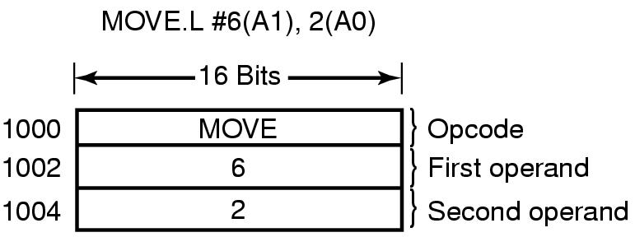
Instruction Backup (Motorola 680 x 2)
Where to re-start the instruction? PC depends on which part of the instruction actually faulted. If it faults at 1002, how does OS know that instruction starts at 1000?.

Slide 24
Instruction Backup
Worse yet: Auto-incrementing loads registers either before or after instruction is executed.
Do it before and needs to be un-done. Do it afterwards and must not reverse it.
Hardware solution to instruction backup-copy current instruction to a register just before the instruction is executed
Otherwise OS is deep in the swamp

Slide 25
Locking Pages in Memory
Process does I/O call, waits for data
Gets suspended while waiting, new process read in, new process observes a page fault.
Global paging algorithm => removes that page engaged in receiving data through DMA.
Incoming data writes over new page
Solution: Lock pages engaged in I/O

Slide 26
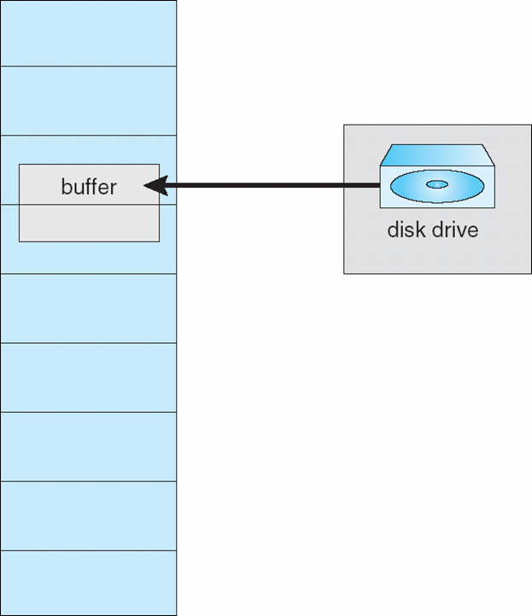
Locking Pages in Memory
Also called I/O Interlock – Pages locked into memory
Consider I/O - Pages that are used for copying a file from a device must be locked from being selected for eviction by a page replacement algorithm

Slide 27
Backing Store
Where to put the page on disk when it is swapped out?
Two approaches:
  Separate disk or
  Use separate partition on disk
  which has no file system on it, which eliminates all the overhead of converting offsets in files to block addresses.

Slide 28
Backing Store
Static Partition: Allocate fixed partition to a process when it starts up.
    Manage as list of free chunks. Assign big enough chunk to hold process
    Starting address of partition kept in process table.
    Page offset in virtual address space corresponds to address on disk.
    Can assign different areas for data, text , stack as data and stack can grow

Slide 29
Backing Store-Dynamic
Dynamic approach: Don’t allocate disk space in advance. (of Same size)
Swap pages in and out as needed, using disk map to be maintained in memory

Slide 30
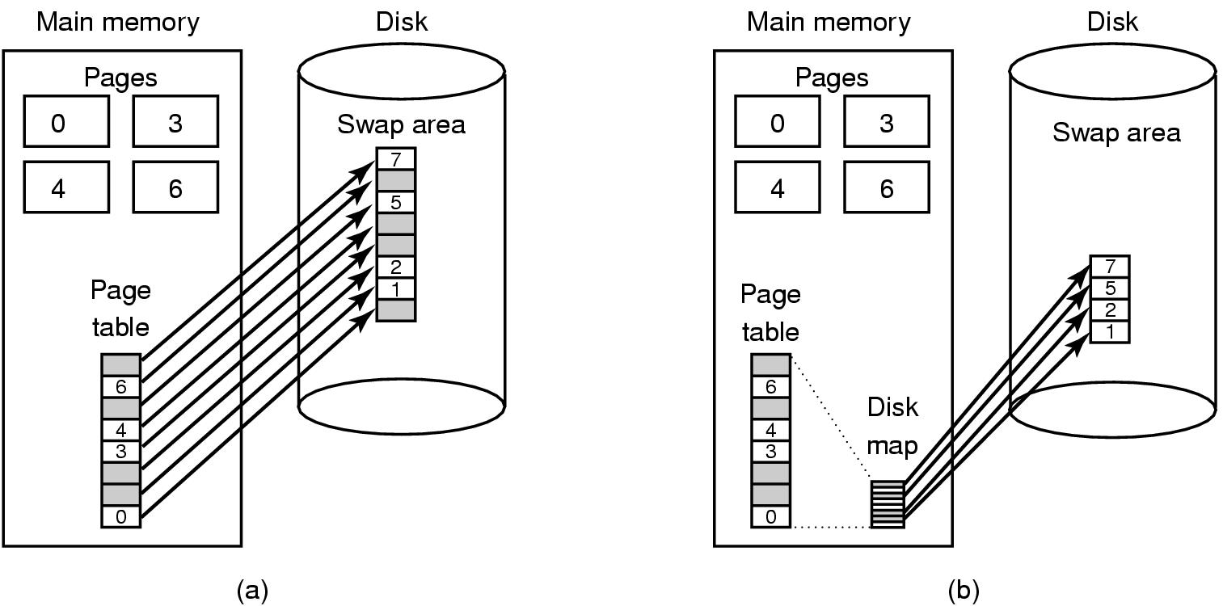
Backing Store-the picture
Paging to a static swap area (a) and
Paging to dynamic area (b)

Slide 31
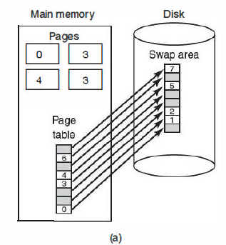
Backing Store-Static swap area
Example: Figure (a),
a page table with eight pages, 0, 3, 4, and 6 are in main memory. Pages 1 , 2, 5, and 7 are on disk.
The swap area on disk is as large as the process virtual address space (eight pages), with each page having a fixed location to which it is written when it is evicted from main memory.
Calculating the address requires only the beginning address of chunk holding pages,

Slide 32
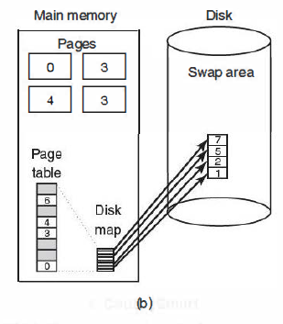
Backing Store-Dynamic Swap Area
Example: Figure (b),
pages do not have fixed addresses on disk.
When a page is swapped out, an empty disk page is chosen on the fly and the disk map (which has room for one disk address per virtual page) is updated accordingly.
A page in memory has no copy on disk. Their entries in the disk map contain an invalid disk address or a bit marking them as not in use.

Slide 33
Separation of Policy and Mechanism
A simple example of how policy and mechanism can be separated is shown in Figure.
Memory management system is divided into three parts:
  A low-level MMU handler (machine dependent)
  A page fault handler that is part of the kernel (machine independent) Asks MMU to assign space for incoming page in the process
  An external pager running in user space which contains the policy for page replacement and asks/receives pages from disk

Slide 34
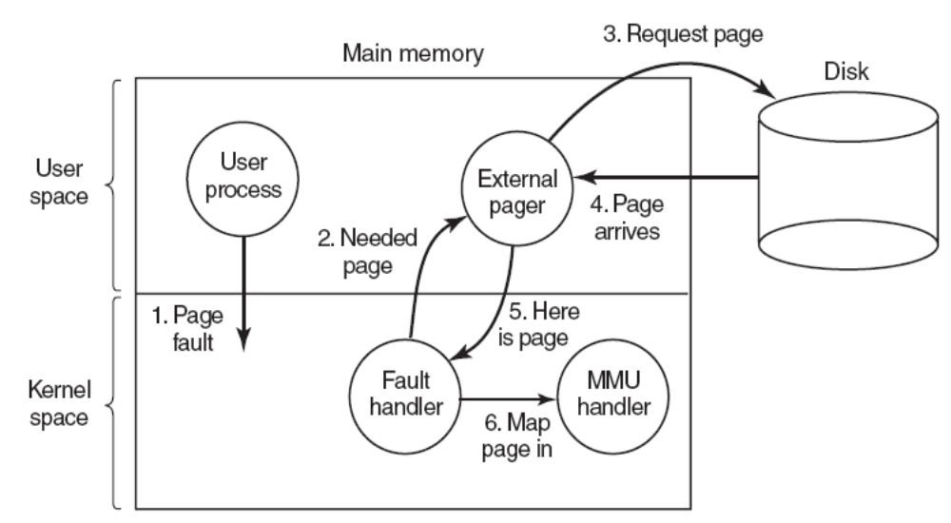
Separation of Policy and Mechanism (2)
How page fault happens-who does what.

Slide 35
Separation of Policy and Mechanism (3)
The implementation is:
Good: modular code => greater flexibility
Bad: Cross the user/kernel interface several times in the course of a page fault

