Slide 1
CSC 322 Operating Systems Concepts
Lecture - 16:
by
Ahmed Mumtaz Mustehsan
Special Thanks To:
Tanenbaum, Modern Operating Systems 3 e, (c) 2008 Prentice-Hall, Inc. (Chapter-3)
Notes:
1

Slide 2
Chapter 3
Memory Management
Virtual Memory
Design Issues for Paging System

Slide 3
Design Issues for Paging System
Need to take into account a number of design issues in order to get a working algorithm

Slide 4
Global is better for the memory
Working sets grow and shrink over time
Processes have different sizes
Assign equal number of pages to each process or proportional to its size ?
Start with allocation based on size and use page fault frequency (PFF) to modify allocation size for each process

Slide 5
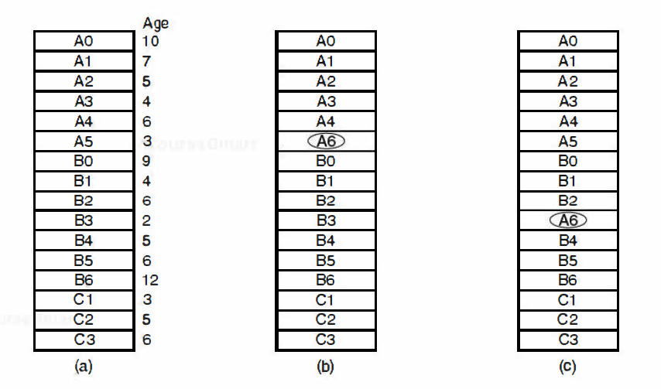
Local versus Global choice of page
Local-take into account just the process which faulted.
Local replacement : from only its own set of allocated frames.
Global-take into account all of the processes. Global replacement : process selects a replacement frame from the set of all frames; one process can take a frame from another
Original configuration.
Local page replacement.
Global page replacement.

Slide 6
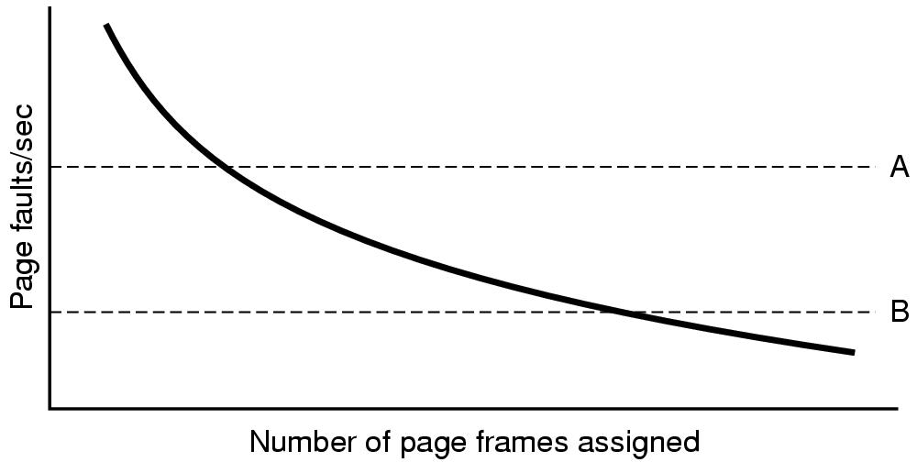
PFF used to determine page allocation
Maintain upper (A) and lower (B) bounds for PFF
Try to keep process in between bounds

Slide 7
Local Versus Global
PFF is global component; determines page allocation
Replacement algorithm Is local component; determines which page to kick out
Can use combination of algorithms

Slide 8
Thrashing
If a process does not have “enough” pages, the page-fault rate is very high. This leads to:
  low CPU utilization
  operating system thinks that it needs to increase the degree of multiprogramming
  another process added to the system
Thrashing ≡ a process is busy swapping pages in and out

Slide 9
Solution of Thrashing; Load Control
Why?
Can still thrash because of too much demand for memory. (local or i.e. accumulative demand of Pages)
Solution-swap process(es) out .i.e. When desperate, get rid of a process

Slide 10
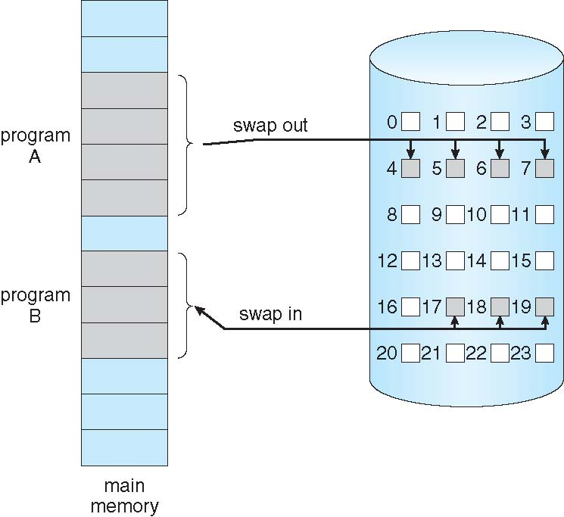
Transfer of a Paged Memory to Contiguous Disk Space

Slide 11
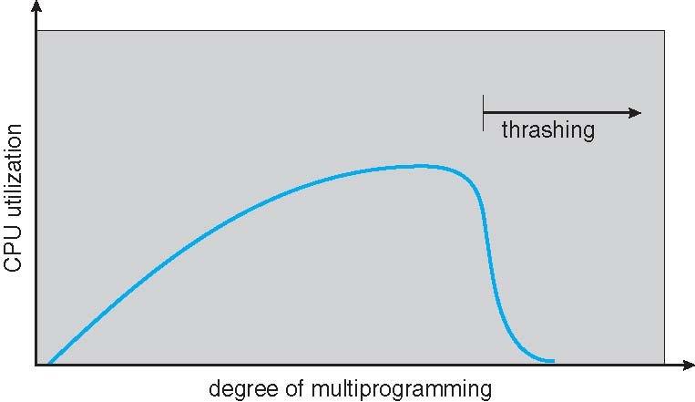
Thrashing (Cont.)
When the number of processes in main memory is too low, the CPU may be idle for substantial periods of time.

Slide 12
Other Issues – Page Size
Page size selection must take into consideration:
  Fragmentation; wastage of ½ Page per process
  Page Table size; Reciprocal to page size
  I/O overhead; Page swap in and swap out
  Locality;

Slide 13

Page size
Overhead= s*e/p + p/2 [size of page entries + frag]
  p is page size,
  s is process size,
  e is size of the page entry (in page table)
Differentiate,
      -se/p ² + 1/2 = 0
      set to zero =>
  s= 1 MB, e=8 bytes 4 KB is optimal
  1 KB is typical
  4-8 KB common
  OK, this is a rough approach

Slide 14
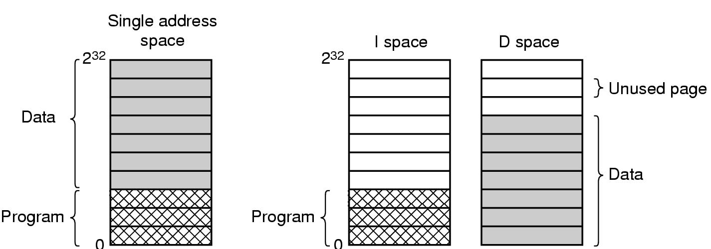
Separate Instruction and Data Address Spaces
Process address space too small => difficult to fit program in space
Split space into instructions (I) and data (D)

Slide 15
Separate Instruction and Data Address Spaces
Pioneer on the (16-bit) PDP- 11, address spaces for instructions (text) and data typically 2¹⁶ - 1 or 2³² - 1.
The linker must know that a separate I & D spaces are used.
Data address space runs from 0 instead after program.
Both address spaces can be paged, independently.
Each has its own page table, own mapping of virtual pages to physical page frames.
When the hardware to fetch an instruction, it uses I-space and D-space page table respectively.
Other than this distinction, no other difference.

Slide 16
Shared Pages
Different users can run same program (with different data) at the same time. Better to share pages then to have 2 copies!
Not all pages can be shared (data can’t be shared, text can be shared)
If D & I spaces have a separate process table point to I and D pages then text (I-space can easily be shared)

Slide 17
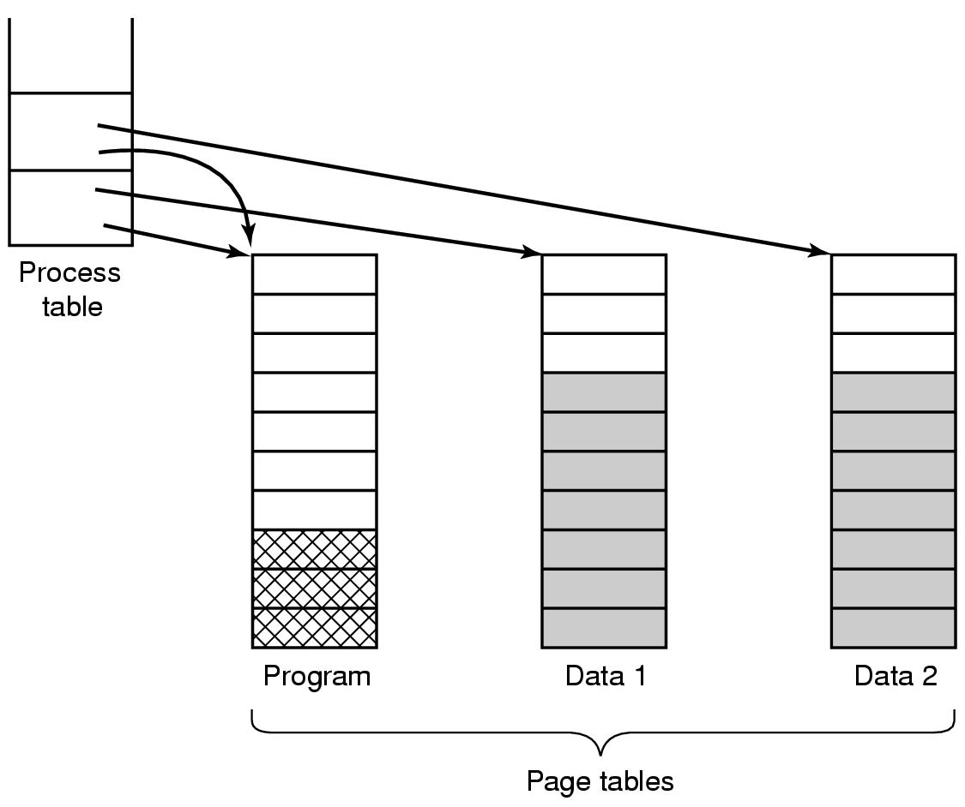
Shared Pages
processes A and B are sharing the editor and its pages.
If the scheduler removes A from memory, evicting all its pages will cause B to generate a large number of page faults to bring back in the pages.

Slide 18
More page sharing
When pages are shared, Process can’t drop pages when it exits w/o being certain that they not still in use
Use special data structure to track shared pages
Data sharing is painful (e.g. Unix fork, parent and child share text and data) because of page writes. So shared pages are READONLY.
But if the process wants to write on shared pages?
  (Copy on write) solution is to map data to read only pages. If write occurs, each process gets its own page.

Slide 19
Copy-on-Write
Copy-on-Write (COW) allows both parent and child processes to initially share the same pages in memory
If either process modifies a shared page, only then is the page copied
COW allows more efficient process creation as only modified pages are copied
Free pages are allocated from a pool of zeroed-out pages

Slide 20
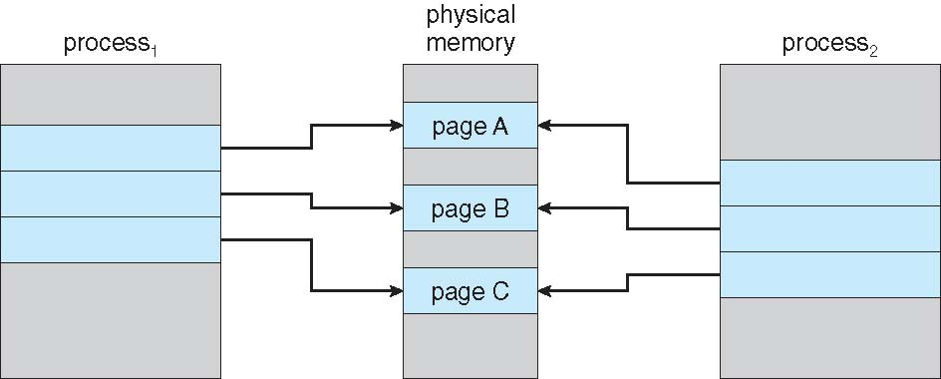
Before Process 1 Modifies Page C
VM benefit during Process Creation; Copy-on-Write

Slide 21
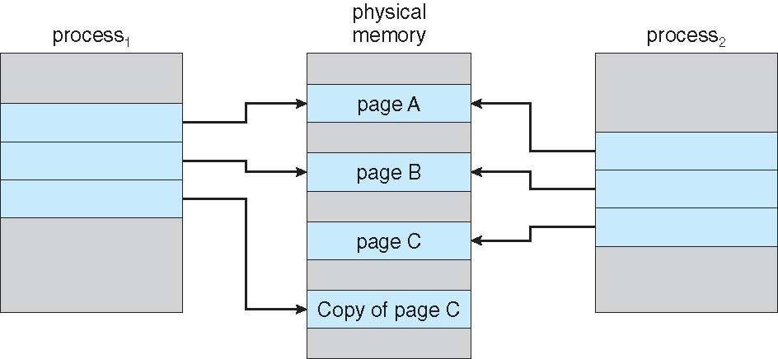
After Process 1 Modifies Page C
VM benefit during Process Creation; Copy-on-Write

Slide 22
Shared Libraries
Large libraries (e.g. graphics) used by many process. Too expensive to bind to each process which wants to use them. Use shared libraries instead.
Unix linking: ld*.o –lc –lm . Files (and no others) not present in .o are located in m or c libraries and included in binaries.
Write object program to disk.

Slide 23
Shared Libraries
Linker uses a stub routine to call which binds to called function AT RUN TIME.
  Shared library is only loaded once (first time that a function of it refers to that).
  It is paged in
Need to use position independent code to avoid going to the wrong address (next slide).
  Idea: Compiler does not produce absolute addresses when using shared libraries; only relative addresses.

Slide 24
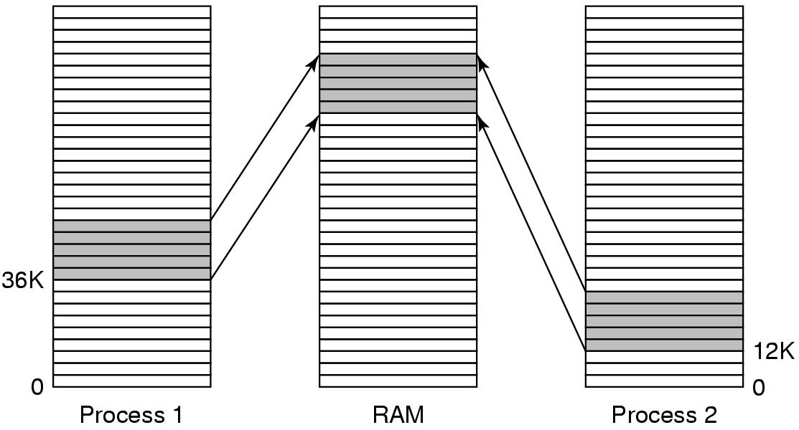
Shared Libraries
.

Slide 25
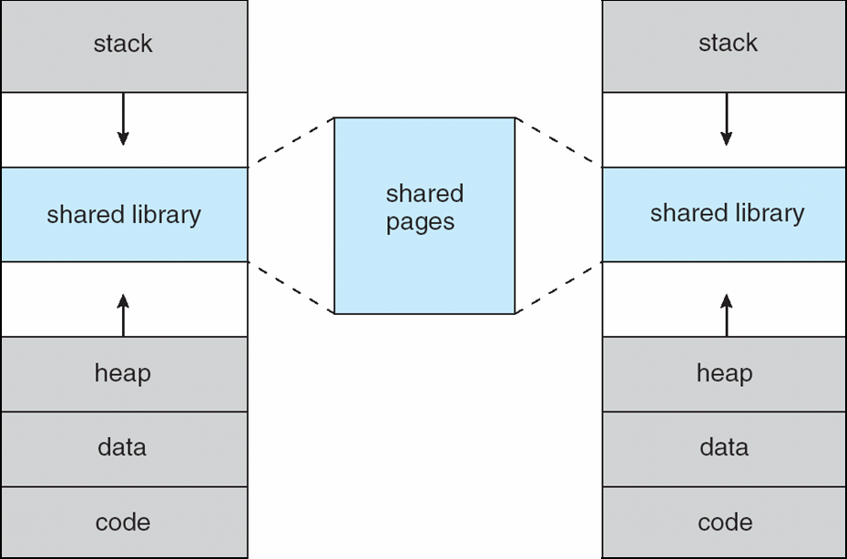
Shared Library Using Virtual Memory

Slide 26
Memory Mapped Files
Shared libraries are a special case of a more general facility called memory-mapped files.
Process issues system call to map a file onto a part of its virtual address space.
Can be used to communicate via shared memory. Processes share same file. Use it to read and write.

Slide 27
Memory Mapped Files
Memory-mapped file I/O allows file I/O to be treated as routine memory access by mapping a disk block to a page in memory.
A file is initially read using demand paging. A page-sized portion of the file is read from the file system into a physical page. Subsequent reads/writes to/from the file are treated as ordinary memory accesses.
Simplifies file access by treating file I/O through memory rather than read() write() system calls.
Also allows several processes to map the same file allowing the pages in memory to be shared.

Slide 28
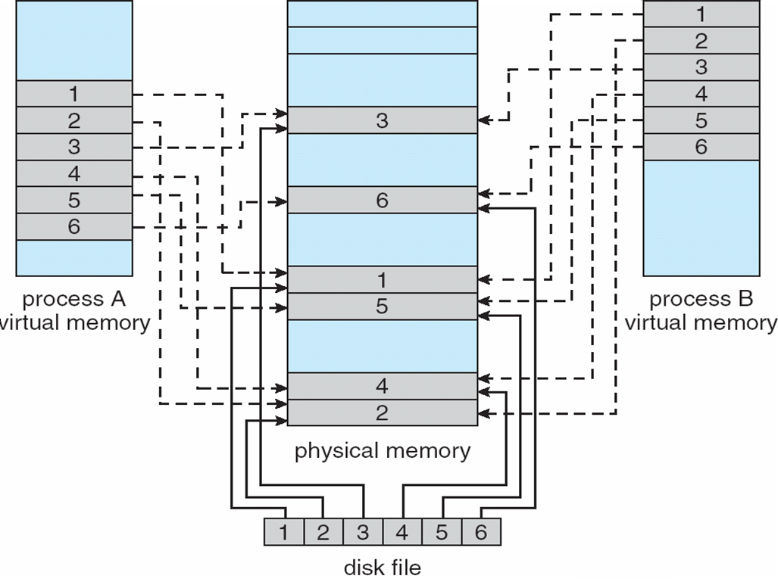
Memory Mapped Files

Slide 29
Performance Issues
Cleaning Policy; (If there is no free frame?)
Page Replacement
Allocation of Frames
Priority Allocation
How to increase TLB Reach ?

