Slide 1
CSC 322 Operating Systems Concepts
Lecture - 15:
by
Ahmed Mumtaz Mustehsan
Special Thanks To:
Tanenbaum, Modern Operating Systems 3 e, (c) 2008 Prentice-Hall, Inc. (Chapter-3)
Notes:
1

Slide 2
Chapter 3
Memory Management
Page Replacement Algorithms
Design Issues

Slide 3
LRU-software called Not Frequently Used (NFU)
Hardware implementation realizable if affordable.
(Not Frequently Used NFU); Software solution.
Implementation: Make use of software counters
  Initially zero, on each clock interrupt OS scans all pages in memory and add R bit (0 or 1) to counter
  Page fault; Lowest counter page is evicted.
  Problem; Never forgets anything, e.g. counting of compiler’s pass one is also valid for pass two
  Solution: (called Aging)
  The counters are SHR 1 bit, before R bit is added.
  R bit is added leftmost instead rightmost bit.

Slide 4
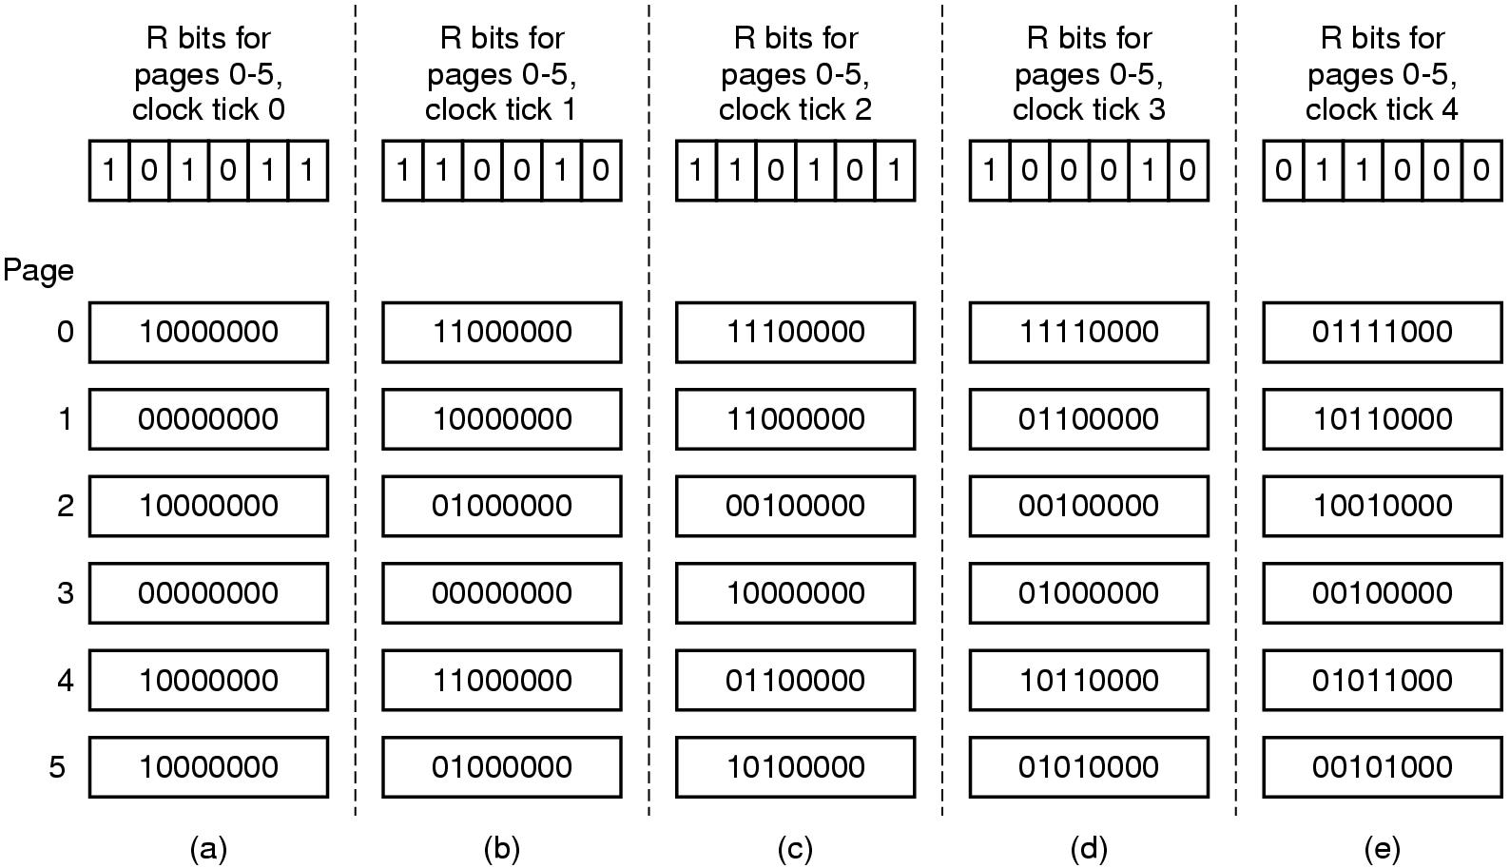
LRU in Software called NFU

Slide 5
LRU-software - NFU
  “aging” algorithm
  Keep a string of values of the R bits for each clock tick (up to some limit)
  After tick, shift bits right and add new R values on the left
  On page fault, evict page with lowest counter
  Size of the counter determines the history
  NFU Differs from LRU in two ways:
    No information of the events between time interval.
    No information beyond 8 clock ticks.

Slide 6
Demand Paging
Bring a page into memory only when it is needed
  Less I/O needed
  Less memory needed
  Faster response
  More users
Page is needed ⇒ reference to it
  invalid reference ⇒ abort
  not-in-memory ⇒ bring to memory
Lazy swapper – never swaps a page into memory unless page will be needed
  Swapper that deals with pages is a pager

Slide 7
Working Set Model
Demand paging-bring a process into memory by trying to execute first instruction and getting page fault. Continue until all pages that process needs to run are in memory (the working set)
Try to make sure that working set is in memory before letting process run (pre-paging)
Thrashing-memory is too small to contain working set, so page fault all of the time

Slide 8
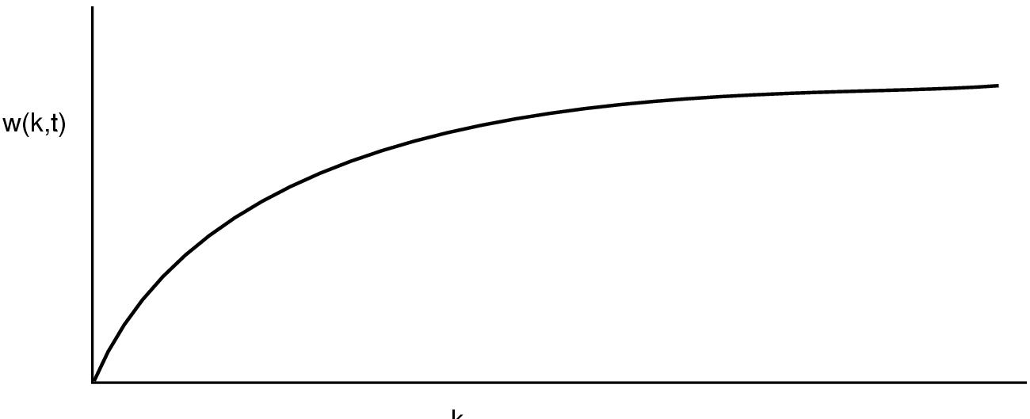
Behavior of working set as a function of k
K
W(k,t) is number of pages at time t used by k most recent memory references

Slide 9
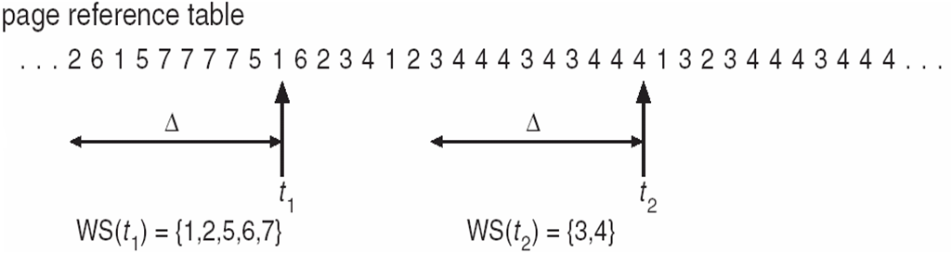
Working set Model
W(k,t) is number of pages at time t used by k most recent memory references

Slide 10
How to implement working set model
When fault occurs can evict page not in working set (if there is such a page)
Need to pick k
Could keep track of pages in memory at every memory reference. Each k references results in a working set.
Shift register implementation. Insert page number at each reference.
Expensive

Slide 11
Use virtual time instead of number of references (k)
Keep track of k last pages referenced during a period t of execution (CPU) time
Virtual time for a process is the amount of CPU time used since it started
      Measure of how much work a process has done

Slide 12
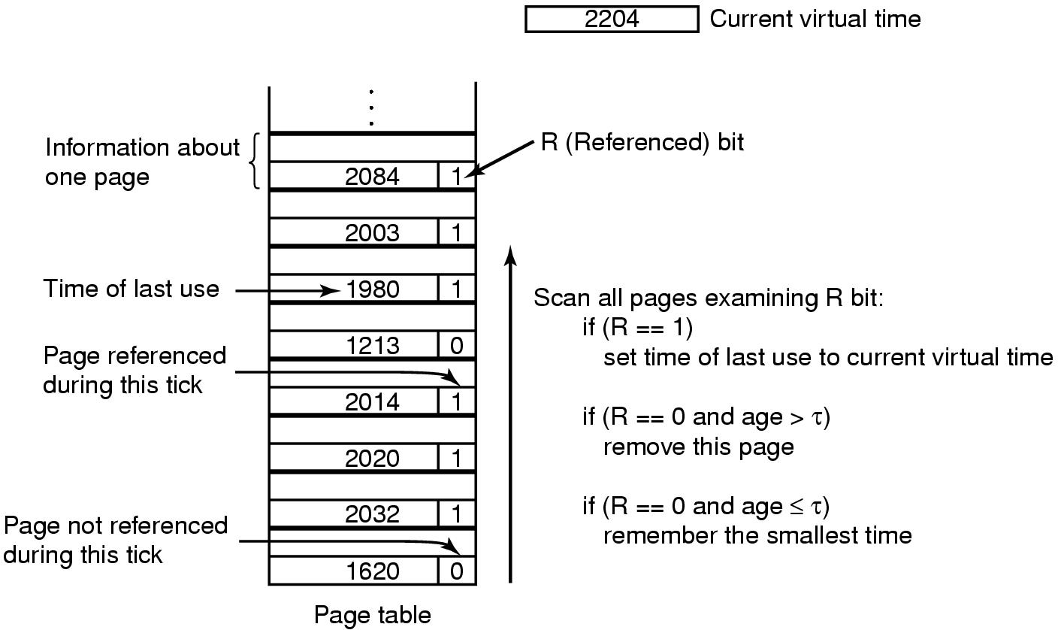
Working Set Page Replacement
(Check each clock tick)
Check each clock tick
Get rid of page with smallest time if all of the pages have R==0

Slide 13
Weakness with WS algorithm
Need to scan entire page table at each page fault to find a victim
Use clock idea with working set algorithm

Slide 14
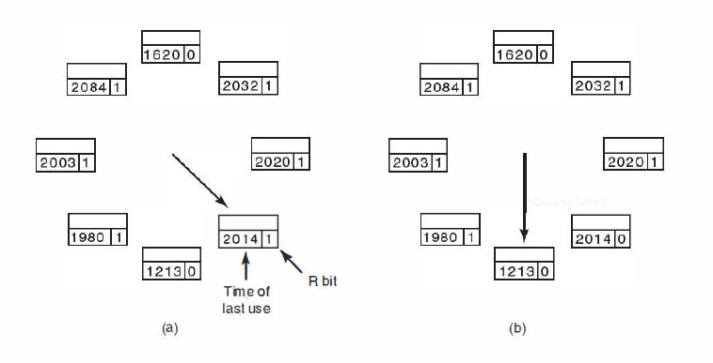
The WS-Clock Page Replacement Algorithm
2204
Current virtual Time
Operation of the WS-Clock algorithm. (a) and (b) give an example of what happens when R = 1.

Slide 15
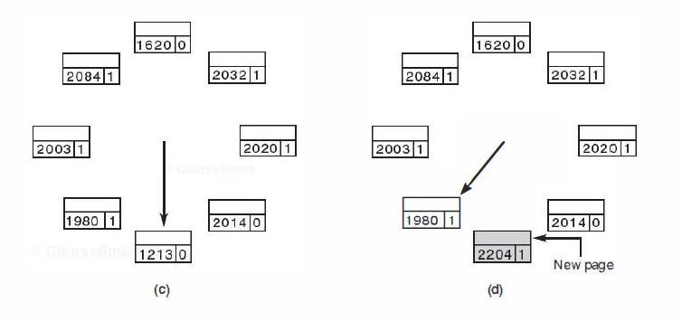
The WSClock Page Replacement Algorithm (3)
2204
Current virtual Time
Operation of the WS-Clock algorithm.
(c) and (d) give an example of R = 0.

Slide 16
The WS-Clock Page Replacement Algorithm
If the hand comes all the way around to its
starting point there are two cases to consider:
At least one write has been scheduled.
    Hand keeps moving looking for clean page. Finds it because a write eventually completes- evicts first clean page hand comes to.
No writes have been scheduled.

Slide 17
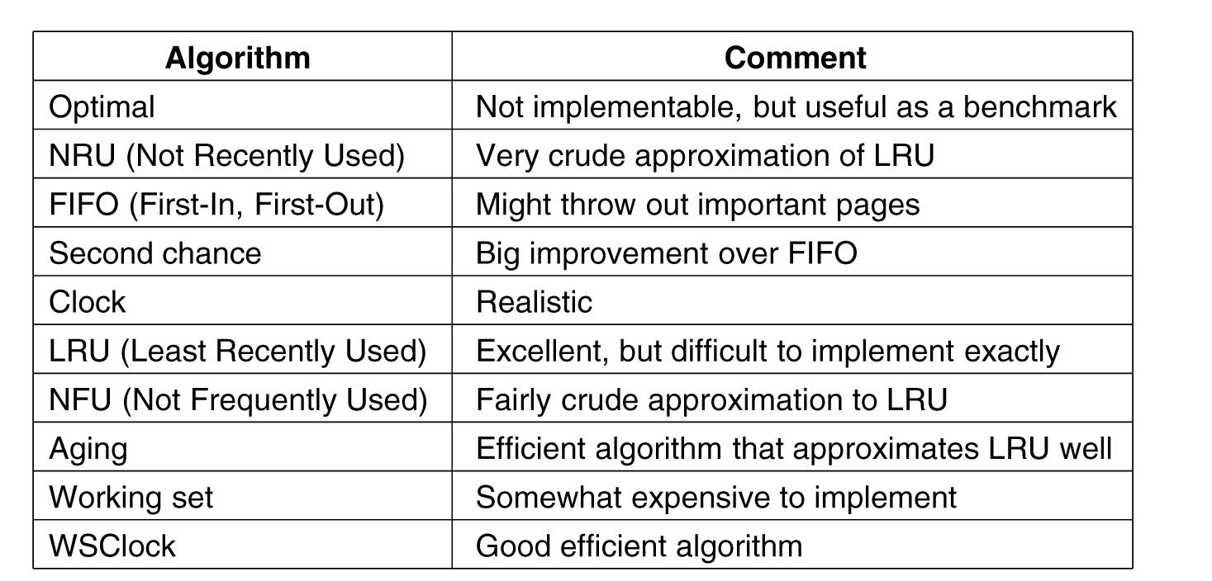
Summary of Page Replacement Algorithms
.

