Slide 1
CSC 322 Operating Systems Concepts
Lecture - 14:
by
Ahmed Mumtaz Mustehsan
Special Thanks To:
Tanenbaum, Modern Operating Systems 3 e, (c) 2008 Prentice-Hall, Inc. (Chapter-3)
Notes:
1

Slide 2
Chapter 3
Memory Management
Virtual Memory (Inverted Page Table)
Page Replacement Algorithms

Slide 3
Multi-level page table gets too big
Multi-level page table works for 32 bit memory
Doesn’t work for 64 bit memory
2⁶⁴ bytes and 4 KB pages => 2⁵² entries in page table
If each entry is 8 bytes => 30 million GB or 30PB for page table
Need a new solution

Slide 4
Inverted Page Table
Keep one entry per (real) page frame in the “inverted” table
Entries keep track of (process, virtual page) associated with page frame
Need to find frame associated with (n, p) for each memory reference process n, virtual page number p

Slide 5
Need to search inverted table efficiently
Search page frames on every memory reference
How to do this efficiently?
    Keep heavily used frames in TLB (Translation is very fact)
    If miss, then can use and associative search to find virtual page to frame mapping
    Use a hash table hashed on virtual address. Use linked list. (If hash table entries equal page frame number, average chain will just have just one entry)
  Inverted Page Table is common on 64 bit machines

Slide 6
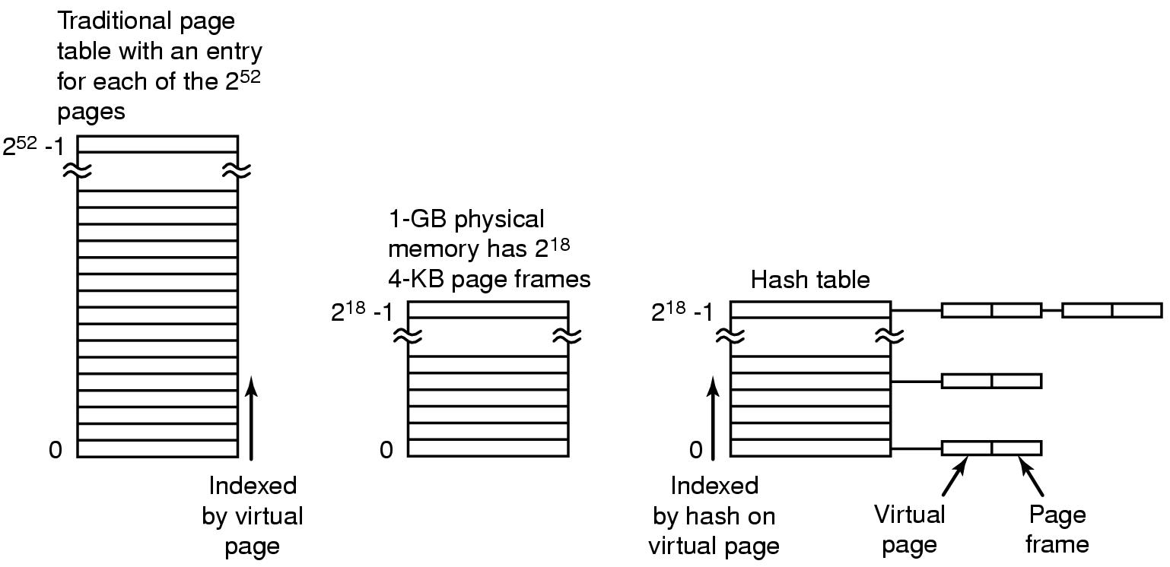
Inverted Page Tables-the Picture

Slide 7
Page Replacement Algorithms
When Page fault occurs!
If new page is brought in, need to chose a page to evict
Don’t want to evict heavily used pages
If page has been written to, need to copy it to disk.
Otherwise, a good copy is on the disk=>can write over it

Slide 8
Page Replacement Algorithms
Similar problem in other parts of Computer Science!
One or more cache (32 or 64 memory Blocks) of recently used memory blocks
Web server: Keeps heavily used web pages in the memory; when cache is full; evicts a page
Which page to evict?
  The probability of evicted page to be referenced in near future should be minimum.
Page replacement form same process or some other process?

Slide 9
Page Replacement Algorithms
Optimal page replacement algorithm
Not recently used page replacement
First-in, first-out page replacement
Second chance page replacement
Clock page replacement
Least recently used page replacement
Working set page replacement
WS-Clock page replacement

Slide 10
Optimal Page Replacement
Pick the one which will not used before the longest time ( 8 million vs 6 million instructions ? )
Not possible unless know when pages will be referenced (run program on simulator, valid for one program and same data?)
Used as ideal reference algorithm, but unrealizable!

Slide 11
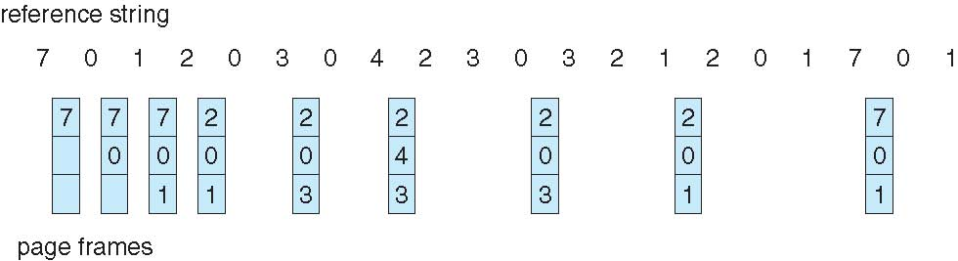
Optimal Page Replacement

Slide 12
Not Recently used (NRU)
Use R and M status bits must be updated on every memory reference.
To be implemented in hardware
If not in h/w simulate in OS with page fault?
OS Periodically clear R bit to distinguish between page in use or not in use.
      Class 0: not referenced, not modified
      Class 1: not referenced, modified
      Class 2: referenced, not modified
      Class 3: referenced, modified
Pick lowest numbered non empty class page to evict

Slide 13
First In First Out (FIFO)
OS maintains a list of all the pages in the memory.
Keep list ordered by time (latest to arrive at the end of the list)
On page fault, evict the oldest, i.e. head of the line
Easy to implement
Oldest might be most heavily used! No knowledge of use is included in FIFO

Slide 14
First In First Out (FIFO)
Reference string: 1, 2, 3, 4, 1, 2, 5, 1, 2, 3, 4, 5
3 frames (3 pages can be in memory per process)
4 frames
Anomaly: more frames ⇒ more page faults
1
1
4
5
2
2
1
3
9 page faults
3
3
2
4
1
1
5
4
2
2
1
10 page faults
5
3
3
2
4
4
3

Slide 15
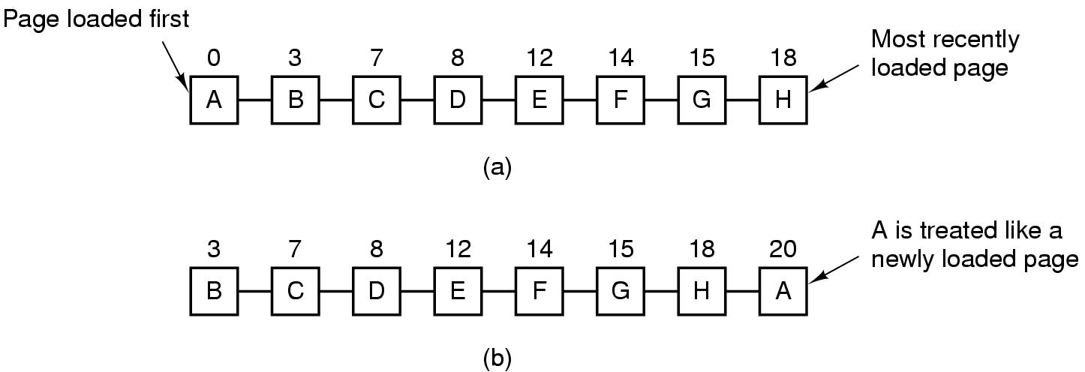
Second Chance Algorithm
Pages sorted in FIFO order by arrival time.
Examine R bit of oldest page. If zero, evict. If one, put page at end of list and R is set to zero, update load time.
If change value of R bit frequently, might still evict a heavily used page

Slide 16
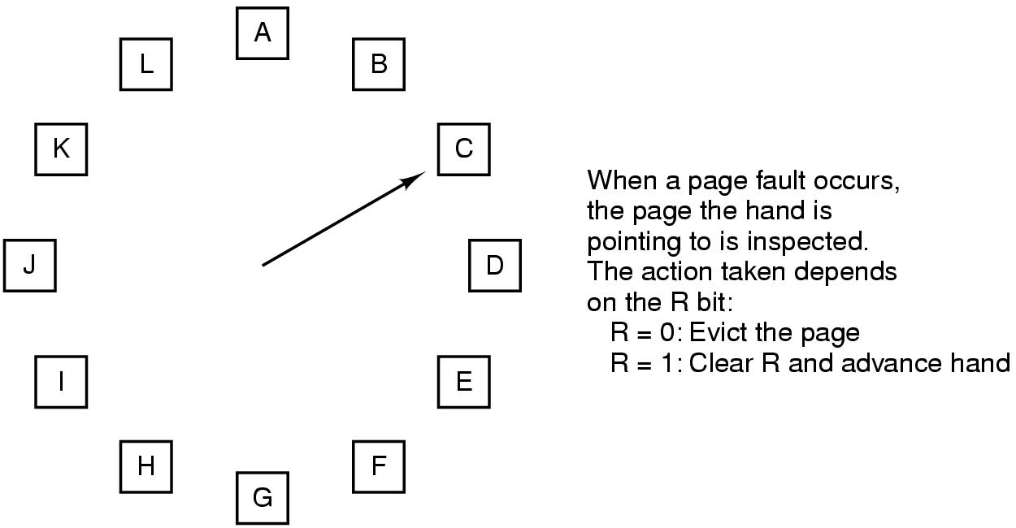
The Clock Page Replacement Algorithm

Slide 17
Clock
Doesn’t use age as a reason to evict page
Faster-doesn’t manipulate a list
Doesn’t distinguish between how long pages have not been referenced

Slide 18
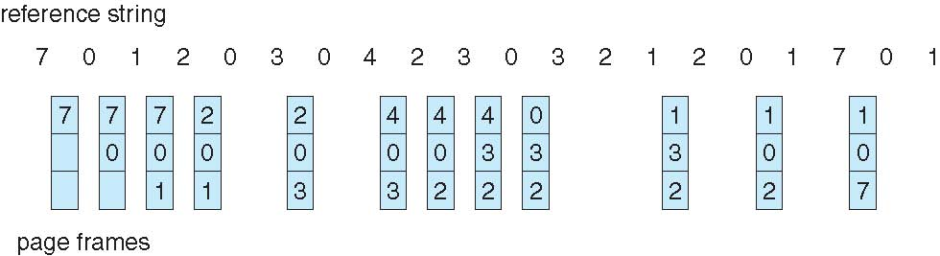
Least Recently Used (LRU)

Slide 19
Least Recently Used (LRU)
Page that have been used recently will be referred again. Converse is also true.
Page Fault; remove the page unused for longest time. Strategy called LRU.
First Implementation; Maintain a linked list, whenever a page is referenced remove the page and insert it at the front, LRU page will be at the rear.
Problem; very expensive to implement in h/w as well as in s/w.
Could associate counters with each page and examine them but this is expensive

Slide 20
Least Recently Used (LRU)
Second Implementation; Special 64bit h/w counter with each page, and Page table entry for counter.
Function; On each memory reference the counter is incremented by one, current value is stored in the PT.
Page Fault; Examine all counters in Page table and find the one with lowest number, evict that page.
Problem; associate counters with each page and examine them is expensive

Slide 21
LRU-the hardware array
Second Implementation; Keep n x n array for n pages (hardware).
Function; Upon reference page k, put 1’s in row k and 0’s in column k.
    Page Fault; Row with smallest binary value corresponds to LRU page. Evict that page.
    Problem; Easy hardware implementation and not relatively expensive

Slide 22
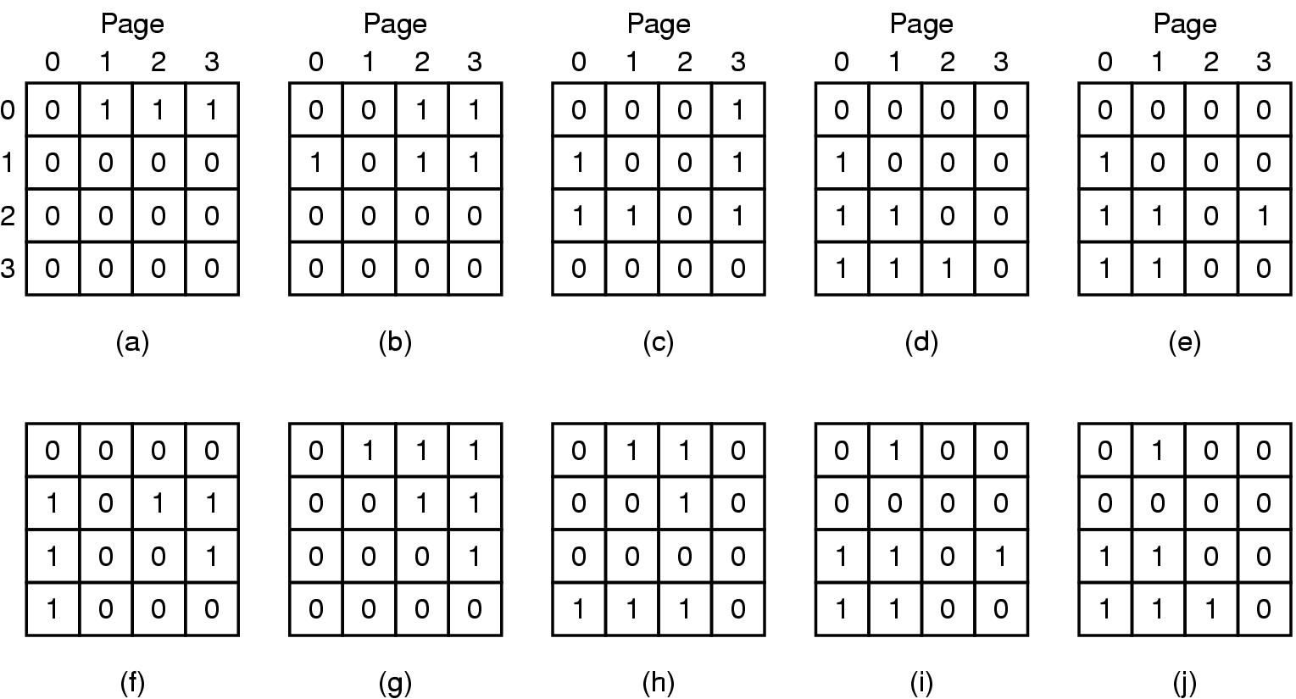
LRU-hardware
LRU using a matrix when pages are referenced in the order 0, 1, 2, 3, 2, 1, 0, 3, 2, 3.

Slide 23
LRU-software called Not Frequently Used (NFU)
Hardware implementation realizable if affordable.
(Not Frequently Used NFU); Software solution.
Implementation: Make use of software counters
  Initially zero, on each clock interrupt OS scans all pages in memory and add R bit (0 or 1) to counter
  Page fault; Lowest counter page is evicted.
  Problem; Never forgets anything, e.g. counting of compiler’s pass one is also valid for pass two
  Solution: (called Aging)
  The counters are SHR 1 bit, before R bit is added.
  R bit is added leftmost instead rightmost bit.

