Slide 1
CSC 322 Operating Systems Concepts
Lecture - 13:
by
Ahmed Mumtaz Mustehsan
Special Thanks To:
Tanenbaum, Modern Operating Systems 3 e, (c) 2008 Prentice-Hall, Inc. (Chapter-3)
Notes:
1

Slide 2
Chapter 3
Memory Management
Virtual Memory

Slide 3
Virtual Memory - The history
Programs require more memory than the growth in the size of memory.
Example: VAX -4MB, for dozens of users , Microsoft suggest 512MB single user, Vista requires 1GB
Swapping is too slow (100 Mbytes/sec disk transfer rate=>10 sec to swap out a 1 Gbyte program)
What if we want to:
Run the program which requires more memory than physical memory
Keep multiple parts of multiple programs in the memory such that the accumulative size is much higher than physical memory

Slide 4
Virtual Memory - The history
How to do that?
Overlays-programmer breaks program into pieces which are swapped in by overlay manager
  Ancient idea-not really accepted with open heart
  Too hard to do-programmer has to break up program
    Complex
    Time consuming
    Boring
    Error prone
  Soon realized that the job has to be done by computer the method adopted is called Virtual Memory

Slide 5
Virtual Memory
Program’s address space is broken up into fixed size chunks called pages
Pages are mapped to physical memory.
Only few pages of the program are kept in memory, the rest are kept on disk.
If instruction refers to a page in memory, fine.
Otherwise OS gets the page, reads it in, and restarts the instruction.
Many programs are in memory therefore while page is being read in, another process gets the CPU.

Slide 6
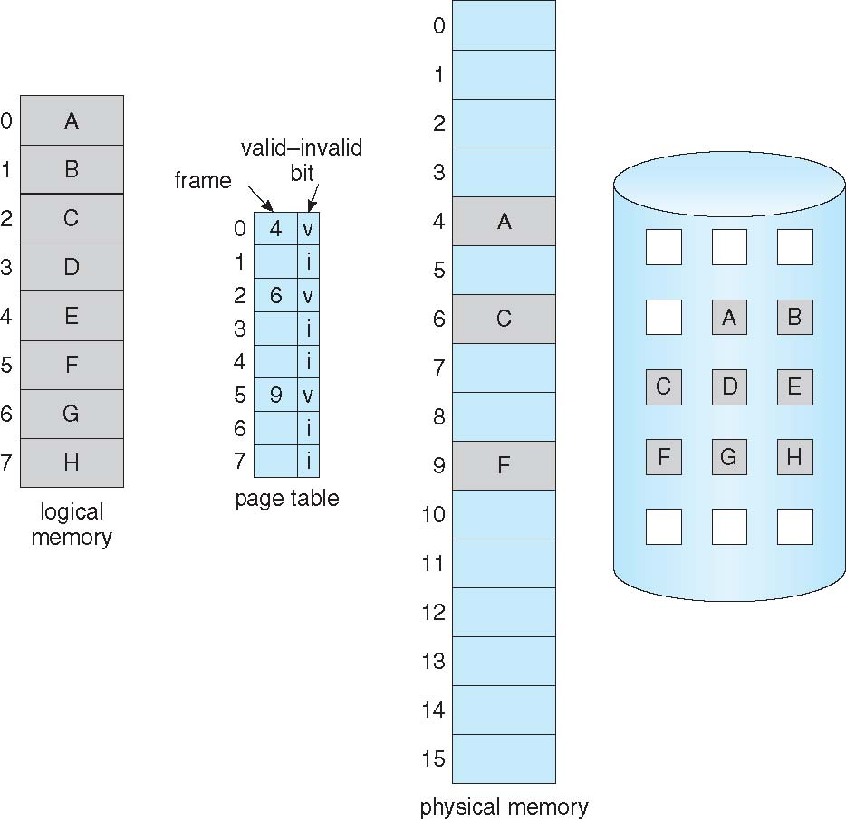
Virtual Memory

Slide 7
Memory Management Unit
Program generated addresses are called virtual addresses; virtual address space.
Memory Management Unit: generates physical address from virtual address provided by the program
Physical Addresses can be generated using indexing: Based Register ( SI, DI), Segment Register (CS, DS, SS, ES) and other ways.
With no virtual memory program generated addresses are directly put on memory bus.
With Virtual Memory the program generated addresses (virtual addresses) are put to MMU that translate them to physical addresses for memory bus

Slide 8
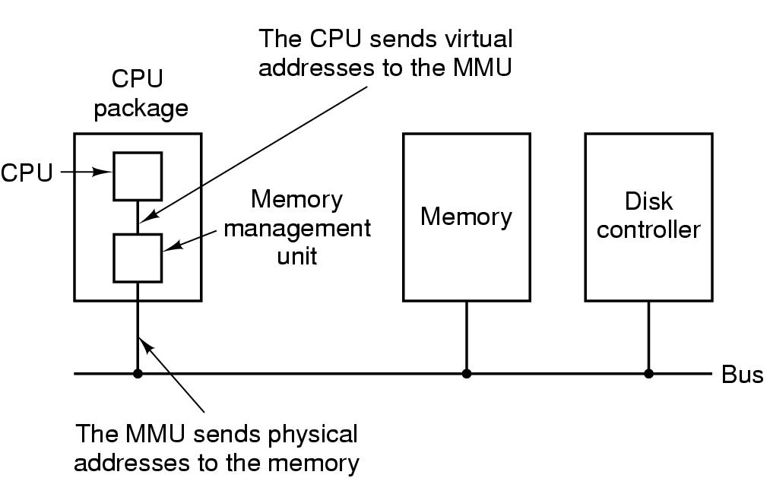
Memory Management Unit
MMU maps virtual addresses to physical addresses and puts them on memory bus

Slide 9
Pages and Page Frames
Virtual addresses divided into fixed-size Pages 512 bytes-64 KB range.
The corresponding units in the physical memory is called Page-frames
  Transfer between RAM and disk are always in whole pages
  Example:
  A virtual address space of 64k is to be executed on 32k physical memory. The page size is 4k; 16 pages are to be mapped on 8 page-frames.
Explanation: Next slide.

Slide 10
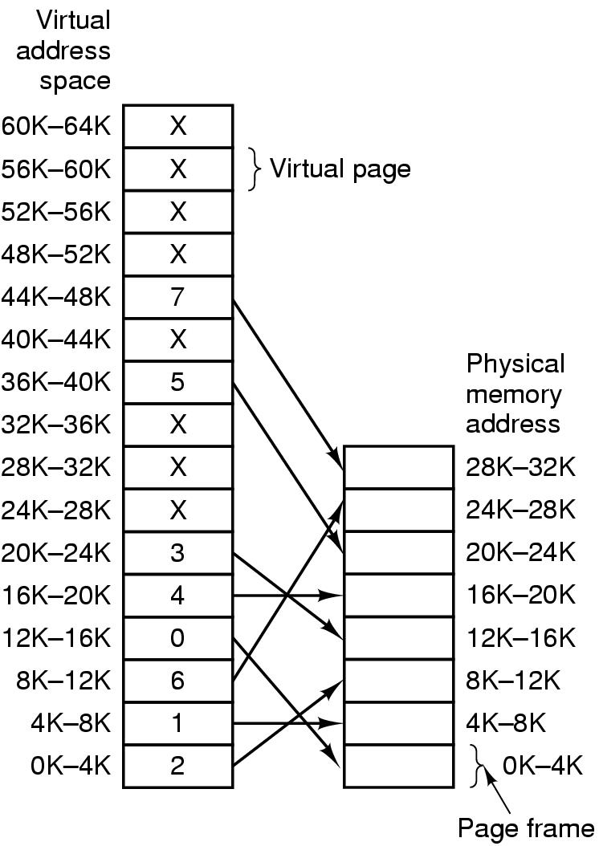
Mapping of pages to page frames
16 bit addresses,
4 KB pages
32 KB physical memory,
16 virtual pages
8 page frames

Slide 11
Page Fault Processing
Present/absent bit tells whether page is in memory
What happens If address is not in memory?
Trap to the OS
    OS picks page to write to disk (page which is little in use)
    Brings page with (needed) address into memory at evicted page
    Mark the absent/preset bit to 1
    Re-starts instruction

Slide 12
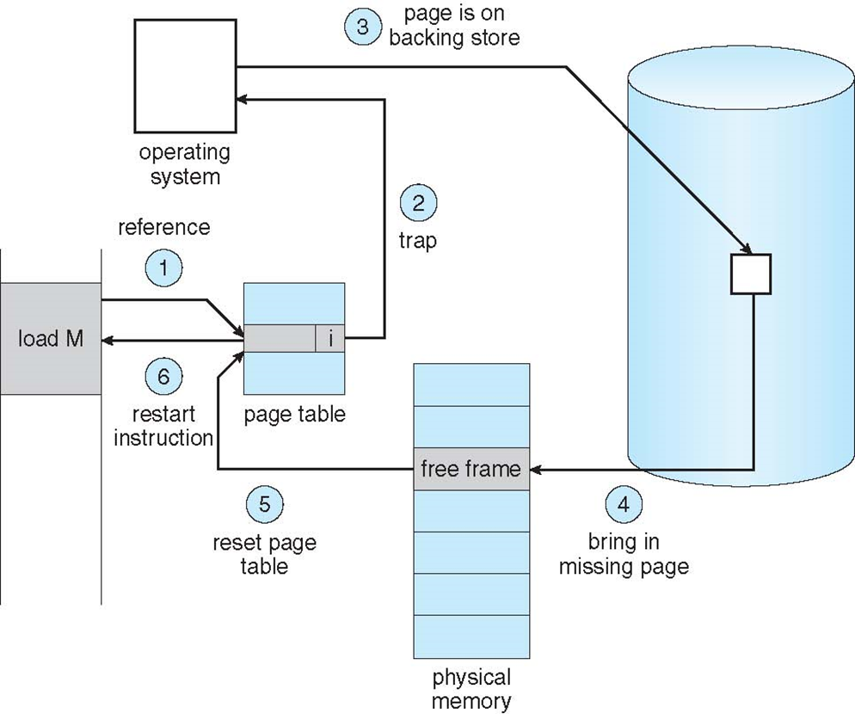
Page Fault Processing

Slide 13
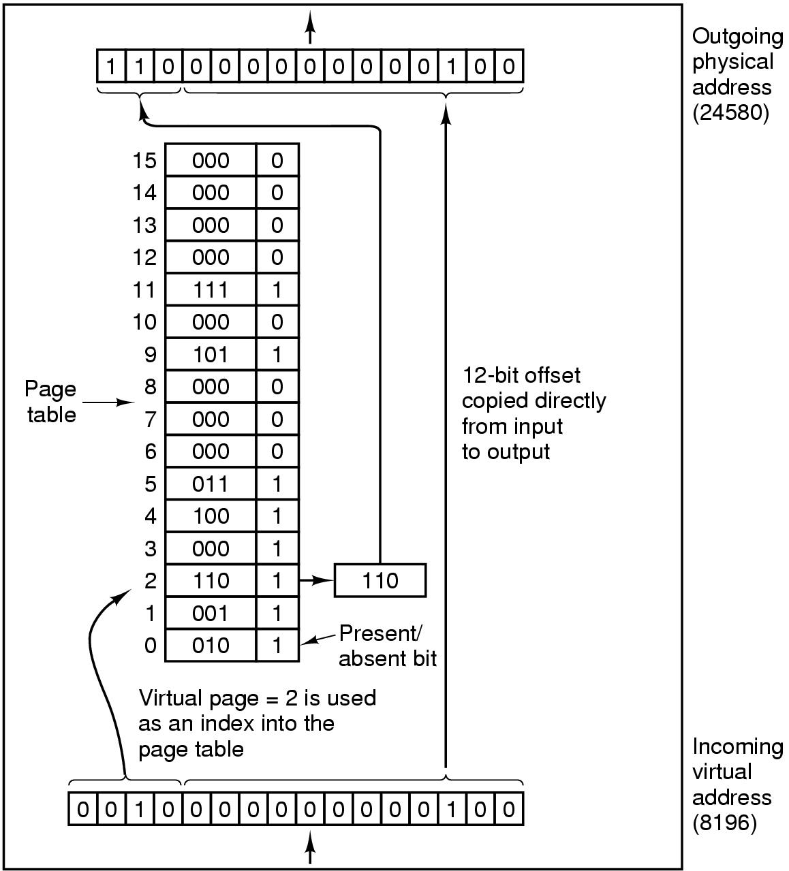
MMU operation

Slide 14


Page Table
Virtual address={virtual page number, offset}
Virtual page number used to index into page table to find page frame number
If present/absent bit is set to 1, attach page frame number to the front of the offset, creating the physical address
which is sent on the memory bus

Slide 15
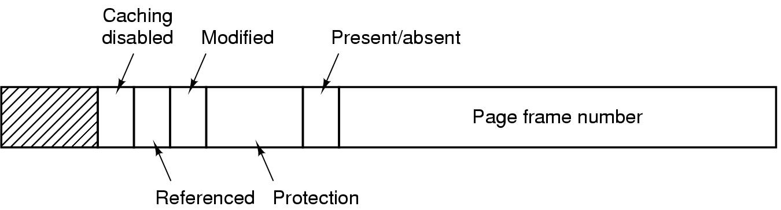
Structure of Page Table Entry
Page frame number; maps virtual to physical address
Present (1) / Absent (0) bit
Protection bits: r, w, r/w
Modified (dirty) bit: 1 means written to => have to write it to disk. 0 means don’t have to write to disk.
.

Slide 16
Structure of Page Table Entry
Referenced bit: 1 means it was either read or written. Used to pick page to evict. Don’t want to get rid of page which is being used.
Caching disabled: disabled if page maps to device registers rather than memory.
(Machines having separate I/O space instead memory mapped I/O space will be taught with I/O Management)
.

Slide 17
Problems for paging
Virtual to physical mapping is done on every memory reference => mapping must be fast
  1, 2 or more page table ref. per instructions.
  If 1 instruction takes 1 ns, page lookup may take 0.2 ns
If the virtual address space is large, the page table will be large. 32 bit addresses now and 64 bits becoming more common
1M pages requires 1M page table entries, each process has its own page table.

Slide 18
solutions
Bring page table for a process into MMU when it is started up and store it in registers
    Load full page table on every context switch
    but very expensive if page table is very large
  Keep page table in main memory
    Use single register to point to the starting address of Page table
    w.o paging 1 instruction needs 1 memory reference with paging even if the page is in the memory it requires 2 memory references (one for PT and one for instruction, performance reduced to half.)

Slide 19
Speed up Address Translation
Most programs access a small number of pages more frequently than highly distributed and scattered pages.
Add Translation Look-aside Buffer (TLB) or associative memory, a hardware in (MMU) store frequently accessed PT entries.
Used to map virtual address to physical address without referring Page table.
TLB contains few frequently referenced entries (8 to 64)

Slide 20
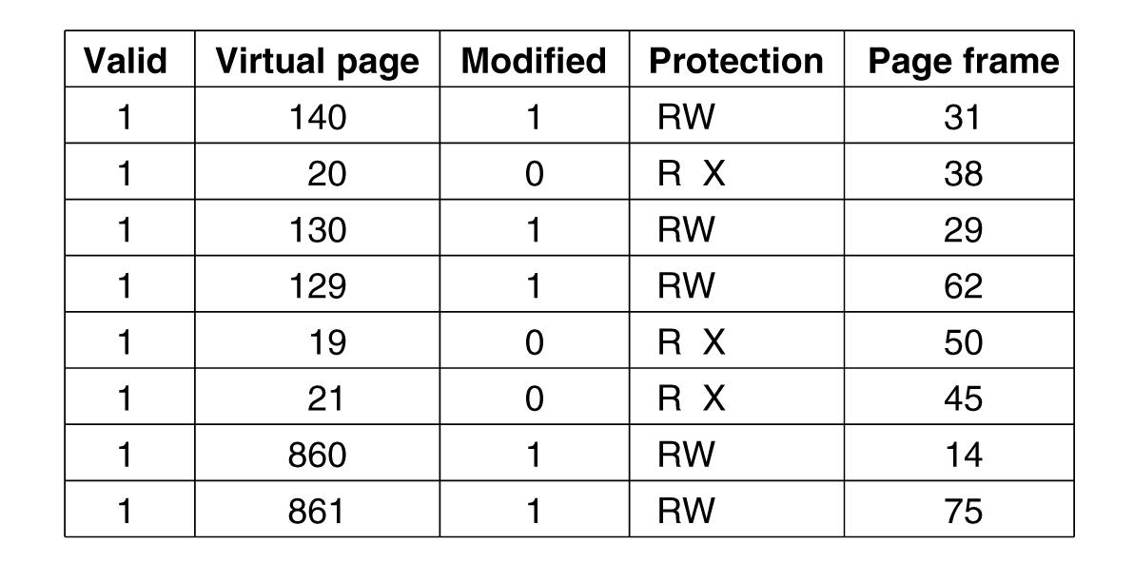
Translation Looka-side Buffers
Valid bit indicates whether page is in use or not Virtual Page number not present in Page table?

Slide 21
Translation Lookaside Buffer(TLB)
If address is in MMU, saves page table reference
Uses parallel search to see if virtual page is in the TLB
If not, does page table look up and evicts TLB entry, replacing it with page just looked up.
If modified bit is 1, bit needs to be saved in page table. Rest of the entries are already there no need to save.
When TLB is loaded from Page Table all entries are taken from memory

Slide 22
Software TLB management
RISC (SPARC, MIPS) machines manage TLB in software
TLB fault processed by OS instead of by MMU. It replaces the entry of TLB with Page Table entry.
TLB miss could be minimized with large TLB size (64 entries) then s/w solution seems to be workable.
TLB miss could be further minimized by maintaining a large (4KB) s/ cache of TLB entries in a fixed location whose page is always present in TLB.
Software can be proactive, figure out which pages to pre-load into TLB (eg. Load server after client request)
A hard miss, page not in TLB, not in PT, requires several ms to load which is million time slower than soft miss.

Slide 23
Multi-level page tables
Want to avoid keeping the entire page table in memory because it is too big
Hierarchy of page tables does this
The hierarchy is a page table of page tables
Example: 32 bit virtual address with multilevel page table.
10- bit PT1, 10-bit PT2, 12-bit Offset; pages are 4-KB and they are 2²⁰ pages.
Suppose a program of 12MB, bottom of 4MB of text,4MB of data and 4MB of stack.

Slide 24
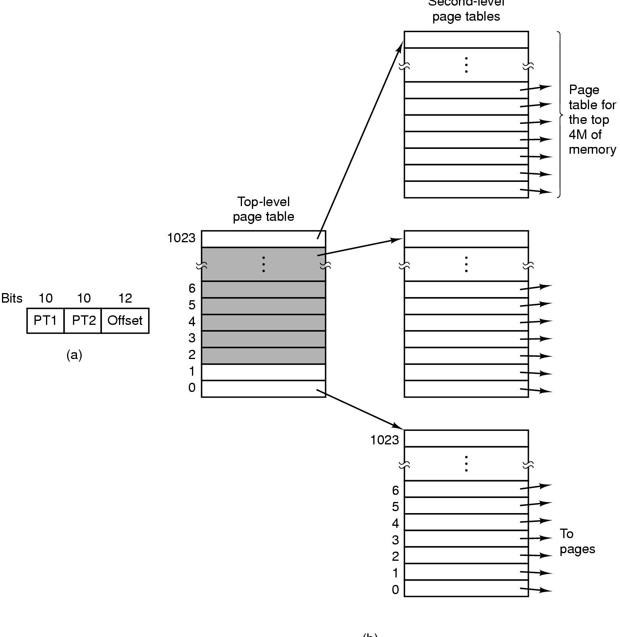
Multilevel Page Tables
(a) A 32-bit address with two page table fields.
(b) Two-level page tables.

Slide 25
Use of multilevel page table
Top level of page table contains
    Entry 0 points to pages for program text
    Entry 1 points to pages for data
    Entry 1023 points to pages for stack
The address space contains over a million of pages but only four page table of 1K entries (4K size each) are needed,
Various sizes of PT1 and PT2 and Offsets are also possible.

