Slide 1
CSC 322 Operating Systems Concepts
Lecture - 12:
by
Ahmed Mumtaz Mustehsan
Special Thanks To:
Tanenbaum, Modern Operating Systems 3 e, (c) 2008 Prentice-Hall, Inc. (Chapter-3)
Notes:
1

Slide 2
Chapter 3
Memory Management

Slide 3
Memory Management Basics
Don’t have infinite RAM
Do have a memory hierarchy
  Cache (Few MB very fast, expensive, volatile )
  Main ( Few GB, medium speed, medium priced, volatile)
  Disk ( Few TB, slow, cheap, nonvolatile )
Memory manager has the job of using this hierarchy to create an abstraction (illusion) of easily accessible memory

Slide 4
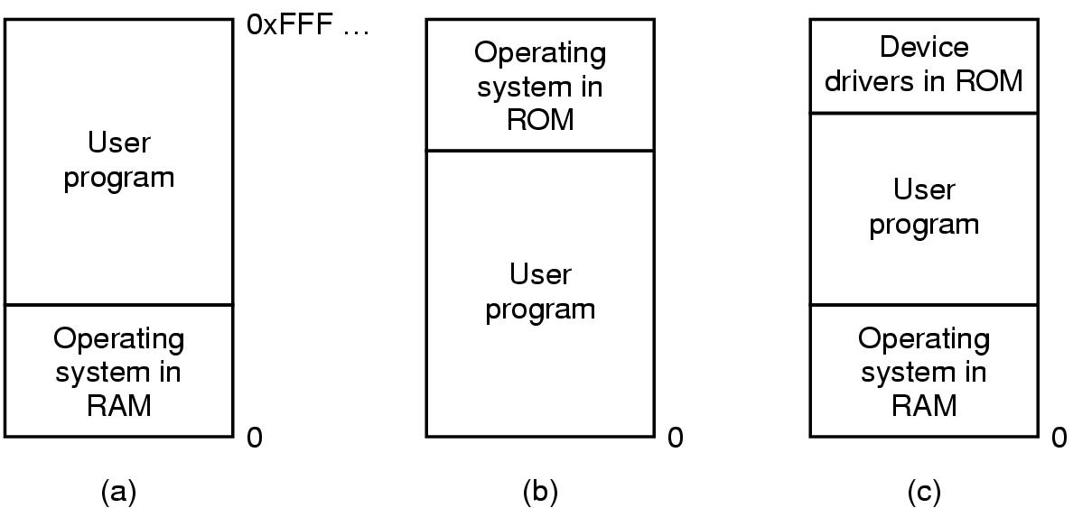
One program at a time in memory
OS loads a program from disk to memory and execute.

Slide 5
One program at a time
The simplest memory abstraction; no abstraction Early mainframe computers (before 1960), early minicomputers (before 1970), and early personal
computers (before 1980) had no memory abstraction
Can only have one program in memory at a time.
Bug in user program can trash the OS (a and c)
Second on some embedded systems (b)
Third on MS-DOS (early PCs) part in ROM called BIOS (Basic Input Output System)

Slide 6
Running Multiple Programs w.o Memory Abstraction
Save the entire contents of memory to a disk file, then bring in and run the next program
Could swap new program into memory from disk and send old one out to disk
Only one program at a time in the memory
Not concurrent so no conflicts

Slide 7
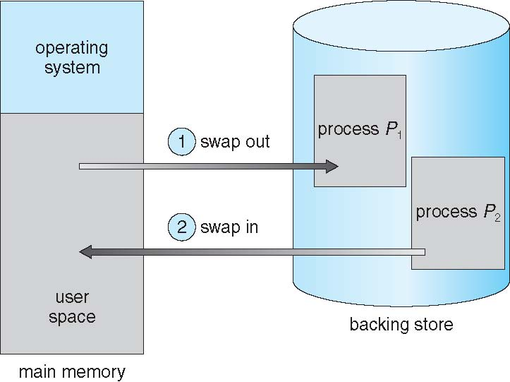
Schematic View of Swapping

Slide 8
IBM static relocation idea
Special hardware, it is possible to run multiple programs concurrently, even without swapping
IBM 360 -divide memory into 2 KB blocks, and associate a 4 bit protection key with chunk. Keep keys in registers.
A machine with a 1-MB memory needed 512 of 4-bit registers for a total of 256 bytes of key storage
Put key into PSW for program
Hardware prevents program from accessing block with another protection key

Slide 9
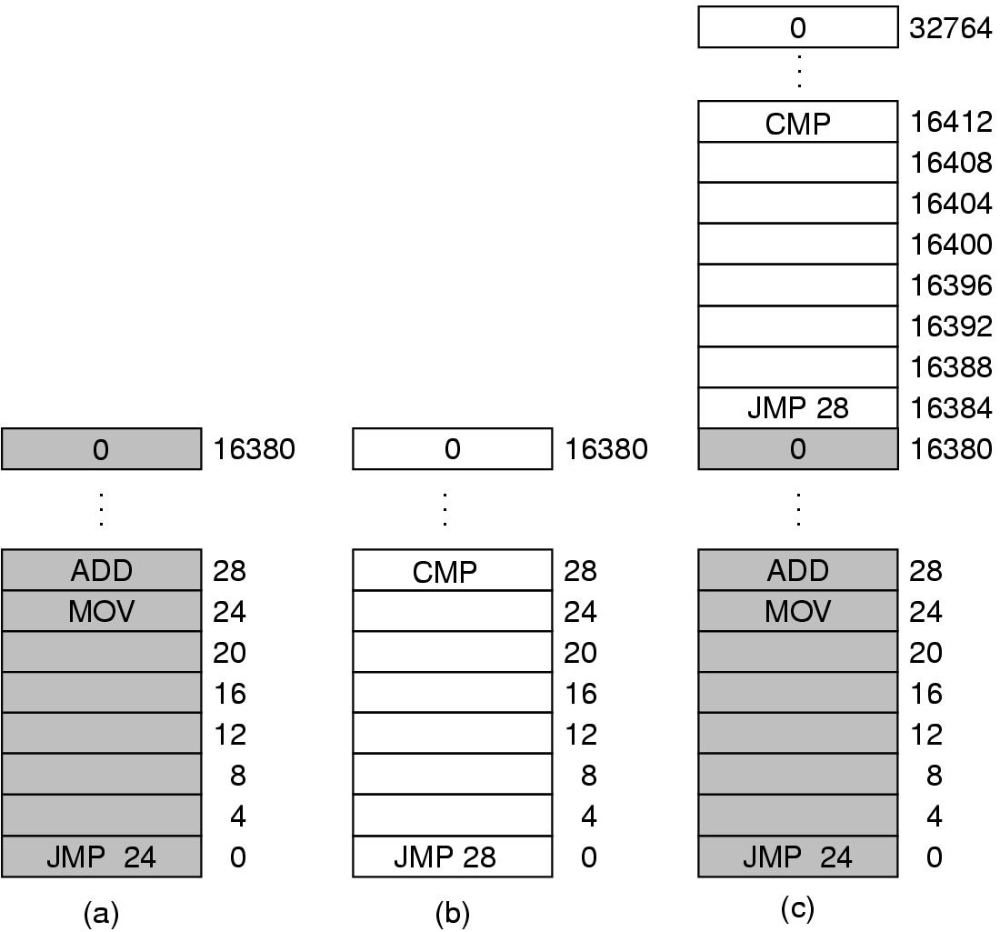
Problem with relocation
Fig 3-2: Illustration of the relocation problem.
(a) A 16-KB program.
(b)Another 16-KB program. (c) The two programs loaded consecutively into memory starting at address 0
In (c) JMP 28 in program (b) trashes ADD instruction in location 28 Program crashes

Slide 10
Static relocation
Problem is that both programs reference absolute physical memory.
Static relocation- load first instruction of program at address x, and add x to every subsequent address during loading
    This is too slow and
    Not all addresses can be modified
      MOV Register, 28 can’t be modified as 28 is data not the address.

Slide 11
Address Space
Create abstract memory space for program to exist in main memory.
  Each program has its own set of addresses
  The addresses are different for each program
  Call it the address space of the program

Slide 12
Logical vs. Physical Address Space
The concept of a logical address space that is bound to a separate physical address space is the main focus for a proper memory management.
  Logical address – Generated by the CPU; also referred to as virtual address
  Physical address – address seen by the memory unit
Logical and physical addresses are the same in compile time and load time address binding schemes; logical (virtual) and physical addresses differ in execution-time address-binding scheme.

Slide 13
Base and Limit Registers
A form of dynamic relocation
Base contains beginning address of program
Limit contains length of program
Program references memory, adds base address to address generated by process. Checks to see if address is not within the limit. it, generates fault
Disadvantage-addition and comparison have to be done on every instruction
Used in the CDC 6600 and the Intel 8088

Slide 14
Memory-Management Unit (MMU)
Hardware device that maps virtual to physical address
In MMU scheme, the value in the relocation register is added to every address generated by a user process at the time it is sent to memory.
The user program deals with logical addresses; it never sees the real physical addresses.

Slide 15
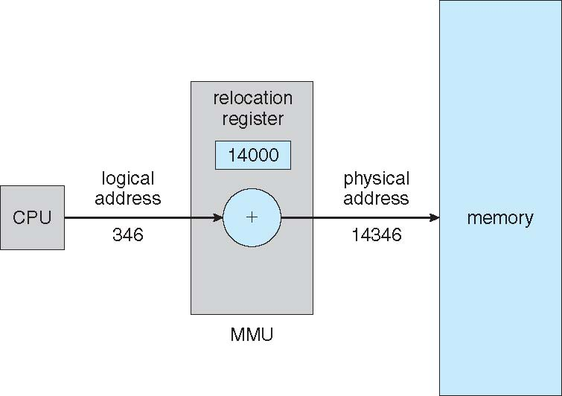
Dynamic Relocation Using a
Relocation Register

Slide 16
Dynamic Loading
Routine is not loaded until it is called
Better memory space utilization; unused routine is never loaded
Useful when large amounts of code are needed to handle infrequently occurring cases
No special support from the operating system is required implemented through program design

Slide 17
Contiguous Allocation
Main memory usually into two partitions:
  Resident operating system, usually held in low memory with interrupt vector
  User processes then held in high memory
Relocation registers used to protect user processes from each other, and from changing operating-system code and data
  Base register contains value of smallest physical address
  Limit register contains range of logical addresses each logical address must be less than the limit register
  MMU maps logical address dynamically

Slide 18
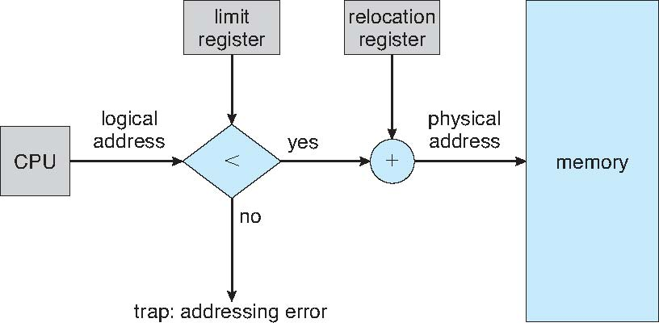
Hardware Support for Relocation and Limit Registers

Slide 19
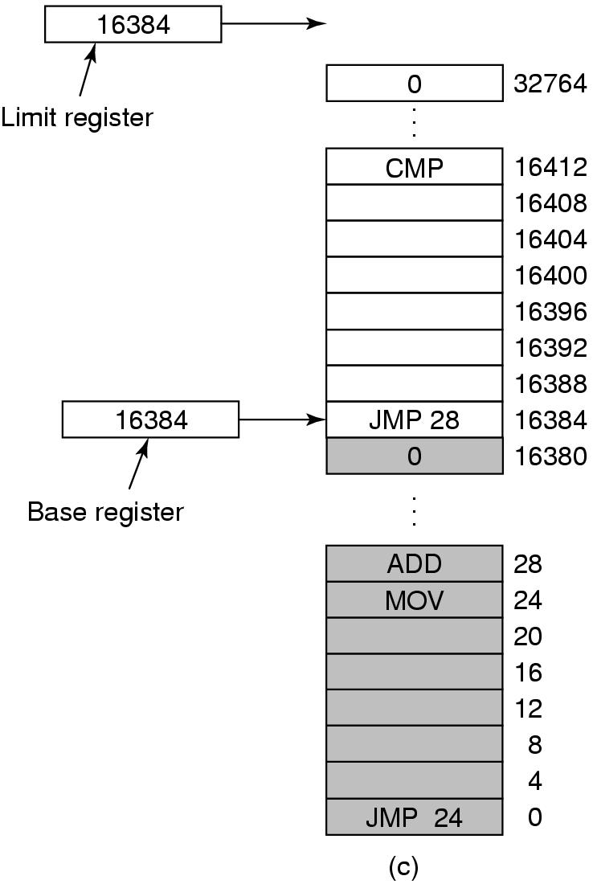
Base and Limit Registers
Add 16384 to JMP 28. Hardware adds 16384 to 28 resulting in JMP 16412

Slide 20
How to run more programs then fit in main memory at once
Can’t keep all processes in main memory
  Too many (hundreds)
  Too big (e.g. 200 MB program)
Two approaches
  Swap-bring program in and run it for awhile
  Virtual memory-allow program to run even if only part of it is in main memory

Slide 21
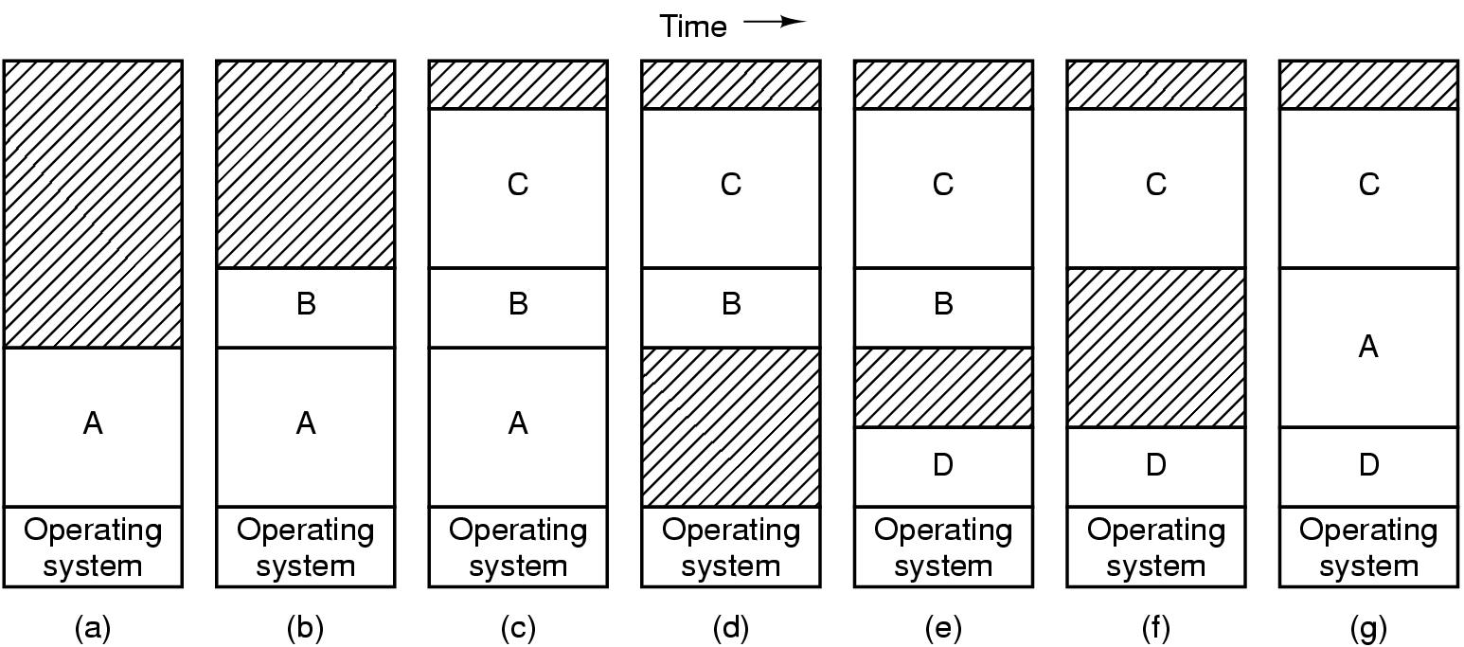
Swapping, a picture
Can compact holes by copying programs into holes
This takes too much time

Slide 22
Programs grow as they execute
Stack (return addresses and local variables)
Data segment (heap for variables which are dynamically allocated and released)
Good idea to allocate extra memory for both
When program goes back to disk, don’t bring holes along with it!!!

Slide 23
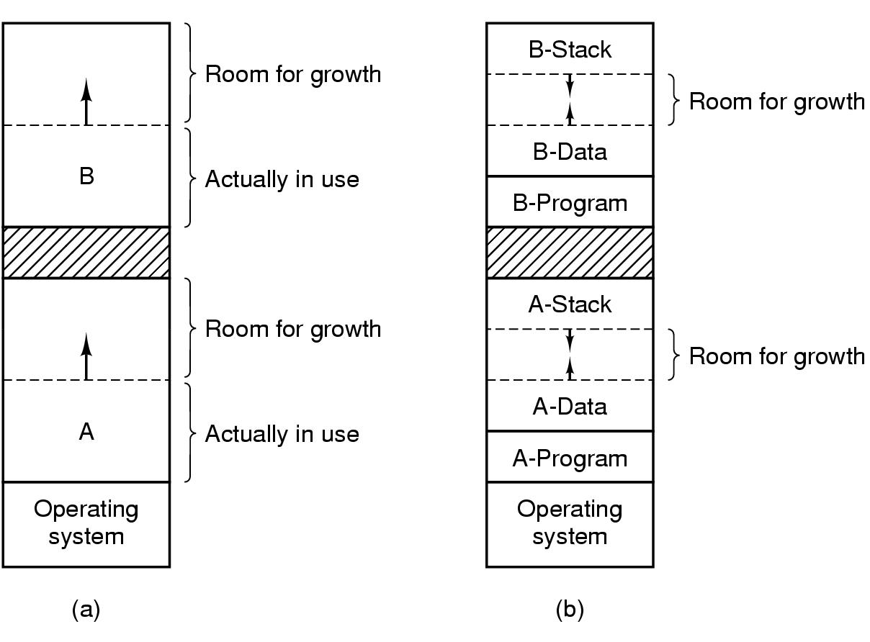
2 ways to allocate space for growth
Just add extra space
Stack grows downwards, data grows upwards

Slide 24
Managing Free Memory
Two techniques to keep track of free memory
  Bitmaps
  Linked lists

Slide 25
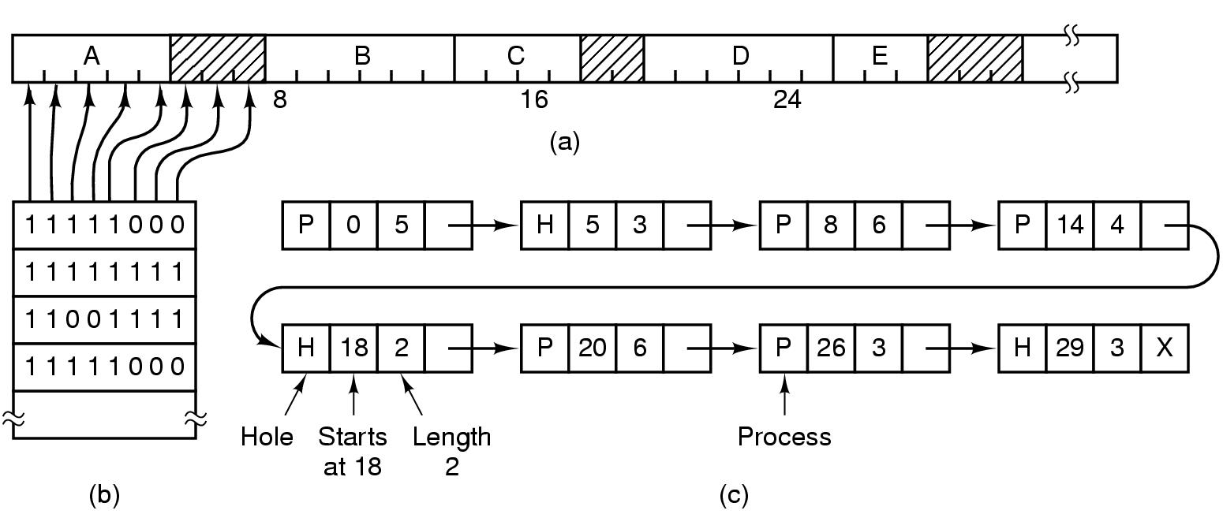
Bitmaps-the picture
(a) Picture of memory
(b) Each bit in bitmap corresponds to a unit of storage (e.g. bytes) in memory
(c) Linked list P: process H: hole

Slide 26
Bitmaps
The good-compact way to keep tract of memory
The bad-need to search memory for k consecutive zeros to bring in a file k units long
  Units can be bits or bytes or…….

Slide 27
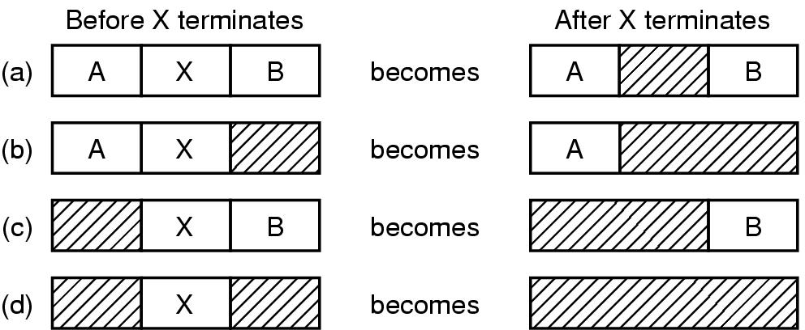
Linked Lists-the picture
Four neighbor combinations for the terminating process, X.

Slide 28
Linked Lists
Might want to use doubly linked lists to merge holes more easily
Algorithms to fill in the holes in memory
  First fit
  Next fit
  Best fit
  Worst fit
  Quick fit

Slide 29
The fits
First fit-fast
Next fit-starts search wherever it is
  Slightly worse
Best fit-smallest hole that fits
  Slower, results in a bunch of small holes (i.e. worse algorithm)
Worst fit-largest hole that fits
  Not good (simulation results)
Quick fit- keep list of common sizes
  Quick, but can’t find neighbors to merge with

Slide 30
The fits
Conclusion: the fits couldn’t out-smart the un-knowable distribution of hole sizes

